Slide 1
LENNY Web App
Dumitrof Dan-Stefan
Preda George-Codrin
Group: 1211EB
Coord professor
sl. dr. ing. Mitrea Dan Alexandru

Slide 2
In our web app, we used:
HTML5
CSS3
JavaScript
weather API: https://openweathermap.org/api
version 4.6.0 of BootStrap from this website: https://www.bootstrapcdn.com/.

Slide 3
Similar apps:
Google Keep
Microsoft To Do
Evernote
Todoist
The other apps have a friendlier minimalist UIs, while LENNY has a basic/simple UI. Furthermore, the other ones doesn’t have a clock, or weather app incorporated in it.
A thing that makes a very big difference between LENNY and other applications is the weather part of it. For example, this feature helps the user to focus and organize it’s activity over the day.

Slide 4
Objectives for the future:
Implementing a function which makes you able to check a task and make it disappear, after you tick the box.
Selecting Fahrenheit grading after region.
Reordering the notes with a move of drag and drop
The posibility to put a timer over some notes/tasks (add timer function)
Adding vocal commands using Artyom.js (Jarvis)

Slide 5
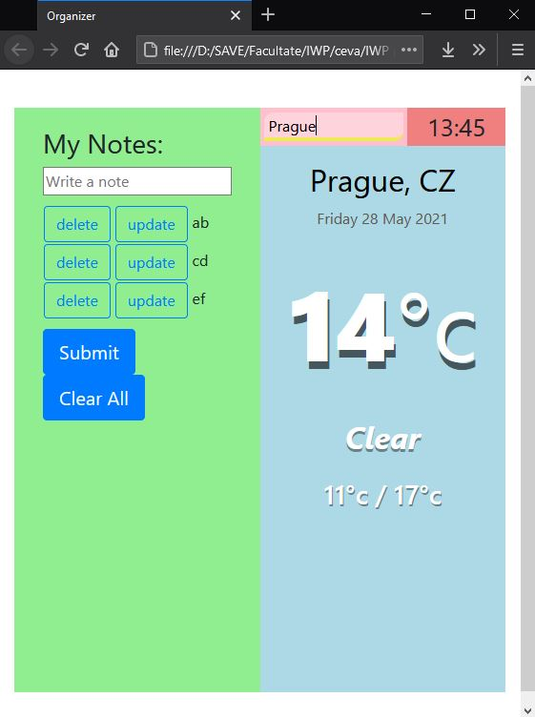
This project resulted in a note/task web app.
Its features:
The notes you write stay there unless deleted, as they are kept in the memory, so if you close our website and then you open it again, you can see your notes from before, unless you deleted them, of course.
Digital Clock and Weather Report that shows the temperature in Celsius
The weather part of our web application is included because people’s activities(tasks) takes place outside and we think that is very important to know.

Slide 6
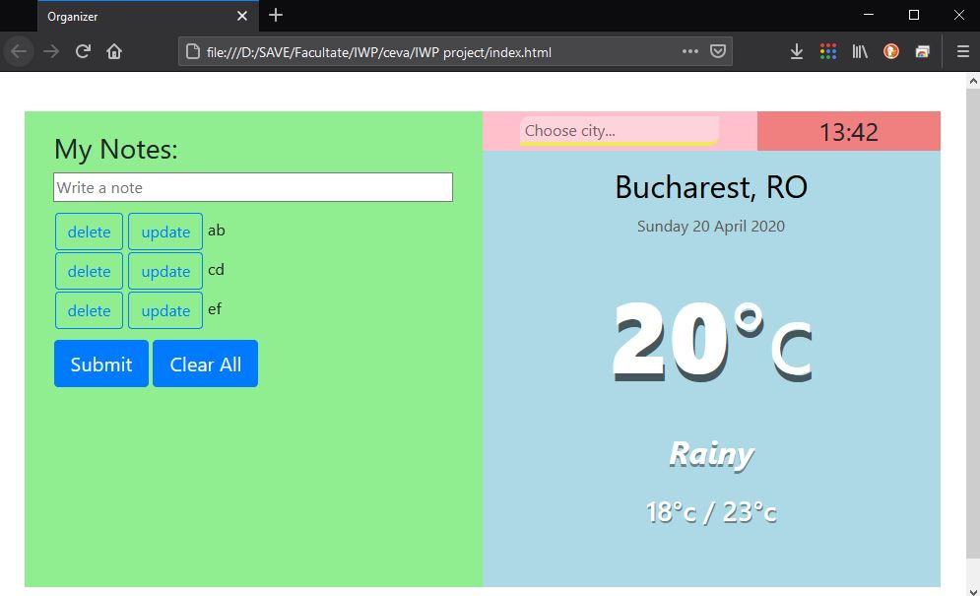
Our Organizer Web App is divided into 4 sections:
First section contains an input box in which you can add notes and then update/delete them using the buttons on their left (1)
Second section has the search box for checking the weather in a city of your choice (2)
Third section has a digital clock (3)
And the last section contains the date and the data from the weather API (4)
1
2
3
4

Slide 7
Conclusion
This web application is a prototype for an all-in-one organizer that will offer much more than the competition and will prove itself to be quite competitive against similar apps made by billion dollar companies, even though it’s a two-man project.

