Slide 1
Web Application Testing http://www.kedooo.ro
Final Project

Slide 2

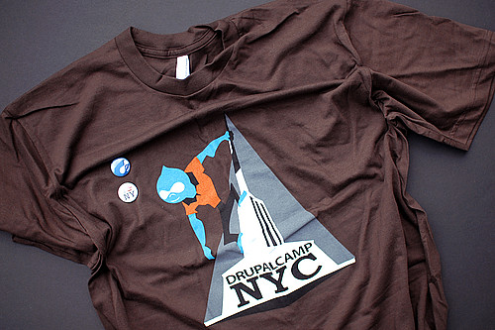
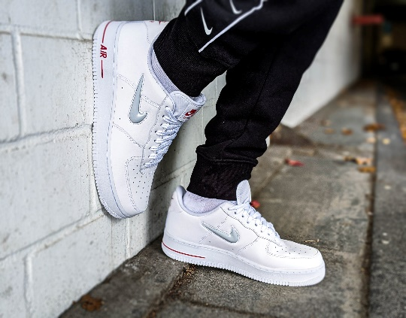
APP DESCRIPTION
http://www.kedooo.ro
Web application
Online store for clothing and footwear
International shipping
This Photo by Unknown Author is licensed under CC BY
This Photo by Unknown Author is licensed under CC BY

Slide 3

TESTING APPROACH
Ad-hoc Testing to decide if the application is worth further testing
Exploratory Testing for main functionalities
Document the Exploratory Testing and write down the defects so they can be replicated
Smoke Testing, Compatibility Testing, Functional Testing,Negative Testing
Focus where bugs were identified, more testing for that area
Write the Smoke tests and execute them
Write the Test Report

Slide 4

TOOLS USED
Mantis Bug Tracker – Bug Reporting
Microsoft Excel – Test Case Management
Itop Screenshot– Screenshots Capture
Xmind Tool – Mind Maps

Slide 5

TESTING TYPES
Functional Testing
ExploratoryTesting
Negative Testing
Positive Testing
Smoke Testing
Compatibility Testing
UI Testing
Usability Testing
Performance Testing
Security Testing
PERFORMED
APPLICABLE

Slide 6
BUGS OVERVIEW
Total: 8 Bugs

Slide 7
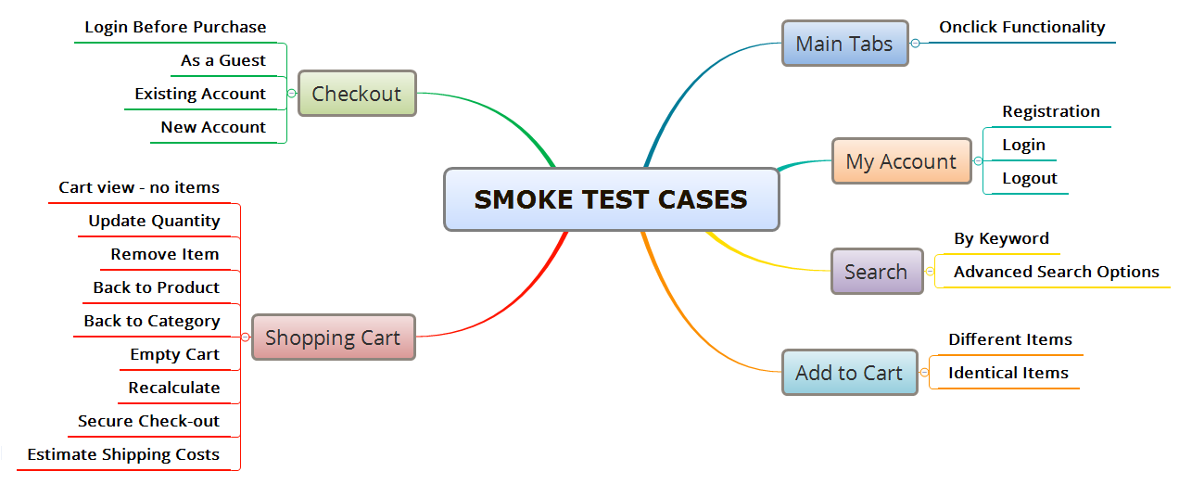
TEST CASES OVERVIEW
Total: 71 Test Cases

Slide 8
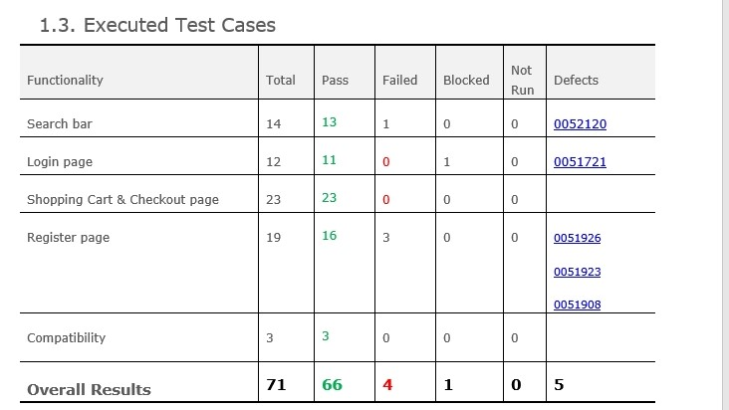
TEST CASES RESULTS

Slide 9

CONCLUSIONS
8 bugs identified:4 major and 4 normal
Most of the bugs were identified by performing Exploratory Testing and Exploratory Testing
Data type used during testing: Blank, Valid, Invalid
Fixing at least the major severity
bugs is recommended

Slide 10


LESSONS LEARNED
Finding a buggy app was the main challenge
Lack of requirements
Using too much invalid data in production
Keep the bug reporting and test cases steps and results easy
to follow
Exploratory Testing facilitates learning of functionalities
Access to the site can be restricted, message 403 Forbidden
Less is more,
simple steps are
better to use for
writting test cases
or reporting bugs
Challenges
Lessons

Slide 11



THANK YOU

