Slide 1





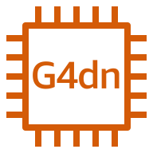



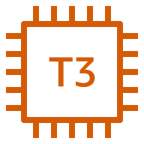







AWS Cloud
Availability Zone 1
VPC
Public subnet
NAT gateway
Elastic IP address
Editorial workstation
Private subnet
Remote
editors
Qumulo instances
Provisioner instance
Metrics collector
Amazon CloudWatch
Teradici PCoIP clients
Internet
gateway
Amazon EBS volumes
Active Directory domain controller and DNS server
EBS health monitor
Amazon SNS

