Slide 1

Agile software design
A brief overview of scrum-agile development

Slide 2
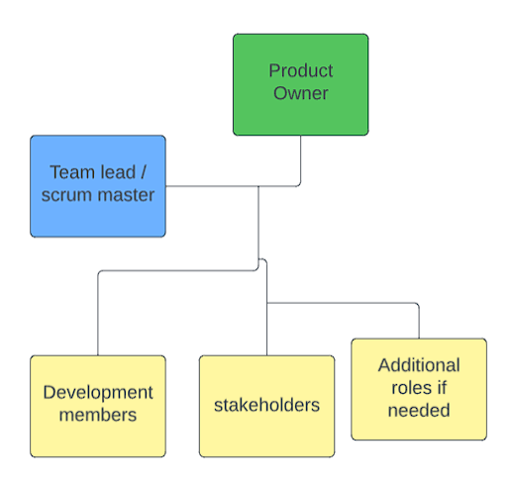
Agile teams and key composition
Product Owner: Represents stakeholders, sets project direction, manages Scrum backlog, ensures value for stakeholders.
Scrum Master/Team Lead: Coordinates team progress, facilitates Scrum events, supports team members, ensures adherence to Scrum framework.
Development Team Members: Cross-functional roles, transform ideas into tangible products, perform work sprints, self-organize and collaborate.
Stakeholders: Represent key roles impacting the Scrum team, provide input for project direction.
“the roles in the Agile methodology and specifically the Scrum framework should be seen from the perspective of responsibilities. These roles don’t reflect job titles and should not be treated as such. The Scrum responsibilities should be distributed among existing team members assigned with the tasks to follow project management activities as well as technical issues using the Agile principles.”

Slide 3
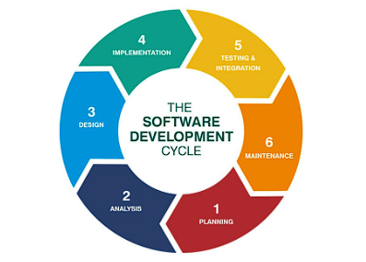
Phases of the SDLC in Agile
Planning: Define project scope, identify features and user stories, prioritize backlog items.
Development: Perform work sprints, iterative and incremental development, collaborate and deliver value incrementally.
Testing: Continuous testing throughout development, validate user stories and functionality, ensure quality and meet acceptance criteria.
Deployment: Release deliverables in iterations, continuous integration and deployment, feedback loops for further improvement.
Pinheiro, Jilvan. "Software Development Life Cycle (SDLC) Phases." Medium, 2 Feb. 2018, medium.com/@jilvanpinheiro/software-development-life-cycle-sdlc-phases-40d46afbe384.

Slide 4
Waterfall vs. Agile
“Saying “Agile is better than waterfall,” is like saying, “A car is better than a boat.” Agile and waterfall are different kinds of methodologies designed for different kinds of projects. The problem is not so much that waterfall or agile are inherently good or bad; the problem comes about when those methodologies are misused and people try to use a single methodology (whatever it might be) for all projects. Using a “one size fits all” strategy to applying either waterfall (plan-driven) or agile (adaptive) approaches to all pprojects is likely to yield optimum results.”
Cobb, Charles G. The Project Manager's Guide to Mastering Agile: Principles and Practices for an Adaptive Approach. Hoboken: Wiley, 2015. eBook. ISBN: 9781118991046.
Waterfall Approach: Sequential and linear process, emphasizes comprehensive planning, limited room for changes, rigid and less adaptable.
Agile Approach: Iterative and incremental process, emphasizes flexibility and adaptability, welcomes changes and stakeholder feedback, collaboration and continuous delivery.
Key takeaway both approaches have they place and a combination of the two is often necessary!

Slide 5

Factors to Consider in Choosing Approach
Considerations:
Project Complexity: Assess the level of complexity involved, including technological aspects, scope, and integration requirements.
Requirements Stability: Evaluate the stability of project requirements. Will they change frequently or remain relatively stable?
Stakeholder Involvement: Determine the level of stakeholder involvement and their ability to provide ongoing feedback and guidance.
Team Experience and Expertise: Assess the skills and experience of the project team. Are they familiar with agile methodologies and adaptable to changing requirements?
Time Constraints: Evaluate the project timeline and any specific time limitations. Is there a need for quick iterations and frequent deliverables?
Conclusion: Choose the appropriate approach based on these factors. Agile is suitable for flexibility, stakeholder involvement, and evolving requirements. Waterfall is more suitable for stable projects with predefined requirements and limited changes. Evaluate these considerations to select the best approach for your project.

Slide 6
References
Pinheiro, J ilvan. "Software Development Life Cycle (SDLC) Phases." Medium, 2 Feb. 2018, medium.com/@jilvanpinheiro/software-development-life-cycle-sdlc-phases-40d46afbe384.
Cobb, Charles G. The Project Manager's Guide to Mastering Agile: Principles and Practices for an Adaptive Approach. Hoboken: Wiley, 2015. eBook. ISBN: 9781118991046.
"BMC Blogs: Agile Roles and Responsibilities: A Comprehensive Guide." BMC, www.bmc.com/blogs/agile-roles-responsibilities/.

