Slide 1
Using Survey Data to Study Gender and Electoral Choice in the United States
Harold Clarke
University of Texas at Dallas
Email: clarke475@msn.com

Slide 2
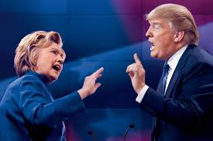
Attitudes Towards Women and Voting in the 2016 Presidential Election

Slide 3
2016 Cooperative Congressional Election Survey
National representative pre-post election survey
Internet survey, YouGov
Stephen Ansolabehere (Harvard) and Brian Schafner (Tufts)
National Science Foundation
Sample size = 60,000
Core questions plus ~50 question modules, each N = 1000 - ~$10,000 per module
UTD module - questions about women’s roles and statuses & several other other topics

Slide 4
Questions About Women’s Roles and Statuses in UTD Module
Please read each of the following statements and then indicate whether you agree or disagree.
1.There is a lot of equality between men and women in the United States.
2.The proper role for women is to be good wives and good mothers.
3. New parents – both mothers and fathers – should get paid leave from their jobs to take care of their newborns.
4. Women often earn lower salaries than men for doing the same jobs.
5. Most people generally feel threatened by women who are strong.
6. Qualified women can get promoted to higher jobs as easily as qualified men. .

Slide 5
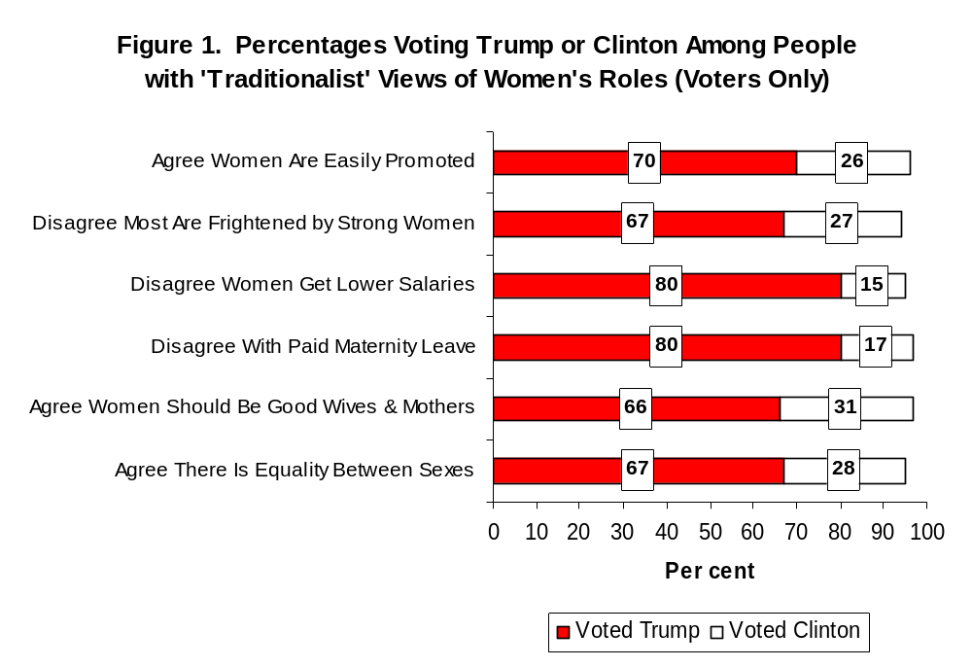
Fig 1. Support for Clinton and Trump Among Voters With Traditionalist Attitudes Towards
Women’s Roles and Statuses

Slide 6
Modeling the Vote
Multivariate model of voting
Controls for several important explanatory variables, e.g., party identification, liberal-conservative ideology, economic evaluations, attitudes towards issues such as health care, immigration, abortion, same-sex marriage, racial resentment, gender and other demographics
Test robustness of effects of attitudes towards women by running all combinations of regressors – 16,384 analyses
Effects are significant (p < .05) & correctly signed in all analyses

Slide 7
Table 1. Binomial Logit Model of Voting for Clinton v. Trump
votehh | Coef. Std. Err. z
-------------+-------------------------------
dempid | 1.242098 .4347151 2.86 Democratic id
repid | -1.266641 .5252519 -2.41 Republican id
opid | -2.229604 1.363784 -1.63 Other party id
obmis | 1.260948 .217907 5.79 Obama-impt issue
women6 | -.2134675 .051575 -4.14 Women’s roles
libcon | .3631819 .256408 1.42 Lib-Cons ideology
raceatt | .0597502 .2809257 0.21 Racial attitudes
ecfac | .5706873 .2246439 2.54 Economic evaluations
obcare | .1028282 .0675678 1.52 Health Care (ACA)
immig | -.5736289 .260272 -2.20 Immigration
rchoose | .2523927 .397997 0.63 Abortion
samesex | .7449416 .4556151 1.64 Same sex marriage
genderz | -.6895644 .4025362 -1.71 Gender
age | .0175611 .0118489 1.48 Age
educ | -.0199206 .1383269 -0.14 Education
black | 2.029357 .9152741 2.22 African American
orace | -.3378043 .6548949 -0.52 Other race
faminc | .1084218 .0695012 1.56 Family income
_cons | -4.013346 1.630472 -2.46 Constant

Slide 8
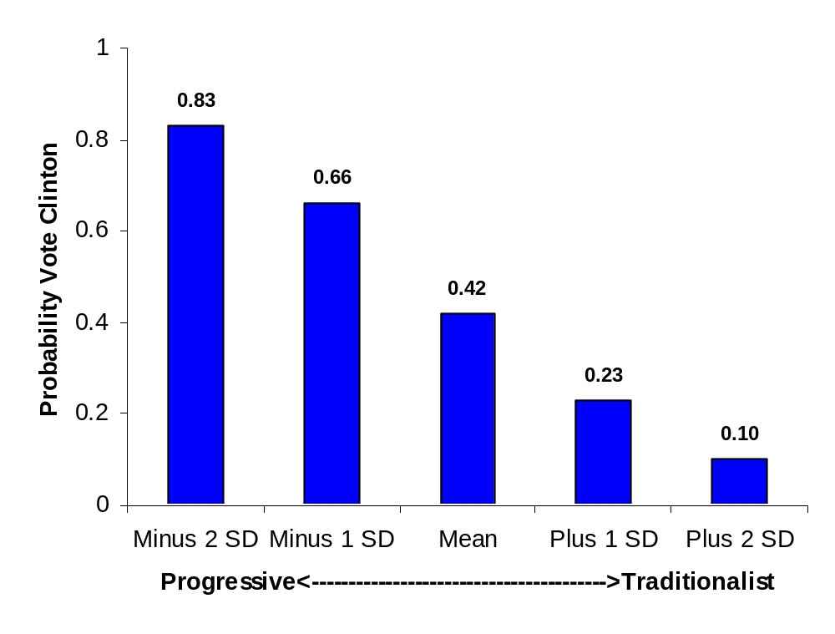
Fig 2. Probability of Voting for Clinton as Attitudes Towards Women’s Roles Move From Progressive to
Traditionalist

Slide 9
Was Hillary Correct?
Attitudes towards women – large individual-level effects on voting
Effects robust – 16,384 regressions – all combinations of predictors
“Mr. Trump accused me of playing the woman card. Well, if fighting for women’s health care and paid family leave and equal pay is playing the woman card, then deal me in!”
Did traditionalist attitudes towards women’s roles & statuses cost Hillary the election?
No - By priming women’s issues, Hillary raised the salience of topics that resonated positively with a majority of voters – so she gained more than she lost

Slide 10
Does Candidate Gender Matter?
The 2018 Congressional Elections
Much discussion of recruitment of women candidates
Few analyses of effects of candidate gender on electoral choice
ANES surveys N’s too small to study congressional district effects – NSF drops mid-term ANES
Replacement - CCES surveys – large N’s and survey design well-suited to study district effects
Use 2018 CCES to study impact of candidate gender effects with multilevel model

Slide 11
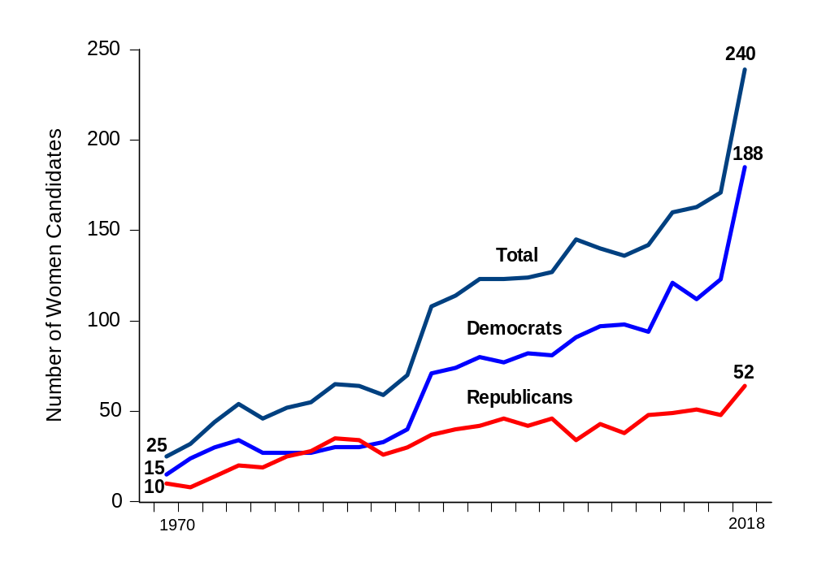
Fig 3. Number of Women Candidates for the House of Representatives 1970-2018

Slide 12
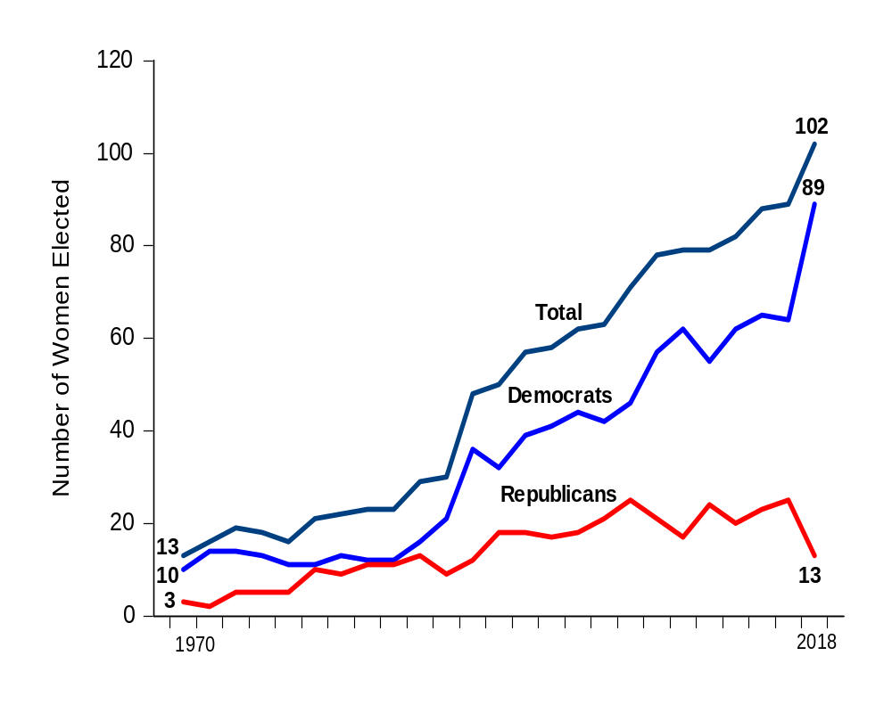
Fig 4. Number of Women Elected to the House of Representatives, 1970-2018

Slide 13
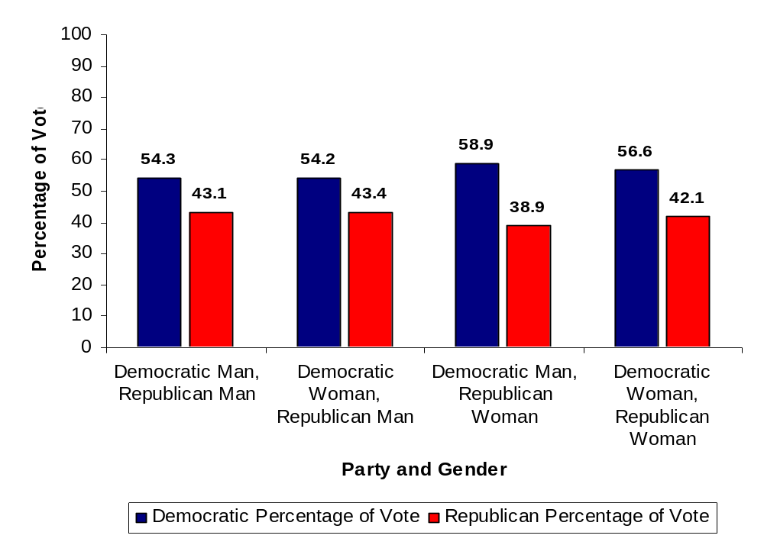
Fig 5. Combinations of Candidate Gender and Voting in the 2018 HR Elections

Slide 14
Multilevel Model of Candidate Gender Effects
Yij = B0j + ΣBmjXmj + Rij (1)
where Yij = dependent variable, Xmj = predictor variables, B0j = random intercept, Bmj = random regression coefficient(s), Rij = voter-level random error term ~N(0,σ2), i = voter, j = group (congressional district), m = 1 to m predictor variables
The models for a random intercept and a random regression coefficient are:
B0j = γ00 + γ0jzj + U0j (2)
Bmj = γ10 + γ1jzj + U1j (3)
where: zj = a group-level predictor variable, γ00 and γ10 = fixed intercepts, γ0j and γmj = fixed parameters,U0j and U1j = random errors ~N(0,τ00) and N(0,τ1j). Variance of the intercept = τ00 variance of the regression coefficient = τ1j, and the covariance between the intercept and the regression coefficients is τ01.

Slide 15
Table 2. Multilevel Model of Voting for Democratic Candidates in 2018 HR Elections
Predictor Variables b s.e.
Congressional District Level:
Women Candidates:
Democrat No, Republican Yes -.221 .451
Democrat Yes, Republican No -.452* .244
Democrat Yes, Republican Yes -.802* .474
Democrat incumbent .572*** .230
Democrat margin 2016 .009** .003
Education Percent B.A. or Higher -.010 .011
Median Family Income -.000 .000
Percent African American .008† .003
Percent Asian .016† .012
Percent Hispanic .005 .005
Cross-Level Interactions:
Women's Roles x Candidate Gender:
Democrat No, Republican Yes -.000 .066
Democrat Yes, Republican No .088** .031
Democrat Yes, Republican Yes .082 .069
Trump Approval -.703*** .026

Slide 16
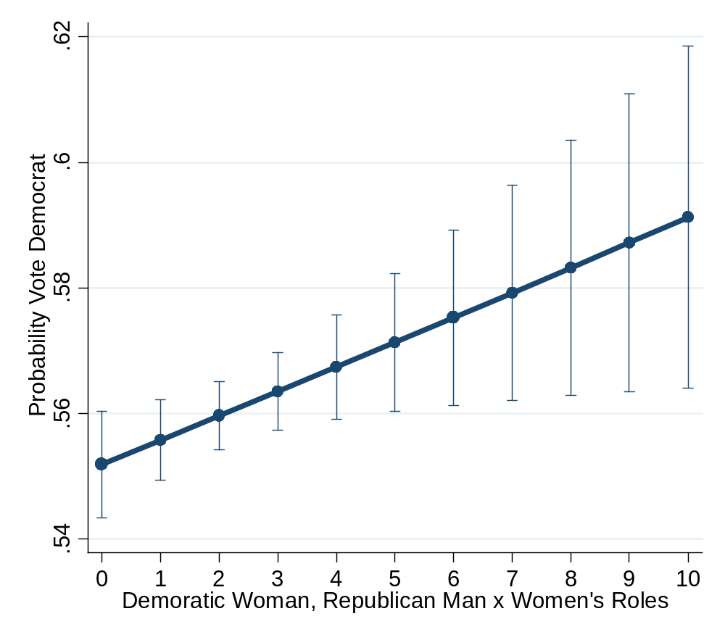
Fig 6. Probability of Democratic Vote by Attitudes Towards Women’s Roles & Combination of Democrat Woman and Republican Man Candidate

Slide 17
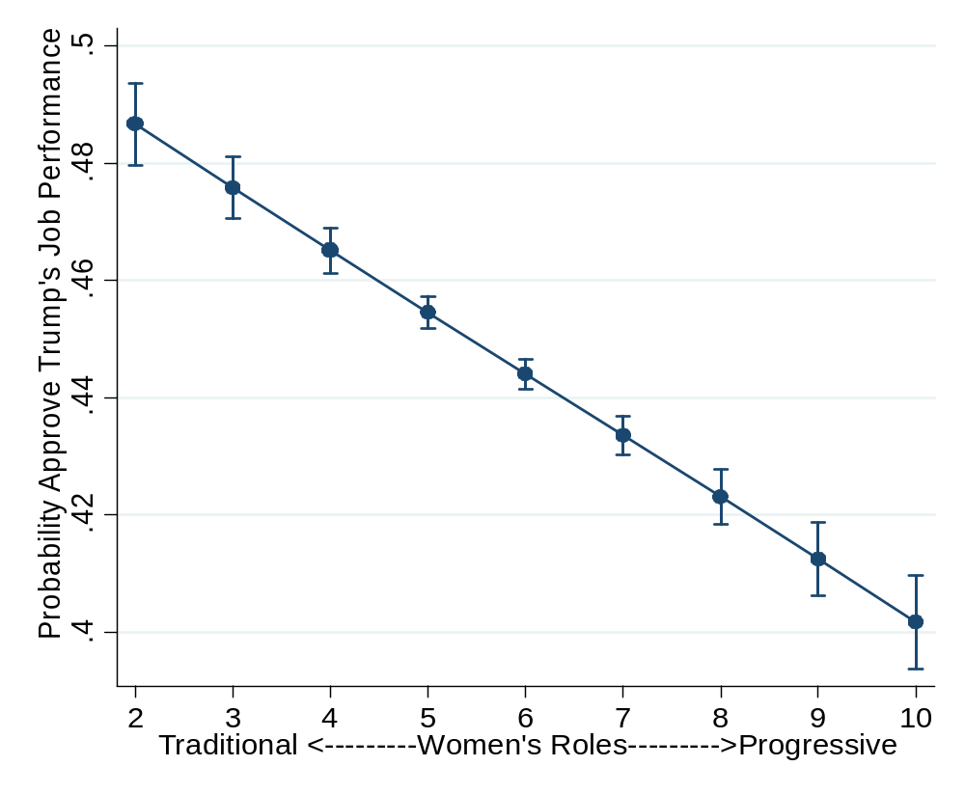
Fig 7. Probability of Trump Job Approval by Attitudes Towards Women’s Roles

Slide 18
Discussion: Candidate Gender Matters
Analyses illustrate how surveys like CCES can address questions about electoral district effects on electoral choice
CCES ideally suited for multilevel modeling
Analyses show candidate gender mattered for voting in 2018 HR elections
Cross-level interactions with attitudes towards women’s roles
Bigger indirect effects - attitudes towards women’s roles ->Trump approval -> voting
Gender attitudes & voting in 2020?

Slide 19
Using Survey Data to Study Presidential Approval & Gender – Dynamic Analyses
Presidential approval & economic conditions
Studies since 1970s
However, few sub-group analyses – e.g., by gender
Here – monthly Gallup poll of presidential approval – Jan 1978 – April 2020
Michigan Surveys of Consumers – consumer confidence by gender
Also party identification (Gallup)
Important events & presidential transitions

Slide 20
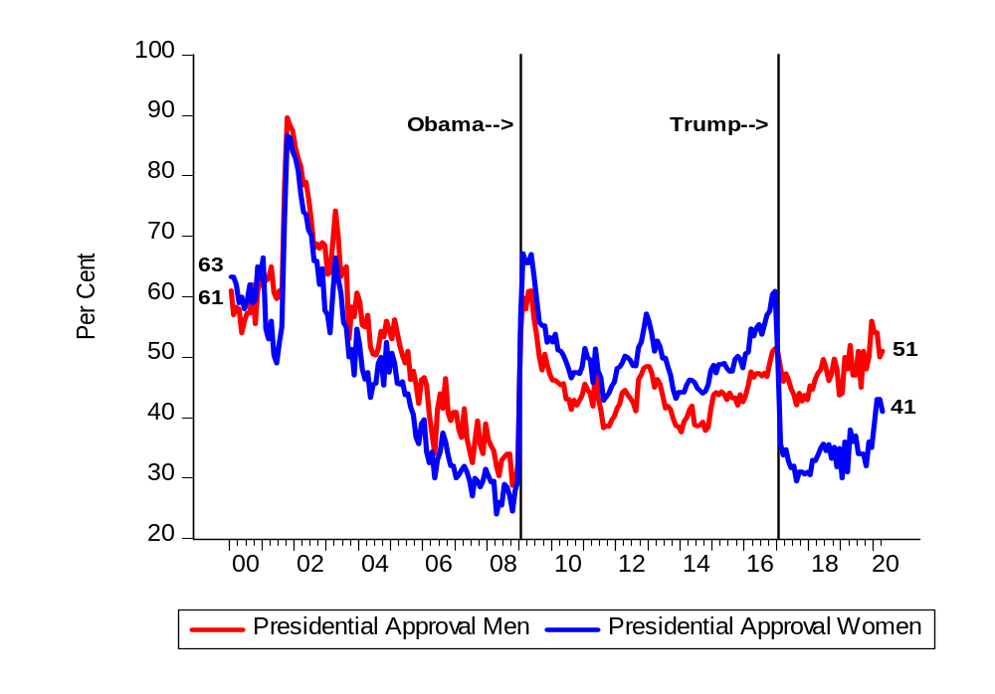
Fig 8. Presidential Approval & Gender,
January 2000 – April 2020

Slide 21
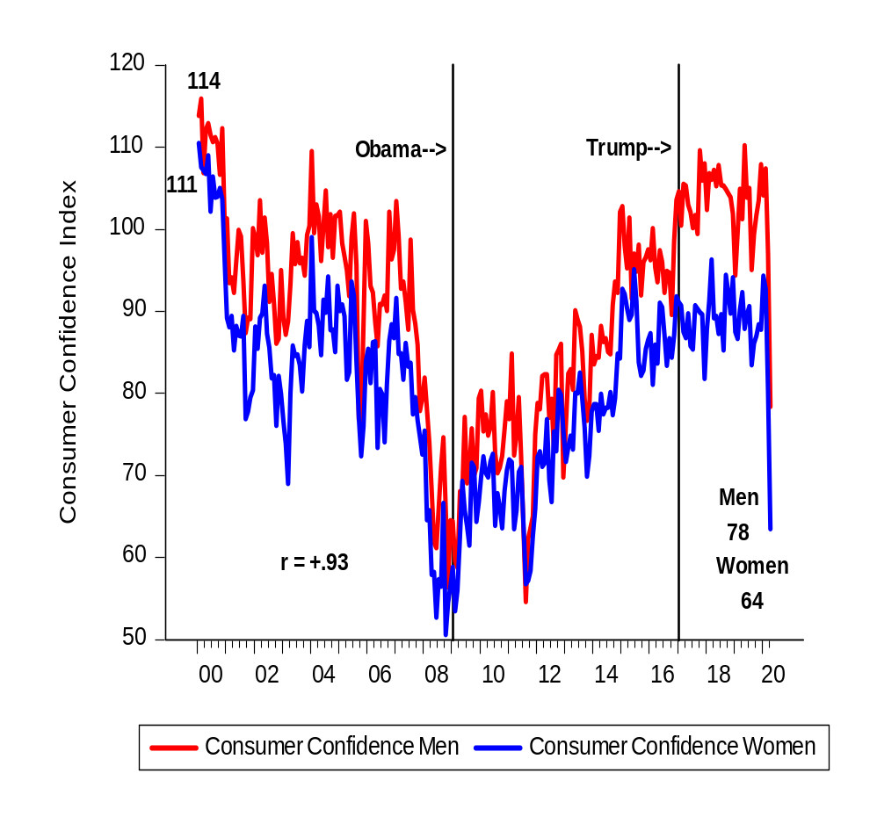
Fig 9. Index of Consumer Sentiment by Gender,
January 2000 – April 2020

Slide 22
Women Don’t Like Trump!
Seemingly unrelated regression analysis – men & women
January 1978 – April 2020
Error correction model – presidential approval cointegrates with consumer confidence
Controlling for all other effects – transition from Obama to Trump – big significant (p < .001) negative effect for women (-9.6 points) but no significant effect for men (-1.6 points)

Slide 23
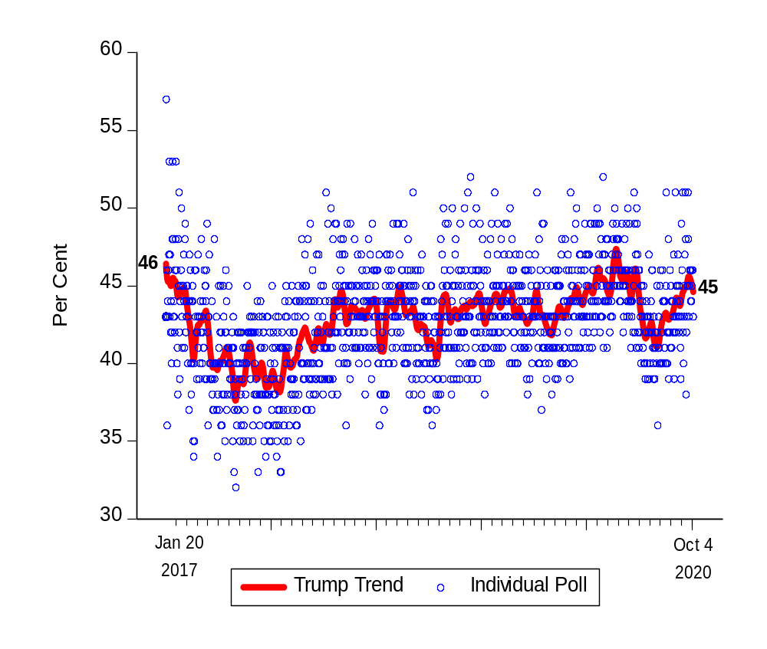
Nov 3rd? Fig 10. Trump Approval,
1253 Polls, Jan 20, 2017 - Oct 4, 2020

Slide 24
General Considerations
Attitudes towards women’s roles have had large effects on support for/opposition to Trump controlling for other important factors
Gender of candidates still matters – but effects modest
Political economy of presidential approval – controlling for all else – big Trump ‘intercept’ effect
Many women simply don’t like Trump
Large stratified surveys like CCES facilitate multilevel modeling of US congressional elections – something researchers have wanted to do since the 1960s.
In internet age surveys are “big data” opportunities – think of N’s both in space and time
2020 Presidential Election? – Women’s attitudes towards Trump may determine election

Slide 25
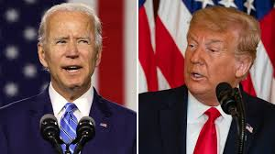
Questions?

