Slide 1
Azure Site Recovery (ASR) for VM Migration Use Case
David Coudriet – Final Project

Slide 2
Problem Statement:
The was a real use case for McKesson within the last year. The problem was we needed in a short period of time migrate Virtual Machines from our VMWare infrastructure, that was coming to capacity, to Azure. The other part of the problem was the group tasked didn’t understand the technologies in Azure. So in this use case it goes through the process of the Azure Site Recovery setup along with processing a failover.

Slide 3
Review Installation Guide
Setup Configuration Server
Setup vNet/Storage in Azure
Create Recovery Services Vault
Configuring Recovery Services Vault
Additional items to try.

Slide 4
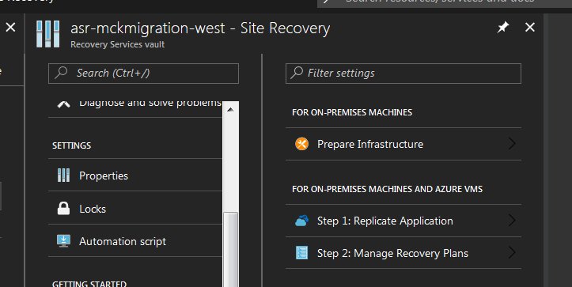
Site Recovery Setup Wizard
Follow the Getting Started ->Site Recovery Setup wizard to build (steps in document)
Select Source VMWare
Configure Gateway VM (on premise)
Connect Vcenter to ASR
Establish Recovery Model
Build Recovery Plan

Slide 5
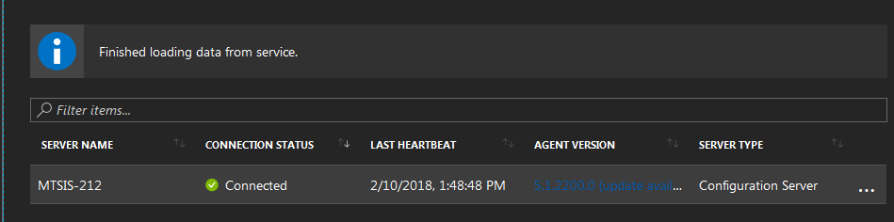
Site Recovery Setup - validation
Gateway/Configuration server – Verify Connection Status Post deploy.

Slide 6
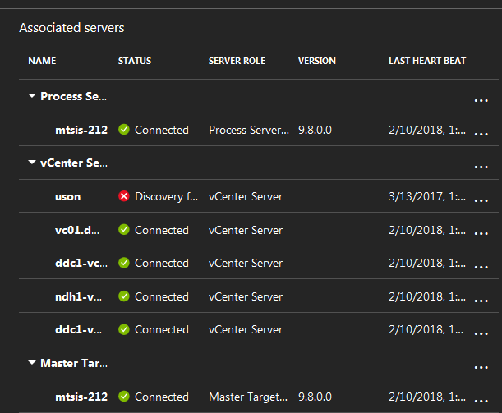
Site Recovery Setup - validation
Verity Process Server/Master Target Server and VCenters are connected post installation.

Slide 7
VM Prerequisites prior to replication
On Premise VM:
1. VMWare tools must be installed.
2. VM powered on.
3. VM needs internet access.
4. UAC disabled (if windows)
5. Verify Admin/Root level access to vm.

Slide 8
Process to Enable Replication
In Azure (ASR)
1. Enter into Recovery Services Vault
2. Select Replicated Items -> Select Add Replication
a. Select Source/Target
b. Select VM(s)
c. Select Configuration Properties (user /disk)
d. Replication Settings (leave default)
e. Enable Replication
1. Process steps
2. Error Reporting.
3. Configure Recovery Plan
a. Pre-failover automation
b. Post-failover automation
c. Manual steps documented.

Slide 9
Process to Failover Infrastructure
In Azure
1. Single VM
a. In Azure -> Recovery Services Vault -> Replicated Items
b. Check VM Health (if error resolve errors)
c. Select Unplanned Failover and follow failover steps.
2. Recovery Plan
a. In Azure -> Recovery Services Vault -> Recovery Plan
b. Select Unplanned Failover
3. Test Failover.
4. ASR vs Zerto Terminology

Slide 10
Nuances of Azure Site Recovery
Limitations for Disk Sizing (< 1 TB)
OS limitations (oldest version Win 2k8 r2 sp1)
Conversion from VMDK to VHD at OS level
VM access/permissions
vCenter Permissions (read only –migration vs full admin access –DR
Region Specific
Recovery Services Vault upgrades.
Azure agent install and when DR already exists to Azure.
Vcenter replication errors and how to resolve.

Slide 11
Manual Migrations/Other Tools
Zerto
Setup Hyper-V site
Physical Server migration (similar to Vmware migration)
DisktoVHD (windows only)
VirtualBox (winodws or Linux)
Azcopy for vhd file transfers.
On premis to Azure storage
Azure storage to Azure storage
Azure storage to on premise

Slide 12
Links
2 Min YouTube: https://youtu.be/Aax2aDeOCS8
15 Min YouTube: https://youtu.be/lmrq8edwxv4
Git Repo: https://github.com/dacoudriet-mck/final_project.git

