Slide 1
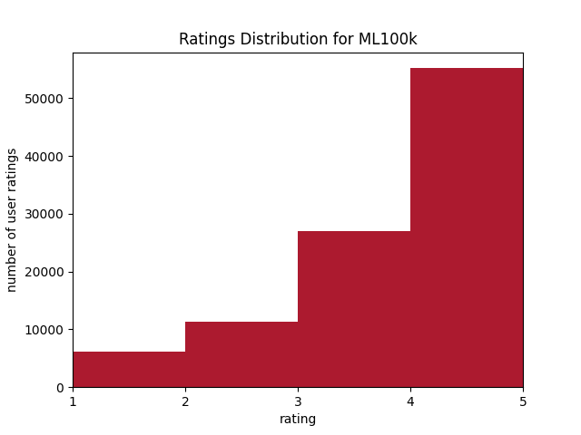

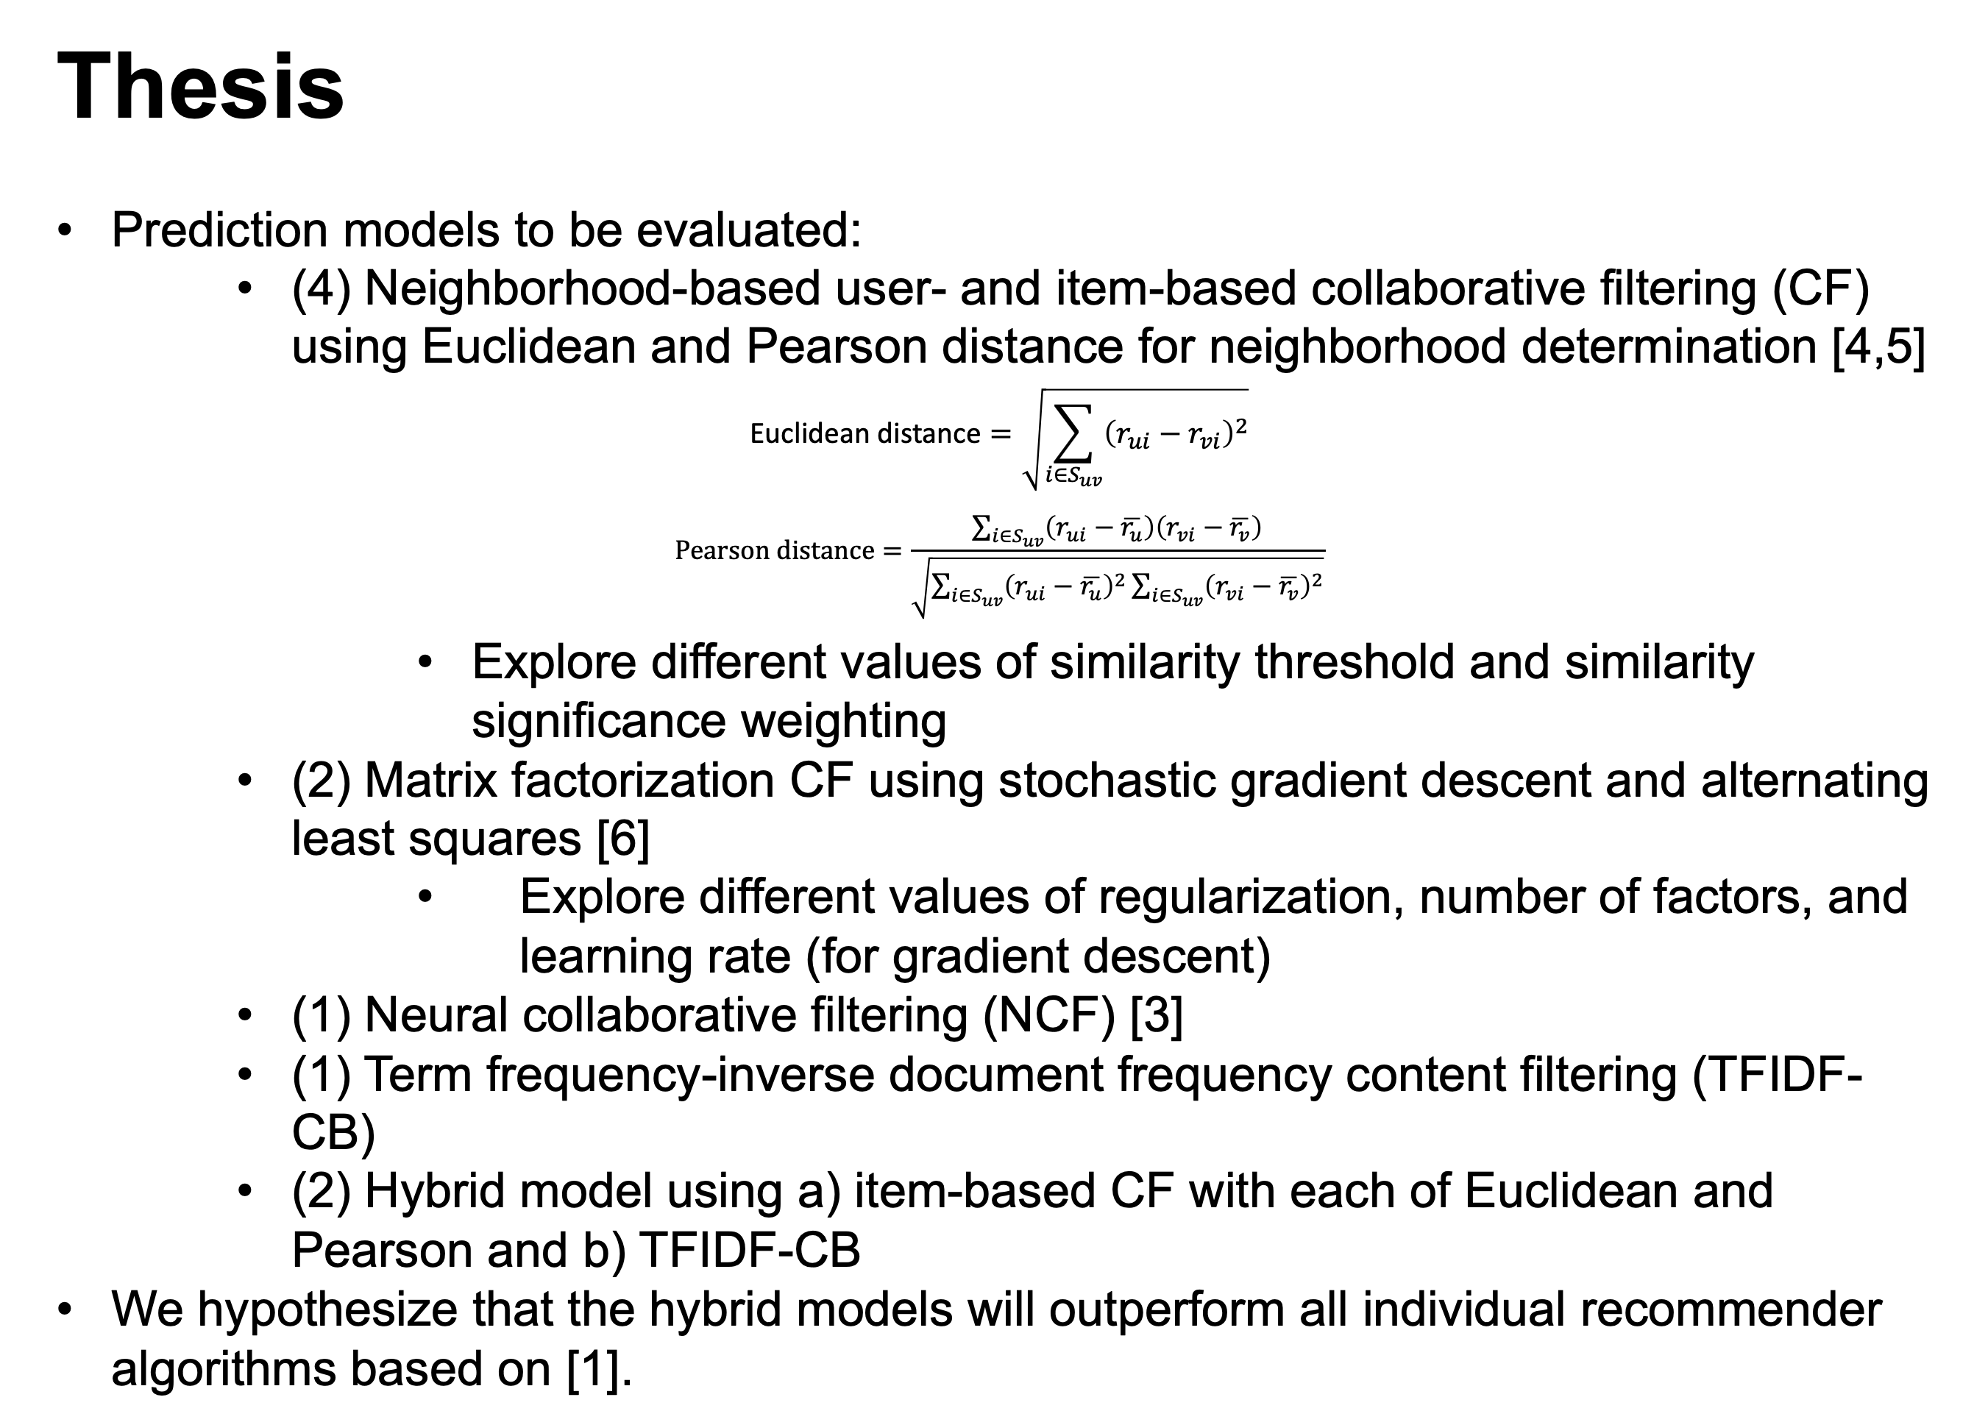
Evaluating the Accuracy and Coverage performance of Collaborative Filtering,
Content-based, and Hybrid Recommender Systems
Brad Shook, Daniel Cowan, Drew Dibble
Introduction
Recommender systems harness data to provide personalized recommendations for users.
These recommendations ease the burden on the user of sifting through all of their options while simultaneously increasing the platform’s likelihood of providing accurate recommendations to the user.
There are two overarching types of recommender systems: collaborative filtering, content-based, and hybrid methods.
Collaborative filtering can be performed using a user-based method, an item-based method, through matrix factorization, or even through a neural network.
Content-based methods utilize item descriptions and a profile of user interests.
Hybrid methods combine components of collaborative filtering and content-based methods to limit the disadvantages of either method individually [1].
We developed and evaluated the 10 recommender systems specified in our Thesis.
Experimental Design
Figure 1 shows the statistics for the ML100k dataset.
We implemented 10 different recommender systems ranging from user-based collaborative filtering nearest neighbor models to neural networks.
In order to evaluate the 10 models, we used mean-squared error (MSE) and the accuracy-coverage metric [2].
These models were tuned using a grid-search approach, with the accuracy-coverage metric determining the “best” set of hyperparameters. The hyperparameter sets were only considered if they yielded a coverage of at least 80%.
Thesis
Prediction models to be evaluated:
(4) Neighborhood-based user- and item-based collaborative filtering (CF) using Euclidean and Pearson distance for neighborhood determination [4,5]
$$\text{Euclidean} \text{distance}=\sqrt{\sum_{i∈S_{uv}}{{\left(r_{ui}−r_{vi}\right)}^{2}}}$$
$$\text{Pearson} \text{distance}=\frac{\sum_{i∈S_{uv}}{\left(r_{ui}−\overline{r_{u}}\right)\left(r_{vi}−\overline{r_{v}}\right)}}{\sqrt{\sum_{i∈S_{uv}}{{\left(r_{ui}−\overline{r_{u}}\right)}^{2}\sum_{i∈S_{uv}}{{\left(r_{vi}−\overline{r_{v}}\right)}^{2}}}}}$$
Explore different values of similarity threshold and similarity significance weighting
(2) Matrix factorization CF using stochastic gradient descent and alternating least squares [6]
Explore different values of regularization, number of factors, and learning rate (for gradient descent)
(1) Neural collaborative filtering (NCF) [3]
(1) Term frequency-inverse document frequency content filtering (TFIDF-CB)
(2) Hybrid model using a) item-based CF with each of Euclidean and Pearson and b) TFIDF-CB
We hypothesize that the hybrid models will outperform all individual recommender algorithms based on [1].
Related Work
[1] Robin Burke. 2002. Hybrid Recommender Systems: Survey and Experiments
[2] Carlos Seminario and David Wilson. 2012. Case study evaluation of Mahout as a recommender platform.
[3] Xiangnan He et al. 2017. Neural Collaborative Filtering.
[4] Desrosiers and Karypis. 2011. A comprehensive survey of neighborhood-based recommendation methods.
[5] Herlocker et al. 1999. An algorithmic framework for performing collaborative filtering.
[6] Koren et al. 2009. Matrix factorization techniques for recommender systems.

