Slide 1
BIRCH:
Balanced Iterative Reducing and Clustering using Hierarchies
Tian Zhang, Raghu Ramakrishnan, Miron Livny
Presented by Zhao Li
2009, Spring
Notes:
Data Mining and Knowledge Discovery, Volume 1, Issue 2, 1997, pp. 141-182

Slide 2

Outline
Introduction to Clustering
Main Techniques in Clustering
Hybrid Algorithm: BIRCH
Example of the BIRCH Algorithm
Experimental results
Conclusions

Slide 3



Clustering
Introduction
Data clustering concerns how to group a set of objects based on their similarity of attributes and/or their proximity in the vector space.
Main methods
  Partitioning : K-Means…
  Hierarchical : BIRCH,ROCK,…
  Density-based: DBSCAN,…
A good clustering method will produce high quality clusters with
  high intra-class similarity
  low inter-class similarity
Notes:
Partitioning clustering, especially k-means algorithm, is widely used, and is regarded as a benchmark clustering algorithm.
Hierarchical clustering is the algorithm on which Birch algorithm based.

Slide 4
Main Techniques (1)
Partitioning Clustering (K-Means) step.1
initial center
initial center
initial center
Notes:
Given the number of clusters, chose the initial centers randomly

Slide 5
K-Means Example
Step.2
new center after 1st iteration
x
x
new center after 1st iteration
x
new center after 1st iteration
Notes:
Assign every data instance to the closest cluster based on the distance between the data and the center of the cluster and compute the new centers of the k clusters

Slide 6
K-Means Example
Step.3
new center after 2nd iteration
new center after 2nd iteration
new center after 2nd iteration

Slide 7
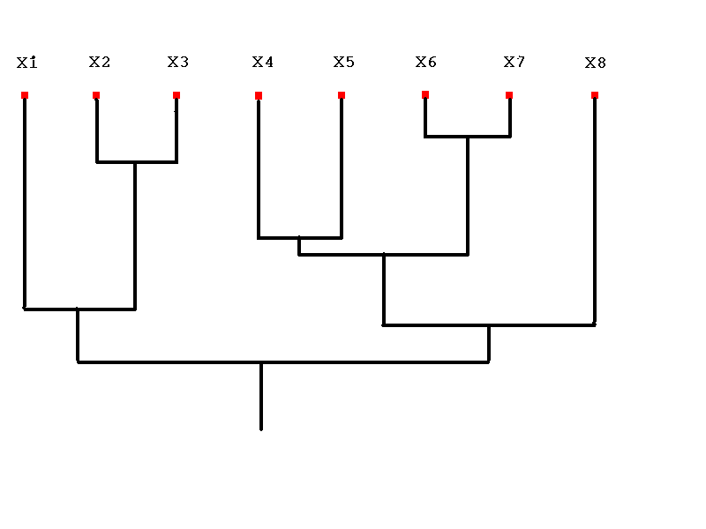

Main Techniques (2)
Hierarchical Clustering
Multilevel clustering: level 1 has n clusters → level n has one cluster, or upside down.
Agglomerative HC: starts with singleton and merge clusters (bottom-up).
Divisive HC: starts with one sample and split clusters (top-down).
Dendrogram

Slide 8
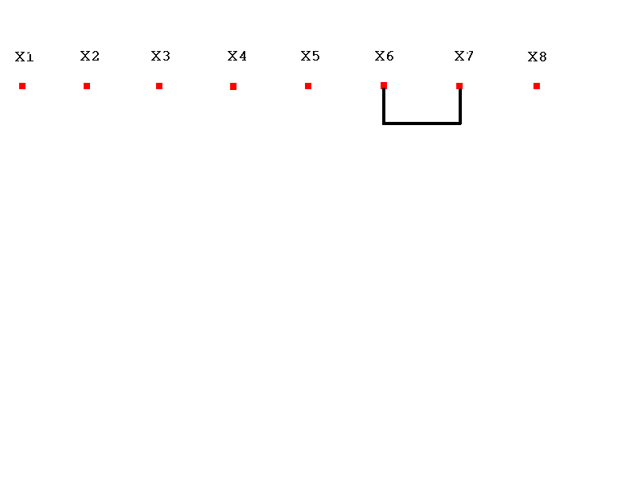
Agglomerative HC Example
Nearest Neighbor Level 2, k = 7 clusters.
Notes:
1. Calculate the similarity between all possible combinations of two data instances

Slide 9
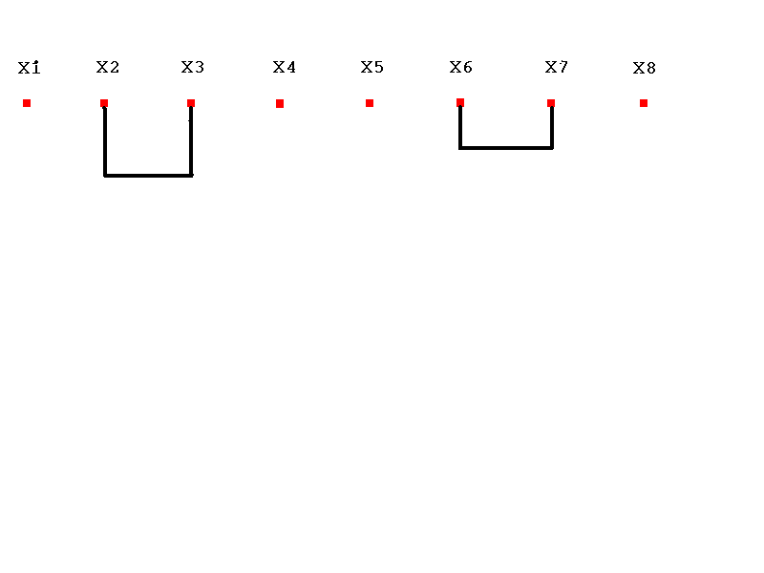
Nearest Neighbor, Level 3, k = 6 clusters.

Slide 10
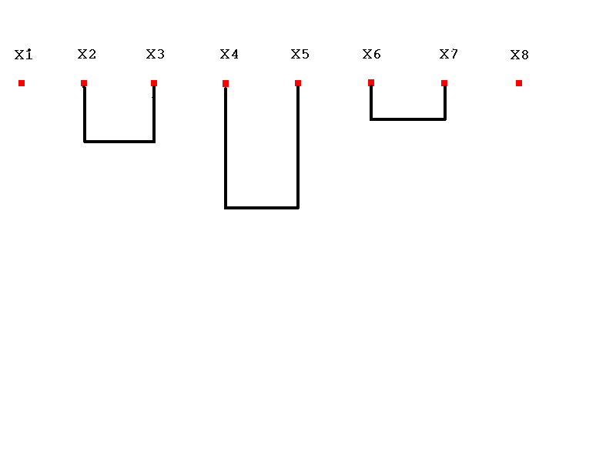
Nearest Neighbor, Level 4, k = 5 clusters.

Slide 11
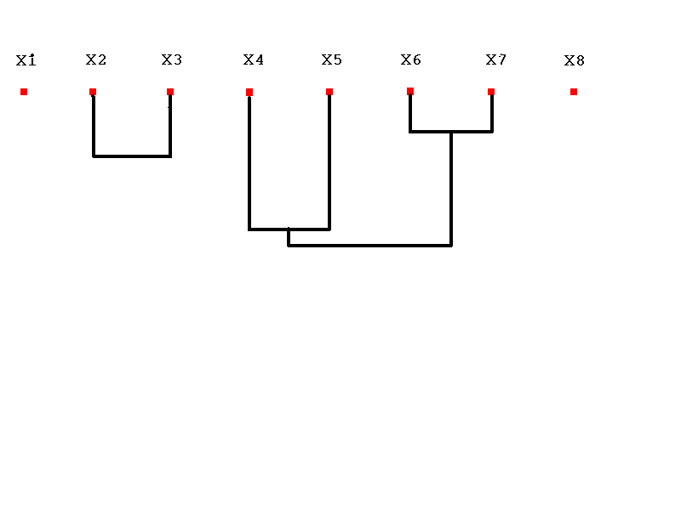
Nearest Neighbor, Level 5, k = 4 clusters.
Notes:
2. Two most similar clusters are grouped together to form a new cluster

Slide 12
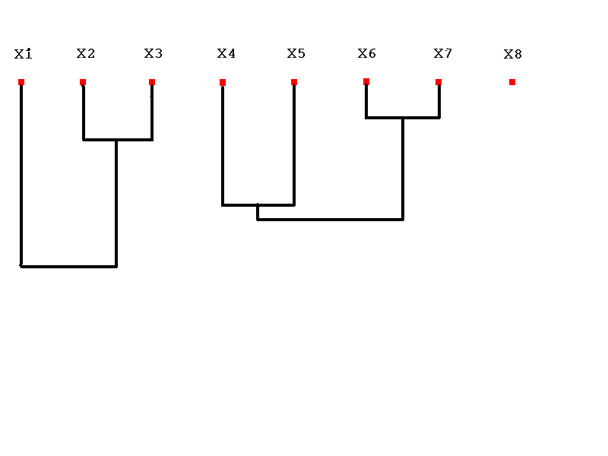
Nearest Neighbor, Level 6, k = 3 clusters.
Notes:
3. Calculate the similarity between the new cluster and all remaining clusters.

Slide 13
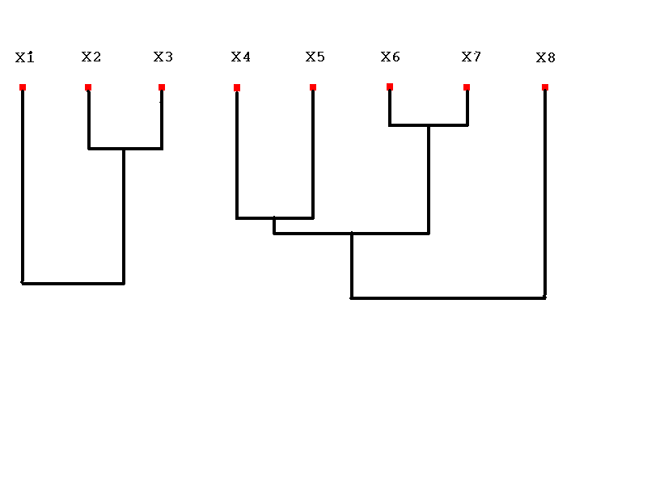
Nearest Neighbor, Level 7, k = 2 clusters.

Slide 14
Nearest Neighbor, Level 8, k = 1 cluster.

Slide 15
Remarks
 | Partitioning Clustering | Hierarchical Clustering
Time Complexity | O(n) | O(n²log n)
Pros | Easy to use and Relatively efficient | Outputs a dendrogram that is desired in many applications.
Cons | Sensitive to initialization; bad initialization might lead to bad results. Need to store all data in memory. | higher time complexity; Need to store all data in memory.
Notes:
1.The time complexity of computing the distance between every pair of data instances is O(n²).
2. The time complexity to create the sorted list of inter-cluster distances is O(n²log n).
Obviously, the algorithms in these regards are failed to effectively handle large datasets that space and time are considered.

Slide 16

Introduction to BIRCH
Designed for very large data sets
  Time and memory are limited
  Incremental and dynamic clustering of incoming objects
  Only one scan of data is necessary
  Does not need the whole data set in advance
Two key phases:
  Scans the database to build an in-memory tree
  Applies clustering algorithm to cluster the leaf nodes

Slide 17



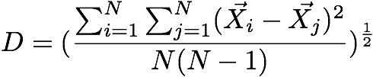
Similarity Metric(1)
Given a cluster of instances , we define:
Centroid:
Radius: average distance from member points to centroid
Diameter: average pair-wise distance within a cluster

Slide 18

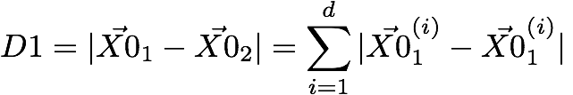

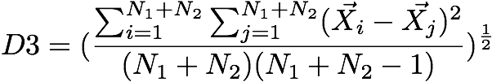
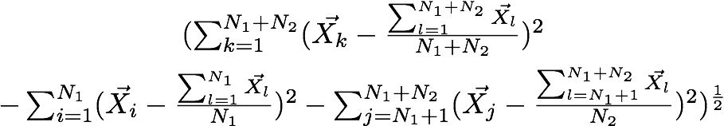
Similarity Metric(2)
centroid Euclidean distance:
centroid Manhattan distance:
average inter-cluster:
average intra-cluster:
variance increase:

Slide 19
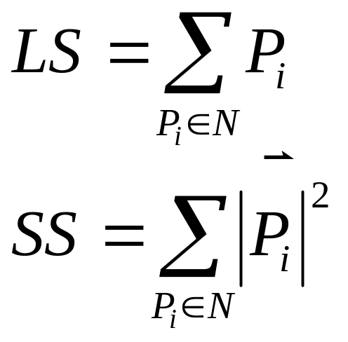
Clustering Feature
The Birch algorithm builds a dendrogram called clustering feature tree (CF tree) while scanning the data set.
Each entry in the CF tree represents a cluster of objects and is characterized by a 3-tuple: (N, LS, SS), where N is the number of objects in the cluster and LS, SS are defined in the following.
Notes:
N is the number of data points
LS is the linear sum of the N points
SS is the square sum of the N points

Slide 20
Properties of Clustering Feature
CF entry is more compact
  Stores significantly less than all of the data points in the sub-cluster
A CF entry has sufficient information to calculate D0-D4
Additivity theorem allows us to merge sub-clusters incrementally & consistently
Notes:
CF Additivity Theorem: if CF_1 and CF_2 are disjoint, merging them is equal to the sum of their parts

Slide 21
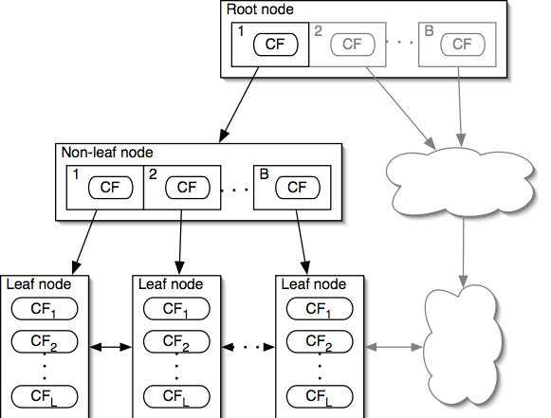

CF-Tree
Each non-leaf node has at most B entries
Each leaf node has at most L CF entries, each of which satisfies threshold T
Node size is determined by dimensionality of data space and input parameter P (page size)
Notes:
CF tree can be viewed as a multilevel compression of the data that tries to preserve the inherent clustering structure of the data
A non-leaf node entry is a CF triplet and a child node link
Each non-leaf node contains a number of child nodes. The number of children that a non-leaf node can contain is limited by a threshold called the branching factor.
A leaf node is a collection of CF triplets and links to the next and previous leaf nodes
Each leaf node contains a number of subclusters that contains a group of data instances
The diameter of a subcluster under a leaf node can not exceed a threshold.

Slide 22
CF-Tree Insertion
Recurse down from root, find the appropriate leaf
  Follow the "closest"-CF path, w.r.t. D0 / … / D4
Modify the leaf
  If the closest-CF leaf cannot absorb, make a new CF entry. If there is no room for new leaf, split the parent node
Traverse back
  Updating CFs on the path or splitting nodes
Notes:
Closest CF is determined by any of D0-D4
Leaf node split: take two farthest CFs and create two leaf nodes, put the remaining CFs (including the new one that caused the split) into the closest node.
Splitting the root on the traverse back increases tree height by one

Slide 23
CF-Tree Rebuilding
If we run out of space, increase threshold T
  By increasing the threshold, CFs absorb more data
Rebuilding "pushes" CFs over
  The larger T allows different CFs to group together
Reducibility theorem
  Increasing T will result in a CF-tree smaller than the original
  Rebuilding needs at most h extra pages of memory
Notes:
Bigger T = Smaller CF-tree
The rebuild will also take no more than h (height of the original tree) extra pages of memory (nodes)

Slide 24
Example of BIRCH
New subcluster
sc8
sc3
sc1
sc4
sc5
sc6
sc7
sc2
LN2
LN3
Root
LN1
LN1
LN2
LN3
sc8
sc1
sc3
sc4
sc5
sc6
sc7
sc2

Slide 25
Insertion Operation in BIRCH
If the branching factor of a leaf node can not exceed 3, then LN1 is split.
sc8
sc3
sc1
sc4
sc5
sc6
sc7
sc2
LN1’
LN2
LN3
LN1”
Root
LN1’
LN2
LN3
LN1”
sc8
sc1
sc3
sc4
sc5
sc6
sc7
sc2

Slide 26
If the branching factor of a non-leaf node can not
exceed 3, then the root is split and the height of
the CF Tree increases by one.
sc8
sc3
sc1
sc4
sc5
sc6
sc7
sc2
LN1’
LN2
LN3
LN1”
Root
NLN1
NLN2
LN1’
LN2
LN3
LN1”
sc8
sc1
sc2
sc3
sc4
sc5
sc6
sc7

Slide 27
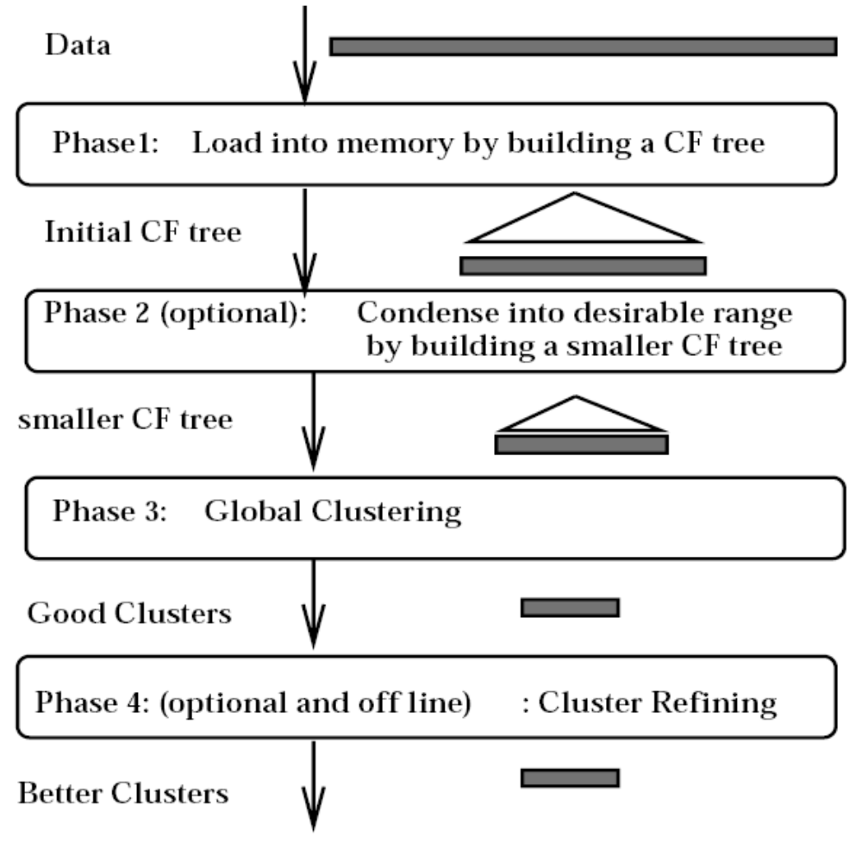
BIRCH Overview
Notes:
Phase 1: Load data into memory
Build an initial in-memory CF-tree with the data (one scan)
Subsequent phases become fast, accurate, less order sensitive
Phase 2: Condense data
Rebuild the CF-tree with a larger T
Condensing is optional
Phase 3: Global clustering
Use existing clustering algorithm on CF leafs
Phase 4: Cluster refining
Do additional passes over the dataset & reassign data points to the closest centroid from phase 3
Refining is optional

Slide 28
Experimental Results
Input parameters:
  Memory (M): 5% of data set
  Disk space (R): 20% of M
  Distance equation: D2
  Quality equation: weighted average diameter (D)
  Initial threshold (T): 0.0
  Page size (P): 1024 bytes
Notes:
Node size is determined by dimensionality of data space and input parameter P (page size)

Slide 29
Experimental Results
KMEANS clustering
DS | Time | D | # Scan | DS | Time | D | # Scan
1 | 43.9 | 2.09 | 289 | 1o | 33.8 | 1.97 | 197
2 | 13.2 | 4.43 | 51 | 2o | 12.7 | 4.20 | 29
3 | 32.9 | 3.66 | 187 | 3o | 36.0 | 4.35 | 241
BIRCH clustering
DS | Time | D | # Scan | DS | Time | D | # Scan
1 | 11.5 | 1.87 | 2 | 1o | 13.6 | 1.87 | 2
2 | 10.7 | 1.99 | 2 | 2o | 12.1 | 1.99 | 2
3 | 11.4 | 3.95 | 2 | 3o | 12.2 | 3.99 | 2
Notes:
Page size
When using Phase 4, P can vary from 256 to 4096 without much effect on the final results
Memory vs. Time
Results generated with low memory can be compensated for by multiple iterations of Phase 4

Slide 30
Conclusions
A CF tree is a height-balanced tree that stores the clustering features for a hierarchical clustering.
Given a limited amount of main memory, BIRCH can minimize the time required for I/O.
BIRCH is a scalable clustering algorithm with respect to the number of objects, and good quality of clustering of the data.

Slide 31
Exam Questions
What is the main limitation of BIRCH?
Since each node in a CF tree can hold only a limited number of entries due to the size, a CF tree node doesn’t always correspond to what a user may consider a nature cluster. Moreover, if the clusters are not spherical in shape, it doesn’t perform well because it uses the notion of radius or diameter to control the boundary of a cluster.

Slide 32
Exam Questions
Name the two algorithms in BIRCH clustering:
  CF-Tree Insertion
  CF-Tree Rebuilding
What is the purpose of phase 4 in BIRCH?
  Do additional passes over the dataset and reassign data points to the closest centroid .

Slide 33
Q&A
Thank you for your patience
Good luck for final exam!

