Slide 1
Quarterly review 1
- Revenue grew 12% year over year
- Latency dropped from 36 ms to 15 ms
- Slide 1: hybrid retrieval keeps recall high
Notes:
Speaker note for slide 1.

Slide 2
Quarterly review 2
- Revenue grew 12% year over year
- Latency dropped from 36 ms to 15 ms
- Slide 2: hybrid retrieval keeps recall high
Notes:
Speaker note for slide 2.

Slide 3
Quarterly review 3
- Revenue grew 12% year over year
- Latency dropped from 36 ms to 15 ms
- Slide 3: hybrid retrieval keeps recall high
R1C1 | R1C2 | R1C3
R2C1 | R2C2 | R2C3
R3C1 | R3C2 | R3C3
Notes:
Speaker note for slide 3.

Slide 4
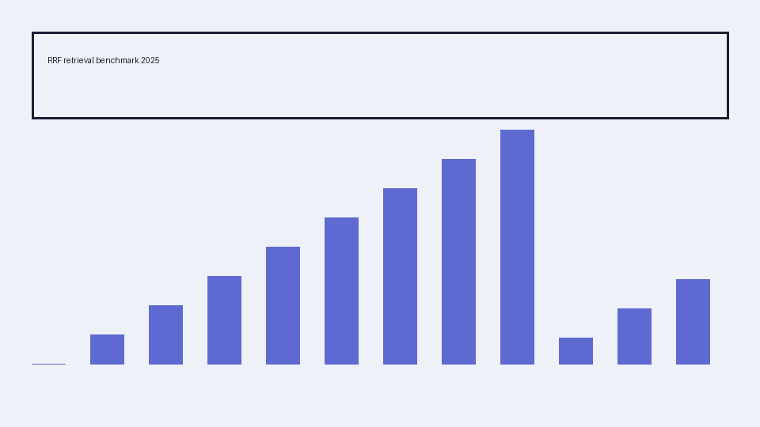
Quarterly review 4
- Revenue grew 12% year over year
- Latency dropped from 36 ms to 15 ms
- Slide 4: hybrid retrieval keeps recall high
Notes:
Speaker note for slide 4.

Slide 5
Quarterly review 5
- Revenue grew 12% year over year
- Latency dropped from 36 ms to 15 ms
- Slide 5: hybrid retrieval keeps recall high
Notes:
Speaker note for slide 5.

Slide 6
Quarterly review 6
- Revenue grew 12% year over year
- Latency dropped from 36 ms to 15 ms
- Slide 6: hybrid retrieval keeps recall high
Notes:
Speaker note for slide 6.

Slide 7
Quarterly review 7
- Revenue grew 12% year over year
- Latency dropped from 36 ms to 15 ms
- Slide 7: hybrid retrieval keeps recall high
Notes:
Speaker note for slide 7.

Slide 8
Quarterly review 8
- Revenue grew 12% year over year
- Latency dropped from 36 ms to 15 ms
- Slide 8: hybrid retrieval keeps recall high
Notes:
Speaker note for slide 8.

