Slide 1
Offline: fixed Train-only case bank
Tₛ, mₛ
Train RGB / SAR
Same frozen encoder
MPF + region encoding
Train GT
Event × class sampling
M = {Tₛ, πₛ, mₛ, ID}
Q-weighted label pool
Qₛ
πₛ
(a) Multimodal pixel frontend
(b) Structure-guided regions
(c) Retrieval-enhanced prediction
Pre RGB
R + B
Local soft association
Select IDs
cosine or supervised projection
Frozen
MPF
Q
Post SAR
Fetch original records
Tₛ, Train soft labels πₛ, metadata mₛ
F + B + b(Q) + H(Q)
Structure-conditioned Adapter
F: fused pixel features
R: RGB structure
B: building probability
Reader
query T + original support content
Q-weighted content
+ pre-Adapter F statistics
+ soft geometry
Same-Q back-projection → C
Joint prediction: z = WₚF + W꜀C + b
T
Preserved pixel feature F
Solid arrows: feature flow. Dashed arrow: case-bank lookup. Val / Test GT is never an input.
Notes:
Fig1_framework: 方法总体流程. Source slide 1. All original image blobs were copied without recompression. Text, geometry and picture objects remain individually editable.

Slide 2
(a) Building-aware soft association Q
RGB structure R
+ pixel coordinates
Local candidates
|N(i)| ≤ 9
Affinity + distance
+ B compatibility
Assignment /
center update
3 iterations
qᵢₖ = softmaxₖ∈N(i)(sᵢₖ) Σₖ qᵢₖ = 1
(b) Structure-conditioned region embedding
F + B + b(Q) + H(Q)
Structure-conditioned Adapter
Pre-Adapter fused F
Q-weighted μ and σ
ψ(μ, σ) × tanh α
Soft geometry from Q
centroid, mass, shape
γ(gₖ)
Adapted feature F̃
Q × importance a
φ(weighted content mean)
Add + LayerNorm → Tₖ ∈ R¹²⁸
B is predicted building probability; b(Q) is assignment discrepancy; H(Q) is association entropy. Neither is a GT map.
Notes:
Fig2_region_encoding: 建筑感知区域编码. Source slide 2. All original image blobs were copied without recompression. Text, geometry and picture objects remain individually editable.

Slide 3
Stored keys
(a) Select support identities
Query Tₖ
Similarity space
identity or supervised G(T)
Exclude same image / event
Top-K support IDs
Fixed Train bank
{Tₛ, πₛ, mₛ}
Projection G affects IDs only. The Reader receives the original stored case content.
(b) Read original support content
(c) Joint classification
Original support Tₛ
Kᵢₙ = Tₛ
Train label / metadata encoding
Vᵢₙ = Tₛ + E(πₛ, mₛ)
Same-Q back-projection
Cᵢ = Σₖ qᵢₖ T′ₖ
Query Tₖ
Qᵢₙ = Tₖ
Pre-LN cross-attention
+ residual FFN
Preserved pixel feature Fᵢ
Enhanced regional content T′ₖ
zᵢ = WₚFᵢ + W꜀Cᵢ + b
Four-class prediction
Parametric-support control uses learned reference vectors instead of Train cases. It is an ablation, not a claim of memory gain.
Notes:
Fig3_retrieval_reader: 检索与Reader流程. Source slide 3. All original image blobs were copied without recompression. Text, geometry and picture objects remain individually editable.

Slide 4
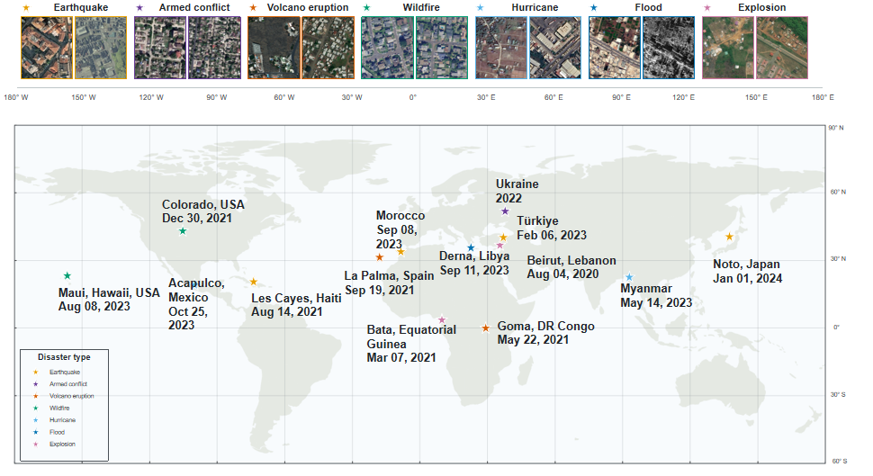
Notes:
Fig4_dataset: 数据集场景与分布. Source slide 4. All original image blobs were copied without recompression. Text, geometry and picture objects remain individually editable.

Slide 5
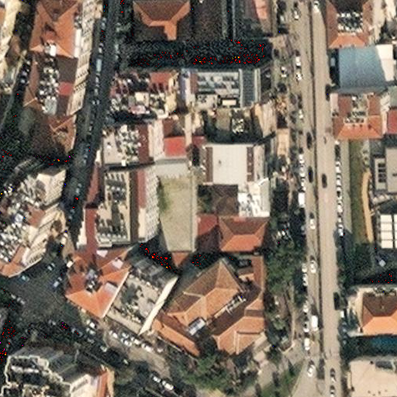
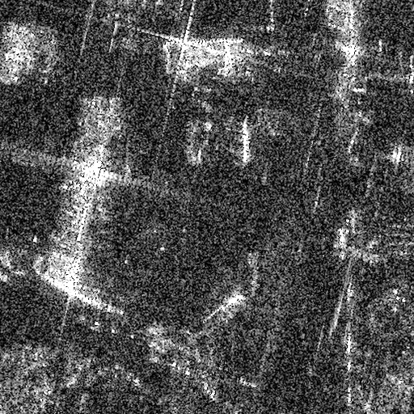
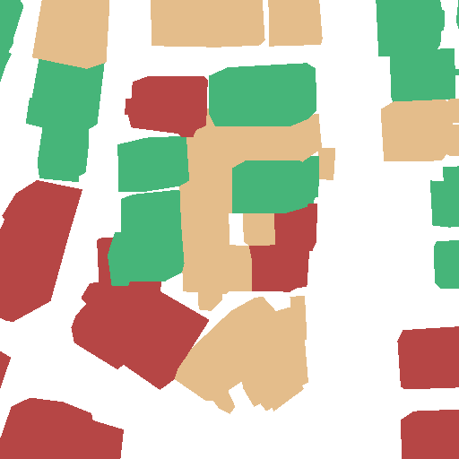
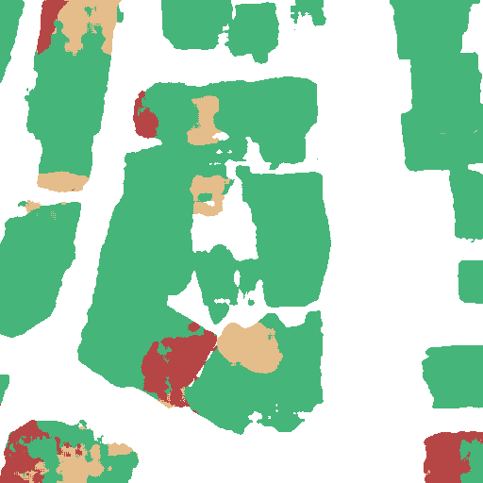
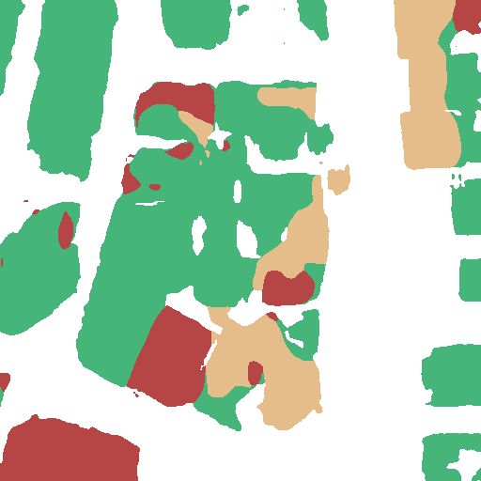
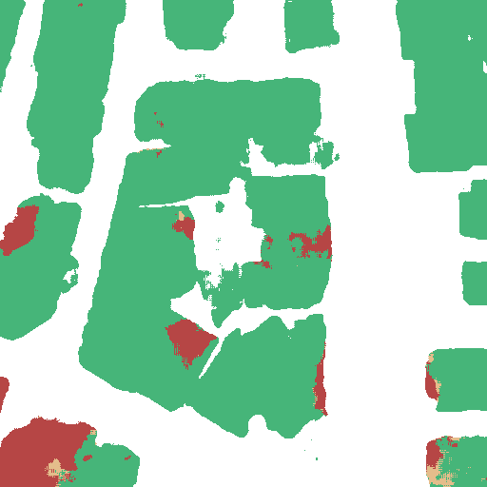
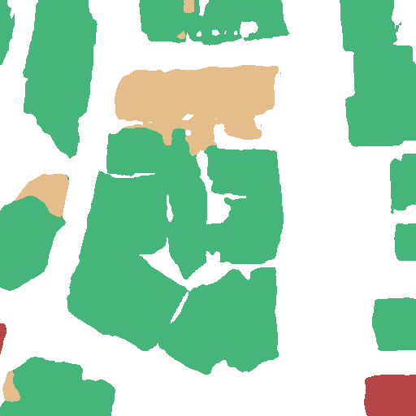
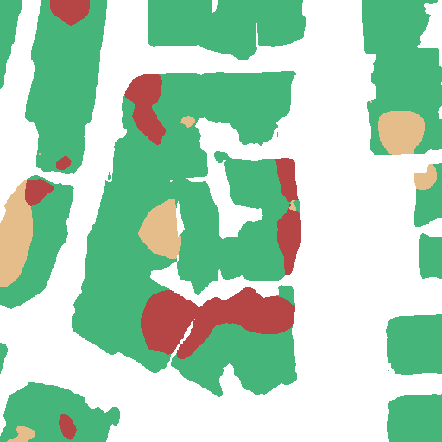
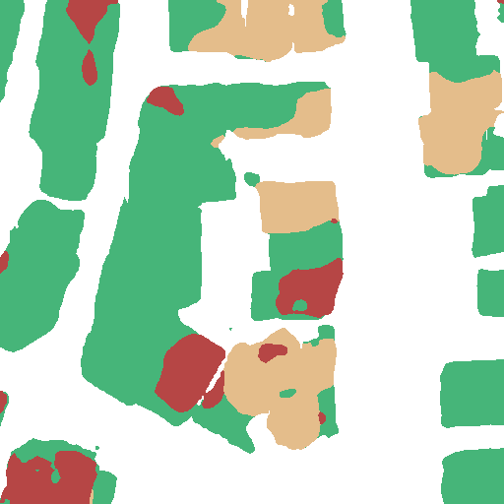
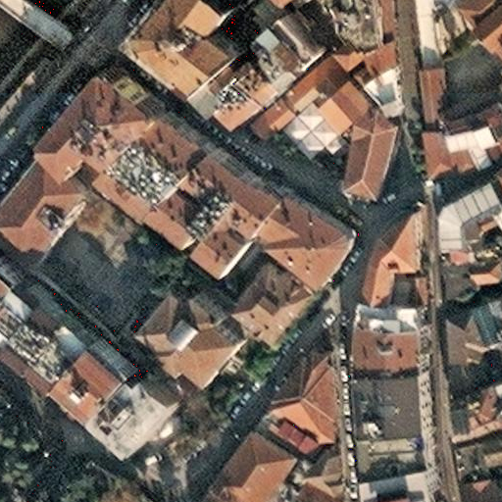
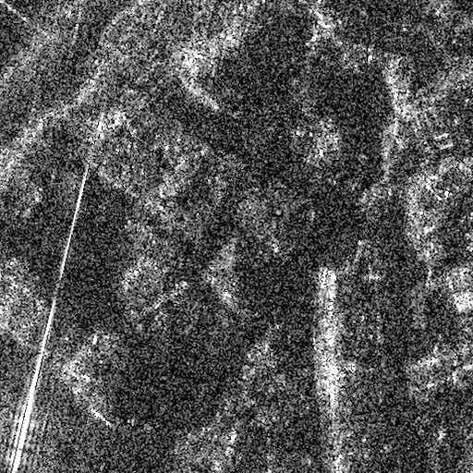
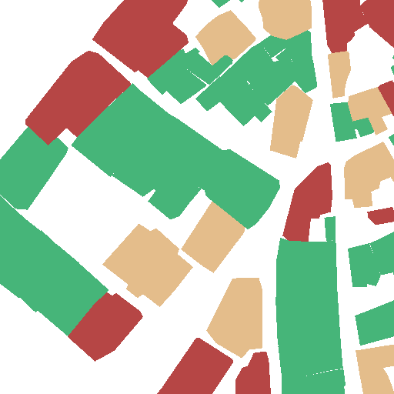
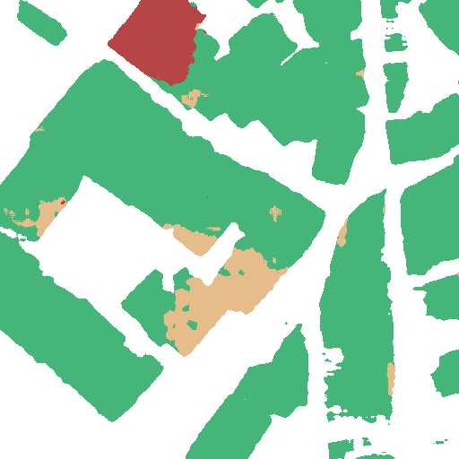
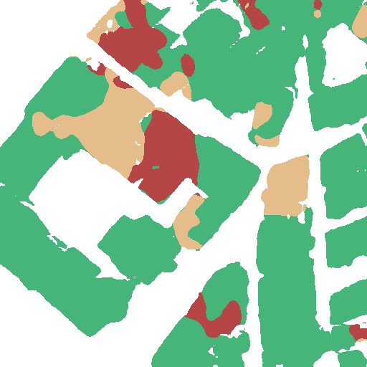
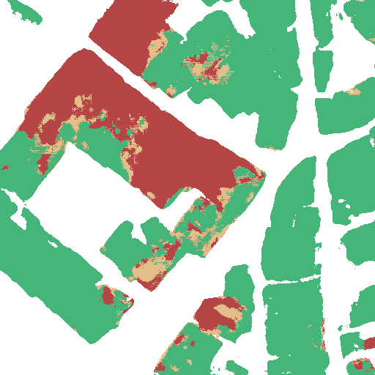
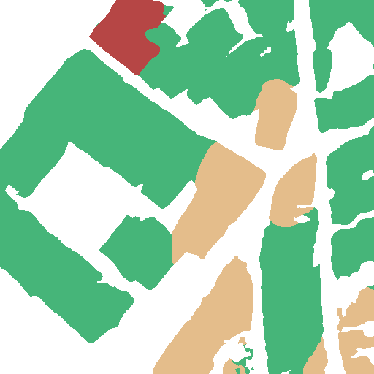
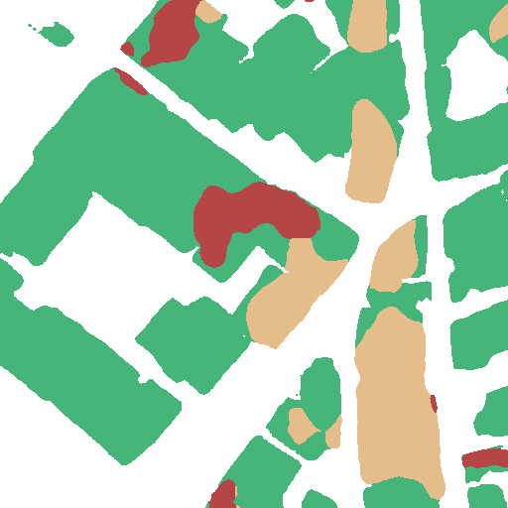
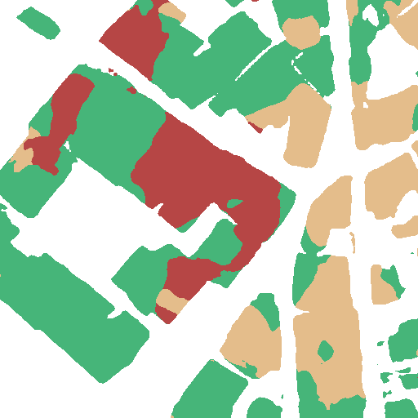
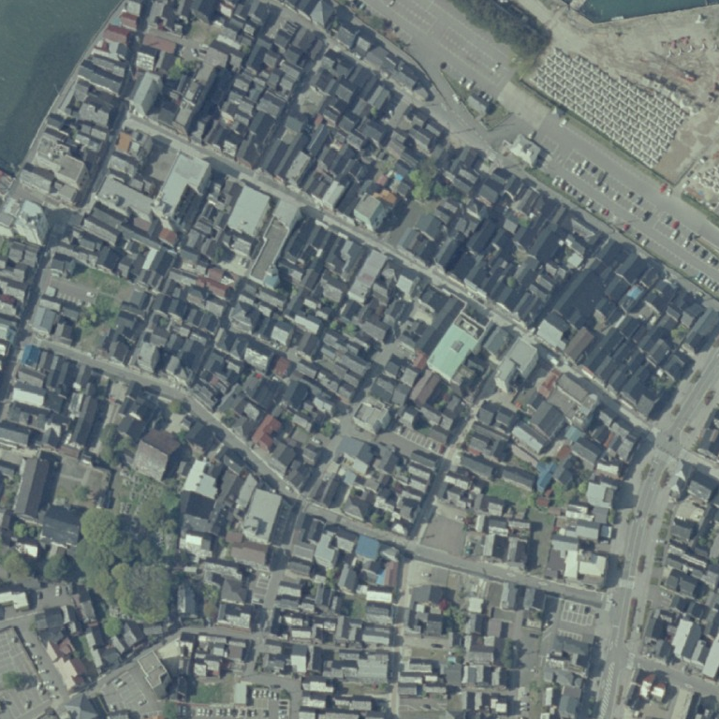
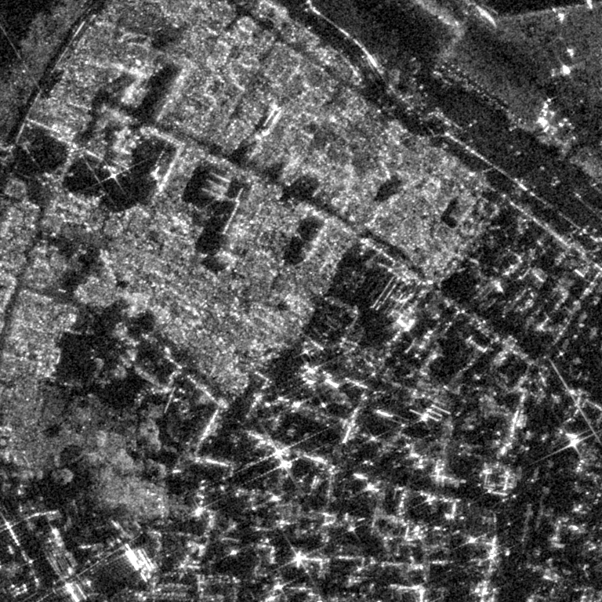
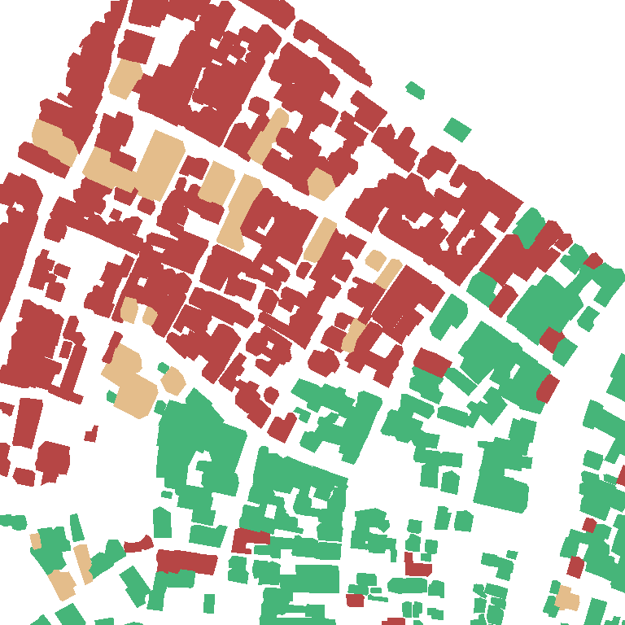
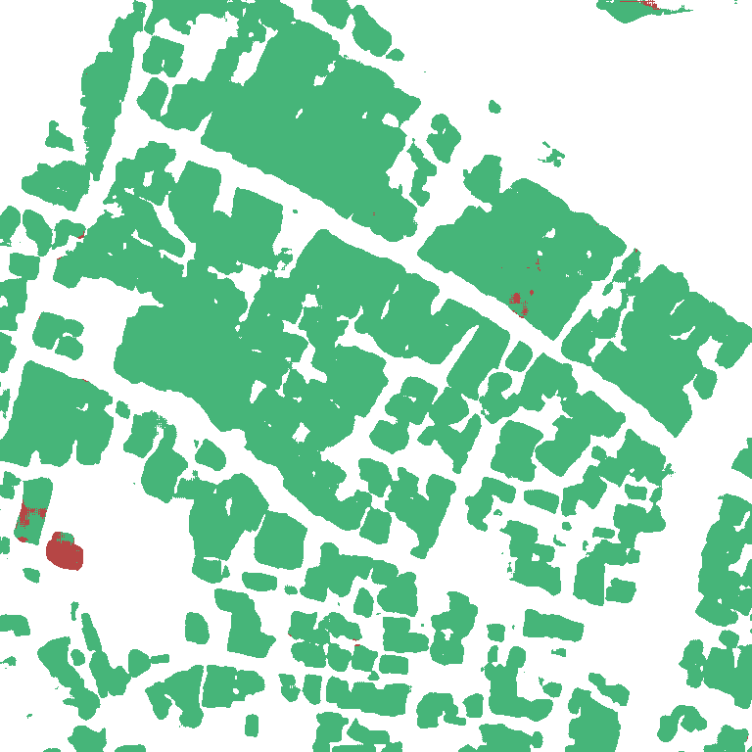
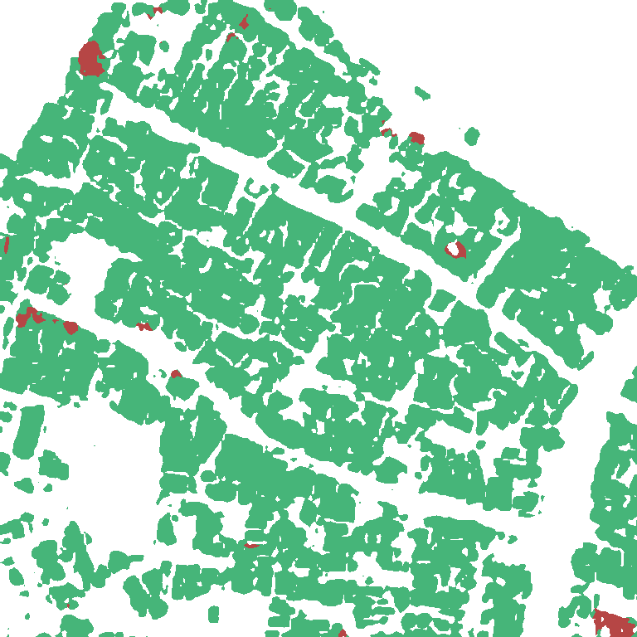
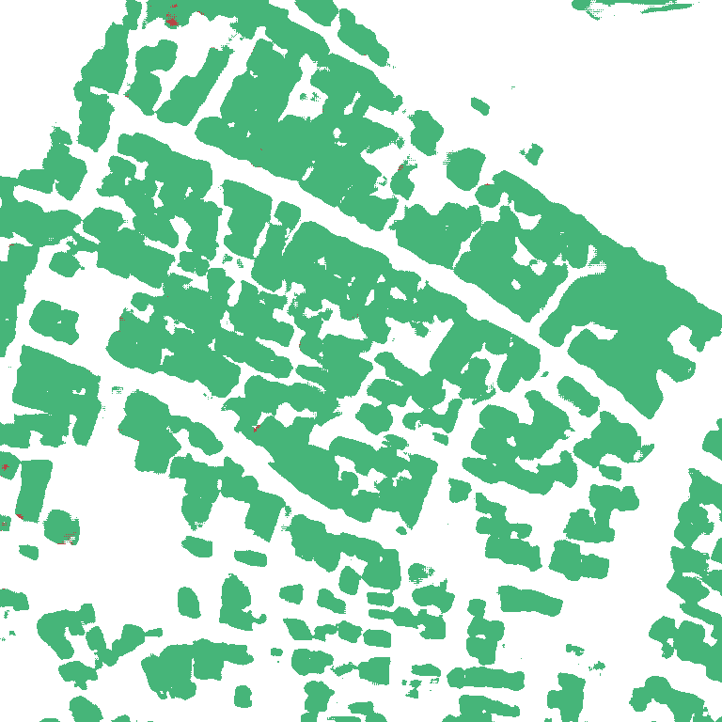
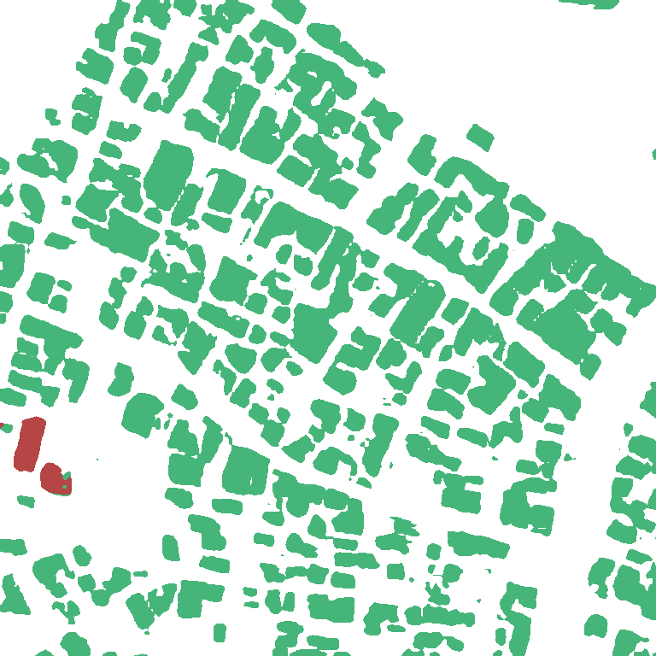
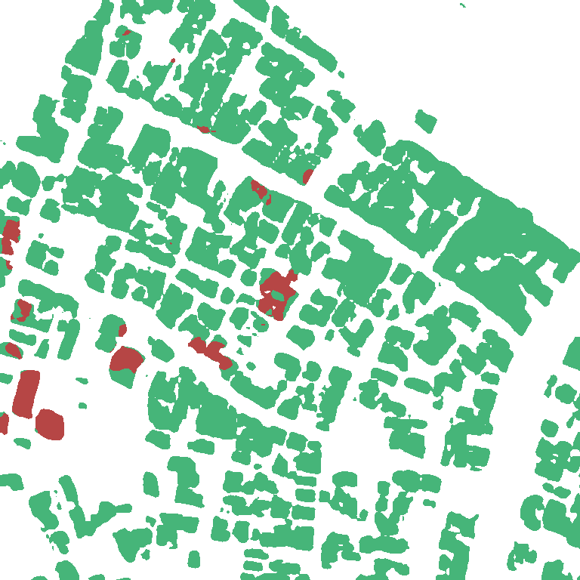
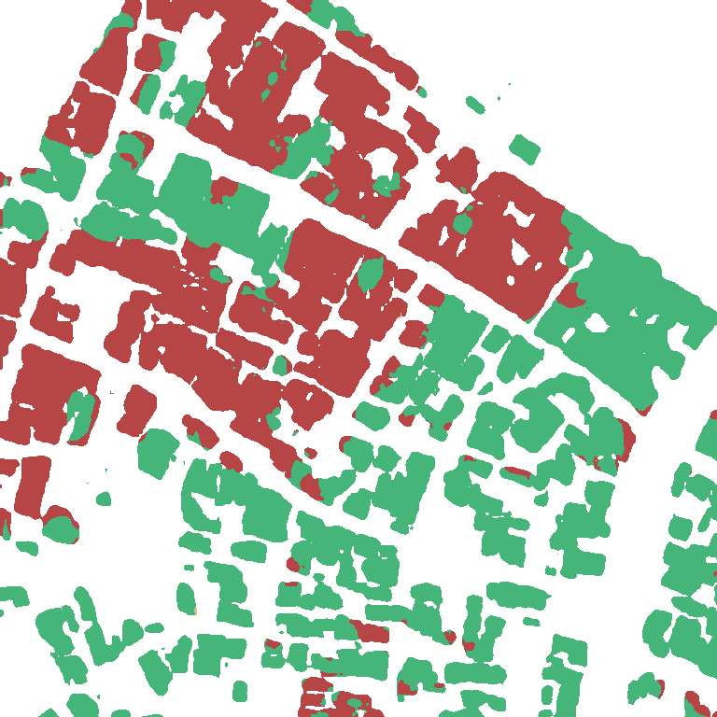
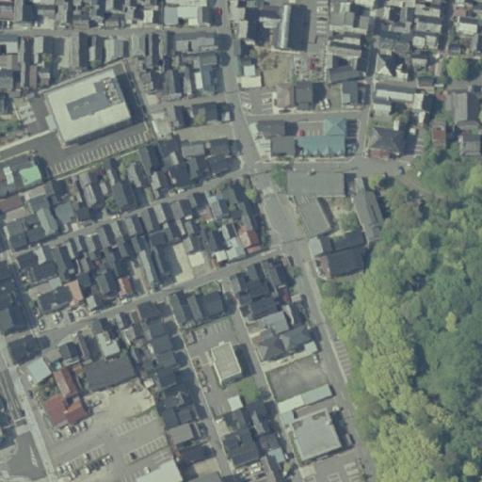
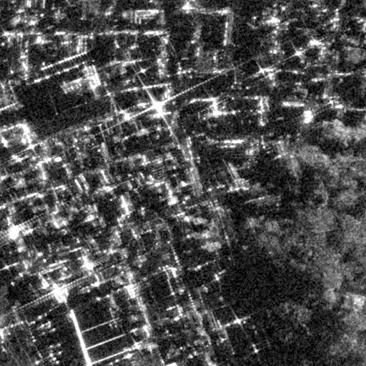
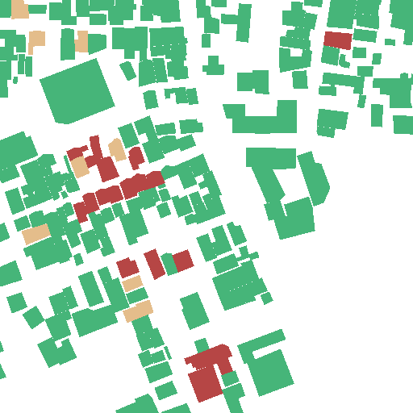
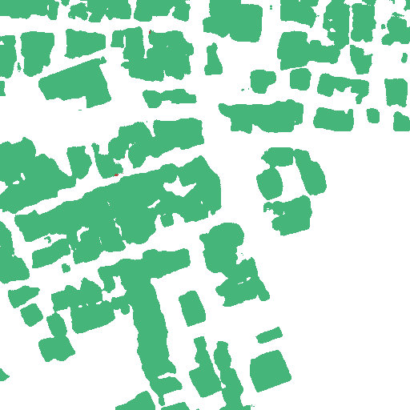
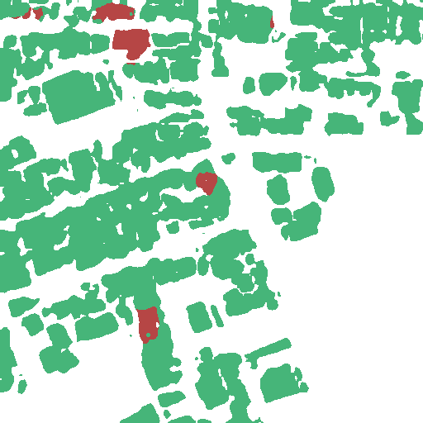
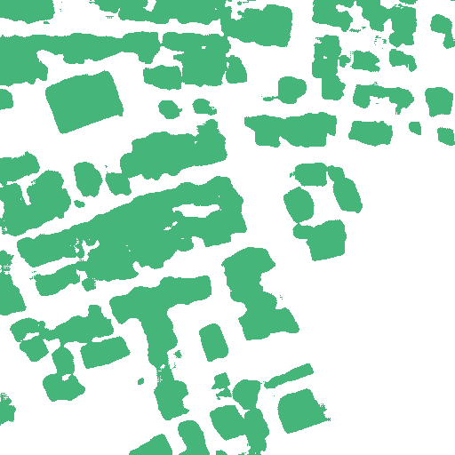
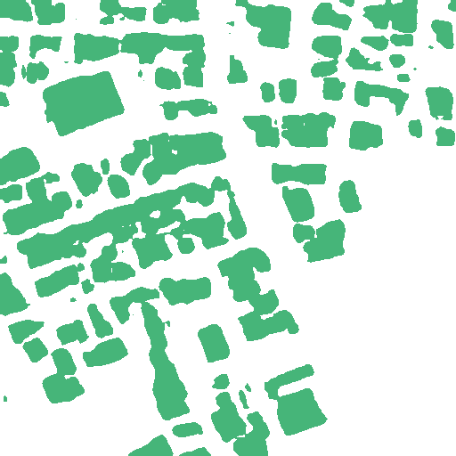
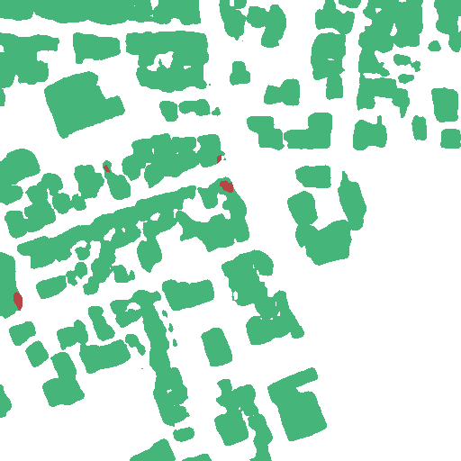
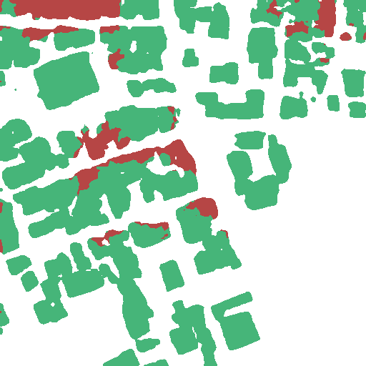
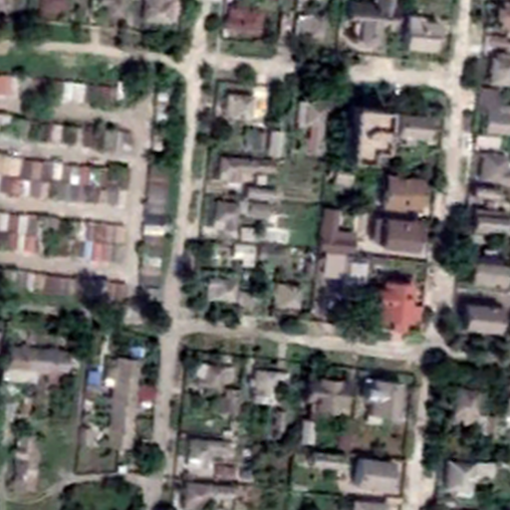
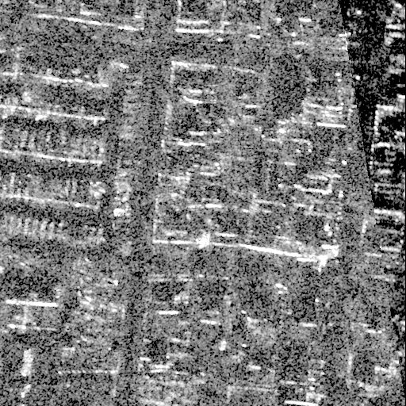
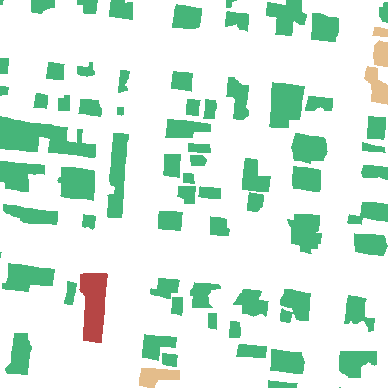
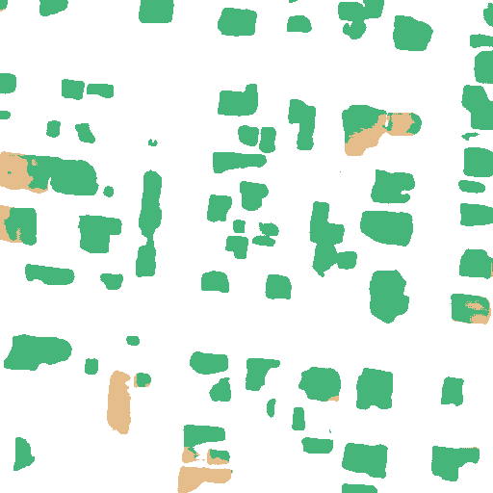
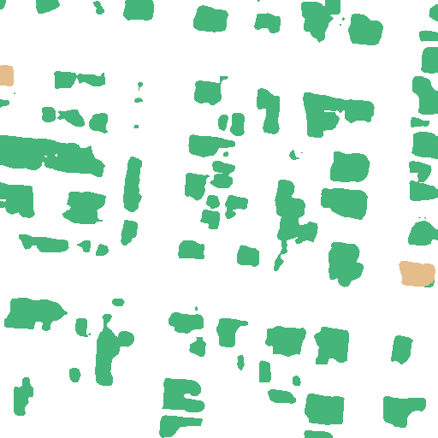
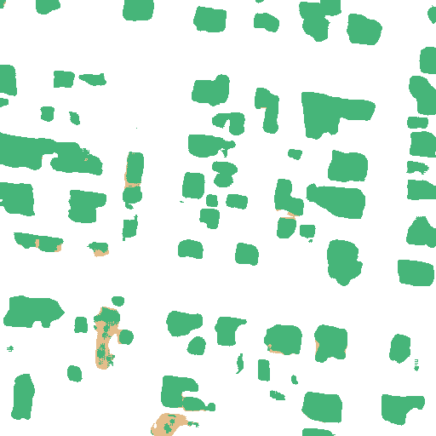
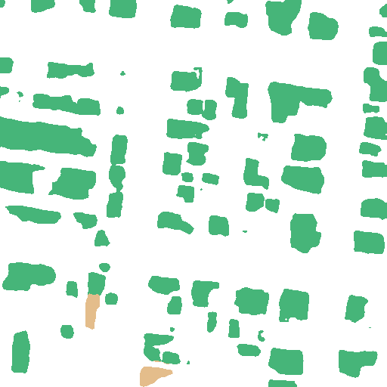
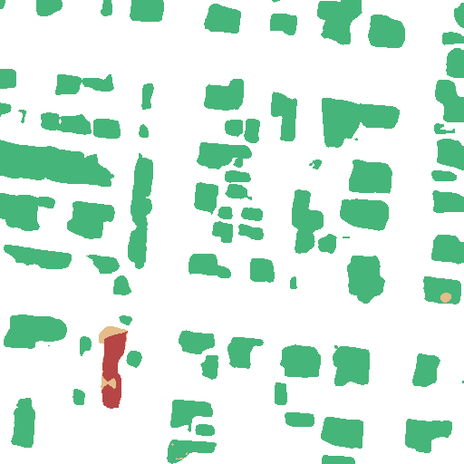
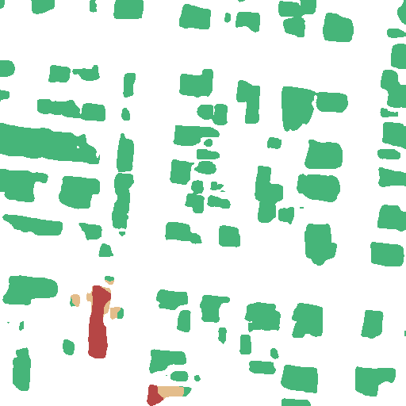
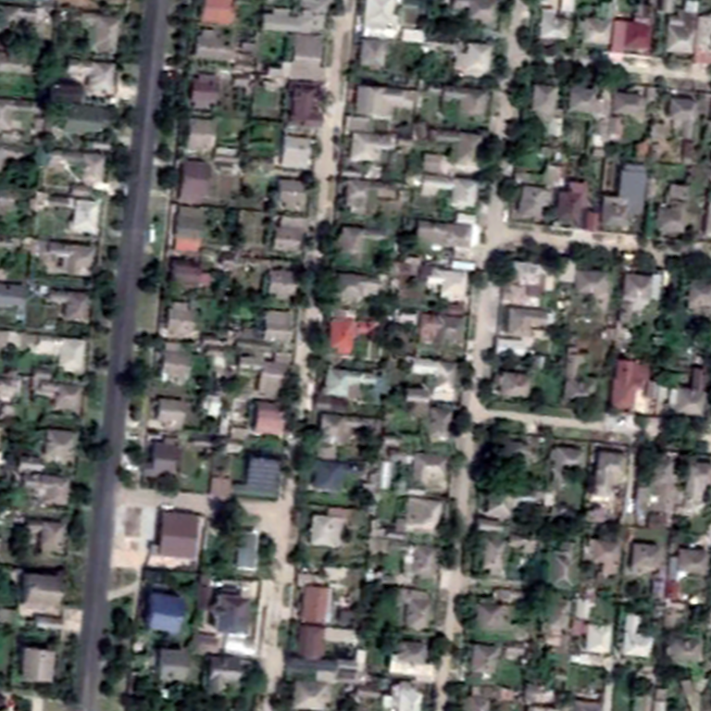
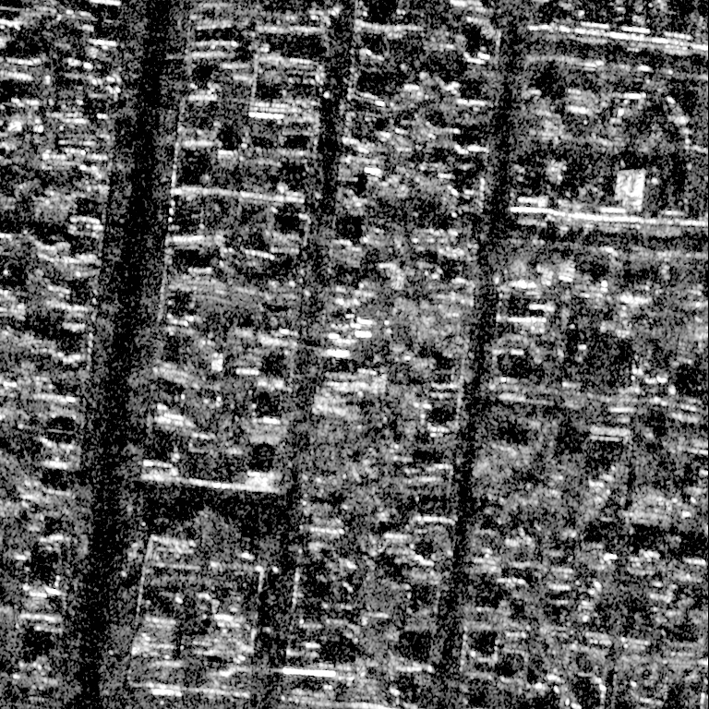
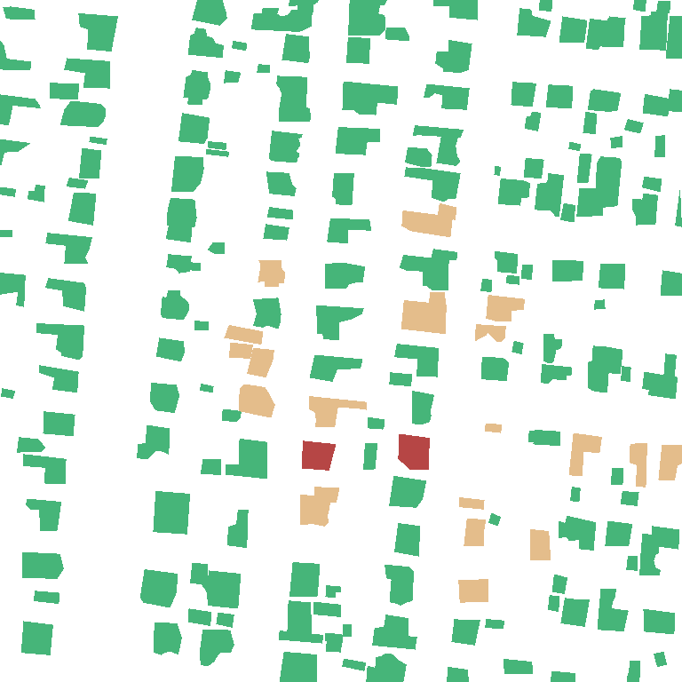
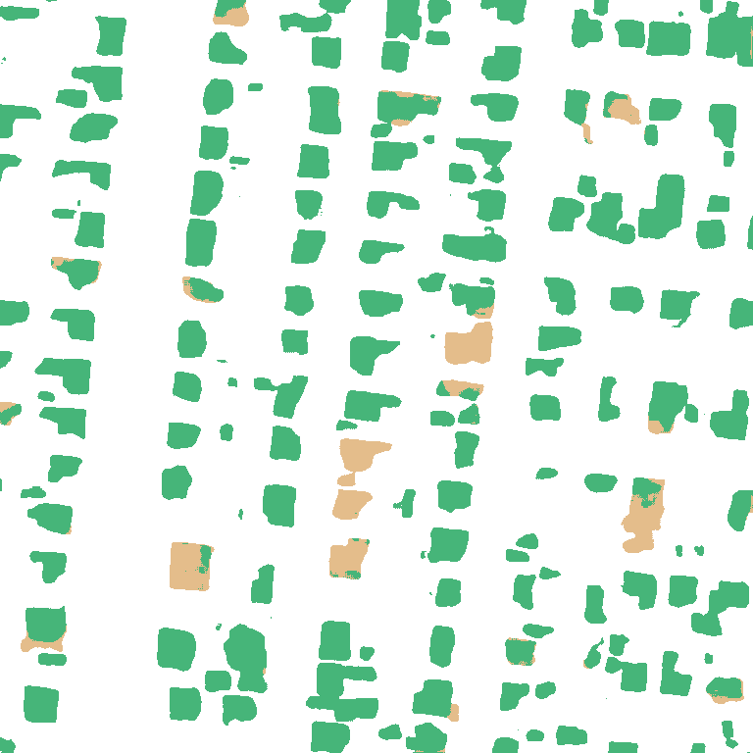





Earthquake and conflict: six selected crops
RGB
SAR
GT
U-Net
DeepLab
v3+
SiamAttn
UNet
SiamCRNN
Damage
Former
MPF
Türkiye
earthquake
00001065
512 × 512 px
Türkiye
earthquake
00001074
512 × 512 px
noto
earthquake
00000038
768 × 768 px
noto
earthquake
00000049
512 × 512 px
ukraine
conflict
00000354
512 × 512 px
ukraine
conflict
00000315
768 × 768 px
Background
Intact
Damaged
Destroyed
Notes:
Fig5a_external_models: 地震与冲突的六个局部案例. Source slide 10. All original image blobs were copied without recompression. Text, geometry and picture objects remain individually editable.
MPF is the pixel frontend from existing predictions. It is not the complete retrieval framework. Ours panels are intentionally blank until genuine full-framework predictions are provided. Identical image windows are used within each row. Different source crop sizes share display dimensions but do not imply equal spatial scales. Selected crops cannot establish full-Test performance.
MPF denotes the legacy A1 multimodal pixel frontend, not the full retrieval model.

Slide 6






















































Volcano and wildfire: six selected crops
RGB
SAR
GT
U-Net
DeepLab
v3+
SiamAttn
UNet
SiamCRNN
Damage
Former
MPF
congo
volcano
00000085
512 × 512 px
congo
volcano
00000092
512 × 512 px
La Palma
volcano
00000597
768 × 768 px
La Palma
volcano
00000353
512 × 512 px
hawaii
wildfire
00000014
512 × 512 px
hawaii
wildfire
00000003
512 × 512 px
Background
Intact
Damaged
Destroyed
Notes:
Fig5b_external_models: 火山与野火的六个局部案例. Source slide 11. All original image blobs were copied without recompression. Text, geometry and picture objects remain individually editable.
MPF is the pixel frontend from existing predictions. It is not the complete retrieval framework. Ours panels are intentionally blank until genuine full-framework predictions are provided. Identical image windows are used within each row. Different source crop sizes share display dimensions but do not imply equal spatial scales. Selected crops cannot establish full-Test performance.
MPF denotes the legacy A1 multimodal pixel frontend, not the full retrieval model.

Slide 7






















































Hurricane, flood and explosion: six selected crops
RGB
SAR
GT
U-Net
DeepLab
v3+
SiamAttn
UNet
SiamCRNN
Damage
Former
MPF
mexico
hurricane
00000005
512 × 512 px
myanmar
hurricane
00000107
768 × 768 px
myanmar
hurricane
00000099
1024 × 1024 px
libya
flood
00000021
768 × 768 px
bata
explosion
00000062
512 × 512 px
bata
explosion
00000049
512 × 512 px
Background
Intact
Damaged
Destroyed
Notes:
Fig5c_external_models: 飓风、洪灾与爆炸的六个局部案例. Source slide 12. All original image blobs were copied without recompression. Text, geometry and picture objects remain individually editable.
MPF is the pixel frontend from existing predictions. It is not the complete retrieval framework. Ours panels are intentionally blank until genuine full-framework predictions are provided. Identical image windows are used within each row. Different source crop sizes share display dimensions but do not imply equal spatial scales. Selected crops cannot establish full-Test performance.
MPF denotes the legacy A1 multimodal pixel frontend, not the full retrieval model.

Slide 8




Pre-event RGB
Ground truth
DamageFormer
MPF
Enlarged blue-box window; the same location is used in every column.
Background
Intact
Damaged
Destroyed
Notes:
Fig6_noto: 能登地震局部放大案例. Source slide 1. All original image blobs were copied without recompression. Text, geometry and picture objects remain individually editable.
noto-earthquake_00000038. MPF is the legacy A1 multimodal pixel frontend (DamageFormer_S8_MICB_DSMIL), not the complete retrieval system. Source slide 8. Scientific image blobs are copied byte for byte; only headers, frames and layout were changed. No numerical gain is asserted by this figure.
MPF denotes the legacy A1 multimodal pixel frontend, not the full retrieval model.

Slide 9




Pre-event RGB
Ground truth
DamageFormer
MPF
Enlarged blue-box window; the same location is used in every column.
Background
Intact
Damaged
Destroyed
Notes:
Fig7_turkey: 土耳其地震局部放大案例. Source slide 2. All original image blobs were copied without recompression. Text, geometry and picture objects remain individually editable.
turkey-earthquake_00001065. MPF is the legacy A1 multimodal pixel frontend (DamageFormer_S8_MICB_DSMIL), not the complete retrieval system. Source slide 9. Scientific image blobs are copied byte for byte; only headers, frames and layout were changed. No numerical gain is asserted by this figure.
MPF denotes the legacy A1 multimodal pixel frontend, not the full retrieval model.

Slide 10





Pre-event RGB
Post-event SAR
Ground truth
DamageFormer
MPF
Enlarged blue-box window; the same location is used in every column.
Background
Intact
Damaged
Destroyed
Notes:
Fig8_myanmar: 缅甸飓风局部放大案例. Source slide 3. All original image blobs were copied without recompression. Text, geometry and picture objects remain individually editable.
myanmar-hurricane_00000099. MPF is the legacy A1 multimodal pixel frontend (DamageFormer_S8_MICB_DSMIL), not the complete retrieval system. Source slide 10. Scientific image blobs are copied byte for byte; only headers, frames and layout were changed. No numerical gain is asserted by this figure.
MPF denotes the legacy A1 multimodal pixel frontend, not the full retrieval model.

Slide 11
Structure diagnostic panels
turkey-earthquake_00001065 | source crop [256, 0, 512, 512]
RGB
SAR
GT
Building B
Q: prior off
Q: prior on
b(Q)
H(Q)
Notes:
Fig9_structure_diagnostic_template: 结构诊断空模板（待填实测输出）. Source slide 7. All original image blobs were copied without recompression. Text, geometry and picture objects remain individually editable.
Only the original RGB, SAR and GT are present. All model-response panels are empty. Q-off and Q-on must use the identical query window and matched checkpoints. B is predicted building probability; b(Q) is assignment discrepancy, H(Q) is association entropy. No GT map is substituted for a model response.
This is a layout template, not a measured model result. Empty cells require actual experiment outputs.

Slide 12
Retrieval and correction diagnostics
Query: turkey-earthquake_00001065
MPF
Cosine Reader
Supervised Reader
Rescued / harmed
RGB
SAR
GT
Cosine-selected Train support
ID:
Event:
Similarity:
Class / purity:
Support RGB
Support SAR
Train GT
Supervised-selected Train support
ID:
Event:
Similarity:
Class / purity:
Support RGB
Support SAR
Train GT
Notes:
Fig10_retrieval_diagnostic_template: 检索诊断空模板（待填实测输出）. Source slide 8. All original image blobs were copied without recompression. Text, geometry and picture objects remain individually editable.
Support panels are empty. They must come from genuinely selected Train IDs, with exclusion of the query image and event. Query GT is for post-hoc evaluation only. Raw cosine and supervised retrieval similarities use distinct spaces and must be identified, not compared as calibrated confidence.
This is a layout template, not a measured model result. Empty cells require actual experiment outputs.

