Slide 1
gRPC Introduction
Oct 2018

Slide 2
Agenda
Google Protocol Buffers
gRPC
Service Definition – IDL
Stub
Streaming - Unary / Client streaming / Server streaming / Bidirectional streaming
Metadata
Authentication

Slide 3
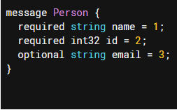
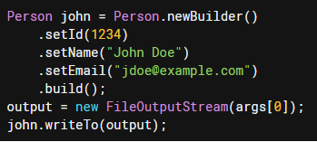
Protocol Buffers
Protocol buffers are a language-neutral, platform-neutral extensible mechanism for serializing structured data.
Think XML
But smaller, faster, and simpler

Slide 4
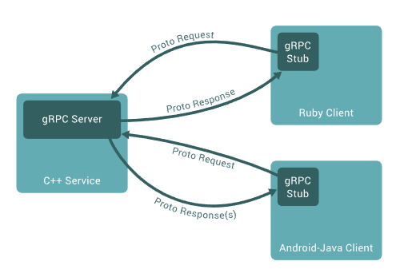
gRPC

Slide 5
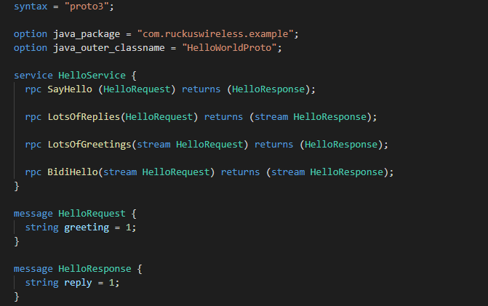
Service Definition
Define a service using Protocol Buffers

Slide 6
Streaming
Unary
Just like a normal function call.
Client Streaming
The client sends a stream of request. The server sends back a single response.
Server Streaming
The client sends a request to the server, and gets a stream to read a sequence of message back.
Bidirectional Streaming
Bidirectional streaming RPCs where both sides send a sequence of messages using a read-write stream. The two streams operate independently

Slide 7
Metadata
Metadata is information about a particular RPC call (such as authentication details) in the form of a list of key-value pairs
Familiar with HTTP headers
For different RPC lifecycles and scenarios, the metadata can be sent before the first request, or after the last response.

Slide 8
Authentication
gRPC java API can accept general certificate chain files, or JAVA keystore files (jks)
SSL/TLS
The server side provides certificate chain and private key.
Client-side TLS (mutual authentication)
Both sides provide certificate chains and private keys.
Additional authentication information in metadata

Slide 9
Thank you!
Notes:
Thank you

