Slide 1
Data information and completion of CTEC 298
CTEC 298
BY: Jire Dada

Slide 2

Table of contents
Introduction
Summary of CTEC 128 paper
Description of CTEC material submitted
Description of the plot deliverables
Summary/conclusion
References

Slide 3

Introduction
This presentation is a representation of the tutorials and different repositories used id this course
Different python tutorials used
Matplotlib
Jupyter notebooks

Slide 4
Summary of CTEC 128
Using Jupyter notebooks from a csv file from data on companies and their profit in millions
To get the file in jupyter notebooks we had to execute the following code:
Import pandas as pd
Pd Df=pd.read_csv(“C:\\Users\dadaj\\Downloads\\fortune500.csv”)

Slide 5
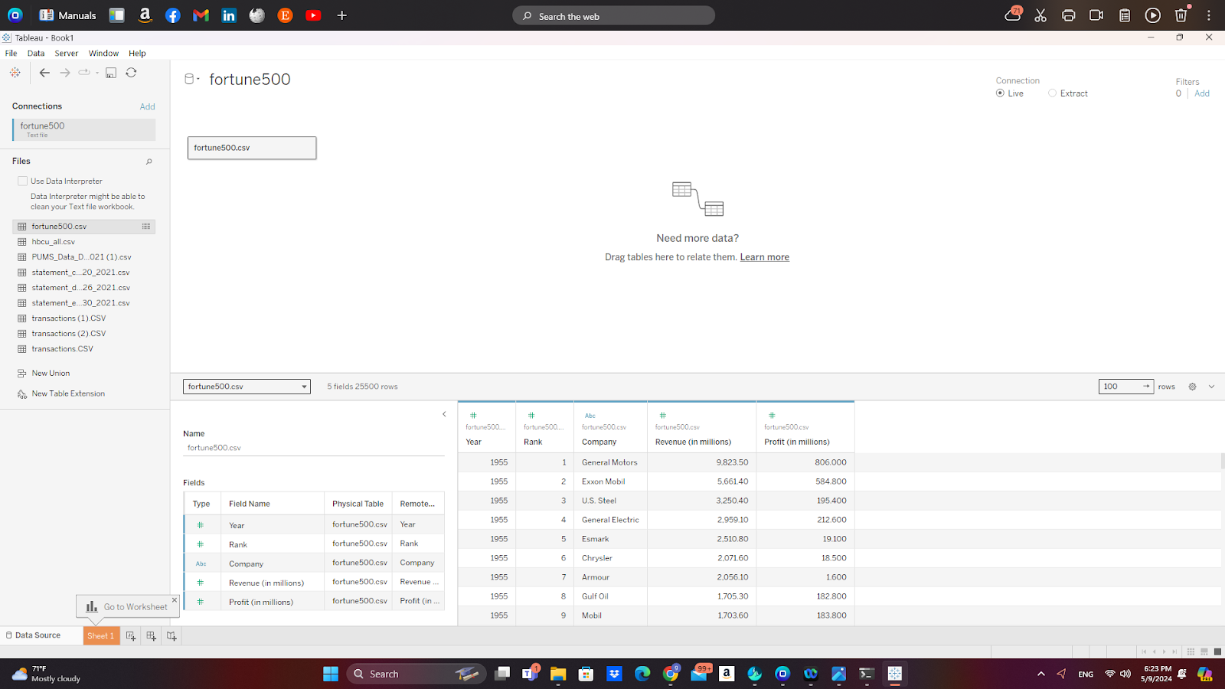
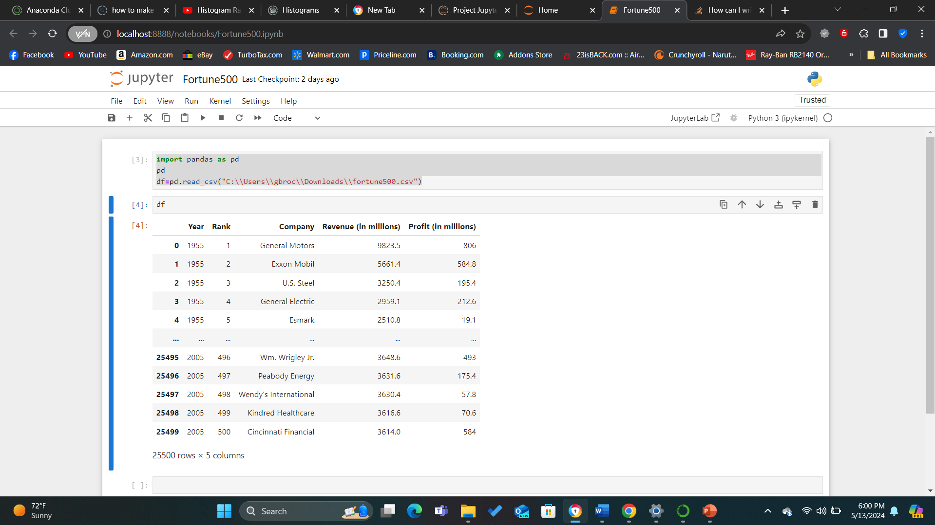
Output of the code executed
The execution of the code output showed the results of the companies in the fortune 500 archives
There are a variety of fortune 500 companies that are contained on this file to where it is displayed as 25500 rows by 5 columns
It displays the revenue by millions and profit in millions over a time span of 50 years of the lists first publication in 1955
It is displayed in tableau and in jupyter notebooks

Slide 6
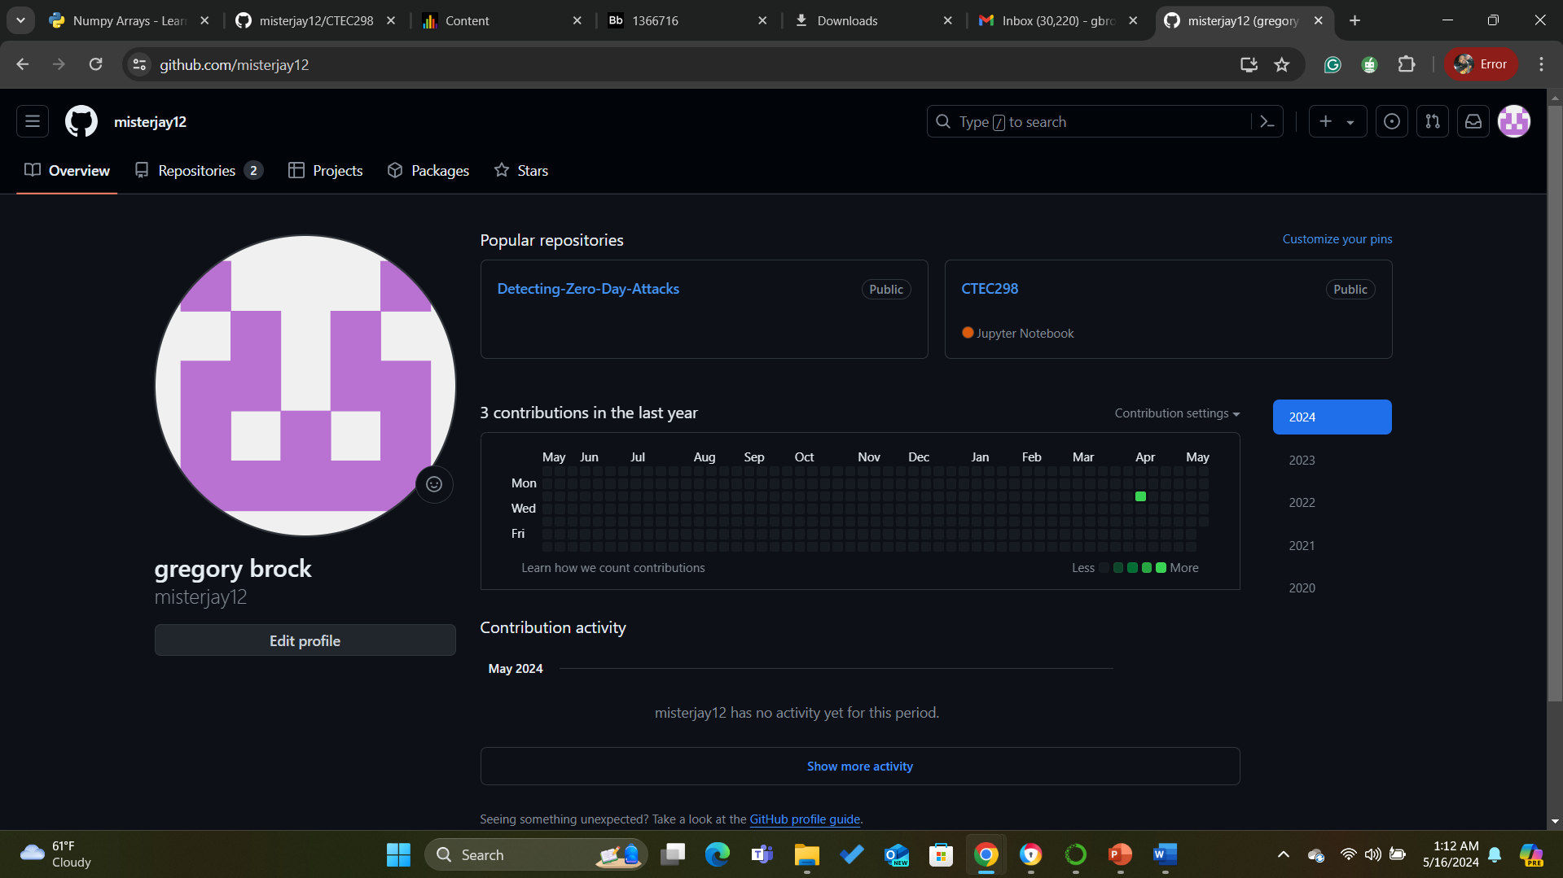
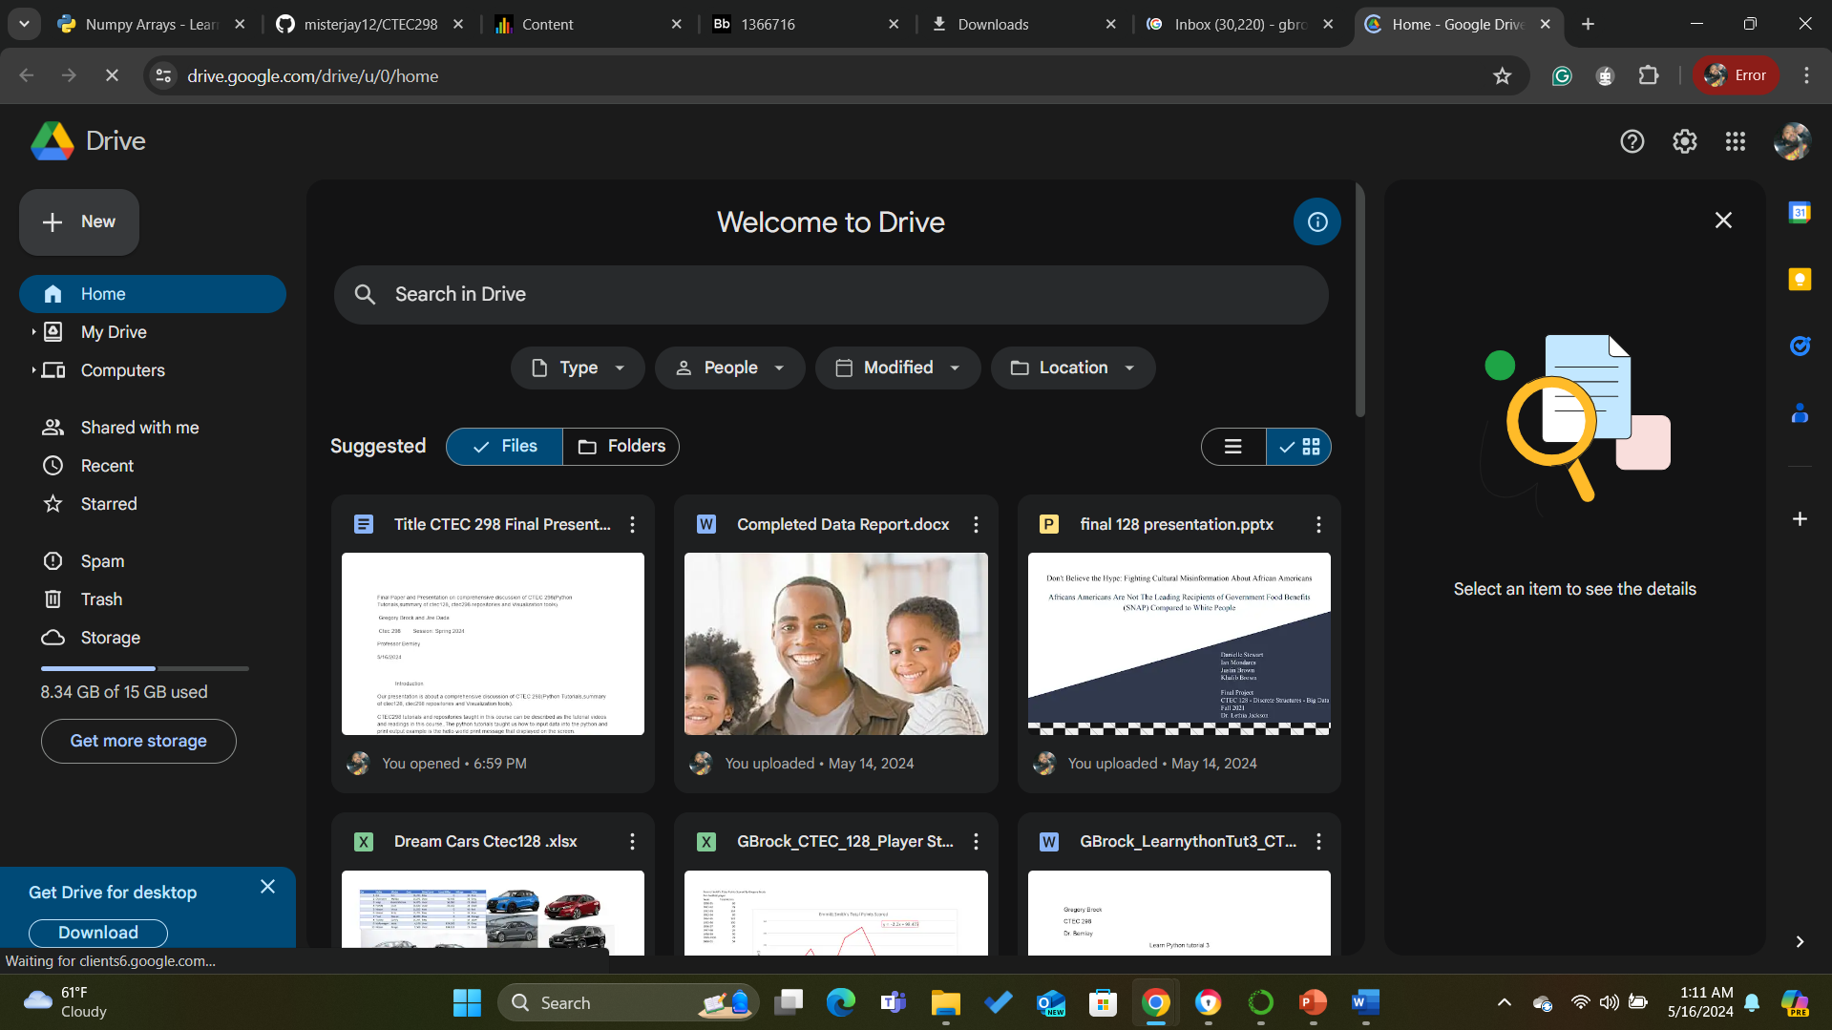
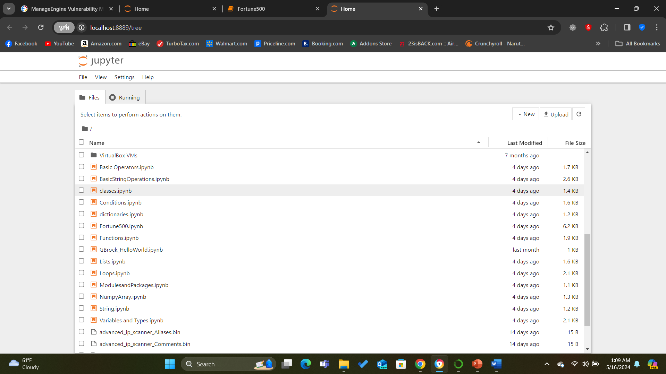
Description of CTEC material submitted
We had to submit our work through github, jupyter notebook, and google drive)
Github is platform for software development, collaboration, and security. Developers can create, store, manage, and share their code.
Jupyter notebooks a powerful web-based interactive computing platform that allows you to create and share computational documents.
Google drive is a file storage and synchronization service developed by Google.

Slide 7
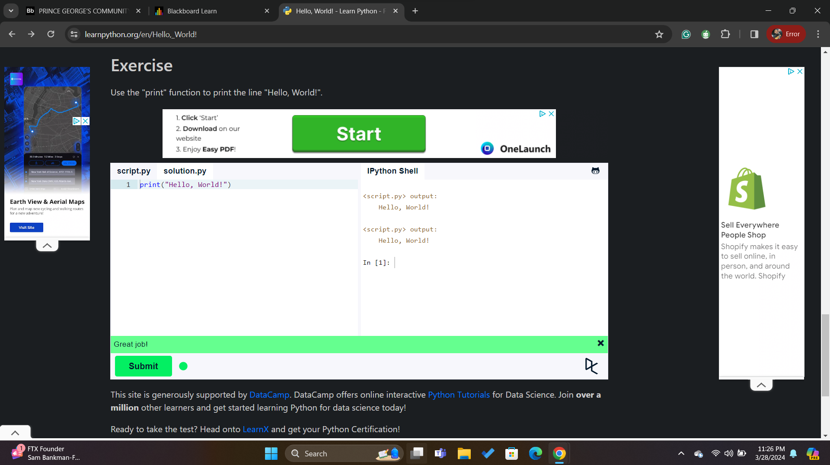
Example of Print Hello World in Tutorials
The following code is used to print Hello World
print(“Hello, World”)
Print is used as a function in python 3 and it needs to have to parenthesis.
In python 2 print is used as a statement and it does not need to have parenthesis when it is run.

Slide 8
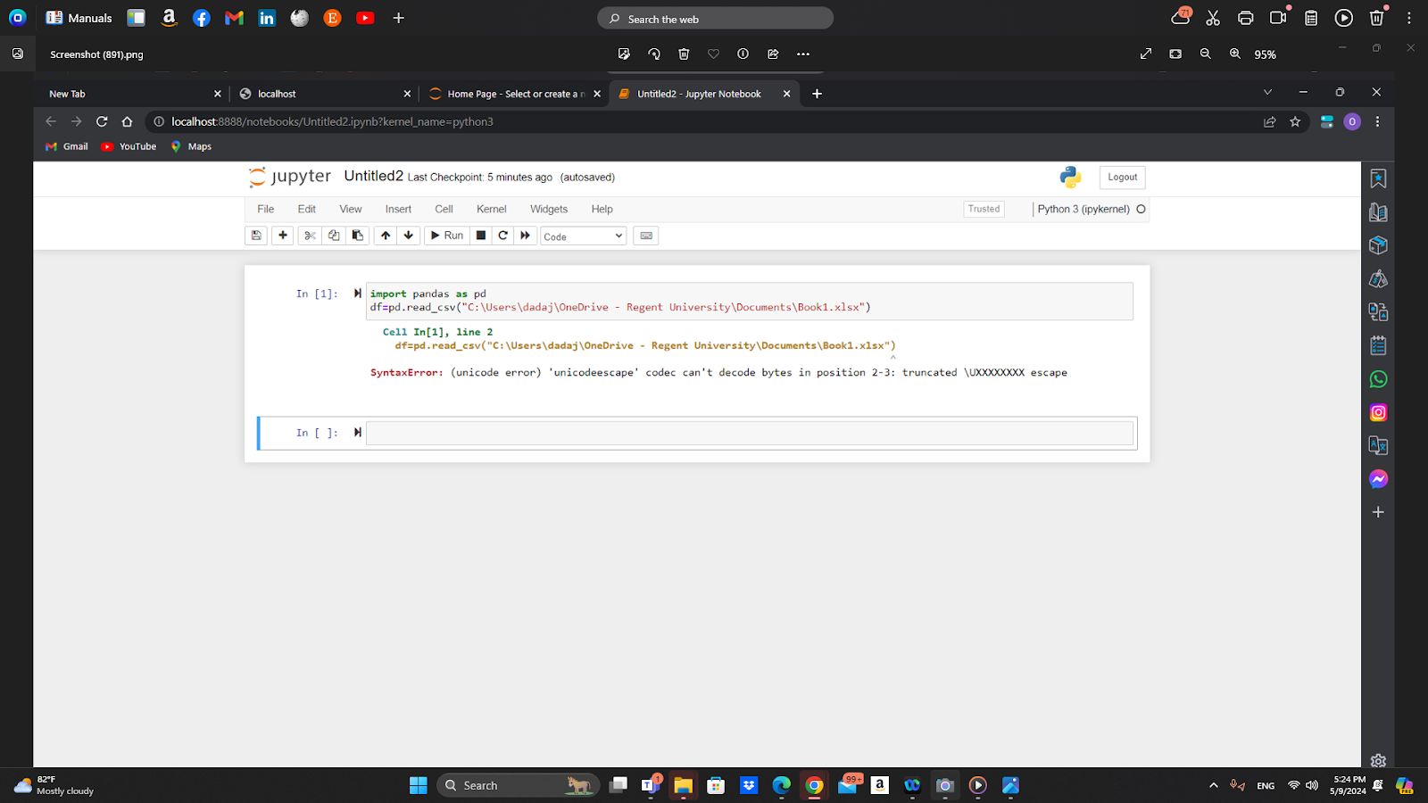
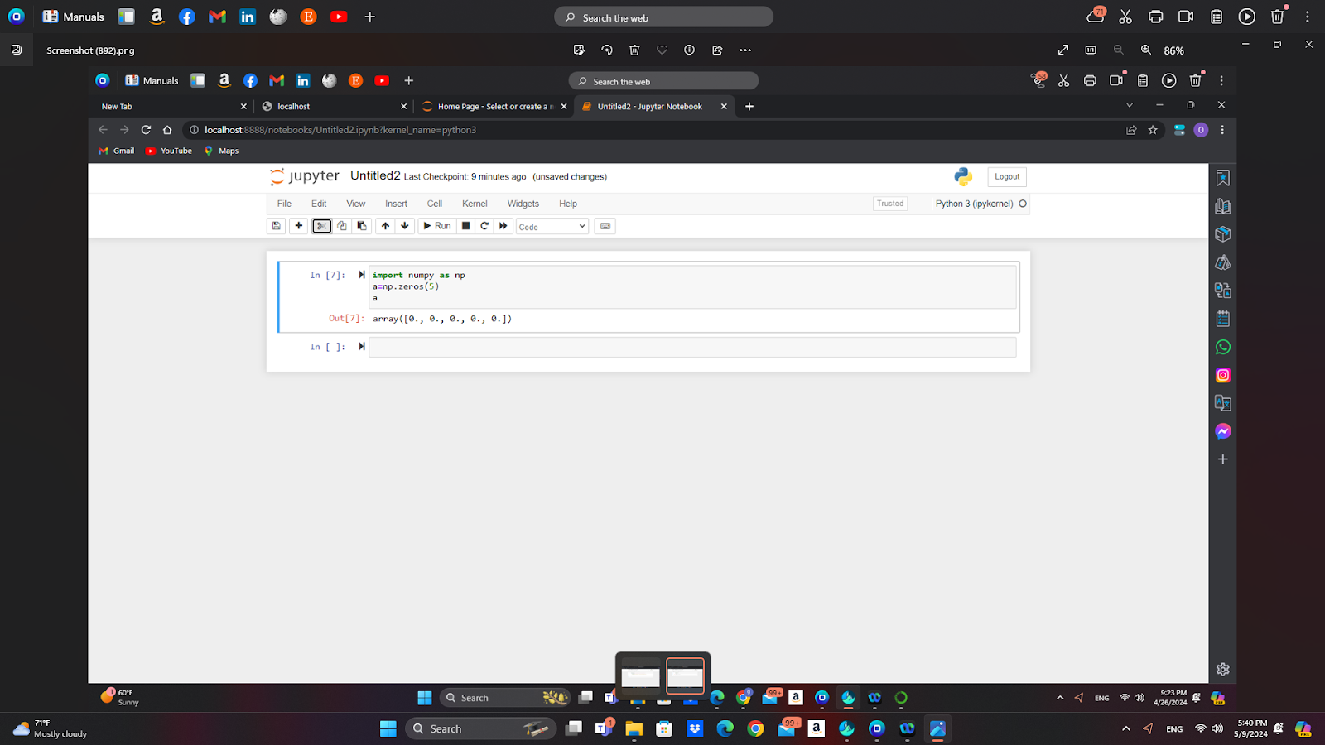
Completion of Numpy and Pandas
NumPy is a library for the Python programming language, adding support for large, multi-dimensional arrays and matrices, along with a large collection of high-level mathematical functions.
Pandas a software library written for the Python programming language for data manipulation and analysis.

Slide 9
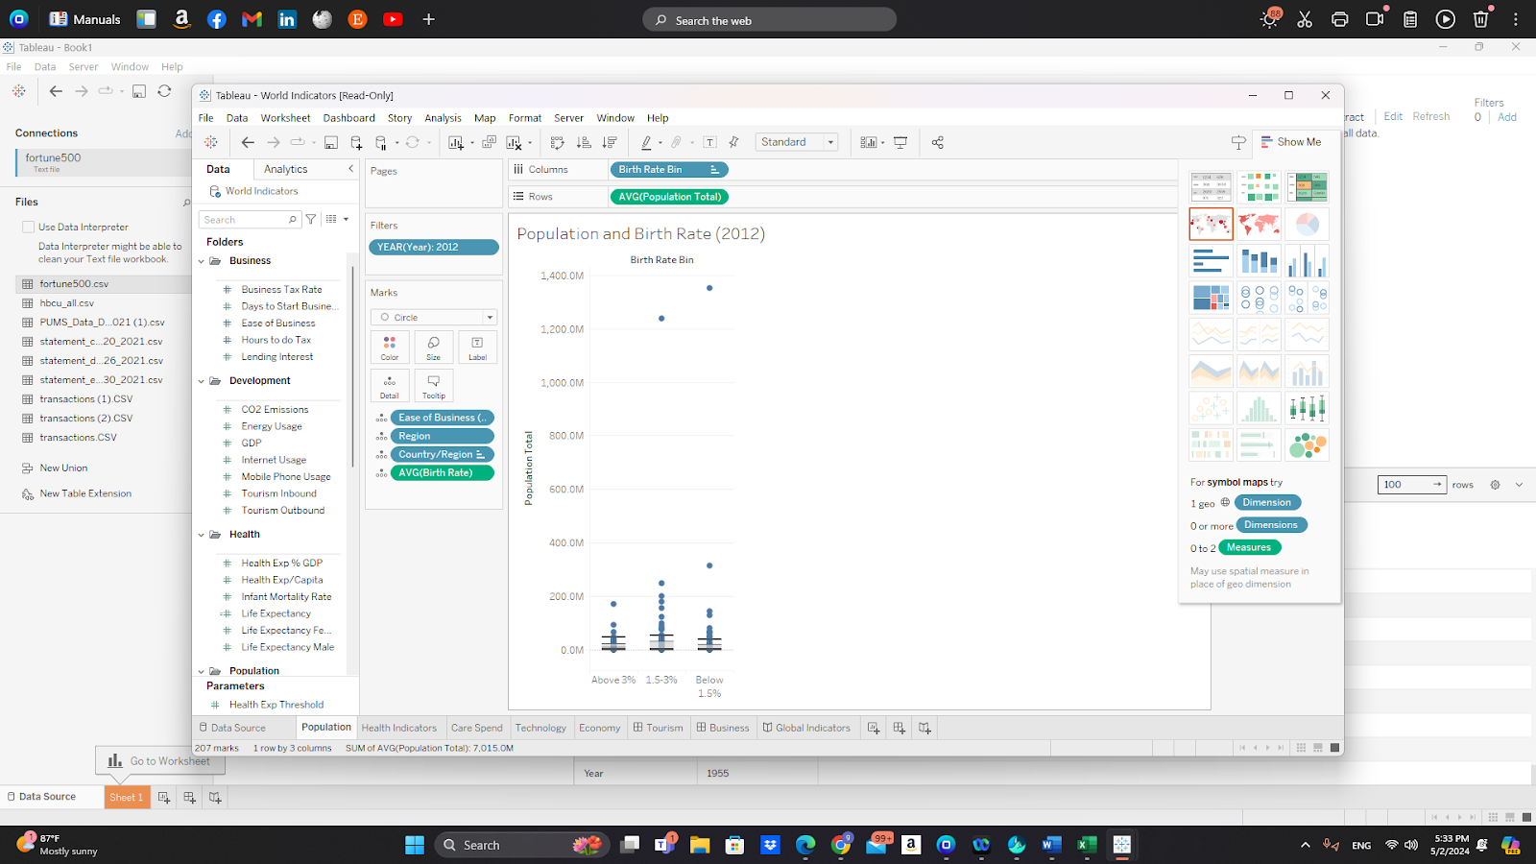
Vizualization in Tableau
Tableau is a visual analytics platform that helps people see, understand, and act on data.
provides fully integrated AI/ML capabilities, allowing you to leverage artificial intelligence and machine learning algorithms to drive deeper insights and make better decisions.
In the example shown is population and birth rate in the year 2002

Slide 10

Description of the plot deliverables
Plotting x and y points
Bar chart
Histogram
Scatter plots
Pie charts
Stem and leaf plot

Slide 11

Plotting X and Y in matplotlib
The plot() function is used to draw points (markers) in a diagram. By default, the plot() function draws a line from point to point. The function takes parameters for specifying points in the diagram. Parameter 1 is an array containing the points on the x-axis. Parameter 2 is an array containing the points on the y-axis.Here is a sample code for plotting X and Y:
import matplotlib.pyplot as plt
import numpy as np
xpoints = np.array([10, 90])
ypoints = np.array([30, 100])
plt.plot(xpoints, ypoints)
plt.show()

Slide 12
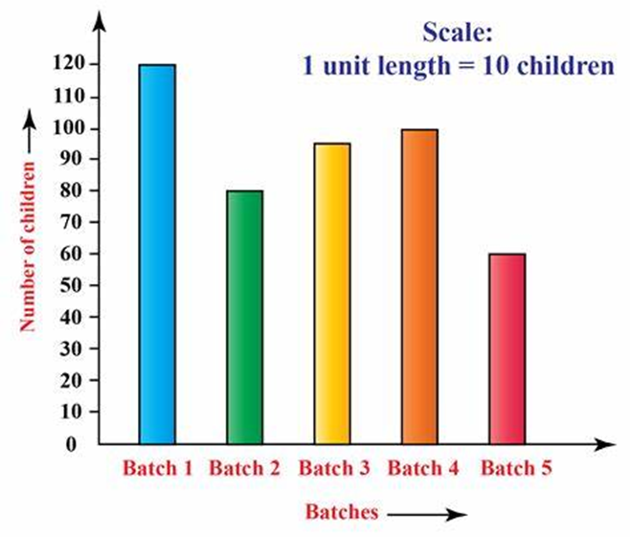
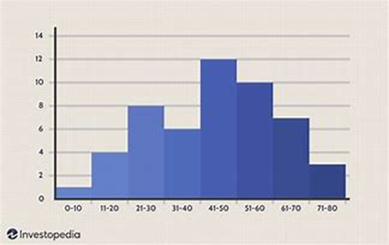
Bar Chart and Histogram
Bar chart is a graph that shows the picture of the variables in plotting the chart
The code to plot a Bar chart is:
import numpy as np
import matplotlib.pyplot as plt
# creating the dataset
data = {'C':20, 'C++':15, 'Java':30,
'Python':35}
courses = list(data.keys())
values = list(data.values())
fig = plt.figure(figsize = (10, 5))
# creating the bar plot
plt.bar(courses, values, color ='maroon',
width = 0.4)
plt.xlabel("Courses offered")
plt.ylabel("No. of students enrolled")
plt.title("Students enrolled in different courses")
plt.show()
Histogram displays the graphical representation of the parameters of the variable used in the table created from the data set.
The following is a code to produce a histogram in matplotlib:
import matplotlib.pyplot as plt
import numpy as np
# Generate random data for the histogram
data = np.random.randn(1000)
# Plotting a basic histogram
plt.hist(data, bins=30, color='skyblue', edgecolor='black')
# Adding labels and title
plt.xlabel('Values')
plt.ylabel('Frequency')
plt.title('Basic Histogram')
# Display the plot
plt.show()

Slide 13
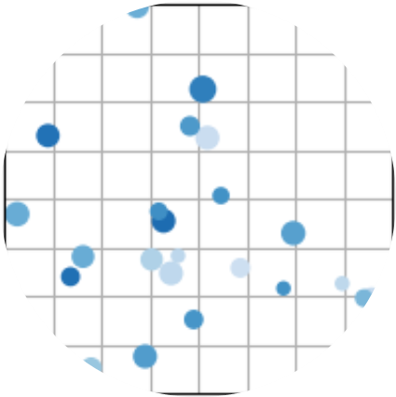
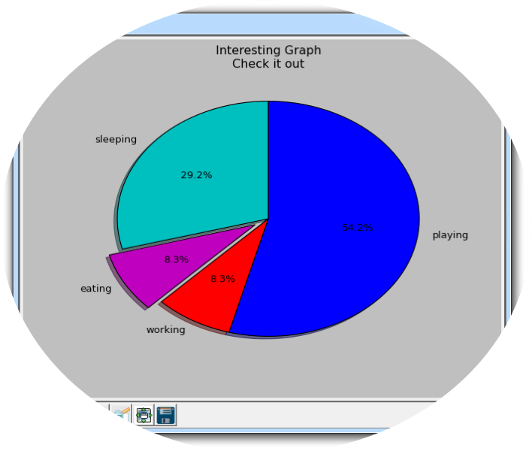
Scatter plot and pie chart
Pie chart shows the various proportions allocated to each of the segments that make up the circle.
Scatter plot shows the dots that represent the variables incorporated in the plot
Code for scatter plot in matplotlib goes as followed:
Import matplotlib.pyplot as plt
Import numpy as np
plt.style.use()
np.random.seed()
x=np.random.normal(0,2,24)
y=np.random.normal(0,2,len(x))
sizes=np.random.uniform(15,80,len(x))
ax=plt.subplot()
ax.scatter(x,y,s=sizes,vmin=0,vmax=100)
ax.set(xlim=(0,8),xticks=np.arange(1,8),
ylim=(0,8),yticks=np.arange(1,8))
The code executed for pie chart is executed as followed:
import matplotlib.pyplot as plt
Import maplotlib.pu
slices = [7,2,2,13]
activities = ['sleeping','eating','working','playing']
cols = ['c','m','r','b']
plt.pie(slices,
labels=activities,
colors=cols,
startangle=90,
shadow= True,
explode=(0,0.1,0,0),
autopct='%1.1f%%')
plt.title('Interesting Graph')
plt.show()

Slide 14
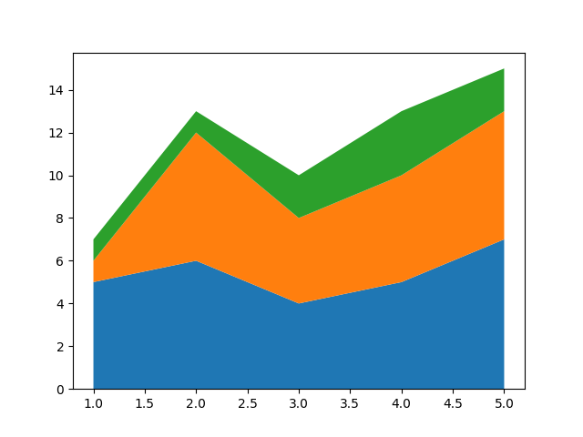
Stem and leaf plot
Stem and a leaf plot. This plot retains the original data,the leaf is the last significant digit in each data value and the stem is the last value or the remaining digit of the data. The code is shown below
import matplotlib.pyplot as plt
days = [1, 2, 3, 4, 5]
facebook = [100, 200, 150, 300]
google = [200, 100, 200, 150]
tv = [300, 350, 200, 150]
newspaper = [100, 120, 200, 220]
plt.stackplot(
days,
facebook, google, tv, newspaper)
plt.show()
2.import matplotlib.pyplot as plt
x = [1, 2, 3, 4, 5]
y1 = [5, 6, 4, 5, 7]
y2 = [1, 6, 4, 5, 6]
y3 = [1, 1, 2, 3, 2]
fig, ax = plt.subplots()
ax.stackplot(x, y1, y2, y3)
plt.show()

Slide 15
Summary/Conclusion
Using these different sources and tools for our work has allowed us to gain more experience in ways to view and input data
Through plots and graph
Using the coding information that we learned in the tutorials
Different tools to execute the data
Different tools to store data

Slide 16

References
https://www2.deloitte.com/us/en/insights/deloitte-review/issue-12/telling-a-story-with-data.html
Matplotlib Plotting (w3schools.com)
https://github.com/dashboard
https://www.tableau.com/
https://www.learnpython.org/en/Hello%2C_World%21

