Slide 1
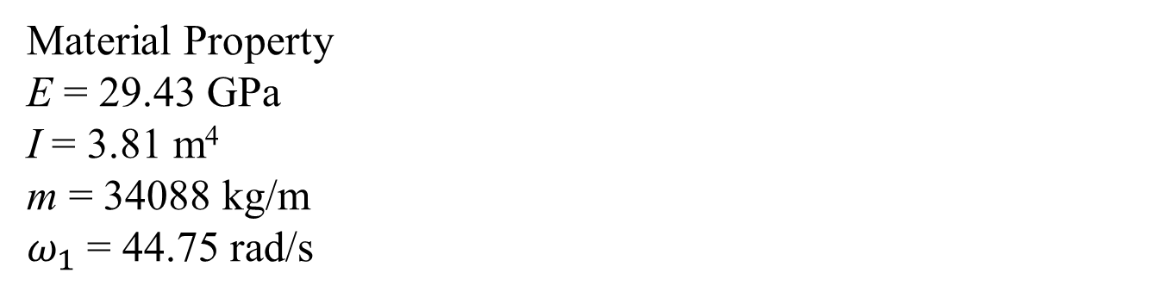
L = 20 m
Material Property
E = 29.43 GPa
I = 3.81 m⁴
m = 34088 kg/m
$ω_{1}$ = 44.75 rad/s

Slide 2
21
2
4
6
8
10
12
14
16
18
22
1
3
5
7
9
11
13
15
17
19
20
1
2
3
4
5
6
7
8
9
10
11
Free DOFs : 20
Fixed DOFs : 2

Slide 3
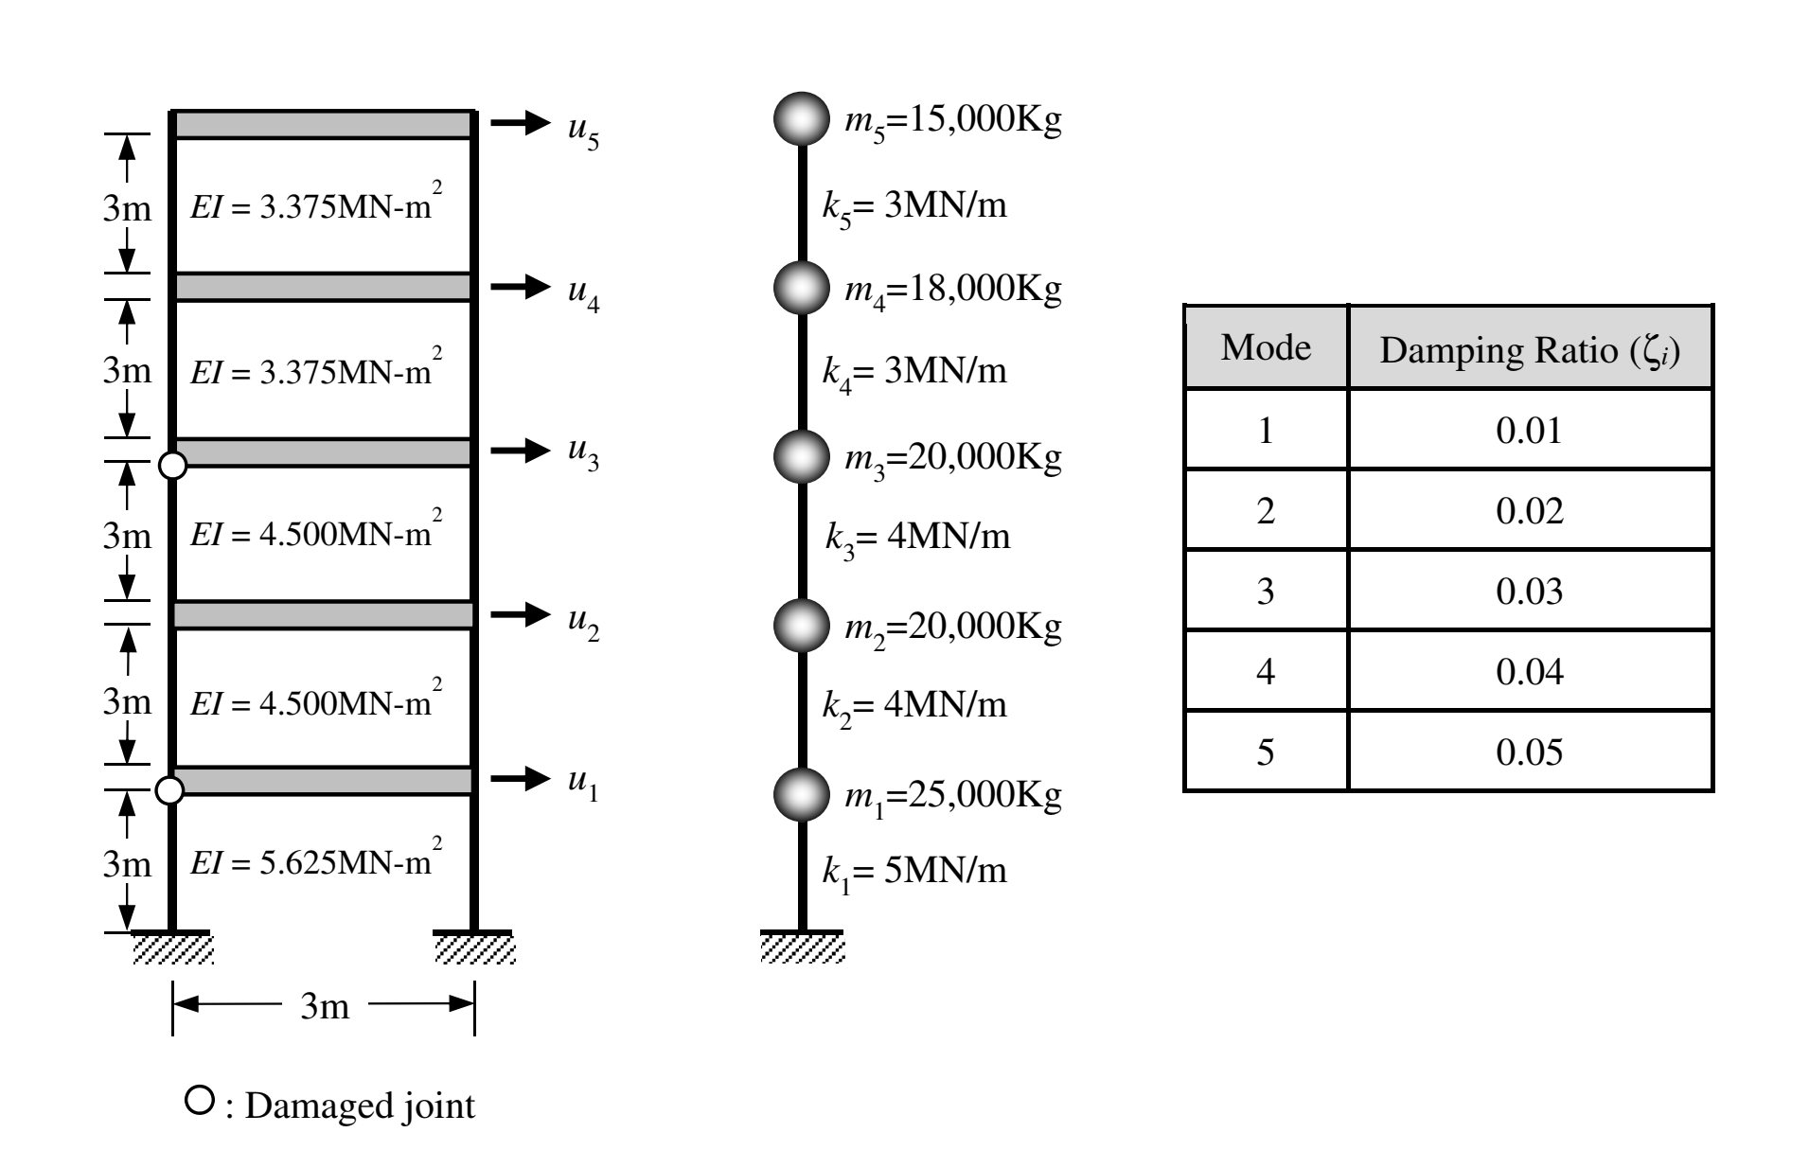
Material Property
f₁ = 0.67 Hz, f₂ = 1.82 Hz, f₃ = 2.85 Hz, f₄ = 3.56 Hz, f₅ = 4.13 Hz

Slide 4
7
1
2
3
4
5
6
8
9
10
11
12
1
2
3
4
5
6
Free DOFs : 5
Fixed DOFs : 7

