Slide 1
Apache camel
Dadaram Jadhav
Capgemini, Talwade, Pune

Slide 2
All topics
Components
Routing
Transforming data
Beans with camel
Error handling
Testing
EIP
deployment

Slide 3
Terminology
Component
Endpoint
Endpoint URI
Route
Processor
Routing
Routing engine
Routebuilder
DSL
Camel context
Interceptors
EIP

Slide 4
What is camel
Apache Camel is an open source integration framework
It allows end users to integrate various systems
It is not esb
It don’t have container or reliable message bus
Its integration framework not esb
It can be deployed in esb

Slide 5
Why camel
Routing and mediation engine
Enterprise integration pattern
Domain Specific Language using java and xml
Component library (more than 80 component) and bean support
Predicates and expressions
Easy configuration
Automatic type converter
Test kit

Slide 6
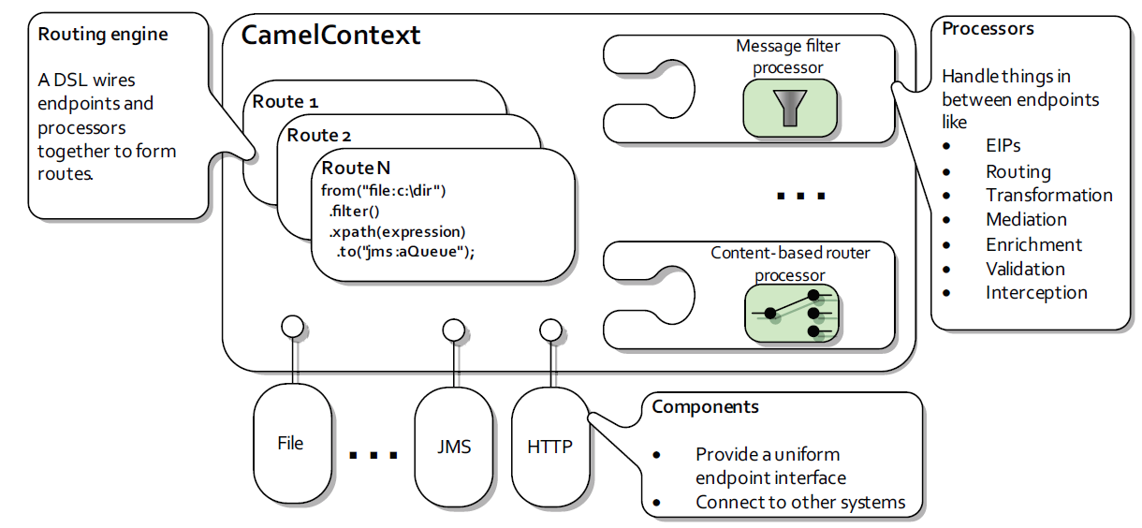
Camel architecture

Slide 7
Camel context
The Camel context is the runtime system
Container of all resources required for the execution of the routing.
Keeps everything together to allow user to execute the routing logic.
When starts, it starts components, endpoints, activates routing rules
Once started, a context can be stopped: it's a cold stop.
All routes, components, endpoints, and other resources loaded by this context will be stopped

Slide 8
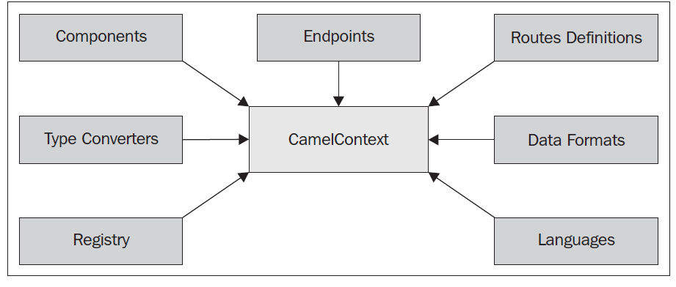
Cont…

Slide 9
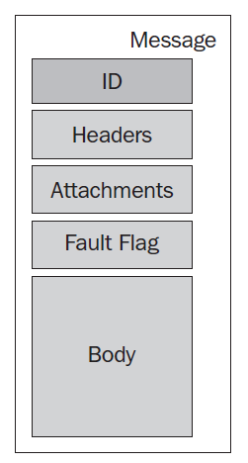
Message

Slide 10
Exchange
Camel doesn't transport a message directly.
The main reason is that a message flows only in one direction.
When dealing with messaging, there are many Message Exchange Patterns (MEP) that we can use
We can see that Camel supports the following MEP:
InOnly, InOptionalOut, InOut
OutIn, OutOptionalIn, RobustInOnly, RobustOutOnly

Slide 11
Cont…
As a message flows in only one direction, in order to support the different MEPs, we need two messages:
The first message is mandatory as it's the in message
The second message is optional as it's the out message
That's why Camel wraps the messages into an Exchange object: the actual object transported is the Exchange, acting as a messages container with all meta-data required for the routing logic.

Slide 12
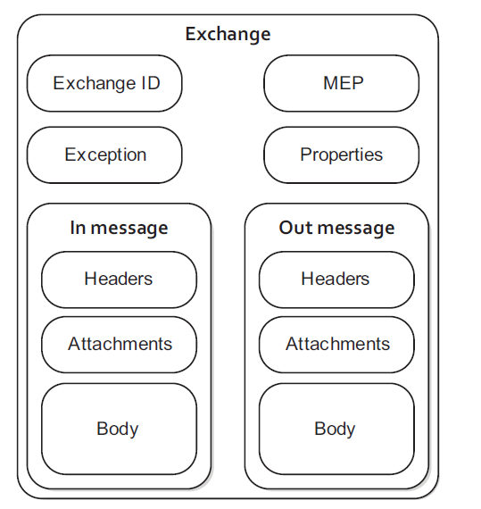
Cont…

Slide 13
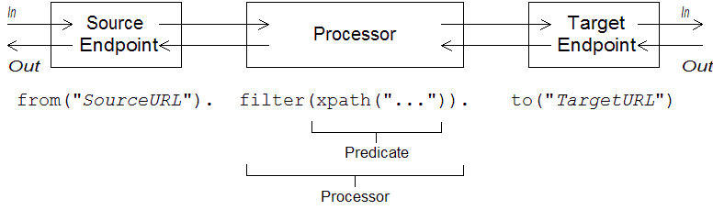
Routing
Endpoint indicates end of message channel
Through end point we send or receive messages

Slide 14
Processor
A processor is a node in the routing which is able to use, create, or modify an incoming exchange
During routing, the exchanges flow from one processor to another
This means all Enterprise Integration Patterns (EIP) are implemented using processors in Camel
The exchanges get in and out of a processor by using components and endpoints
Given in Processor interface

Slide 15
Cont…
Some sample processor
Choice.
Filter.
Throttler.
Custom processor.

Slide 16
Choice processor
rom("SourceURL")
.choice()
.when(Predicate1).to("Target1")
.when(Predicate2).to("Target2")
.otherwise().to("Target3");

Slide 17
Custom processor
Can always define your own custom processor
Define a class that implements the Processor interface and overrides process() method

Slide 18
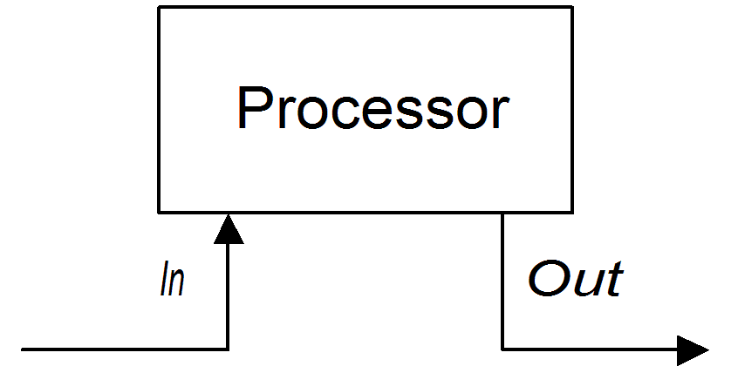
Processor node
Every node in a route, except for the initial endpoint, is a processor, in the sense that they inherit from Processor interface
Processors make up the basic building blocks of a DSL route
DSL commands such as filter(), delayer(), setBody(), setHeader(), and to() all are processors

Slide 19
Multiple inputs
from("URI1", "URI2", "URI3").to("DestinationUri");

Slide 20
Route
The Camel route is the routing definition
It's a graph of processors
The routes (routing definition) are loaded in the Camel context
The execution and flow of the exchange in a route is performed by the routing engine
Each route has a unique identifier that you can specify
This identifier is used to easily find the route, especially when you want to log, debug, monitor, or manage a route

Slide 21
Channels
In every route, there is a channel that sits between each processor in the route graph
It's responsible for the routing of an Exchange to the next Processor
The channel acts as a controller that monitors and controls the routing at runtime
It allows Camel to enrich the route with interceptor
For instance, the Camel tracer or the error handling are functionalities implemented using an interceptor on the channel.
The channel is described by the org.apache.camel.Channel interface

Slide 22
Cont…
Camel supports three kinds of interceptors on the channels:
Global interceptors: This intercepts all exchanges on the channels
Interceptors on the incoming exchanges: This has limited the scope of the interceptor only on the first channel
Interceptors on the exchanges going to one specific endpoint: This limits the interceptor to the channel just before a given endpoint

Slide 23
Endpoints
It acts either as a source of messages (a consumer endpoint) or as a sink of messages (a producer endpoint)
Endpoint identifies using endpoint uri
Uri identifies protocol, context path, options

Slide 24
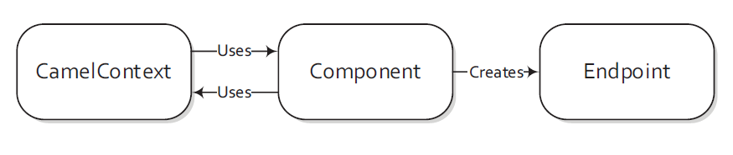
Camel components
Each URI scheme maps to a Apache Camel component
Apache Camel component is essentially an endpoint factory
Deploy the corresponding Apache Camel component in your runtime container
For JMS endpoints, need to deploy the JMS component in container
It is in Component interface
More than 80 components

Slide 25
Cont…
The components are the main extension points in Camel
We don't directly use a component in a route, we define an endpoint from the component
First, you load the component in the Camel context
Then, in the route definition, you define an endpoint on a component loaded in the Camel context

Slide 26
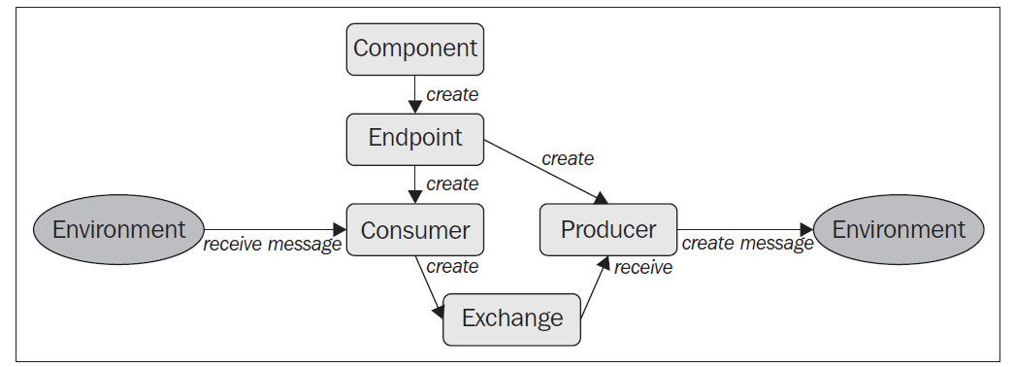
Cont…

Slide 27
Built in component in camel core
Bean Browse
Dataset Direct
File Log
Mock Properties
Ref SEDA
FTP JMS
JDBC JPA
Note: all components: https://camel.apache.org/components.html

Slide 28
Cont…
There are two main ways in which components are added to a Camel runtime
Manually adding them to the CamelContext
CamelContext context = new DefaultCamelContext();
context.addComponent("jms",
JmsComponent.jmsComponentAutoAcknowledge(connectionFactory));
Through autodiscovery.

Slide 29
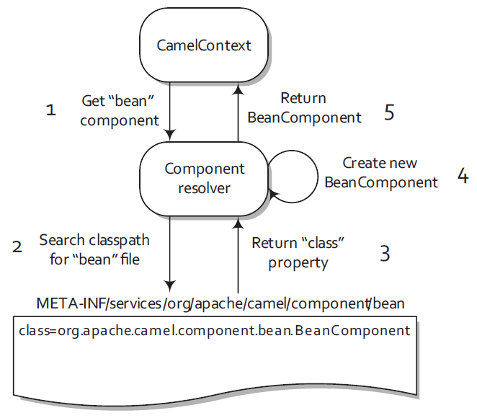
Autodiscover component

Slide 30
Common component
File
Stream.in
Stream.out
ftp
Jms
Sql
Mock
log

Slide 31
File and ftp component
File component configured through uri. Options are as follows
Delay
Recursive
Noop
filename
Fileexist (Override, Append, Fail, and Ignore)
Delete
Move

Slide 32
Database component
Jdbc
SQL
JPA
Hibernate
iBatis

Slide 33
In memory messaging
Synchronous : Direct, direct-vm
Asynchronous : Seda, Vm

Slide 34
Automating tasks
Timer (options: period, delay, fixedRate, daemon)
Quartz

Slide 35
Time period in uri
from("timer:foo?period=1h15m")
.to("log:foo");
from("timer:bar?period=2h30s")
.to("log:bar");
from("timer:bar?period=3h45m58s")
.to("log:bar");

Slide 36
Direct endpoints
The direct component provides the simplest mechanism for linking together routes
The event model for the direct component is synchronous, so that subsequent segments of the route run in the same thread as the first segment
Example
from("activemq:Nyse").to("direct:mergeTxns");
from("activemq:Nasdaq").to("direct:mergeTxns");
from("direct:mergeTxns").to("activemq:USTxn");

Slide 37
SEDA endpoints
The SEDA component provides an alternative mechanism for linking together routes
It has a different underlying event and threading model
Processing of a SEDA endpoint is not synchronous
When you send an exchange to a SEDA producer endpoint, control immediately returns to the preceding processor in the route.
SEDA endpoints contain a queue buffer, which stores all of the incoming exchanges prior to processing by the next route segment.
Each SEDA consumer endpoint creates a thread pool (size is 5) to process exchange objects

Slide 38
Cont…
The SEDA component supports the competing consumers pattern, which guarantees that each incoming exchange is processed only once, even if there are multiple consumers attached to a specific endpoint.
E.g.
from("activemq:Nyse").to("seda:mergeTxns");
from("activemq:Nasdaq").to("seda:mergeTxns");
from("seda:mergeTxns").to("activemq:USTxn");

Slide 39
VM endpoints
The VM component is very similar to the SEDA endpoint
SEDA limited to linking route from within same CamelContext whereas VM component enables to link together routes from distinct Apache Camel applications, as long as they are running within the same Java virtual machine.
example
from("activemq:Nyse").to("vm:mergeTxns");
from("activemq:Nasdaq").to("vm:mergeTxns");

Slide 40
Direct vs SEDA vs VM vs Direct-vm
Direct - single CamelContext, synchronous (blocks producer)
SEDA - single CamelContext, asynchronous (does not block producer)
VM - multiple CamelContext, asynchronous (does not block producer)
direct-VM - multiple CamelContext, synchronous (blocks producer)
The direct and direct-VM mechanisms are synchronous, in the sense that the producing endpoint blocks until the consuming endpoint
The SEDA and VM mechanisms both use a pool of threads on the consumer, such that each request made by the producer is assigned to one of the threads in the pool

Slide 41
DSL
Domain specific language
Java dsl: from("file:data/inbox").to("jms:queue:order");
Spring dsl
<route>
<from uri="file:data/inbox"/>
<to uri="jms:queue:order"/>
</route>
Router schema: http://camel.apache.org/schema/spring

Slide 42
Producer template
Allows you to send message exchanges to endpoints
It can be configured with a default endpoint or you can specify an Endpoint or uri as the first parameter.
Supports different approaches to invoking producer endpoints
There are methods to support both the synchronous and the asynchronous style of invocation

Slide 43
Cont…
ProducerTemplate template = exchange.getContext().createProducerTemplate();
1. send to default endpoint → template.sendBody("<hello>world!</hello>");
2. send to a specific queue → template.sendBody("activemq:MyQueue", "<hello>world!</hello>");
3. send with a body and header → template.sendBodyAndHeader( “jms:queue", “Hello", "Rating", "Gold");

Slide 44
Consumer template
Polling a consumer endpoint in order to receive messages
Receive message in the form of an exchange object or message body
Can use a consumer template to poll a consumer endpoint for exchanges using one polling methods: blocking receive(); receive() with a timeout; or receiveNoWait(), which returns immediately
Need to start the service thread by calling start() before poll for exchanges

Slide 45
Cont…
ConsumerTemplate ct = context.createConsumerTemplate();
String out = ct.receiveBody("seda:end", String.class);
System.out.println(out);

Slide 46
Message exchange pattern
InOnly
RobustInOnly
InOut
InOptionalOut
OutOnly
RobustOutOnly
OutIn
OutOptionalIn

Slide 47
Data transformation
Data format transformation e.g. csv to xml, json to xml
Data type transformation e.g. string to javax.jms.TextMessage

Slide 48
Data transformation methods
In routes
In components
Using data formats
Using templates
Using camels type converters( typeconverterregistry, typeconverter, loading converter into registry, use of convertBodyto(String.class), writing own converter)

Slide 49
Transformation
Transformation using processor
Using bean
Using <Transform>

Slide 50
Exchange methods
getIn
getOut

Slide 51
Bindy data format
The goal of this component is to allow the parsing/binding of non-structured data to/from Java Beans that have binding mappings defined with annotations.
Using Bindy, you can bind data from sources such as
CSV records,
Fixed-length records,
FIX messages,
or almost any other non-structured data

Slide 52
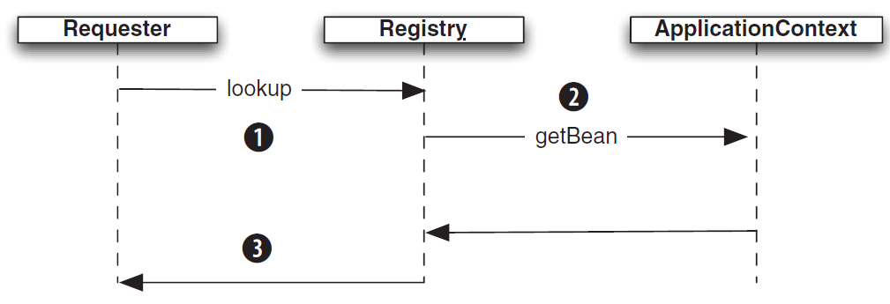
Camels Bean registry

Slide 53
Registry implementation
SimpleRegistry
JndiRegistry
ApplicationContextRegistry
OsgiServiceRegistry

Slide 54
Exception handling
Apply between lifecycle of exchange
DefaultErrorHandler: no redelivery, exception propagated to caller, no dead letter queue
TransactionErrorHandler
NoErrorHandler
LoggingErrorHandler
Error handler scope: context scope, route scope

Slide 55
DeadLetterChannel
Move failed messages to dedicated error queue(dead letter queue)
It handles exceptions and move failed messages to dead letter queue
It implements dead letter channel EIP
Messages which are not processed are move to dead letter queue
Can choose different endpoint database, a file, or just log
Need to configure dead letter queue endpoint

Slide 56
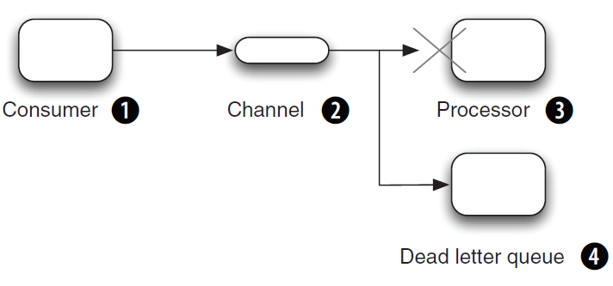
Cont…

Slide 57
onException
The onException clause is used for trapping exceptions
Traps exceptions that occur at any point in a route
It implicitly encloses each route node in a try block.
Wrapping is done automatically, not visible in route definitions.
Can have multiple onException clause

Slide 58
Use original message
If exception is raised in the middle of a route, the message in the exchange could have been modified considerably
It is easier for an administrator to decide what corrective actions to take, if the messages visible in the deadletter queue are the original messages, as received at the start of the route.
Can replace the message in the exchange by the original message
onException(ValidationException.class)
.useOriginalMessage()
.to("activemq:validationFailed");

Slide 59
Redelivery policy
Camel gives option of attempting to redeliver the message at the point where the exception occurred
In networked systems, where timeouts can occur and temporary faults arise
Redelivery supports various strategies for redelivering messages
maximumRedeliveries(): Specifies the maximum number of times redelivery can be attempted
retryWhile(): Specifies a predicate (of Predicate type)

Slide 60
Conditional trapping
Exception trapping with onException can be made conditional by specifying the onWhen option
If you specify the onWhen option in an onException clause, a match is triggered only when the thrown exception matches the clause and the onWhen predicate evaluates to true on the current exchange
onException(MyUserException.class)
.onWhen(header("user").isNotNull())
.maximumRedeliveries(2)
.to(ERROR_USER_QUEUE);

Slide 61
Handling exceptions
When an exception is raised in the middle of a route, processing of the current exchange is interrupted and the thrown exception is propagated back to the consumer endpoint at the start of the route.
onException clause performs some processing before the thrown exception is propagated back.
The onException provides various options
Suppressing exception rethrow
Continuing processing
Sending a response

Slide 62
Suppressing exception rethrow
To prevent the current exception from being rethrown and propagated back to the consumer endpoint, you can set the handled() option to true in the Java DSL, as follows:
onException(ValidationException.class)
.handled(true)
.to("activemq:validationFailed");

Slide 63
Continuing processing
To continue processing the current message from the point in the route where the exception was originally thrown, you can set the continued option to true in the Java DSL, as follows:
onException(ValidationException.class)
.continued(true);

Slide 64
Sending a response
Construct a custom fault reply message, instead of simply letting the thrown exception propagate back to the consumer.
// we catch MyFunctionalException and want to mark it as handled (= no failure returned to client). but we want to return a fixed text response, so we transform OUT body as Sorry.
onException(MyFunctionalException.class)
.handled(true)
.transform().constant("Sorry");

Slide 65
Exception thrown while handling an exception
An exception that gets thrown while handling an existing exception is handled in a special way
Such an exception is handled by the special fallback exception handler, which handles the exception as follows
All existing exception handlers are ignored and processing fails immediately.
The new exception is logged.
The new exception is set on the exchange object.

Slide 66
Scopes
The onException clauses can be effective in either of the following scopes:
RouteBuilder scope affect all of the routes defined in that RouteBuilder instance
Route scope affect only the route in which they are defined.

Slide 67
Route scope
Can embed an onException clause anywhere inside a route definition
from("direct:start")
.onException(OrderFailedException.class)
.maximumRedeliveries(1)
.handled(true)
.beanRef("orderService", "orderFailed")
.to("mock:error")
.end()
.beanRef("orderService", "handleOrder")
.to("mock:result");

Slide 68
Error Handler
Similar to onException, except it is not able to discriminate between different exception types
defaultErrorHandler
deadLetterChannel
loggingErrorChannel
noErrorHandler

Slide 69
doTry, doCatch, and doFinally
To handle exceptions within a route, you can use a combination of the doTry, doCatch, and doFinally
from("direct:start")
.doTry()
.process(new ProcessorFail())
.to("mock:result")
.doCatch(IOException.class, IllegalStateException.class)
.to("mock:catch")
.doFinally()
.to("mock:finally")
.end();

Slide 70
errorHandler vs onException
The errorHandler is used to handle any uncaught Exception that gets thrown during the routing and processing of a message
onException is used to handle specific Exception

Slide 71
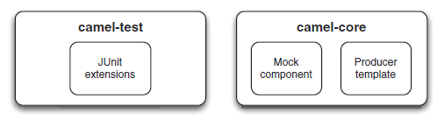
Unit testing
Camel provides rich facilities for testing your projects, and it includes a test kit that
Provides CamelTestSupport class
Mock component is useful

Slide 72
Enterprise integration patterns
Messaging systems
Messaging channels
Message construction
Message routing
Message transformation
Messaging endpoints

Slide 73
Messaging systems
Message
Message channel
Message endpoint
Pipes and filters
Message router
Message translator

Slide 74

Message
A message is the smallest unit for transmitting
Types of message
In message
Out message
Message structure
Headers
Body
Attachments

Slide 75
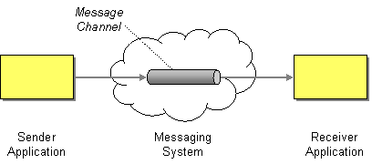
Message channel
A message channel is a logical channel in a messaging system.
Sending messages to different message channels provides an elementary way of sorting messages into different message types.
Message queues and message topics are examples of message channels.

Slide 76
Cont…
Message-oriented components
ActiveMQ
JMS
AMQP

Slide 77
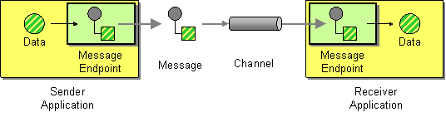
Message endpoints
Interface between an application and a messaging system
Types of endpoint
Consumer endpoint
Producer endpoint
Endpoint URIs
endpoint is represented by an endpoint URI
Endpoint URI for a consumer endpoint
Endpoint URI for a producer endpoint
Syntax: ComponentPrefix:ComponentSpecificURI

Slide 78

Pipe and filter
Describes a way of constructing a route by creating a chain of filters
It enables to compose services to create more complex forms of message processing.
from("jms:order").pipeline("cxf:bean:decrypt", "cxf:bean:authenticate", "cxf:bean:dedup", "jms:Clean")

Slide 79
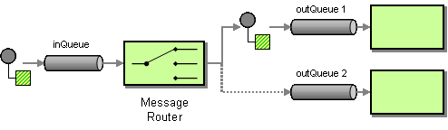
Message router
Filter consumes messages from a single consumer endpoint and redirects them to target endpoint
A message router is concerned only with redirecting messages
Does not modify the message content.

Slide 80
Cont…
Implemented using the choice() processor
from("seda:a").choice()
.when(header(“first").isEqualTo(“first")).to("seda:b")
.otherwise().to("seda:d");

Slide 81
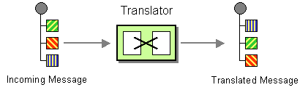
Message translator pattern
Component that modifies the contents of a message
from(“jms:Queue")
.beanRef(“beanName", “method")
.to(“jms: nextqueue");

Slide 82
Messaging channel
Point to point channel
Publish Subscribe channel
Dead letter channel
Guaranteed Delivery
Message Bus

Slide 83
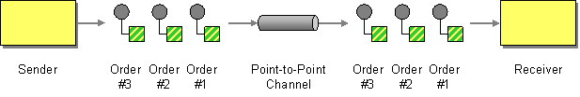
Point to point channel
A point-to-point channel, that guarantees that only one receiver consumes any given message.
Component supporting point to point channel: JMS, ActiveMQ, SEDA, JPA

Slide 84
Publish-Subscribe Channel
Enables multiple subscribers to consume any given message
Used as a means of broadcasting events to multiple subscribers
JMS
ActiveMQ
XMPP
SEDA in EIP Component Reference for working with SEDA
VM

Slide 85
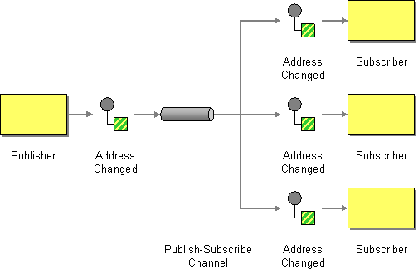
Cont…

Slide 86
Dead letter channel
Describes the actions to take when message fails to deliver
Message do not send to the dead letter channel, if a delivery attempt fails.
re-attempt delivery up to some maximum limit
After all redelivery attempts fail you would send the message to the dead letter channel.

Slide 87
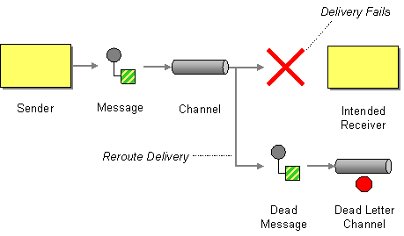
Cont…

Slide 88
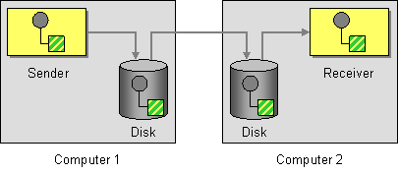
Guaranteed Delivery
Guaranteed delivery means that once a message is placed into a message channel, the messaging system guarantees that the message will reach its destination

Slide 89
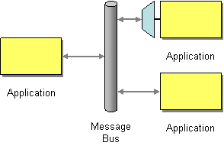
Message bus
It enables to connect diverse applications

Slide 90
Message routing
Content Based Router Message Filter
Recipient List Splitter
Aggregator Resequencer
Composed Message Processor Scatter-Gather
Routing Slip Throttler
Delayer Load Balancer
Multicast Loop

Slide 91
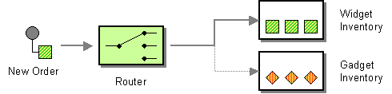
Content Based Router
It enables to route messages based on the message contents.

Slide 92
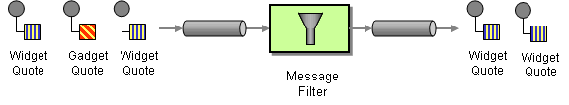
Message Filter
It eliminates undesired messages based on specific criteria
Implemented by the filter() Java DSL command
It takes a single predicate argument, which controls the filter

Slide 93
Cont…
from("direct:start")
.filter().method(MyBean.class, "isGoldCustomer").to("mock:result").end()
.to("mock:end");
public static class MyBean {
public boolean isGoldCustomer(@Header("level") String level) {
return level.equals("gold");
}
}

Slide 94
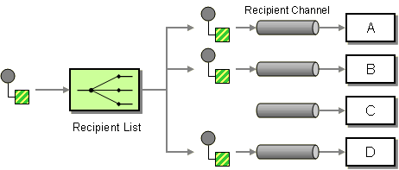
Recipient List
It is a type of router that sends each incoming message to multiple different destinations

Slide 95
Cont…
from("seda:a").to("seda:b", "seda:c", "seda:d");
from("direct:a").recipientList(header("recipientListHeader").tokenize(","));
from("direct:a").recipientList(header("myHeader")).parallelProcessing();
from("direct:a").recipientList(header("myHeader")).stopOnException();
from("activemq:queue:test").recipientList().method(MessageRouter.class, "routeTo");

Slide 96
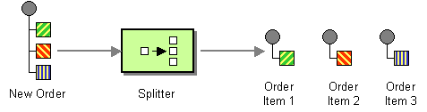
Splitter
A splitter is a type of router that splits an incoming message into a series of outgoing messages

Slide 97
Cont…
The Apache Camel splitter actually supports two patterns
Simple splitter—implements the splitter pattern on its own.
Splitter/aggregator—combines the splitter pattern with the aggregator pattern

Slide 98
Cont…
RouteBuilder builder = new RouteBuilder() {
public void configure() {
from("seda:a")
.split(bodyAs(String.class).tokenize("\n"))
.to("seda:b");
}
};

Slide 99
Splitter/aggregator pattern
It is a common pattern for the message pieces to be aggregated back into a single exchange, after processing of the individual pieces has completed.
split() DSL command provide an AggregationStrategy object as the second argument.

Slide 100
Cont…
from("direct:start")
.split(body().tokenize("@"), new MyOrderStrategy())
.to("bean:MyOrderService?method=handleOrder")
.end()
.to("bean:MyOrderService?method=buildCombinedResponse")

Slide 101
Cont…
Stream processing
from("direct:streaming")
.split(body().tokenize(","), new MyOrderStrategy())
.parallelProcessing()
.streaming()
.to("activemq:my.parts")
.end()
.to("activemq:all.parts");

Slide 102
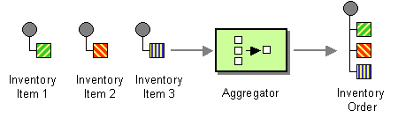
Aggregator
It enables you to combine a batch of related messages into a single message.

Slide 103
Cont…
from("direct:start")
.aggregate(header("id"), new UseLatestAggregationStrategy())
.completionTimeout(3000)
.to("mock:aggregated");

Slide 104
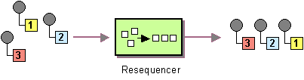
Resequencer
It enables you to resequence messages according to a sequencing expression
Messages that generate a low value for the sequencing expression are moved to the front of the batch and messages that generate a high value are moved to the back.

Slide 105
Cont…
from("direct:start")
.resequence(header("TimeStamp"))
.to("mock:result");

Slide 106
Routing Slip
It enables you to route a message consecutively through a series of processing steps
Sequence of steps is not known at design time and can vary for each message
The list of endpoints through which the message should pass is stored in a header field
Camel reads at run time to construct a pipeline on the fly.
from("direct:b").routingSlip("aRoutingSlipHeader");

Slide 107
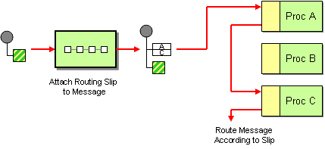
Cont…

Slide 108
Throttler
A throttler is a processor that limits the flow rate of incoming messages
You can use this pattern to protect a target endpoint from getting overloaded
Pattern implemented using the throttle()
from("seda:a").throttle(100).to("seda:b");

Slide 109
Delayer
It is a processor that enables you to apply a relative time delay to incoming messages.
from("seda:a").delay(2000).to("mock:result");
You can use an expression combined with a bean to determine the delay as follows:
from("activemq:foo").
delay().expression().method("someBean", "computeDelay").
to("activemq:bar");

Slide 110
Load Balancer
It allows us to delegate message processing to one of several endpoints using load-balancing policies.
from("direct:start").loadBalance().roundRobin().to("mock:x", "mock:y", "mock:z");
The Apache Camel load balancer supports the following load-balancing policies:Round robin, Random, Sticky, Topic, Failover, Weighted round robin and weighted random, Custom Load Balancer

Slide 111
Multicast
It is a variation of the recipient list with a fixed destination pattern
It is compatible with the InOut message exchange pattern
This is in contrast to recipient list, which is only compatible with the InOnly exchange pattern
from("cxf:bean:offer").multicast(new HighestBidAggregationStrategy()).
to("cxf:bean:Buyer1", "cxf:bean:Buyer2", "cxf:bean:Buyer3");

Slide 112
Cont…

Slide 113
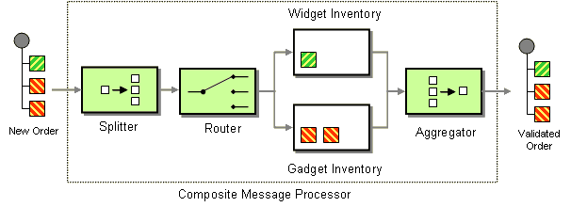
Composed Message Processor
It allows you to process a composite message by splitting it up
Routing the sub-messages to appropriate destinations
re-aggregating the responses back into a single message.

Slide 114
Cont…
// split up the order so individual OrderItems can be validated by the appropriate bean
from("direct:start")
.split().body()
.choice()
.when().method("orderItemHelper", "isWidget")
.to("bean:widgetInventory")
.otherwise()
.to("bean:gadgetInventory")
.end()
.to("seda:aggregate");

Slide 115
Cont…
// collect and re-assemble the validated OrderItems into an order again
from("seda:aggregate")
.aggregate(new MyOrderAggregationStrategy())
.header("orderId")
.completionTimeout(1000L)
.to("mock:result");

Slide 116
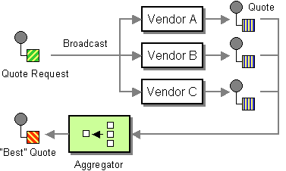
Scatter-Gather
It enables you to route messages to a number of dynamically specified recipients and re-aggregate the responses back into a single message.

Slide 117
Cont…
from("direct:start").multicast().to("seda:vendor1", "seda:vendor2", "seda:vendor3");
from("seda:vendor1").to("bean:vendor1").to("seda:quoteAggregator");
from("seda:vendor2").to("bean:vendor2").to("seda:quoteAggregator");
from("seda:vendor3").to("bean:vendor3").to("seda:quoteAggregator");
from("seda:quoteAggregator")
.aggregate(header("quoteRequestId"), new LowestQuoteAggregationStrategy()).to("mock:result")

Slide 118
Dynamic Router
It enables you to route a message consecutively through a series of processing steps
Sequence of steps is not known at design time
The list of endpoints through which the message should pass is calculated dynamically
Each time the message returns from an endpoint, the dynamic router calls back on a bean to discover the next endpoint in the route

Slide 119
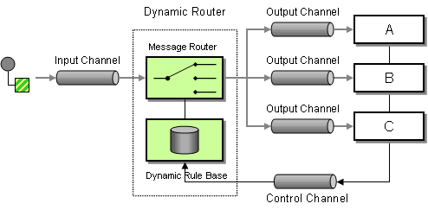
Cont…
from("direct:start")
// use a bean as the dynamic router
.dynamicRouter(bean(DynamicRouterTest.class, "slip"));

Slide 120
Message transformation
Content Enricher
Content Filter
Claim Check
Normalizer
Sort

Slide 121
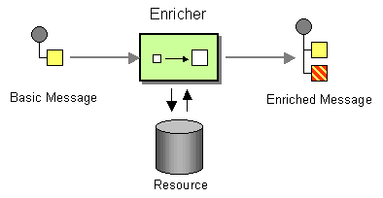
Content Enricher
Describes a scenario where the message destination requires more data than is present in the original message
Use a content enricher to pull in the extra data from an external resource.

Slide 122
Cont…
enrich()—obtains additional data from the resource by sending a copy of the current exchange to a producer endpoint and then using the data from the resulting reply (the exchange created by the enricher is always an InOut exchange).
pollEnrich()—obtains the additional data by polling a consumer endpoint for data. Effectively, the consumer endpoint from the main route and the consumer endpoint in pollEnrich() are coupled, such that exchanges incoming on the main route trigger a poll of the pollEnrich() endpoint.

Slide 123
Cont…
from("direct:start")
.enrich("direct:resource")
.to("direct:result");

Slide 124
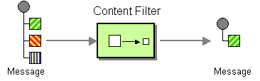
Content Filter
The content filter pattern describes a scenario where you need to filter out extraneous content from a message before delivering it to its intended recipient

Slide 125
Cont…
Implementing a content filter
Message translator
Processors
Bean integration.

Slide 126
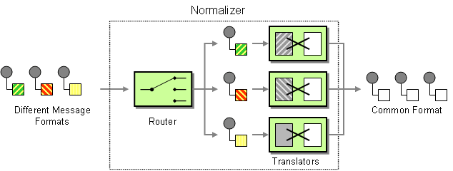
Normalizer
The normalizer pattern is used to process messages that are semantically equivalent, but arrive in different formats
The normalizer transforms the incoming messages into a common format.

Slide 127
Cont…
from("direct:start")
.choice() .when().xpath("/employee").to("bean:normalizer?method=employeeToPerson") .when().xpath("/customer").to("bean:normalizer?method=customerToPerson")
.end()
.to("mock:result");

Slide 128
Sort
The sort pattern is used to sort the contents of a message body, assuming that the message body contains a list of items that can be sorted.
from("file://inbox")
.sort(body()
.tokenize("\n"))
.to("bean:MyServiceBean.processLine");

Slide 129
Validate
The validate pattern provides a convenient syntax to check whether the content of a message is valid
The validate DSL command takes a predicate expression as its sole argument
if the predicate evaluates to true, the route continues processing normally; if the predicate evaluates to false, a PredicateValidationException is thrown.
from("jms:queue:incoming")
.validate(body(String.class).regex("^\\w{10}\\,\\d{2}\\,\\w{24}$"))
.to("bean:MyServiceBean.processLine");

Slide 130
Messaging endpoints
Messaging Mapper Event Driven Consumer
Polling Consumer Competing Consumers
Message Dispatcher Selective Consumer
Durable Subscriber Idempotent Consumer
Transactional Client Messaging Gateway
Service Activator

Slide 131
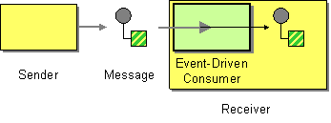
Event Driven Consumer
It is pattern for implementing the consumer endpoint in a Apache Camel component
Only relevant to programmers who need to develop a custom component in Apache Camel
Existing components already have a consumer implementation pattern hard-wired into them.

Slide 132

Polling Consumer
Pattern for implementing the consumer endpoint in a Apache Camel component
It is only relevant to programmers who need to develop a custom component in Apache Camel
Existing components already have a consumer implementation pattern hard-wired into them.

Slide 133
Competing Consumers
The competing consumers pattern, enables multiple consumers to pull messages from the same queue, with the guarantee that each message is consumed once only
This pattern can be used to replace serial message processing with concurrent message processing

Slide 134
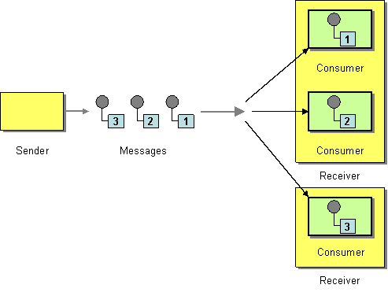
Cont…
from("jms:HighVolumeQ").to("cxf:bean:replica01");
from("jms:HighVolumeQ").to("cxf:bean:replica02");
from("jms:HighVolumeQ").to("cxf:bean:replica03");

Slide 135
Message Dispatcher
Used to consume messages from a channel and then distribute them locally to performers, which are responsible for processing the messages
Performers are usually represented by in-process endpoints, which are used to transfer messages to another section of the route.

Slide 136
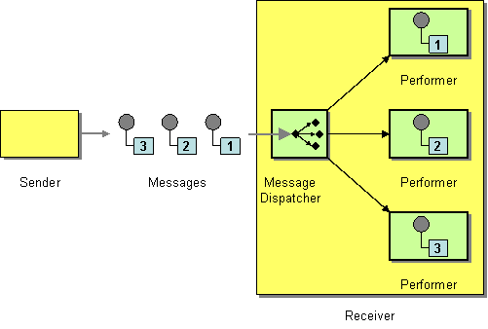
Cont…

Slide 137
Cont…
from("jms:dispatcher?selector=CountryCode='US'").to("cxf:bean:replica01");
from("jms:dispatcher?selector=CountryCode='IE'").to("cxf:bean:replica02");
from("jms:dispatcher?selector=CountryCode='DE'").to("cxf:bean:replica03");

Slide 138
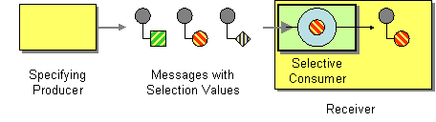
Selective Consumer
from("jms:selective?selector=" + java.net.URLEncoder.encode("CountryCode='US'","UTF-8")).
to("cxf:bean:replica01");
from("seda:a").filter(header("CountryCode").isEqualTo("US")).process(myProcessor);

