Slide 1
RESTful API

Slide 2
Web services
A web service is a collection of open protocols and standards used for exchanging data between applications or systems.
Software applications written in various programming languages and running on various platforms can use web services to exchange data over computer networks
This interoperability is due to the use of open standards.

Slide 3
Introduction
REpresentational State Transfer
Architecture style or design criteria
Not a standard Stateless, client-server, cacheable communications protocol
Use HTTP requests to post, read, and delete data.
Lightweight Nouns as URI, verbs as HTTP method
It revolves around resource where every component is a resource and a resource is accessed by a common interface using HTTP standard methods.

Slide 4
Cont…
In REST architecture, a REST Server simply provides access to resources and REST client accesses and modifies the resources.

Slide 5
HTTP methods
Commonly used HTTP methods
GET − Provides a read only access to a resource.
POST − Used to create a new resource.
DELETE − Used to remove a resource.
PUT − Used to update a existing resource or create a new resource.

Slide 6
REST response
Text
JSON
XML
HTML

Slide 7
Types of web services
SOAP (Simple Object Access Protocol)
REST ful web services

Slide 8
Java web services API
There are two main API's defined by Java for developing web service applications since JavaEE 6.
JAX-WS: for SOAP web services. The are two ways to write JAX-WS application code: by RPC style and Document style.
JAX-RS: for RESTful web services. There are mainly 2 implementation currently in use for creating JAX-RS application: Jersey and RESTeasy.

Slide 9
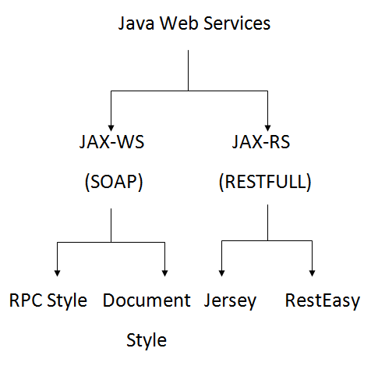
Web services in Java

Slide 10
REST implementation
Implementation of JAX-RS
Apache CXF
Jersey
RESTeasy
Restlet

Slide 11
Example URI
GET
http://www.example.com/v1/hr/employees/19328389
POST
http://www.example.com/v1/hr/employees
DELETE
http://www.example.com/v1/hr/employees/14283949
PUT
http://www.example.com/v1/hr/employees/13448784

Slide 12
HTTP status codes
1×× Informational
100 Continue
101 Switching Protocols
102 Processing

Slide 13
Cont…
2×× Success
200 OK
201 Created
202 Accepted
203 Non-authoritative Information
204 No Content
205 Reset Content
206 Partial Content
207 Multi-Status
208 Already Reported
226 IM Used

Slide 14
Cont…
3×× Redirection
300 Multiple Choices
301 Moved Permanently
302 Found
303 See Other
304 Not Modified
305 Use Proxy
307 Temporary Redirect
308 Permanent Redirect

Slide 15
Cont…
4×× Client Error 400 Bad Request 401 Unauthorized 402 Payment Required 403 Forbidden 404 Not Found 405 Method Not Allowed 406 Not Acceptable 407 Proxy Authentication Required 408 Request Timeout 409 Conflict 410 Gone 411 Length Required 412 Precondition Failed 413 Payload Too Large 414 Request-URI Too Long | 415 Unsupported Media Type 416 Requested Range Not Satisfiable 417 Expectation Failed 418 I'm a teapot 421 Misdirected Request 422 Unprocessable Entity 423 Locked 424 Failed Dependency 426 Upgrade Required 428 Precondition Required 429 Too Many Requests 431 Request Header Fields Too Large 444 Connection Closed Without Response 451 Unavailable For Legal Reasons 499 Client Closed Request

Slide 16
Cont…
5×× Server Error
500 Internal Server Error
501 Not Implemented
502 Bad Gateway
503 Service Unavailable
504 Gateway Timeout
505 HTTP Version Not Supported
506 Variant Also Negotiates
507 Insufficient Storage
508 Loop Detected
510 Not Extended
511 Network Authentication Required
599 Network Connect Timeout Error

Slide 17
Rest client
A browser can only make a GET request to the serve and receive response in HTML form.
Postman
Rest- Assured
Rest Console

Slide 18
Parameters in RESTFul web services
@PathParam: Path parameters are part of the endpoint itself and are not optional. For example, {user} and {bicycleId} are the path parameters in the following endpoint.
/service/myresource/user/{user}/bicycles/{bicycleId}

Slide 19
Cont…
@QueryParam: Query string parameters appear after a question mark (?) in the endpoint. The question mark followed by the parameters and their values is referred to as the “query string.” In the query string, each parameter is listed one right after the other with an ampersand (&) separating them. The order of the query string parameters does not matter.
/surfreport/{beachId}?days=3&units=metric&time=1400

Slide 20
Cont…
@MatrixParam:
/books/2011;author=mkyong
/books/2011;author=mkyong;country=Malaysia
/books/2011;country=malaysia;author=mkyong

