Slide 1
Jenkins

Slide 2
Introduction
It is continuous integration tool
It can integrate with testing and deployment technology
Jenkins is a software that allows continuous integration.
Jenkins will be installed on a server where the central build will take place.

Slide 3
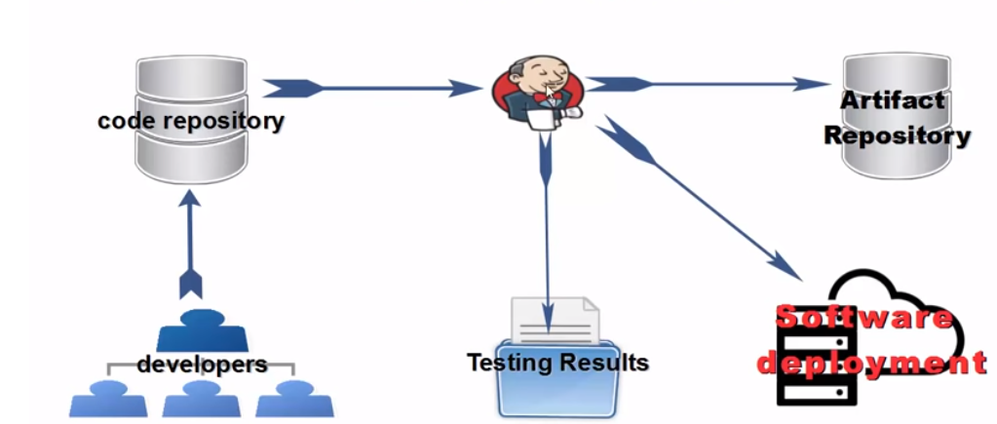
Typical flow
Developer commit code → Jenkins pick up code and trigger a build and run any test if required → build output available in Jenkins dashboard

Slide 4
What is Continuous Integration?
Continuous Integration is a development practice that requires developers to integrate code into a shared repository at regular intervals.
This concept was meant to remove the problem of finding later occurrence of issues in the build lifecycle.
Continuous integration requires the developers to have frequent builds.
The common practice is that whenever a code commit occurs, a build should be triggered.

Slide 5
Environment setup
Download Jenkins.war file from https://jenkins.io/download/
Execute java –jar Jenkins.war
Access through http://localhost:8080
Enter password through given url

Slide 6
Git set up
Go to manage Jenkins
Go to manage plugins
Go to available (enble setting in manage Jenkins → configure global security → enable use browser for metadata)
Search for git plugin and add it
Install gitbash on local machine
Add git path (C:\Program Files\Git\bin\git) in global tool configuration

Slide 7
Maven setup
Download and extract maven
Go to manage Jenkins → configure global security → Check Enable security, -In Security Realm, select Jenkins own user database and check Allow users to sign up, -In authorization, Logged-in users can do anything
Now go to configure system
Add environment variables JAVA_HOME =C:\Program Files\Java\jdk1.8.0_91, MAVEN_HOME =C:\Users\dadjadha\Documents\MavenJenkinSonar\Maven\apache-maven-3.6.0, Maven_OPTS = –Xmx512m –XX:MaxPermSize=128m

Slide 8
Cont…
Now add plugin (maven integration)

Slide 9
Freestyle project in maven
Create new item, choose freestyle project
Add some java code in workspace (jenkin workspace)
Go to add build step , choose execute windows batch command
Add couple of commands (javac example.java java example)
Build project
Check output

Slide 10
Build project remotely
Choose existing project
Choose build trigger → build trigger remotely
Enter authentication token
Copy url, paste in new window, change to localhost:8080 and token value

Slide 11
Job chaining
Create three jenkins jobs (first for compilation, second for running and third for printing message)
Choose copy from during creation
One for build (change build trigger)
One for run ( change build trigger to build after other projects are built), mention build project name
One for printing message (command: dir)

Slide 12
Integrating with git and github
Create separate folder (add java source and class file)
Open terminal and type git init
Check status: git status
Add using git add file.java file.class
Commit changes : git commit –m “First commit” file.java file.class
Create empty github repository
git remote add origin https://github.com/dadaramjadhav/jenkingit.git
git push -u origin master

Slide 13
Cont…
Now create new item
Choose freestyle
Choose SCM as git
Paste git url
Add windows commands
Choose project build now and check output
For repeated trigger choose poll SCM (give * * * * * )
Schedule (minutes, hours, dayinmonth, month, dayinweek)

Slide 14
Maven project
Create maven project
git init
git add README.md
git commit -m "first commit"
git remote add origin https://github.com/dadaramjadhav/mavenprojectusingjenkins.git
git push -u origin master

Slide 15
Cont…
Create new item in Jenkins
Mention github details
In build choose invoke top-level maven targets
Mention goal as clean test

Slide 16
Jenkin pipeline
Pipeline is group of events
Jenkins Pipeline is a combination of plugins that support the integration and implementation of continuous delivery pipelines using Jenkins
A pipeline has an extensible automation server for creating simple or complex delivery pipelines
In a Jenkins pipeline, every job or event has some sort of dependency on at least one or more events.

Slide 17
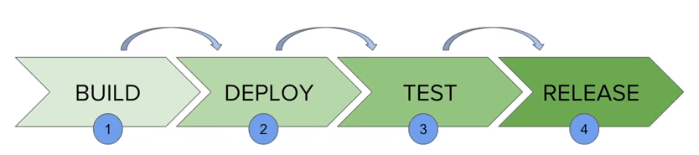
Cont…
It contains a group of states called build, deploy, test and release
These events are interlinked with each other. Every state has its events, which work in a sequence called a continuous delivery pipeline

Slide 18
Cont…
Pipeline: The pipeline is a set of instructions given in the form of code for continuous delivery and consists of instructions needed for the entire build process. With pipeline, you can build, test, and deliver the application
Node: machine on which Jenkins runs is called a node.
Stage: stage block contains a series of steps in a pipeline. That is, the build, test, and deploy processes all come together in a stage.
Step: step is nothing but a single task that executes a specific process at a defined time. A pipeline involves a series of steps

Slide 19
JenkinsFile
Jenkins pipelines can be defined using a text file called JenkinsFile
You can implement pipeline as code using JenkinsFile
With JenkinsFile, you can write the steps needed for running a Jenkins pipeline.
You can create pipelines automatically for all branches and execute pull requests with just one JenkinsFile.
You can review your code on the pipeline
You can audit your Jenkins pipeline

Slide 20
Cont…
Declarative:
Declarative pipeline syntax offers an easy way to create pipelines.
It contains a predefined hierarchy to create Jenkins pipelines.
Scripted:
Scripted Jenkins pipeline runs on the Jenkins master with the help of a lightweight executor.
It uses very few resources to translate the pipeline into atomic commands.

Slide 21
Jenkinfile example(declarative)
pipeline {
agent any
stages {
stage('Build') {
steps {
//
}
}

Slide 22
Cont…
stage('Test') {
steps {
//
}
}
stage('Deploy') {
steps {
//
}
}
}
}

Slide 23
Cont…
Agent any: execute pipeline on any agent
Build: define build stage
Steps: perform some step related to build
Stage: define stage

Slide 24
Jenkinsfile (scripted pipeline)
node {
stage('Build') {
//
}
stage('Test') {
//
}
stage('Deploy') {
//
}
}

Slide 25
Why Use Jenkin's Pipeline?
You can create multiple automation jobs with the help of use cases, and run them as a Jenkins pipeline.
Jenkins pipeline is implemented as a code which allows multiple users to edit and execute the pipeline process.
Pipelines are robust. So if your server undergoes an unforeseen restart, the pipeline will be automatically resumed.
You can pause the pipeline process and make it wait to resume until there is an input from the user.

Slide 26
Jenkins Pipeline example
Create new item
Choose pipeline
Choose Pipeline script
Enter following code

Slide 27
Cont…
pipeline {
agent any
stages {
stage('Stage 1') {
steps {
echo ‘welcome’
}
}
}
}

Slide 28
Cont…
Choose build now

Slide 29
Creating pipeline using script
Create new item
Choose pipeline
Choose pipeline script and following

Slide 30
Cont…
node {
stage('Build') {
echo 'build'
}
stage('Test') {
input('do you want to continue')
}
stage('Deploy') {
echo 'deploy'
}
}

