Slide 1

Stock Market Predictive Modeling Spanning the COVID-19 Global Pandemic
- PROJECT 4 -

Slide 2
Team Members
Dario Micucci
Brett Chau-dang
Justin Butler
Rebeca Perez
Ron Brennan

Slide 3
The Question
The question our team set out to answer was:
The continued impact of COVID-19 on stock market performance

Slide 4



Stocks Chosen
These stocks are listed on the NASDAQ Exchange

Slide 5
Data
The stock data was retrieved from Yahoo Finance for the selected stocks.
The time frame selected was Spring 2018 to Fall 2023 for a total of number of datapoints:
– 1405 Datapoints
– 1405 Datapoints
– 1324 Datapoints

Slide 6
Extract-Transform-Load
The data for each stock was extracted and saved as a .csv file.
Each .csv file was then imported into a hosted MySQL Database for data integrity (everyone using the same data source)
The data was extracted, then converted into dataframe(s)

Slide 7
The Machine Models
The predictive models used:
Arima
XGBoost
Artificial Neural Network for Regression

Slide 8
Arima

Slide 9
XGBoost

Slide 10

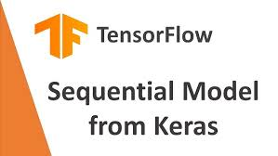
Artificial Neural Network for Regression – Seqential model

Slide 11
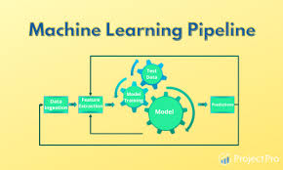
Model Pipeline
Data Acquisition
Data Ingestion
Exploratory Analysis
Preprocessing
Model Building & Training
Visualize
Optimization & Re-Run

Slide 12
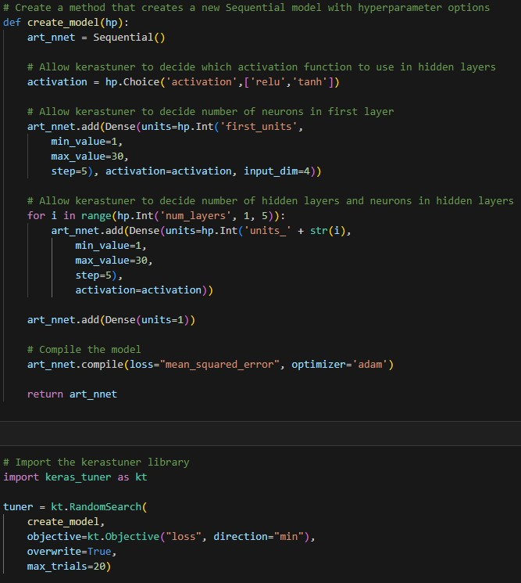
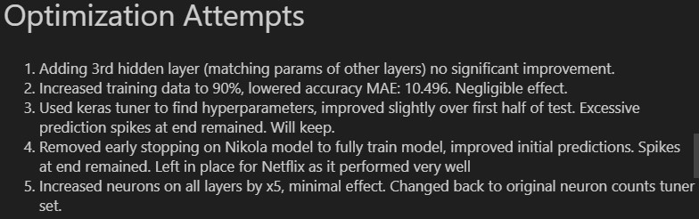
Defining & Optimizing
Netflix EVS : 0.99
Nikola EVS : -12.21

Slide 13
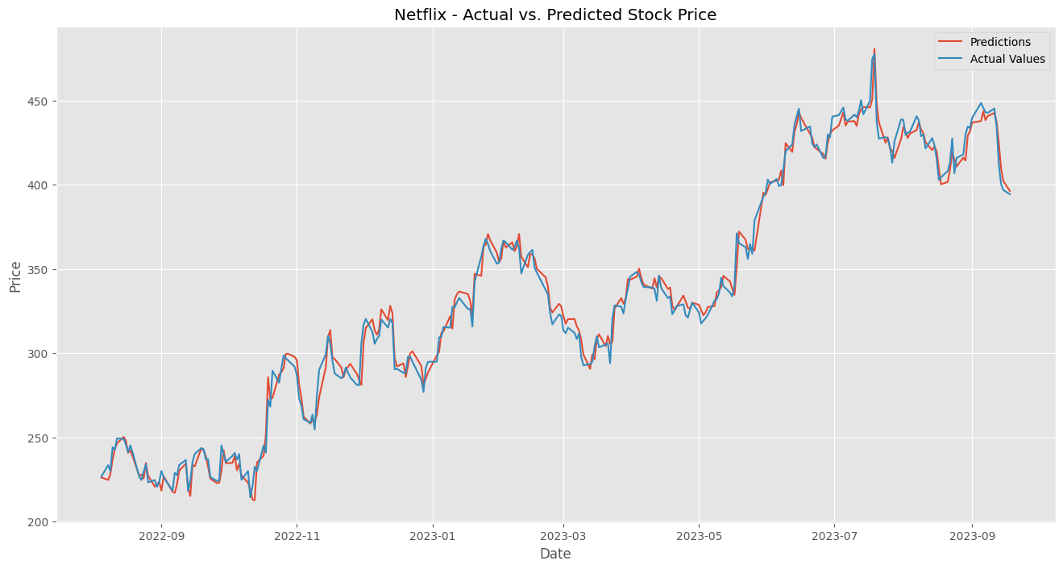
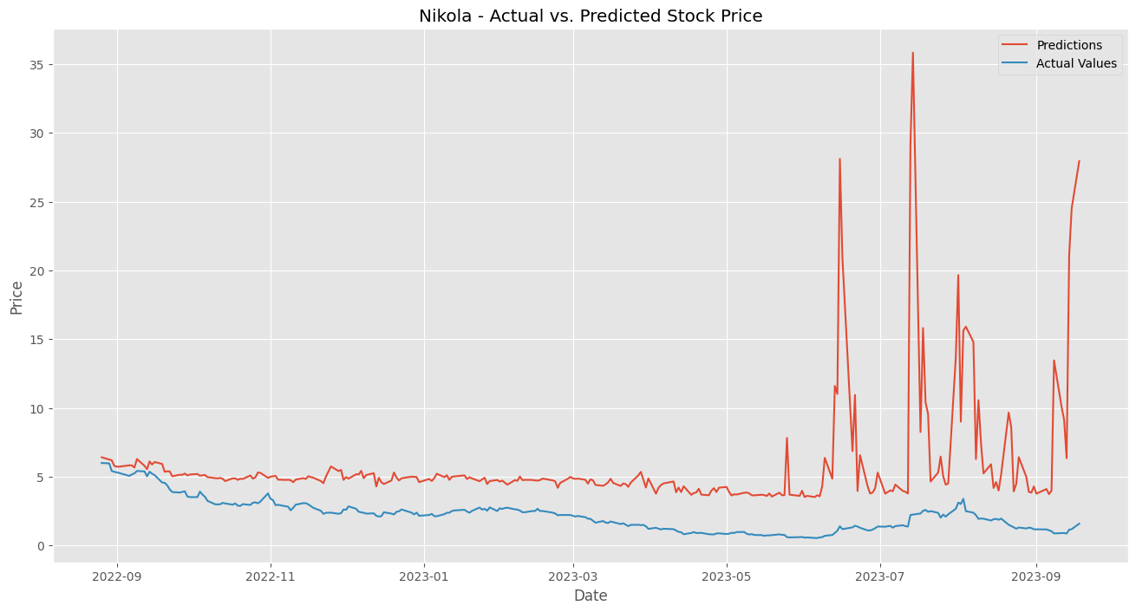

Slide 14
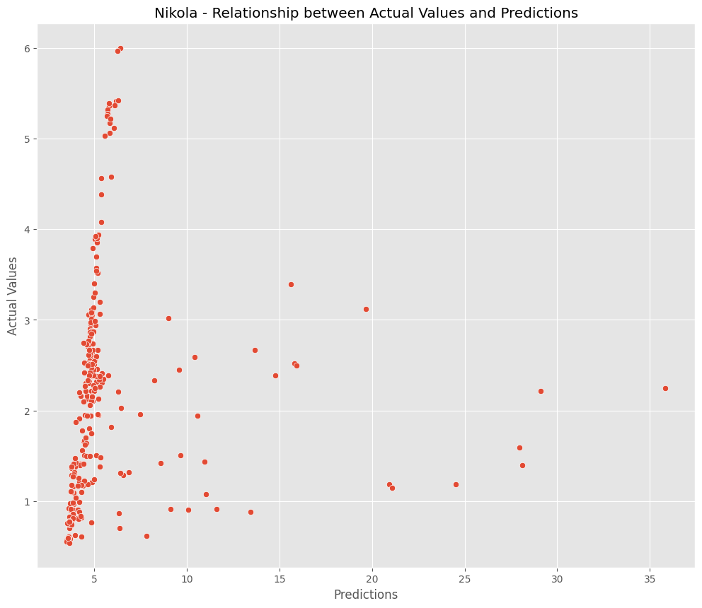
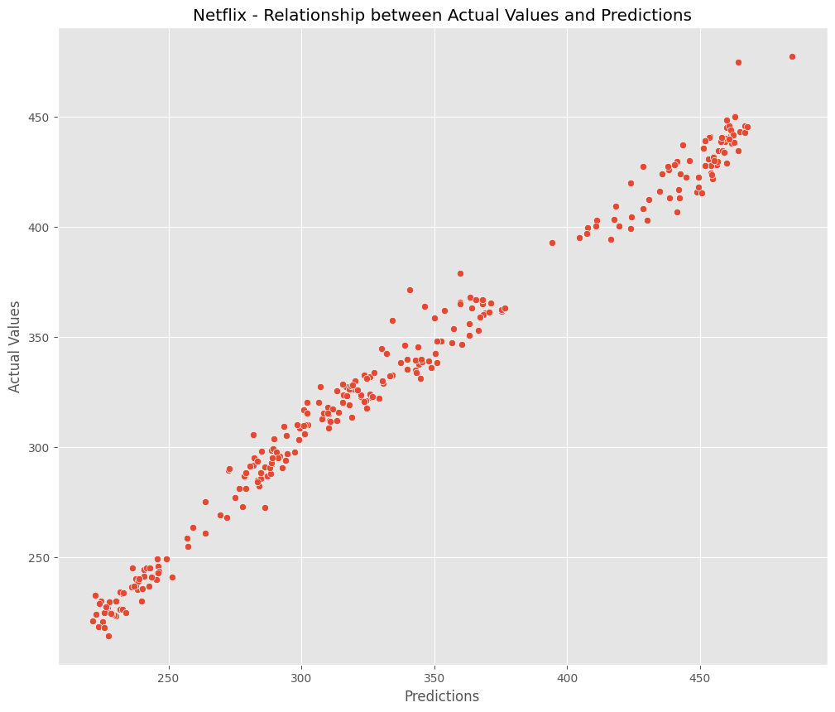

Slide 15
My Sequential Model Ideal Case
Inability to track past values or patterns
Works best with linear, simpler data
Data complexity, irregularity can hinder performance
e.g. XGBoost worked better as it is designed for non-linear data

Slide 16
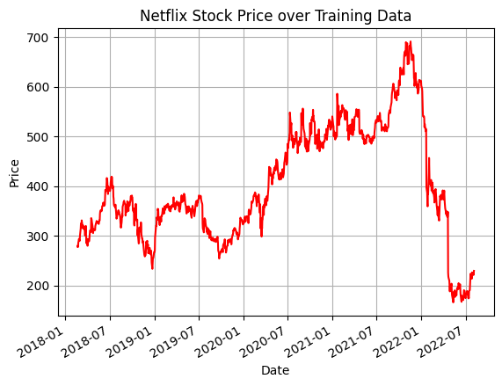
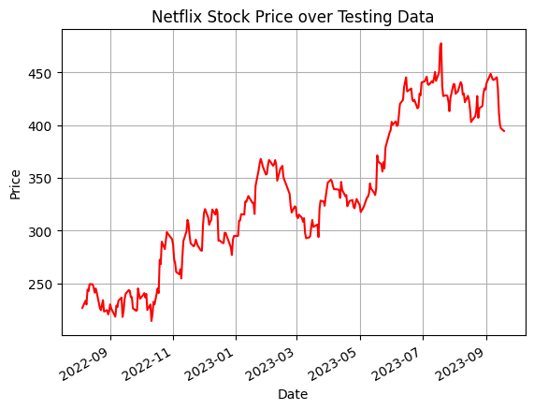
More linear shape
Similar price range
Predictable patterns

Slide 17
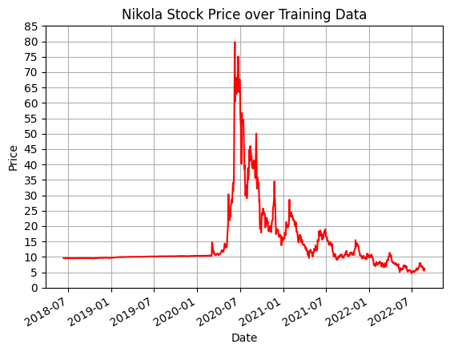
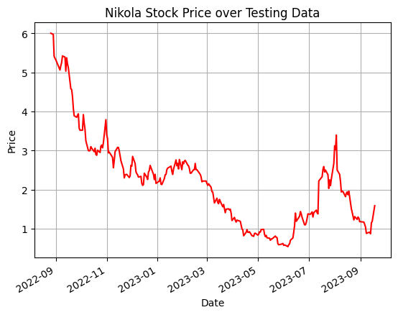
Irregular Shape
No clear patterns/
trends
Mostly different price ranges

Slide 18
Conclusion & Going Forward
Data distribution plays significant role in learning ability of models
More memory-oriented models would likely work best with time-series data
LSTM (long short term memory) may be an ideal choice
Other optimization methods such as:
Reducing potentially noisy features (Volume)
Increasing training data significantly
Selecting shorter periods of data

Slide 19
Summary
Answer to the question

Slide 20
Challenges
Model selections
Complexity and shape of the data
Limited experience level of Models
More advanced engineered features required

Slide 21
Further Analysis
Use the LSTM Model
Investigate stock performance with factors that was not effect

Slide 22
Resources
The following resources were leveraged in this project
Yahoo Finance - https://ca.finance.yahoo.com/
Tutors
Kaggle
MySql
Tableau

