Slide 1
The Next Big One: Detecting Earthquakes and Other Rare Events from Community Sensors
Matthew Faulkner, Michael Olson, Rishi Chandy, Jonathan Krause, Mani Chandy, Andreas Krause
Notes:
IPSN 2011. Equations rendered with IguanaTex 1.04
Notes:

Slide 2

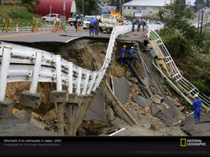


Community-Based Sense & Response
Research that helps the community detect and respond to rapidly changing situations.
earthquakes, nuclear radiation, epidemics
Checking for radiation
Washington Post
Earthquake damage
National Geographic
Nuclear reactor explosion
tihik.com
Funded by NSF Cyber Physical Systems

Slide 3

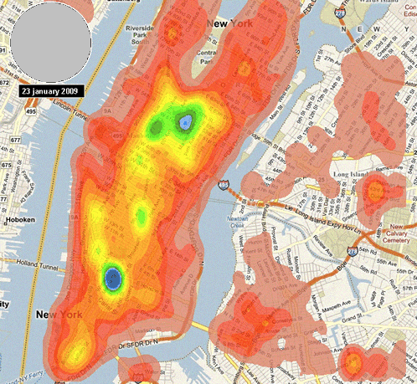
Earthquake Detection
Smart phones have accelerometers, GPS, gyroscopes. Potentially excellent seismic sensors.
Smart phones densely cover urban areas
How to scale to city-wide network? e.g. 1M phones?
How to detect rare events from noisy, uncertain sensors?
skyhookwireless.com

Slide 4









Classical Hypothesis Testing
Naïve: send all accelerometer data to fusion center that decides Quake (E = 1) vs. No Quake (E = 0)
Fusion Center
1M phones produce 30TB of acceleration data a day!
Centralized solution does not scale.

Slide 5

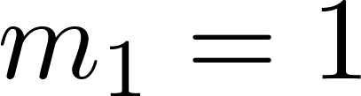




Decentralized Hypothesis Testing
Each sensor tests Quake (E = 1) vs. No Quake (E = 0) and sends a signal m to the fusion center.
“pick”
“pick”

Slide 6
Decentralized Hypothesis Testing
Each sensor tests Quake (E = 1) vs. No Quake (E = 0) and sends a signal m to the fusion center.
Tsitsiklis 88: Hierarchical hypothesis test is optimal for decentralized, conditionally i.i.d. variables.
Likelihood of data during quake

Slide 7



Detecting Rare Events
Likelihood ratio is difficult to estimate for rare events.
Not enough positive examples to estimate
Can estimate accurately from normal data

Slide 8
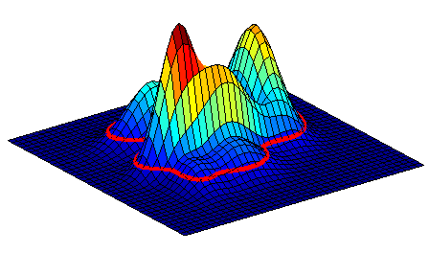

Detecting Rare Events
Likelihood ratio is difficult to estimate for rare events.
Not enough positive examples to estimate
Can estimate accurately from normal data
Decision threshold
Idea: send message when
is sufficiently low
Is this reasonable?

Slide 9



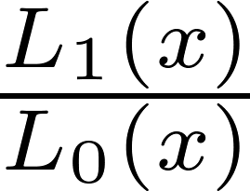

Anti-Monotonicity
Anti-monotonicity replaces assumption of
Anti-monotonicity:
Under anti-monotonicity, thresholding produces the same decisions as thresholding
The same decentralized framework remains optimal!

Slide 10

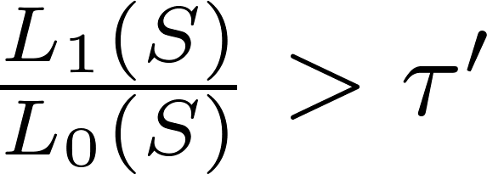

Decentralized Anomaly Detection
The fusion center receives picks from N sensors. The optimal decision rule is the hypothesis test:

Slide 11
Decentralized Anomaly Detection
The fusion center receives picks from N sensors. The optimal decision rule is the hypothesis test:
True and false pick rates

Slide 12






Controlling False Positive Rates
For rare events, nearly all picks are false positives.
1. False Pick rate
2. System-wide False Alarm rate
controls false pick rate
Can learn , e.g. online percentile estimation
Doesn’t depend on
Controls messages and false alarms without !

Slide 13
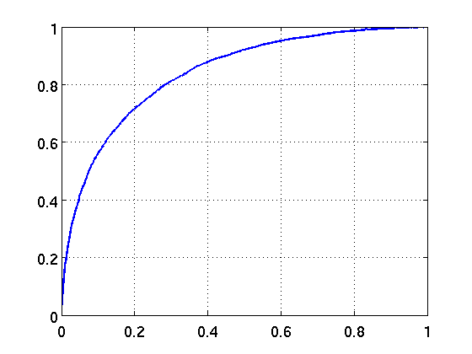


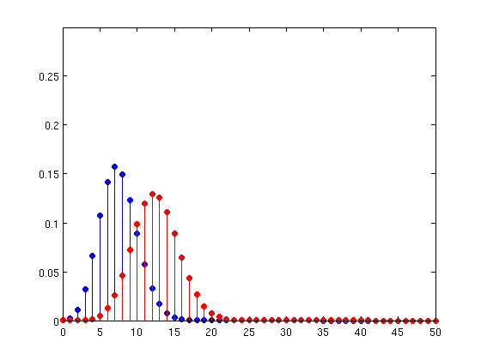
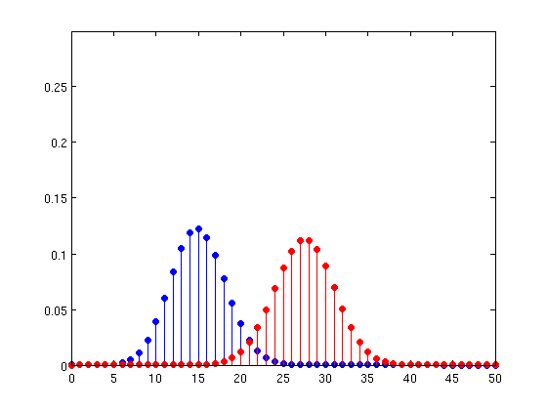
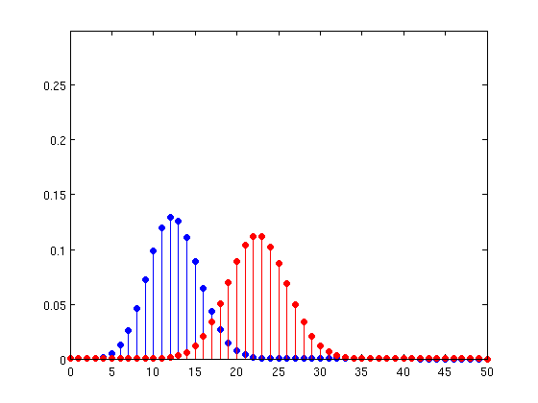

Detection Performance
Also want to maximize detection rate.
Sensor ROC curve
True Pick Rate
False Pick Rate

Slide 14
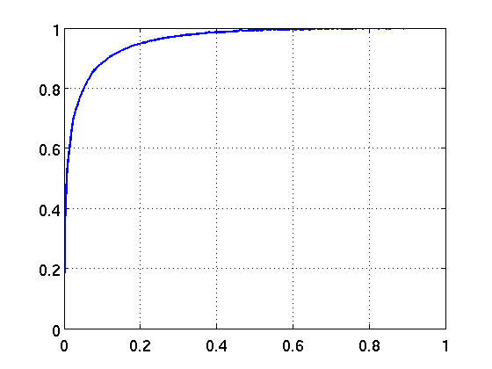


Detection Performance
Also want to maximize detection rate.
Fusion Center ROC curve
Detection Rate
max
Miss rate
False alarm rate
False Alarm Rate
Optimizes fusion threshold under constraints, but requires sensor operating point

Slide 15
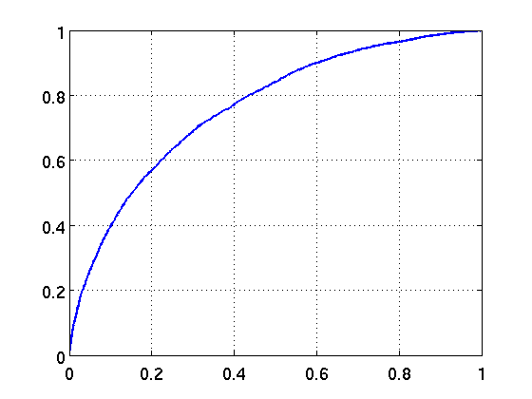
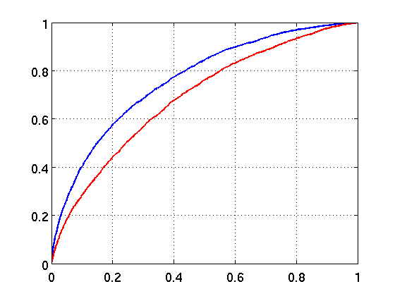
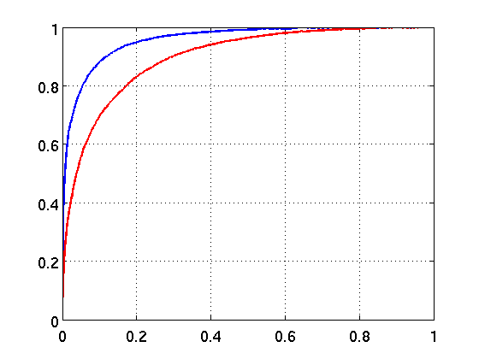
Lower-bounding Detection
Don’t know sensor true pick rate , but can lower bound
Sensor ROC curve
Fusion Center ROC curve
Lower bound
Lower bound
Sensor bound gives lower bound on fusion detection rate.

Slide 16
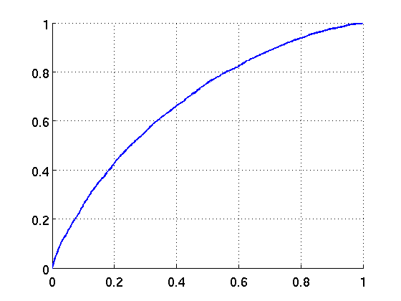
Joint Threshold Optimization
Maximize detection performance, under constraints on sensor messages and system false alarm rate
Sensor ROC curve
Fusion Center ROC curve
B’
C
A’
B
True Pick Rate
Detection Rate
C’
A
max
max
False Pick Rate
False Alarm Rate
Sensor and Fusion Center thresholds are optimized, e.g. by grid search, subject to false positive constraints

Slide 17
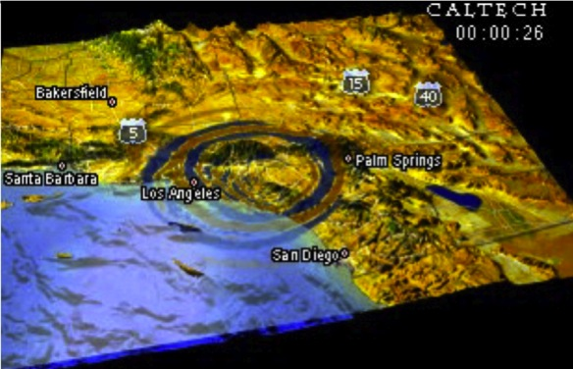
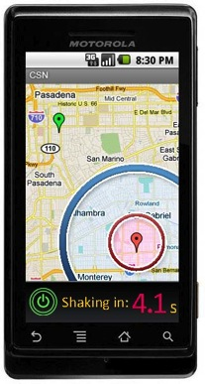
Community Seismic Network (CSN)
Detect and monitor earthquakes using smart phones, USB sensors, and cloud computing.

Slide 18
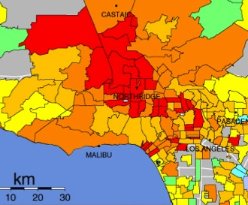
CSN Applications
Earthquake early warning tens of seconds of warning
Rapid, detailed ShakeMaps block-by-block maps of acceleration guide emergency teams after quake
Detailed subsurface maps Determine subsurface structures and soil conditions that enhance ground shaking.
Images of Fault Rupture
Building/Structure Monitoring
Didyoufeelit.com

Slide 19
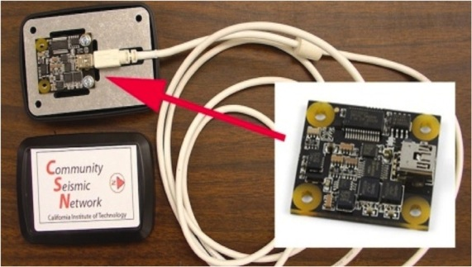
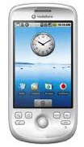

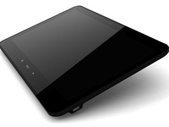
Community Sensors
Android phones and tablets
Phidgets, Inc. 16-bit USB accelerometer

Slide 20





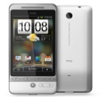
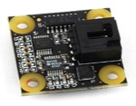
CSN Network Overview
Event Detection
Google
App Engine
Network Management

Slide 21

App Engine
Cloud fusion center is Scalable, Secure, Maintainable
Scalable Automatic load balancing creates and destroys instances
Secure Data replicated geographically to different data centers
Maintainable Not our problem!
Design Implications
Sync spatial-temporal data between instances
Loading time of new instances

Slide 22
Implementing Decision Rules
Implementing Anomaly Detection on Community Sensors

Slide 23
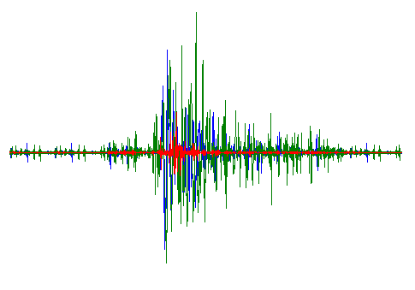

Sensor Anomaly Detection
Implementing Anomaly Detection on Community Sensors
5s
2.5s
Sliding Window
Feature Vector:
Mixture of Gaussians
Orient, remove gravity
Cross Validation
FFT Coefficients, Moments, Max
PCA linear dimensionality reduction
CSN-Droid on Market,
And demo today

Slide 24
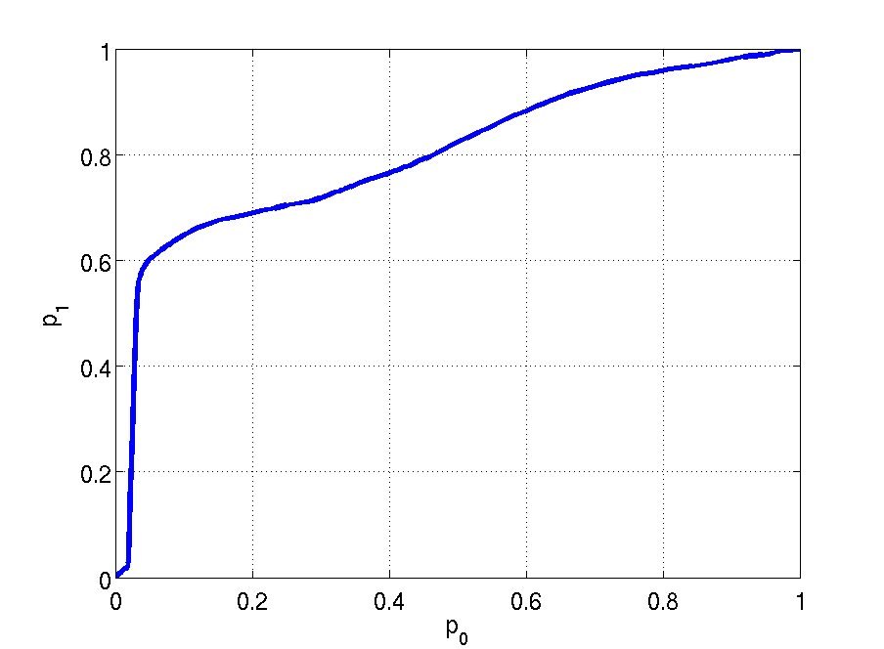
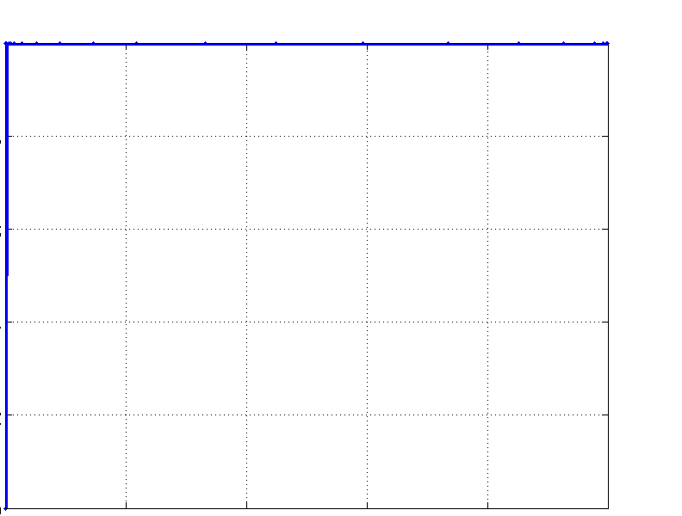
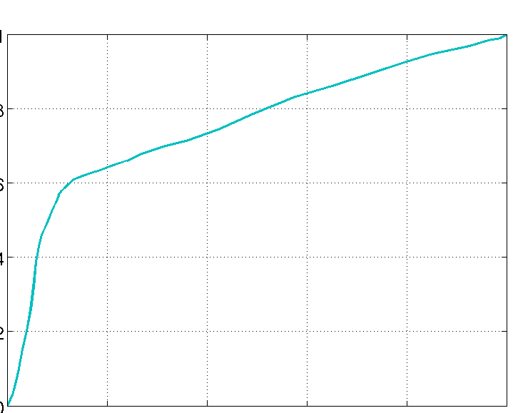
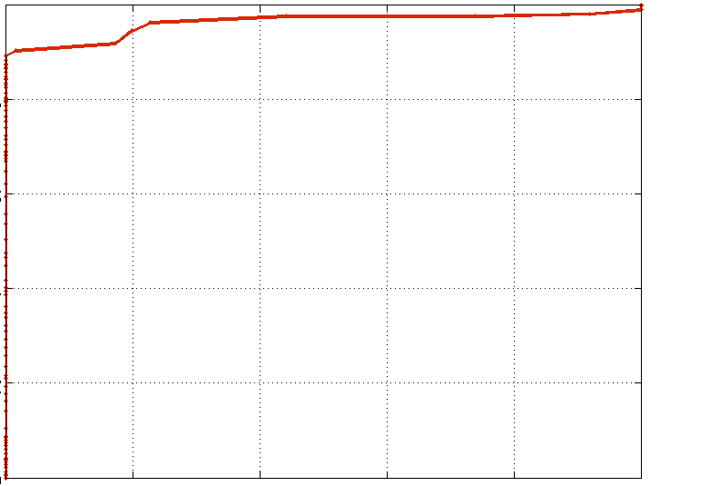
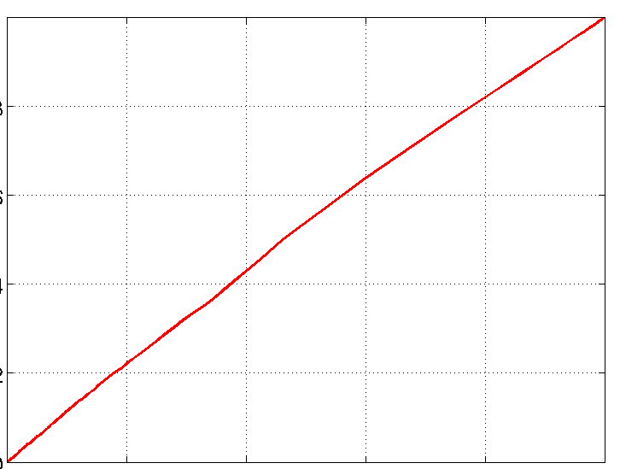
Experiment: M5-5.5, 0-40km
Sensor pick performance. Phone and Phidget noise overlaid on resampled historic quake recordings.
Phidget Detection Performance
Phone Detection Performance
Anomaly Detection
Anomaly
Detection
STA/LTA
True Pick Rate
True Pick Rate
HT
STA/LTA
False Pick Rate
False Pick Rate

Slide 25
Earthquake Detection in the Cloud
No pick
Pick

Slide 26
Earthquake Detection in the Cloud
No pick
Pick

Slide 27
Earthquake Detection in the Cloud
No pick
Pick
1/5
2/5
2/7

Slide 28
Earthquake Detection in the Cloud
No pick
Pick
1/5
1/1
2/8
4/5
1/5
5/7

Slide 29
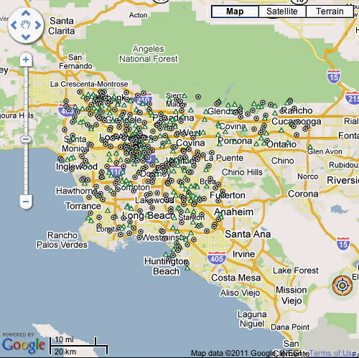

Slide 30
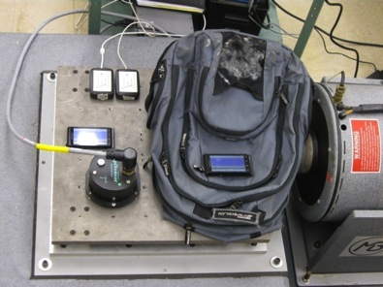
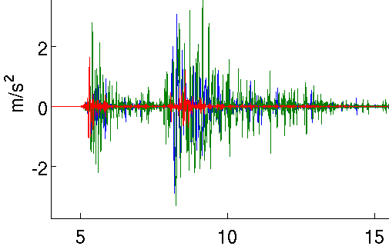
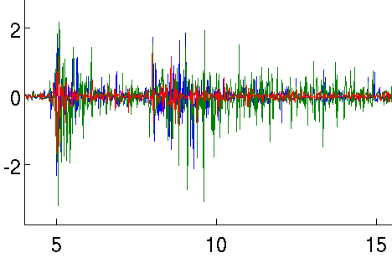
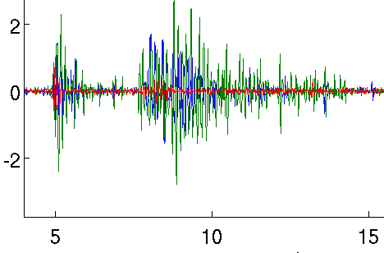
Shake Table Validation
Empirically compared sensors and tested pick algorithm on historic M6-8 quakes.
All 6 events triggered picks from the phones
Episensor
Phone on table
Phone in backpack

Slide 31
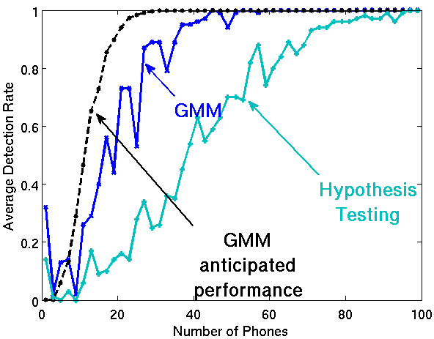
Baja 7.2 Simulation
April 4, 2010 Baja M7.2. 60-160km
Anomaly
Anticipated Anomaly Detection

Slide 32
Conclusions
Decentralized Anomaly Detection for Rare Events.
Learn decision rules to control messages, false alarms
Conservative estimates of sensor performance lower bounds system detection rate.
Network implemented with USB sensors, Android phones, App Engine cloud fusion center.
Performs well on simulations and shake table experiments.
Be sure to visit the demo!

