Slide 1
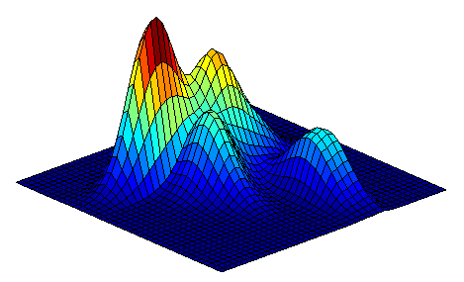


Scalable Training of Mixture Models via Coresets
Daniel
Feldman
Matthew
Faulkner
Andreas Krause
MIT

Slide 2

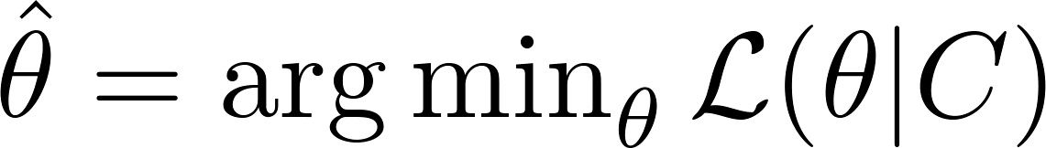
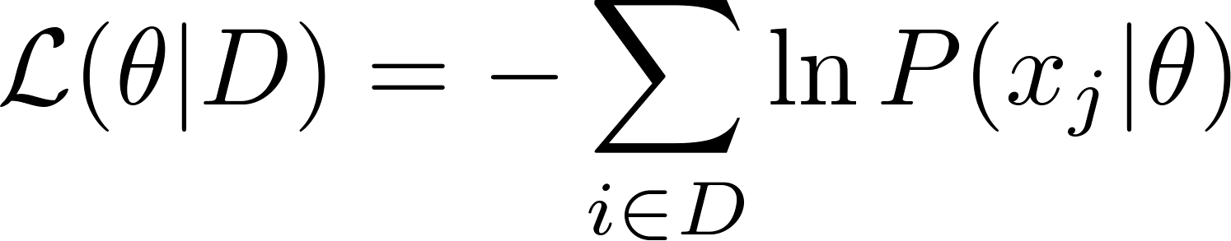
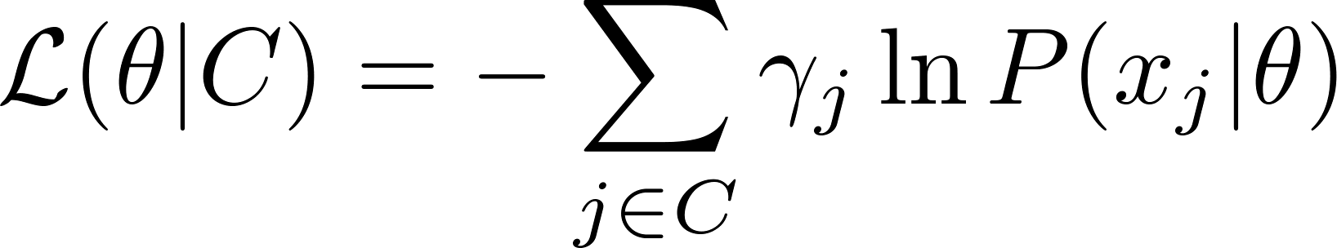
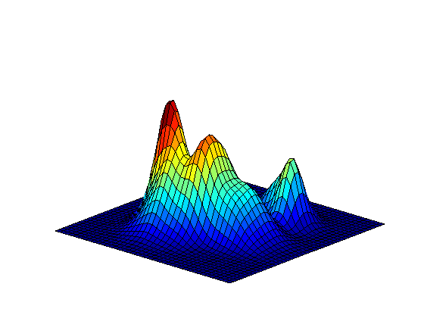


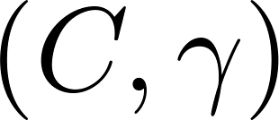
Fitting Mixtures to Massive Data
EM, generally expensive
Weighted EM, fast!
Importance
Sample

Slide 3
Coresets for Mixture Models
*

Slide 4
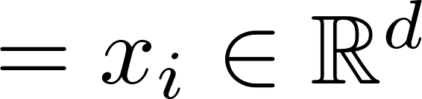
Naïve Uniform Sampling

Slide 5
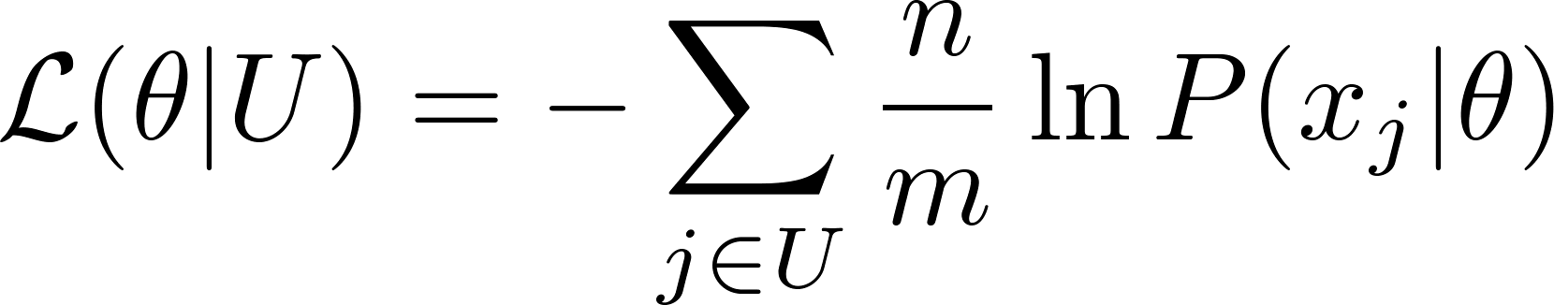
Naïve Uniform Sampling
Small cluster is missed
Sample a set U of m points uniformly
← High variance

Slide 6
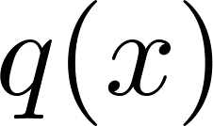
Sampling Distribution
Bias sampling
towards small clusters
Sampling distribution

Slide 7
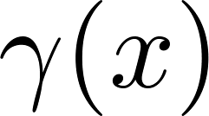
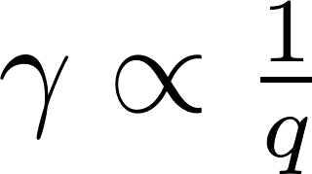
Importance Weights
Sampling distribution
Weights

Slide 8
Creating a Sampling Distribution
Iteratively find representative points

Slide 9
Creating a Sampling Distribution
Iteratively find representative points
Sample a small set uniformly at random

Slide 10
Creating a Sampling Distribution
Iteratively find representative points
Sample a small set uniformly at random
Remove half the blue points nearest the samples

Slide 11
Creating a Sampling Distribution
Iteratively find representative points
Sample a small set uniformly at random
Remove half the blue points nearest the samples

Slide 12
Creating a Sampling Distribution
Iteratively find representative points
Sample a small set uniformly at random
Remove half the blue points nearest the samples

Slide 13
Creating a Sampling Distribution
Iteratively find representative points
Sample a small set uniformly at random
Remove half the blue points nearest the samples

Slide 14
Creating a Sampling Distribution
Iteratively find representative points
Sample a small set uniformly at random
Remove half the blue points nearest the samples

Slide 15
Creating a Sampling Distribution
Iteratively find representative points
Sample a small set uniformly at random
Remove half the blue points nearest the samples

Slide 16
Creating a Sampling Distribution
Small clusters
are represented
Iteratively find representative points
Sample a small set uniformly at random
Remove half the blue points nearest the samples

Slide 17
Creating a Sampling Distribution
Partition data via a Voronoi diagram centered at points

Slide 18

Creating a Sampling Distribution
Points in sparse cells get more mass
and points far from centers
Sampling distribution

Slide 19
Importance Weights
Points in sparse cells get more mass
and points far from centers
Sampling distribution
Weights

Slide 20
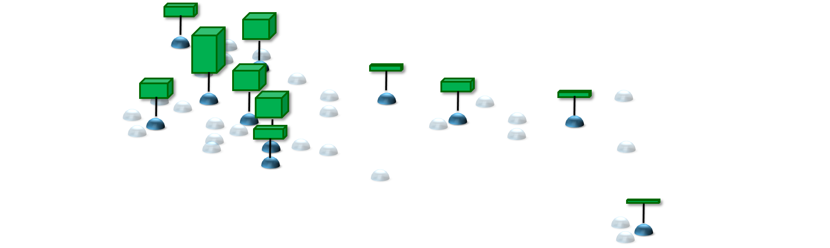

Importance Sample

Slide 21
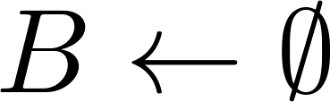

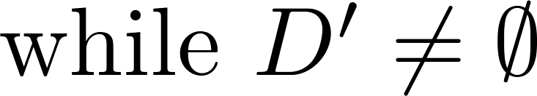

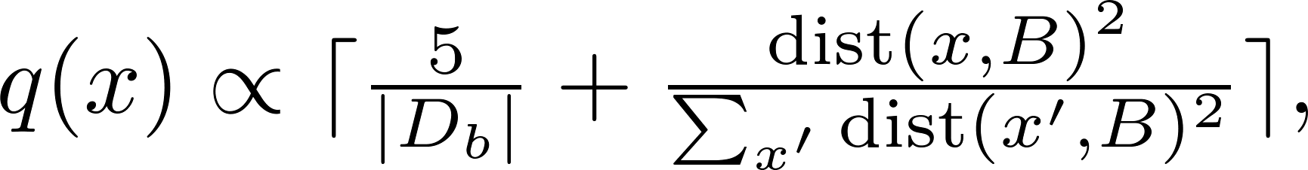
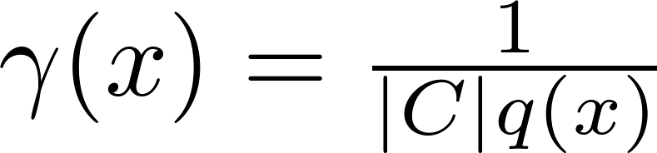
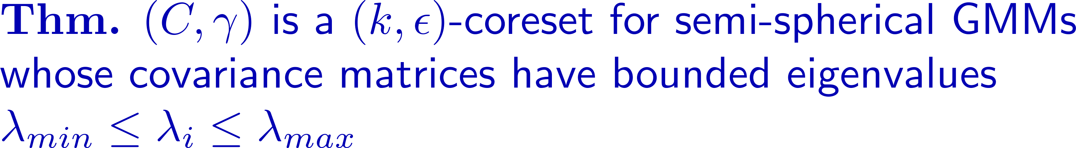
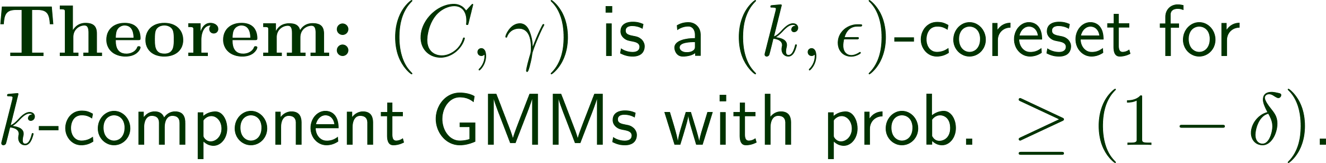
Coresets via Adaptive Sampling

Slide 22
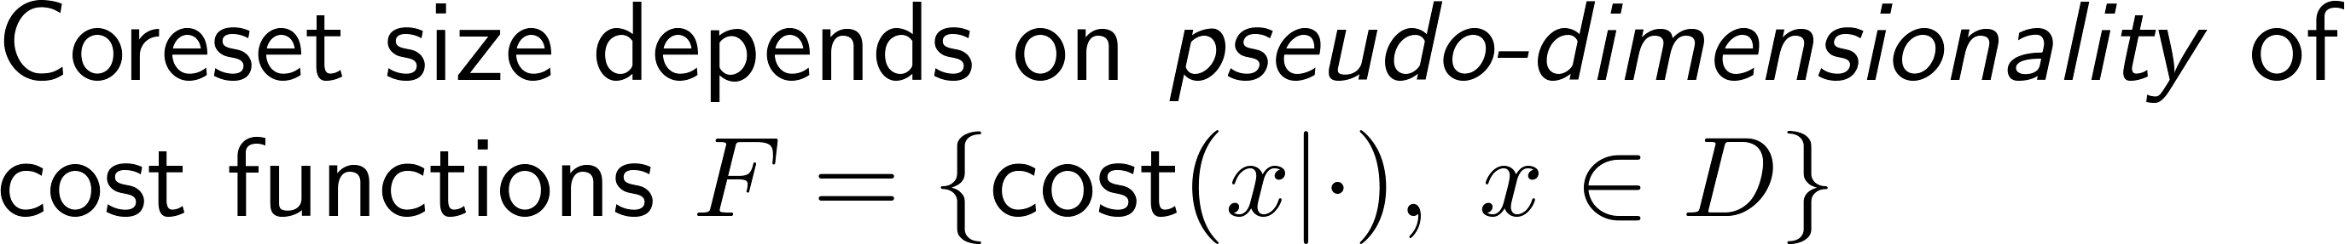
A General Coreset Framework
Contributions for Mixture Models:

Slide 23
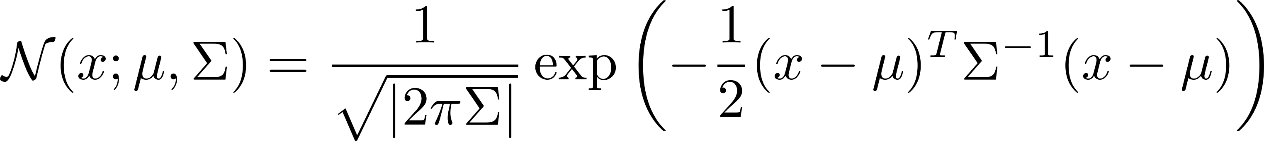
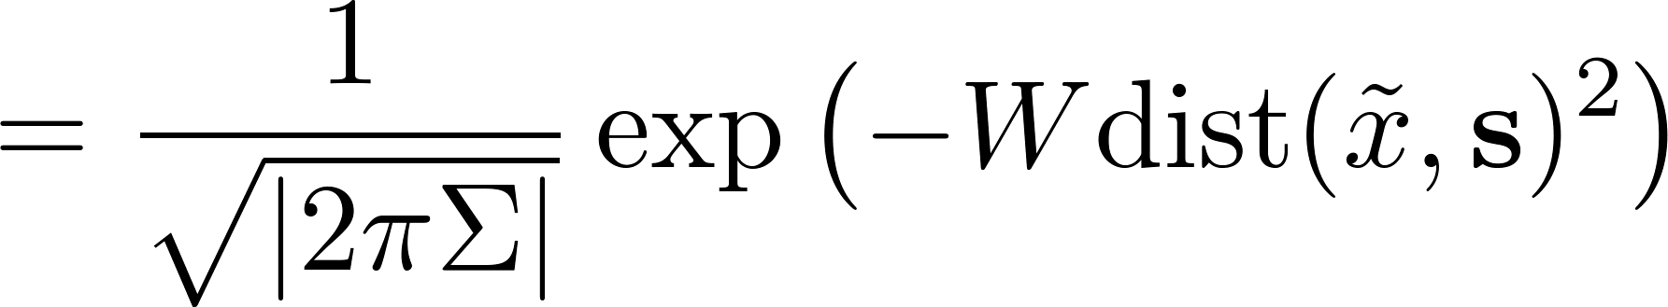
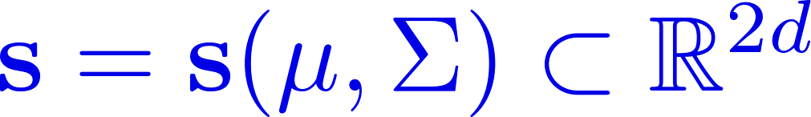

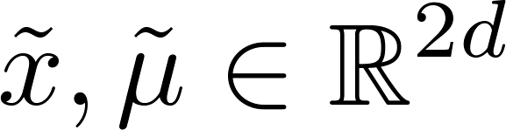
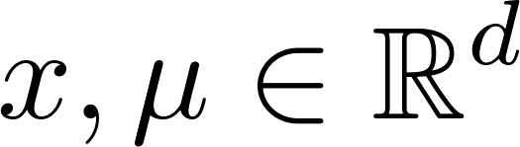




A Geometric Perspective
Gaussian level sets can be expressed purely geometrically:
affine subspace

Slide 24



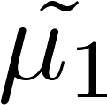
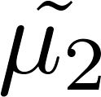

Geometric Reduction
Soft-min
Lifts geometric coreset tools to mixture models

Slide 25
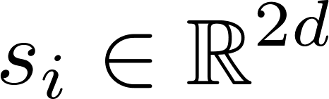
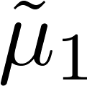
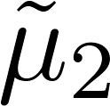
Semi-Spherical Gaussian Mixtures

Slide 26

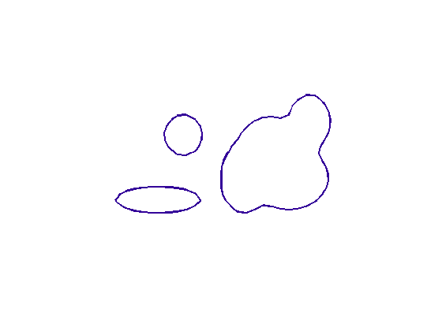



Extensions and Generalizations
Level Sets

Slide 27



Composition of Coresets
[c.f. Har-Peled, Mazumdar 04]
Merge

Slide 28
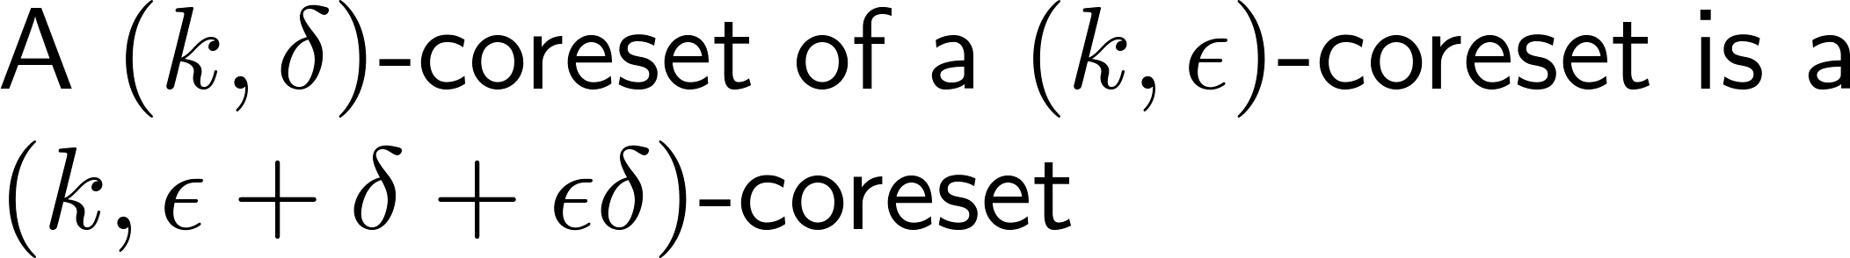
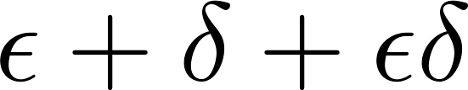
Composition of Coresets
[Har-Peled, Mazumdar 04]
Merge
Compress

Slide 29
Coresets on Streams
[Har-Peled, Mazumdar 04]
Merge
Compress

Slide 30
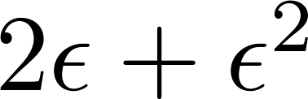
Coresets on Streams
[Har-Peled, Mazumdar 04]
Merge
Compress

Slide 31
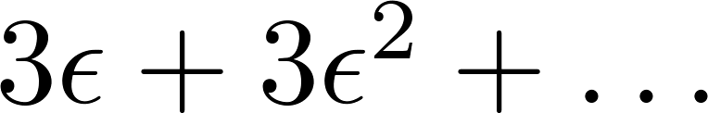
Coresets on Streams
[Har-Peled, Mazumdar 04]
Merge
Compress
Error grows linearly with number of compressions

Slide 32
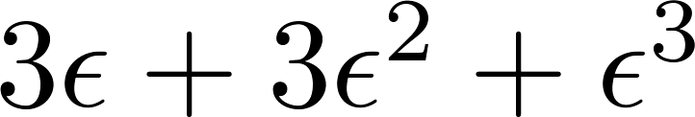




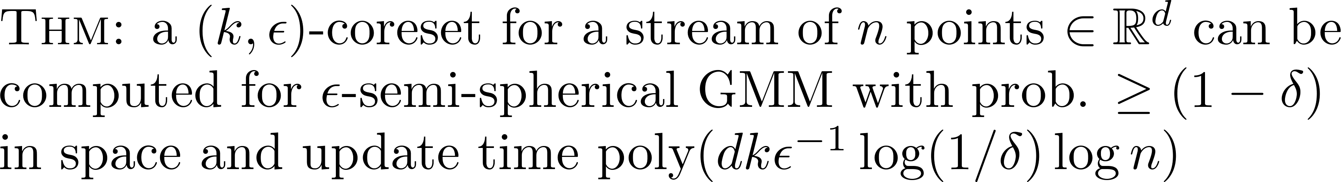
Coresets on Streams
Error grows with height of tree

Slide 33
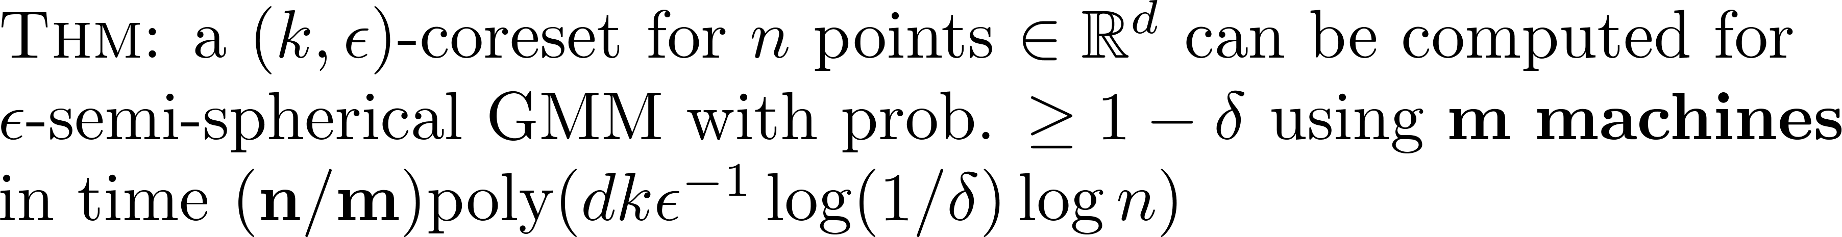
Coresets in Parallel

Slide 34
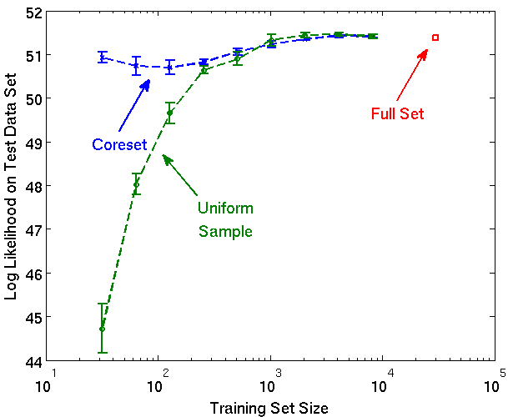
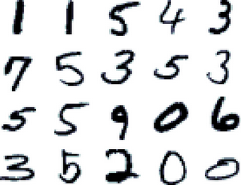
Handwritten Digits
Obtain 100-dimensional features from 28x28 pixel images via PCA. Fit GMM with k=10 components.
MNIST data:
60,000 training,
10,000 testing

Slide 35
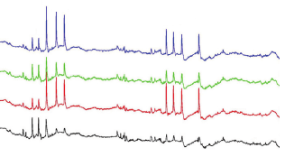
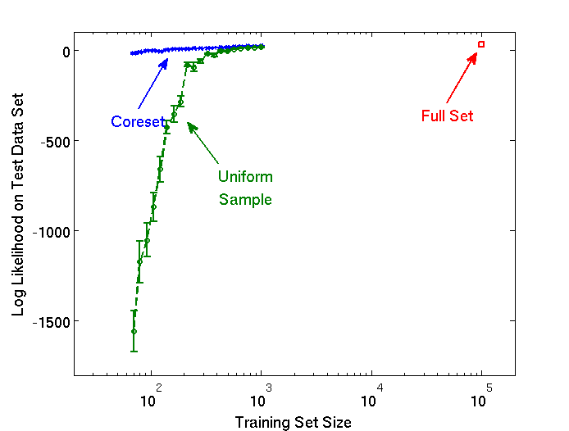

Neural Tetrode Recordings
Waveforms of neural activity at four co-located electrodes in a live rat hippocampus. 4 x 38 samples = 152 dimensions.
T. Siapas et al, Caltech

Slide 36

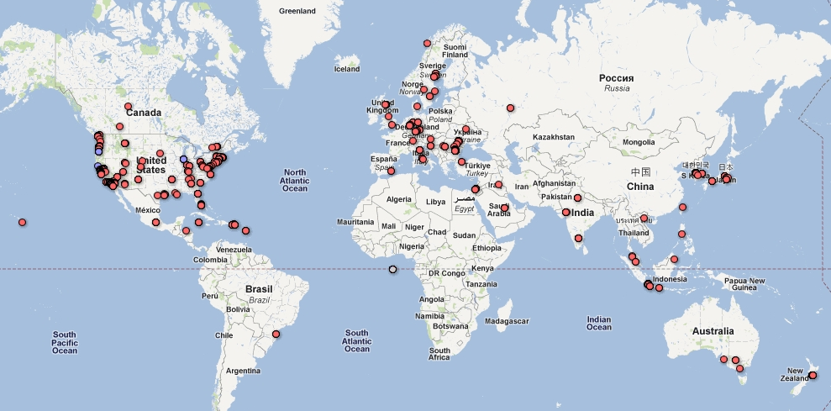
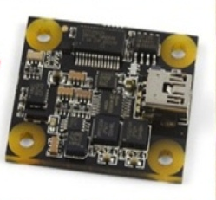
Community Seismic Network
Detect and monitor earthquakes using smart phones, USB sensors, and cloud computing.
CSN Sensors Worldwide

Slide 37
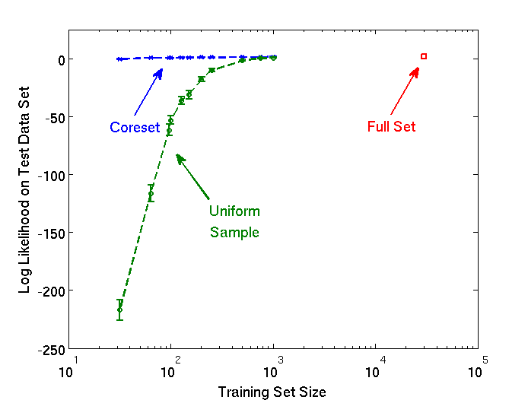
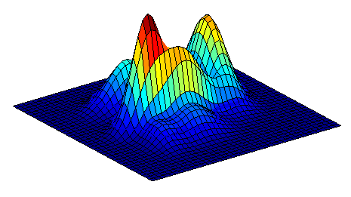

Learning User Acceleration
17-dimensional acceleration feature vectors
Good
Bad

Slide 38

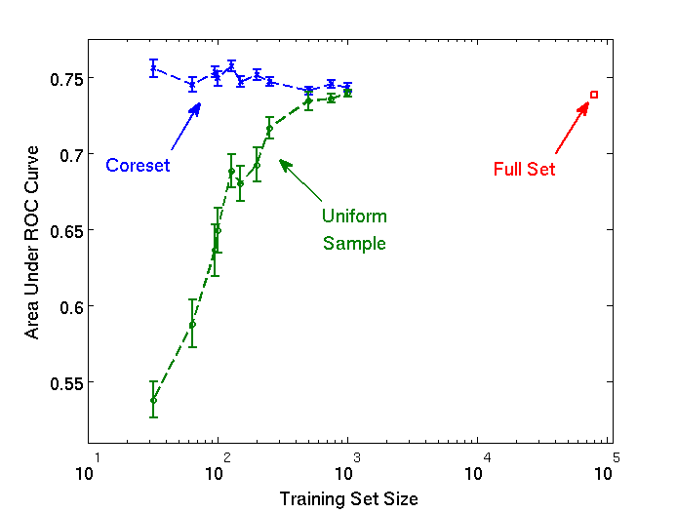
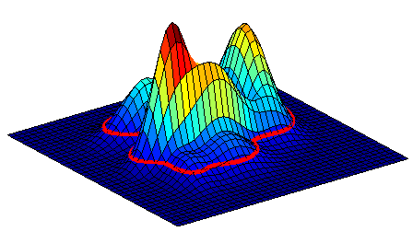
Seismic Anomaly Detection
GMM used for anomaly detection
Good
Bad

Slide 39
Conclusions
GMMs admit coresets of size independent of n
- Extensions for other mixture models
Parallel (MapReduce) and Streaming implementations
Lift geometric coreset tools to the statistical realm
- New complexity result for GMM level sets
Strong empirical performance, enables learning on mobile devices

