Slide 1

Adaptive Submodularity: A New Approach to Active Learning and Stochastic Optimization
Daniel Golovin and Andreas Krause

Slide 2


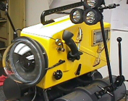
Max K-Cover (Oil Spill Edition)

Slide 3
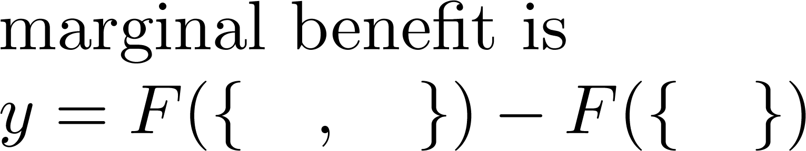
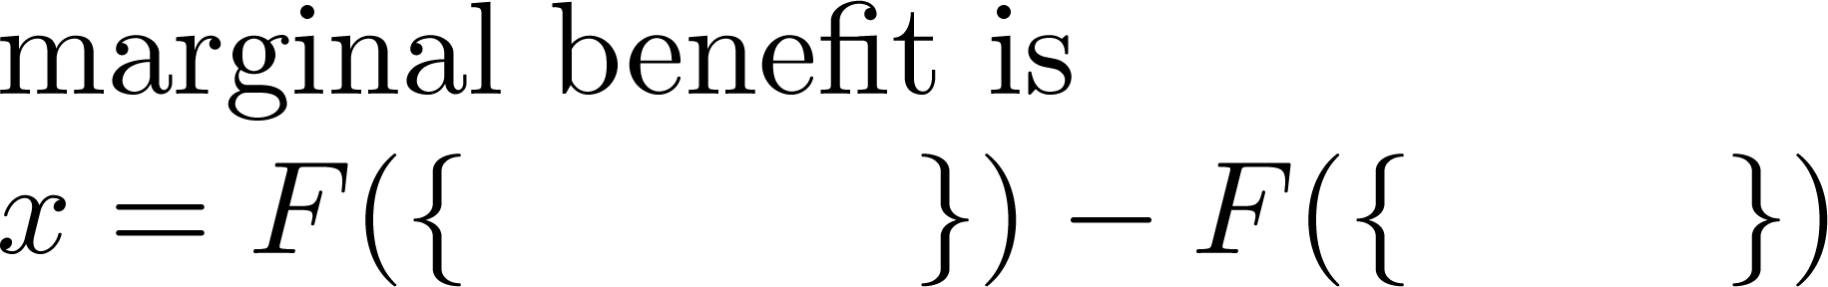
Submodularity
Discrete diminishing returns property for set functions.
``Playing an action at an earlier stage
only increases its marginal benefit''
Time
Time

Slide 4
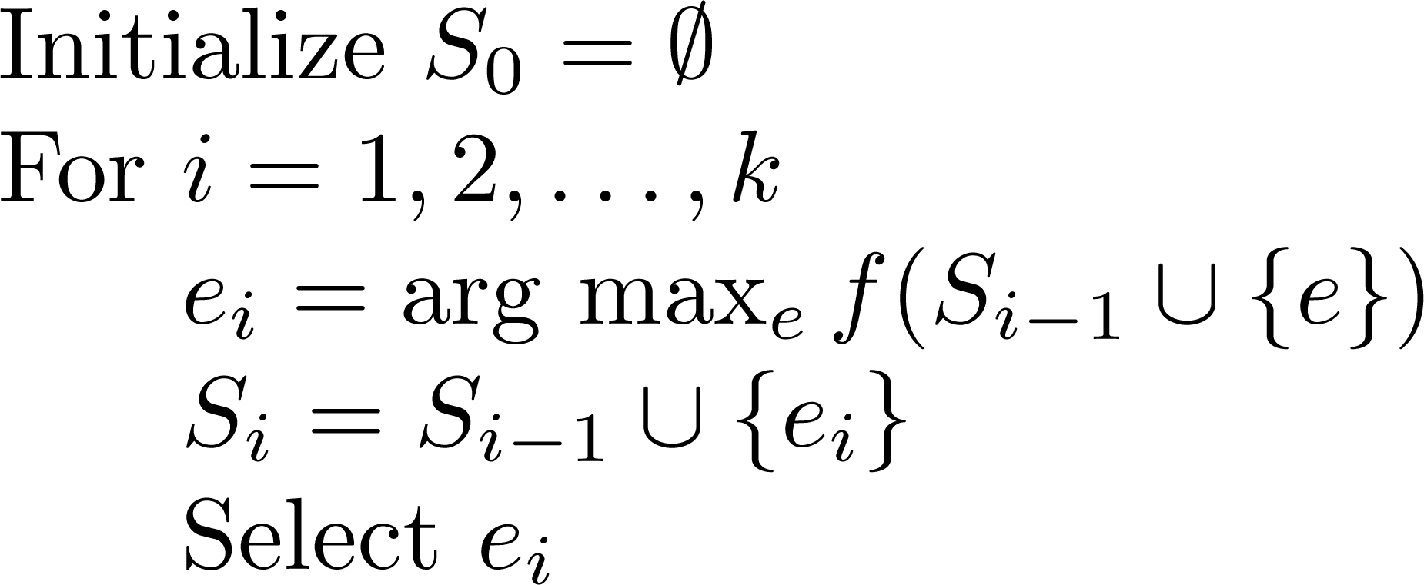
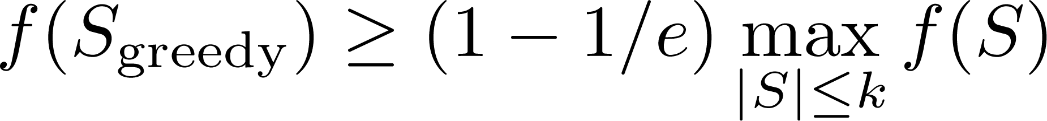
The Greedy Algorithm
Theorem [Nemhauser et al ‘78]

Slide 5

Stochastic Max K-Cover
Bayesian: Known failure distribution.
Adaptive: Deploy a sensor and see what you get. Repeat K times.
At 1st location
0.3
0.2
0.5
Asadpour & Saberi (`08): (1-1/e)-approx if sensors
(independently) either work perfectly or fail completely.

Slide 6
Adaptive Submodularity
Select Item
Stochastic
Outcome
Time
Gain less
Gain more
Playing an action at an earlier stage
only increases its marginal benefit
(i.e., at an ancestor)
expected
(taken over its outcome)

Slide 7
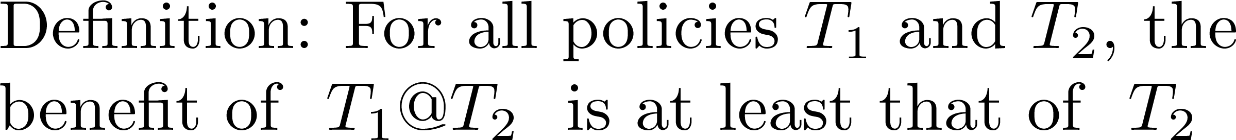
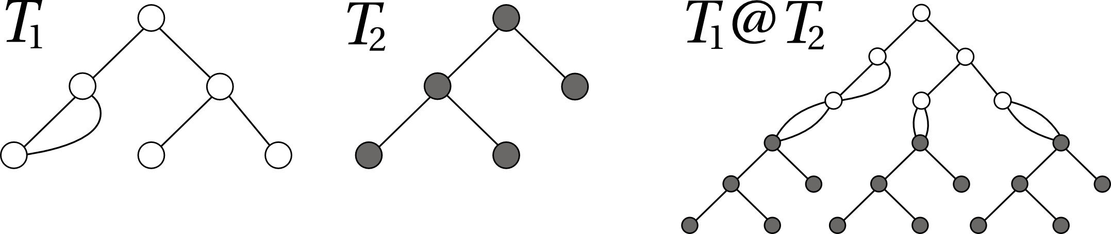
Adaptive Monotonicity

Slide 8
What is it good for?
Allows us to generalize various results to the adaptive realm, including:
(1-1/e)-approximation for Max K-Cover, submodular
maximization subject to a cardinality constraint
(ln(n)+1)-approximation for Set Cover

Slide 9
Recall the Greedy Algorithm
Theorem [Nemhauser et al ‘78]

Slide 10
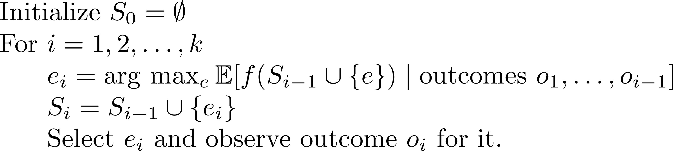
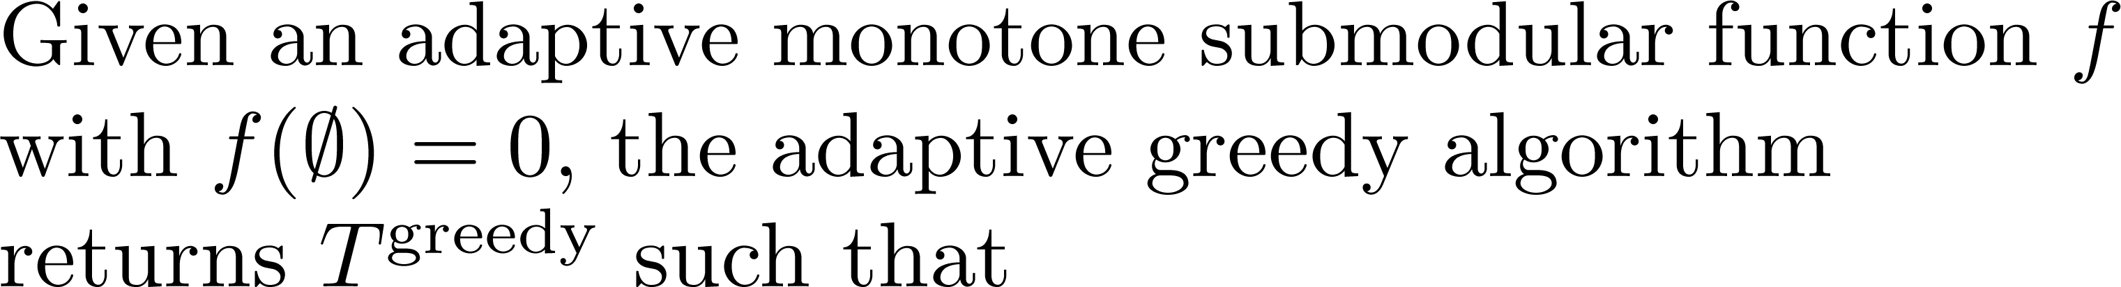
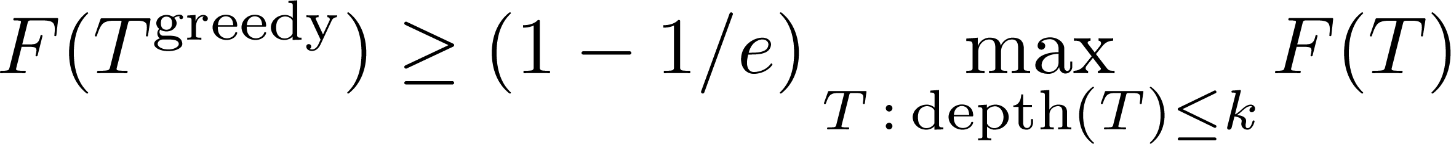
The Adaptive-Greedy Algorithm
Theorem

Slide 11
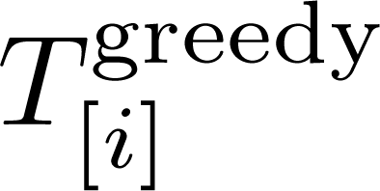
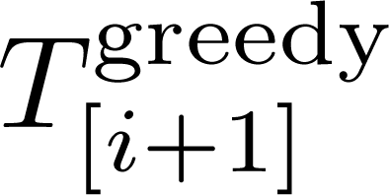


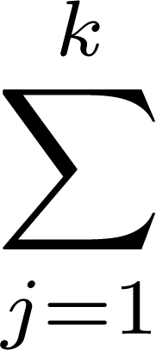

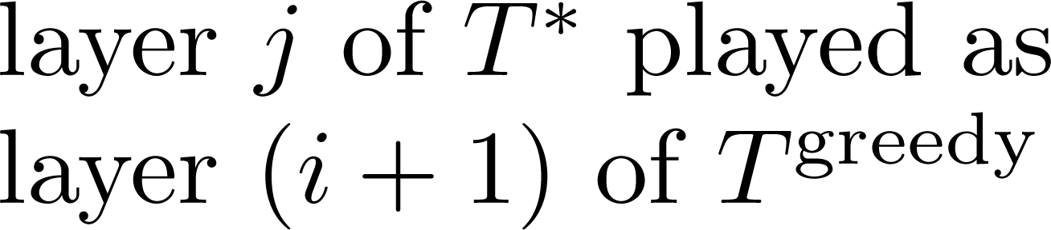
-
-
[Adapt-monotonicity]
(
-
)
[Adapt-submodularity]

Slide 12
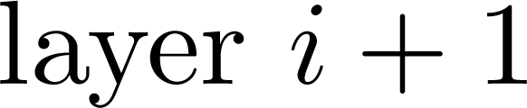
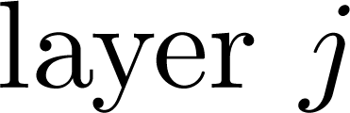
How to play layer j at layer i+1
The world-state dictates which path in the tree we’ll take.
For each node at layer i+1,
Sample path to layer j,
Play the resulting layer j action at layer i+1.
By adapt. submod.,
playing a layer earlier
only increases it’s
marginal benefit
…

Slide 13


-
-
[Adapt-monotonicity]
(
-
)
[Adapt-submodularity]
(
-
)
-
(
)
[Def. of adapt-greedy]

Slide 14
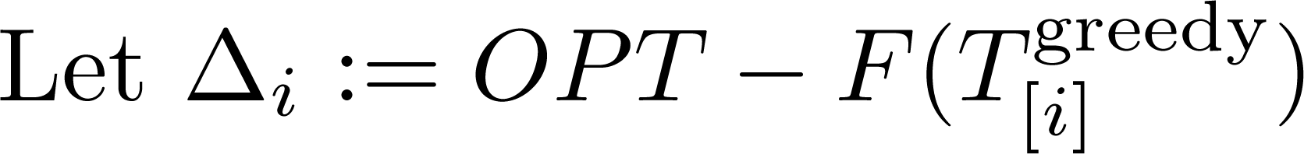

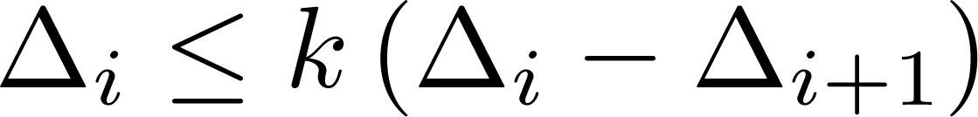

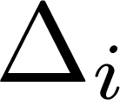
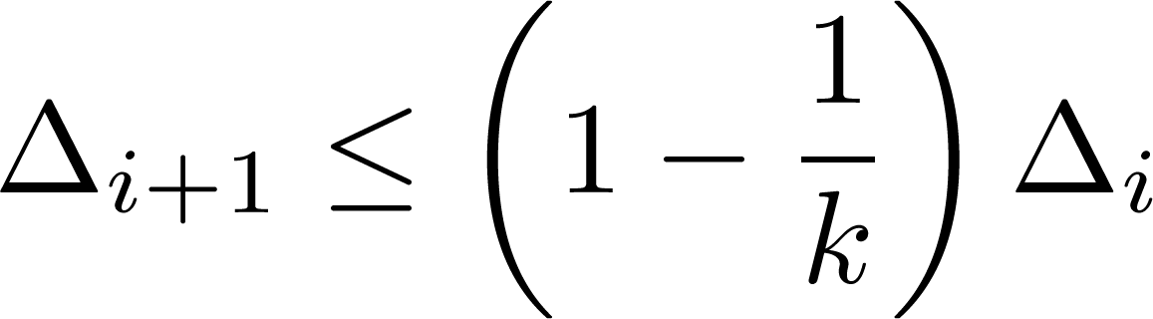
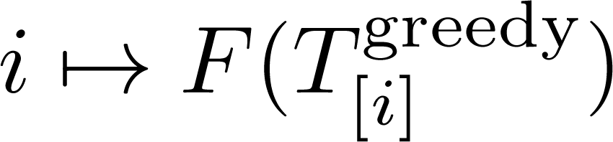
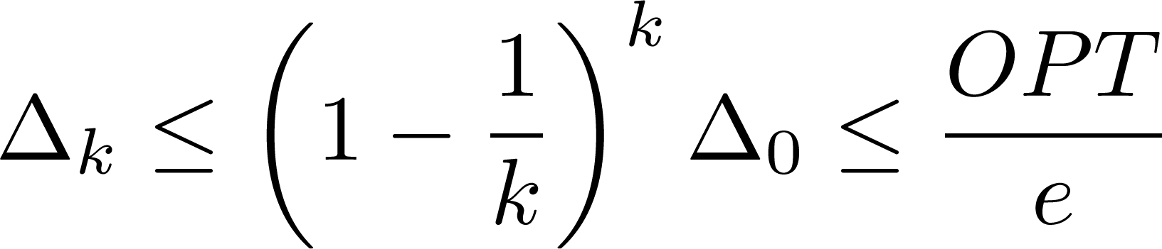
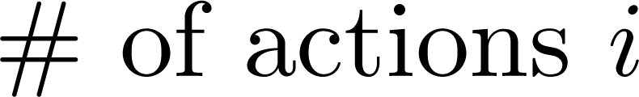
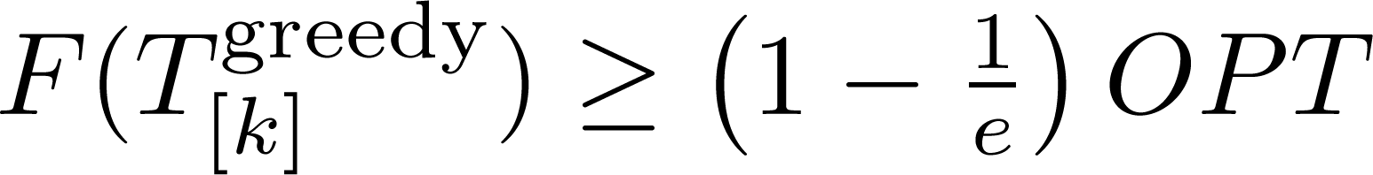

Slide 15
Stochastic Max Cover is Adapt-Submod
2
1
3
1
3
Random sets distributed
independently.
adapt-greedy is a (1-1/e) ≈ 63%
approximation to the
adaptive optimal solution.
Gain less
Gain more

Slide 16
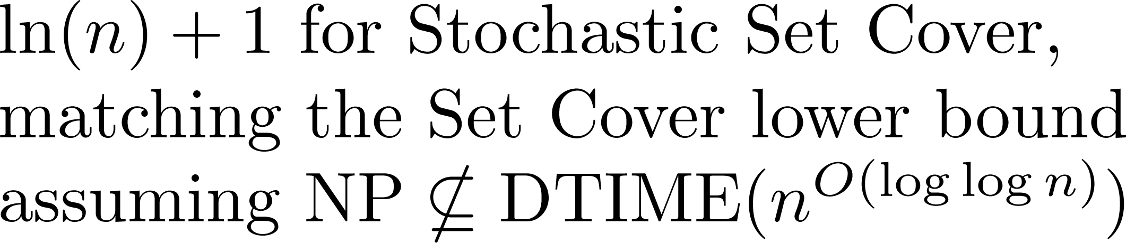
Stochastic Min Cost Cover
Adaptively get a threshold amount of value.
Minimize expected number of actions.
If objective is adapt-submod and monotone, we get a logarithmic approximation.
[Goemans & Vondrak, LATIN ‘06]
[Liu et al., SIGMOD ‘08]
[Feige, JACM ‘98]
c.f., Interactive Submodular Set Cover
[Guillory & Bilmes, ICML ‘10]

Slide 17



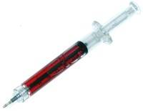
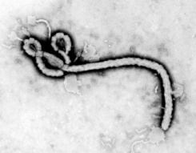
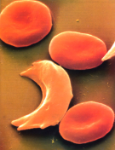
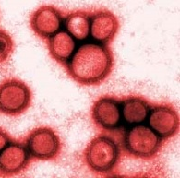
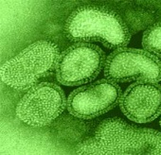

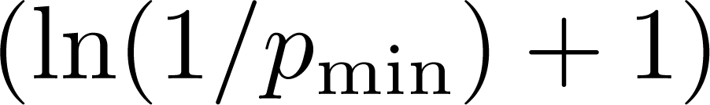
Optimal Decision Trees
“Diagnose the patient as cheaply as possible (w.r.t. expected cost)”
x₁
=
Garey & Graham, 1974;
Loveland, 1985;
Arkin et al., 1993;
Kosaraju et al., 1999;
Dasgupta, 2004;
Guillory & Bilmes, 2009;
Nowak, 2009;
Gupta et al., 2010
0
1
x₂
=
0
1
0
1
x₃
=
0
1

Slide 18




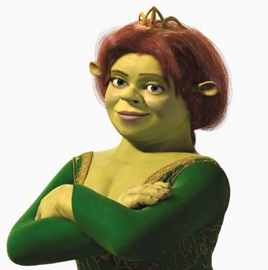
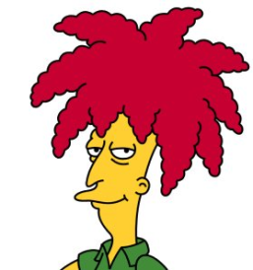
Conclusions
New structural property useful for design & analysis of adaptive algorithms
Powerful enough to recover and generalize many known results in a unified manner. (We can also handle costs)
Tight analyses and optimal approximation factors in many cases.
x₁
0.2
2
0
1
x₂
0.5
0.4
0.2
1
3
0.3
0.5
0
1
0
1
x₃
0.5

