Slide 1

Online Distributed Sensor Selection
Daniel Golovin, Matthew Faulkner, Andreas Krause
rsrg @caltech
..where theory and practice collide

Slide 2

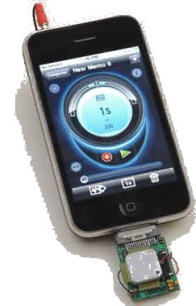
Community Sensing
Sensor-equipped cell phones are ubiquitous.
Used for traffic monitoring, pollution detection, earthquake measurement.
Constraints on bandwidth, power, privacy… Impractical to query all phones.
Which sensors should send data?
Can current measurements inform selection?

Slide 3

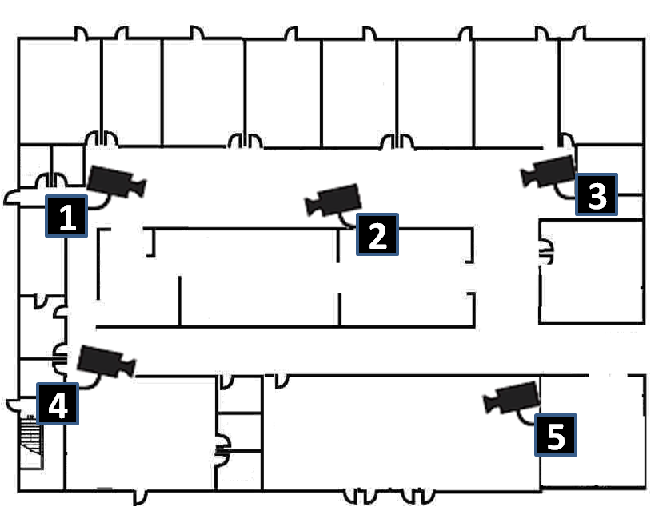

A Sensor Selection Problem
Select two cameras to query, in order to detect the most people.
Duplicates only counted once
People Detected:
4
2

Slide 4
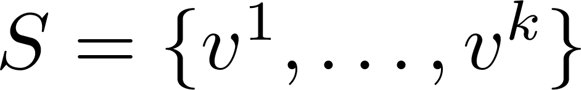
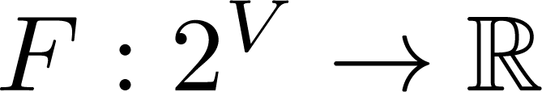
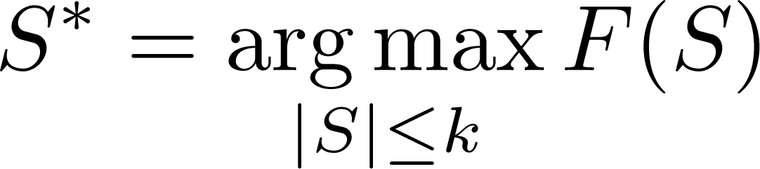
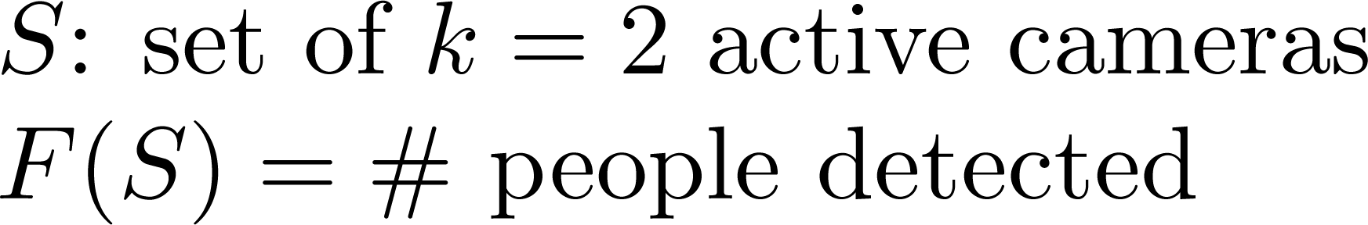

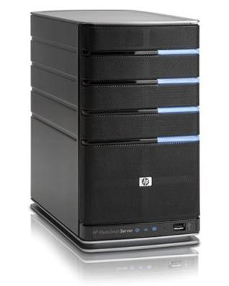
A Sensor Selection Problem
Set V of sensors, |V| = N
Select a set of k sensors
Sensing quality model
Typically NP-hard…

Slide 5
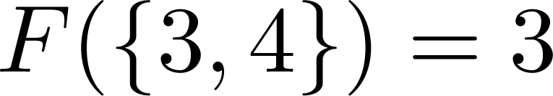
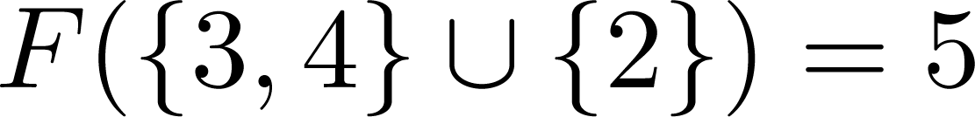
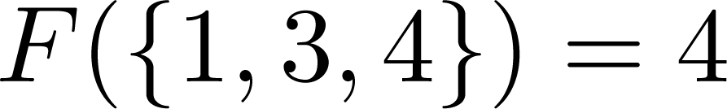
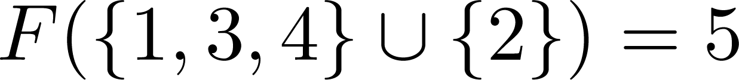
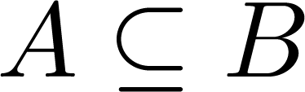
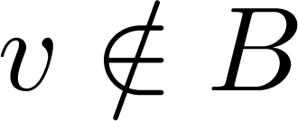
Submodularity
Diminishing returns property for adding more sensors.
+2
+1
Many objectives are submodular:
Detection, coverage, mutual information, and others.
For all , and a sensor ,

Slide 6
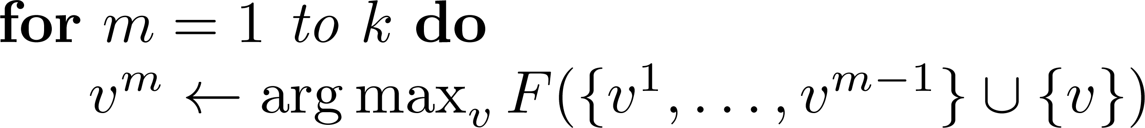
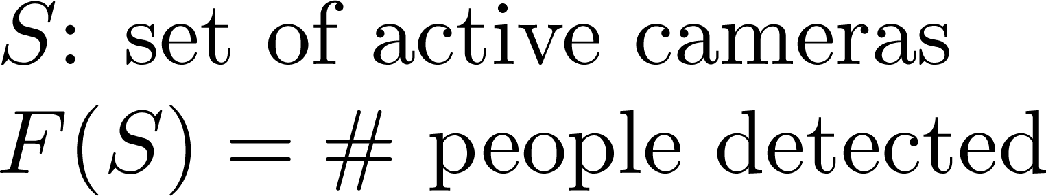
Greedy Selection
Lets choose sensors S = {v¹ , … , v^{k}} greedily
[Nemhauser et al ‘78] If F is submodular, the Greedy algorithm gives constant factor approximation:
Must know sensing model F
Greedy is centralized
Selection ignores current sensor values

Slide 7
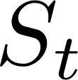
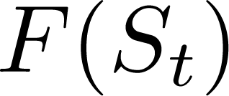
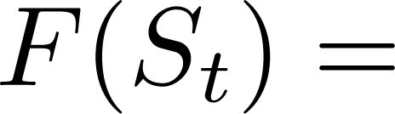
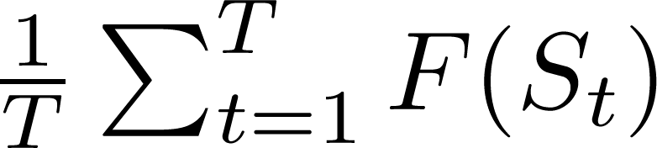
Online Sensor Selection
Get to choose sensors on each round t. Then is revealed.
3
2
2
Need to explore different sets.
Only need to evaluate F for chosen sets.

Slide 8
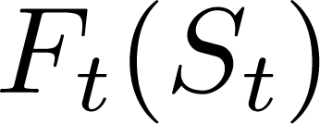
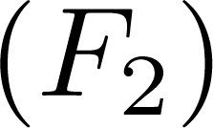
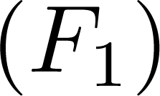
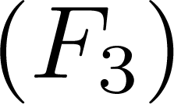
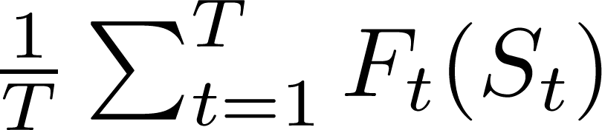
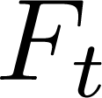
Online Sensor Selection
Get to choose sensors on each round t. Then is revealed.
Round 2
Round 1
Round 3
Only assume is submodular and bounded

Slide 9
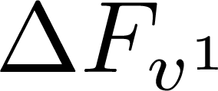
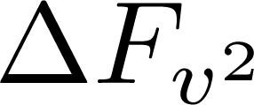
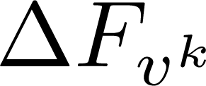




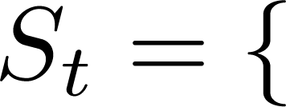
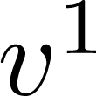
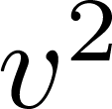
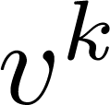


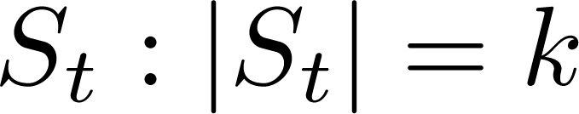
Online Greedy Selection
At each round, choose a set . Learn to choose greedily.
What algorithm?
Value of
Theorem [Streeter & Golovin ‘08]: Online Greedy (OG)
The centralized Online Greedy algorithm chooses

Slide 10
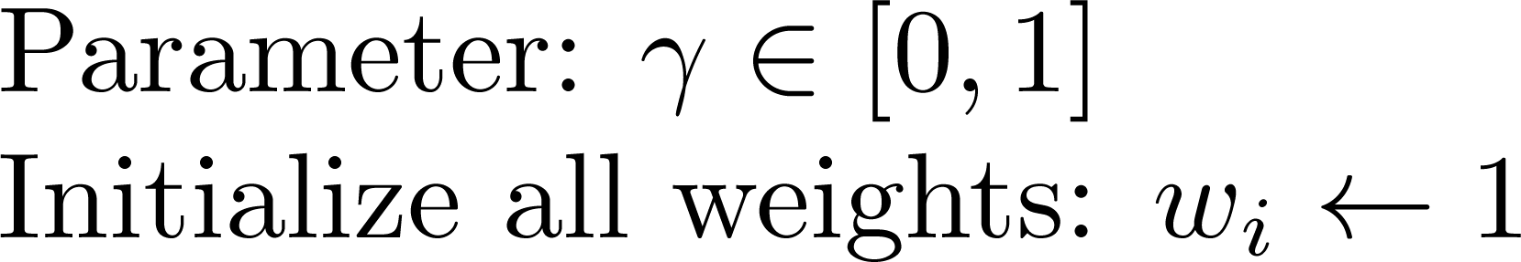

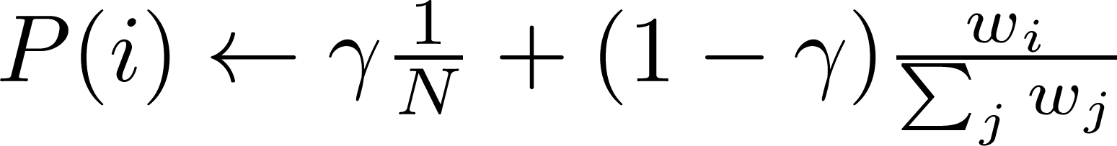
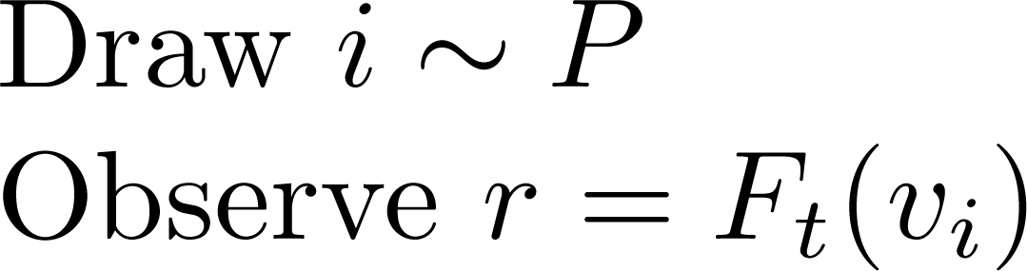
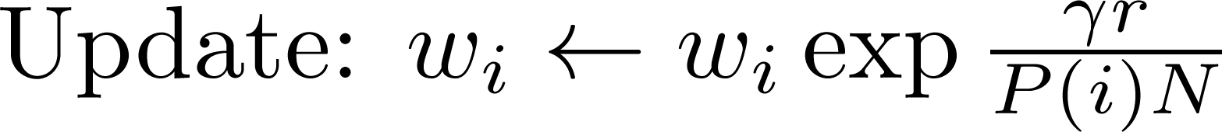
Single Sensor Selection
On each round, choose one sensor and observe it value.
EXP3 [Auer et al ‘95]
balances exploring and exploiting
Can we avoid centralized sampling?
Theorem [Auer et al ‘95]: The average value obtained by EXP3 converges to the value of the fixed optimum:

Slide 11
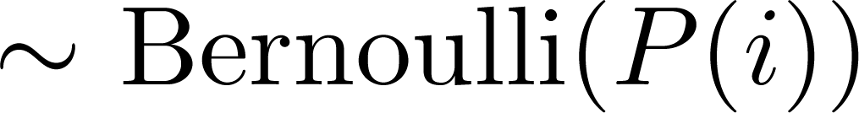
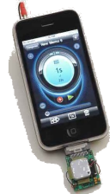
Distributed Sampling
Centralized sampling may not scale practically.
Idea: Independent draws until exactly one sensor broadcasts a success.
P(1)
P(2)
P(3)
Doesn’t sample from correct distribution

Slide 12
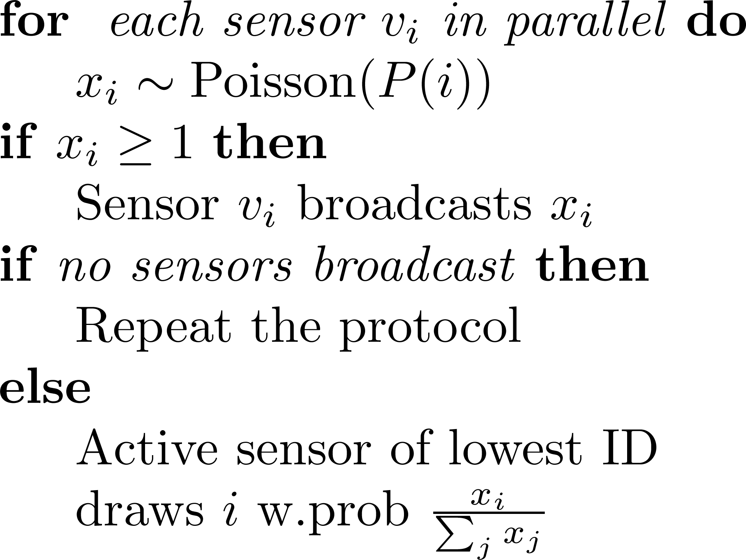

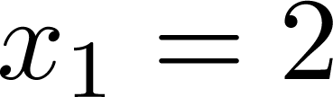
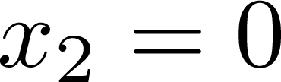
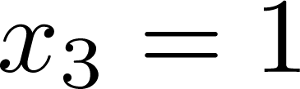
A Distributed Sampling Protocol
We can sample from correct distribution, while using few messages!
Theorem: Protocol correctly samples from P.
Requires < 4 messages in the broadcast model
P(1)
P(2)
P(3)

Slide 13
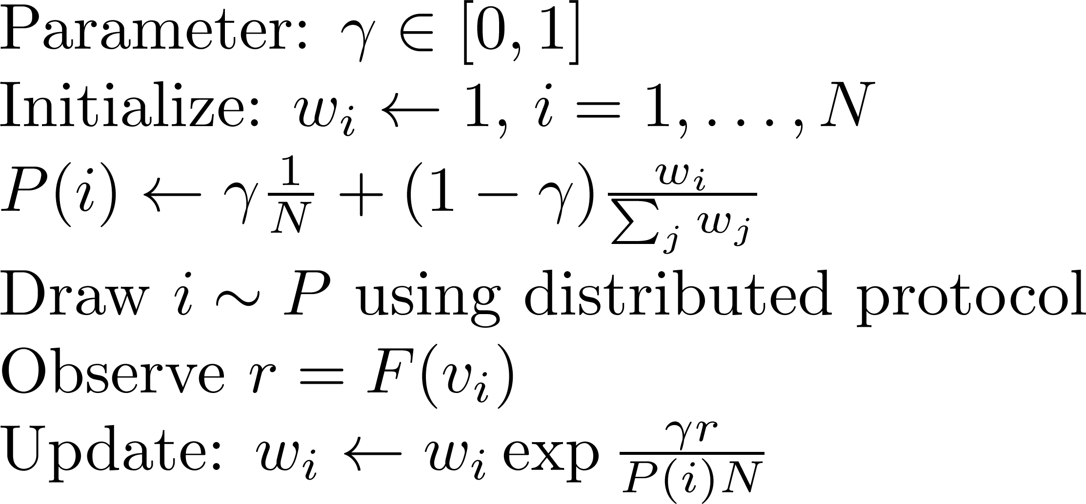
Distributed EXP3
Use distributed sampling protocol in EXP3.
Yields distributed single-sensor selection algorithm
Distributed EXP3
Broadcast the change of weight for now
Theorem: Exact same performance as centralized EXP3

Slide 14
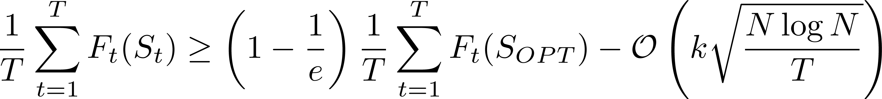
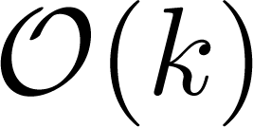
Distributed Online Greedy
Distributed Online Greedy (DOG) selects a set of k sensors on each round, using Distributed EXP3 as a subroutine.
D-EXP3
D-EXP3
D-EXP3
Theorem : DOG selects sensors S_{t} that obtain
Using messages per round in expectation.

Slide 15


Communication Models
Selection techniques extend efficiently to non-broadcast communication models.
Star Network Model: messages between base station and one sensor are unit cost.
D-EXP3 samples from
Each sensor needs to know the sum of all weights
Lazy-DOG. A sensor only updates its sum when it communicates with base station.
Theorem: Lazy-DOG gives same selection performance as DOG, and reduces messages in star model from N to log(N).

Slide 16


Observation-Dependent Selection
Sensing can be cheap while communication is costly. Can current observations inform selection?
Valuable observation
Domain knowledge

Slide 17
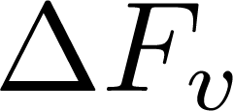

Observation-Dependent Selection
OD-DOG. A sensor’s current measurement can influence its decision to activate.
1. Each sensor v estimates its marginal value
2. Sensor v activates if exceeds a threshold.
Learn the threshold
3. Given communication cost C, feed back
Useful for detecting important and rare events

Slide 18
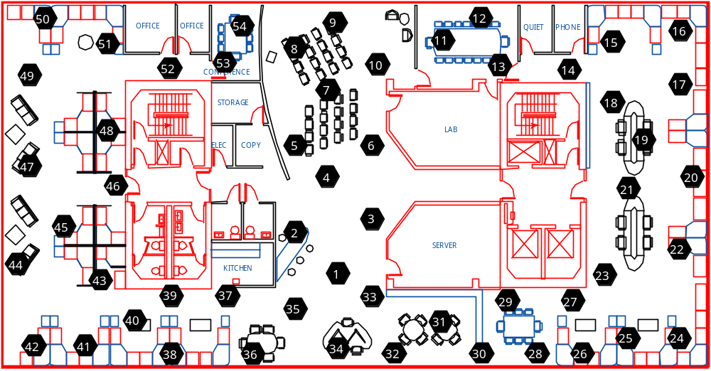
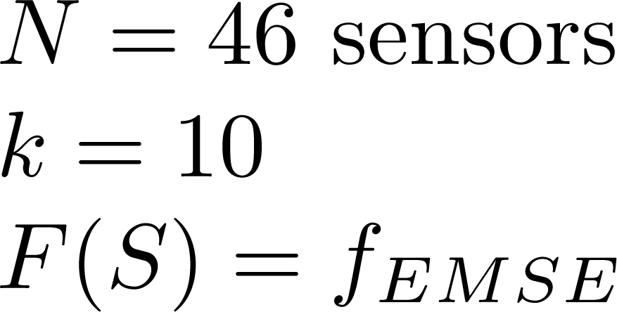
Temperature Monitoring
Select 10 from 46 temperature sensors deployed at Intel Research Berkeley.
Optimize the expected reduction in mean squared prediction error (EMSE).
(often) submodular*
Notes:
*see paper for details

Slide 19
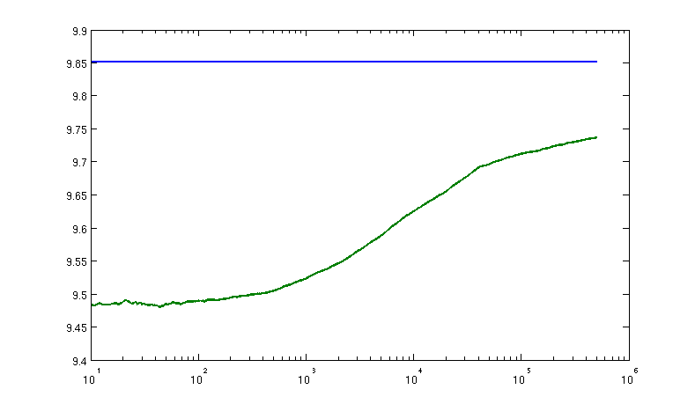
Temperature Monitoring
Optimize sensor placement for monitoring temperature in an office building. Select 10 of 46 sensors.
Offline greedy
Distributed Online Greedy

Slide 20


Outbreak Detection
Battle of Water Sensor Networks: Detect contamination events in an urban water distribution network.
Contamination models provided by EPA
Observation-dependent selection to ensure important events are detected
Submodular

Slide 21
Outbreak Detection
OD-DOG with observation-dependent selection for various communication costs C.
Low communication cost
5 avg. extra activations
Greedy
0.1 avg. extra activations
High communication cost
Balances added value and communication cost

Slide 22
Conclusions
DOG, a distributed sensor selection algorithm that applies to many sensing applications.
Strong theoretical guarantees on performance and communication cost.
OD-DOG for observation-specific selection. Can incorporate domain knowledge.
Performs well on several real sensor data sets.

