Slide 1

Budgeted Nonparametric Learning from Data Streams
Ryan Gomes and Andreas Krause
California Institute of Technology
Notes:
Thank you all for being here. This is work with Andreas Krause, and we’re at Caltech.

Slide 2
















































































Application Examples
Clustering Millions of Internet Images
Torralba et al. 80 Million tiny images. IEEE PAMI Nov. 2008
Notes:
-explore images on web
-cluster them based on their appearance
-get a sense of reoccuring patterns and image types

Slide 3
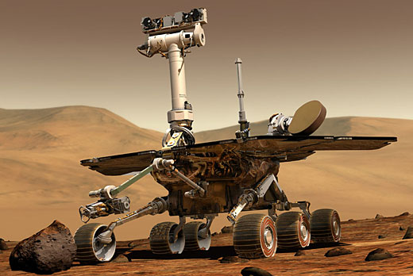
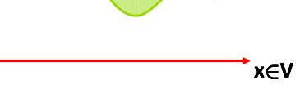
Application Examples
Nonlinear Regression in Embedded Systems
Actuator State
Control Input
Notes:
-consider an autonomous robot
-facilitate control of some actuator
-model relationship of control input with the actuator’s actual state with nonlinear regression
-learn relationship in the field during operational conditions

Slide 4
Data Streams
Can’t access data set all at once
Can’t control order of data access (random access may be available)
Charikar et al. Better streaming algorithms for clustering problems. STOC 2003
Notes:
-So what do these applications have in common?
-useful to treat these problems as data streams
-many definitions of Data Streams in the literature, but for our purposes it means
-Charikar et al
-for clustering: size can’t store in primary memory at once
-embedded system: memory size, may have to learn during operation can’t control order

Slide 5

Data Streams
elements available at iteration t
maximum wait until an element is revisited

Slide 6









Nonparametric Methods
Highly flexible, use training examples to make predictions
In streaming environment: select budget of K examples to do prediction
Notes:
\mathcal{A}\subseteq\mathcal{V}
F(\mathcal{A}) \leq F(\mathcal{B})

Slide 7






Problem Statement
active set at iteration t:
,
monotone utility function:
when
Given sequence of available elements
,
maintain active sets
where final
active set satisfies:
Notes:
\mathcal{A}_t \subseteq \mathcal{V}
\mathcal{B}_1 \cdots \mathcal{B}_T
\argmax_{\mathcal{A}_T\subseteq \mathcal{V}}F(\mathcal{A}_T) \text{ s.t. } |\mathcal{A}_T|=K

Slide 8
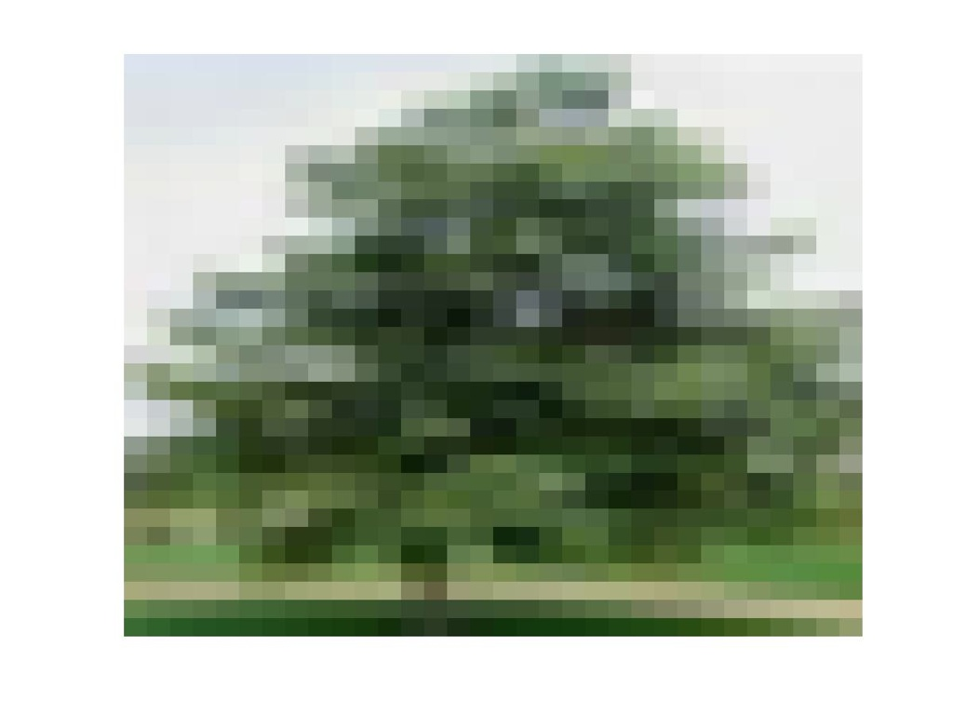






Exemplar Based Clustering
Notes:
-select examples to serve as cluster prototypes
-d is a positive dissimilarity function, no need to be metric or symmetric, very flexible
-compared to other approaches like k-means, appropriate when it’s not meaningful to talk about averages of data items in a cluster
L(\mathcal{A}) = \frac{1}{|\mathcal{V}|}\sum_{s\in \mathcal{V}} \min_{c\in \mathcal{A}} d(\mathbf{x}_s,\mathbf{x}_c)
F_C(\mathcal{A}) = L(\{\mathbf{x}_0\}) - L(\mathcal{A}\cup \{\mathbf{x}_0\})

Slide 9


Gaussian Process Regression
information gain
M. Seeger et al. Fast forward selection to speed up sparse gaussian process regression. (AISTATS 2003)
Notes:
H(\mathcal{X}_\mathcal{V})-H(\mathcal{X}_\mathcal{V}\mid\mathcal{X}_\mathcal{A})
F_{H}(\mathcal{A})=H(\mathcal{X}_\mathcal{A})

Slide 10


Gaussian Process Regression
expected variance reduction
Notes:
L(\mathcal{A})=\sum_{s\in\mathcal{V}\setminus\mathcal{A}} (\mathbf{x}_s-\mu_{s\mid\mathcal{A}})^2

Slide 11


Submodularity
FC, FV, and FH are all submodular!
“diminishing returns”
smaller change
greater change
If
and
then
Notes:
\mathcal{A}\subseteq\mathcal{B}
s\in\mathcal{V}\setminus\mathcal{B}
F(\mathcal{A}\cup\{s\})-F(\mathcal{A})\geq F(\mathcal{B}\cup\{s\})-F(\mathcal{B})

Slide 12





StreamGreedy
Repeat:
1.
2.
3.
consecutive iterations
Until
for
Notes:
(s',s)=\argmax_{s'\in\mathcal{A}_{t-1},s\in\mathcal{A}_{t-1}\cup\mathcal{B}_t} F(\mathcal{A}_{t-1}\setminus\{s'\}\cup\{s\})
\mathcal{A}_{t}\leftarrow\mathcal{A}_{t-1}\backslash s'\cup\{s\}
t\leftarrow t+1
F(\mathcal{A}_t)-F(\mathcal{A}_{t-1}) \leq \eta

Slide 13
Optimality of StreamGreedy
Clustering-consistency
FC, FV, and FH are clustering-consistent when data consists of very well-separated clusters
Preferable to select exemplar from new cluster rather than two from same cluster
Notes:
-How well does it do?
-Turns out for some situations, we can find the optimal active set.
-We introduce the notion of “cluster consistency”, can’t go into detail but:
F(\cA_t)=\max_{|\cA|\leq K} F(\cA)

Slide 14


Optimality of StreamGreedy
Theorem: If F is monotonic, submodular, and clustering-consistent then StreamGreedy finds
after at most
iterations.

Slide 15


Approximation Guarantee
Typically, data does not consist of well-separated clusters
Maximizing F is NP-hard in general
Theorem: Assume F is monotonic submodular and further assume F is bounded by constant B. Then StreamGreedy finds
after at most
iterations.
Notes:
F(\mathcal{A}_t)\geq \frac{1}{2}\max_{|\mathcal{A}|\leq k} F(\mathcal{A})-k (\varepsilon+\eta)

Slide 16

Limited Stream Access
Approximate
and
within
accuracy.
Uniform subsample approximation
“validation set”
Notes:
\mathcal{W}\subseteq \mathcal{V}
\hat{F}(\mathcal{A})=\frac{1}{|\mathcal{W}|}\sum_{s\in \mathcal{W}} f(\mathcal{A},\bf{x}_s)

Slide 17

Approximation Guarantee
May only be able to approximately evaluate F
Theorem: Assume F is monotonic submodular and may be evaluated to ε-precision. Further, assume F is bounded by constant B. Then StreamGreedy finds
after at most
iterations.
Notes:
F(\mathcal{A}_t)\geq \frac{1}{2}\max_{|\mathcal{A}|\leq K} F(\mathcal{A})-K(\varepsilon + \eta)

Slide 18

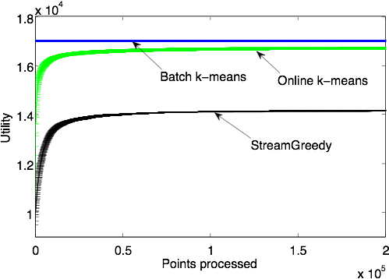
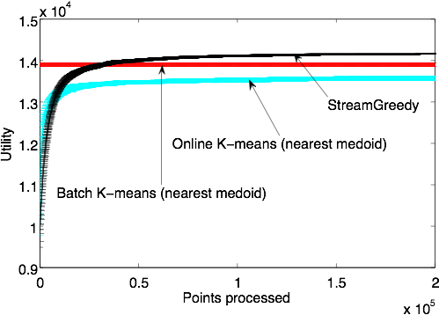
MNIST Convergence
with distance
Unconstrained centers
Example based centers
Convergence rate comparable to online k-means
Quantization performance difference due to exemplar constraint

Slide 19
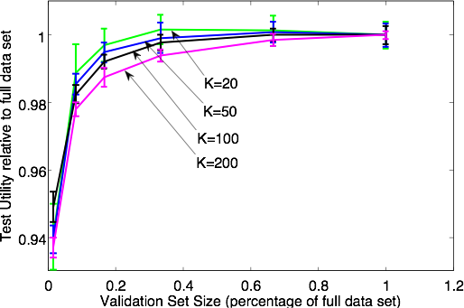
Validation Set Size
Good performance with small validation sets
Larger validation set needed for larger number of clusters K

Slide 20
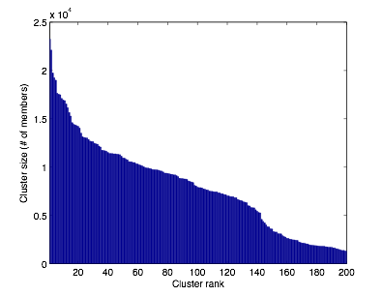
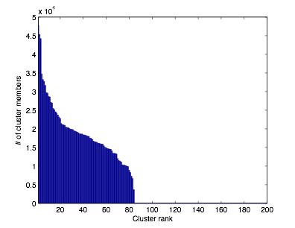
Tiny Images
> 1.5 millions 28 x 28 pixel RGB images
StreamGreedy
Online K-means
Online K-means finds many singleton or empty clusters

Slide 21
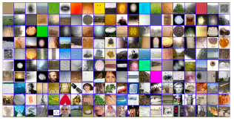

Tiny Images
StreamGreedy Exemplars
Online k-means centers

Slide 22
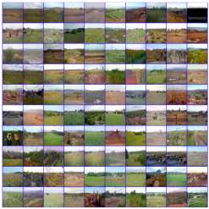
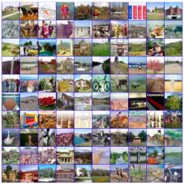
Tiny Images
Nearest to exemplar
Randomly Chosen
StreamGreedy Cluster Examples

Slide 23
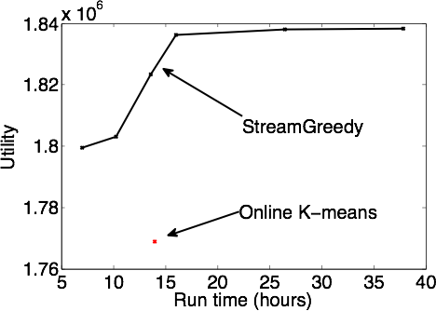


Run time vs. Accuracy
Vary and
StreamGreedy performance saturates with run time
Outperforms Online K-means in less time

Slide 24
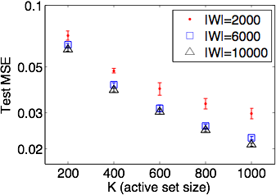
Gaussian Process Regression
Kin-40k dataset
outperforms
but requires sufficient validation set

Slide 25
Conclusions
StreamGreedy
Flexible framework
Theoretical performance guarantees:
Exemplar based clustering with non-metric similarities in streaming environment
Leads to efficient algorithms
Excellent empirical performance

