Slide 1
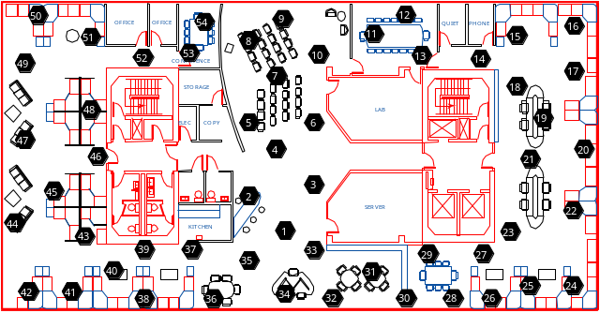
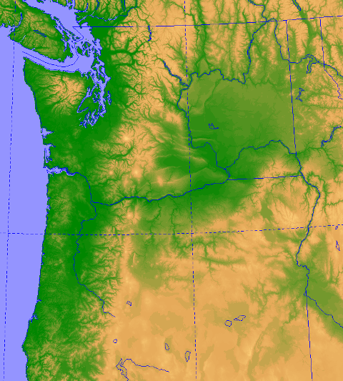
Sensor placement applications
Monitoring of spatial phenomena
  Temperature
  Precipitation
  ...
Active learning, Experiment design
Precipitation
data from
Pacific NW
Temperature data
from sensor network

Slide 2
Sensor placement
This deployment:
Evenly distributed sensors
Chicken-and-Egg problem: ☹
No data or assumptions
about distribution
What’s the
optimal placement?
Don’t know where to
place sensors

Slide 3
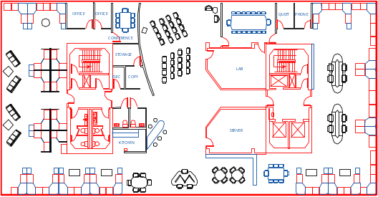
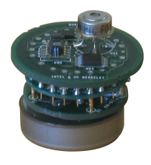
Strong assumption –
Sensing radius
Becomes a covering problem
Problem is NP-complete
But there are good algorithms with (PTAS) ε-approximation guarantees
[Hochbaum & Maass ’85]
Node predicts
values of positions
with some radius
Unfortunately, approach is usually not useful… Assumption is wrong! ☹
For example…

Slide 4
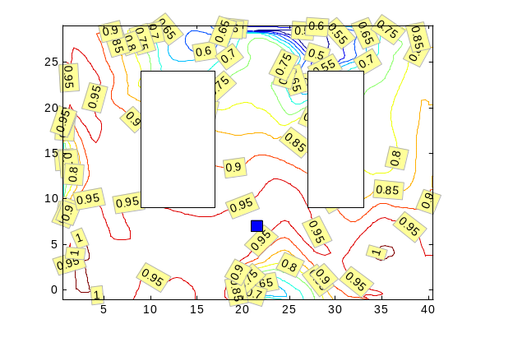
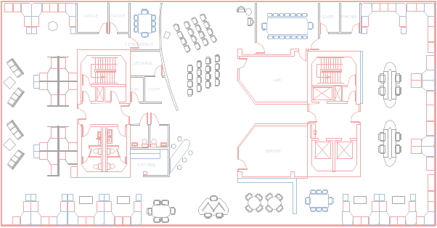
Complex, noisy correlations
Circular sensing regions?
Invalid:
Non-local, Non-circular
correlations
Complex sensing regions?
Individually, sensors are
bad predictors.
Rather: Noisy correlations!
Invalid:

Slide 5
Combining multiple sources of information
Temp
here?
Combined information is more reliable
How do we combine information?
  Focus of spatial statistics

Slide 6
How do we predict temperatures at unsensed locations?
Regression
more sure
here
How sure are we
about the prediction?
y - temperature
less sure
here
x - position
But, regression function has no notion of uncertainty!!! ☹

Slide 7
Gaussian process (GP) - Intuition
GP – Non-parametric; represents uncertainty;
complex correlation functions (kernels)
Uncertainty
after observations
are made
more sure
here
y - temperature
less sure
here
x - position

Slide 8
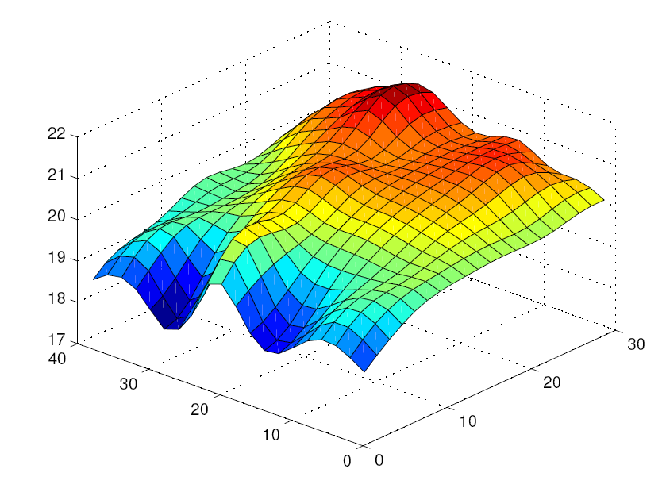
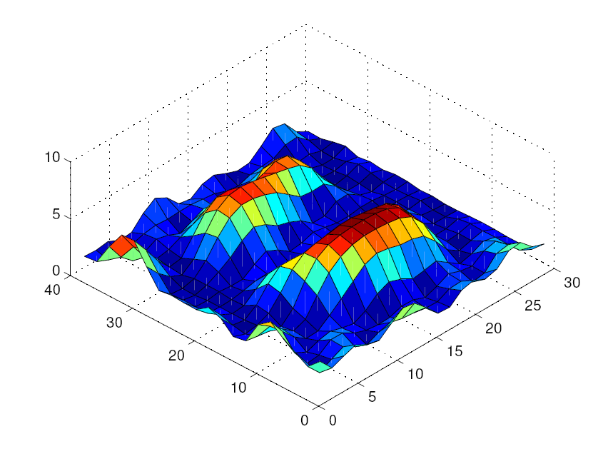
Gaussian processes for sensor placement
Posterior
mean temperature
Posterior
variance
Goal:
Find sensor placement with least uncertainty after observations
Problem is still NP-complete ☹
Need approximation

Slide 9
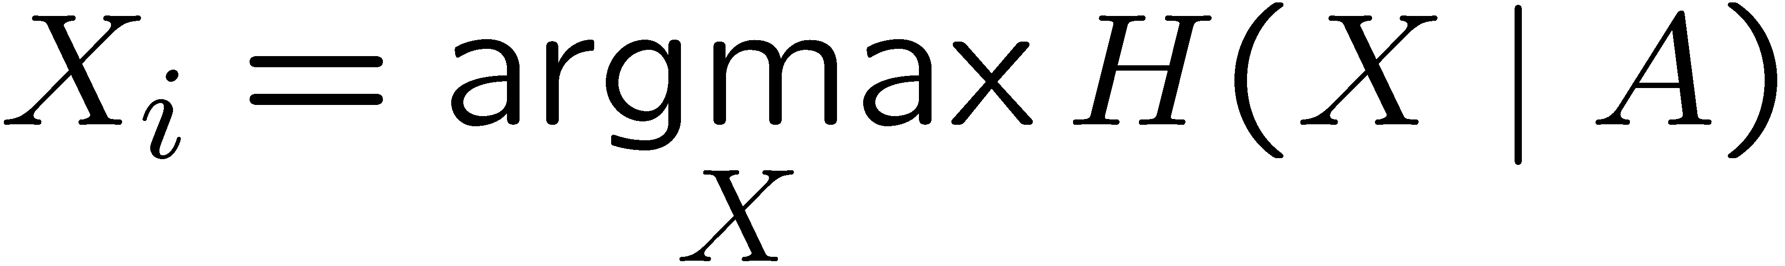
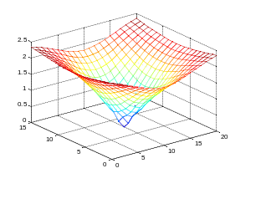
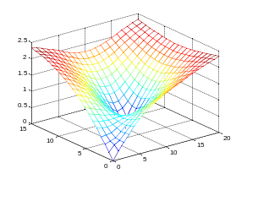
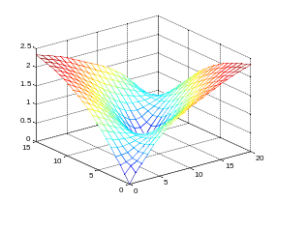
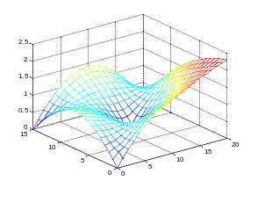
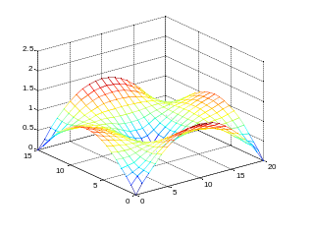
Entropy criterion (c.f., [Cressie ’91])
A Ã ;
For i = 1 to k
  Add location X_{i} to A, s.t.:
4
3
1
Entropy
High uncertainty
given current set A –
X is different
2
5
Uncertainty (entropy) plot
1
2
3
4
5

Slide 10
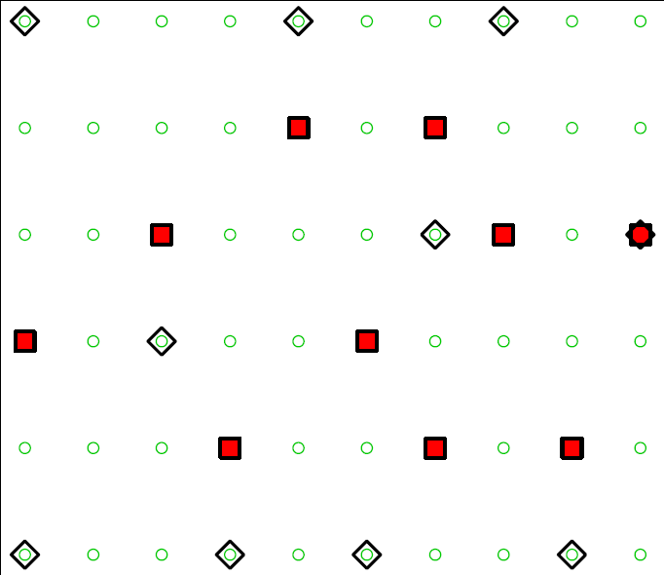
Entropy criterion (c.f., [Cressie ’91])
“Wasted”
information
Example placement
Entropy criterion wastes information,
Indirect, doesn’t consider sensing region –
No formal guarantees ☹

Slide 11
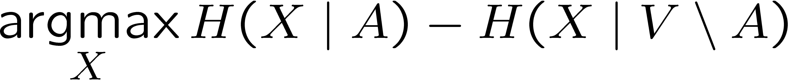
We propose:
Mutual information (MI)
Locations of interest V
Find locations AµV maximizing mutual information:
Intuitive greedy rule:
Uncertainty of
uninstrumented locations
before sensing
Uncertainty of
uninstrumented locations
after sensing
High uncertainty given A
X is different
Low uncertainty given rest
X is informative

Slide 12
Mutual information
Intuitive criterion – Locations that
are both different and informative
Temperature data
placements:
Entropy
Mutual information
Can we give guarantees about the greedy algorithm?

Slide 13
Important Observation
Intuitively, new information is worth less if we know more (diminishing returns)
Submodular set functions are a natural formalism for this idea:
f(A [ {X}) – f(A)
Greedy rule proves that MI is submodular!
B
A
{X}
¸ f(B [ {X}) – f(B) for A µ B
Decreasing Increasing with increasing A

Slide 14
How can we leverage submodularity?
Theorem [Nemhauser et al ‘78]:
The greedy algorithm guarantees (1-1/e) OPT approximation for monotone SFs!
Same guarantees hold for the budgeted case [Sviridenko / Krause, Guestrin]
Unfortunately, I(V,{}) = I({},V) = 0,
Hence MI in general is not monotonic!
Locations can have different costs
Notes:
1) animate; 2) highlight important things (1-1/e) apx, same, budgeted: flow: animation (emphasis) monotone SFs become red bold;

Slide 15
Guarantee for mutual information sensor placement
Theorem: For fine enough (polynomially small) discretization, greedy MI algorithm provides constant factor approximation. For placing k sensors and ε>0:
Result of
our algorithm
Constant
factor
Optimal
solution

Slide 16
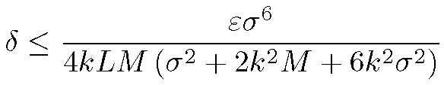
Theorem: Mutual information sensor placement
Proof sketch
  Nemhauser et al. ’78 theorem approximately holds for approximately non-decreasing submodular functions
  For smooth kernel function, prove that MI is approximately non-decreasing if A is small compared to V
  Quantify relation between A and V to guarantee that a discretization of
  suffices, where M is maximum variance per location, and σ is the measurement noise.

Slide 17
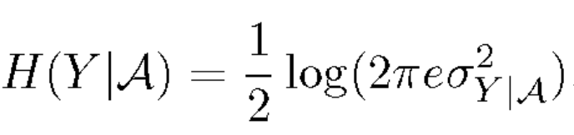
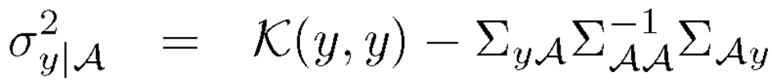
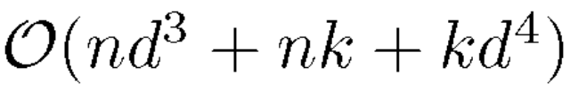
Efficient computation using local kernels
Computation of the greedy rule requires computing
where
This requires solving systems of N variables, time O(N³) with N locations to select from, total O(k N⁴)
Exploiting locality in covariance structure leads to an algorithm running in time
for a problem specific constant d.

Slide 18
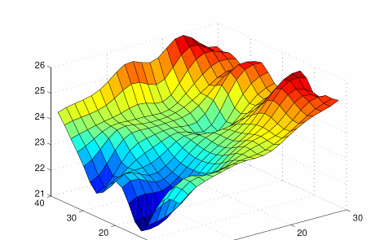
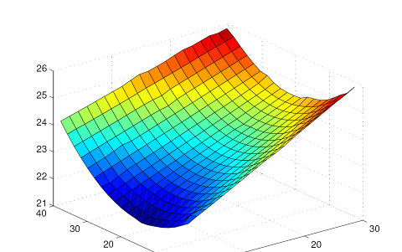
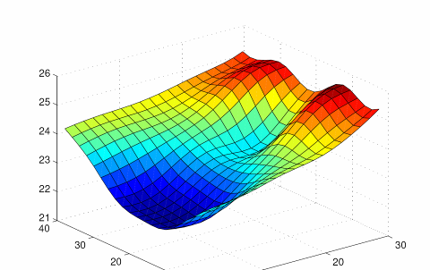
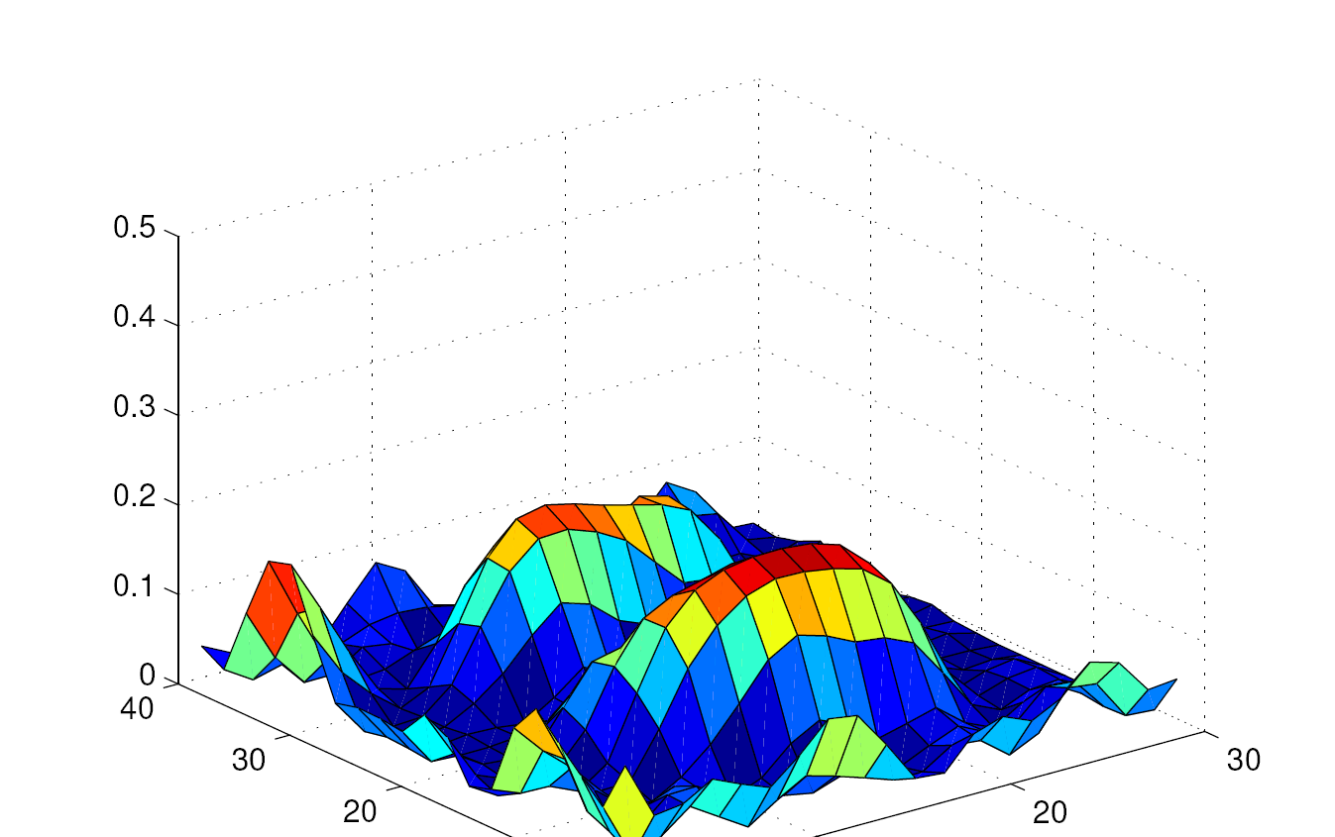
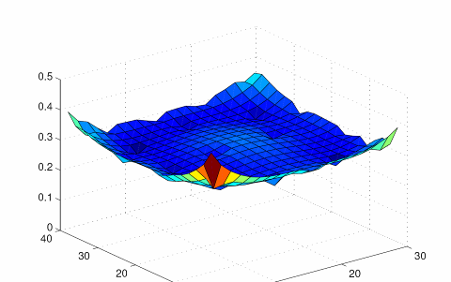
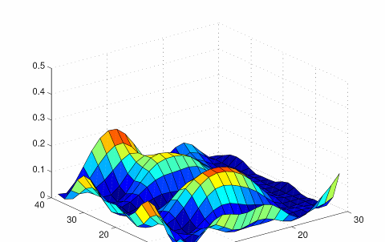
Deployment results
Used initial deployment to select 22 sensors
Learned new Gaussian process on test data using just these sensors
All sensors
Entropy selection
MI selection
Posterior
mean
Posterior
variance
Mutual information has 3 times less variance than entropy

Slide 19
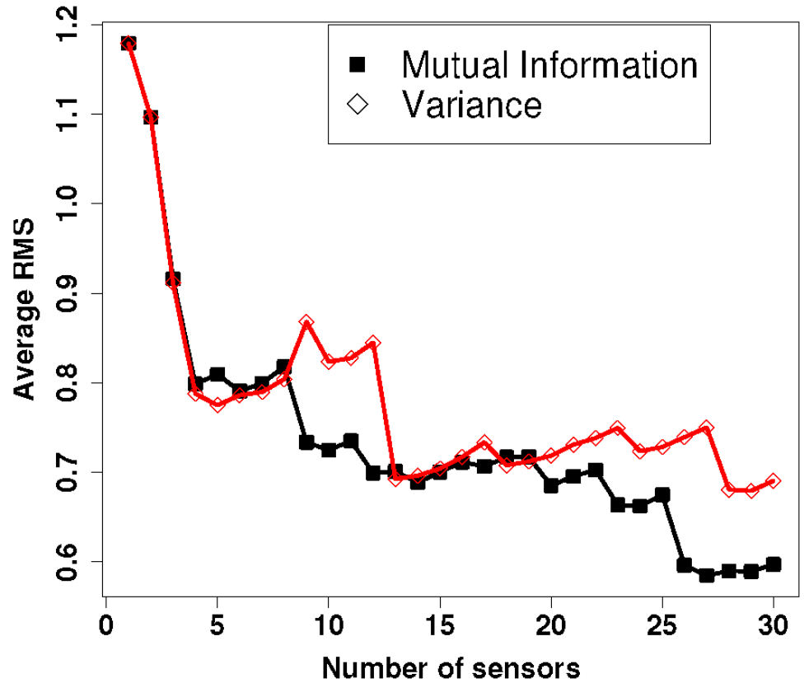
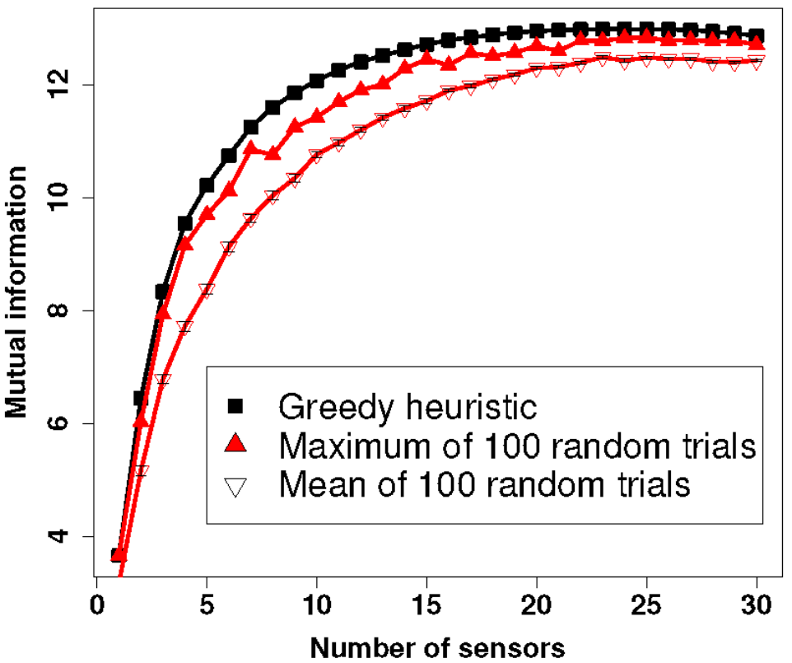
Temperature data

Slide 20
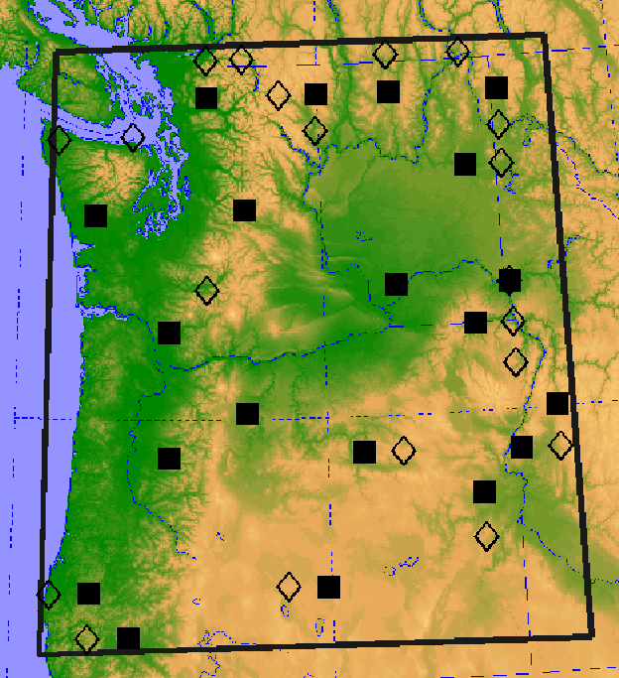
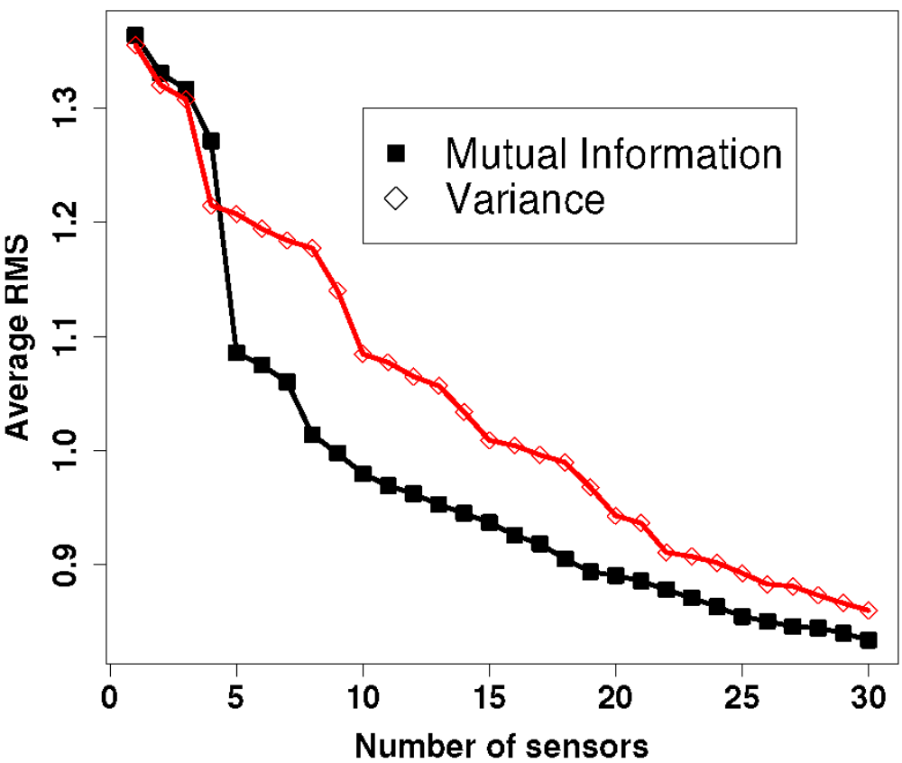
Precipitation data

Slide 21
Summary of Results
Proposed mutual information criterion for sensor placement in Gaussian processes
Exact maximization is NP-hard
Efficient algorithms for maximizing MI placements, strong approximation guarantee (1-1/e) OPT-ε
Exploitation of local structure improves efficiency
Compared to commonly used entropy criterion,
MI placements provide superior prediction accuracy for several real-world problems.

