Slide 1
Near-optimal Nonmyopic
Value of Information in
Graphical Models
Andreas Krause, Carlos Guestrin
Computer Science Department
Carnegie Mellon University
Notes:
read aloud title and coauthors

Slide 2
Applications for sensor selection
Medical domain
➔ select among potential examinations
Sensor networks
➔ observations drain power, require storage
Feature selection
➔ select most informative attributes for classification, regression etc.
...
Notes:
more informal / anecdotal; 1 sentence per bullet

Slide 3
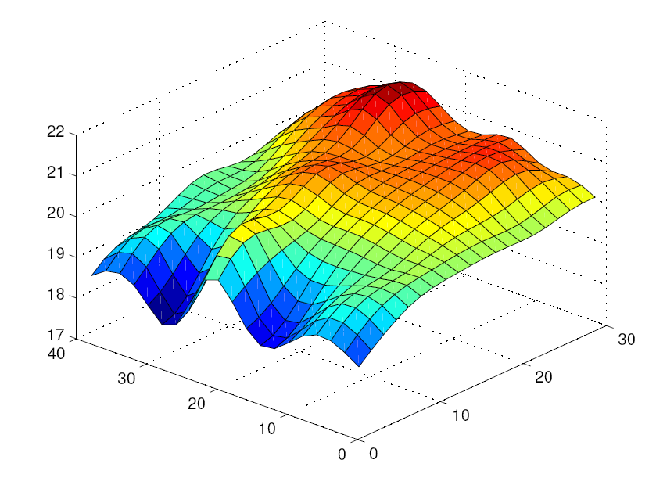
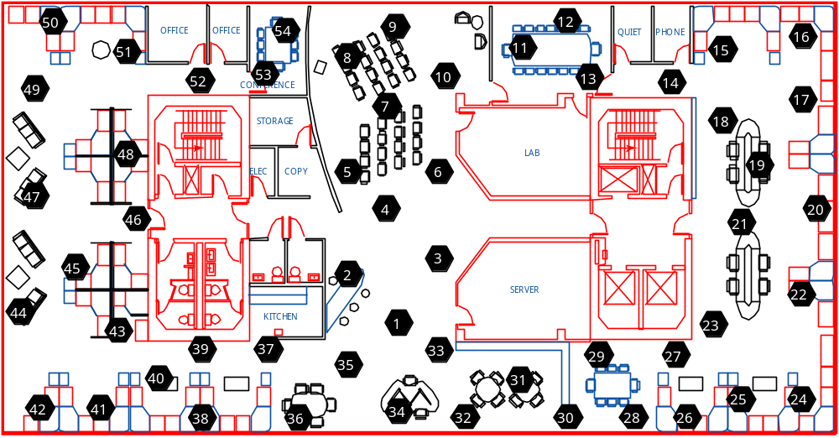
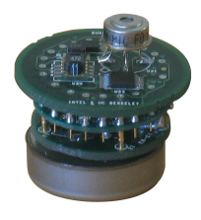
An example: Temperature prediction
Estimating temperature in a building
Wireless sensors with limited battery

Slide 4
Probabilistic model
Hidden variables
of interest U
C N H
T₂
C N H
T₁
C N H
What does
“become most certain”
mean?
Values:
(C)old,
(N)ormal,
(H)ot
T₃
S₂
S₁
S₃
C N H
T₅
C N H
T₄
Observable
variables O
S₅
S₄
Task: Select subset of observations
to become most certain about U
Notes:
introduce U and O; define selection task in terms of U and O; introduce distributions
explain bars; read aloud reward numbers; relate them to each other
animate: observe, different sensors; show colors for posterior mean, draw Gaussian on T4; show notation in slides

Slide 5
Making observations
C N H
T₂
C N H
C N H
T₂
C N H
T₁
T₁
C N H
C N H
T₃
S₂
S₁
S1=hot
S₃
C N H
observed
C N H
T₅
C N H
C N H
T₄
S₅
S₄
Reward = 0.2
Notes:
introduce U and O; define selection task in terms of U and O; introduce distributions
explain bars; read aloud reward numbers; relate them to each other
animate: observe, different sensors; show colors for posterior mean, draw Gaussian on T4; show notation in slides

Slide 6
Making observations
C N H
T₂
C N H
T₂
T₁
C N H
T₃
T₃
S₂
S₁
S3=hot
S₃
C N H
T₅
C N H
T₄
observed
T₄
S₅
S₄
Reward = 0.4
Notes:
animate: observe, different sensors; show colors for posterior mean, draw Gaussian on T4; show notation in slides

Slide 7
A different outcome...
C N H
T₂
C N H
T₂
Need to compute
expected reduction of uncertainty for any sensor selection!
T₁
C N H
T₃
T₃
S₂
S₁
S3=cold
C N H
T₅
C N H
How should uncertainty be defined?
T₄
observed
S₅
S₄
Reward = 0.1
Notes:
after slide: Show Box: What’s uncertainty?

Slide 8
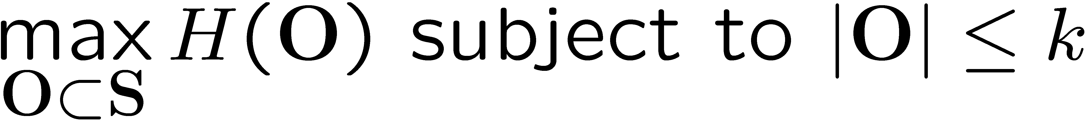
Selection criteria: Entropy
[Cressie ’91]
Consider myopically selecting
This can be seen as an attempt to nonmyopically maximize
Effect: Selects sensors which are most uncertain about each other
H(O₁)
+ H(O₂ | {O₁})
+ ... + H(O_{k} | {O₁ ... O_{k-1}})
most uncertain
most uncertain
given O₁
most uncertain
given O₁ ... O_{k-1}
This is exactly the joint entropy
H(O) = H({O₁ ... O_{k}})
Notes:
talk intuitively about summation rule of entropy (terms appear individually); -> greedy approach special case of general problem of max. joint entropy

Slide 9
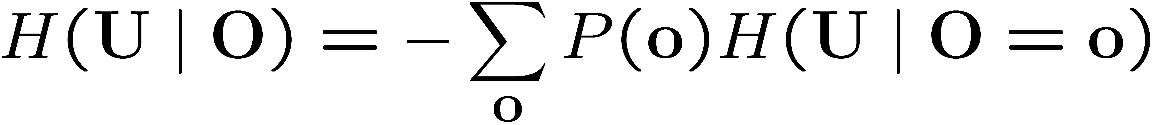
Selection criteria: Information Gain
Nonmyopically select sensors O ½ S to maximize
Effect: Selects sensors which most effectively reduce uncertainty about variables of interest
Prior
uncertainty
about U
Expected
posterior
uncertainty
about U

Slide 10
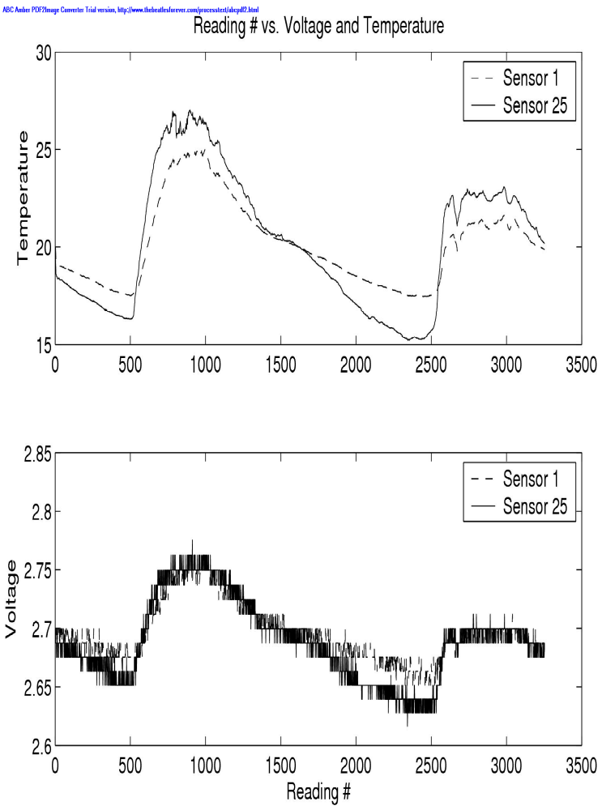
Observations can have different cost
T₂
Each variable S_{i} has cost c(S_{i})
Sensor | Energy / sample (mJ)
Humidity and Temperature | 0.5
Voltage | 0.00009
T₁
$$
T₃
S₁
S₂
$$$
S₃
$$
T₅
$
T₄
Sensor networks:
Power consumption
S₅
S₄
$
Medical domain:
Cost of Examinations
$
Feature selection:
Computational complexity
Notes:
without mountain example; move rightmost $; Instead of “Remaining power” -> “Power consumption”; have table come up; show other domains
drop solar radiation and bar. pressure

Slide 11
Inference in graphical models
Inference P(X = x | O = o) needed to compute entropy or information gain
Efficient inference possible for many graphical models:
X₁
X₄
X₁
X₃
X₅
X₁
X₂
X₃
X₃
X₂
X₅
X₂
X₄
X₆
What about nonmyopically optimizing
sensor selections?

Slide 12
Results for optimal nonmyopic algorithms
(presented at IJCAI ‘05)
Efficiently and optimally solvable for chains!
If we cannot solve exactly, can we approximate?
X₁
X₂
X₃
but
Even on discrete polytree graphical models, subset selection is NP^{PP}-complete!
X₁
X₄
X₃
X₂
X₅
Notes:
If you are one of the people who went to our IJCAI talk next week, you saw that we came up with …; pause, explain, mention inference again

Slide 13
An important observation
Observing S₁ tells sth.
about T₁, T₂ and T₅
Observing S₃ tells sth.
about T₃, T₂ and T₄
T₂
In many cases, new information is worth less if we know more (diminishing returns)!
T₁
T₃
S₂
S₁
S₃
T₅
T₄
S₅
S₄
Now adding S₂ would not help much.
Notes:
introduce U and O; define selection task in terms of U and O; introduce distributions
explain bars; read aloud reward numbers; relate them to each other
animate: observe, different sensors; show colors for posterior mean, draw Gaussian on T4; show notation in slides

Slide 14
Submodular set functions
Submodular set functions are a natural formalism for this idea:
f(A [ {X}) – f(A)
Maximization of SFs is NP-hard ☹
Let’s look at a heuristic!
¸ f(B [ {X}) – f(B) for A µ B
B
A
{X}
Notes:
introduce idea pictorially (intersecting circles…). Let’s look at a heuristics (say)

Slide 15
The greedy algorithm
Gain by adding
new element
S₁
S₂
S₃
S₄
S₅
0.3
0.2
0.5
T₂
0.4
0.3
T₁
T₃
0.2
0.2
S₂
S₂
0.1
0.1
S₁
S₁
S₃
S₃
T₅
R = 0.5
R = 0.3
R = 0.2
T₄
R = 0.3
R = 0.4
S₅
S₄
R = 0.2
R = 0.1
Notes:
explain table (gain) on slide

Slide 16
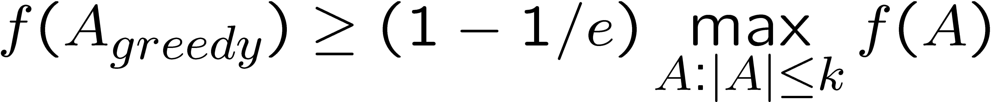
How can we leverage submodularity?
Theorem [Nemhauser et al]:
The greedy algorithm guarantees (1-1/e) OPT approximation for monotone SFs, i.e.
Same guarantees hold for the budgeted case: [Sviridenko / Krause, Guestrin]
  Here, OPT = max {f(A): ∑_{X2 A} c(X) · B}
~ 63%
Notes:
explain approximation explicitly; say 1-1/e ~63%
no caveat
define budgeted case

Slide 17
How can we leverage submodularity?
Theorem [Nemhauser et al]:
The greedy algorithm guarantees (1-1/e) OPT approximation for monotone SFs, i.e.
Same guarantees hold for the budgeted case: [Sviridenko / Krause, Guestrin]
  Here, OPT = max {f(A): ∑_{X2 A} c(X) · B}
~ 63%
Notes:
explain approximation explicitly; say 1-1/e ~63%
no caveat
define budgeted case

Slide 18
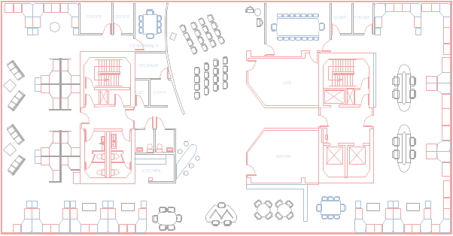
Are our objective functions submodular and monotonic?
(Discrete) Entropy is! [Fujishige ‘78]
However, entropy can waste information:
H(O₁)
+ H(O₂ | {O₁})
+ ... + H(O_{k} | {O₁ ... O_{k-1}})
“Wasted”
information
Notes:
show greedy rule

Slide 19
Information Gain in general is not submodular
A, B ~ Bernoulli(0.5)
C = A XOR B
C | A and C | B ~ Bernoulli(0.5) (entropy 1)
C | A,B is deterministic! (entropy 0)
Hence IG(C;{A,B}) – IG(C;{A}) = 1, but
IG(C;{B}) – IG(C;{}) = 0
A
B
Hence we cannot get the (1-1/e) approximation guarantee!
C
Or can we?
Notes:
is not submodular
make box: if IG not submod, we cannot use approx. result. Or can we?

Slide 20
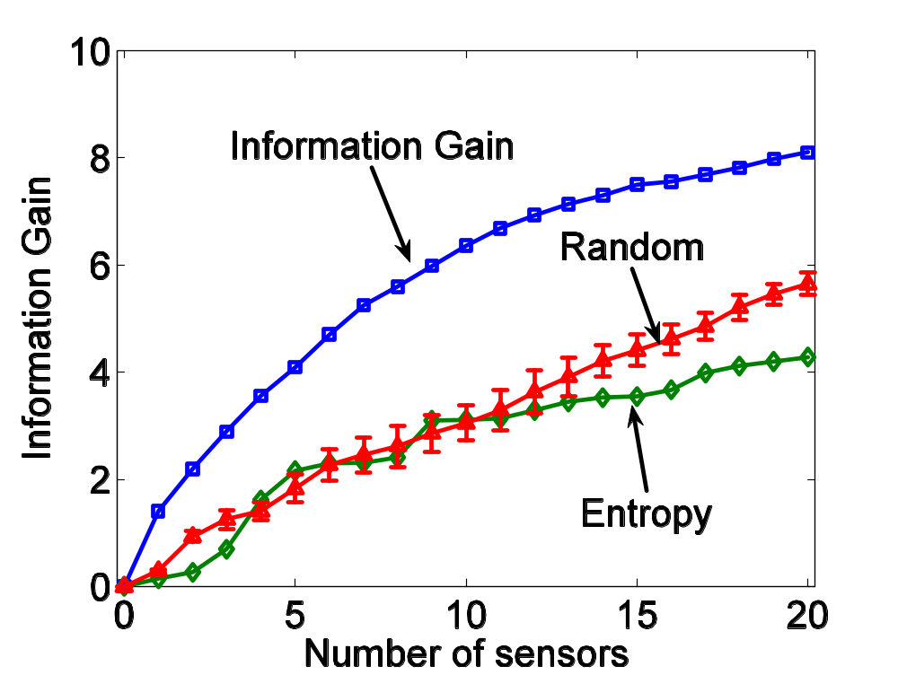
Conflict between maximizing
Entropy and Information Gain
Can we optimize
information gain directly?
Results on
temperature data
from real sensor
network

Slide 21
Submodularity of information gain
Theorem: Under certain
conditional independence assumptions,
information gain is submodular and nondecreasing!

Slide 22
Example with fulfilled conditions
Feature selection in Naive Bayes models
Fundamentally relevant for many classification tasks
T
S₁
S₂
S₃
S₄
S₅
Notes:
text about example: ftr. sel. in Naïve Bayes model. Why relevant?

Slide 23
Example with fulfilled conditions
T₂
General sensor selection problem
Noisy sensors which are conditionally independent given the hidden variables
True for many practical problems
T₁
T₃
S₁
S₂
S₃
T₅
T₄
S₅
S₄
Notes:
General sensor selection problem:
sensors which are cond. ind. given hidden variables. True for most medical applications, sensor deployments etc.

Slide 24
Example with fulfilled conditions
T₂
Sometimes the hidden variables can also be queried directly (at potentially higher cost)
We also address this case!
T₁
T₃
S₁
S₂
S₃
T₅
T₄
S₅
S₄
Notes:
General sensor selection problem:
sensors which are cond. ind. given hidden variables. True for most medical applications, sensor deployments etc.

Slide 25
Algorithms and Complexity
Unit-cost case: Greedy algorithm
  Complexity: O( k n )
Budgeted case: Partial enumeration + greedy
  Complexity: O( n⁵ )
  For guarantee of ½ (1-1/e) OPT: O( n² ) possible!
Complexity measured in evaluations of
greedy rule
Caveat:
Often, evaluating the greedy rule
is itself a hard problem!
k: number of selected sensors
n: number of sensors to select from
Notes:
move Caveat at end of slide; define k, n

Slide 26
Greedy rule
Xk+1 = arg max H(X | A_{k}) – H(X | U)
    X 2 S n A_{k}
How to compute conditional entropies?
Prefers
sensors
which are
different
Prefers
sensors
which are
relevant to U
Notes:
spell out IG; give example why conditional entropy is hard => 2 slides (hardness, sampling); say what’s sampled from what

Slide 27
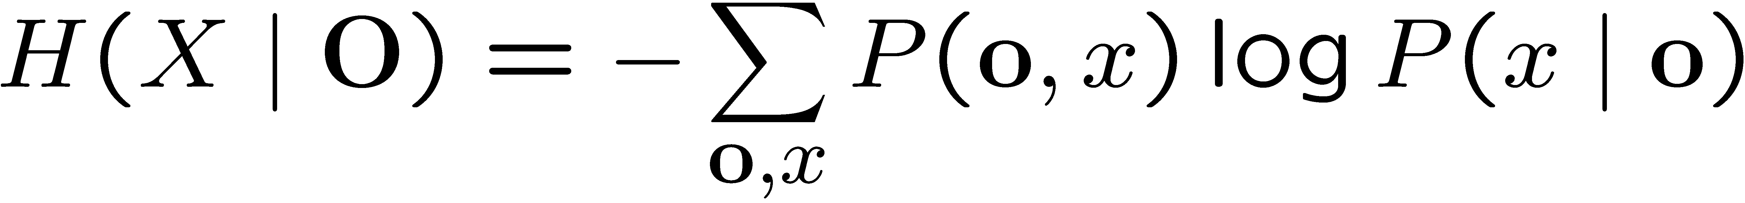
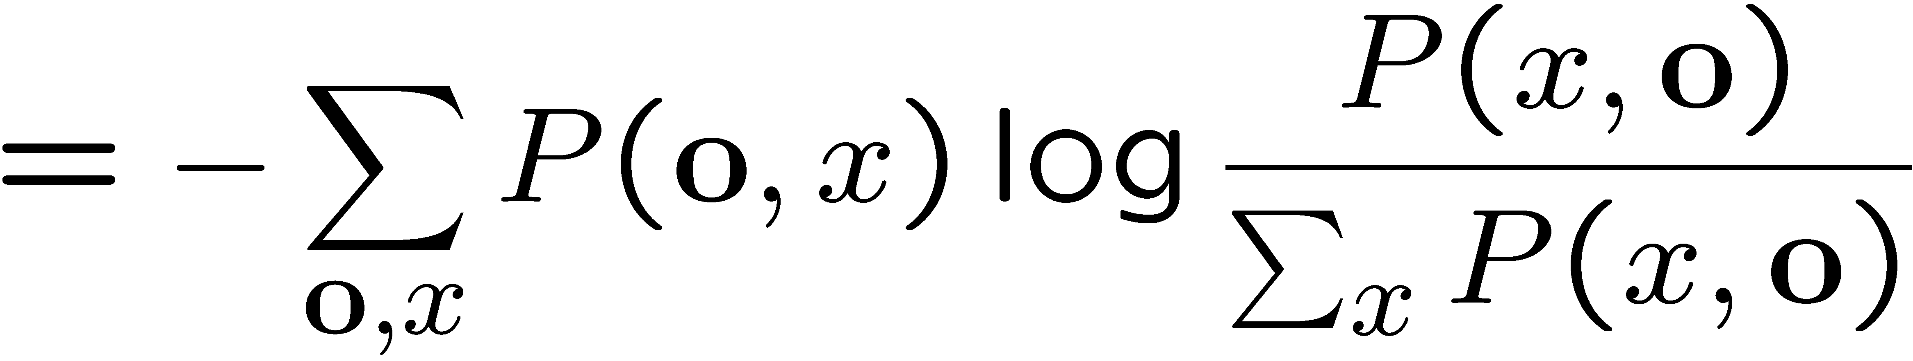
Hardness of computing conditional entropies
Entropy decomposes along graphical model ☺
Conditional entropies do not decompose along graphical model structure ☹
does not decompose!
Notes:
show intuition using naïve bayes (summing out connects all nodes)

Slide 28
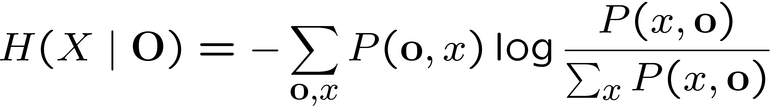
Hardness of computing conditional entropies
Entropy decomposes along graphical model ☺
Conditional entropies do not decompose along graphical model structure ☹
S₁
S₁
S₂
T
S₂
S₄
Summing out T
makes all variables
dependent
S₄
S₃
S₃
Notes:
show intuition using naïve bayes (summing out connects all nodes)

Slide 29
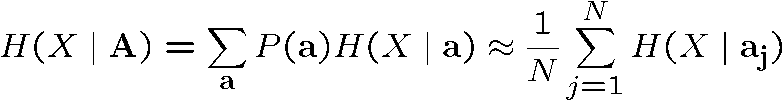
But how to compute the information gain?
Randomized approximation by sampling:
a_{j} is sampled from the graphical model
H(X | a_{j}) is computed using exact inference for particular instantiations a_{j}
Notes:
compute particular instantiations

Slide 30

How many samples are needed?
H(X | A) can be approximated with
absolute error ε and confidence 1-δ using
samples (using Hoeffding’s inequality).
Empirically, many fewer samples suffice!

Slide 31
Theoretical Guarantee
Theorem: For any graphical model (satisfied conditional independence, efficient inference), one can nonmyopically select a subset of variables O s.t.
IG(O;U) ¸ (1-1/e) OPT – ε
with confidence 1-δ, using a number of samples polynomial in
1/ε, log 1/δ, log |dom(X)| and |V|
1-1/e is only ~ 63%...
Can we do better?
Notes:
1-1/e is only ~63%...

Slide 32
Hardness of Approximation
Theorem: If maximization of information gain can be approximated by a constant factor better than 1-1/e, then P = NP
Proof by reduction from MAX-COVER
How to interpret our results?
  Positive: We give a 1-1/e approximation
  Negative: No efficient algorithm can provide
  better guarantees
  Positive: Our result provides a baseline for any algorithm maximizing information gain
Notes:
paper gives positive and negative result (we give 63%; nobody gives more than 63%)
another positive result: baseline for other

Slide 33
Baseline
In general, no algorithm will be able to provide better results than the greedy method unless P = NP
But, in special cases, we may get lucky
Assume, algorithm TUAFMIG gives results which are 10% better than the results obtained from the greedy algorithm
Then we immediately know, TUAFMIG is within 70% of optimum!

Slide 34
Evaluation
Two real world data sets
  Temperature data from sensor network deployment
  Traffic data from California Bay area
Notes:
show separate slide per data set (high level details)

Slide 35
Temperature prediction
52 Sensor network deployed
at a research lab
Predict mean temperature
in building areas
Training data 5 days, testing 2 days

Slide 36
Temperature monitoring
Notes:
build up slide, define task in text

Slide 37
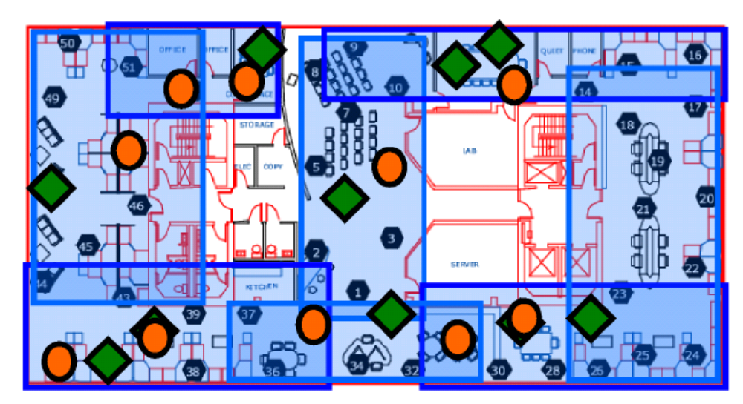
Temperature monitoring
Entropy
Information gain
Notes:
what;s the circle what’s the diamond
build up slide, define task in text

Slide 38
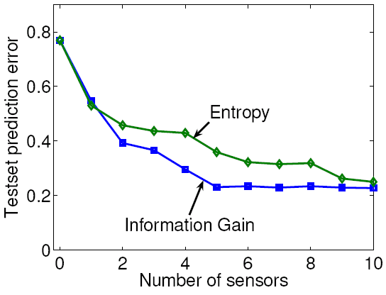
Temperature monitoring
Information gain provides significantly higher prediction accuracy
Notes:
other graphs; sampling, pairwise exchange (baseline)

Slide 39
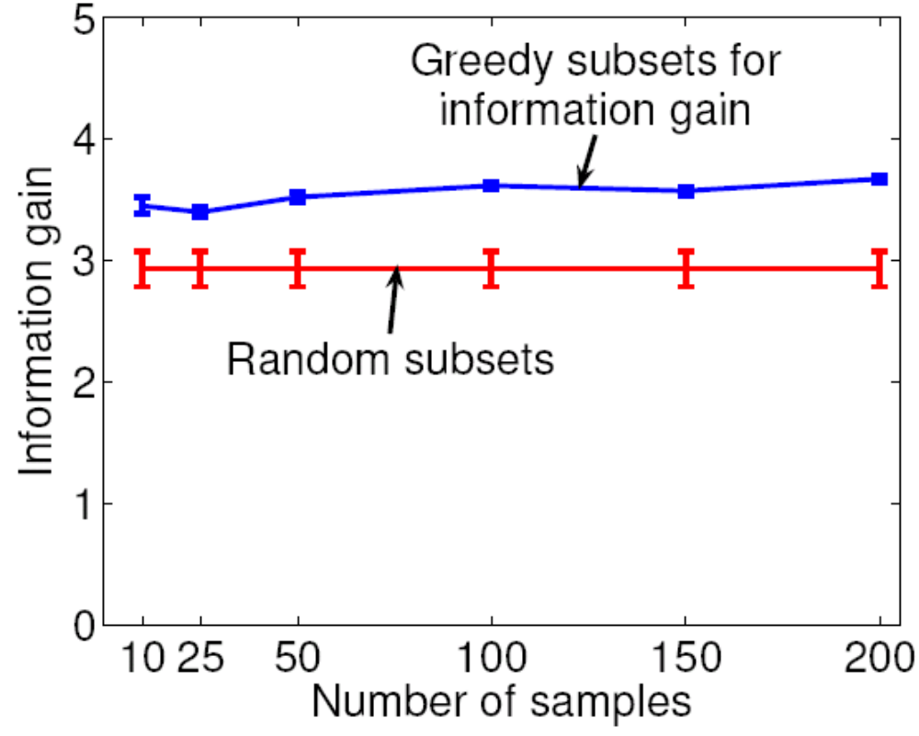
Do fewer samples suffice?
Sample size bounds are very loose;
Quality of selection quite constant
Notes:
shorter; quality of placement doesn’t change much, random baseline.

Slide 40
Traffic monitoring
77 Detector stations
at Bay Area highways
Predict minimum speed
in different areas
Training data 18 days,
testing data 2 days
Notes:
show separate slide per data set (high level details)

Slide 41
Hierarchical model
Zones represent highway segments

Slide 42
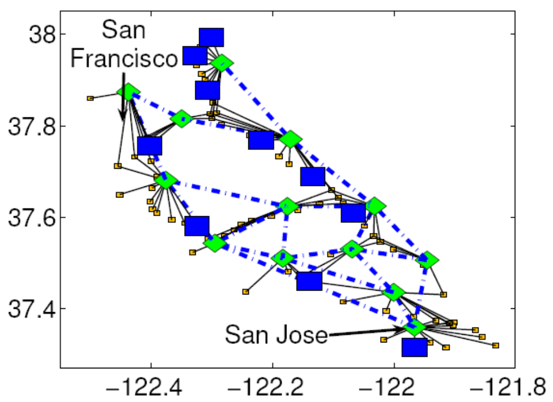
Traffic monitoring: Entropy
Entropy selects most variable nodes

Slide 43
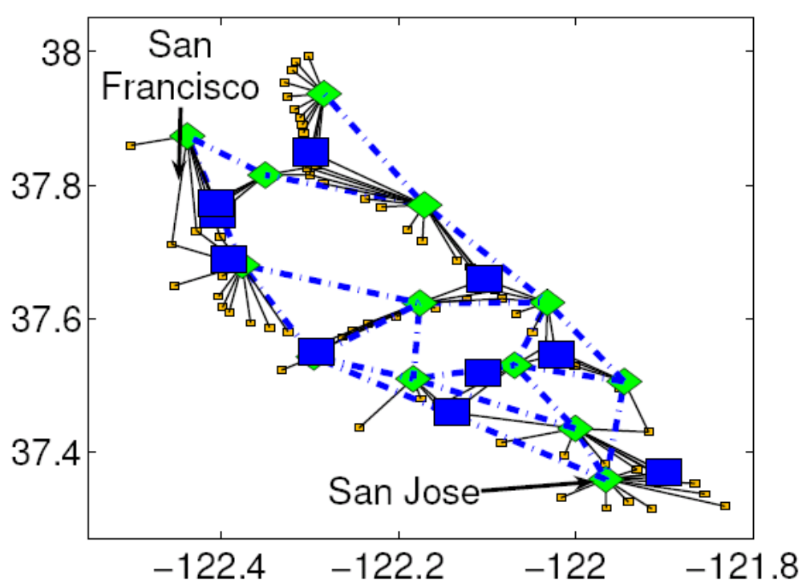
Traffic monitoring: Information Gain
Information gain selects nodes relevant to aggregate nodes
Notes:
build up slide

Slide 44
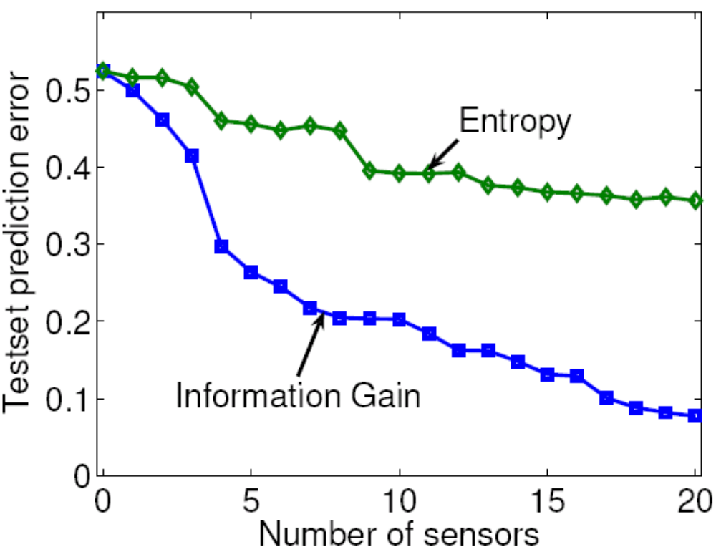
Traffic monitoring: Prediction
Information gain provides significantly higher prediction accuracy
Notes:
add summary bullet to all plots

Slide 45
Summary of Results
Efficient randomized algorithms for information gain with strong approximation guarantee
(1-1/e) OPT for large class of graphical models
This is (more or less) the best possible guarantee unless P = NP
Methods lead to improved prediction accuracy

