Slide 1
Optimal Nonmyopic Value of Information in Graphical Models
Efficient Algorithms and
Theoretical Limits
Andreas Krause, Carlos Guestrin
Computer Science Department
Carnegie Mellon University
Notes:
transition to next slide while making problem more specific (IN GENERAL: GIVE TIME TO READ)

Slide 2
Related applications
Medical expert systems
➔ select among potential examinations
Sensor scheduling
➔ observations drain power, require storage
Active learning, experimental design
...

Slide 3
Part-of-Speech Tagging
reward: 0.9
reward: 0.3
reward: 0.8
Values:
(S)ubject,
(P)redicate,
(O)bject
observe
observe
Classification must respect sentence structure
S P O
S P O
S P O
S P O
S P O
S P O
S P O
S P O
S P O
S P O
S P O
S P O
S P O
S P O
S P O
S P O
S P O
S P O
S P O
S P O
Ask expert k most informative questions
Need to compute
expected reward for any selection!
Y₁
Y₂=P
Y₂=O
Y₂
Y₃=P
Y₃
Y₄
Y₅
Our probabilistic model provides
certain a priori classification accuracy.
What does “most informative” mean?
Classify each word to belong to
subject, predicate, object
Which reward function should we use?
What if we could ask an expert?
X₁
X₂
X₃
X₄
X₅
Andreas
is
giving
a
talk
Notes:
lines crossing – add white background
change color
drop clip art
what are you observing
don’t make values: disappear
introduce expert slowly
k-best questions to ask expert

Slide 4
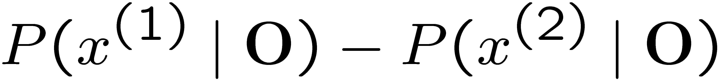
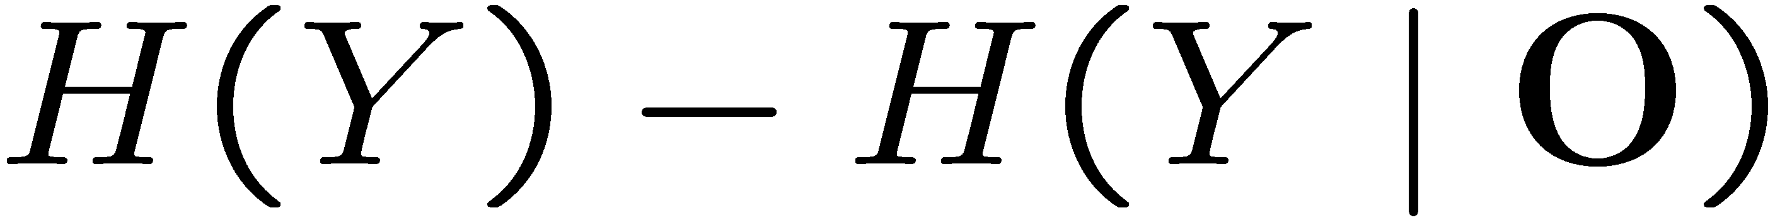
Reward functions
Depend on probability distributions:
  E[ R(X | O) ] := ∑_{o} P(o) R( P(X | O = o) )
In classification / prediction setting,
rewards measure reduction of uncertainty
  Margin to runner-up:
    ➔ confidence in most likely assignment
  Information gain:
  ➔ uncertainty about hidden variables
In decision theoretic setting, reward measures the value of information
Notes:
say R(X|O)=...
introuduce expectation
notationreward function
depends on prob dist
confidence in classification:
uncertainty about hidden vars:

Slide 5
Reward functions:
Value of Information (VOI)
Medical decision making: Utility depends on actual condition and chosen action
Actual condition unknown! Only know P(ill | O=o)
EU(a | O=o) = P(ill | O=o) U(ill, a)
+ P(healthy | O=o) U(healthy, a)
VOI = expected maximum expected utility
Conditions
 | healthy | ill
Treatment | -$$ | $
No treatment | 0 | -$$$
Actions
The more we know,
the more effectively we can act
Notes:
sometimes you have periods at the end of sentences and sometimes you don’t.... perhaps you can be consistent
what are actions/rv
r(o)=voi(o)

Slide 6
Local reward functions
Often, we want to evaluate rewards on multiple variables
Natural way of generalizing rewards to this setting:
  E[ R(X | O) ] := ∑_{i} E[ R(X_{i} | O) ]
Useful representation for many practical problems
Not fundamentally necessary in our approach
For any particular observation,
local reward functions can be efficiently evaluated using probabilistic inference!
Notes:
E_O ???

Slide 7
Costs and budgets
Each variable X can have a different cost c(X)
Instead of only allowing k questions, we specify integer budget B which we can spend
Examples:
  Medical domain: Cost of examinations
  Sensor networks: Power consumption
  Part-of-speech tagging: Fee for asking expert

Slide 8
The subset selection problem
Consider myopically selecting
This can be seen as an attempt to nonmyopically maximize
Selected subset O is specified in advance (open loop)
E[R({O₁})]
, E[R({O₂, O₁})]
, ... , E[R({O_{k},O_{k-1} ... O₁})]
Often, we can acquire information
based on earlier observations.
What about this closed loop setting?
most
informative
singleton
most informative
(greedy)
improvement
greedy selection
= ∑_{X2O} c(X)
total cost of observing
budget

Slide 9
The conditional plan problem
Now assume we observe a different outcome
Assume, most informative query would be Y₂
This outcome is consistent with our beliefs,
so we can e.g. stop querying.
This outcome is inconsistent with our beliefs,
so we better explore further by querying Y₁
Y₁
Y₂=P
Y₂=S
Y₂
Y₃
Y₄
Y₅
Values:
(S)ubject,
(P)redicate,
(O)bject
X₁
X₂
X₃
X₄
X₅
Andreas
is
giving
a
talk
Notes:
change color
drop clip art
what are you observing
don’t make values: disappear
introduce expert slowly
k-best questions to ask expert

Slide 10
The conditional plan problem
Conditional plan selects different subset π(s) for all outcomes S = s
Find conditional plan π nonmyopically maximizing
Y₂ = ?
S
O
P
Nonmyopic planning implies that we construct the entire (exponentially large) plan in advance!
Not clear if even compactly representable!
Y₁ = ?
stop
Y₄ = ?
S
O
S
O
P
P
Y₃ = ?
Y₃ = ?
Y₄ = ?
Y₅ = ?
Y₃ = ?
Y₅ = ?

Slide 11
A nonmyopic analysis
Problems intuitively seem hard
Most previous approaches are myopic
  Greedily select next best observation
In this paper, we present
the first optimal nonmyopic algorithms for a non-trivial class of graphical models
complexity theoretic hardness results

Slide 12
Inference in graphical models
Inference P(X_{i} = x | O = o) needed to compute local reward functions
Efficient inference possible for many graphical models:
X₁
X₄
X₁
X₃
X₅
X₁
X₂
X₃
X₃
X₂
X₅
X₂
X₄
X₆
What about optimizing value of information?

Slide 13
Chain graphical models
X₁
X₂
X₃
X₄
X₅
flow of information
flow of information
Filtering: Only use past observations
  Sensor scheduling, ...
Smoothing: Use all observations
  Structured classification, ...
Contains conditional chains
  HMMs, chain CRFs
Notes:
picture of undirected model

Slide 14
Key insight
Making observation
Reward functions
decompose along chain!
X₁
X₂
X₃
X₃
X₄
X₅
X₆
Reward(1:3)
Reward(3:6)
Expected Reward for subchain 1:3 when
observing X₁ and X₃
Expected Reward for subchain 3:6 when
observing X₃ and X₆
Reward(1:6) = Reward(1:3) + Reward(3:6) + const(3)
Expected Reward for subchain 1:6 when
observing X₁ , X₃ and X₆
Notes:
add dot dot dot to the left and right

Slide 15
Dynamic programming
Base case: 0 observations left
Compute expected reward for all sub-chains without making observations
Inductive case: k observations left
Find optimal observation (= split), optimally allocate budget (depending on observation)
Notes:
base case -0 obs
inductive – k obs

Slide 16
Base case
Beginning of sub-chain
 | 1 | 2 | 3 | 4 | 5 | 6
2
3
4
5
6
0.8
1.7
0.7
End of sub-chain
2.4
1.8
3.0
2.4
2.9
3.0
X₁
X₁
X₁
X₁
X₁
X₁
X₁
X₂
X₂
X₂
X₂
X₂
X₂
X₂
X₂
X₂
X₃
X₃
X₃
X₃
X₃
X₃
X₃
X₃
X₃
X₄
X₄
X₄
X₄
X₄
X₄
X₄
X₄
X₅
X₅
X₅
X₅
X₅
X₅
X₅
X₆
X₆
X₆
X₆
X₆
Reward(1:2)
Reward(1:3)
Reward(1:4)
Reward(2:3)
Reward(1:5)
Reward(2:4)
Reward(1:6)
Reward(2:5)
Reward(2:6)

Slide 17
Inductive case
Compute expected reward for subchain a:b, making k observations, using expected rewards for all subchains with at most k-1 observations
Can compute value of any split by optimally allocating budgets, referring to base and earlier inductive cases.
For subset selection / filtering,
speedups are possible.
E.g., compute value for spending first of three observations at X₃; have 2 observations left
X₁
X₂
X₃
X₄
X₅
X₆
1
spend obs. here
0
1
2
1
spend obs. here
0
Reward =
1.0 + 3.0 = 4.0
2.0 + 2.5 = 4.5
2.0 + 2.6 = 4.6
computed using base case and inductive case for 1,2 obs.
Notes:
give intuition with 1-2-3-4-5-6 chain, select 3 and spolit k-1 between each
first howe to compute
then max
relate to base case by say subchain 1-2-3 with 0 obs was base case
perhaps a note about speeding things up with subset selection and with filtering versus smoothing???

Slide 18
Inductive case (continued)
Compute expected reward for subchain a:b, making k observations, using expected rewards for all subchains with at most k-1 observations
Value of information for split at 3: 3.9, best: 3.9
Value of information for split at 2: 3.7, best: 3.7
Value of information for split at 4: 3.8, best: 3.9
Value of information for split at 5: 3.3, best: 3.9
current best
current best
current best
current best
Tracing back the maximal values allows to recover the optimal subset or conditional plan!
Beginning of sub-chain
X₁
X₂
X₃
X₄
X₅
X₆
X₁
X₂
X₃
X₄
X₅
X₆
X₁
X₁
X₂
X₂
X₃
X₃
X₄
X₄
X₅
X₅
X₆
 | 1 | 2 | 3 | 4 | 5 | 6
2 | 0.8
3 | 2.1
4 | 2.8
5 | 3.4
6
X₆
Here we don’t need
to allocate budget
Now we need to
optimally allocate
our budget!
Reward(1:3)
Reward(1:2)
Reward (1:4)
Reward(1:5)
Reward(3:6)
Reward(2:6)
Reward(4:6)
End of sub-chain
Reward(5:6)
Tables represent solution in
polynomial space!
Reward(1:6) = Reward (1:3) + Reward (3:6) + const(3)
Reward(1:6) = Reward(1:2) + Reward(2:6) + const(2)
Reward(1:6) = Reward(1:4) + Reward(4:6) + const(4)
Reward(1:6) = Reward(1:5) + Reward(5:6) + const(5)
3.9
Optimal VOI for subchain 1:6
and k observations to make = 3.9
need to compute optimal VOI with k observation left
Notes:
move table labels to top, shrink if necessary...
Fix order...
talk about splitting the budget
use bold face
info box yto saythat best include budget allocation
no budget allocatio0n, budget allocation
subchain starts at, ends at on the table
give intuition with 1-2-3-4-5-6 chain, select 3 and spolit k-1 between each
first howe to compute
then max
relate to base case by say subchain 1-2-3 with 0 obs was base case
perhaps a note about speeding things up with subset selection and with filtering versus smoothing???

Slide 19
Results about optimal algorithms
Theorem: For chain graphical models, our algorithms compute
the nonmyopic optimal subset
in time O( d B n² ) for filtering and
in time O( d² B n³ ) for smoothing
the nonmyopic optimal conditional plan
in time O( d² B n² ) for filtering and
in time O( d³ B² n³ ) for smoothing
d: maximum domain size;
B: budget we can spend for observations
n: number of random variables

Slide 20
Evaluation of our algorithms
Three real-world data sets
  Sensor scheduling
  CpG-island detection
  Part-of-speech tagging
Goals:
  Compare optimal algorithms with (myopic) heuristics
  Relating objective values to prediction accuracy

Slide 21
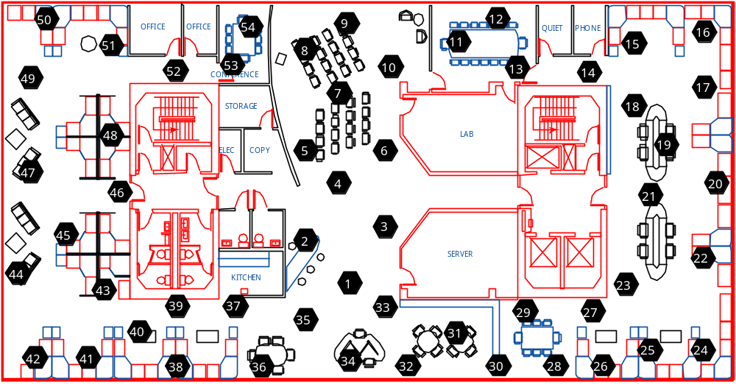
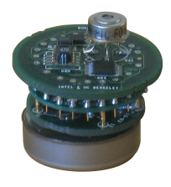
Evaluation: Temperature
Temperature data from sensor deployment at Intel Research Berkeley
Task: Scheduling of single sensor
  Select k optimal times to observe sensor during each day
  Optimize sum of residual entropies

Slide 22
Evaluation: Temperature
Optimal algorithms significantly improve on
commonly used myopic heuristics
Conditional plans give higher rewards than subsets
Baseline:
Uniform spacing
of observations
0h
24h
Notes:
discuss reward functions for all experiments

Slide 23
Evaluation: CpG-island detection
Annotated gene DNA sequences
Task: Predict start and end of CpG island
  ask expert to annotate k places in sequence
  optimize classification margin

Slide 24
Evaluation: CpG-island detection
Optimal algorithms provide better prediction accuracy
Even small differences in objective value can lead to improved prediction results
Notes:
make lines come in one at a time

Slide 25
Evaluation: Reuters data
POS-Tagging CRF trained on Reuters news archive data
Task:
  Ask expert for k most informative tags
  Maximize classification margin

Slide 26
Evaluation: POS-Tagging
Optimizing classification margin leads to improved precision and recall
Notes:
chsnge animation order
lines one at a time

Slide 27
Can we generalize?
Many Graphical Models Tasks (e.g. Inference, MPE) which are efficiently solvable for chains can be generalized to polytrees
Even computing expected rewards is hard
Optimization is a lot harder!
X₁
X₄
X₃
X₂
X₅

Slide 28
Complexity Classes (Review)
Probabilistic inference
in polytrees
P
NP – SAT
#P – #SAT
NP^{PP} – E-MAJSAT
Probabilistic inference
in general graphical models
MAP assignment
on general GMs;
Some planning problems
Wildly more complex!!

Slide 29
Hardness results
Theorem: Even on discrete polytrees,
computing expected rewards is #P-complete
subset selection is NP^{PP}-complete
computing conditional plans is NP^{PP}-hard
Proof by reduction from #3CNF-SAT and E-MAJSAT
As we presented last week at UAI,
approximation algorithms with
strong guarantees available!
subset selection
computing rewards
Notes:
label graphs
all at once
with strong performace guarantees
picture of graphical models used for reduction

Slide 30
Summary
We developed efficient optimal nonmyopic algorithms for chain graphical models
  subset selection and conditional plans
  filtering + smoothing
Even on discrete polytrees, problems become wildly intractable!
  Chain is probably only graphical model we can hope to solve optimally
Our algorithms improve prediction accuracy
Provide viable optimal approach for a wide range of value of information tasks

