Slide 1
Data Association for Topic Intensity Tracking
Andreas Krause
Jure Leskovec
Carlos Guestrin
School of Computer Science,
Carnegie Mellon University

Slide 2
Document classification
Emails from two topics: Conference and Hiking
Will you go to
ICML too?
Let’s go hiking
on Friday!
P(C | words) = .9
P(C | words) = .1
➔ Conference
➔ Hiking

Slide 3
A more difficult example
Emails from two topics: Conference and Hiking
What if we had temporal information?
How about modeling emails as HMM?
2:00 pm
2:03 pm
Let’s have dinner
after the talk.
Should we go on
Friday?
P(C | words) = .7
P(C | words) = .5
➔ Conference
Could refer to both topics! ☹
C₁
C₂
C_{t}
C_{t+1}
Assumes equal time steps,
“smooth” topic changes.
Valid assumptions?
D₁
D₂
D_{t}
D_{t+1}
Notes:
Try to make HMM bigger etc. Introduce Di

Slide 4
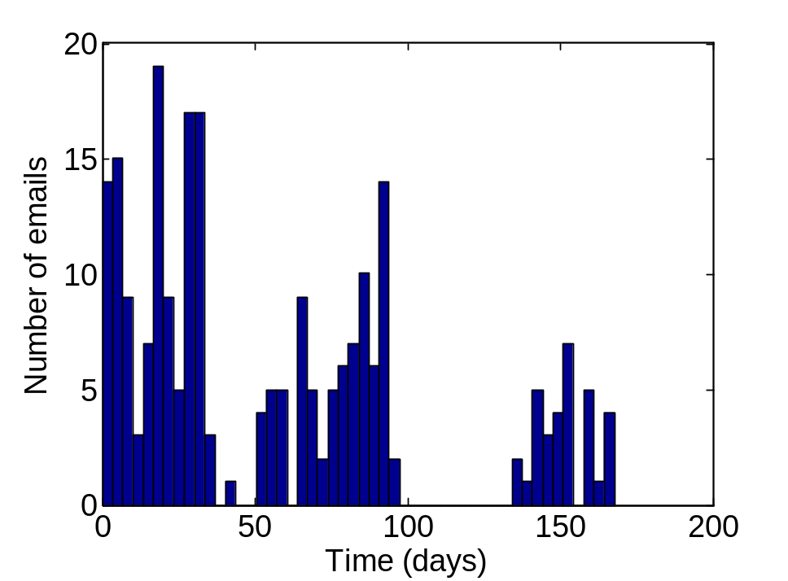
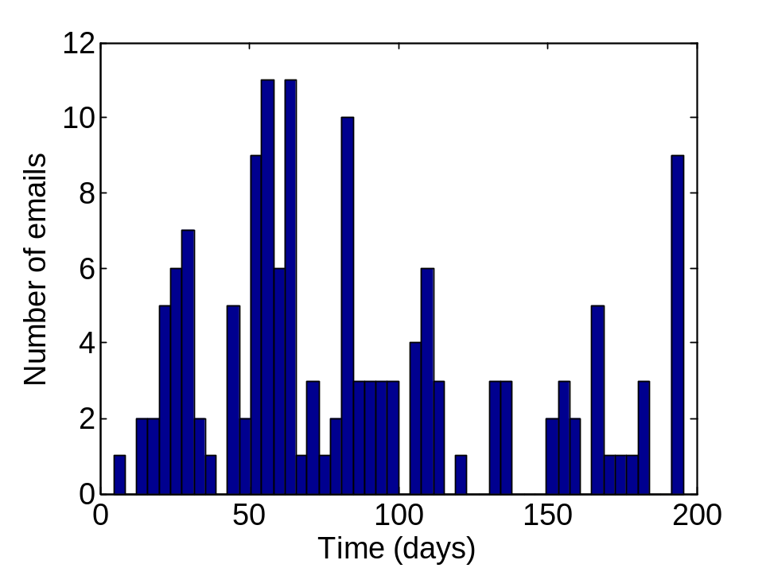
Typical email traffic (Enron data)
Topic 1
Topic 2
Bursts
No emails
Email traffic very bursty
Cannot model with uniform time steps! ☹
Topic intensities change over time, separately per topic
Bursts tell us, how intensely a topic is pursued
➔ Bursts are potentially very interesting!
Notes:
Enron traffic (show for two topics)

Slide 5
Identifying both topics and bursts
Given:
  A stream of documents (emails):
  d₁, d₂, d₃, …
  and corresponding document inter-arrival times (time between consecutive documents):
  Δ₁, Δ₂, Δ₃, ...
Simultaneously:
  Classify (or cluster) documents into K topics
  Predict the topic intensities – predict time between consecutive documents from the same topic

Slide 6
Data association problem
Conference
Hiking
If we know the email topics, we can identify bursts
If we don’t know the topics, we can’t identify bursts!
Two-step solution: First classify documents, then identify bursts [Kleinberg ’03] Can fail badly! ☹
This paper:
Simultaneously identify topics and bursts! ☺
time
High intensity for “Conference”,
Low intensity for “Hiking”
Intensity for “Conference” ???
Intensity for “Hiking” ???
Low intensity for “Conference”,
High intensity for “Hiking”
Notes:
Add legend

Slide 7
The Task
Have to solve a data association problem:
We observe:
  Message Deltas – time between the arrivals of consecutive documents
We want to estimate:
  Topic Deltas – time between messages of the same topic
  We can then compute the topic intensity L = E[ 1/Δ ]
  Therefore, need to associate each document with a topic
Need topics to
identify intensity
Chicken and Egg
problem:
Need intensity to
classify (better)
Notes:
Simplify slide?

Slide 8
How to reason about topic deltas?
Associate with each email time vectors τ per topic
Email 1,
Conference
At 2:00 pm
Email 2,
Hiking
At 2:30 pm
Email 3,
Conference
At 4:15 pm
Expected
arrival times τ
per topic
τ₁
τ₂
τ₃
C: 2:00 pm
C: 4:15pm
C: 4:15 pm
H: 2:30 pm
H: 2:30 pm
H: 7:30 pm
Topic Δ = 2h 15min
(consecutive msg.
of same topic)
Δ₂
C₂
Message Δ
= min τ₂ – min τ₁
(= 30min)
Topic C
= argmin τ₂
(= Hiking)
Conference
Hiking

Slide 9
Generating message arrival times
Want generative model for the time vectors τ
L^{(C)}₁
L^{(C)}₂
L^{(C)}₂
L^{(H)}₁
L^{(H)}₂
L^{(H)}₃
Incremented by
exponential distribution,
parameter Exp(L^{(C)})
τ₁
τ₂
τ₃
C: 2:00 pm
C: 4:15pm
C: 4:15 pm
Does not change,
as topic not “active”.
H: 2:30 pm
H: 2:30 pm
H: 7:30 pm

Slide 10
Generative Model (conceptual)
Intensity for
“Hiking”
L^{(C)}_{t-1}
L^{(C)}_{t}
L^{(C)}_{t+1}
Intensity for
“Conference”
L^{(H)}_{t-1}
L^{(H)}_{t}
L^{(H)}_{t+1}
Problem:
Need to reason about entire history of timesteps τ_{t}!
(Domain of τ_{t} grows linearly with time.)
Makes inference intractable, even for few topics!
τ_{t-1}
τ_{t}
τ_{t+1}
ETA per topic
Δ_{t}
C_{t}
D_{t}
Message Δ
Topic
Document
Notes:
Change W to D everywhere

Slide 11
Do we really need ETA vectors?
We know Message Δ_{t} = min τ_{t} – min τ_{t-1.}
Since Topic Δ follow exponential distribution,
memorylessness implies
P(τ_{t+1}^{(C)} > 4pm | τ_{t} ^{(C)} = 2pm, it’s now 3pm) =
P(τ_{t+1}^{(C)} > 4pm | τ_{t} ^{(C)} = 3pm, it’s now 3pm)
Hence Δ_{t} distributed as min {Exp(L_{t}^{(C)}),Exp(L_{t}^{(H)})}
  Closed form: Δ_{t} ~ Exp(L_{t}^{(C)} + L_{t}^{(H)} )
Similarly, C_{t} ~ argmin {Exp(L_{t}^{(C)}),Exp(L_{t}^{(H)})}
  Closed form: C_{t} ~ Bernoulli( L_{t}^{(C)} / (L_{t}^{(C)} + L_{t}^{(H)} ) )
Last arrival time irrelevant!
Can discard ETA vectors τ!
Quite general modeling trick!

Slide 12
Generative Model (conceptual)
Implicit Data Association (IDA) Model
L^{(C)}_{t-1}
L^{(C)}_{t}
L^{(C)}_{t+1}
L^{(H)}_{t-1}
L^{(H)}_{t}
L^{(H)}_{t+1}
τ_{t-1}
τ_{t}
τ_{t+1}
Δ_{t}
C_{t}
D_{t}
Turns model (essentially) into Factorial HMM
Many efficient inference techniques available! ☺

Slide 13
Exponential distribution appropriate?
Previous work on document streams (E.g., Kleinberg ‘03)
Frequently used to model transition times
When adding hidden variables, can model arbitrary transition distributions (Nodelman et al)

Slide 14
Experimental setup
Inference Procedures
  Full (conceptual) model:
    Particle filter
  Simplified Model:
    Particle filter
    Fully factorized mean field
    Extract inference
Comparison to the two-step approach
(first classify, then identify bursts)

Slide 15
Results (Synthetic data)
Periodic message arrivals (uninformative Δ) with noisy class assignments: ABBBABABABBB…
Naïve Bayes
misclassifies based on
features
30
Topic Δ
25
20
Topic delta
15
10
5
0
0
20
40
60
80
Message number

Slide 16
Results (Synthetic data)
Periodic message arrivals (uninformative Δ) with noisy class assignments: ABBBABABABBB…
Naïve Bayes
misclassifies based on
features
30
Topic Δ
Part. Filt.
(Full model)
25
20
Topic delta
15
0
0
20
40
60
80
Message number

Slide 17
Results (Synthetic data)
Periodic message arrivals (uninformative Δ) with noisy class assignments: ABBBABABABBB…
Naïve Bayes
misclassifies based on
features
30
Topic Δ
Exact
inference
Part. Filt.
(Full model)
25
20
Topic delta
15
0
0
20
40
60
80
Message number
Notes:
Full model (no memorylessness), Exact inference (exploits memorylessness)

Slide 18
Results (Synthetic data)
Periodic message arrivals (uninformative Δ) with noisy class assignments: ABBBABABABBB…
Naïve Bayes
misclassifies based on
features
Implicit Data Association gets both topics and intensity right, inspite severe (30%) label noise.
Memorylessness trick identifies true intensity.
Separate topic and burst identification fails badly.
30
Topic Δ
Exact
inference
Part. Filt.
(Full model)
25
20
Topic delta
15
10
5
Weighted automaton
(first classify, then bursts)
0
0
20
40
60
80
Message number

Slide 19
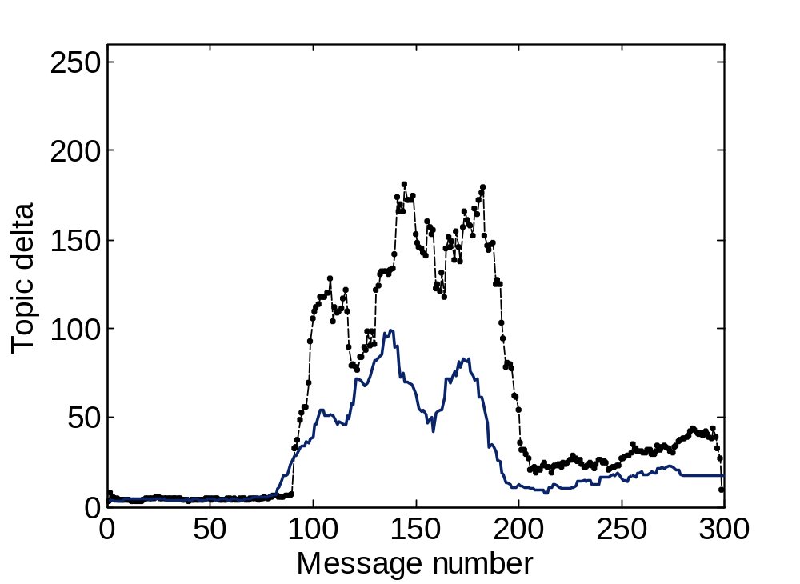
Inference comparison (Synthethic data)
Two topics, with different frequency pattern
Topic Δ
for topic 1
More bursty
Message Δ
(both combined)

Slide 20
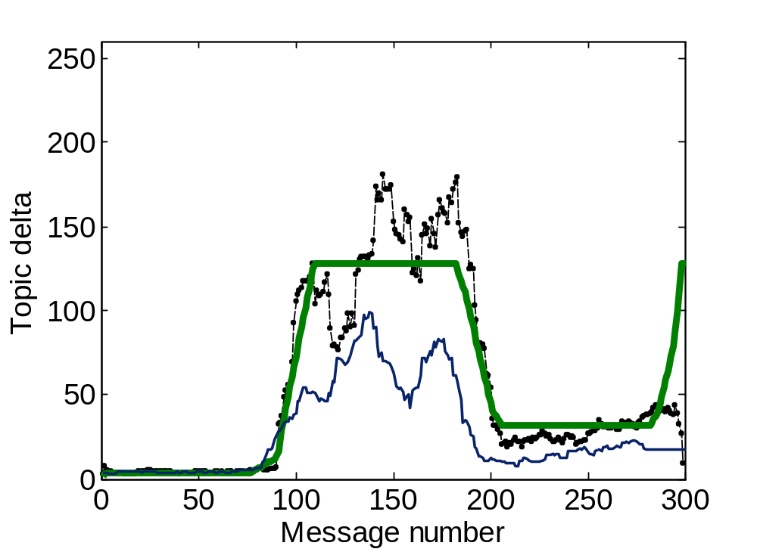
Inference comparison (Synthethic data)
Two topics, with different frequency pattern
Exact
inference
Topic Δ
for topic 1
More bursty
Message Δ
(both combined)
Notes:
What i’d like to see / model

Slide 21
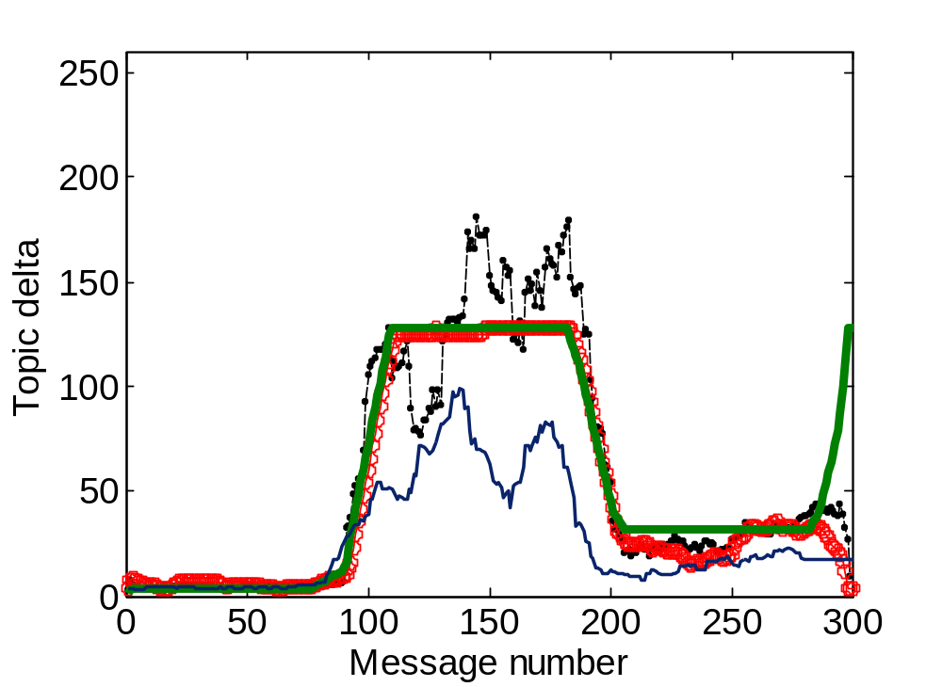
Inference comparison (Synthethic data)
Two topics, with different frequency pattern
Particle
filter
Exact
inference
Topic Δ
for topic 1
More bursty
Message Δ
(both combined)

Slide 22
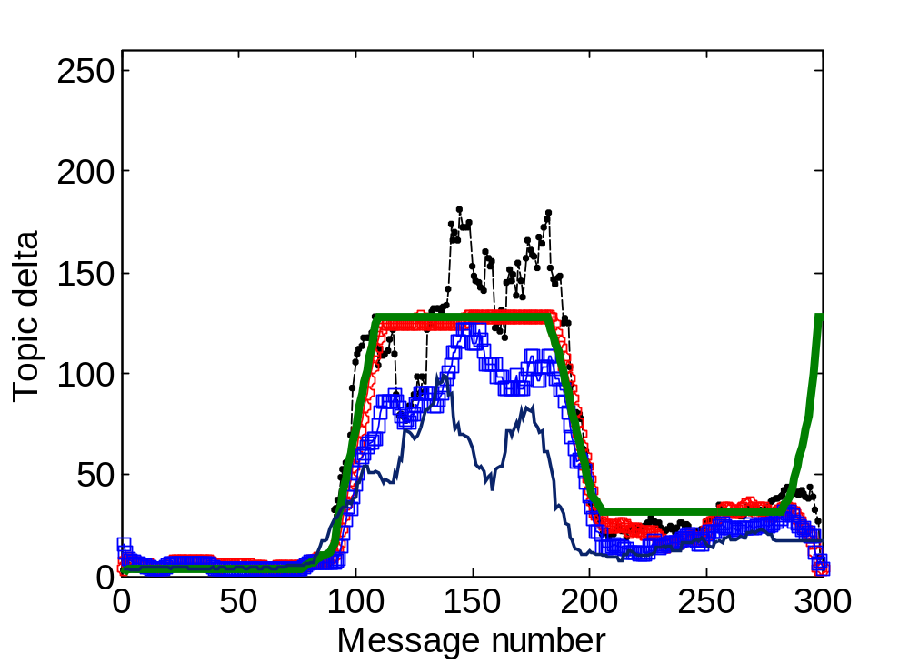
Inference comparison (Synthethic data)
Two topics, with different frequency pattern
Particle
filter
Mean-
field
Exact
inference
Topic Δ
for topic 1
Implicit Data Association identifies true frequency parameters (does not get distracted by observed Δ)
In addition to exact inference (for few topics),
several approximate inference techniques perform well.
More bursty
Message Δ
(both combined)
Notes:
True -> Topic delta; Little box explanation
Observed -> Message delta;

Slide 23
Experiments on real document streams
ENRON Email corpus
  517,431 emails from 151 employees
  Selected 554 messages from tech-memos and universities folders of Kaminski
  Stream between December 1999 and May 2001
Reuters news archive
  Contains 810,000 news articles
  Selected 2,303 documents from four topics: wholesale prices, environment issues, fashion and obituaries

Slide 24
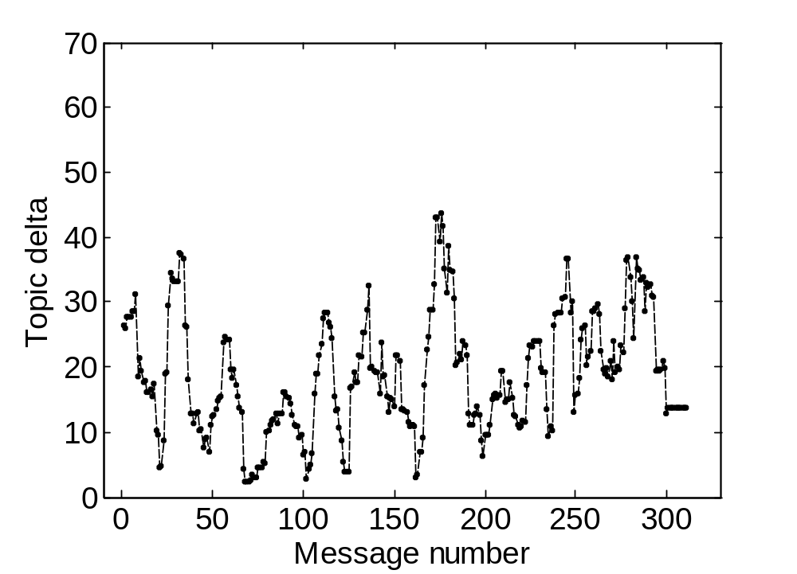
Intensity identification for Enron data
Topic Δ
More bursty

Slide 25
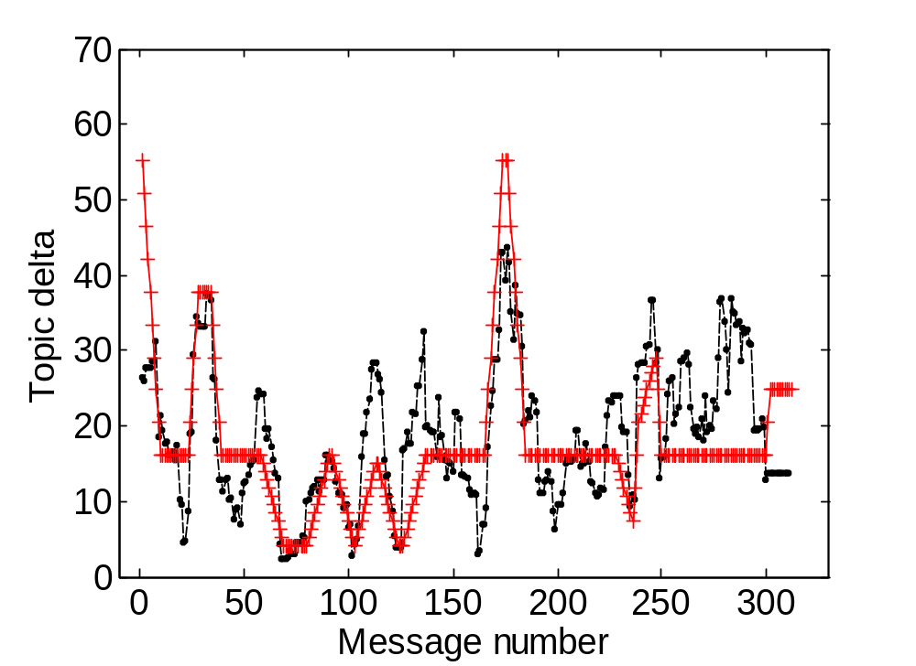
Intensity identification for Enron data
Topic Δ
WAM
More bursty

Slide 26
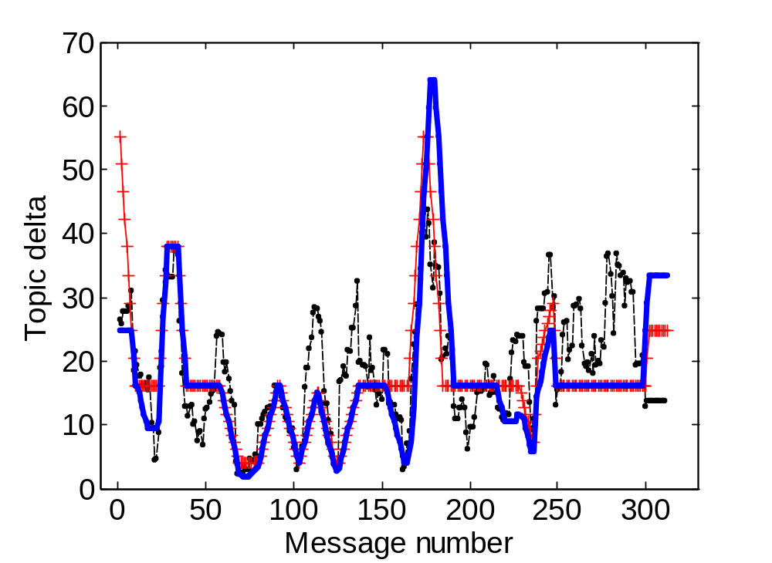
Intensity identification for Enron data
Topic Δ
WAM
IDA-IT
More bursty

Slide 27
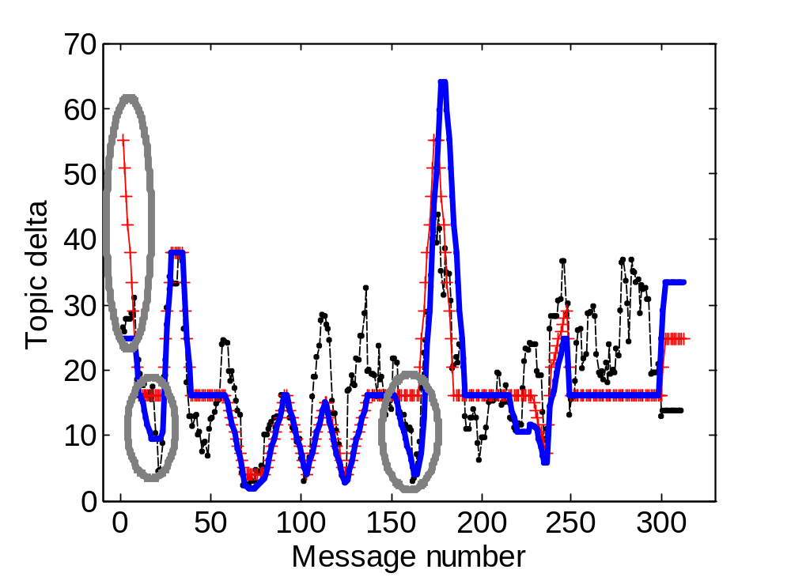
Intensity identification for Enron data
Topic Δ
WAM
IDA-IT
More bursty
Implicit Data Association identifies bursts which
are missed by two-step approach
Notes:
Add legend; add arrow (less / more frequent); indicate bursts

Slide 28
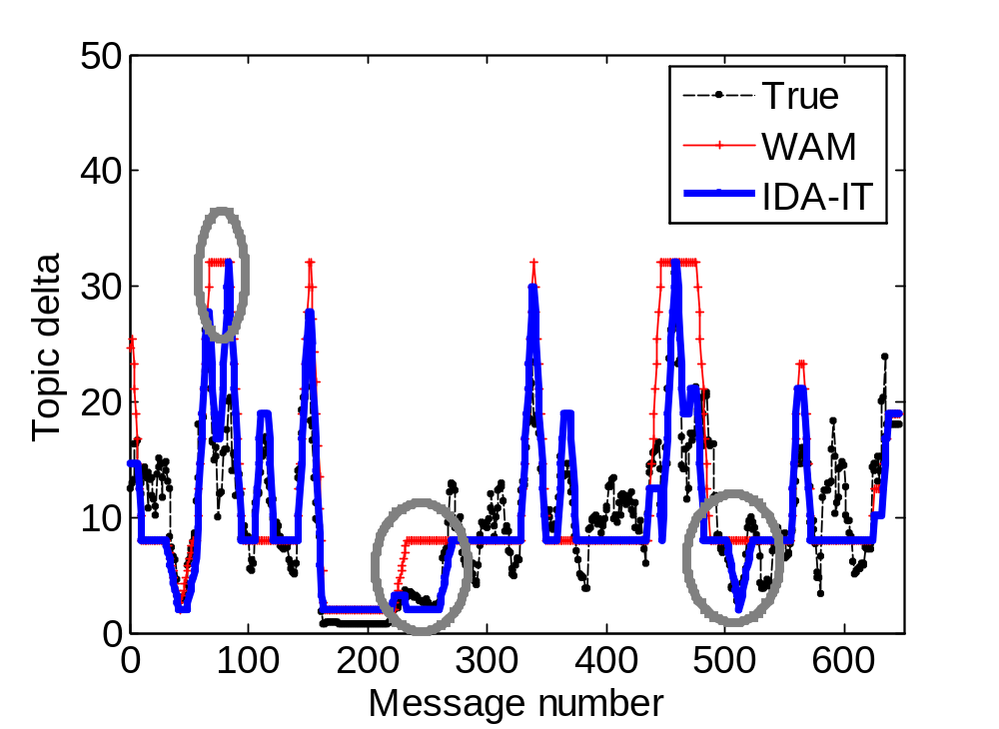
Reuters news archive
50
40
30
20
10
0
0
100
200
300
400
500
600
700
Again, simultaneous topic and burst identification outperforms separate approach

Slide 29
What about classification?
Temporal modeling effectively changes class prior over time.
Impact on classification accuracy?

Slide 30
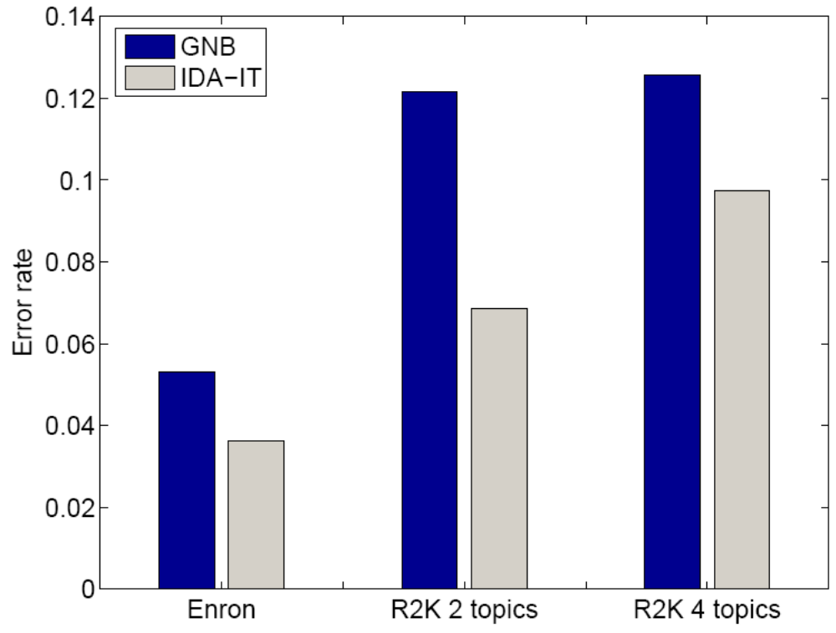
Classification performance
IDA
Model
Naïve
Bayes
Lower is better
Modeling intensity leads to improved
classification accuracy ☺
Notes:
Lower is better

Slide 31
Generalizations
Learning paradigms
  Not just supervised setting, but also:
  Unsupervised- / semisupervised learning
  Active learning (select most informative labels)
  See paper for details.
Other document representations / classifiers
(Just need P(D_{t} | C_{t}))
Other applications
  Fault detection
  Activity recognition
  …
Notes:
Examples for document representations

Slide 32
Tracking topic drift over time
L^{(C)}_{t-1}
L^{(C)}_{t}
L^{(C)}_{t+1}
Topic param.
(Mean for LSI representation)
L^{(H)}_{t-1}
L^{(H)}_{t}
L^{(H)}_{t+1}
μ_{t} tracks topic means (Kalman Filter)
μ_{t-1}
μ_{t}
μ_{t+1}
Δ_{t}
C_{t}
D_{t}
Document
(LSI)
Notes:
Show something? Emphasize tracking topic drift

Slide 33
Conclusion
General model for data association in
data streams
  Exponential order statistics enable implicit data association and tractable exact inference
  A principled model for “changing class priors”
  over time
Can be used in supervised, unsupervised and (semisupervised) active learning setting
Synergetic effect between intensity estimation and classification on several real-world data sets
Notes:
Merge conclusions

