Slide 1
Near-optimal Sensor Placements:
Maximizing Information while
Minimizing Communication Cost
Andreas Krause, Carlos Guestrin, Anupam Gupta, Jon Kleinberg

Slide 2
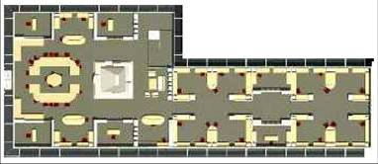
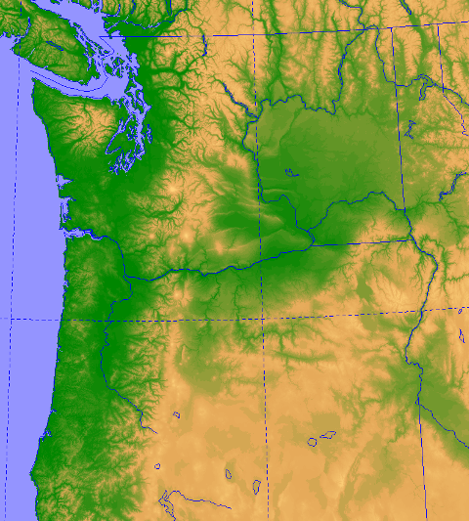
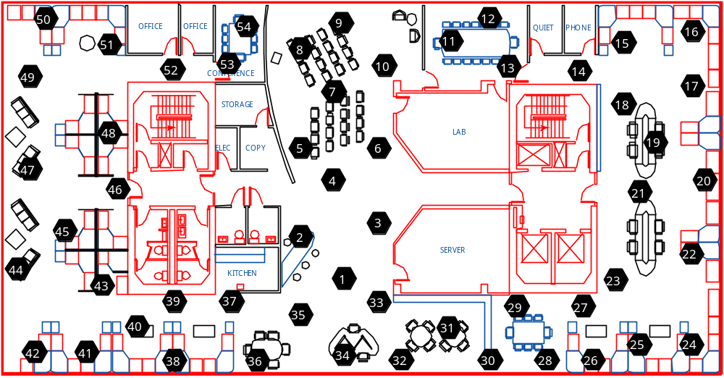
Monitoring of spatial phenomena
Building automation (Lighting, heat control)
Weather, traffic prediction, drinking water quality...
Fundamental problem:
Where should we place the sensors?
Light data
from sensor network
Temperature data
from sensor network
Precipitation data from Pacific NW

Slide 3
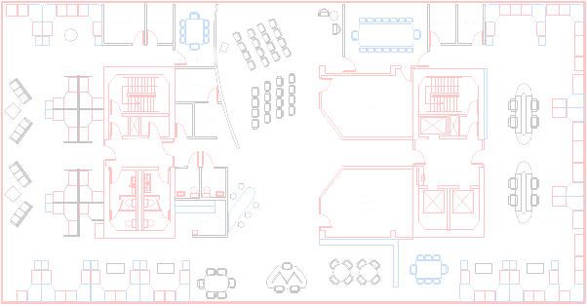
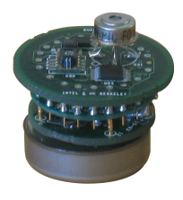
Trade-off: Information vs. communication cost
The “closer” the sensors:
The “farther” the sensors:
extra
node
extra
node
efficient communication! ☺
better information quality! ☺
worse information quality! ☹
worse communication! ☹
We want to optimally trade-off
information quality and communication cost!
Notes:
Make clear that’s extremes

Slide 4
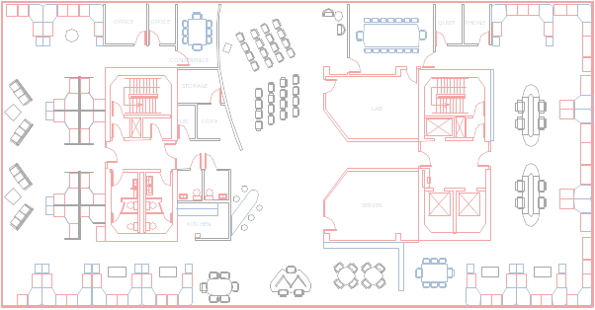
Predicting spatial phenomena from sensors
Can only measure where we have sensors
Multiple sensors can be used to predict phenomenon at uninstrumented locations
A regression problem: Predict phenomenon
based on location
Temp
here?
X₁=21 C
23 C
X₃=26 C
X₂=22 C

Slide 5

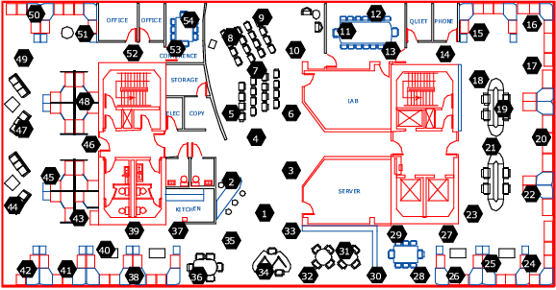
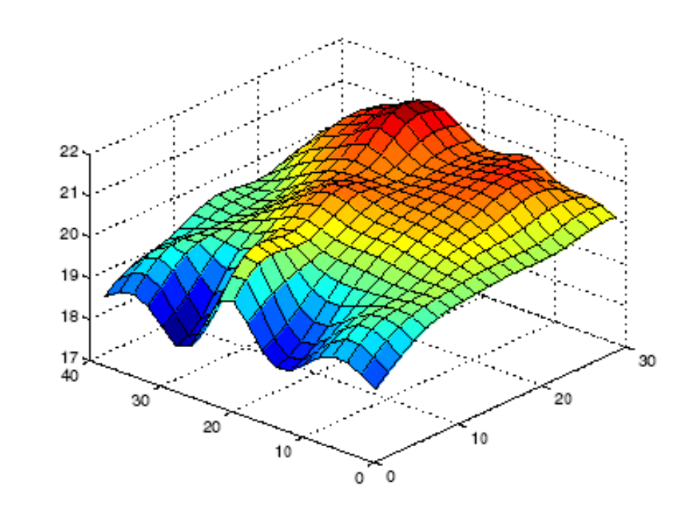
Regression models for spatial phenomena
Real deployment
of temperature sensors
y
many sensors around !
trust estimate here
measurements from 52 sensors
(black dots)
x
Data collected at Intel
Research Berkeley
Temp. (C)
few sensors around !
don’t trust estimate
x
y
Good sensor placements:
Trust estimate everywhere!
Predicted temperature
throughout the space
Notes:
Data collected at Intel; Inner areas walled off

Slide 6
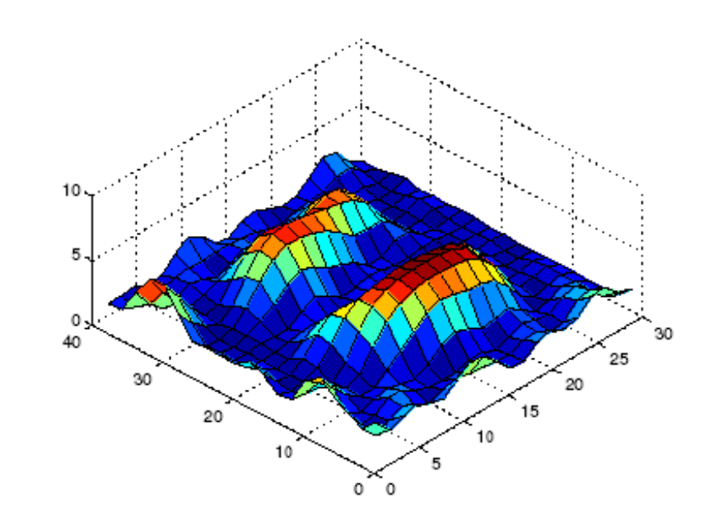
Probabilistic models for spatial phenomena
y
Temp. (C)
regression
model
sensor
locations
Modeling uncertainty is fundamental!
We use a rich probabilistic model
  Gaussian process, a non-parametric model [O'Hagan ’78]
  Learned from pilot data or expert knowledge
Learning model is well-understood
! focus talk on optimizing sensor locations
x
y
x
estimate uncertainty in prediction
many sensors around !
trust estimate here
few sensors around !
don’t trust estimate
variance
x
y
Notes:
Quantify I(A)=10

Slide 7
Information quality
uncertainty in prediction
after placing sensors
uncertainty
x
y
y
x
sensor placement A
(a set of locations)
information quality I(A)
(a number)
Pick locations A with highest information quality
  lowest “uncertainty” after placing sensors
  measured in terms of entropy of the posterior distribution
I(A) = 10
I(B) = 4
placement A
placement B
Notes:
Less details, pause at the end (in general)

Slide 8
The placement problem
Let V be finite set of locations to choose from
For subset of locations A µ V, let
  I(A) be information quality and
  C(A) be communication cost of placement A
Want to optimize
  min C(A) subject to I(A) ¸ Q
Q>0 is information quota
How do we measure communication cost?

Slide 9
Communication Cost
Message loss requires retransmission
This depletes the sensor’s battery quickly
Communication cost for two sensors means expected number of transmissions (ETX)
Communication cost for placement is sum of all ETXs along routing tree
Modeling and predicting link quality hard!
We use probabilistic models
(Gaussian Processes for classification)
! Come to our demo on Thursday! ☺
ETX 1.2
Total cost = 8.2
ETX 1.6
ETX 2.1
ETX 1.9
ETX 1.4
Many other criteria possible in our approach
(e.g. number of sensors, path length of a robot, …) ☺
Notes:
Communication between pairs of sensors; what do retransmissions depend on (relate to link quality)

Slide 10
We propose:
The pSPIEL Algorithm
pSPIEL: Efficient, randomized algorithm
(padded Sensor Placements at Informative and cost-Effective Locations)
In expectation, both information quality and communication cost are close to optimum
Built system using real sensor nodes
for sensor placement using pSPIEL
Evaluated on real-world placement problems
Notes:
less text
merge with graph???

Slide 11
Minimizing communication cost while maximizing information quality
First: simplified case, where each sensor provides independent information:
  I(A) = I(A₁) + I(A₂) + I(A₃) + I(A₄) + …
V – set of possible locations
For each pair, cost is ETX
Select placement A µ V, such that:
tree connecting A is cheapest
min_{A} C(A)
C(A)=
locations are informative:
I(A) ¸ Q
I(A) = I(
A₈
1.3
ETX = 3
ETX = 1.3
A₄
ETX₃₄
+
+
+ …
A₁
ETX = 10
ETX₁₂
[
[
[…)
Notes:
Set notation (brackets?) make non-bold

Slide 12
Quota Minimum Steiner Tree
(Q-MST) Problem
Problem:
Each node A_{i} has a reward I (A_{i})
Find the cheapest tree that collects at least Q reward:
=10
I(A) = I(A₁) + I(A₂) + I(A₃) + I(A₄) + …
I(A₁)
I(A₂)
I(A₃)
I(A₄)
=12
+
+
+ … ¸ Q
Perhaps could use to solve our problem!!! ☺
=12
NP-hard… ☹
=8
but very well studied [Blum, Garg, …]
Constant factor 2 approximation algorithm available! ☺
Notes:
SLOWER!!! Spell abbreviation out; boldness of A and Ai

Slide 13
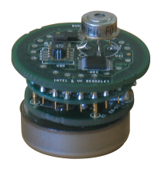
Are we done?
Q-MST algorithm works if I(A) is modular, i.e., if A and B disjoint, I(A [ B)=I(A)+I(B)
Makes no sense for sensor placement!
  Close by sensors are not independent
For sensor placement, I is submodular
I(A [ B) · I(A)+I(B) [Guestrin, K., Singh ICML 05]
I(B)
B₁
A₂
A₁
B₂
I(A)
“Sensing regions” overlap,
I(A [ B) < I(A) + I(B)
Notes:
Spell out Q-MST again; make sure box doesn’t seem trivial?

Slide 14
Must solve a new problem
Want to optimize
  min C(A) subject to I(A) ¸ Q
if sensors provide
independent information
I(A) = I(A₁) + I(A₂) + I(A₃) + …
a modular problem
solve with Q-MST ☺
but info not independent ☹
a new open problem!
submodular steiner tree
strictly harder than Q-MST
generalizes existing problems
e.g., group steiner
sensors provide
submodular information
I(A₁ [ A₂) · I(A₁) + I(A₂)
Insight: our sensor problem has additional structure! ☺

Slide 15
Locality
If A, B are placements closeby, then I(A [ B) < I(A) + I(B)
If A, B are placements, at least r apart, then
I(A [ B) ¼ I(A) + I(B)
Sensors that are far apart are approximately independent
  We showed locality is empirically valid!
I(B)
B₁
A₂
A₁
B₂
I(A)
r

Slide 16
Our approach: pSPIEL
submodular
steiner tree
with locality
I(A₁ [ A₂) · I(A₁) + I(A₂)
approximate by a modular problem:
for nodes A
sum of rewards A ¼ I(A)
obtain solution of
original problem
(prove it’s good)
solve modular approximation
with Q-MST
use off-the-shelf
Q-MST solver

Slide 17
pSPIEL: an overview
Build small, well-separated clusters over possible locations
  [Gupta et al ‘03]
  discard rest (doesn’t hurt)
Information additive between clusters! ☺
  locality!!!
Don’t care about comm. within cluster (small)
Use Q-MST to decide which nodes to use from each cluster and how to connect them
¸ r
C₁
C₂
diameter · α r
C₄
C₃

Slide 18
Our approach: pSPIEL
submodular
steiner tree
with locality
I(A₁ [ A₂) · I(A₁) + I(A₂)
approximate by a modular problem (MAG):
for nodes A
sum of rewards A ¼ I(A)
obtain solution of
original problem
(prove it’s good)
solve modular approximation
with Q-MST
use off-the-shelf
Q-MST solver

Slide 19
pSPIEL: Step 3 modular approximation graph
if we were to solve
Q-MST in MAG:
Order nodes in “order of informativeness”
Build a modular approximation graph (MAG)
  edge weights and node rewards ! solution in MAG ¼ solution of original problem
C₁
C₁
R(G_{2,2})
R(G_{2,1})
w_{2,1–2,2}
G_{1,3}
G_{2,3}
G_{1,2}
G_{2,3}
G_{1,2}
G_{2,2}
G_{1,1}
G_{2,1}
G_{2,1}
C₂
C₂
R(G_{4,2})
w_{2,1–3,1}
G_{4,2}
w_{4,1–4,2}
G_{4,3}
G_{4,1}
w_{3,1–4,1}
G_{3,1}
G_{3,2}
G_{3,3}
G_{4,4}
R(G_{4,1})
R(G_{3,1})
G_{3,4}
C₄
C₄
C₃
C₃
To learn how rewards are
computed, come to our demo!
most importantly,
additive rewards:
Info: I(G_{2,1}[G_{2,2}[G_{3,1}[G_{4,1}[G_{4,2}) ¼
+
+
+
+
Cost: C(G_{2,1}[G_{2,2}[G_{3,1}[G_{4,1}[G_{4,2}) ¼
+
+
+

Slide 20
Our approach: pSPIEL
approximate by a modular problem (MAG):
for nodes A
sum of rewards A ¼ I(A)
submodular
steiner tree
I(A₁ [ A₂) · I(A₁) + I(A₂)
obtain solution of
original problem
(prove it’s good)
solve modular approximation
with Q-MST
use off-the-shelf
Q-MST solver

Slide 21
pSPIEL: Using Q-MST
C₁
C₂
tree in MAG ! solution in original graph
C₄
C₃
Q-MST on MAG !
solution to original
problem! ☺
C₁
C₂
C₄
C₃
Notes:
Why is cluster one not connected

Slide 22
Our approach: pSPIEL
approximate by a modular problem (MAG):
for nodes A
sum of rewards A ¼ I(A)
submodular
steiner tree
I(A₁ [ A₂) · I(A₁) + I(A₂)
obtain solution of
original problem
(prove it’s good)
solve modular approximation
with Q-MST
use off-the-shelf
Q-MST solver

Slide 23
Guarantees for sensor placement
const.
factor
approx.
info.
Theorem:
pSPIEL finds a placement A with
info. quality I(A) ¸ Ω(1) OPT_{quality,}
comm. cost C(A) · O (r log |V|) OPT_{cost}
r depends on locality property
log
factor
approx.
comm.
cost

Slide 24
Summary of our approach
Use small, short-term “bootstrap” deployment to collect some data (or use expert knowledge)
Learn/Compute models for
information quality and communication cost
Optimize tradeoff between information quality
and communication cost using pSPIEL
Deploy sensors
If desired, collect more data and
continue with step 2

Slide 25
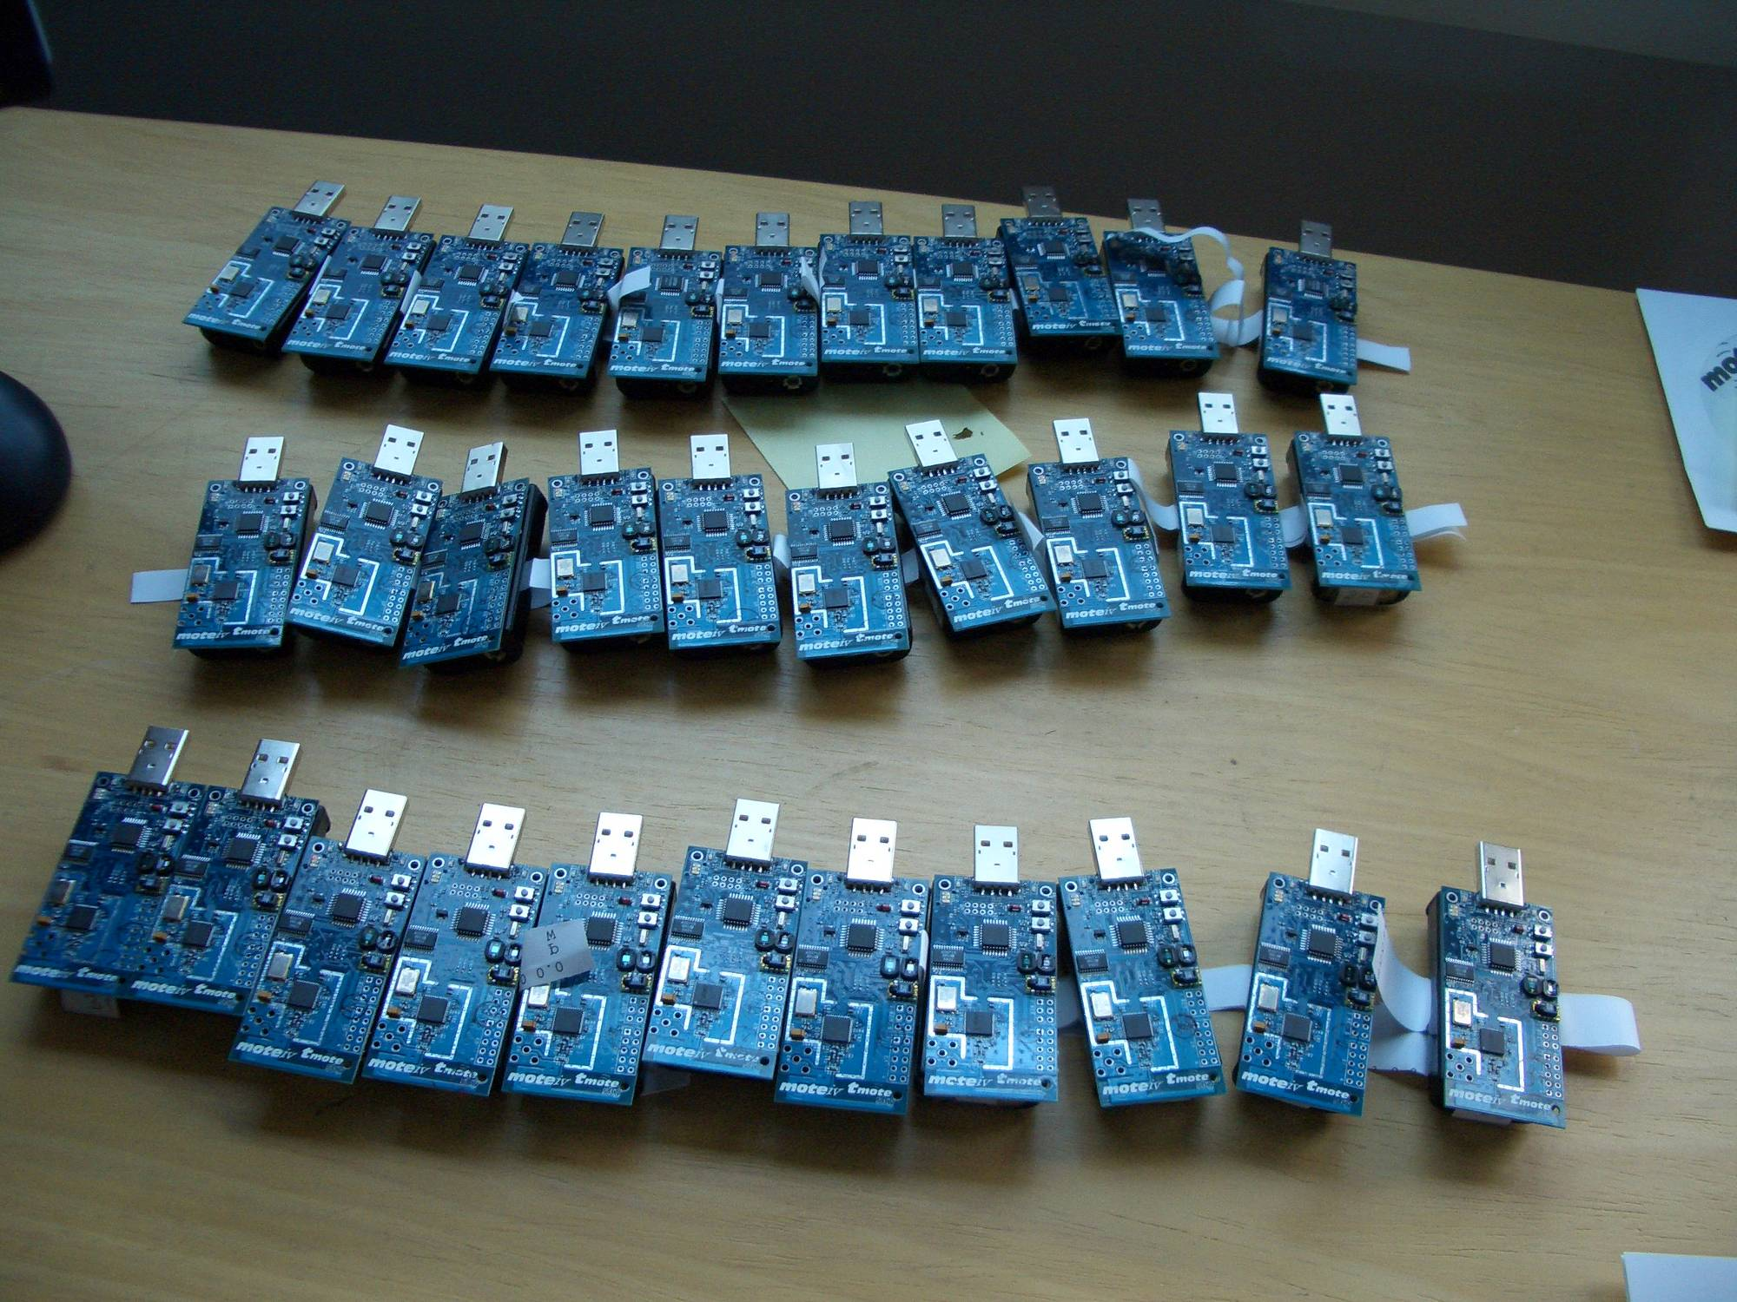
We implemented this…
Implemented using Tmote Sky motes
Collect measurement and link information and
send to base station
We can now deploy nodes, learn models and come up with placements!
See our demo on
Thursday!!

Slide 26
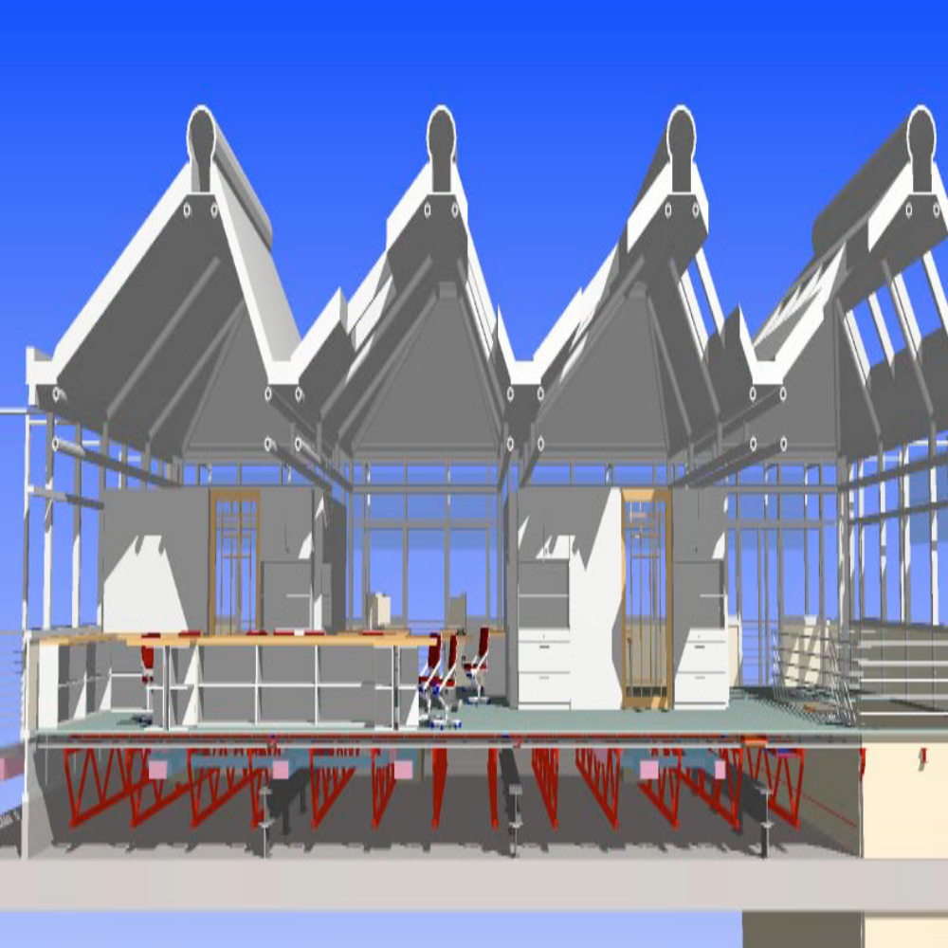
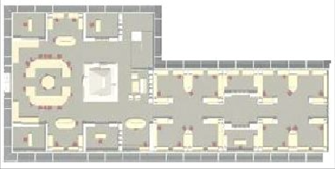
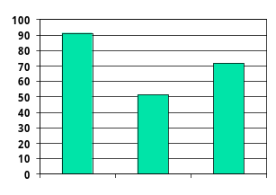
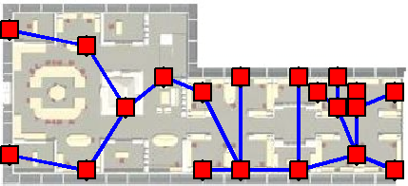
Proof of concept study
Learned model from short deployment of 46 sensors at the Intelligent Workplace
CMU’s Intelligent Workplace
accuracy
learned GPs for
light field &
link qualities
deployed 2
sets of sensors:
pSPIEL and
manually selected
locations
evaluated both
deployments on
46 locations
Time
Notes:
Simplify discussion: Went to architecture dept., learned models, …, evaluated.

Slide 27
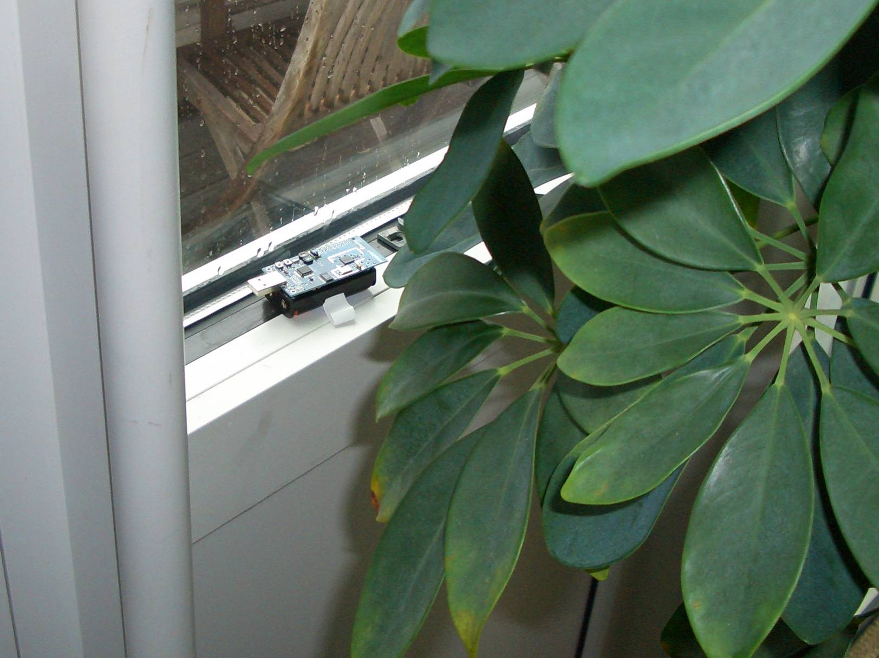

Slide 28
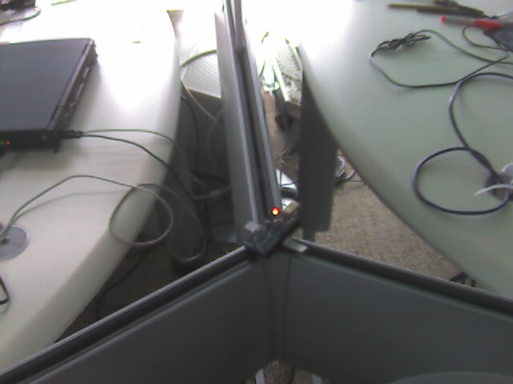

Slide 29
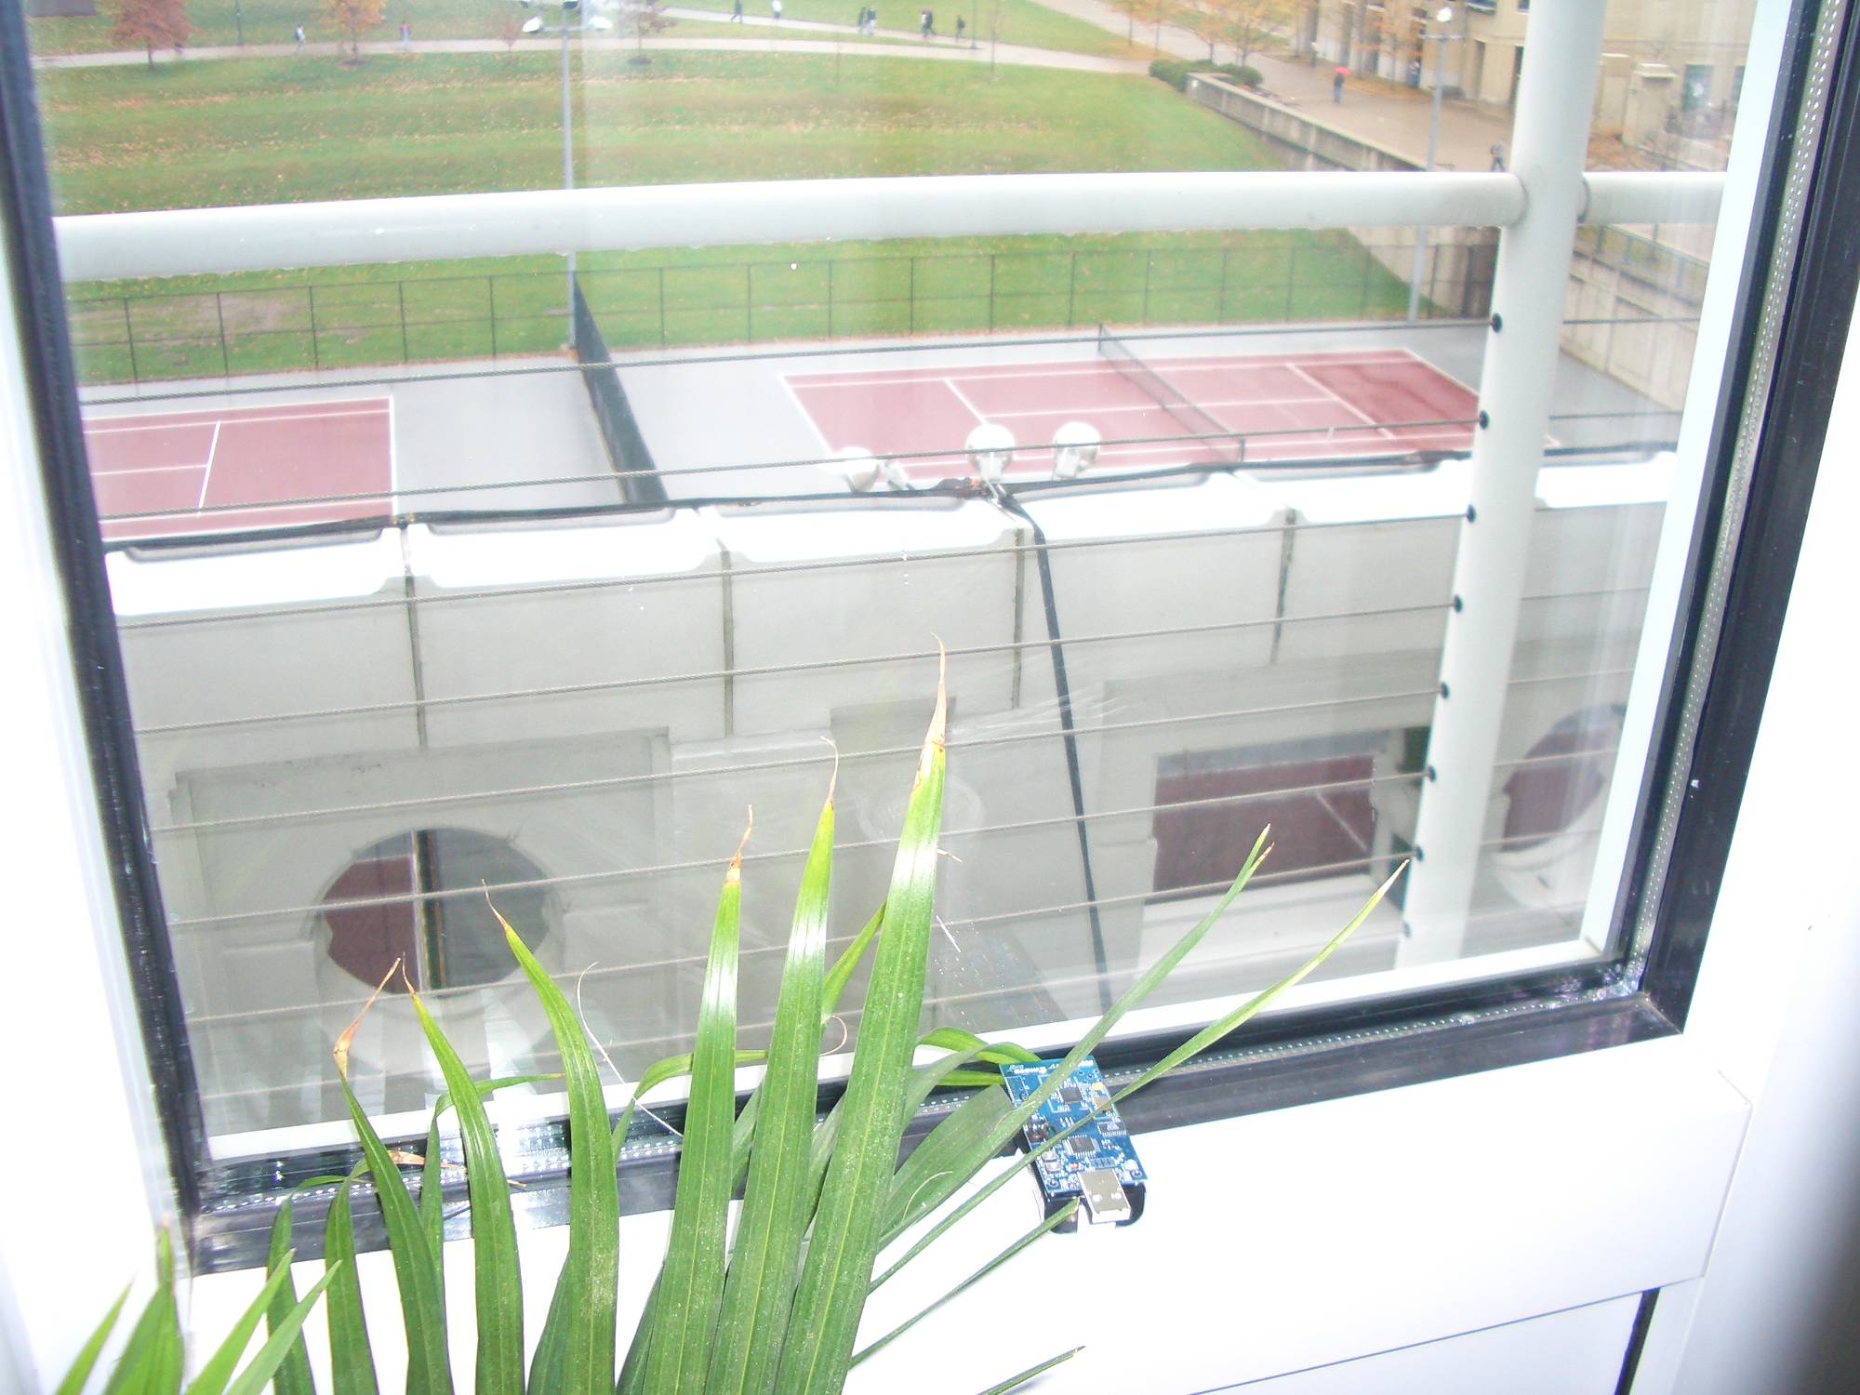

Slide 30
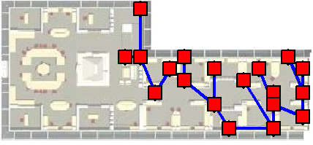
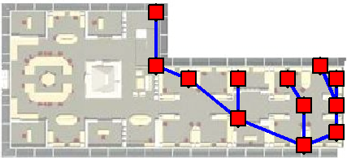
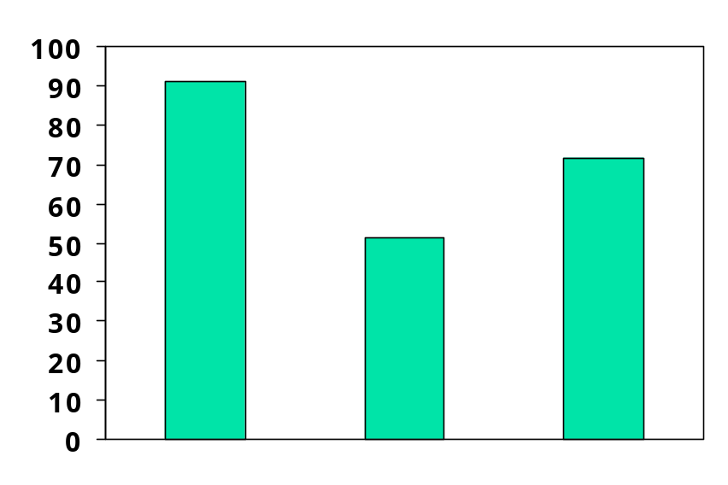
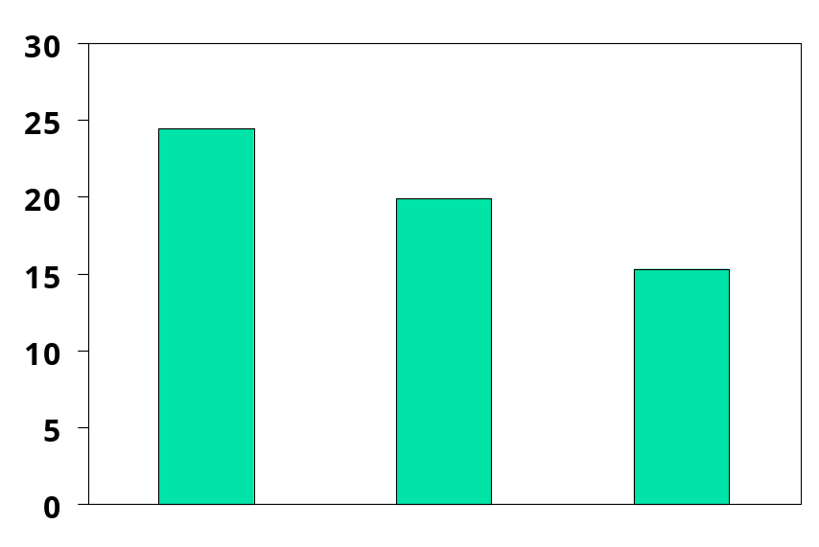
Proof of concept study
accuracy on
46 locations
pSPIEL improve solution over intuitive manual placement:
  50% better prediction and 20% less comm. cost, or
  20% better prediction and 40% less comm. cost
Poor placements can hurt a lot!
  Good solution can be unintuitive
Manual (M20)
pSPIEL (pS19)
pSPIEL (pS12)
Root mean squares error (Lux)
Communication cost (ETX)
M20
M20
better
pS12
better
pS19
pS19
pS12
Notes:
Went to IW with Vipul (evenly spread); run pspiel, got worried, tried nevertheless -> surprise!! Tradeoff -> Even with 12 better. This is why.

Slide 31
Comparison with heuristics
8
Optimal
solution
6
Higher information quality
Temperature data from
sensor network
16 placement locations
4
2
0
5
10
15
20
25
30
35
More expensive (ETX)
Roughly number of sensors

Slide 32
Comparison with heuristics
8
Optimal
solution
6
Higher information quality
Temperature data from
sensor network
Greedy-
Temperature data from
sensor network
16 placement locations
Connect
4
2
0
5
10
15
20
25
30
35
More expensive (ETX)
Roughly number of sensors
Greedy-Connect: Maximizes information quality, then connects nodes
Notes:
Explain heuristics a bit more (this is what you might try)

Slide 33
Comparison with heuristics
8
Optimal
solution
6
Higher information quality
Temperature data from
sensor network
Greedy-
Temperature data from
sensor network
16 placement locations
Connect
4
Cost-benefit
Greedy
2
0
5
10
15
20
25
30
35
More expensive (ETX)
Roughly number of sensors
Greedy-Connect: Maximizes information quality, then connects nodes
Cost-benefit greedy: Grows clusters optimizing benefit-cost ratio info. / comm.

Slide 34
Comparison with heuristics
pSPIEL is significantly closer to optimal solution
  similar information quality at 40% less comm. cost!
pSPIEL
8
Optimal
solution
6
Higher information quality
Temperature data from
sensor network
Greedy-
Temperature data from
sensor network
16 placement locations
Connect
4
Cost-benefit
Greedy
2
0
5
10
15
20
25
30
35
More expensive (ETX)
Roughly number of sensors
Greedy-Connect: Maximizes information quality, then connects nodes
Cost-benefit greedy: Grows clusters optimizing benefit-cost ratio info. / comm.
Notes:
Need pause!!! People need to see we’re close to opt

Slide 35
Comparison with heuristics
Temperature
data
100 locations
Precipitation
data
167 locations
pSPIEL outperforms heuristics
Sweet spot captures important region: just enough sensors to capture spatial phenomena
35
25
Greedy-
30
Connect
20
25
pSPIEL
pSPIEL
Greedy-
20
15
Connect
Higher information quality
Higher information quality
15
10
10
Cost-benefit
Cost-benefit
Greedy
5
Greedy
Sweet spot
of pSPIEL
5
0
0
0
20
40
60
80
100
120
0
20
40
60
80
More expensive (ETX)
More expensive (ETX)
Greedy-Connect: Maximizes information quality, then connects nodes
Cost-benefit greedy: Grows clusters optimizing benefit-cost ratio info. / comm.
Notes:
Explain the sweet spot more

Slide 36
Conclusions
Unified approach for deploying wireless sensor networks – uncertainty is fundamental
  Data-driven models for phenomena and link qualities
pSPIEL: Efficient, randomized algorithm
optimizes tradeoff: info. quality and comm. cost guaranteed to be close to optimum
Built a complete system on Tmote Sky motes, deployed sensors, evaluated placements
pSPIEL significantly outperforms alternative methods

