Slide 1
Nonmyopic Active Learning of Gaussian Processes
An Exploration – Exploitation Approach
Andreas Krause, Carlos Guestrin
Carnegie Mellon University
TexPoint fonts used in EMF.
Read the TexPoint manual before you delete this box.: AAAAAAAAAAAAAA

Slide 2
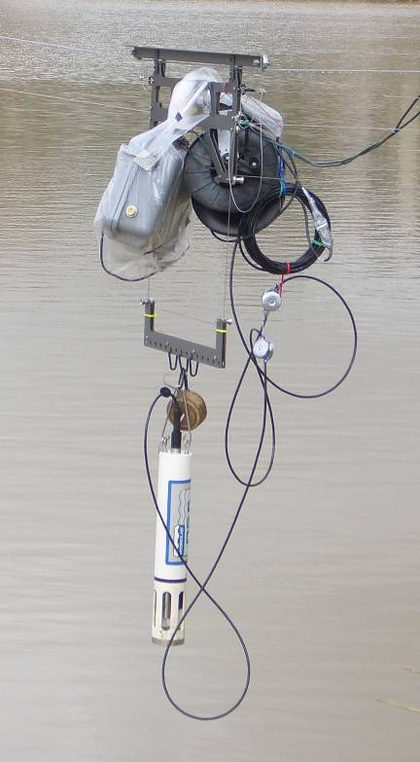
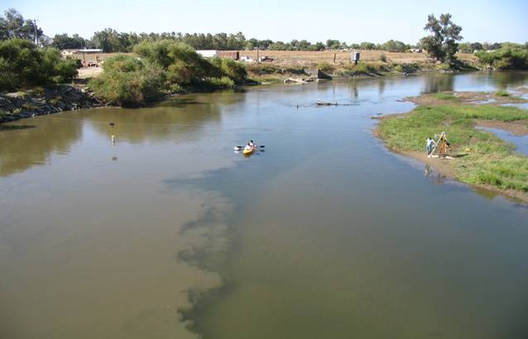
River monitoring
NIMS
(UCLA)
8
Mixing zone of
San Joaquin and
Merced rivers
7.8
7.6
pH value
7.4
Position along transect (m)
Want to monitor ecological condition of river
Need to decide where to make observations!
Notes:
text layout is confusing.
make last bullet red, decrease some fonts, etc.

Slide 3
Observation Selection for
Spatial prediction
observations
Prediction
pH value
Confidence
bands
Unobserved
process
Horizontal position
Gaussian processes
  Distribution over functions (e.g., how pH varies in space)
  Allows estimating uncertainty in prediction

Slide 4
Mutual Information
[Caselton Zidek 1984]
Finite set of possible locations V
For any subset A µ V, can compute
Want: A* = argmax MI(A) subject to |A| ≤ k
Finding A* is NP hard optimization problem ☹
Entropy of
uninstrumented
locations
before sensing
Entropy of
uninstrumented
locations
after sensing

Slide 5
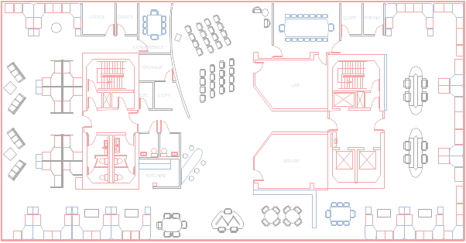
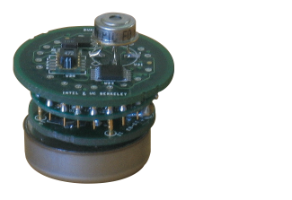
The greedy algorithm for finding optimal a priori sets
Want to find: A* = argmax_{|A|=k} MI(A)
Greedy algorithm:
  Start with A = ;
  For i = 1 to k
    s* := argmax_{s} MI(A [ {s})
    A := A [ {s*}
2
4
1
5
3
Theorem [ICML 2005, with Carlos Guestrin, Ajit Singh]
Result of
greedy algorithm
Constant
factor, ~63%
Optimal
solution

Slide 6
Sequential design
X₅=?
X₅=17
X₅=21
Observation
policy π
¸ 20°C
<20°C
X₃ =?
X₃ =16
X₂ =?
>15°C
<18°C
¸ 18°C
X₇ =?
X₇ =19
X₁₂=?
X₂₃ =?
MI(π) = 3.1
MI(X₅=17, X₃=16,
X₇=19) = 3.4
MI(…) = 2.1
MI(…) = 2.4
Observed variables depend on previous measurements and observation policy π
MI(π) = expected MI score over outcome of observations

Slide 7
A priori vs. sequential
Sets are very simple policies. Hence:
max_{A} MI(A) · max_{π} MI(π) subject to |A|=|π|=k
Key question addressed in this work:
How much better is sequential vs. a priori design?
Main motivation:
  Performance guarantees about sequential design?
  A priori design is logistically much simpler!

Slide 8
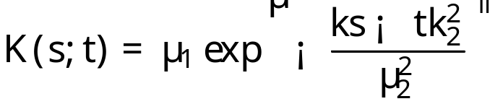
GPs slightly more formally
Set of locations V
Joint distribution P(X_{V})
For any A µ V, P(X_{A}) Gaussian
GP defined by
  Prior mean μ(s) [often constant, e.g., 0]
  Kernel K(s,t)
8
7.8
X_{V}
pH value
7.6
7.4
…
…
Position along transect (m)
V
Example: Squared
exponential kernel
1
θ₁: Variance
(Amplitude)
Correlation
0.5
0
4
2
0
2
4
Distance
θ₂: Bandwidth

Slide 9
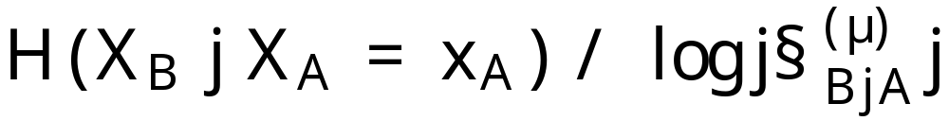
Known parameters
Known parameters θ
(bandwidth, variance, etc.)
Mutual Information does not depend on observed values:
No benefit in sequential design!
max_{A} MI(A) = max_{π} MI(π)

Slide 10
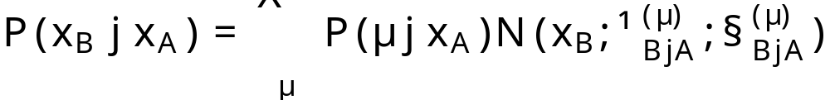
Unknown parameters
Unknown (discretized) parameters:
Prior P(Θ = θ)
Mutual Information does
depend on observed values!
depends on observations!
Sequential design can be better!
max_{A} MI(A) · max_{π} MI(π)

Slide 11
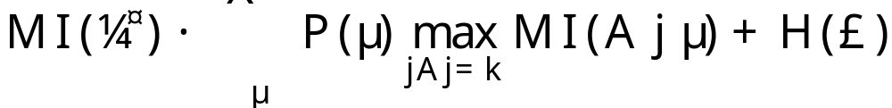
Key result: How big is the gap?
Gap depends on H(Θ)
MI
0
MI(A*)
MI(π*)
If Θ=θ known: MI(A*) = MI(π*)
If Θ “almost” known: MI(A*) ¼ MI(π*)
Theorem:
MI of best policy
MI of best param. spec. set
As H(Θ) ! 0:
MI of best policy
MI of best set
Gap size
Notes:
Associate text with bars
Repetitive?

Slide 12
Near-optimal policy if parameter approximately known
Use greedy algorithm to optimize
MI(A_{greedy} | Θ) = ∑_{θ} P(θ) MI(A_{greedy} | θ)
Note:
  | MI(A | Θ) – MI(A) | · H(Θ)
  Can compute MI(A | Θ) analytically, but not MI(A)
Corollary [using our result from ICML 05]
Result of
greedy algorithm
~63%
Optimal
seq. plan
Gap ≈ 0
(known par.)

Slide 13
Exploration—Exploitation for GPs
 | Reinforcement Learning | Active Learning in GPs
Parameters | P(S_{t+1}|S_{t}, A_{t}), Rew(S_{t}) | Kernel parameters Θ
Known parameters: Exploitation | Find near-optimal policy by solving MDP! | Find near-optimal policy by finding best set
Unknown parameters: Exploration | Try to quickly learn parameters! Need to waste only polynomially many robots! ☺ | Try to quickly learn parameters. How many samples do we need?

Slide 14
Parameter info-gain exploration (IGE)
Gap depends on H(Θ)
Intuitive heuristic: greedily select
  s* = argmax_{s} I(Θ; X_{s}) = argmax_{s} H(Θ) – H(Θ | X_{s})
Does not directly try to improve spatial prediction
No sample complexity bounds ☹
Parameter entropy
before observing s
P.E. after
observing s

Slide 15
Implicit exploration (IE)
Intuition: Any observation will help us reduce H(Θ)
Sequential greedy algorithm: Given previous
observations X_{A} = x_{A}, greedily select
s* = argmax_{s} MI ({X_{s}} | X_{A}=x_{A}, Θ)
Contrary to a priori greedy, this algorithm takes observations into account (updates parameters)
Proposition: H(Θ | X_{π}) · H(Θ)
“Information never hurts” for policies
No sample
complexity
bounds ☹

Slide 16
Learning the bandwidth
Sensors outside
bandwidth are
≈ independent
Kernel
Bandwidth
A
B
C
Sensors within
bandwidth are
correlated
Can narrow down kernel bandwidth by sensing inside and outside bandwidth distance! ☺

Slide 17
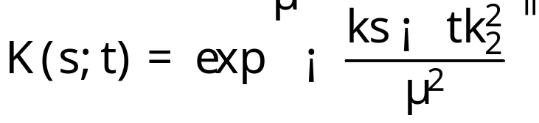
Hypothesis testing:
Distinguishing two bandwidths
Square exponential kernel:
Choose pairs of samples at distance Δ
to test correlation!
1
BW = 3
2
2
0.5
0
0
BW = 1
-2
-2
0
-2
0
2
-2
0
2
-4
-2
0
2
4
At this distance Δ
correlation gap largest
Correlation
under BW=1
Correlation
under BW=3
Notes:
Put 2 sensors on map, show bandwidths; measure correlation to differentiate

Slide 18
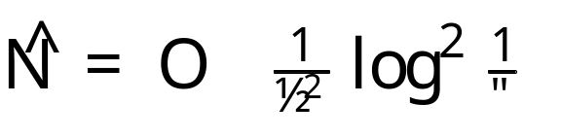
Hypothesis testing:
Sample complexity
Theorem: To distinguish bandwidths with minimum gap ρ in correlation and error < ε
we need independent samples.
In GPs, samples are dependent, but “almost” independent samples suffice! (details in paper)
Other tests can be used for variance/noise etc.
What if we want to distinguish more than two bandwidths?

Slide 19
Hypothesis testing:
Binary searching for bandwidth
Find “most informative split” at posterior median
0.6
)
0.4
θ
P(
0.2
0
1
2
3
4
5
Testing policy π_{ITE} needs only logarithmically
many tests! ☺
Theorem: If we have tests with error < ε_{T} then
Notes:
Define terms

Slide 20
Exploration—Exploitation Algorithm
Exploration phase
  Sample according to exploration policy
  Compute bound on gap between best set and best policy
  If bound < specified threshold, go to exploitation phase, otherwise continue exploring.
Exploitation phase
  Use a priori greedy algorithm select remaining samples
For hypothesis testing, guaranteed to proceed to exploitation after logarithmically many samples! ☺

Slide 21
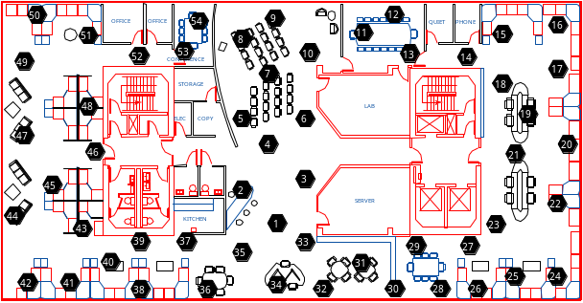
Results
Temperature data
IGE: Parameter info-gain
ITE: Hypothesis testing
0.5
2
IE: Implicit exploration
0.45
IE
1.5
IGE
0.4
More RMS error
More param. uncertainty
ITE
1
0.35
IE
0.3
IGE
0.5
ITE
0
5
10
15
20
25
0
5
10
15
20
More observations
More observations
None of the strategies dominates each other
Usefulness depends on application
Notes:
Legend (IGE,…)

Slide 22
Nonstationarity by spatial partitioning
Isotropic GP for each region, weighted by region membership
spatially varying linear combination
1
0
10
20
30
40
50
Coordinates (m)
Stationary fit
Nonstationary fit
Problem: Parameter space grows exponentially in #regions!
Solution: Variational approximation (BK-style) allows efficient approximate inference (Details in paper) ☺

Slide 23
Results on river data
0.2
0.15
IE,
More RMS error
isotropic
0.1
a priori,
(13.10/0.03)
(14.49/0.02)
nonstationary
1
(14.54/0.04)
(13.82/0.10)
0.05
IE,
0
nonstationary
0
0
10
20
30
40
10
20
30
40
50
Coordinates (m)
More observations
Larger bars = later sample
Nonstationary model + active learning
lead to lower RMS error

Slide 24
Results on temperature data
1.5
Random,
10
nonstationary
9.5
IGE,
IE
nonstationary
9
nonstationary
8.5
More RMS error
More param. uncertainty
1
IE,
isotropic
8
7.5
IE,
IGE
nonstationary
7
nonstationary
0.5
0
5
10
15
20
6.5
0
5
10
15
20
25
30
More observations
More observations
IE reduces error most quickly
IGE reduces parameter entropy most quickly

Slide 25
Conclusions
Nonmyopic approach towards active learning in GPs
If parameters known, greedy algorithm achieves
near-optimal exploitation
If parameters unknown, perform exploration
  Implicit exploration
  Explicit, using information gain
  Explicit, using hypothesis tests, with logarithmic sample complexity bounds!
  Each exploration strategy has its own advantages
Can use bound to compute stopping criterion
Presented extensive evaluation on real world data
Notes:
their own -> its own
sample complexity -> logarithmic sample complexity

