Slide 1
Nonmyopic Active Learning of Gaussian Processes
An Exploration – Exploitation Approach
Andreas Krause, Carlos Guestrin
Carnegie Mellon University
TexPoint fonts used in EMF.
Read the TexPoint manual before you delete this box.: AAAAAAAAA

Slide 2
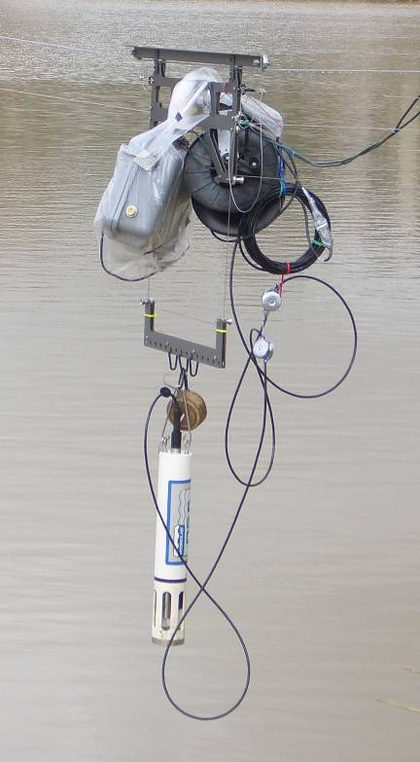
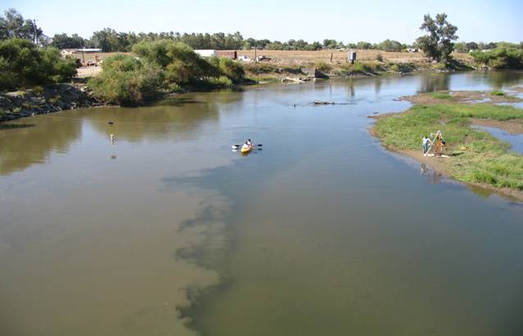
River monitoring
NIMS
(Kaiser et al,
UCLA)
8
Mixing zone of
San Joaquin and
Merced rivers
7.8
7.6
pH value
7.4
Position along transect (m)
Want to monitor ecological condition of river
Need to decide where to make observations!

Slide 3
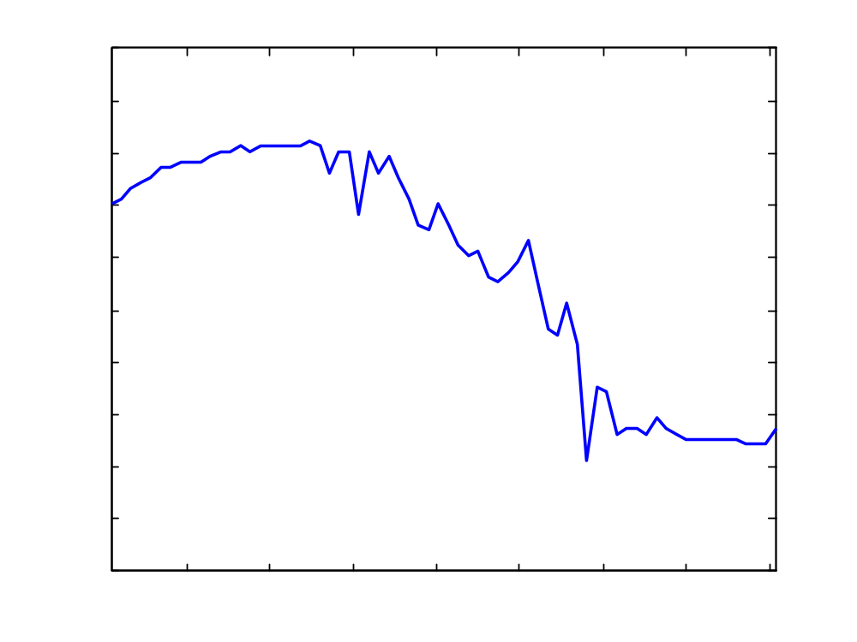
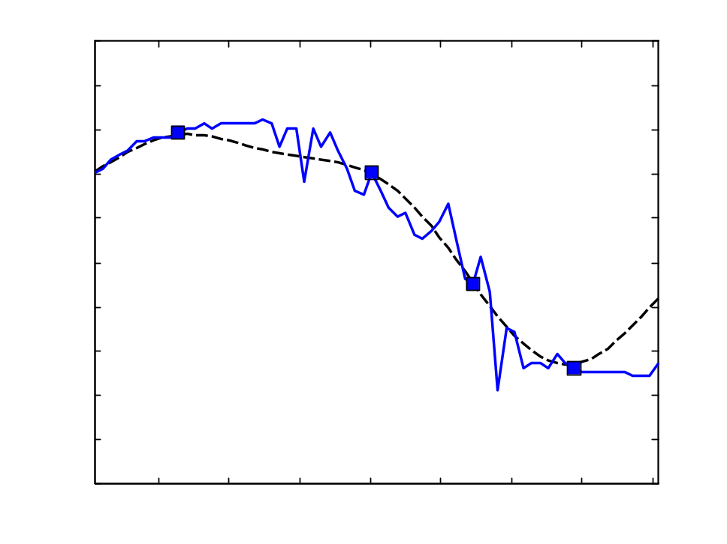
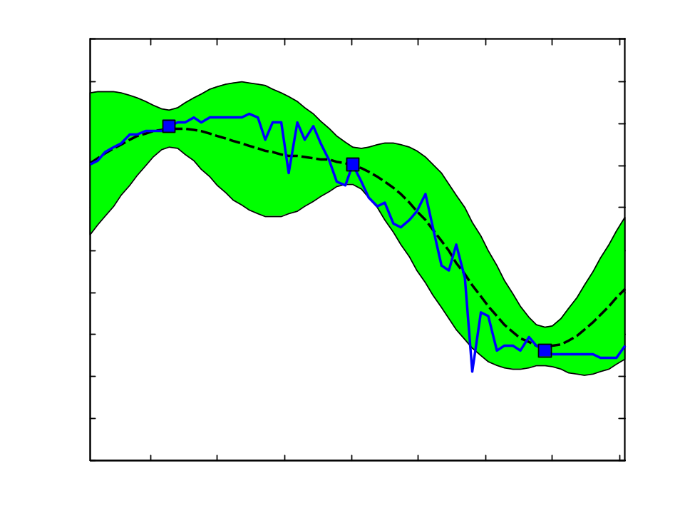
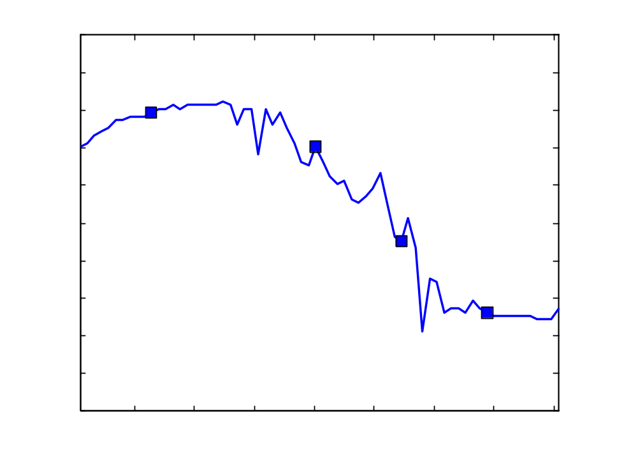
Observation selection for spatial prediction
observations
Prediction
pH value
Confidence
bands
Unobserved
process
Horizontal position
Gaussian processes
  Allow prediction at unobserved locations (regression)
  Allows estimating uncertainty in prediction

Slide 4
Mutual Information
[Caselton Zidek 1984]
Finite set of possible locations V
For any subset A µ V, can compute
Want: A* = argmax MI(A) subject to |A| · k
Finding A* is NP hard optimization problem ☹
Entropy of
uninstrumented
locations
before sensing
Entropy of
uninstrumented
locations
after sensing

Slide 5
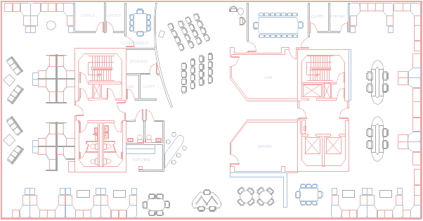
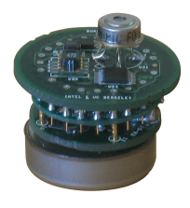
The greedy algorithm
Want to find: A* = argmax_{|A|=k} MI(A)
Greedy algorithm:
  Start with A = ;
  For i = 1 to k
    s* := argmax_{s} MI(A [ {s})
    A := A [ {s*}
Theorem [ICML 2005, with Carlos Guestrin, Ajit Singh]
Result of
greedy algorithm
Constant
factor, ~63%
Optimal
solution

Slide 6
A priori vs. sequential
Greedy algorithm finds near-optimal a priori set:
  Sensors are placed before making observations
In many practical cases, we want to sequentially select observations:
  Select next observation depending on the previous observations made
Focus of the talk!

Slide 7
Sequential design
X₅=?
X₅=17
X₅=21
Observation
policy π
X₃ =?
X₃ =16
X₂ =?
X₇ =?
X₇ =19
X₁₂=?
X₂₃ =?
MI(π) = 3.1
MI(X₅=17, X₃=16,
X₇=19) = 3.4
MI(…) = 2.1
MI(…) = 2.4
Observed variables depend on previous measurements and observation policy π
MI(π) = expected MI score over outcome of observations
Notes:
No labels; say something about richness

Slide 8
Is sequential better?
Sets are very simple policies. Hence:
max_{A} MI(A) · max_{π} MI(π) subject to |A|=|π|=k
Key question addressed in this work:
How much better is sequential vs. a priori design?
Main motivation:
  Performance guarantees about sequential design?
  A priori design is logistically much simpler!

Slide 9
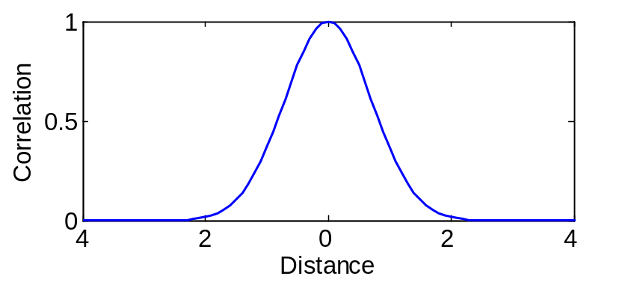
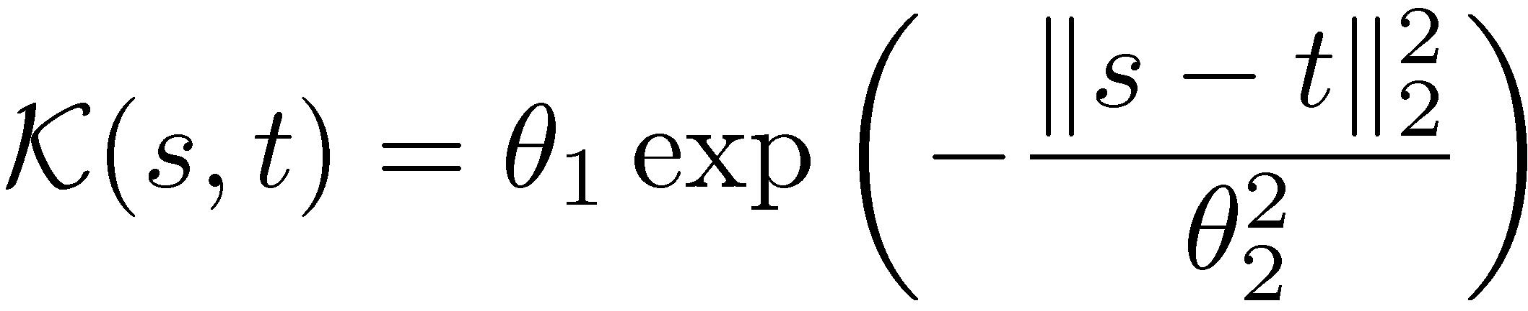
GPs slightly more formally
Set of locations V
Joint distribution P(X_{V})
For any A µ V, P(X_{A}) Gaussian
GP defined by
  Prior mean μ(s) [often constant, e.g., 0]
  Kernel K(s,t)
8
7.8
X_{V}
pH value
7.6
7.4
…
…
Position along transect (m)
V
Example: Squared
exponential kernel
θ₁: Variance
(Amplitude)
θ₂: Bandwidth
Notes:
Label for x-axis, not smooth

Slide 10
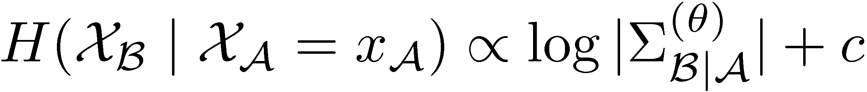
Known parameters
Known parameters θ
(bandwidth, variance, etc.)
Mutual Information does not depend on observed values:
No benefit in sequential design!
max_{A} MI(A) = max_{π} MI(π)
Notes:
More umph between 1&2 (perhaps surprisingly)

Slide 11
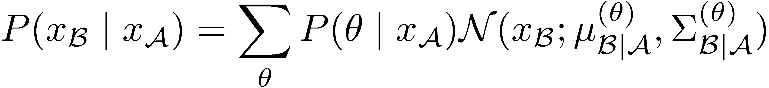
Unknown parameters
Assume
discretized
in this talk
Unknown parameters:
Bayesian approach: Prior P(Θ = θ)
Mutual Information does
depend on observed values!
depends on observations!
Sequential design can be better!
max_{A} MI(A) · max_{π} MI(π)
Notes:
bottom box should be <=
need to be clear about discretization of theta somewhere in talk, perhaps here.

Slide 12
Key intuition of our main result
How large is this gap?
Gap depends on H(Θ)
No gap!
MI
0
MI(A*)
MI(π*)
Best set
Best policy
If Θ=θ known: MI(A*) = MI(π*)
If Θ “almost” known: MI(A*) ¼ MI(π*)
“Almost” known ⬄ H(Θ) small
Notes:
Define pi*, A* here

Slide 13
How big is the gap?
Theorem: As H(Θ) ! 0
If H(Θ) small, no point in active learning:
we can concentrate on finding the best set A*!
Notes:
Practice….!! MI(pi*)-MI(A*)

Slide 14
Near-optimal policy if parameter approximately known
Use greedy algorithm to optimize
MI(A_{greedy} | Θ) = ∑_{θ} P(θ) MI(A_{greedy} | θ)
If parameters almost known,
can find near-optimal sequential policy.
What if parameters are unknown?
Corollary [using our result from ICML 05]
Result of
greedy algorithm
~63%
Optimal
seq. plan
Gap ¼ 0
(known par.)
Notes:
Pop up summary box – what happens if gap is large?

Slide 15
Exploration—Exploitation for GPs
 | Reinforcement Learning | Active Learning in GPs
Parameters | P(S_{t+1}|S_{t}, A_{t}), Rew(S_{t}) | Kernel parameters Θ
(Almost) Known parameters: Exploitation | Find near-optimal policy by solving MDP! | Find near-optimal policy by finding best set
Unknown parameters: Exploration | Try to quickly learn parameters! Need to waste only polynomially many robots! ☺ | Try to quickly learn parameters. How many samples do we need?

Slide 16
Info-gain exploration (IGE)
Gap depends on H(Θ)
Intuitive heuristic: greedily select
  s* = argmax_{s} H(Θ) – H(Θ | X_{s})
No sample complexity bounds ☹
Does not directly try to improve spatial prediction
Notes:
what’s predictive uncertainty?

Slide 17
Implicit exploration (IE)
Sequential greedy algorithm: Given previous
observations X_{A} = x_{A}, greedily select
s* = argmax_{s} MI ({s} | X_{A}=x_{A}, Θ)
Contrary to a priori greedy, this algorithm takes observations into account (updates parameters)
Proposition: H(Θ | X_{π}) · H(Θ)
“Information never hurts” for policies
Neither of the two strategies has
sample complexity bounds ☹
Is there any way to get them?
No sample
complexity
bounds ☹
Notes:
Popup circle on Xa=xa
if there is room, say”
“information never hurts” for policies

Slide 18
Learning the bandwidth
Sensors outside
bandwidth are
¼ independent
Kernel
Bandwidth
Sensors within
bandwidth are
correlated
Can narrow down kernel bandwidth by sensing within and outside bandwidth distance! ☺
Notes:
replace sampling with measuring or sensing

Slide 19
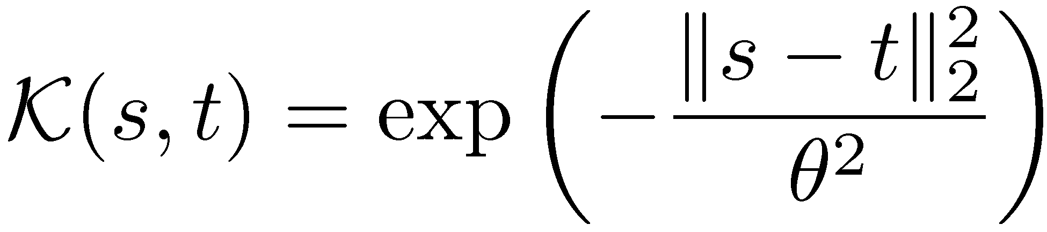
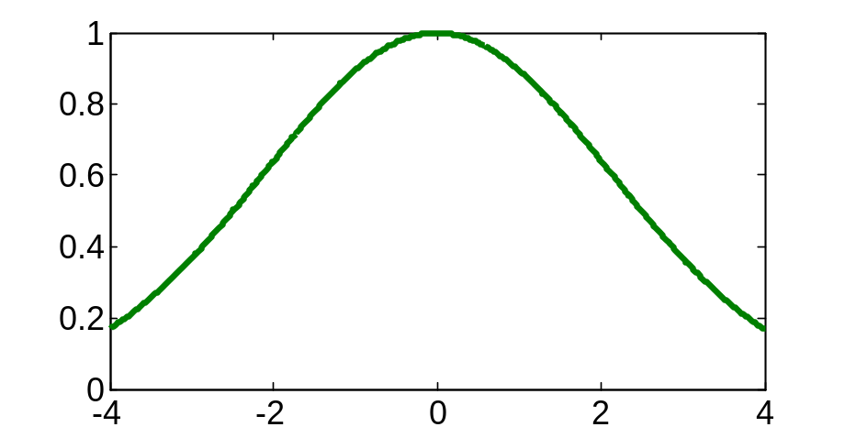
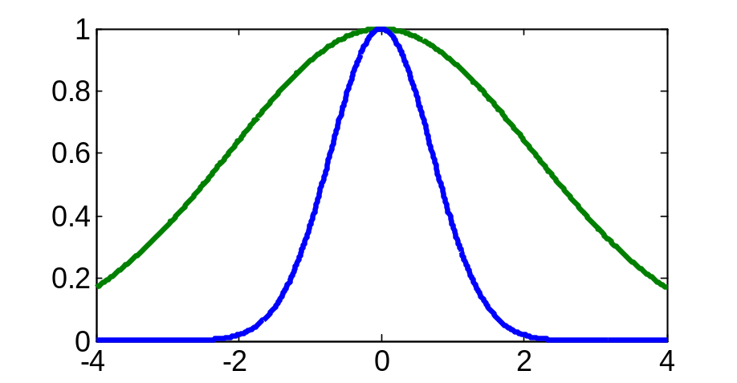
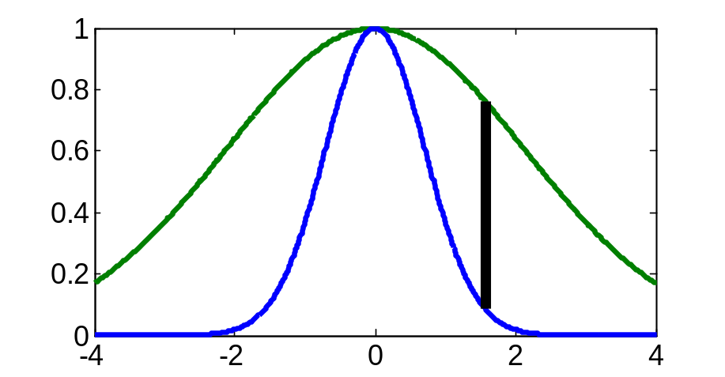
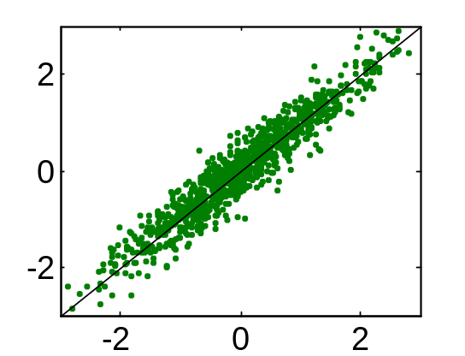
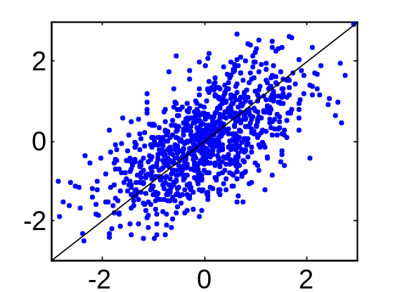
Hypothesis testing:
Distinguishing two bandwidths
Square exponential kernel:
Choose pairs of samples at distance Δ
to test correlation!
BW = 3
BW = 1
Distance Δ
Correlation
under BW=3
Correlation
under BW=1
correlation gap largest
Notes:
PRACTICE!!!!!!!!!!!!!!!

Slide 20
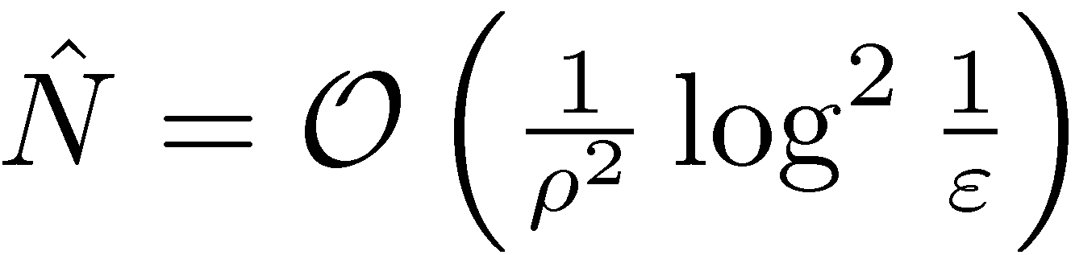
Hypothesis testing:
Sample complexity
Theorem: To distinguish bandwidths with minimum gap ρ in correlation and error < ε
we need independent samples.
In GPs, samples are dependent, but “almost” independent samples suffice! (details in paper)
Other tests can be used for variance/noise etc.
What if we want to distinguish more than two bandwidths?

Slide 21
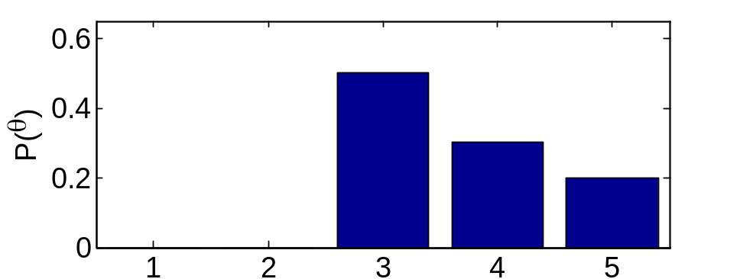
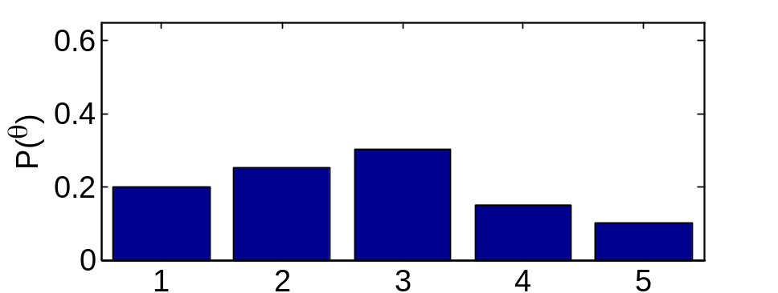
Hypothesis testing:
Searching for bandwidth
Find “most informative split” at posterior median
Test: BW>2?
Test: BW>3?
Testing policy π_{ITE} needs only logarithmically
many tests! ☺
Notes:
Define terms

Slide 22
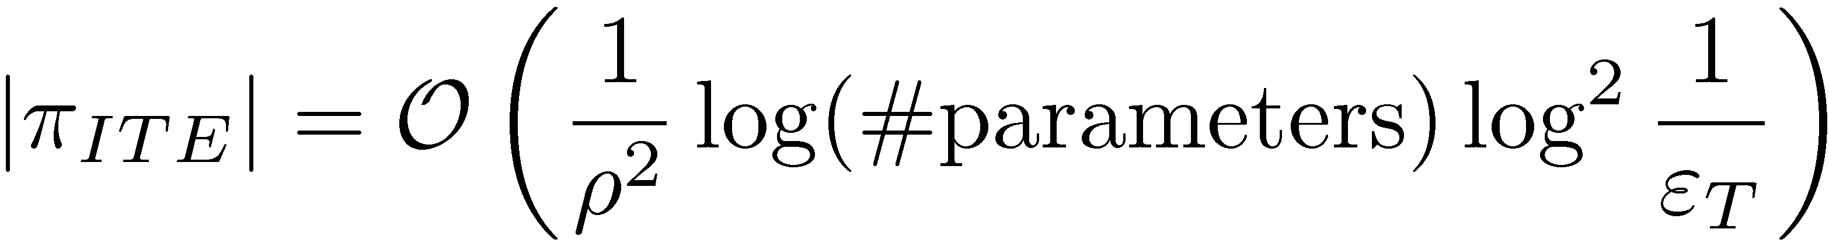
Hypothesis testing:
Exploration Theorem
Theorem: If we have tests with error < ε_{T} then
Logarithmic sample complexity
ε_{T} error probability of hypothesis tests
π_{ITE} Hypothesis testing exploration policy
Notes:
MORE UMPH!!!!!!

Slide 23
Exploration—Exploitation Algorithm
Exploration phase
  Sample according to exploration policy
  Compute bound on gap between best set and best policy
  If bound < specified threshold, go to exploitation phase, otherwise continue exploring.
Exploitation phase
  Use a priori greedy algorithm select remaining samples
For hypothesis testing, guaranteed to proceed to exploitation after logarithmically many samples! ☺
Notes:
Make exploit appear earlier

Slide 24
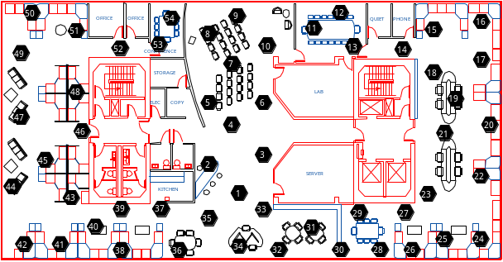
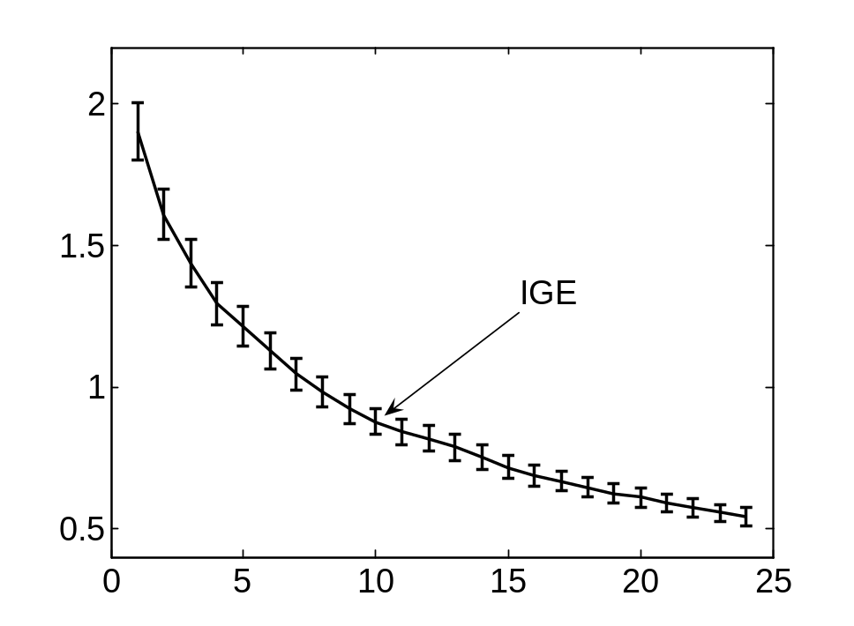
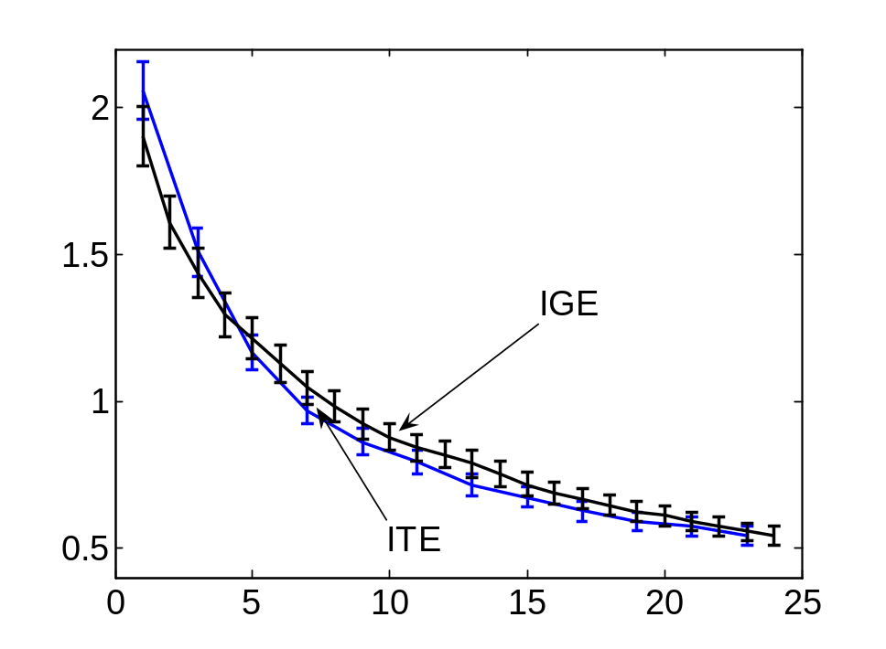
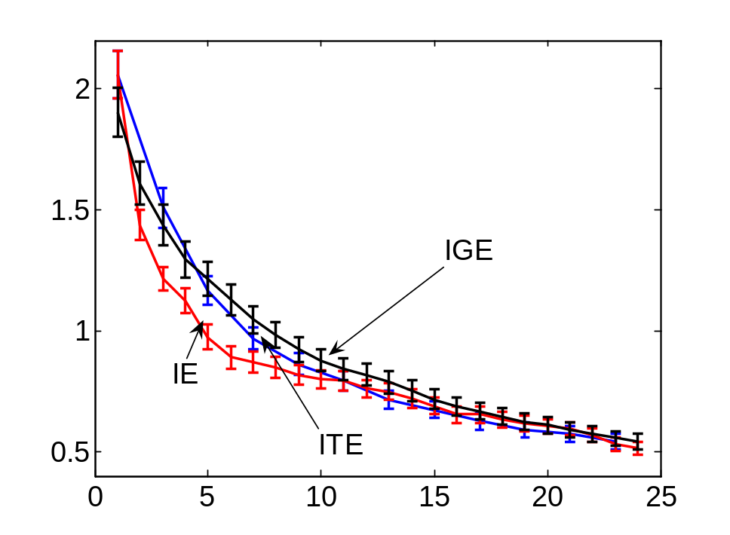
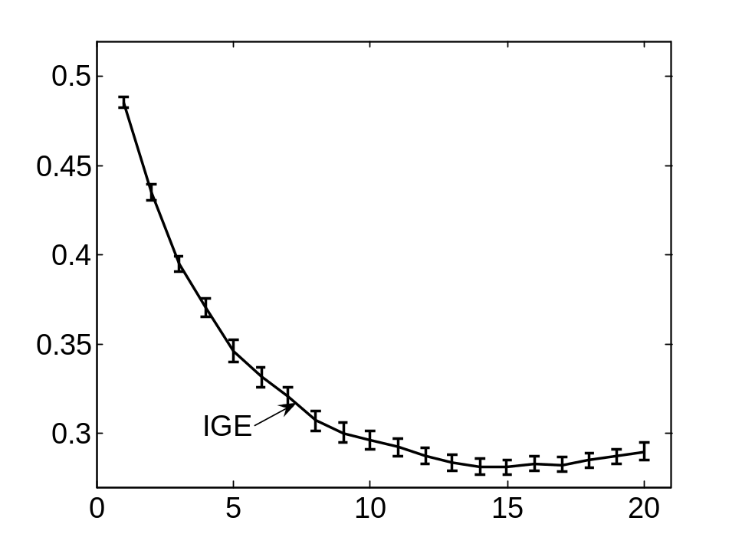
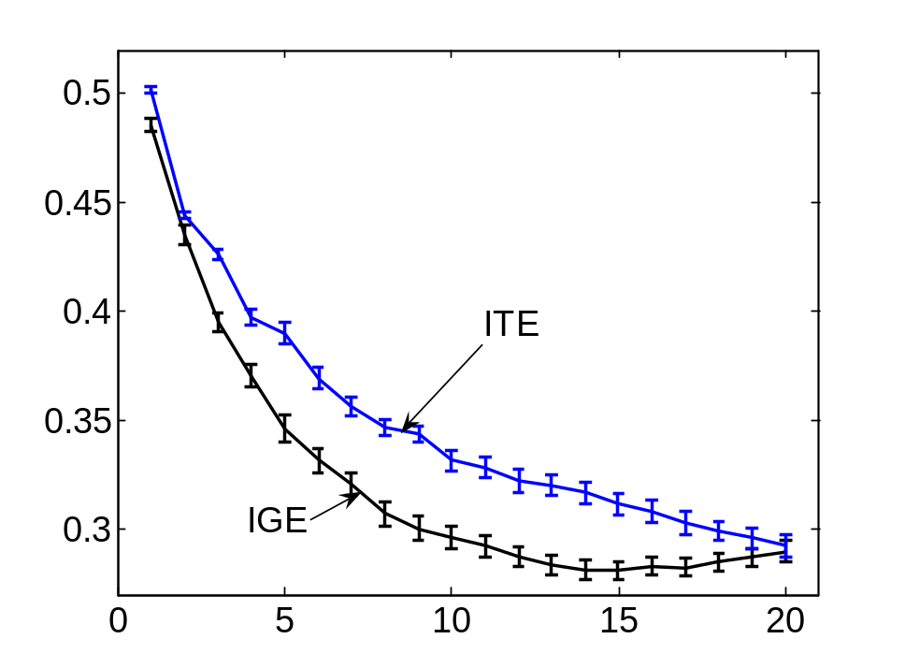
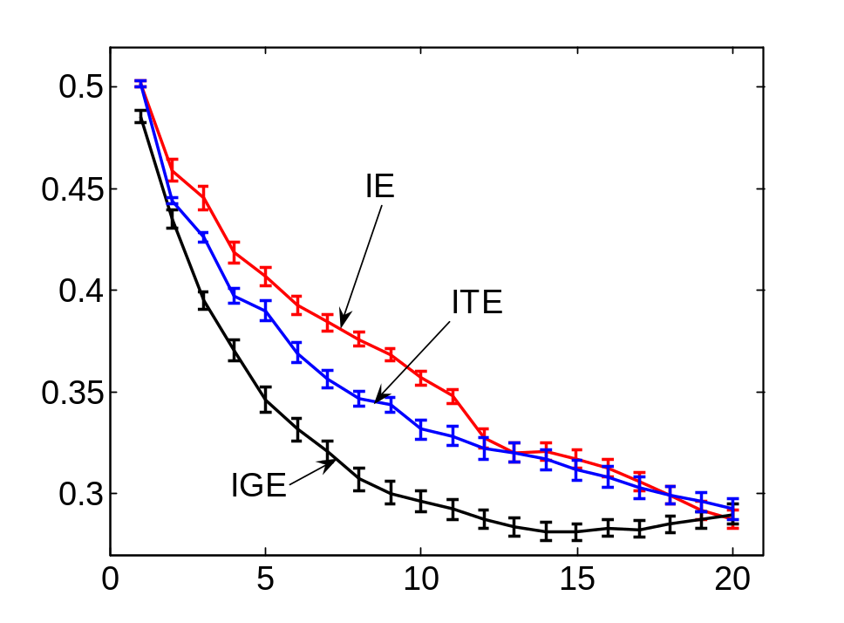
Results
Temperature data
IGE: Parameter info-gain
ITE: Hypothesis testing
IE: Implicit exploration
More RMS error
More param. uncertainty
More observations
More observations
None of the strategies dominates each other
Usefulness depends on application
Notes:
IGE legend: Parameter Info-Gain
Legend (IGE,…)

Slide 25
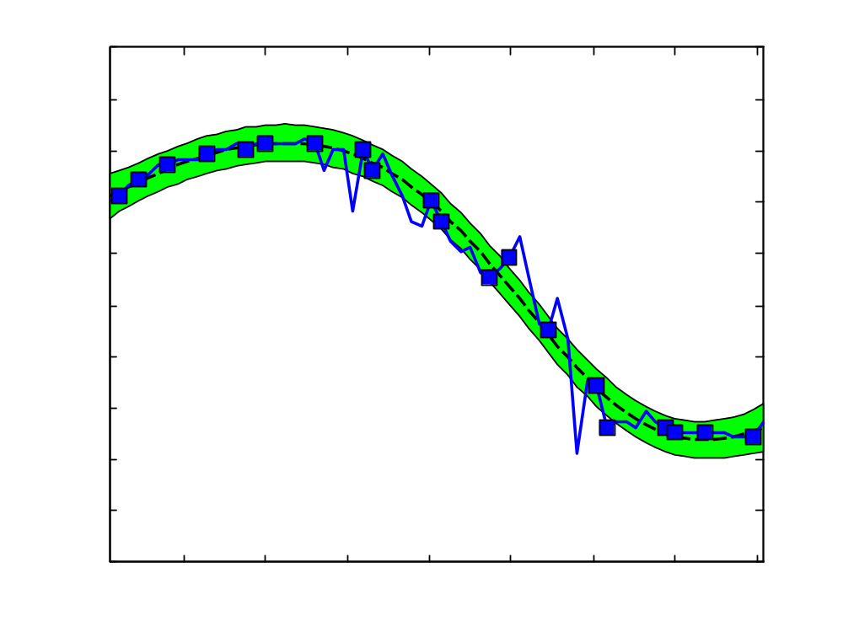
River data
pH data from Merced river
Isotropic process is a bad fit
Need nonstationary approach

Slide 26
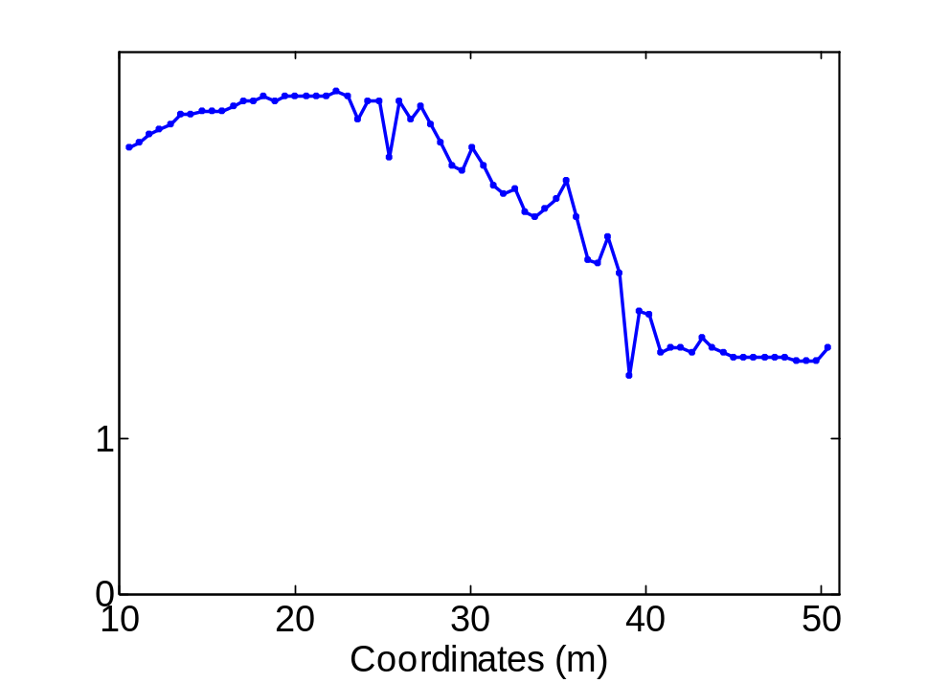
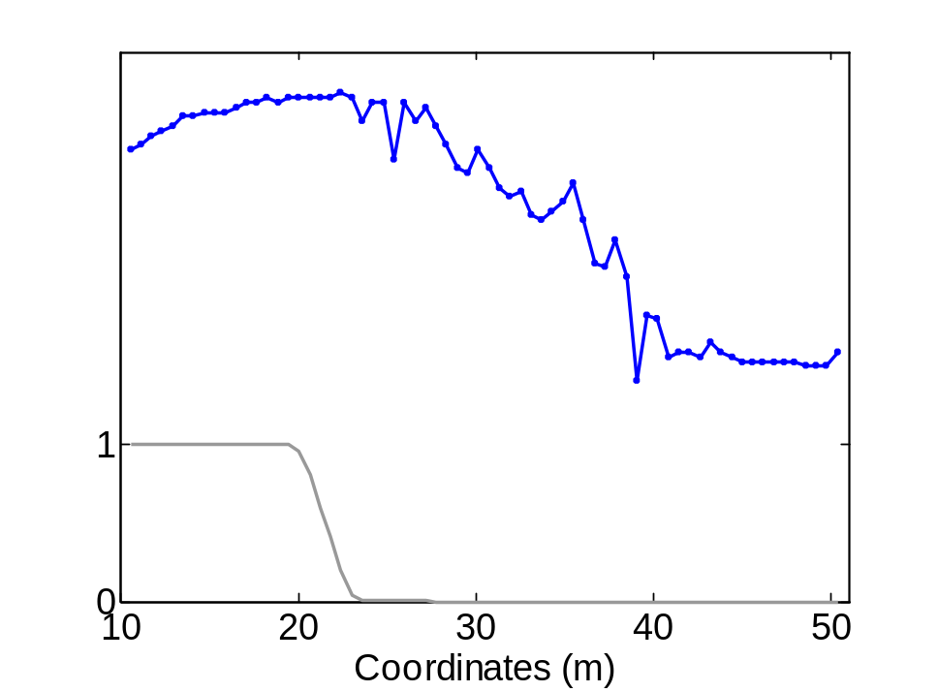
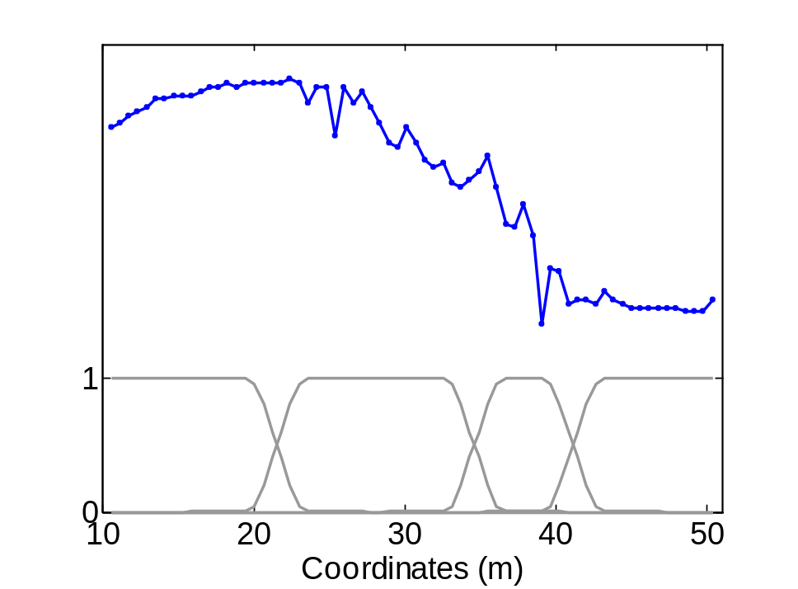
Nonstationarity by spatial partitioning
Partition into regions
Isotropic GP for each region, weighted by region membership
Final GP is spatially varying linear combination
Exploration—Exploitation approach applies to nonstationary models as well!

Slide 27
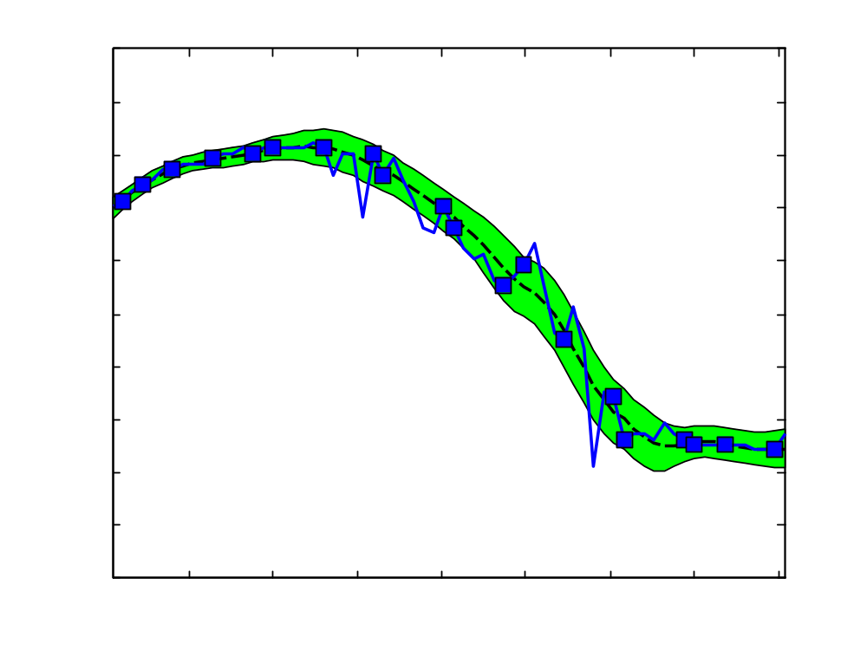
Nonstationary GPs
Stationary fit
Nonstationary fit
Nonstationary model fits much better
Problem: Parameter space blows up exponentially in #regions
Solution: Variational approximation (BK-style) allows efficient approximate inference (Details in paper) ☺
Notes:
exponentially in what?

Slide 28
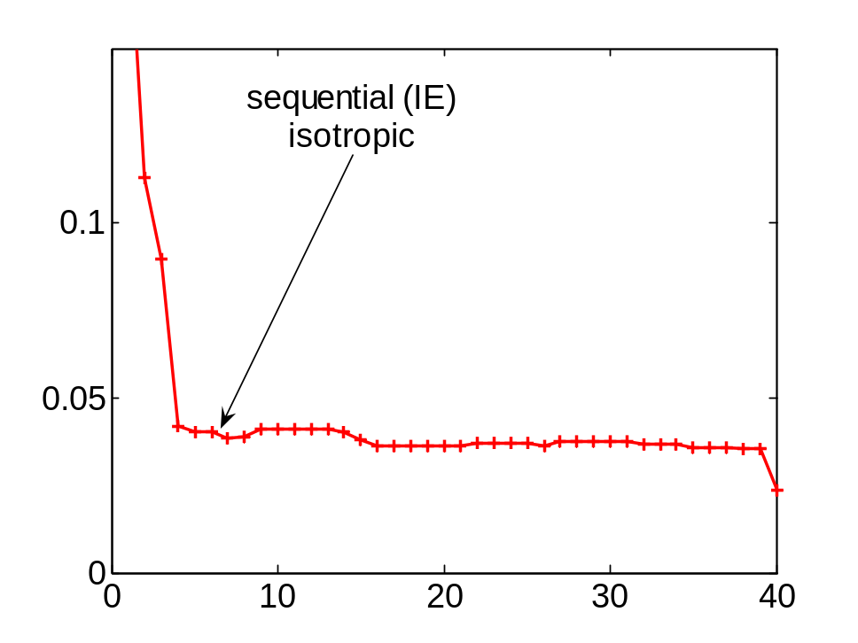
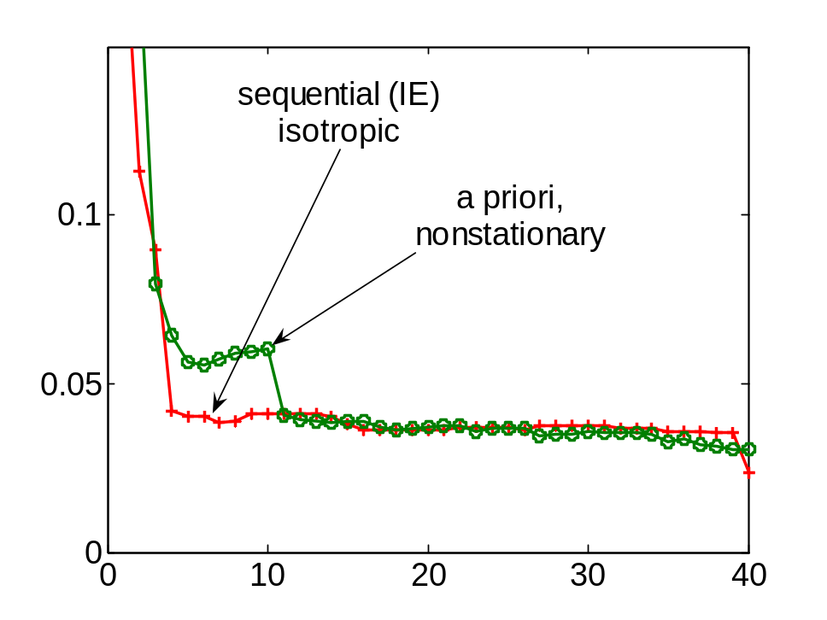
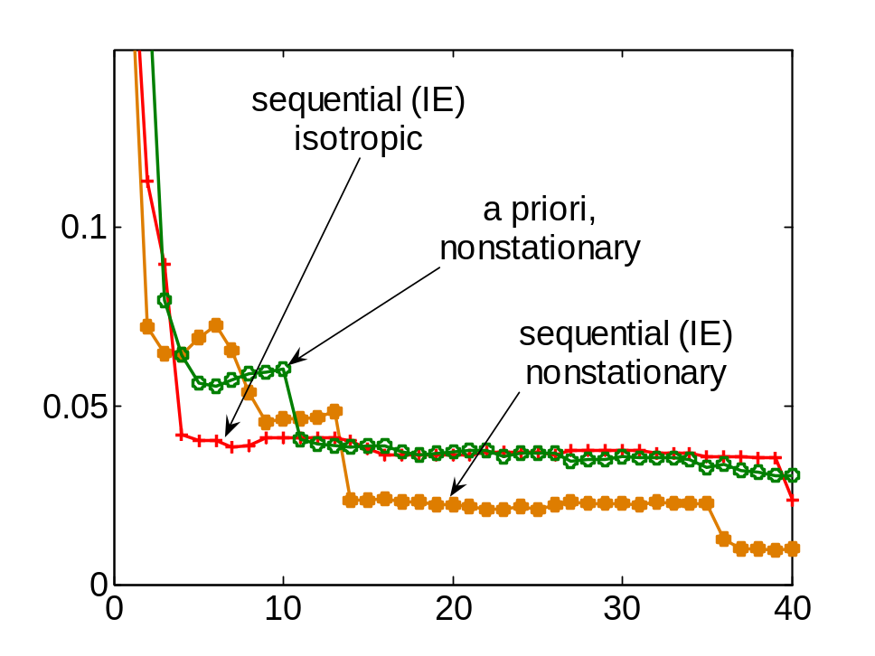
Results on River data
More RMS error
pH data from Merced river
(Kaiser et al.)
More observations
Nonstationary model + active learning
lead to lower RMS error
Notes:
Isotropic as before; maybe nonstationary has less bias? Key is to combine…

Slide 29
Conclusions
Nonmyopic approach towards active learning in GPs
If parameters known, greedy algorithm achieves
near-optimal exploitation
If parameters unknown, perform exploration
  Implicit exploration
  Explicit, using information gain
  Explicit, using hypothesis tests, with logarithmic sample complexity bounds!
  Each exploration strategy has its own advantages
Can use bound to compute when to stop exploring
Presented extensive evaluation on real world data
  See poster yesterday for more details
Notes:
Less time on exploration; don’t mention

