Slide 1
A Utility-Theoretic Approach to Privacy and Personalization
Andreas Krause
Carnegie Mellon University
work performed during an internship at Microsoft Research
Joint work with Eric Horvitz
Microsoft Research
23rd Conference on Artificial Intelligence | July 16, 2008
TexPoint fonts used in EMF.
Read the TexPoint manual before you delete this box.: AAAAAA

Slide 2

Value of private information to enhancing search
Personalized web search is a prediction problem:
“Which page is user X most likely interested in for query Q?”
The more information we have about the user,
the better services can be provided to users
Users are reluctant to share private information
(or don’t want search engines to log data)
We apply utility theoretic methods to optimize tradeoff:
Getting the biggest “bang” for the “personal data buck”

Slide 3
Utility theoretic approach
Utility of
knowing
Net benefit
to user
Sensitivity
of sharing
–
=
Sharing personal information
(topic interests, search history, IP address etc.)

Slide 4
Utility theoretic approach
Utility of
knowing
Sensitivity
of sharing
Net benefit
to user
–
=
Sharing more information might decrease net benefit

Slide 5
Maximizing the net benefit
?
Net benefit
Share no
information
Share much
information
How can we find optimal tradeoff maximizing net benefit?

Slide 6

Trading off utility and privacy
Set V of 29 possible attributes (each · 2 bits)
  Demographic data (location)
  Query details (working hours / week day?)
  Topic interests (ever visited business / science / … website)
  Search history (same query / click before / searches/day?)
  User behavior (ever changed Zip, City, Country)?
For each A µ V compute utility U(A) and cost C(A)
Find A maximizing U(A) while minimizing C(A)

Slide 7

Estimating utility U(A) of sharing data
Ideally: how does knowing A help increase the relevance of displayed results?
  Very hard to estimate from data ☹
Proxy [Mei and Church ’06, Dou et al ‘07]: Click entropy!
  Learn probabilistic model for
  P( C | Q, A) = P( click | query, attributes )
  U(A) = H( C | Q ) – H( C | Q, A )
C
Search goal
Q
Query
X₁
Age
X₂
Gender
X₃
Country
Entropy before
revealing attributes
Entropy after
revealing attributes
E.g.: A = {X₁, X₃}
U(A) = 1.3

Slide 8
Click entropy example
C
Search goal
Q
Query
X₁
Age
X₂
Gender
X₃
Country
Query: sports
Freq
Country:
USA
Freq
Entropy
Reduction:
0.9
Pages
1
2
3
4
5
6
1
2
3
4
5
6
Entropy H = 2.6
H = 1.7
U(A) = expected click entropy reduction knowing A

Slide 9
Study of Value of Personal Data
Estimate click entropy from volunteer search log data.
  ~15,000 users
  Only frequent queries (¸ 30 users)
  Total ~250,000 queries during 2006
Example: Consider topics of prior visits,
V = {topic_arts,topic_kids}
Query: “cars”, prior entropy: 4.55
  U({topic_arts}) = 0.40
  U({topic_kids}) = 0.41
How does U(A) increase as we pick more attributes A?

Slide 10
Diminishing returns for click entropy
2
1.8
1.6
A*: Search activity
T*: Topic interests
1.4
More utility
(entropy reduction)
1.2
1
0.8
0.6
0.4
0.2
0
none
ATLV
THOM
ACTY
TGAM
TSPT
AQRY
ACLK
AWDY
AWHR
TCIN
TADT
DREG
TKID
AFRQ
TSCI
THEA
TNWS
TCMP
ACRY
TREF
More private attributes (greedily chosen)
The more attributes we add, the less we gain in utility
Theorem: Click entropy U(A) is submodular!*
*See store for details
Notes:
Add legend (A*,D*,T*)

Slide 11
Trading off utility and privacy
Set V of 29 possible attributes (each · 2 bits)
  Demographic data (location)
  Query details (working hours / week day?)
  Topic interests (ever visited business / science / … website)
  Search history (same query / click before / searches/day?)
  User behavior (ever changed Zip, City, Country)?
For each A µ V compute utility U(A) and cost C(A)
Find A maximizing U(A) while minimizing C(A)

Slide 12
Getting a handle on cost
Identifiability: “Will they know it’s me?”
Sensitivity: “I don’t feel comfortable sharing this!”

Slide 13
Identifiability cost
Intuition: The more attributes we already know, the more identifying it is to add another
Goal: Avoid identifiability
For example: k-anonymity [Sweeney ‘02], and others
Occupation
Age
Gender

Slide 14
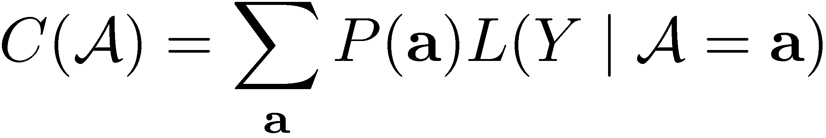

Identifiability cost
Predict person Y from attributes A
Example: P(Y | gender = female, country = US)
Define “loss” function [c.f., Lebanon et al.]
Identifiability cost
Freq
Freq
User
1
2
3
4
5
6
User
1
2
3
4
5
6
Good! Predicting user is hard.
Bad! Predicting user is easy!
Worst-case probability of detection

Slide 15
Identifiability cost
0.7
0.6
0.5
0.4
Less identifiability cost
0.3
0.2
0.1
0
none
TCMP
AWDY
AWHR
AQRY
ACLK
ACRY
TREG
TWLD
TART
TREF
ACTY
TBUS
THEA
TREC
AZIP
TNWS
TSPT
TSHP
TSOC
AFRQ
TSCI
ATLV
TKID
DREG
TADT
THOM
TGMS
TCIN
More private attributes (greedily chosen)
The more attributes we add, the larger the
increase in cost: Accelerating cost
Theorem: Identifiability cost C(A) is supermodular!*
*See store for details

Slide 16
Trading off utility and privacy
Set V of 29 possible attributes (each · 2 bits)
  Demographic data (location)
  Query details (working hours / week day?)
  Topic interests (ever visited business / science / … website)
  Search history (same query / click before / searches/day?)
  User behavior (ever changed Zip, City, Country)?
For each A µ V compute utility U(A) and cost C(A)
Find A maximizing U(A) while minimizing C(A)

Slide 17

Trading off utility and cost
Utility
Cost
Final objective
Greedy forward selection for utility
1.4
0.8
(Lazy) Greedy forward selection
1.4
1.2
1.2
1
0.6
1
- λ
0.8
=
0.4
0.8
0.6
Utility - Cost
Reduction in click entropy
0.2
0.6
Privacy cost (p log(1-p))
0.4
Trade-off
parameter
0.4
0
0.2
0.2
0
0
wday
whour
reg
bus
adult
world
ctry
gdr
arts
comp
refs
kids
home
age
occ
all
-0.2
no
occ
adult
age
whour
gdr
home
wday
ctry
kids
refs
bus
comp
world
arts
reg
none
occ
home
whour
age
wday
gender
reg
bus
world
adult
arts
country
comp
ref
kids
U(A)
C(A)
F_{λ}(A)
submodular
supermodular
submodular
(non-monotonic)
Want: A* = argmax F_{λ}(A)
Optimizing value of private information is a submodular problem!
➔ Can use algorithms for optimizing submodular functions:
  Goldengorin et al. (branch and bound), Feige et al. (approx. algorithm),..
Can efficiently get provably near-optimal tradeoff! ☺
NP hard (and large: 2²⁹ subsets)

Slide 18
Finding the “sweet spot”
Want: A* = argmax U(A) - λ C(A)
Which λ should we choose?
2
Sweet spot!
Maximal utility at
maximal privacy
1.5
λ = 1
λ = 0
1
λ = 10
“ignore
cost”
More utility U(A)
Tradeoff-curve purely based on log data.
What λ do users prefer?
0.5
λ = 1
“ignore utility”
0
0
0.1
0.2
0.3
0.4
0.5
0.6
Less cost C(A)

Slide 19
Survey for eliciting cost
Microsoft internal online survey
Distributed internationally
N=1451 responses from 35 countries (80% US)
Incentive: 1 Zune™ digital music player

Slide 20

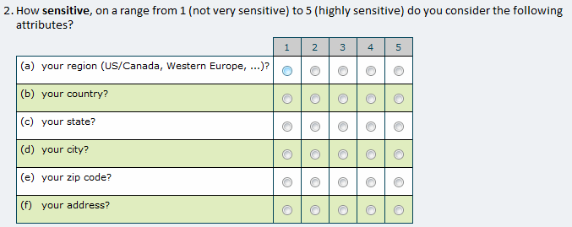
Identifiability vs sensitivity

Slide 21
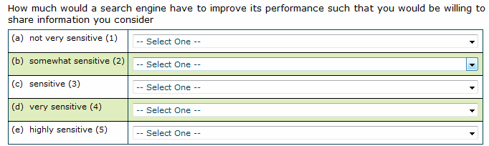
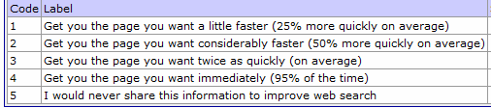
Sensitivity vs utility

Slide 22
Seeking a common currency
Address
never
Zip
City
Speedup required
Location Granularity
4
State
Country
2
1.5
1.25
Region
1
2
3
4
5
1
2
3
4
5
Sensitivity
Sensitivity
Sensitivity acts as common currency to
estimate utility-privacy tradeoff

Slide 23
Calibrating the tradeoff
4
4
2
λ
= 1
1.5
3
3
Identifiability cost
λ
= 10
Identifiability cost
Utility (entropy reduction)
(from search logs)
1
Entropy reduction required
(from search logs)
Entropy reduction required
2
2
λ
= 100
0.5
Survey data
Survey data
Survey data
(median)
(median)
1
(median)
0
1
0
0.1
0.2
0.3
0.4
0.5
0.6
Cost (maxprob)
Best fit for
λ = 5.12
0
0
F_{λ}(A) = U(A) - λ C(A)
region
region
country
country
state
state
city
city
zip
zip
Can use survey data to calibrate utility privacy tradeoff!
User preferences map into sweet spot!

Slide 24
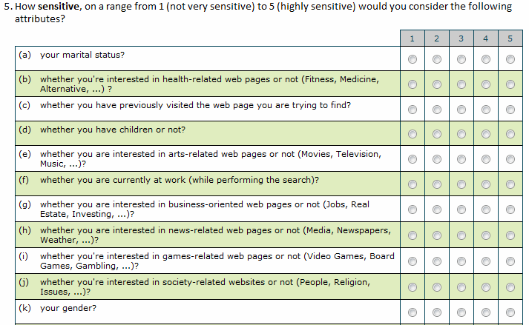
Understanding Sensitivities:
“I don’t feel comfortable sharing this!”

Slide 25
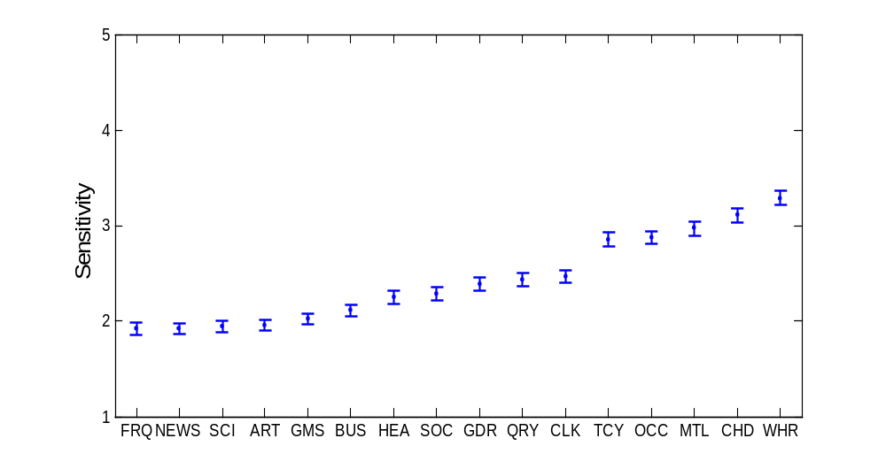
Attribute sensitivities
Significant differences
between topics!
We incorporate sensitivity in our cost function by calibration
Notes:
© 2007 Microsoft Corporation. All rights reserved. Microsoft, Windows, Windows Vista and other product names are or may be registered trademarks and/or trademarks in the U.S. and/or other countries. The information herein is for informational purposes only and represents the current view of Microsoft Corporation as of the date of this presentation. Because Microsoft must respond to changing market conditions, it should not be interpreted to be a commitment on the part of Microsoft, and Microsoft cannot guarantee the accuracy of any information provided after the date of this presentation. MICROSOFT MAKES NO WARRANTIES, EXPRESS, IMPLIED OR STATUTORY, AS TO THE INFORMATION IN THIS PRESENTATION.
This plot shows the sensitivity of the different attributes. FRQ = avg 1+ query/day, NEWS = Visited News related websites, SCI = Vis. Science rel. websites, ART = Vis. Art related WS; GMS = Vis. Games rel. WS; BUS = Vis. Business rel. WS.; HEA = Vis. Health related WS; SOC = Vis. Society rel WS; GDR = Gender, QRY = Done same query before? CLK = Done same click before; TCY = Recently traveled between cities; OCC = Occupation; MTL = Marital status; CHD = Has children? WHR = Query done during working hours? Error bars are 95% confidence intervals

Slide 26
Comparison with heuristics
Utility U(A)
Cost C(A)
2
Net Benefit F(A)
1.5
1
0.899
More net benefit (bits of info.)
0.573
0.5
-1.73
-1.81
-3.3
0
-0.5
Optimized
tradeoff
Search statistics
(ATLV, AWDY,
AWHR, AFRQ)
All topic
interests
IP Address
Bytes 1&2
IP Address
Optimized solution: Repeated visit / query, workday / working hour,
top-level domain, avg. queries per day, topic: sports, topic: games
Optimized solution outperforms naïve selection heuristics!

Slide 27
Summary
Use of private information by online services as an optimization problem (with user permission /awareness)
  Utility (Click entropy) is submodular
  Privacy (Identifiability) is supermodular
Can use theoretical and algorithmic tools to efficiently find provably near-optimal tradeoff
Can calibrate tradeoff using user preferences
Promising results on search logs and survey data! ☺

Slide 28
Diminishing returns for click entropy
Selection A = {}
Selection B = {X₂,X₃}
C
Search goal
C
Search goal
X₂
Gender
X₃
Country
Adding X₁
will help a lot!
X₁
Age
Adding X₁
doesn’t help much
Theorem [based on Krause, Guestrin ’05]:
Click entropy reduction is submodular!*
New
feature X₁
Submodularity:
B
+
s
Large improvement
A
+
s
Small improvement
For Aµ B, U(A [ {s}) – U(A) ¸ U(B [ {s}) – U(B)
*See store for details

