Slide 1
Randomized Sensing in Adversarial Environments
Andreas Krause
Joint work with
Daniel Golovin and Alex Roper
International Joint Conference on Artificial Intelligence 2011
TexPoint fonts used in EMF.
Read the TexPoint manual before you delete this box.: AAAAAAAA

Slide 2
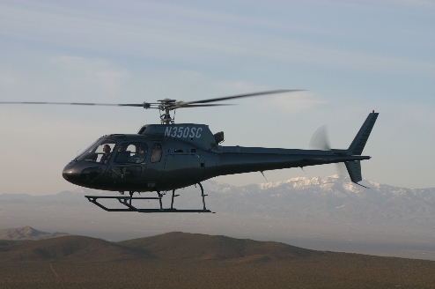
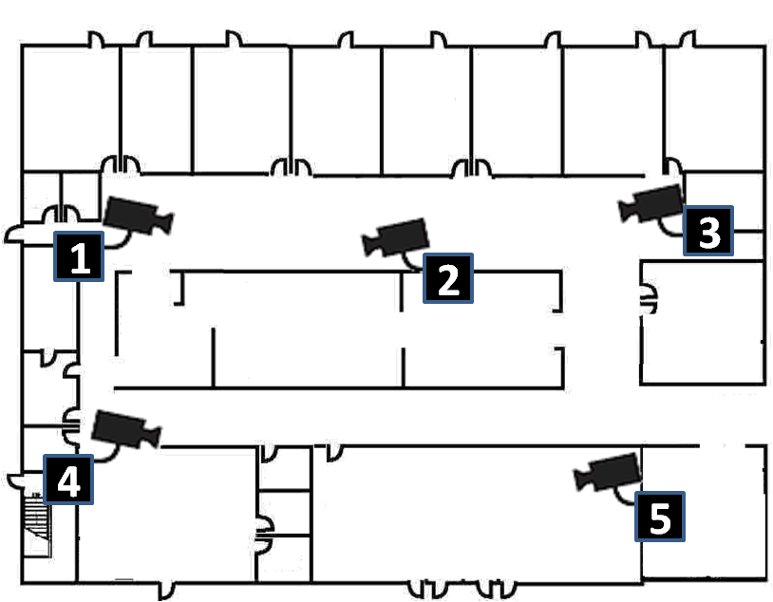
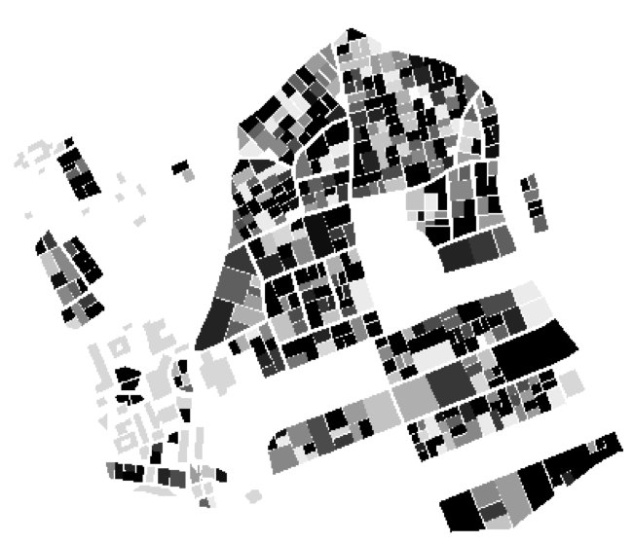
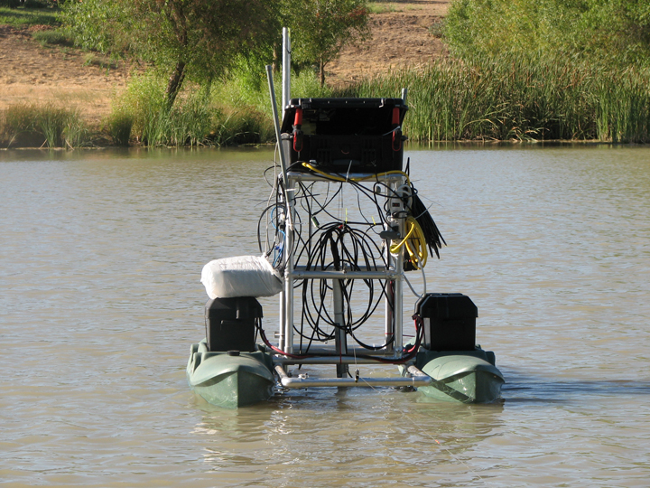
Motivation
Robotic environmental monitoring
Detect survivors after disaster
Coordinate cameras to detect intrusions
Want to manage sensing resources to enable robust monitoring under uncertainty

Slide 3


A Sensor Selection Problem
Select two cameras to query, in order to detect the most people.
Duplicates only counted once
People Detected:
4
2

Slide 4
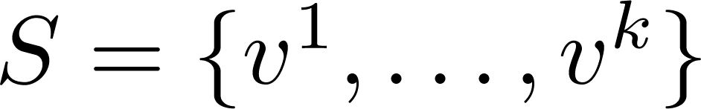

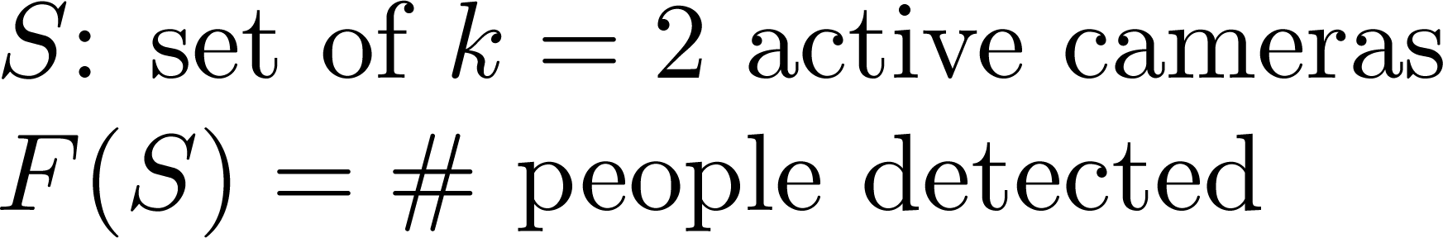
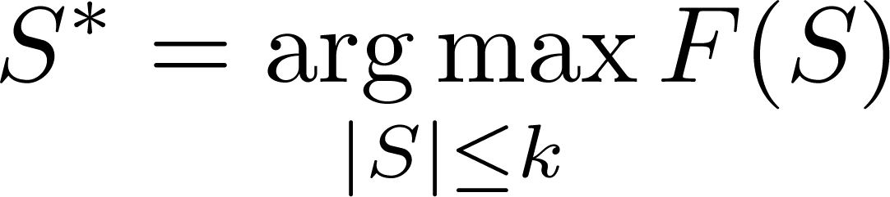
A Sensor Selection Problem
Set V of sensors, |V| = n
Select a set of k sensors
Sensing quality model
NP-hard…

Slide 5
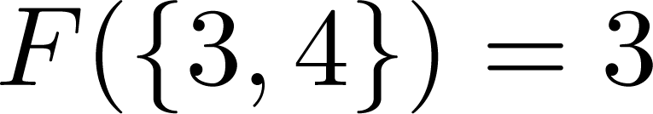
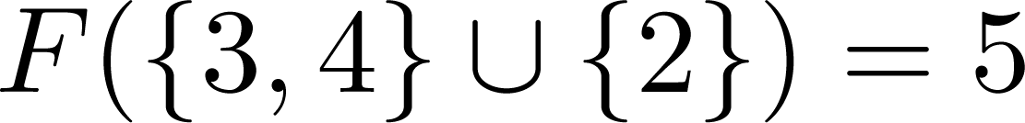
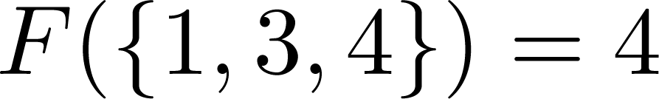
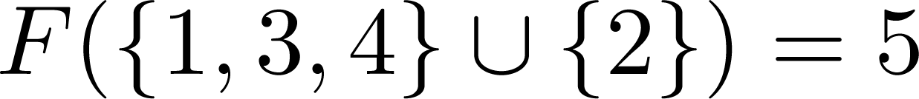

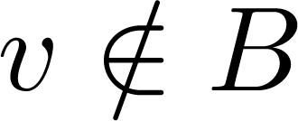
Submodularity
Diminishing returns property for adding more sensors.
+2
+1
For all , and a sensor ,
Many objectives are submodular [K, Guestrin ‘07]
Detection, coverage, mutual information, and others

Slide 6
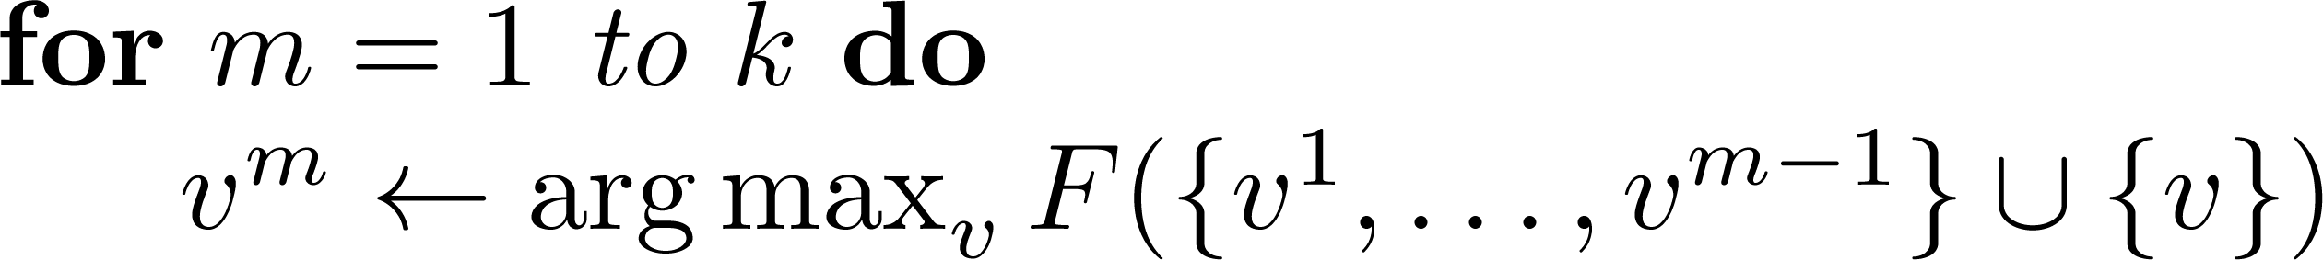
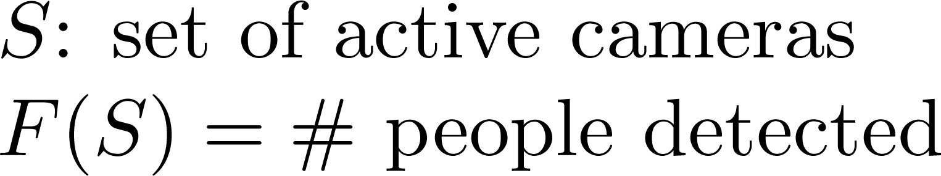
Greedy algorithm
Lets choose sensors S = {v¹ , … , v^{k}} greedily
[Nemhauser et al ‘78] If F is submodular, greedy algorithm gives constant factor approx.:

Slide 7
Sensing in Adversarial Environments
2
i | F_{i}({3}) | F_{i}({5})
1 | 0 | 1
2 | 1 | 0
1
Set I of m intrusion scenarios
For scenario i: F_{i}(A) is sensing utility when selecting A
Intruder chooses worst-case scenario, knowing the sensors

Slide 8
Deterministic minimax solution
One approach: Want to solve
[K, McMahan, Guestrin, Gupta ’08]:
NP-hard
Greedy algorithm fails arbitrarily badly
Saturate algorithm provides near-optimal solution

Slide 9
Disadvantage of minimax approach
i | F_{i}({3}) | F_{i}({5})
1 | 1 | 0
2 | 0 | 1
1
2
Suppose we pick {3} and {5} with probability 1/2
Randomization can perform arbitrarily better!

Slide 10
The randomized sensing problem
Given submodular functions F₁,…,F_{m}, want to find
NP-hard!
Even representing the optimal solution may require exponential space! ☹
Notes:
p^*=\mathop{\arg\max}_{p: p_A\geq 0\Rightarrow |A|\leq k} \min_i \sum_A p_A F_i(A)
p^*=\mathop{\arg\max}_{p: p_A\geq 0\Rightarrow |A|\leq k} \min_i \mathbb{E}_{A\sim p}[F_i(A)]
p^*=\mathop{\arg\max}_{p: p_A\geq 0\Rightarrow |A|\leq k} \mathbf{V}(p)
p^*=\mathop{\arg\max}_{p: p_A> 0\Rightarrow A\in\mathfrak{C}} \mathbf{V}(p)

Slide 11
Existing approaches
Many techniques for solving matrix games
Typically don’t scale to combinatorially large strategy sets
Security games [Tambe et al]
Solve large scale Stackelberg games for security applications
Cannot capture general submodular objective functions
LP based approach [Halvorson et al ‘09]
Double oracle with approximate best response
No polynomial time convergence convergence guarantee

Slide 12
Randomized sensing
Define
Distribution over sensing actions
Distribution over intrusions
Thus, can minimize over q instead of over p!
Notes:
M(p,q)=\mathbb{E}_{i\sim q}\mathbb{E}_{A\sim p}[F_i(A)]

Slide 13
Equivalent problem: Finding q*
Want to solve
Use multiplicative update algorithm [Freund & Schapire ‘99]
Initialize
For t = 1:T
NP-hard ☹
But submodular! ☺
Notes:
\beta=\frac{1}{1+\sqrt{2\ln m / T}}
A^{(t)}=\arg\max_A \sum_i q^{(t-1)}_i F_i(A)

Slide 14
The RSense algorithm
Initialize
For t=1:T
Use greedy algorithm to compute based on objective function
Update
Return
Notes:
\hat{p}_A = \frac{1}{T}\bigl|\{t: A^{(t)}=A\}\bigr|
F^{(t)}(A) = \sum_i q^{(t)}_i F_i(A)

Slide 15
Performance guarantee
Theorem: Let Suppose RSense runs for iterations. For the resulting distribution it holds that
Notes:
\min_i \mathbb{E}_{A\sim \hat{p}}[F_i(A)]\geq(1-1/e) \max_p \min_i \mathbb{E}_{A\sim p}[F_i(A)]

Slide 16
Handling more general constraints
So far: wanted
Many application may require more complex constraints:
Examples:
Informative path planning:
Controlling PTZ cameras:
Nonuniform cost:
Can replace greedy algorithm by - best response
RSense guarantees
Notes:
p^*=\mathop{\arg\max}_{p: p_A> 0\Rightarrow \color{blue}{A\in\mathfrak{C}}} \mathbf{V}(p)
\mathfrak{C}=\{|A|\leq k, A \text{ connected}\}

Slide 17
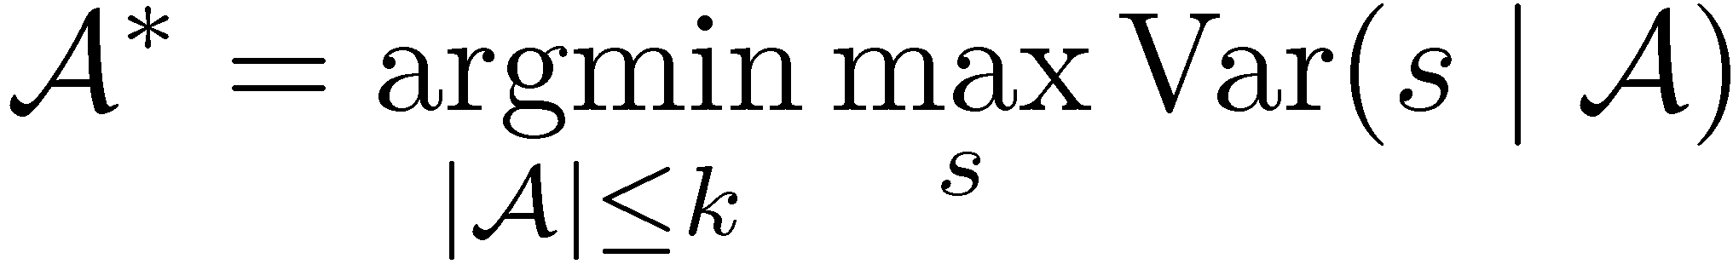
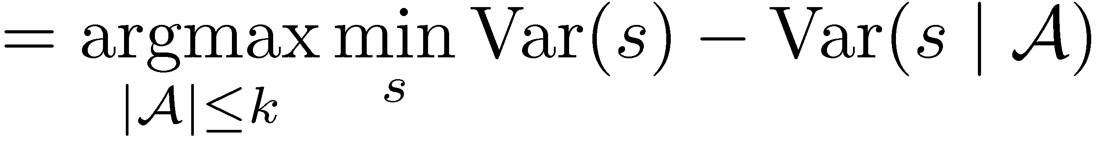
Example: Lake monitoring
Monitor pH values using robotic sensor
transect
Prediction at unobserved locations
Observations A
pH value
True (hidden) pH values
Var(s | A)
Use probabilistic model (Gaussian processes) to estimate prediction error
Position s along transect
Where should we sense to minimize our maximum error?
(often) submodular
[Das & Kempe ’08]

Slide 18
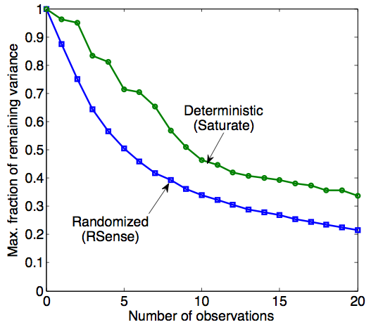
Experimental results
Randomized sensing outperforms deterministic solutions

Slide 19
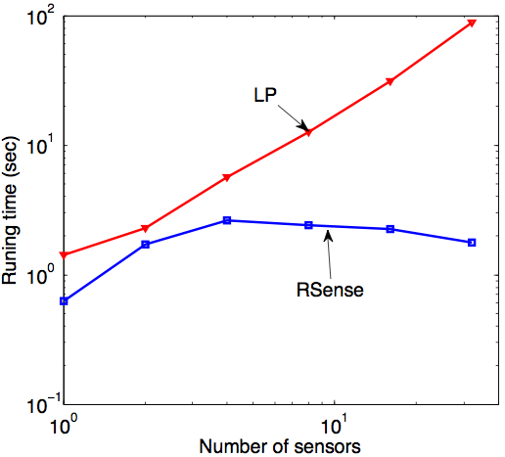
Running time
RSense outperforms existing LP based method

Slide 20
pSPIEL Results: Search & Rescue
Map from Robocup Research Challenge
Coordination of multiple mobile sensors to detect survivors of major urban disaster
Buildings obstruct viewfield of camera
F_{i}(A) = Expected # of people detected at location i
Detection Range
Detected Survivors

Slide 21
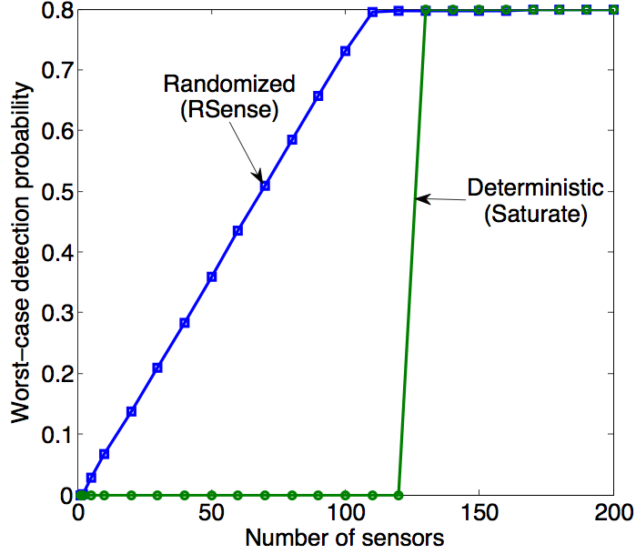
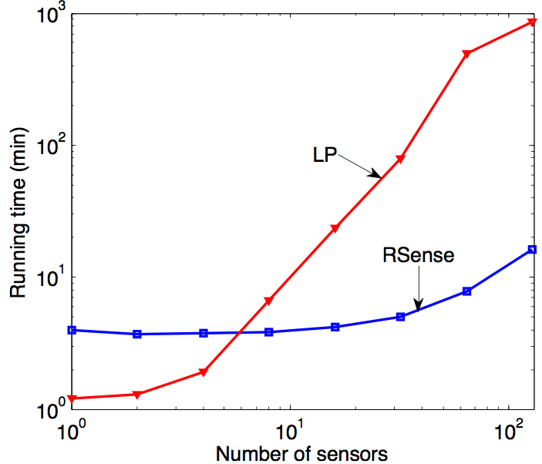
Experimental results
Randomization outperforms deterministic solution
RSense finds solution faster than existing methods

Slide 22
Worst- vs. average case
Given: Possible locations V, submodular functions F₁,…,F_{m}
Average-case score | Worst-case score
Strong assumptions! | Very pessimistic!
Want to optimize both average- and worst-case score!
Can modify RSense to solve this problem!
Compute best response to
Notes:
F_\lambda^{(t)}(A) = \sum_i \Bigl(\lambda q^{(t)}_i +\frac{1-\lambda}{m}\Bigr) F_i(A)

Slide 23
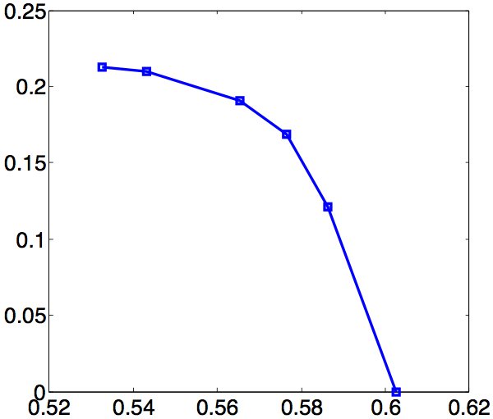
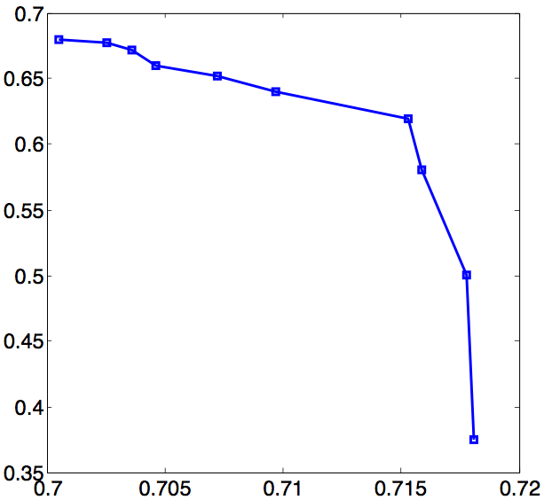





Tradeoff results
Knee in
tradeoff curve
Worst case score
Worst case score
Envtl. monitoring
Search &rescue
Average case score
Average case score
Can find good compromise between average- and worst-case score!

Slide 24
Conclusions
Wish to find randomized strategy for maximizing an adversarially-chosen submodular function
Developed RSense, which provides near-optimal performance
Performs well on two real applications
Search and rescue
Environmental monitoring

