Slide 1
Non-myopic Informative Path Planning in Spatio-Temporal Models
Alexandra Meliou
Andreas Krause
Carlos Guestrin
Joe Hellerstein
Notes:
Insert an outline slide:
Background and continuous query problem statement
Exploiting submodularity
Expensive solutions
Efficient solutions (mention the problem)

Slide 2
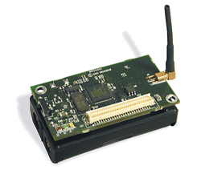


Collection Tours

Slide 3
Approximate Queries
Approximate representation of the world:
  Discrete locations
  Lossy communication
  Noisy measurements
Applications do not expect accurate values (tolerance to noise)
Monitored phenomena usually demonstrate strong correlations
    Correlation makes approximation cheap
Example:
  Return the temperature at all locations ±1C, with 95% confidence
Notes:
Make 30 sec
Merge with previous slide
Take first bullet out
-discretization
-lossy communication
-noisy sensors
Usual applications do not expect accurate values (tolerant to noise)
Correlation makes approximation cheap.

Slide 4
Optimizing Information
Search for most informative paths
: sensing nodes on path
Approximate answers

Slide 5
Continuous Queries
Repeated at periodic intervals
  Finite horizon
Example:
  Return the temperature at all locations ±1C, with 95% confidence, every 10 minutes for the next 5 hours.

Slide 6
Myopic vs Nonmyopic tradeoff
Myopic approach: repeat optimization for every timestep
Timestep 1
Timestep 2

Slide 7
Myopic vs Nonmyopic tradeoff
Nonmyopic approach: optimize for all timesteps
Timestep 1
No work!
Timestep 2
Extra node

Slide 8
Quantify Informativeness
Entropy
  [Shewry & Wynn ‘87]
Mutual Information
  [Caselton & Zidek ‘84]
Reduction of predictive variance
  [Chaloner & Verdinelli ‘95]

Slide 9
Measuring Information
Observing 1 gives information on 3 and 4
Observing 2 gives information on 3 and 5
1
2
3
4
5
After observing 2, observing 3 becomes less useful
Diminishing Returns
Notes:
Important exhale point

Slide 10
Submodular Functions
X
+
More reward
B
A
X
+
Less reward
Entropy, mutual information and reduction of predictive variance are all submodular.
Notes:
Don’t talk about equation
Objective function satisfy submodularity

Slide 11
Non-myopic Spatio-Temporal Path Planning (NSTP)
Given:
  A collection of submodular functions f_{t}
    f_{t} only depends on data collected at times 1..t
  A set of accuracy constraints k_{t}
Find:
  A collection of paths P_{t} with
Minimize cost
Subject to reward constraints
Notes:
F of t only depends on past info
Textboxes to explain problem
Relate to temp example
exhale

Slide 12
Planning for multiple timesteps
obviously
Harder than planning for one
First idea :
  Solve an equivalent single step problem instead!

Slide 13
Nonmyopic Planning Graph
t=1
t=2
t=3
A solution path on the NPG = collection of paths for multiple timesteps
Notes:
Make arrows thicker

Slide 14
Solve the single step problem
NP hard
  No good known approximation guarantees
Dual: Submodular Orienteering Problem
Maximize reward
dual:
primal:
Minimize cost
Subject to budget constraints
Subject to reward constraints
Notes:
Etxtboxes exhale

Slide 15
Good News
The dual algorithm [Chekuri & Pal ’05] provides an O(logn) factor approximation
(where n is the size of the network)
Notes:
Move bad after covering

Slide 16
Covering Algorithm
Transform a dual blackbox solution to a primal solution
dual:
Call with B_{OPT}
Return solution with reward ≥K/α
(with α approximation factor)
primal:
Reward required
to “cover”
Notes:
Show covering in the oval

Slide 17
Covering
Algorithm
Transform a dual blackbox solution to a primal solution
Call SOP for increasing budgets
uncovered reward
Call for budget 1
Call for budget 2
Call for budget B_{OPT}
: insufficient reward
: reward sufficient!
Guaranteed to cover K/α reward when called for B_{OPT}
Update chosen set and repeat for uncovered reward
Terminate when ε portion left
Reward required
to “cover”
Guaranteed to use at most budget
Notes:
Box around guarantee

Slide 18
Bad News
On the unrolled graph the Chekuri-Pal guarantee becomes O(log(nT))
The running time on the unrolled graph is O((BnT)^{log(nT)})

Slide 19


Addressing Computation Complexity
DP Algorithm
  Algorithm details in proceedings
  Bug in proof of guarantees. Not fixed (yet)
New algorithm: Nonmyopic Greedy
  Details on my webpage…
  Guaranteed to provide O(logn) approximation
Better than the previous O(log(nT))
Notes:
Insert bad new before this
First bullet goes to bad news
(addressing computation complexity)

Slide 20
Approach
Replace expensive blackbox, with cheaper blackbox
More efficient:
Nonmyopic greedy calls the dual on the smaller network graph instead of the unrolled graph
Covering transformation
Blackbox for dual
Blackbox for dual
Chekuri-Pal
SOP on NPG
Nonmyopic greedy algorithm
Notes:
Put chekuri and Pal in blackbox

Slide 21
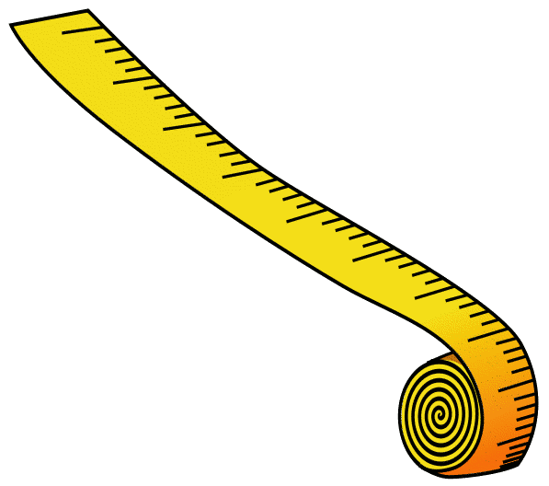
Nonmyopic Greedy
Time
1. Condition on picked data
2. Recompute matrix
Return best of A₁, A₂
Best ratio R/C
R = 2
C = 1
R = 2
C = 1
R = 0
C = 1
R = 1
C = 1
R = 1
C = 1
R = 0
C = 1
R = 1
C = 1
R = 1
C = 1
R = 1
C = 1
budget
Budget
dual(budget=1,time=3)
P₃
_{Cost = 1}
_{Time = 3}
R = 3
C = 2
R = 2
C = 2
X
R = 4
C = 2
R = 1
C = 2
X
R = 3
C = 2
R = 1
C = 2
X
For border cases were A₁ is bad, A₂ is guaranteed to be good
P₂
_{Cost = 1}
_{Time = 1}
R = 3
C = 2
X
R = 5
C = 3
X
R = 4
C = 3
X
A₁
dual(b,G_{t})
P₁
_{Cost = 2}
_{Time = 2}
A₂
R = 5
C = 4
X
R = 6
C = 4
X
R = 5
C = 4
X
Best greedy choice condition on A₁
dual(budget=4,time=1)
Notes:
Make return bigger
Give explanation of A2

Slide 22
Nonmyopic Greedy Guarantees
 | Nonmyopic greedy | Chekuri-Pal on NPG
 | O(B²T(nB)^{logn}) | O((nBT)^{log(nT)})
running
time
approximation
Notes:
More time more oomph exhale

Slide 23
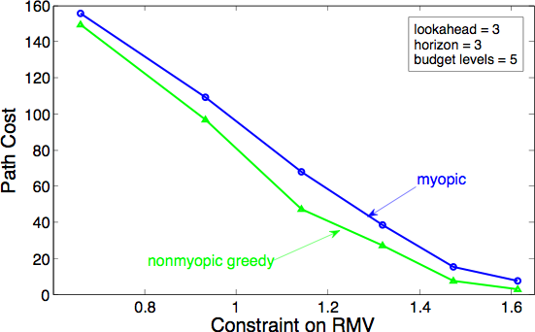
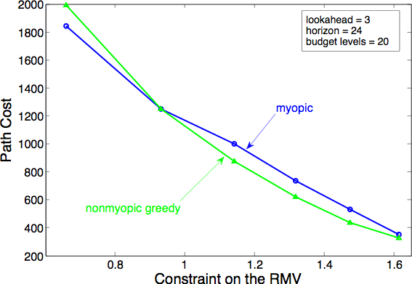
Myopic and Nonmyopic evaluation
Setup:
46 nodes on the Intel Berkeley Lab deployment
7 days of data (5 for learning, 2 for testing)
Varying Constraints

Slide 24
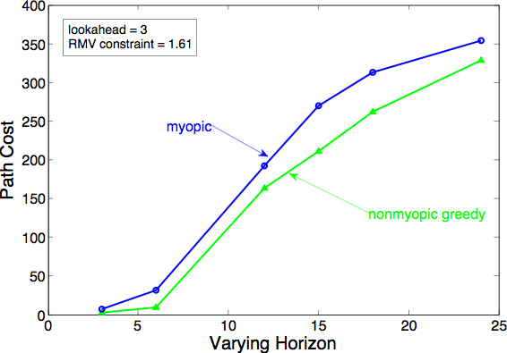
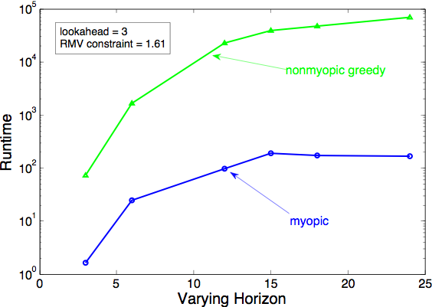
Cost and Runtime
Varying Horizon

Slide 25
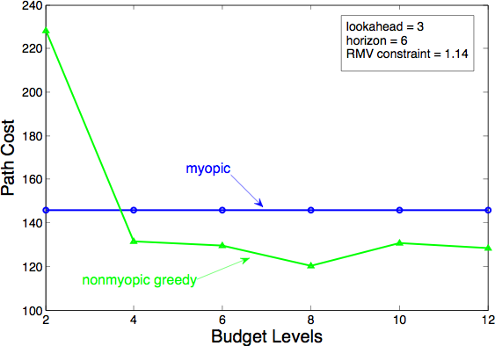
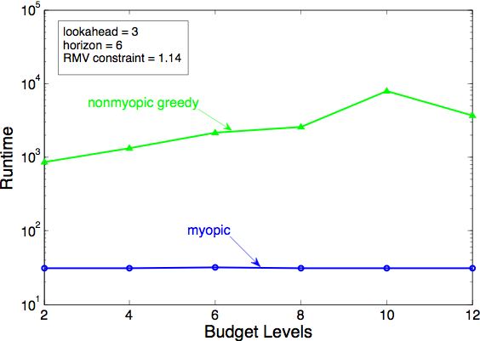
Effect of greedy parameters
Varying budget levels
Notes:
(fix that point)

Slide 26
Conclusions
Transform any blackbox solution to nonmyopic
Obtain primal from dual
Nonmyopic greedy provides significant runtime improvements and better theoretical guarantees

