Slide 1
law of large number and central limit theorem
GradQuant Workshop Fall23

Slide 2
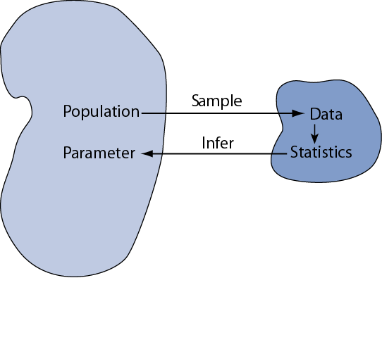
Why T-test

Slide 3
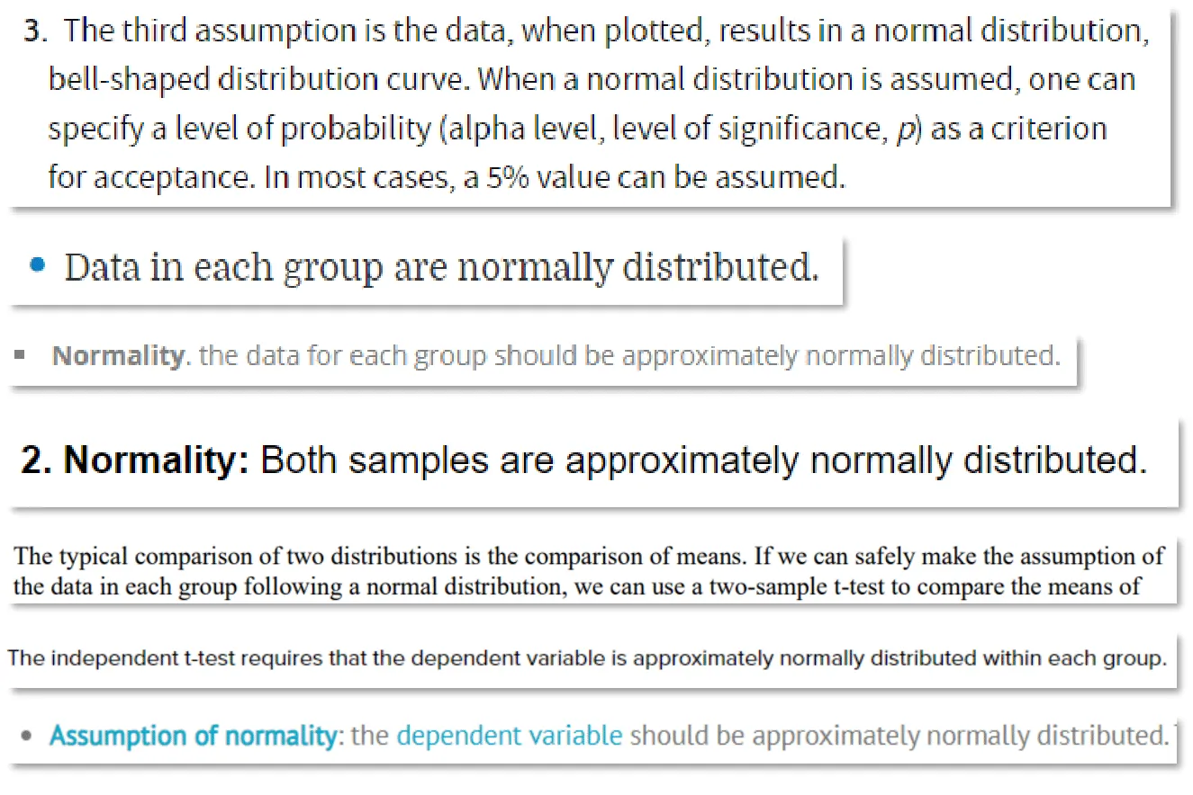
T-Test or ANOVA

Slide 4
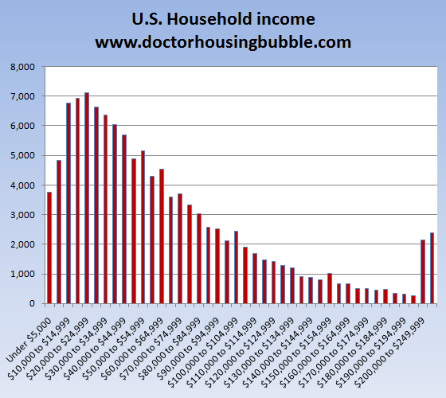
However…

Slide 5
CLT:
The samples do not have to be normally distributed, given a sufficient sample size.
T- Test: parameter of interest is the mean (or… )
Central Limit Theorem: given a sufficiently large sample size, the sampling distribution of the mean for a variable will approximate a normal distribution regardless of that variable’s distribution in the population

Slide 6
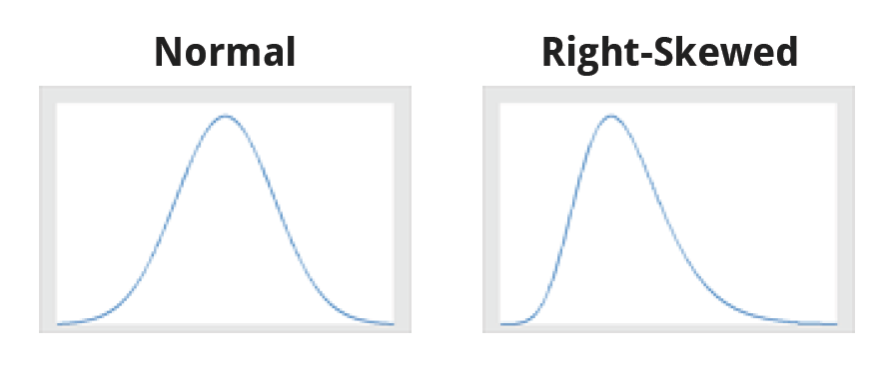
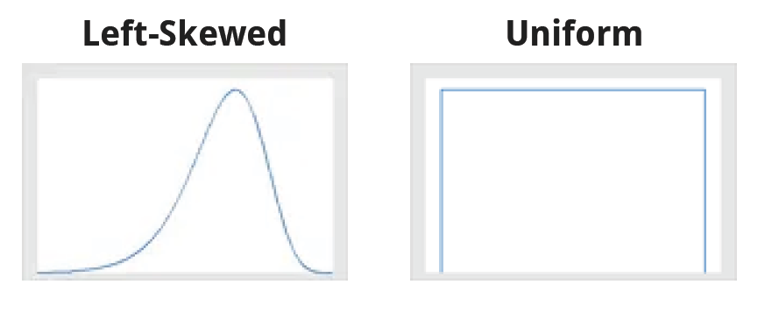
Distribution of the Variable in the Population

Slide 7
Sampling Distribution of the Mean
you perform a study once, and you might calculate the mean of that one sample (n=500)
imagine that you repeat the study many times and collect the same sample size (n=500) for each one
Then, you calculate the mean for each of these samples and graph them on a histogram
The histogram displays the distribution of sample means

Slide 8
How large does the sample size have to be?
a sample size of 30 is sufficient for most distribution
100

Slide 9
Example 1
the population distribution
the sampling distribution

Slide 10
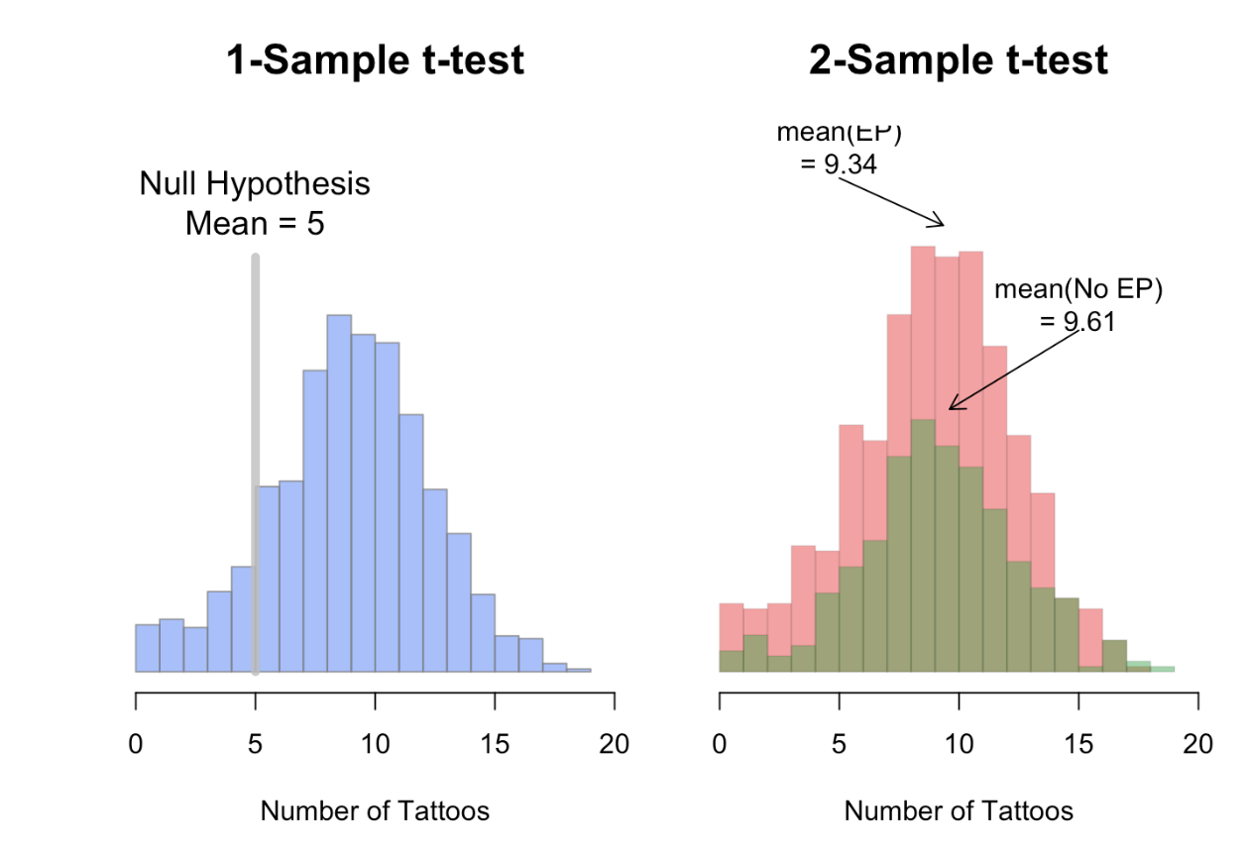
Hypothesis Tests

Slide 11
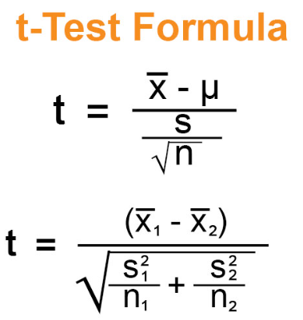
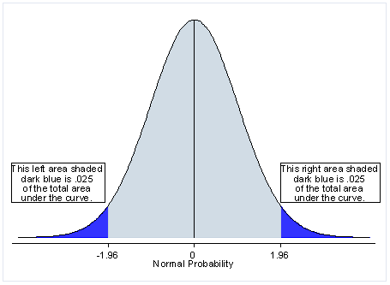

Slide 12
Why CLT is important
T-test are not valid when the data are nonnormally distributed?
What is your sample size?

Slide 13
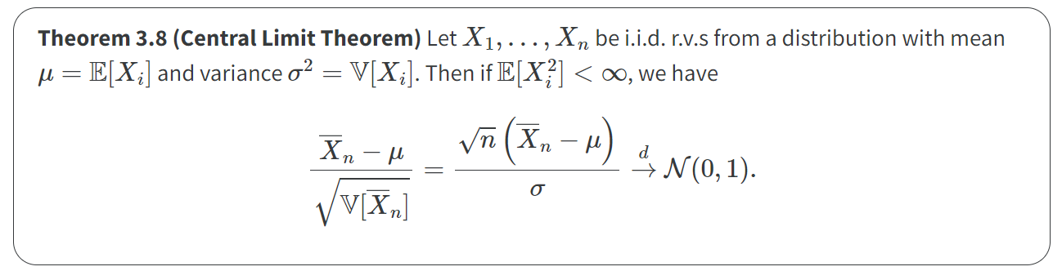

Slide 14
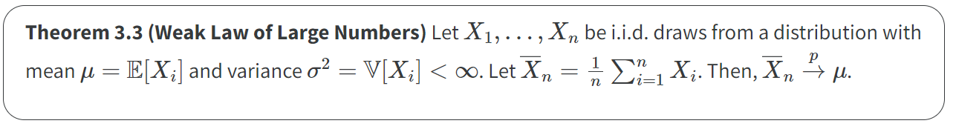
The law of large numbers
WLLN: The sample mean gets closer to the population mean as N goes to infinity.
(The probability of the sample mean being close to the population mean converges to 1)

Slide 15
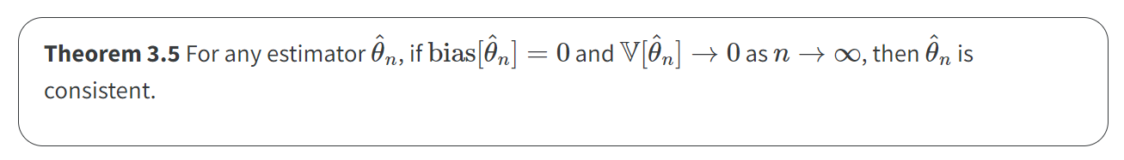
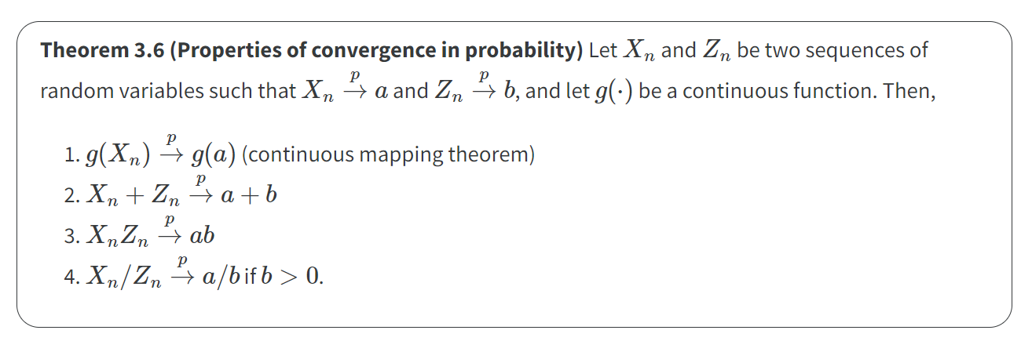
Consistency of estimators

Slide 16
LLN: Summary
Convergence in probability and the law of large numbers are beneficial for understanding how our estimators will (or will not) collapse to their estimand as the sample size increases. But what about the shape of the sampling distribution of our estimators?
If it’s a normal distribution, what is mean and sd?

Slide 17
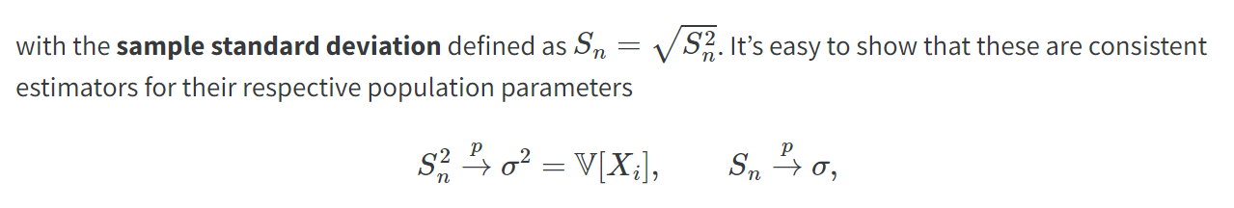
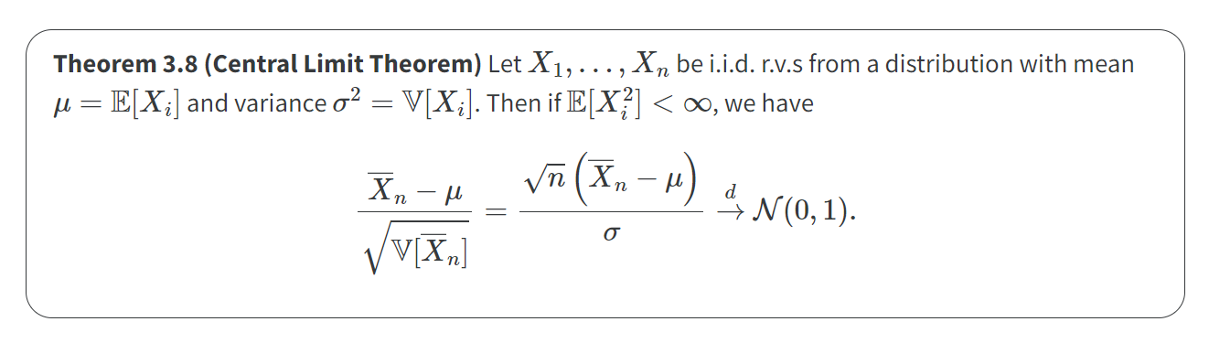

Back to CLT

Slide 18
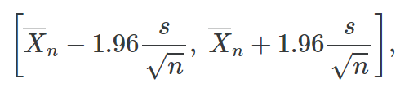
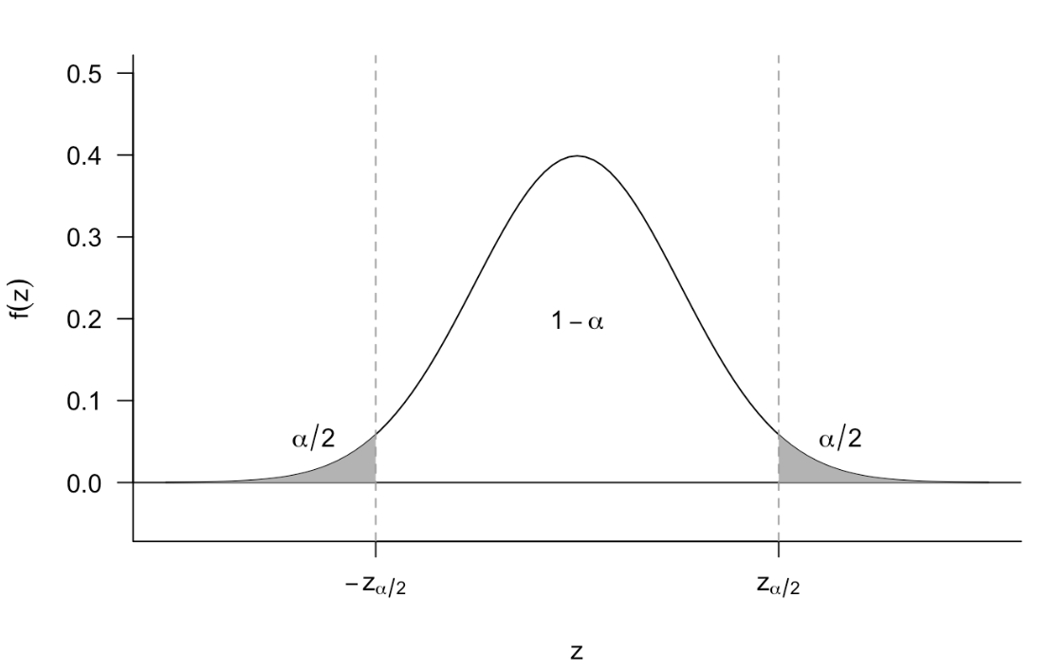
Hypothesis Test (Again)

Slide 19
Reference
https://mattblackwell.github.io/gov2002-book/03_asymptotics.html
https://miroslavtushev.medium.com/does-my-sample-have-to-be-normally-distributed-for-a-t-test-7ee91aaaca2a
https://statisticsbyjim.com/basics/central-limit-theorem

