Slide 1
Causal Inference: What's Trending in Difference-in-Differences
GradQuant UC Riverside
May02, 2023

Slide 2
Credits:
DiD Reading Group
Andrew Goodman-Bacon
Scott Cunningham
Nick Huntington-Klein
Hans H. Sievertsen
And many other researchers

Slide 3
What is Difference-in-Differences?

Slide 4
The difference-in-differences design is an early quasi-experimental
identification strategy for estimating causal effects
John Snow’s 1855 findings cholera was spread by fecally-contaminated water
and not via the air.
several water companies served different areas of the city.
They took their water from the Thames, which had been polluted by
victims’ evacuations via runoff.
But in 1849, the Lambeth water company had moved its intake pipes upstream higher up
the Thames, above the main sewage discharge point,
thus giving its customers uncontaminated water.

Slide 5
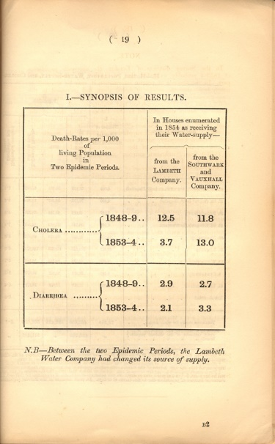

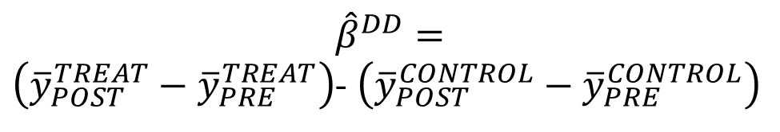
What is Difference-in-Differences?
$${\hat{β}}^{DD}=$$
$\left({\overline{y}}_{POST}^{TREAT}−{\overline{y}}_{PRE}^{TREAT}\right)$- $\left({\overline{y}}_{POST}^{CONTROL}−{\overline{y}}_{PRE}^{CONTROL}\right)$
Treatment
Control
PRE
POST
$$\left({\overline{y}}_{POST}^{}−{\overline{y}}_{PRE}^{}\right)$$
-8.8
1.2
-8.8 – 1.2 = -10

Slide 6

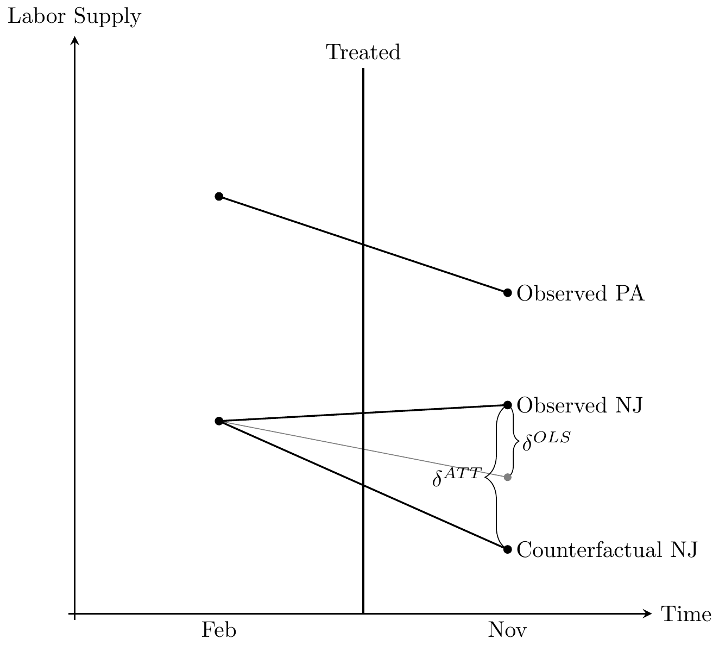
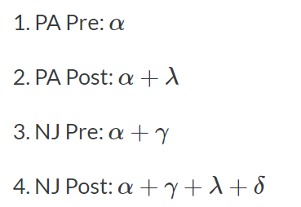
Minimum Wage
Card and Krueger (1994) is an infamous study both because of its use of an explicit counterfactual for estimation,
and because the study challenges many people’s common beliefs about the negative effects of the minimum wage.
So controversial was this study that James Buchanan, the Nobel Prize winner, called those influenced by
Card and Krueger (1994) “camp following whores” in a letter to the editor of the Wall Street Journal.

Slide 7
What is Difference-in-Differences?
$$y_{it}=γ_{0}{TREAT}_{i}+γ_{1}{POST}_{t}+{\hat{β}}^{DD}{TREAT}_{i}{POST}_{t}+u_{it}$$
${\hat{β}}^{DD}=\left({\overline{y}}_{POST}^{TREAT}−{\overline{y}}_{PRE}^{TREAT}\right)$- $\left({\overline{y}}_{POST}^{CONTROL}−{\overline{y}}_{PRE}^{CONTROL}\right)$

Slide 8

Two-Way Fixed Effects Estimator

Slide 9






What is Difference-in-Differences?
$${\overline{y}}_{POST}^{TREAT}$$
$$\left({\overline{y}}_{POST}^{TREAT}−{\overline{y}}_{PRE}^{TREAT}\right)$$
$${\overline{y}}_{PRE}^{TREAT}$$
$${\overline{y}}_{POST}^{CONTROL}$$
$$\left({\overline{y}}_{POST}^{CONTROL}−{\overline{y}}_{PRE}^{CONTROL}\right)$$
$${\overline{y}}_{PRE}^{CONTROL}$$

Slide 10
Parallel Trends Assumption
The parallel trends assumption says that, if no treatment had occurred,
the difference between the treated group and the untreated group would have stayed
the same in the post-treatment period as it was in the pre-treatment period.
Parallel trends is inherently unobservable.
It’s about the counterfactual of what would have happened if treatment had not occurred.

Slide 11
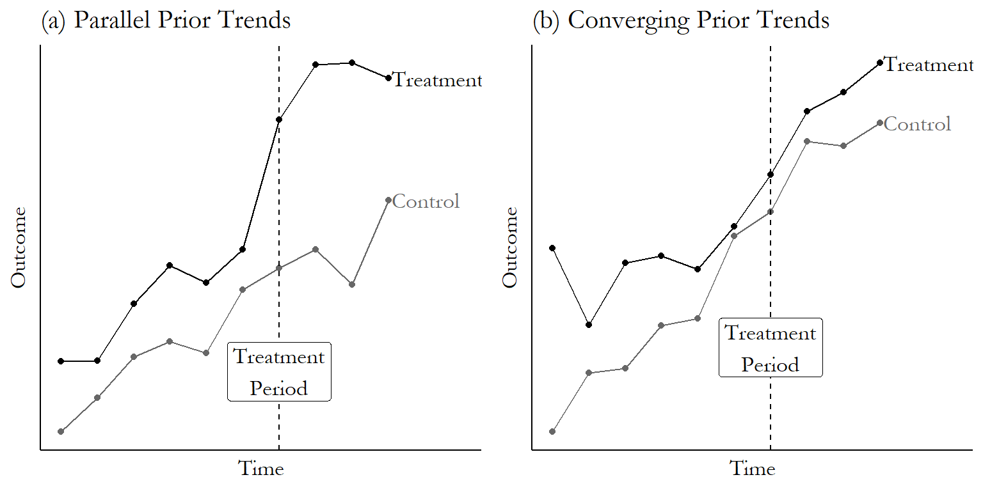
Raw Data Prior Trends

Slide 12
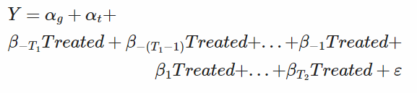
Event Study
T1 periods before the treatment, and T2 periods afterwards. Beta_0 is set as reference.
First, Beta_ –T1 to Beta_-1 should be close to zero (and insignificant, if doing statistical significance testing).
Second, the after-treatment coefficients , Beta_ 1 to Beta_T2 show the difference-in-difference estimated effect in the relevant period: the effect one period after treatment is Beta_1 , and so on.

Slide 13

Event Study

Slide 14
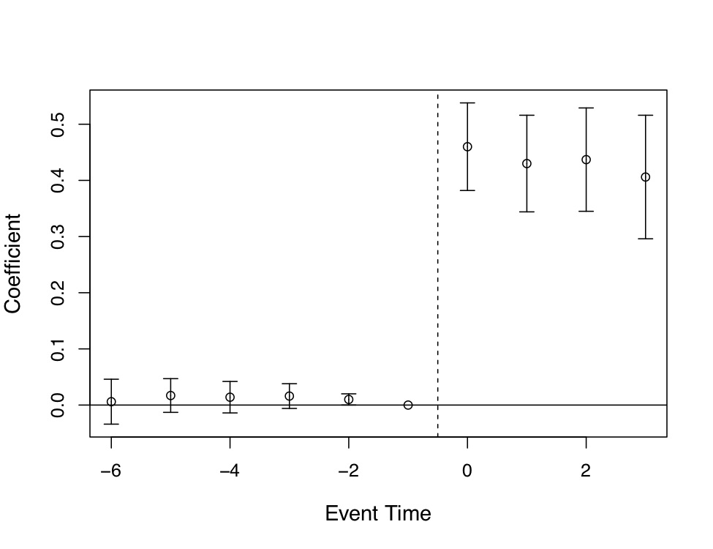
Expansion of Medicaid (Miller)
The pre-treatment coefficients are nearly on the zero line itself.
their standard errors are very small
Post-treatment, the probability that someone
becomes eligible for Medicaid immediately
shoots up to 0.4 , the authors can rule out effects
as low as 0.3 to 0.35.

Slide 15

Stagger DiD: Variation in Timing
Treatment turns on at different times $t^{∗}$

Slide 16
Variation in Timing

Slide 17

Variation in Timing
$D_{it}$ turns on at different times $t^{∗}$
Federalism (at least 25 countries)

Slide 18

Variation in Timing
$D_{it}$ turns on at different times $t^{∗}$
Federalism
Case-by-case judicial enforcement

Slide 19

Variation in Timing
$D_{it}$ turns on at different times $t^{∗}$
Federalism
Case-by-case judicial enforcement
Sub-federal funding process

Slide 20

Variation in Timing
$D_{it}$ turns on at different times $t^{∗}$
Federalism
Case-by-case judicial enforcement
Sub-federal funding process
Natural disasters

Slide 21
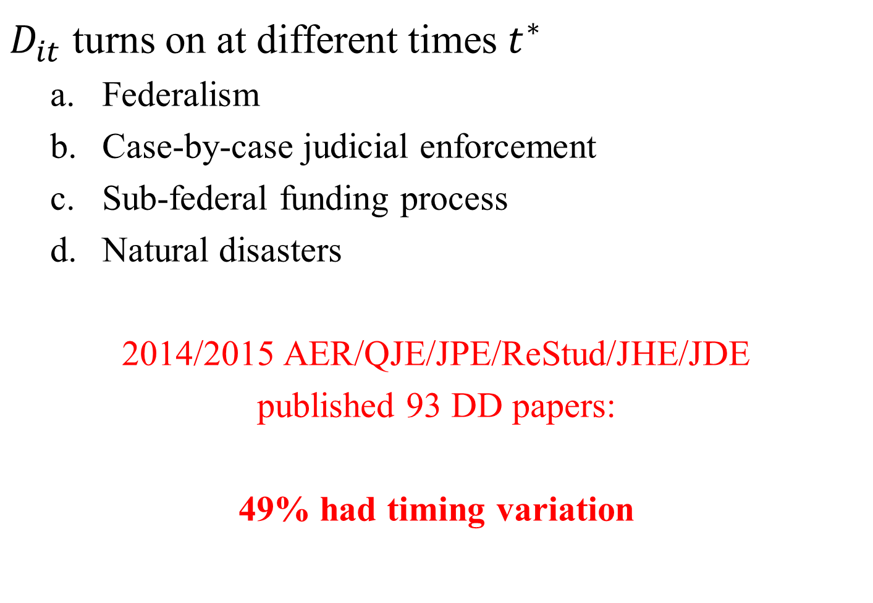
Variation in Timing
$D_{it}$ turns on at different times $t^{∗}$
Federalism
Case-by-case judicial enforcement
Sub-federal funding process
Natural disasters
2014/2015 AER/QJE/JPE/ReStud/JHE/JDE
published 93 DD papers:
49% had timing variation

Slide 22
Two-Way Fixed Effects Estimator
$$y_{it}=α_{i}+α_{t}+{\hat{β}}^{DD}D_{it}+u_{it}$$
Unit fixed effects
Time fixed effects
Treatment dummy

Slide 23

What is ${\hat{β}}^{DD}$?

Slide 24
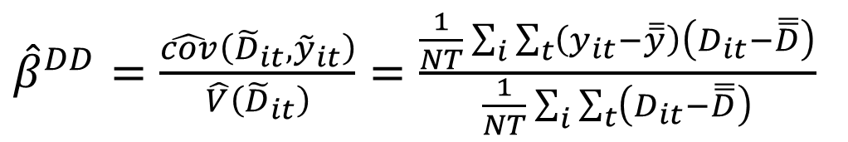
What is ${\hat{β}}^{DD}$?
$$y_{it}=α_{i}+α_{t}+{\hat{β}}^{DD}D_{it}+u_{it}$$
1. Partial out fixed effects (Frisch-Waugh):
$${\tilde{D}}_{it}=\left(D_{it}−\overline{\overline{D}}\right)−\left({\overline{D}}_{i}−\overline{\overline{D}}\right)−\left({\overline{D}}_{t}−\overline{\overline{D}}\right)$$
$${\tilde{y}}_{it}=\left(y_{it}−\overline{\overline{y}}\right)−\left({\overline{y}}_{i}−\overline{y}\right)−\left({\overline{y}}_{t}−\overline{\overline{y}}\right)$$
2. Calculate univariate coefficient by brute force:
${\hat{β}}^{DD}=\frac{\hat{cov}\left({\tilde{D}}_{it},{\tilde{y}}_{it}\right)}{\hat{V}\left({\tilde{D}}_{it}\right)}=\frac{\frac{1}{NT}\sum_{i}{\sum_{t}{\left(y_{it}−\overline{\overline{y}}\right)}}\left(D_{it}−\overline{\overline{D}}\right)}{\frac{1}{NT}\sum_{i}{\sum_{t}{\left(D_{it}−\overline{\overline{D}}\right)}}}$

Slide 25

${\hat{β}}^{DD}$?

Slide 26

$${\hat{β}}_{kU}^{DD}$$

Slide 27

$${\hat{β}}_{ℓU}^{DD}$$

Slide 28
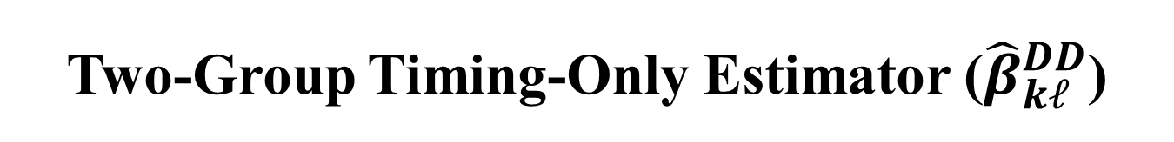
Two-Group Timing-Only Estimator (${\hat{β}}_{kℓ}^{DD}$)

Slide 29

${\hat{β}}_{kℓ}^{DD,k}$
$${\hat{β}}_{kℓ}^{DD,k}=\left({\overline{y}}_{k}^{MID(k,ℓ)}−{\overline{y}}_{ℓ}^{MID(k,ℓ)}\right)−\left({\overline{y}}_{k}^{PRE(k)}−{\overline{y}}_{ℓ}^{PRE(k)}\right)$$
Treatment
Control

Slide 30

${\hat{β}}_{kℓ}^{DD,ℓ}$
$${\hat{β}}_{kℓ}^{DD,ℓ}=\left({\overline{y}}_{ℓ}^{POST(ℓ)}−{\overline{y}}_{k}^{POST(ℓ)}\right)−\left({\overline{y}}_{ℓ}^{MID(k,ℓ)}−{\overline{y}}_{k}^{MID(k,ℓ)}\right)$$
Control
Treatment

Slide 31
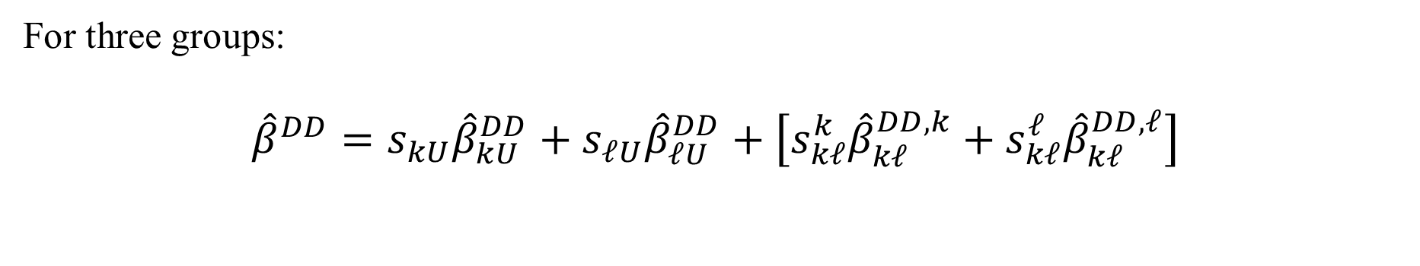
What is ${\hat{β}}^{DD}$?
$$y_{it}=α_{i}+α_{t}+{\hat{β}}^{DD}D_{it}+u_{it}$$
For three groups:
$${\hat{β}}^{DD}=s_{kU}{\hat{β}}_{kU}^{DD}+s_{ℓU}{\hat{β}}_{ℓU}^{DD}+\left[s_{kℓ}^{k}{\hat{β}}_{kℓ}^{DD,k}+s_{kℓ}^{ℓ}{\hat{β}}_{kℓ}^{DD,ℓ}\right]$$

Slide 32
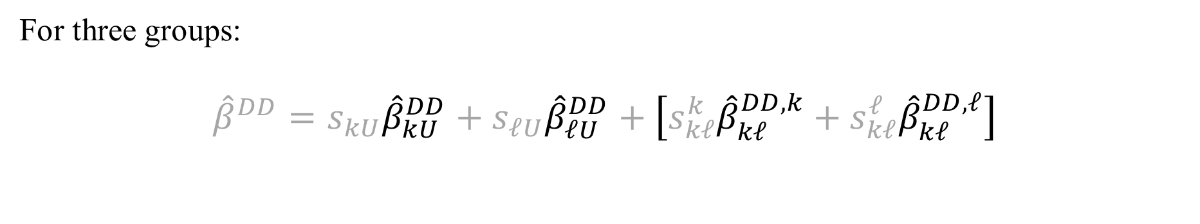
What is ${\hat{β}}^{DD}$?
$$y_{it}=α_{i}+α_{t}+{\hat{β}}^{DD}D_{it}+u_{it}$$
For three groups:
$${\hat{β}}^{DD}=s_{kU}{\hat{β}}_{kU}^{DD}+s_{ℓU}{\hat{β}}_{ℓU}^{DD}+\left[s_{kℓ}^{k}{\hat{β}}_{kℓ}^{DD,k}+s_{kℓ}^{ℓ}{\hat{β}}_{kℓ}^{DD,ℓ}\right]$$

Slide 33
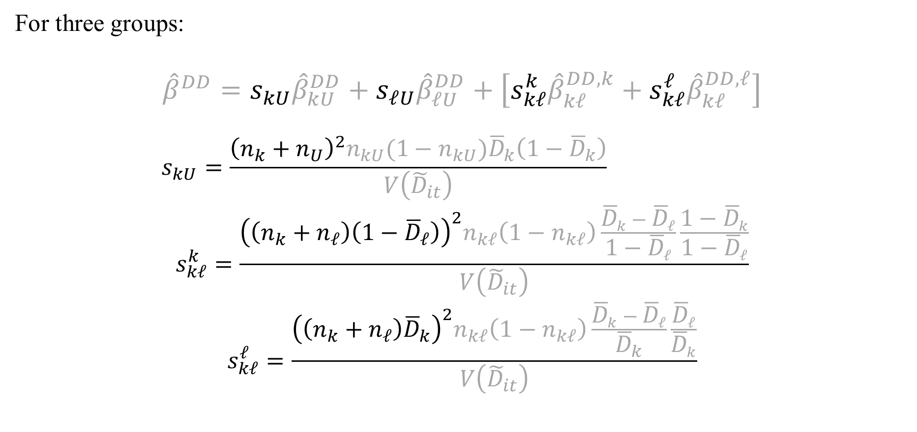
What is ${\hat{β}}^{DD}$?
$$y_{it}=α_{i}+α_{t}+{\hat{β}}^{DD}D_{it}+u_{it}$$
For three groups:
$${\hat{β}}^{DD}=s_{kU}{\hat{β}}_{kU}^{DD}+s_{ℓU}{\hat{β}}_{ℓU}^{DD}+\left[s_{kℓ}^{k}{\hat{β}}_{kℓ}^{DD,k}+s_{kℓ}^{ℓ}{\hat{β}}_{kℓ}^{DD,ℓ}\right]$$
$$s_{kU}=\frac{{\left(n_{k}+n_{U}\right)}^{2}n_{kU}(1−n_{kU}){\overline{D}}_{k}\left(1−{\overline{D}}_{k}\right)}{V\left({\tilde{D}}_{it}\right)}$$
$$s_{kℓ}^{k}=\frac{{\left(\left(n_{k}+n_{ℓ}\right)\left(1−{\overline{D}}_{ℓ}\right)\right)}^{2}n_{kℓ}\left(1−n_{kℓ}\right)\frac{{\overline{D}}_{k}−{\overline{D}}_{ℓ}}{1−{\overline{D}}_{ℓ}}\frac{1−{\overline{D}}_{k}}{1−{\overline{D}}_{ℓ}}}{V\left({\tilde{D}}_{it}\right)}$$
$$s_{kℓ}^{ℓ}=\frac{{\left(\left(n_{k}+n_{ℓ}\right){\overline{D}}_{k}\right)}^{2}n_{kℓ}\left(1−n_{kℓ}\right)\frac{{\overline{D}}_{k}−{\overline{D}}_{ℓ}}{{\overline{D}}_{k}}\frac{{\overline{D}}_{ℓ}}{{\overline{D}}_{k}}}{V\left({\tilde{D}}_{it}\right)}$$
Sample size²

Slide 34
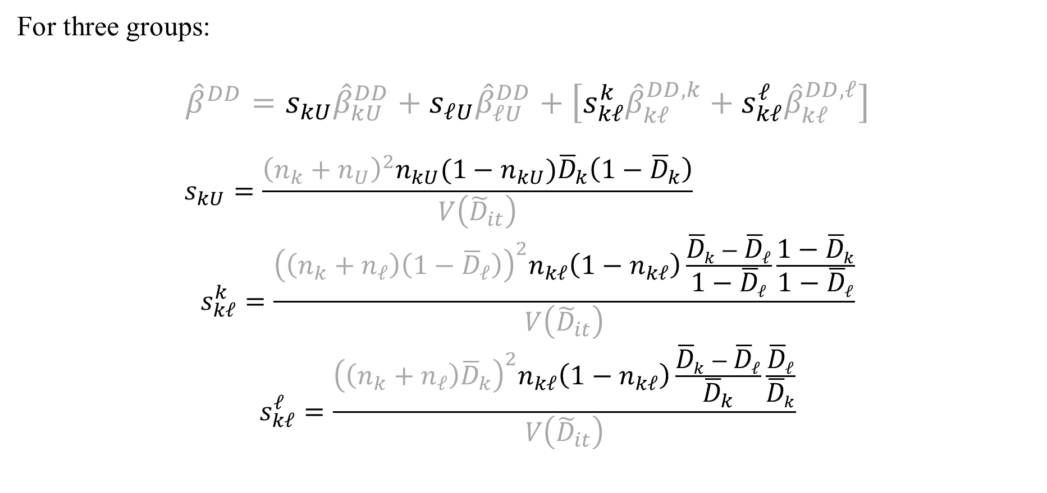
What is ${\hat{β}}^{DD}$?
$$y_{it}=α_{i}+α_{t}+{\hat{β}}^{DD}D_{it}+u_{it}$$
For three groups:
$${\hat{β}}^{DD}=s_{kU}{\hat{β}}_{kU}^{DD}+s_{ℓU}{\hat{β}}_{ℓU}^{DD}+\left[s_{kℓ}^{k}{\hat{β}}_{kℓ}^{DD,k}+s_{kℓ}^{ℓ}{\hat{β}}_{kℓ}^{DD,ℓ}\right]$$
$$s_{kU}=\frac{{\left(n_{k}+n_{U}\right)}^{2}n_{kU}(1−n_{kU}){\overline{D}}_{k}\left(1−{\overline{D}}_{k}\right)}{V\left({\tilde{D}}_{it}\right)}$$
$$s_{kℓ}^{k}=\frac{{\left(\left(n_{k}+n_{ℓ}\right)\left(1−{\overline{D}}_{ℓ}\right)\right)}^{2}n_{kℓ}\left(1−n_{kℓ}\right)\frac{{\overline{D}}_{k}−{\overline{D}}_{ℓ}}{1−{\overline{D}}_{ℓ}}\frac{1−{\overline{D}}_{k}}{1−{\overline{D}}_{ℓ}}}{V\left({\tilde{D}}_{it}\right)}$$
$$s_{kℓ}^{ℓ}=\frac{{\left(\left(n_{k}+n_{ℓ}\right){\overline{D}}_{k}\right)}^{2}n_{kℓ}\left(1−n_{kℓ}\right)\frac{{\overline{D}}_{k}−{\overline{D}}_{ℓ}}{{\overline{D}}_{k}}\frac{{\overline{D}}_{ℓ}}{{\overline{D}}_{k}}}{V\left({\tilde{D}}_{it}\right)}$$
Subsample
variance of
treatment

Slide 35
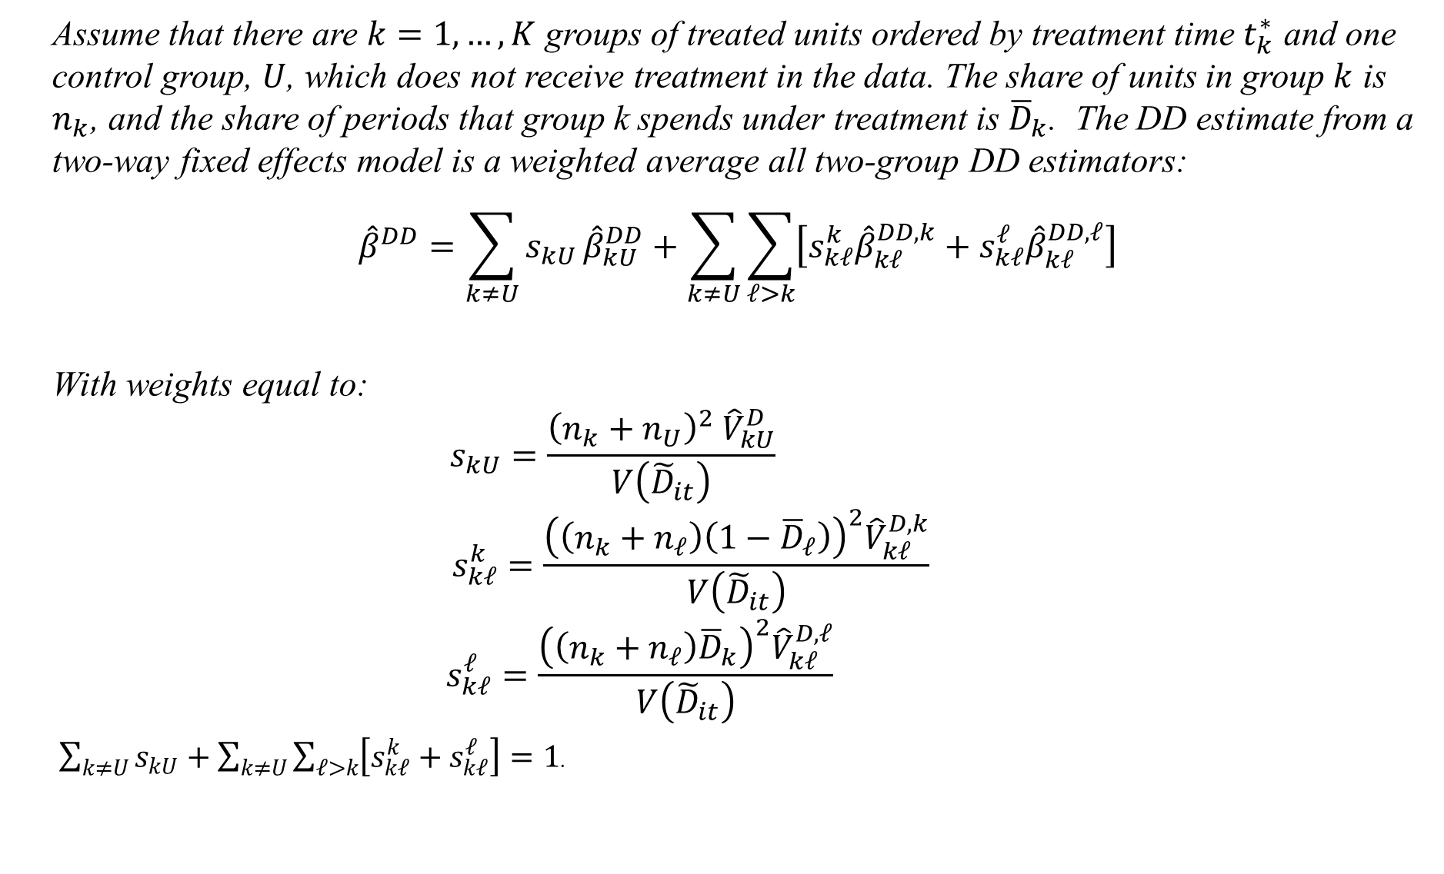
Difference-in-Differences Decomposition Theorem
Assume that there are $k=1,…,K$ groups of treated units ordered by treatment time $t_{k}^{∗}$ and one control group, $U$, which does not receive treatment in the data. The share of units in group $k$ is $n_{k}$, and the share of periods that group k spends under treatment is ${\overline{D}}_{k}$. The DD estimate from a two-way fixed effects model is a weighted average all two-group DD estimators:
$${\hat{β}}^{DD}=\sum_{k≠U}{s_{kU}}{\hat{β}}_{kU}^{DD}+\sum_{k≠U}{\sum_{ℓ>k}{\left[s_{kℓ}^{k}{\hat{β}}_{kℓ}^{DD,k}+s_{kℓ}^{ℓ}{\hat{β}}_{kℓ}^{DD,ℓ}\right]}}$$
With weights equal to:
$$s_{kU}=\frac{{\left(n_{k}+n_{U}\right)}^{2} {\hat{V}}_{kU}^{D}}{V\left({\tilde{D}}_{it}\right)}$$
$$s_{kℓ}^{k}=\frac{{\left(\left(n_{k}+n_{ℓ}\right)\left(1−{\overline{D}}_{ℓ}\right)\right)}^{2}{\hat{V}}_{kℓ}^{D,k}}{V\left({\tilde{D}}_{it}\right)}$$
$$s_{kℓ}^{ℓ}=\frac{{\left(\left(n_{k}+n_{ℓ}\right){\overline{D}}_{k}\right)}^{2}{\hat{V}}_{kℓ}^{D,ℓ}}{V\left({\tilde{D}}_{it}\right)}$$
$\sum_{k≠U}{s_{kU}}+\sum_{k≠U}{\sum_{𝓁>k}{\left[s_{k𝓁}^{k}+s_{k𝓁}^{𝓁}\right]}}=1$.

Slide 36
Graphing the Decomposition

Slide 37
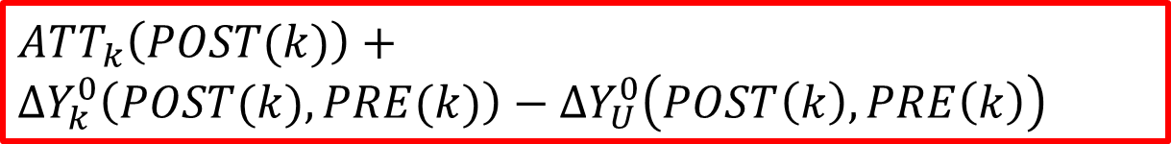
$${\hat{β}}_{kU}^{DD}$$
$$ATT_{k}\left(POST(k)\right)+$$
$$ΔY_{k}^{0}\left(POST(k),PRE(k)\right)−ΔY_{U}^{0}\left(POST\left(k\right),PRE\left(k\right)\right)$$

Slide 38
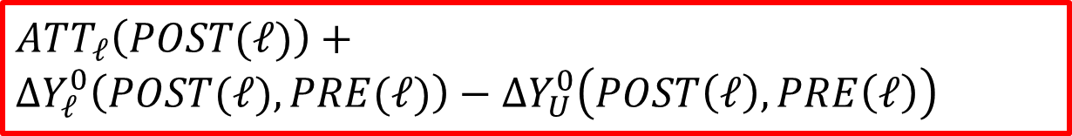
$${\hat{β}}_{ℓU}^{DD}$$
$$ATT_{ℓ}\left(POST(ℓ)\right)+$$
$$ΔY_{ℓ}^{0}\left(POST(ℓ),PRE(ℓ)\right)−ΔY_{U}^{0}\left(POST\left(ℓ\right),PRE\left(ℓ\right)\right)$$

Slide 39
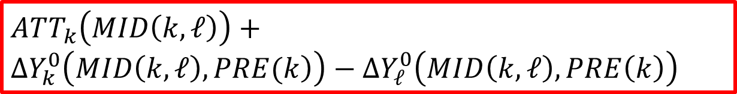
${\hat{β}}_{kℓ}^{DD,k}$
$$ATT_{k}\left(MID\left(k,𝓁\right)\right)+$$
$$ΔY_{k}^{0}\left(\left.MID\left(k,𝓁\right),PRE(k\right)\right)−ΔY_{𝓁}^{0}\left(MID\left(k,𝓁\right),PRE\left(k\right)\right)$$
Treatment
Control

Slide 40
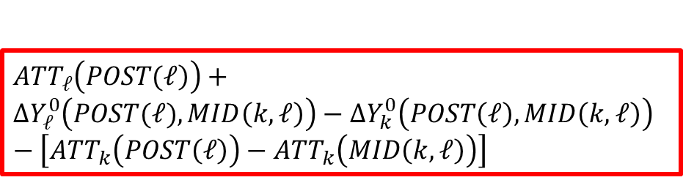
${\hat{β}}_{kℓ}^{DD,ℓ}$
$${\hat{β}}_{kℓ}^{DD,ℓ}=\left({\overline{y}}_{ℓ}^{POST(ℓ)}−{\overline{y}}_{k}^{POST(ℓ)}\right)−\left({\overline{y}}_{ℓ}^{MID(k,ℓ)}−{\overline{y}}_{k}^{MID(k,ℓ)}\right)$$
Control
$$ATT_{𝓁}\left(\left.POST(𝓁\right)\right)+$$
$$ΔY_{𝓁}^{0}\left(POST(𝓁),MID\left(k,𝓁\right)\right)−ΔY_{k}^{0}\left(POST\left(𝓁\right),MID\left(k,𝓁\right)\right)−\left[ATT_{k}\left(POST\left(𝓁\right)\right)−ATT_{k}\left(MID\left(k,𝓁\right)\right)\right]$$
Treatment

Slide 41
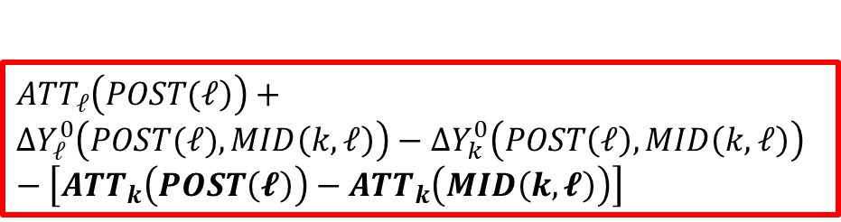
${\hat{β}}_{kℓ}^{DD,ℓ}$
$${\hat{β}}_{kℓ}^{DD,ℓ}=\left({\overline{y}}_{ℓ}^{POST(ℓ)}−{\overline{y}}_{k}^{POST(ℓ)}\right)−\left({\overline{y}}_{ℓ}^{MID(k,ℓ)}−{\overline{y}}_{k}^{MID(k,ℓ)}\right)$$
Control
$$ATT_{𝓁}\left(\left.POST(𝓁\right)\right)+$$
$$ΔY_{𝓁}^{0}\left(POST(𝓁),MID\left(k,𝓁\right)\right)−ΔY_{k}^{0}\left(POST\left(𝓁\right),MID\left(k,𝓁\right)\right)−\left[ATT_{k}\left(POST\left(𝓵\right)\right)−ATT_{k}\left(MID\left(k,𝓵\right)\right)\right]$$
Treatment

Slide 42
Example
https://hhsievertsen.shinyapps.io/twowayfedecomp/

Slide 43
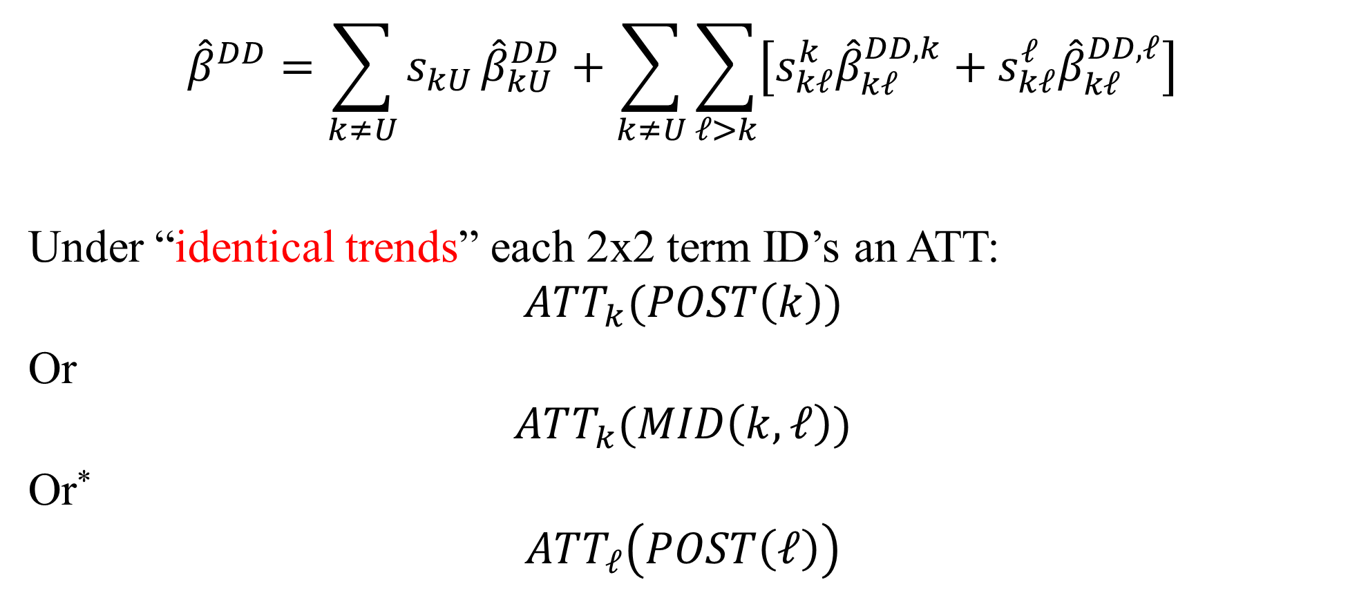
Intuition for how DD weights heterogeneity
$${\hat{β}}^{DD}=\sum_{k≠U}{s_{kU}}{\hat{β}}_{kU}^{DD}+\sum_{k≠U}{\sum_{ℓ>k}{\left[s_{kℓ}^{k}{\hat{β}}_{kℓ}^{DD,k}+s_{kℓ}^{ℓ}{\hat{β}}_{kℓ}^{DD,ℓ}\right]}}$$
Under “identical trends” each 2x2 term ID’s an ATT:
$$ATT_{k}(POST\left(k\right))$$
Or
$$ATT_{k}(MID\left(k,ℓ\right))$$
Or*
$$ATT_{ℓ}\left(POST\left(ℓ\right)\right)$$
*There’s an issue here—will return to it.

Slide 44
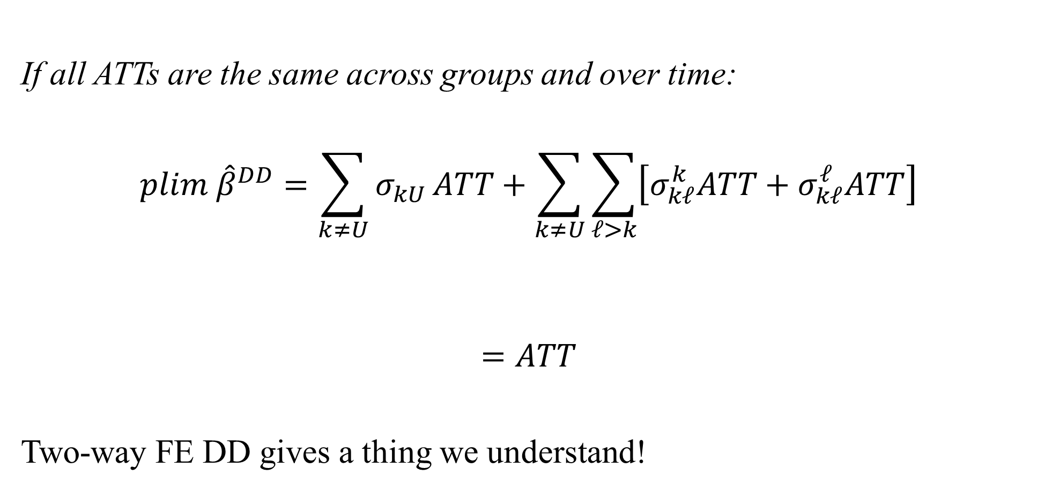
Constant Homogeneous Effects
If all ATTs are the same across groups and over time:
$$plim {\hat{β}}^{DD}=\sum_{k≠U}{σ_{kU}}ATT+\sum_{k≠U}{\sum_{ℓ>k}{\left[σ_{kℓ}^{k}ATT+σ_{kℓ}^{ℓ}ATT\right]}}$$
$$=ATT$$
Two-way FE DD gives a thing we understand!

Slide 45
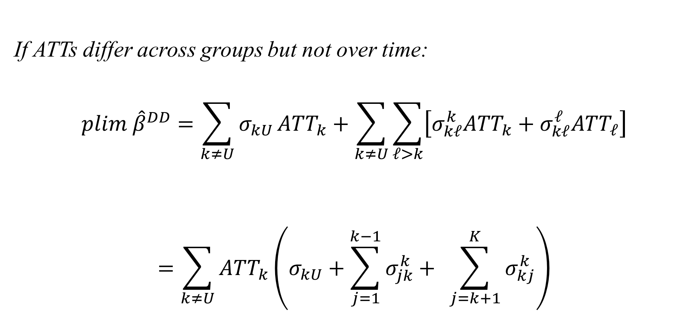
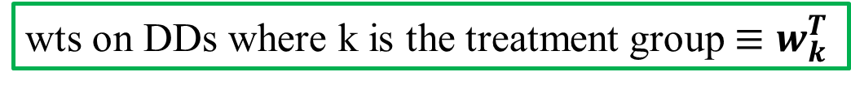
Constant Heterogeneous Effects
If ATTs differ across groups but not over time:
$$plim {\hat{β}}^{DD}=\sum_{k≠U}{σ_{kU}}ATT_{k}+\sum_{k≠U}{\sum_{ℓ>k}{\left[σ_{kℓ}^{k}ATT_{k}+σ_{kℓ}^{ℓ}ATT_{ℓ}\right]}}$$
$$=\sum_{k≠U}{ATT_{k}\left(σ_{kU}+\sum_{j=1}^{k−1}{σ_{jk}^{k}+ }\sum_{j=k+1}^{K}{σ_{kj}^{k}}\right)}$$
wts on DDs where k is the treatment group $≡w_{k}^{T}$
Not generally proportional to $n_{k}$→ $plim {\hat{β}}^{DD}≠ATET$

Slide 46
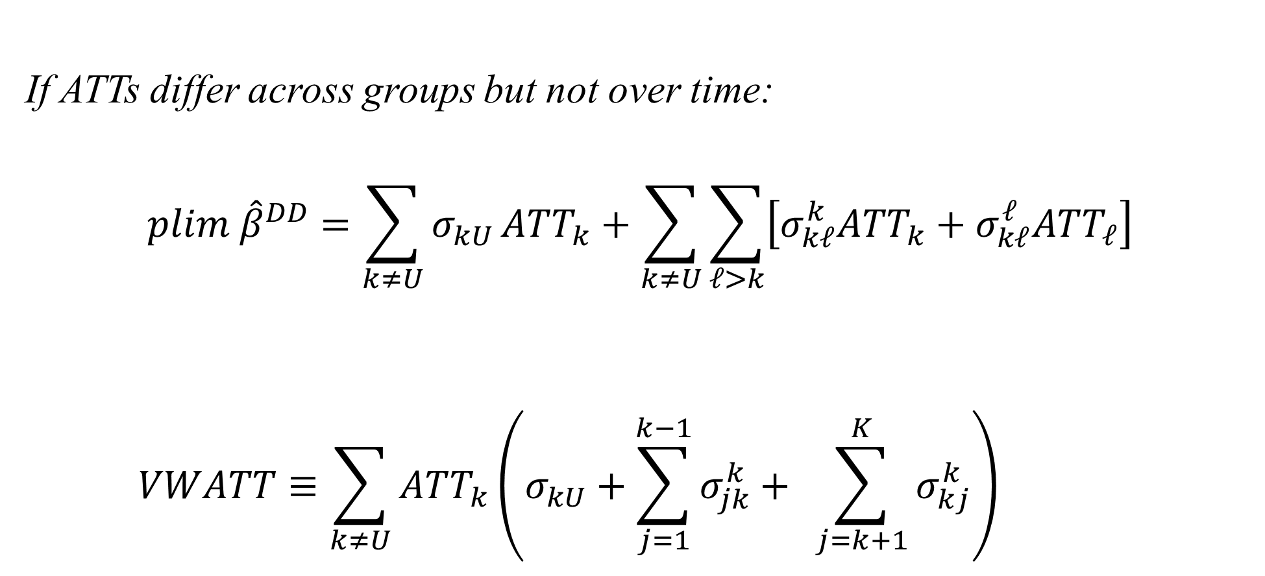
Constant Heterogeneous Effects
If ATTs differ across groups but not over time:
$$plim {\hat{β}}^{DD}=\sum_{k≠U}{σ_{kU}}ATT_{k}+\sum_{k≠U}{\sum_{ℓ>k}{\left[σ_{kℓ}^{k}ATT_{k}+σ_{kℓ}^{ℓ}ATT_{ℓ}\right]}}$$
$$VWATT≡\sum_{k≠U}{ATT_{k}\left(σ_{kU}+\sum_{j=1}^{k−1}{σ_{jk}^{k}+ }\sum_{j=k+1}^{K}{σ_{kj}^{k}}\right)}$$
“Variance-Weighted Average
Treatment Effect” ™

Slide 47

Time-Varying Homogeneous Effects
VWATT
$$plim {\hat{β}}^{DD}=\sum_{k≠U}{σ_{kU}}ATT\left(POST\left(k\right)\right)$$
$$+\sum_{k≠U}{\sum_{ℓ>k}{\left[σ_{kℓ}^{k}ATT\left(MID\left(k,ℓ\right)\right)+σ_{kℓ}^{ℓ}ATT\left(POST\left(k\right)\right)\right]}}$$
$$+\sum_{k≠U}{\sum_{𝓁>k}{σ_{k𝓁}^{𝓁}\left[ATT_{k}\left(POST\left(𝓁\right)\right)−ATT_{k}\left(MID\left(k,𝓁\right)\right)\right]}}$$

Slide 48

Time-Varying Homogeneous Effects
VWATT
$$plim {\hat{β}}^{DD}=\sum_{k≠U}{σ_{kU}}ATT\left(POST\left(k\right)\right)$$
$$+\sum_{k≠U}{\sum_{ℓ>k}{\left[σ_{kℓ}^{k}ATT\left(MID\left(k,ℓ\right)\right)+σ_{kℓ}^{ℓ}ATT\left(POST\left(k\right)\right)\right]}}$$
$$+\sum_{k≠U}{\sum_{𝓁>k}{σ_{k𝓁}^{𝓁}\left[ATT_{k}\left(POST\left(𝓁\right)\right)−ATT_{k}\left(MID\left(k,𝓁\right)\right)\right]}}$$
Borusyak and Jaravel:
Here’s why: Most 2x2 “post” windows are small.

Slide 49

Time-Varying Homogeneous Effects
$$plim {\hat{β}}^{DD}=\sum_{k≠U}{σ_{kU}}ATT\left(POST\left(k\right)\right)$$
$$+\sum_{k≠U}{\sum_{ℓ>k}{\left[σ_{kℓ}^{k}ATT\left(MID\left(k,ℓ\right)\right)+σ_{kℓ}^{ℓ}ATT\left(POST\left(k\right)\right)\right]}}$$
$$+\sum_{k≠U}{\sum_{𝓁>k}{σ_{k𝓁}^{𝓁}\left[ATT_{k}\left(POST\left(𝓁\right)\right)−ATT_{k}\left(MID\left(k,𝓁\right)\right)\right]}}$$
But you don’t even get VWATT

Slide 50

Time-Varying Homogeneous Effects
$$plim {\hat{β}}^{DD}=\sum_{k≠U}{σ_{kU}}ATT\left(POST\left(k\right)\right)$$
$$+\sum_{k≠U}{\sum_{ℓ>k}{\left[σ_{kℓ}^{k}ATT\left(MID\left(k,ℓ\right)\right)+σ_{kℓ}^{ℓ}ATT\left(POST\left(k\right)\right)\right]}}$$
$$+\sum_{k≠U}{\sum_{𝓁>k}{σ_{k𝓁}^{𝓁}\left[ATT_{k}\left(POST\left(𝓁\right)\right)−ATT_{k}\left(MID\left(k,𝓁\right)\right)\right]}}$$
$$ΔATT$$
But you don’t even get VWATT

Slide 51
Time-Varying Homogeneous Effects
This one is fine
This one is not

Slide 52
Graphing the Decomposition: Divorce Example

Slide 53
Is event-study OK?
Abraham and Sun:
Maybe this isn’t
even real!

Slide 54
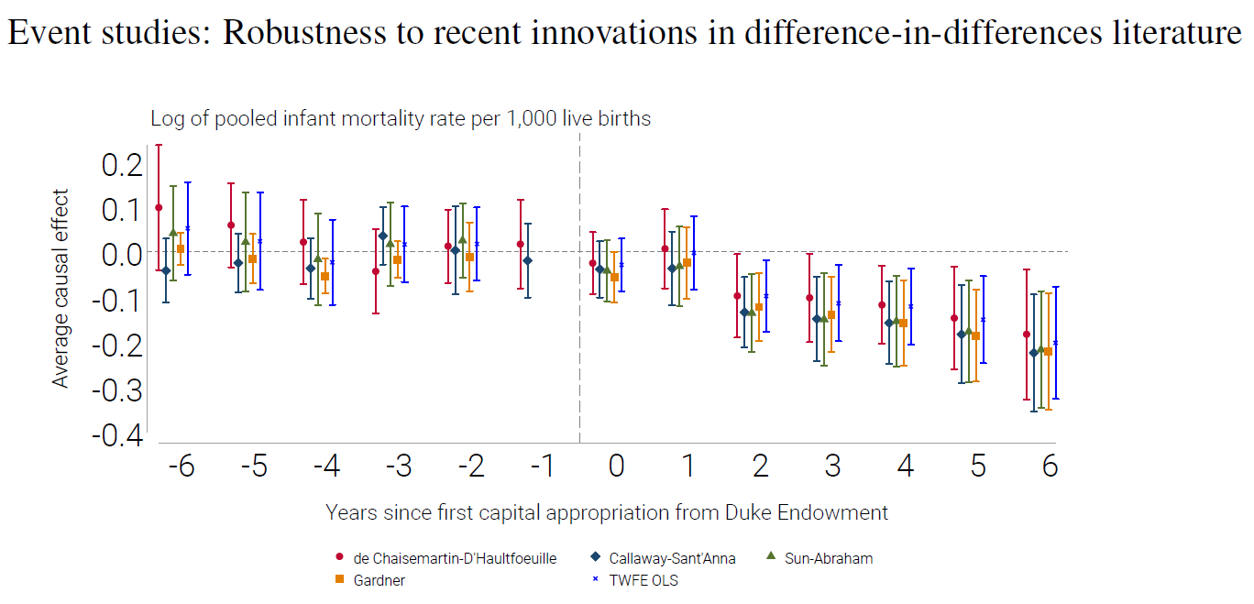
Hollingsworth. et al. (2022)

Slide 55
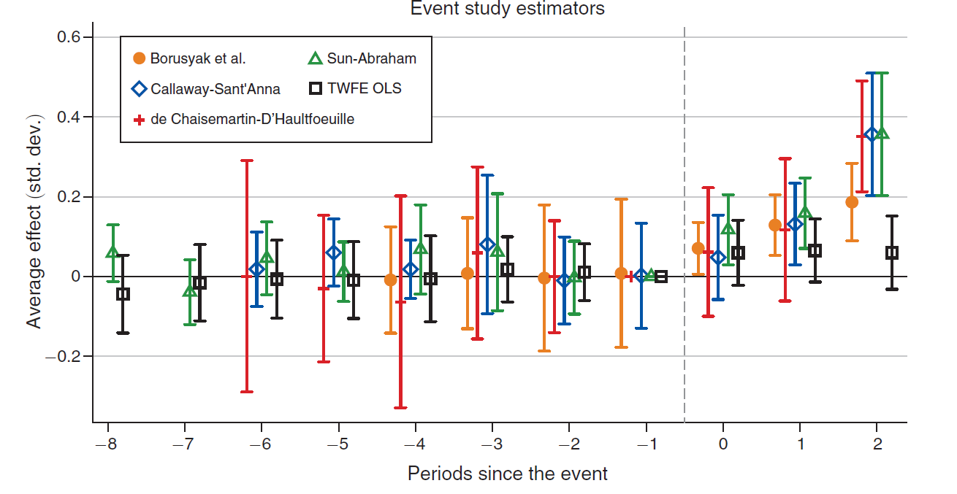
Braghieri.et al. (2022)

Slide 56
Survey:
Clément de Chaisemartin, Xavier D’Haultfœuille, Two-way fixed effects and differences-in-differences with heterogeneous treatment effects: a survey, The Econometrics Journal, 2022;, utac017, https://doi.org/10.1093/ectj/utac017

Slide 57
Code Examples

