Slide 1

Enver AI Tech
U4719OM H2O23PTC4O2519
27AAHCE 5539J1ZA

Slide 2

,',"’ :
ENVER AI TECH
1
- .'
E hl V E R A I T E C H
0 l — T H E P - OP L E
ARTIFICER MVP
F O U N D E R , C E O A P P L I E D A I A R C I-J I T E C T
Amaan Shaikh
Builds the Artificer agent fleet on Vertex / Gemin-i ingestion, grounded scoring, XAI drower, and the GCP orgo nisotion it already
runs on.
C O - F O U N D E B & D I R E C T O R D I N 1 0 1 5 4 2 4 7
Needa Kaiser Shaikh
Governonce, security posture, and the AI monitoring / evaluation layer. Woman co—founded, DPllT—recognised entity.
0›
02
Oõ
Multi-agent systems
Document intelligence
Quantitative telemetry
Deterministic fi—oil la r ratios- math i code. not in the model
Ind ian bank D ^s , GSM chaIlans
TO • atoCement la youI s
0
Oö
Oö
MSME credit domain
N^C co sh —Łow und erw rit in g . SL. RB XA
Vertex AI / GCP
Product cockpit
o n g noge
Reoc40leníoworkbevh GoogleSSO oFterCX
OY
08
09
Guardrails & XAI
India Stack
SecOps & evaluation
A Inon itor ing . ino ct iv ity sent incl , SI ock SecOo s
Schemo ro iIs . cit o Iion Ied
ger, ten oero I u re-0 scor ing
G S^ N. Accon nt Ag g reg of or ' So ho not i. M CAPS . e- Con rts
E N V E R A I T E C H C O N F I D E N T I A L

Slide 3
We did not start in credit. Credit found the work.
ENVER AI TECH
ARTIFICER MVP

Slide 4

,',"’ :
ENVER AI TECH
1
-'.'
E hl V E R A I T E C H
0 3
T H E P E O B L E M
ARTIFICER MVP
70Sò of New-to-Credit MSMEs
IBM MSMEs -30% of GDP $300B+ credit gap (RB / FOR
CABIL needs a repayment history these firms do not have — even when cosh flow is real
OfŁîcer s still line-read 100+ page statements. 3—5 days. $80—$150 a file.
Fraud the eye misses: circular trading, spoofed PDFs, GSTR-1 vs GB gaps
NTC F LES REV ECT ED B BU REAU SCOR NG
MAN UAL TAT VS 55 S ECON DS
E N V E R A I T E C H C O N F I D E N T I A L

Slide 5

,',"’ :
ENVER AI TECH
1
- .'
E hl V E R A I T E C H
ARTIFICER MVP
Bank statements
P D PSV 0* in dian layou Is
GST returns
STR- as STR-GB tax-gap ch eck
Account Aggregator
Public registries
Sch omoti SO N Sets / in ve / An omoti
SS E-streamed TAT vs 3—5 days
Health score * LOW / M ED / H GH
Liquidity, reven ue, stability, leverage, behaviour
A I cost per £Ie vs $8O— Al
O man uaI
E N V E R A I T E C H C O N F I D E N T I A L
0 5 / 13

Slide 6








then System 2.Math "IS
ENVER AI TECH
ARTIFICER MVP
Four
System
model.

Slide 7




like a
ENVER AI TECH
ARTIFICER MVP
Alternate data,
committee.

Slide 8




a line. Then
ENVER AI TECH
ARTIFICER MVP
Every number
cockpit locks.

Slide 9
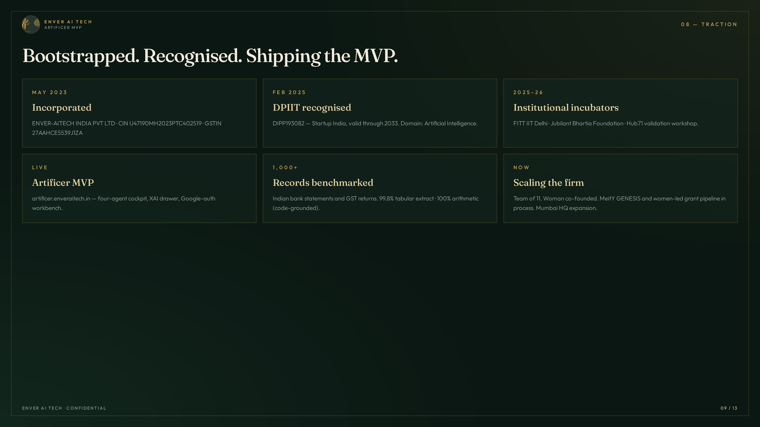
ENVER AI TECH
ARTIFICER MVP

Slide 10

,',"’ :
ENVER AI TECH
1
- .'
E hl V E R A I T E C H
0 9 — M A F' l¢ E T & M O D E L
ARTIFICER MVP
T A M
SOA
list price per evaluation
Buyers: CRO / CCO, Head of MSME. Users: credit officers. API ev alua tions plus enterprise licences — not
a consumer app.
Gemini cost -8. Ok tokens / Ale
cost reduc tio n vs S 8O— Al
O man uaI review
E N V E R A I T E C H C O N F I D E N T I A L

Slide 11

runs on Vertex.
ENVER AI TECH
ARTIFICER MVP
The MVP already runs on Google Cloud
The MVP
Enver already runs in its own Google Cloud organisation. This room helps move an existing Google-native MVP into live lender pilots.

Slide 12







seat. No
ENVER AI TECH
ARTIFICER MVP
Credits.
credits
seat
o e aIready
he organisation.
Drocurement.
1 2 13

Slide 13
