Slide 1

Demonstration of STDP Learning Rule using RRAM
EE658 Memory Devices and Technology
Advisor: Prof. Sandip Lashkare
Hriday Pandya 23110136
Nirjara Mehta 23110220
Parth Dembla 23110234

Slide 2

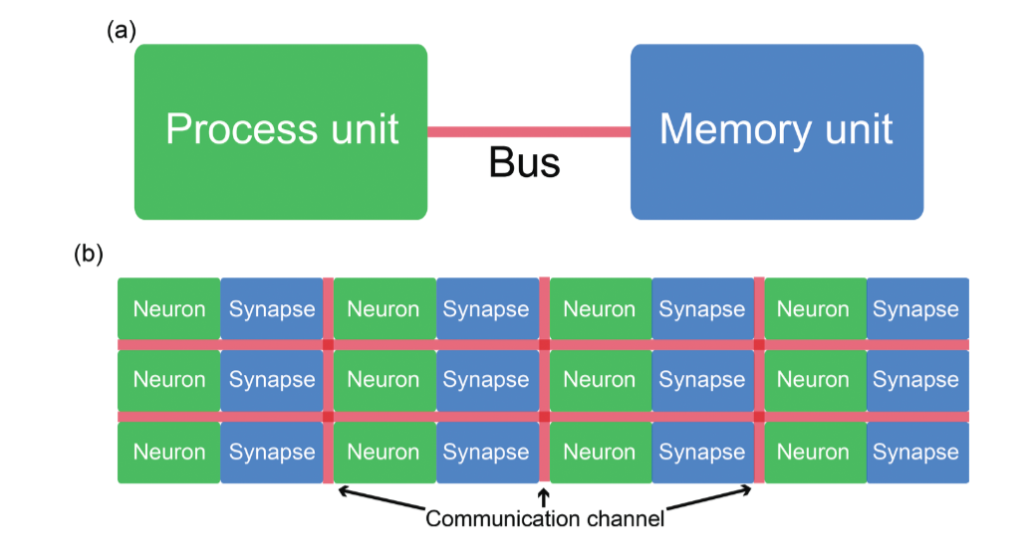
Why Mimic the Brain in Hardware?
The brain performs ~10¹⁶ synaptic operations per second at roughly 20W — a feat no conventional Von Neumann architecture can match. Neuromorphic engineering bridges neuroscience and hardware design, embedding learning directly into silicon.
Neuromorphic Computing inspired by the Human Brain, synapses and neurons [I].
Parallelism
Co-located Memory
Billions of neurons fire simultaneously, enabling massive real-time computation.
Memory and computation share the same physical substrate — no data movement bottleneck.
The Synapse
The core unit of learning: a tunable connection whose strength encodes information.
a) Von Neumann Architecture b) Neuromorphic Architecture [2]

Slide 3
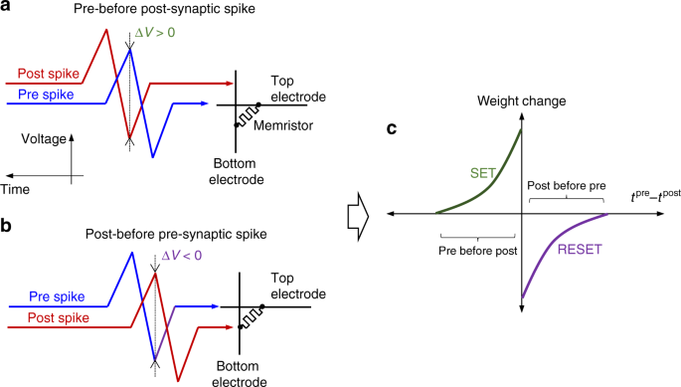
Biological Foundation: Spike-Timing-Dependent Plasticity
Temporal Connection Strengthens Synapses
Hebb's rule: synapses strengthen when pre- and post-synaptic neurons fire in close temporal proximity. STDP formalises this through the timing difference Δ= t_{post}- t_{pre}.
This learning rule can be implemented in hardware using resistive networks: RRAM
LTP — Long-Term Potentiation
STDP implementation. Relative timing of the pre- and post-synaptic spikes for performing a potentiation and b depression of the synaptic weight for the memristor-based implementation¹¹, resulting in c the specific STDP, which is commonly observed in biology [3].
Pre fires before post (\Delta t > 0): synapse strengthens.
LTD — Long-Term Depression
Pre fires after post (\Delta t < 0): synapse weakens.

Slide 4
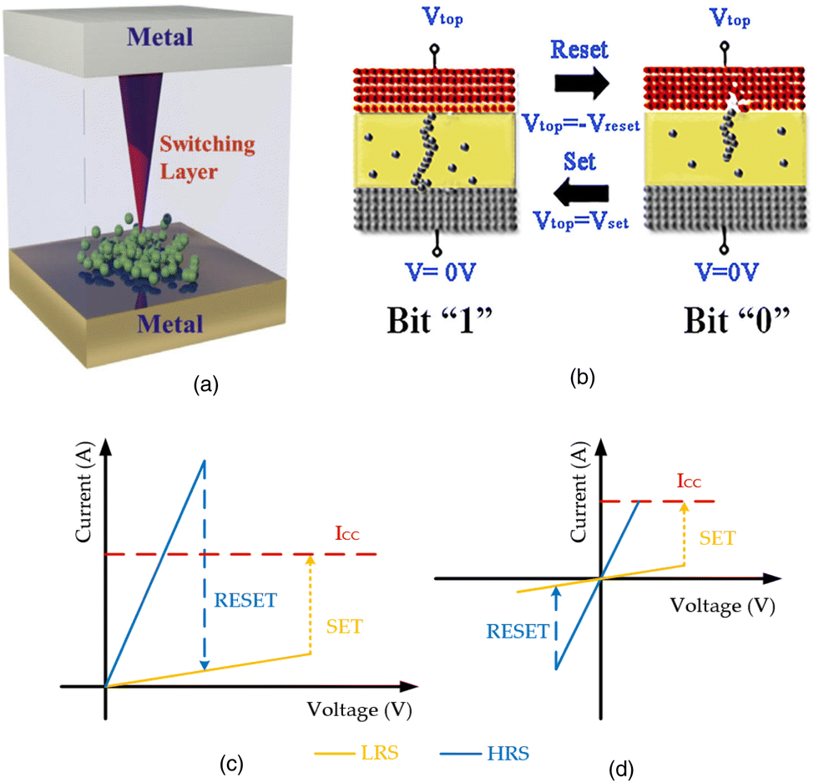
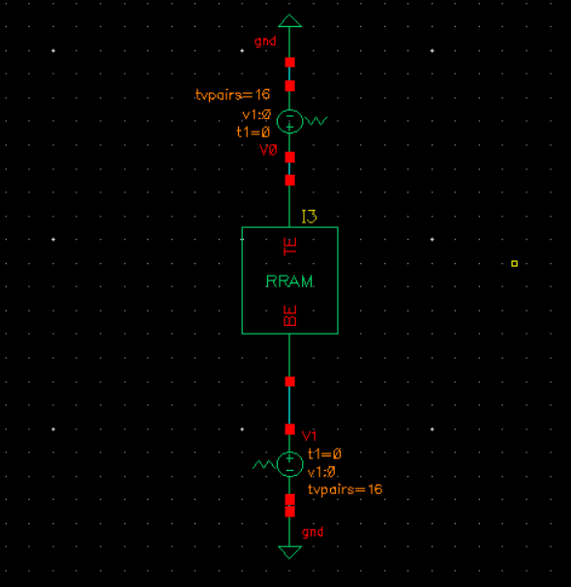
Hardware Implementation: The RRAM Cell
Resistive RAM as a Memristor
RRAM is a two-terminal device whose resistance depends on the history of applied voltage — a physical realization of the memristor. Conductance G is modulated by the growth and rupture of a conductive filament within a metal-oxide layer.
a) Cross-sectional view of an RRAM.
b) Set/Reset Process c) Unipolar switching
(d) bipolar switching I–V curve in an RRAM [4].
Designed custom RRAM Schematic
SET process: Positive voltage grows the filament → low resistance state (LRS)
RESET process: Negative voltage ruptures the filament → high resistance state (HRS)
Analog switching: Partial filament growth enables continuous conductance levels

Slide 5
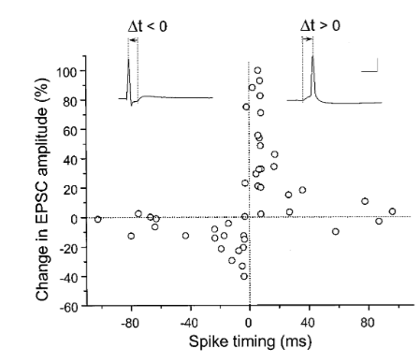
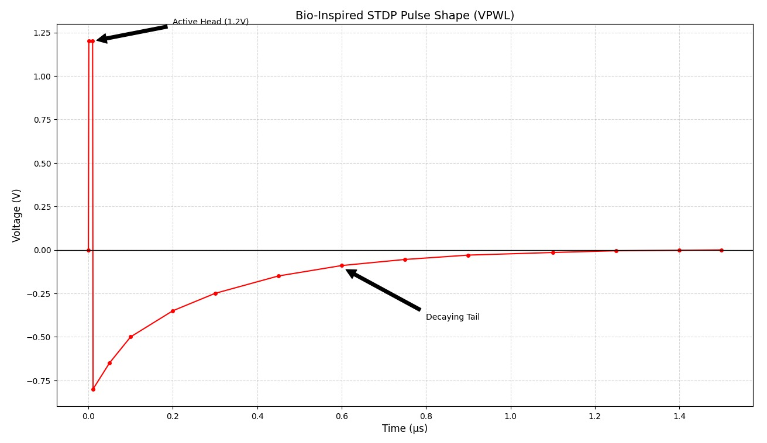
Input Stimulus Design: Bio-Inspired VPWL
Spikes are modeled using VPWL (Voltage Piecewise Linear) sources that replicate the asymmetric shape of biological action potentials, enabling precise Δt overlap for STDP.
Active Head — 1.2V
Decaying Tail
Sharp rising edge exceeds the RRAM threshold voltage V_{th}, triggering filament modulation. Acts as the "spike" event.
Gradual exponential fall creates a timing-sensitive overlap window. The degree of overlap between pre/post tails encodes \Delta t.
Input Piecewise Linear Voltage function [5]
Timing Overlap
The integral of overlapping tails determines net conductance change — directly mapping biological STDP curves onto hardware.
Mathematical Intuition: ΔG ∝ exp(-|Δt| / τ)
Generated Piecewise Linear Voltage function

Slide 6
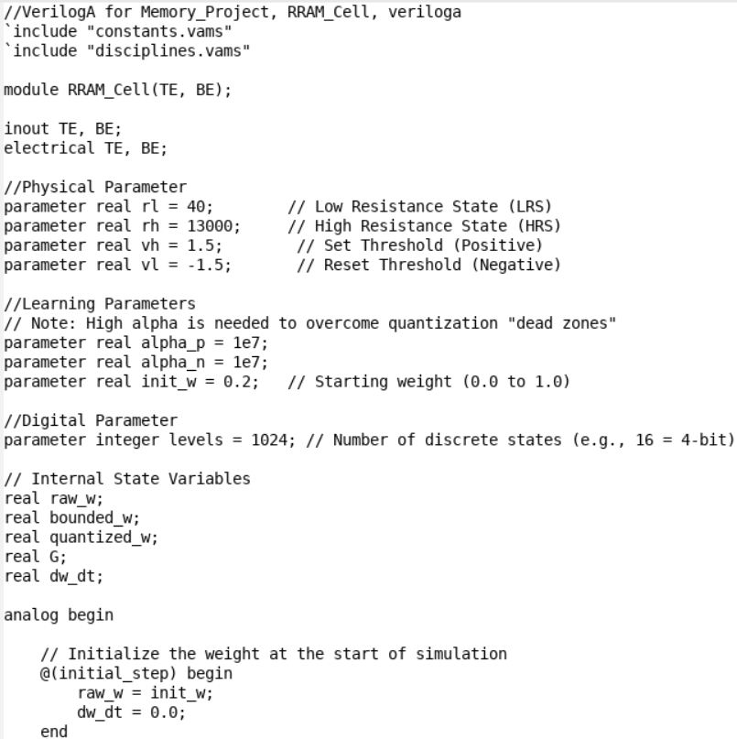
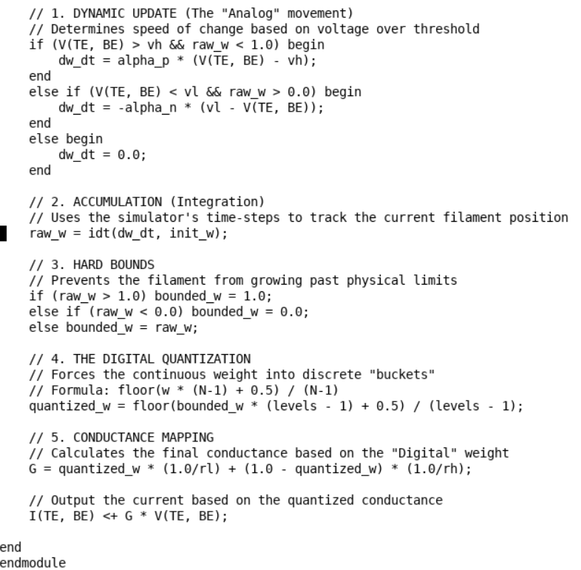
Verilog-A Modeling Logic
State Variable Pipeline
Three cascaded state variables implement the full STDP learning rule within a single Verilog-A module.
Voltage (TE–BE) ↓ Weight Update (dw/dt) ↓ Bound + Quantize ↓ Conductance Mapping ↓ Current Output (I = G·V)
w(t) = ∫ (dw/dt) dt
G = w·(1/RL) + (1 − w)·(1/RH)
I = G·V
Multi-level conductance (256 states)
Models LRS and HRS switching
Incremental weight updates
Enables synaptic learning behaviour.

Slide 7
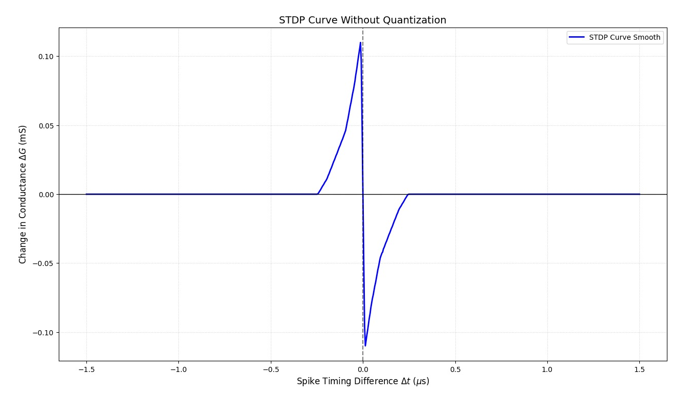

Results: Ideal ΔG vs Δt Curve
Key Observations
Exponential decay away from Δt = 0:
As |Δt| increases, ΔG approaches zero, meaning distant spikes have negligible influence on learning.
Symmetric Learning Window
LTP and LTD lobes are well-balanced, confirming correct \ |Δt| centering and VPWL overlap logic.
Initial Filament Condition
The following graph was generated using 701 values of Δt between 0.5 to 3.5us.
Δt = t_{pre}- t_{post}.
Simulation has been started at 50% filament to create symmetrical graph.

Slide 8
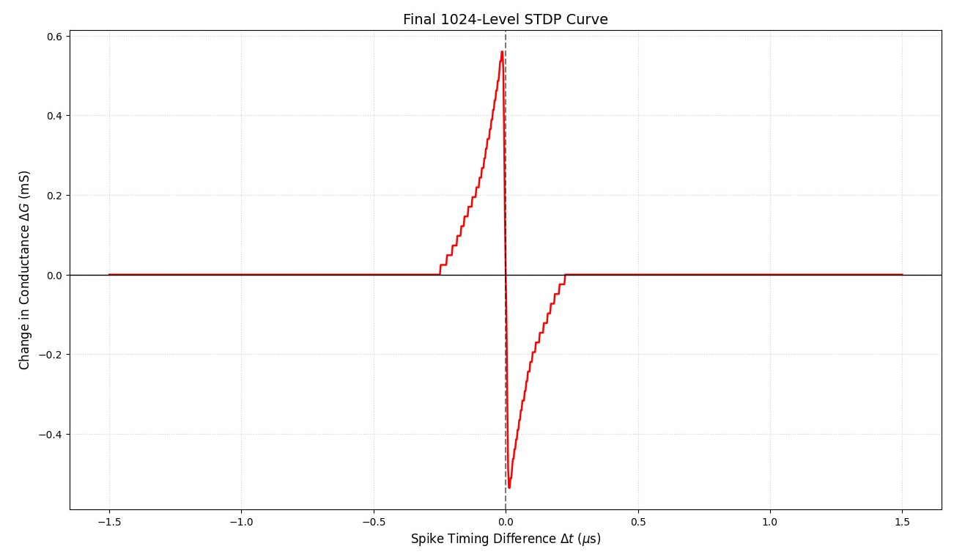
Results: Quantized Graph
From Analog Conductance to Digital Levels
Physical RRAM devices exhibit continuous conductance, but digital systems require discrete weight representations. This presentation bridges the gap through a 10-bit quantisation scheme that maps analogue G to 1024 discrete levels.
High density of states helps minimize quantization noise, which can otherwise lead to instability during the neural network training.
10-Bit Architecture
Quantization Step
Rounding Logic
2^{10} = 1024 levels spanning G_{min} to G_{max}
Delta G = (G_{min} to G_{max} )/ 1023
Nearest-level quantization preserves STDP curve fidelity

Slide 9

This work demonstrates a Verilog-A framework for STDP learning in RRAM-based synapses, bridging biological accuracy with digital storage constraints.
Biological Fidelity
VPWL-driven STDP faithfully reproduces the LTP/LTD learning window in hardware.
Conclusion
& Future Scope
Digital Integration
10-bit quantization enables deployment in digital neuromorphic systems with minimal precision loss.
Edge AI Applications
Scalable to crossbar arrays for on-chip learning in low-power edge devices.
Future Directions
Multi-level cell variability modeling, array-level simulations, and FPGA co-emulation.

Slide 10
References
[1]“Neuromorphic Hardware and Computing 2024,” Nature, May 06, 2024. Available: https://www.nature.com/collections/jaidjgeceb/content/brain-inspired-computing-and-algorithms. [Accessed: Apr. 19, 2026]
[2] S. Choi, S. Ham, and G. Wang, “Memristor Synapses for Neuromorphic Computing,” IntechOpen eBooks, Mar. 2019, doi: https://doi.org/10.5772/intechopen.85301
[3]M. Prezioso et al., “Spike-timing-dependent plasticity learning of coincidence detection with passively integrated memristive circuits,” Nature Communications, vol. 9, no. 1, Dec. 2018, doi: https://doi.org/10.1038/s41467-018-07757-y
[4]Furqan Zahoor et al., “An overview of critical applications of resistive random access memory,” Nanoscale Advances, Jan. 2024, doi: https://doi.org/10.1039/d4na00158c. Available: https://pubs.rsc.org/en/content/articlelanding/2024/na/d4na00158c. [Accessed: Nov. 08, 2024]
[5] G. Bi and M. Poo, “Synaptic Modifications in Cultured Hippocampal Neurons: Dependence on Spike Timing, Synaptic Strength, and Postsynaptic Cell Type,” The Journal of Neuroscience, vol. 18, no. 24, pp. 10464–10472, Dec. 1998, doi: https://doi.org/10.1523/jneurosci.18-24-10464.1998. Available: https://www.jneurosci.org/content/jneuro/18/24/10464.full.pdf

