Slide 1
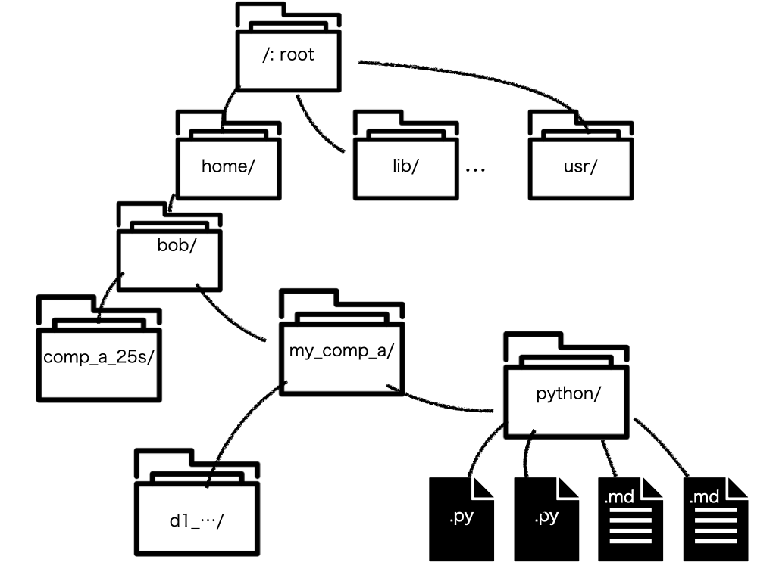
/usr/bin/python3 /home/bob/comp_a_25s/python/d1_hello.py
Python3 d1_hello.py

