Slide 1
Ruby advance
bundle gem hyper_card_builder
bob 2025/11/23

Slide 2
# use scaffolding
# initialize
 bundle gem hyper_card_builder --test=minitest --exe
Creating gem 'hyper_card_builder'...
MIT License enabled in config
Code of conduct enabled in config
Changelog enabled in config
Initializing git repo in /Users/bob/git_hub/hyper_card_builder
create hyper_card_builder/Gemfile
create hyper_card_builder/lib/hyper_card_builder.rb
create hyper_card_builder/lib/hyper_card_builder/version.rb
create hyper_card_builder/sig/hyper_card_builder.rbs
create hyper_card_builder/hyper_card_builder.gemspec
create hyper_card_builder/Rakefile
create hyper_card_builder/README.md
create hyper_card_builder/bin/console
create hyper_card_builder/bin/setup
create hyper_card_builder/.gitignore
create hyper_card_builder/test/test_helper.rb
create hyper_card_builder/test/test_hyper_card_builder.rb
create hyper_card_builder/LICENSE.txt
create hyper_card_builder/CODE_OF_CONDUCT.md
create hyper_card_builder/CHANGELOG.md
create hyper_card_builder/exe/hyper_card_builder
Gem 'hyper_card_builder' was successfully created. For more information on making a RubyGem visit https://bundler.io/guides/creating_gem.html
 cat Gemfile
# frozen_string_literal: true
source "https://rubygems.org"
# Specify your gem's dependencies in hyper_card_builder.gemspec
gemspec
gem "irb"
gem "rake", "~> 13.0"
gem "minitest", "~> 5.16"
 bundle update
Fetching gem metadata from https://rubygems.org/..........
Resolving dependencies...
Fetching date 3.5.0
Fetching erb 6.0.0
Fetching io-console 0.8.1
Fetching stringio 3.1.8
Fetching tsort 0.2.0
Fetching prettyprint 0.2.0
Fetching minitest 5.26.2
Installing erb 6.0.0 with native extensions
Installing io-console 0.8.1 with native extensions
Installing date 3.5.0 with native extensions
Installing stringio 3.1.8 with native extensions
Installing tsort 0.2.0
Installing prettyprint 0.2.0
Installing minitest 5.26.2
Fetching pp 0.6.3
Installing pp 0.6.3
Fetching reline 0.6.3
Installing reline 0.6.3
Fetching psych 5.2.6
Installing psych 5.2.6 with native extensions
Fetching rdoc 6.15.1
Installing rdoc 6.15.1
Fetching irb 1.15.3
Installing irb 1.15.3
Bundle updated!
 tree -C
.
├── bin
│ ├── console
│ └── setup
├── CHANGELOG.md
├── CODE_OF_CONDUCT.md
├── exe
│ └── hyper_card_builder
├── Gemfile
├── Gemfile.lock
├── hyper_card_builder.gemspec
├── lib
│ ├── hyper_card_builder
│ │ └── version.rb
│ └── hyper_card_builder.rb
├── LICENSE.txt
├── Rakefile
├── README.md
├── sig
│ └── hyper_card_builder.rbs
└── test
├── test_helper.rb
└── test_hyper_card_builder.rb
7 directories, 16 files

Slide 3
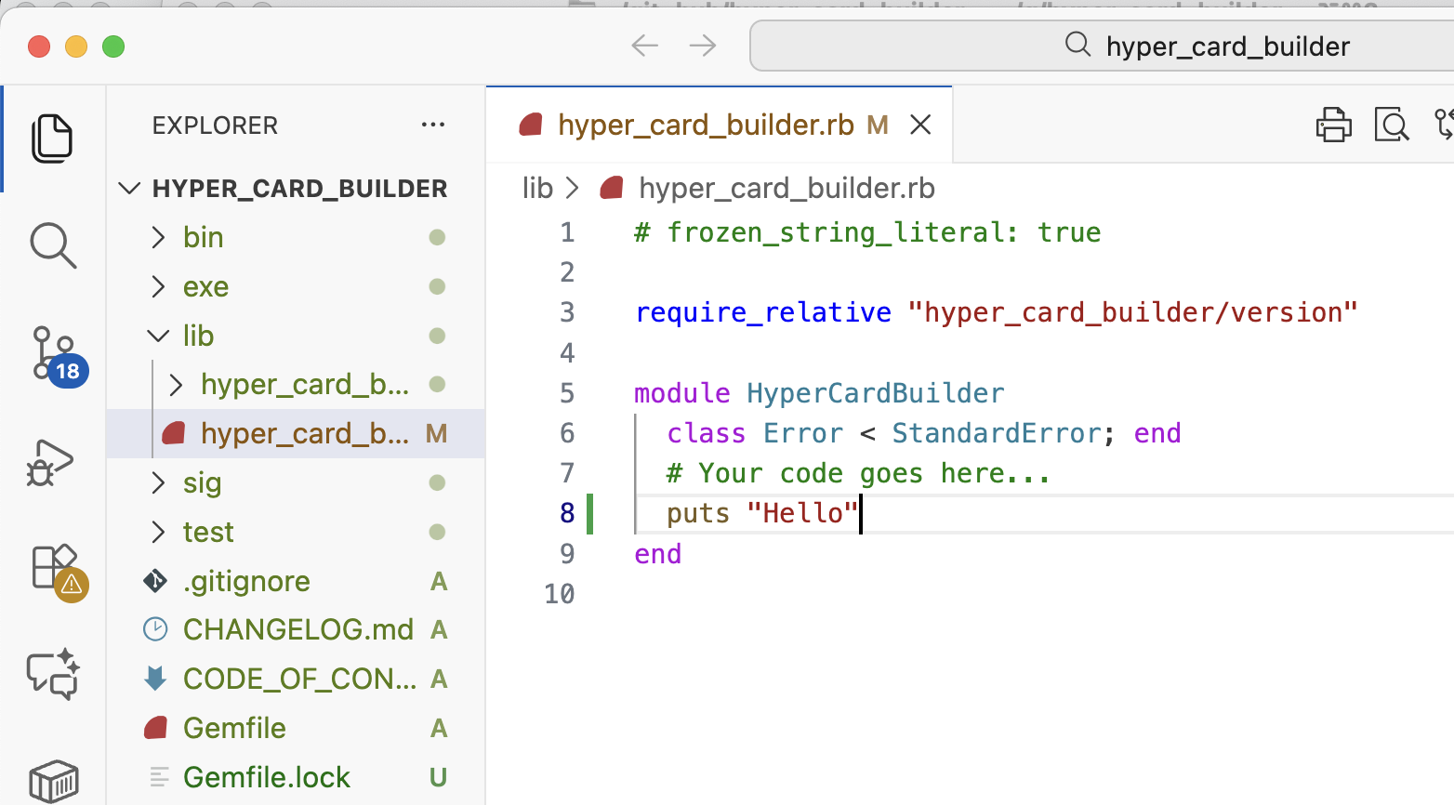
# first step
# chat
 shell comms
 code edit
 bundle exec exe/hyper_card_builder
 code .
 bundle exec exe/hyper_card_builder
Hello
> code hyper_card_builder.gemspec
│ File: hyper_card_builder.gemspec
1 │ # frozen_string_literal: true
2 │
3 │ require_relative "lib/hyper_card_builder/version"
36 │ spec.add_dependency "thor"
37 │
40 │ spec.add_development_dependency "minitest"
41 │ spec.add_development_dependency "minitest-reporters"
42 │ spec.add_development_dependency "minitest-hooks"
 rake test
Hello
Run options: --seed 178
# Running:
..
Finished in 0.000256s, 7812.4974 runs/s, 7812.4974 assertions/s.
2 runs, 2 assertions, 0 failures, 0 errors, 0 skips

Slide 4
# colorful report
# chat
 shell comms
 code edit
 rake test
Hello
Run options: --seed 178
# Running:
..
Finished in 0.000256s, 7812.4974 runs/s, 7812.4974 assertions/s.
2 runs, 2 assertions, 0 failures, 0 errors, 0 skips
# minitestの出力をcolorfullに見やすくするように修正
GitHub Copilot: `minitest-reporters` を使ってカラフルな出力にできます。
`test_helper.rb` に以下を追加してください。
````ruby
# ...existing code...
require "minitest/reporters"
Minitest::Reporters.use! Minitest::Reporters::SpecReporter.new
# ...existing code...
````
これで `rake test` の出力がカラフルで見やすくなります。
 bundle exec rake test
Hello
Started with run options --seed 42050
TestHyperCardBuilder
test_it_does_something_useful PASS (0.00s)
test_exe_outputs_hello PASS (0.06s)
test_that_it_has_a_version_number PASS (0.00s)
Finished in 0.06135s
3 tests, 4 assertions, 0 failures, 0 errors, 0 skips

Slide 5
# red, green, refact
# chat
 shell comms
 code edit
# bundle exec exe/hyper_card_builder
helloで"Hello."と返るテストを作成．
 bat test/test_hyper_card_builder.rb
1 │ # frozen_string_literal: true
2 │
3 │ require "test_helper"
4 │
5 ~ │ class TestHyperCardBuilderTest < Minitest::Test
6 ~ │ def test_exe_hello_outputs_hello_dot
7 ~ │ require "open3"
8 ~ │ output, status = Open3.capture2(
"bundle exec exe/hyper_card_builder hello")
9 ~ │ assert_equal "Hello.\n", output
10 ~ │ assert status.success?
11 ~ │ end
 bundle exec rake test
TestHyperCardBuilderTest
test_it_does_something_usefulPASS (0.00s)
...
Finished in 0.12164s
4 tests, 5 assertions,
1 failures, 0 errors, 0 skips
rake aborted!
# Thorを使ってcommand cliでhelloを受け取るように修正
 bundle exec rake test
/Users/bob/.rbenv/versions/3.4.4/lib/ruby/3.4.0/bundled_gems.rb:82:in 'Kernel.require': cannot load such file -- thor (LoadError)
 bat lib/hyper_card_builder.rb
1 │ # frozen_string_literal: true
2 │
3 │ require_relative "hyper_card_builder/version"
4 + │ require "thor"
5 │
6 │ module HyperCardBuilder
7 │ class Error < StandardError; end
8 ~ │
9 ~ │ class CLI < Thor
10 ~ │ desc "hello", "Prints Hello."
11 ~ │ def hello
12 ~ │ puts "Hello."
13 ~ │ end
14 ~ │ end
15 │ end
 bat hyper_card_builder.gemspec
36 ~ │ spec.add_dependency "thor"
 bundle update
Fetching gem metadata from https://rubygems....
Resolving dependencies...
Bundle updated!
# ThorのCLIが起動するように修正．
 bundle exec rake test
Started with run options --seed 27872
TestHyperCardBuilderTest
test_it_does_something_useful PASS (0.00s)
test_that_it_has_a_version_numberPASS (0.00s)
test_exe_hello_outputs_hello_dot PASS (0.06s)
Finished in 0.06452s
3 tests, 4 assertions, 0 failures, 0 errors, 0 skips
 bat exe/hyper_card_builder
1 │ #!/usr/bin/env ruby
2 │
3 │ require "hyper_card_builder"
4 + │
5 + │ HyperCardBuilder::CLI.start(ARGV)

Slide 6
# puts_sample_yaml
# chat
 shell comms
 code edit
# hyper_card_builder puts_hc_arrayでhc_array.yamlを出力するテストを作成．
 bat test/test_hc_array_yaml.rb
│ File: test/test_hc_array_yaml.rb
1 │ # frozen_string_literal: true
2 │
3 │ require "test_helper"
4 │ require "yaml"
5 │ require "fileutils"
...
 bundle exec rake test
Started with run options --seed 7229
TestHcArrayYaml
Could not find command "puts_hc_array".
# Could not find command "puts_hc_array".
なので，hyper_card_builder.rbが
そのコマンドを受け付けるように修正
 bat lib/hyper_card_builder.rb
16 ~ │ desc "puts_hc_array", "Outputs hc_array.yaml"
17 ~ │ def puts_hc_array
18 ~ │ hc_array = {
19 ~ │ source_file: "./linux_basic.pdf",
 bundle exec rake test
Started with run options --seed 59575
TestHcArrayYaml
bundler: failed to load command:
exe/hyper_card_builder (exe/hyper_card_builder)
/Users/bob/git_hub/hyper_card_builder/lib/hyper_card_builder.rb:26:in 'block in HyperCardBuilder::CLI#puts_hc_array':
undefined method 'to_yaml' for an instance of Hash (NoMethodError)
File.open("hc_array.yaml", "w") { |f| f.write(hc_array.to_yaml) }
^^^^^^^^
# ...を修正
 bat lib/hyper_card_builder.rb
4 + │ require "thor"
5 + │ require "yaml" # ← 追加
 bundle exec rake test
Started with run options --seed 33318
TestHyperCardBuilderTest
test_that_it_has_a_version_number PASS (0.00s)
test_it_does_something_useful PASS (0.00s)
test_exe_hello_outputs_hello_dot PASS (0.07s)
TestHcArrayYaml
test_puts_hc_array_outputs_expected_yaml PASS (0.07s)
Finished in 0.13971s
4 tests, 7 assertions, 0 failures, 0 errors, 0 skips

Slide 7
 bat test/test_hc_array_yaml.rb
1 │ # frozen_string_literal: true
2 │
3 │ require "test_helper"
4 │ require "yaml"
5 │ require "fileutils"
6 │
7 │ class TestHcArrayYaml < Minitest::Test
8 │ GENERATED_FILE = "hc_array.yaml"
9 │ EXPECTED_YAML = {
10 │ source_file: "./linux_basic.pdf",
11 │ target_dir: "./linux_basic",
12 │ toc: [
13 │ { no: nil, init: 1, fin: nil, head: "title" },
14 │ { no: "s0", init: 2, fin: nil, head: "commands" },
15 │ { no: "sf", init: 8, fin: 8, head: "summary" }
16 │ ]
17 │ }
18 │
19 │ def setup
20 │ FileUtils.rm_f(GENERATED_FILE)
21 │ end
22 │
23 │ def teardown
24 │ FileUtils.rm_f(GENERATED_FILE)
25 │ end
26 │
27 │ def test_puts_hc_array_outputs_expected_yaml
28 │ require "open3"
29 │ output, status = Open3.capture2("bundle exec exe/hyper_card_builder puts hc_array")
30 │ assert status.success?, "Command failed: #{output}"
31 │
32 │ assert File.exist?(GENERATED_FILE), "Expected #{GENERATED_FILE} to be generated"
33 │
34 │ actual_yaml = YAML.load_file(GENERATED_FILE)
35 │ assert_equal EXPECTED_YAML, actual_yaml
36 │ end
37 │ end
# def puts_hc_array
# TestHcArrayYaml
 bat lib/hyper_card_builder.rb
16 ~ │ desc "puts_hc_array", "Outputs hc_array.yaml"
17 ~ │ def puts_hc_array
18 ~ │ hc_array = {
19 ~ │ source_file: "./linux_basic.pdf",
20 ~ │ target_dir: "./linux_basic",
21 ~ │ toc: [
22 ~ │ { no: nil, init: 1, fin: nil, head: "title" },
23 ~ │ { no: "s0", init: 2, fin: nil, head: "commands" },
24 ~ │ { no: "sf", init: 8, fin: 8, head: "summary" }
25 ~ │ ]
26 ~ │ }
27 ~ │ File.open("hc_array.yaml", "w")
{ |f| f.write(hc_array.to_yaml) }
28 ~ │ puts "hc_array.yaml generated."
29 ~ │ end

Slide 8
# in test_env
 bat test/test_hc_array_yaml.rb
1 │ # frozen_string_literal: true
2 │
3 │ require "test_helper"
4 │ require "yaml"
5 │ require "fileutils"
6 │
7 │ class TestHcArrayYaml < Minitest::Test
8 │ GENERATED_FILE = "hc_array.yaml"
9 │ EXPECTED_YAML = {
10 │ source_file: "./linux_basic.pdf",
11 │ target_dir: "./linux_basic",
12 │ toc: [
13 │ { no: nil, init: 1, fin: nil, head: "title" },
14 │ { no: "s0", init: 2, fin: nil, head: "commands" },
15 │ { no: "sf", init: 8, fin: 8, head: "summary" }
16 │ ]
17 │ }
18 │
19 │ def setup
20 │ FileUtils.rm_f(GENERATED_FILE)
21 │ end
22 │
23 │ def teardown
24 │ FileUtils.rm_f(GENERATED_FILE)
25 │ end
26 │
27 │ def test_puts_hc_array_outputs_expected_yaml
28 │ require "open3"
29 │ output, status = Open3.capture2("bundle exec exe/hyper_card_builder puts hc_array")
30 │ assert status.success?, "Command failed: #{output}"
31 │
32 │ assert File.exist?(GENERATED_FILE), "Expected #{GENERATED_FILE} to be generated"
33 │
34 │ actual_yaml = YAML.load_file(GENERATED_FILE)
35 │ assert_equal EXPECTED_YAML, actual_yaml
36 │ end
37 │ end
 bat lib/hyper_card_builder.rb
16 ~ │ desc "puts_hc_array", "Outputs hc_array.yaml"
17 ~ │ def puts_hc_array
18 ~ │ hc_array = {
19 ~ │ source_file: "./linux_basic.pdf",
20 ~ │ target_dir: "./linux_basic",
21 ~ │ toc: [
22 ~ │ { no: nil, init: 1, fin: nil, head: "title" },
23 ~ │ { no: "s0", init: 2, fin: nil, head: "commands" },
24 ~ │ { no: "sf", init: 8, fin: 8, head: "summary" }
25 ~ │ ]
26 ~ │ }
27 ~ │ File.open("hc_array.yaml", "w")
{ |f| f.write(hc_array.to_yaml) }
28 ~ │ puts "hc_array.yaml generated."
29 ~ │ end

Slide 9
# test_split_pdf_wo_pages
 ruby -Ilib:test test/test_split_pdf_wo_pages.rb
Started with run options --seed 58979
TestSplitPDFwoPages
qpdf: operation succeeded with warnings; resulting file may have some problems
"./linux_basic/title.pdf"
qpdf ./linux_basic.pdf --pages . 1-1 -- ./linux_basic/title.pdf
"./linux_basic/s0_commands.pdf"
qpdf ./linux_basic.pdf --pages . 2-2 -- ./linux_basic/s0_commands.pdf
"./linux_basic/sf_summary.pdf"
qpdf ./linux_basic.pdf --pages . 8-8 -- ./linux_basic/sf_summary.pdf
test_split_linux_basic_pdf_by_yaml PASS (0.10s)
Finished in 0.09615s
1 tests, 5 assertions, 0 failures, 0 errors, 0 skips

