Slide 1
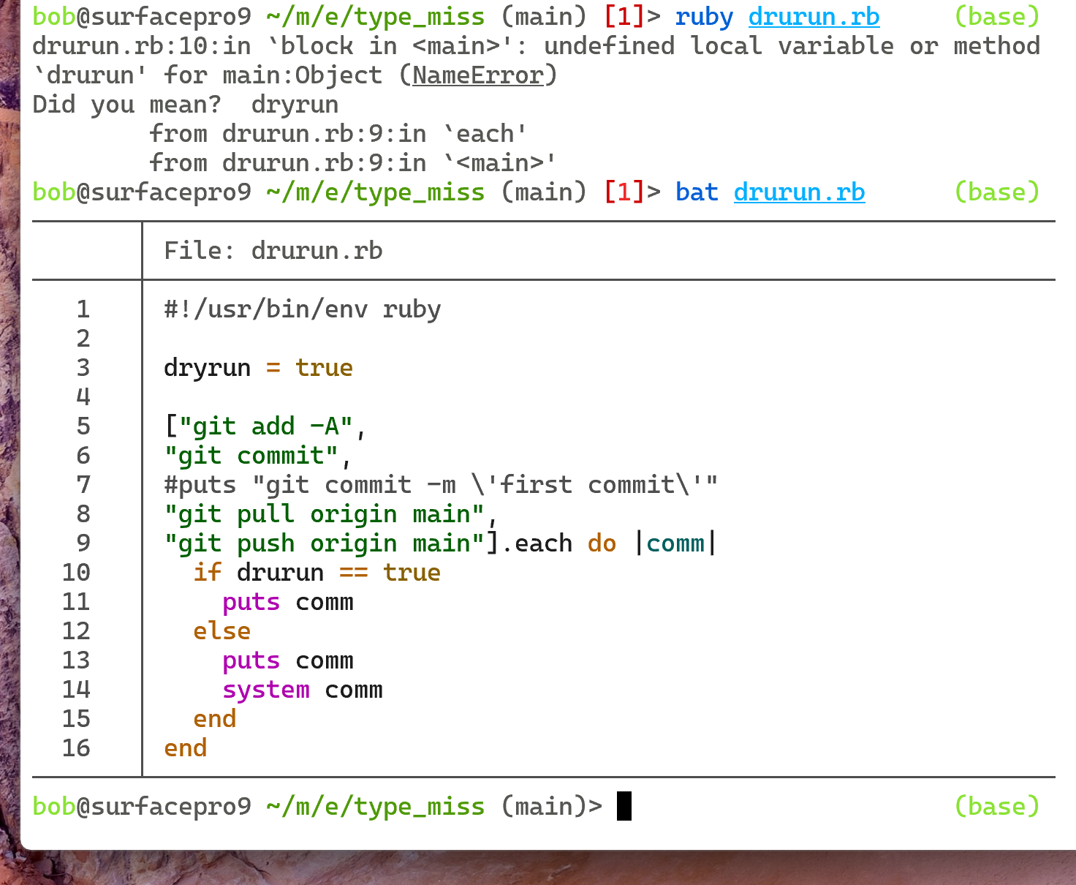










































Slide 2
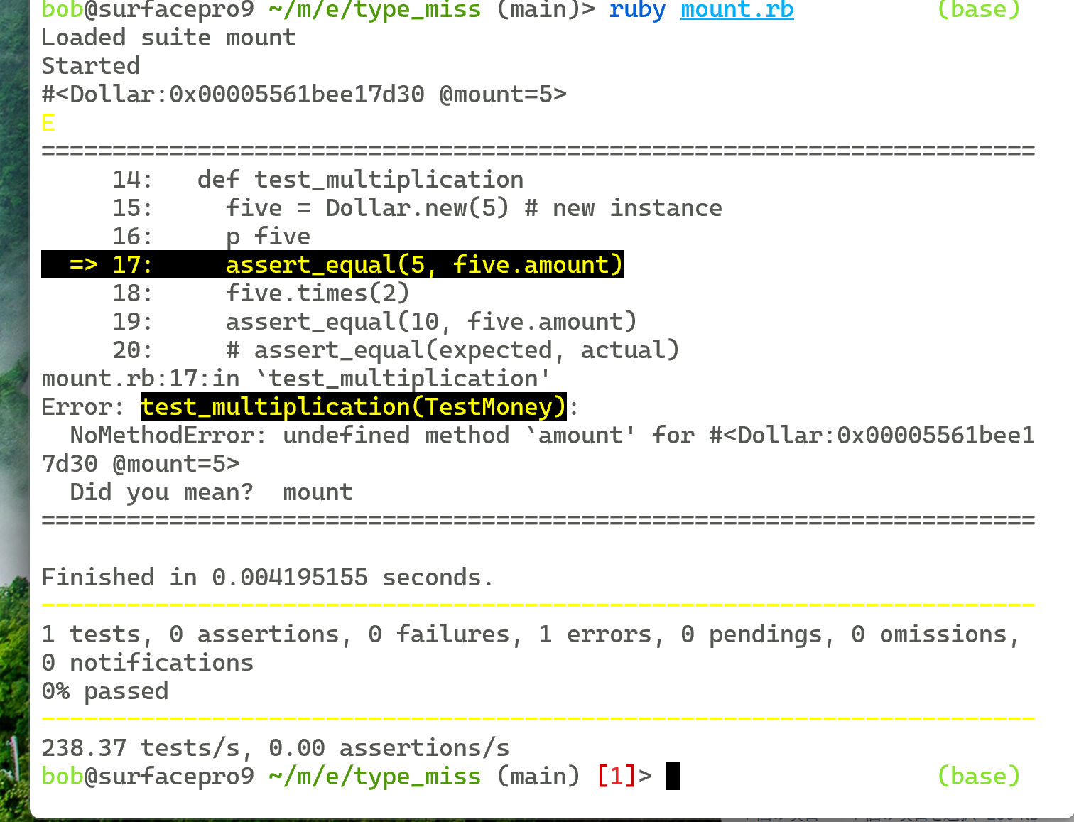
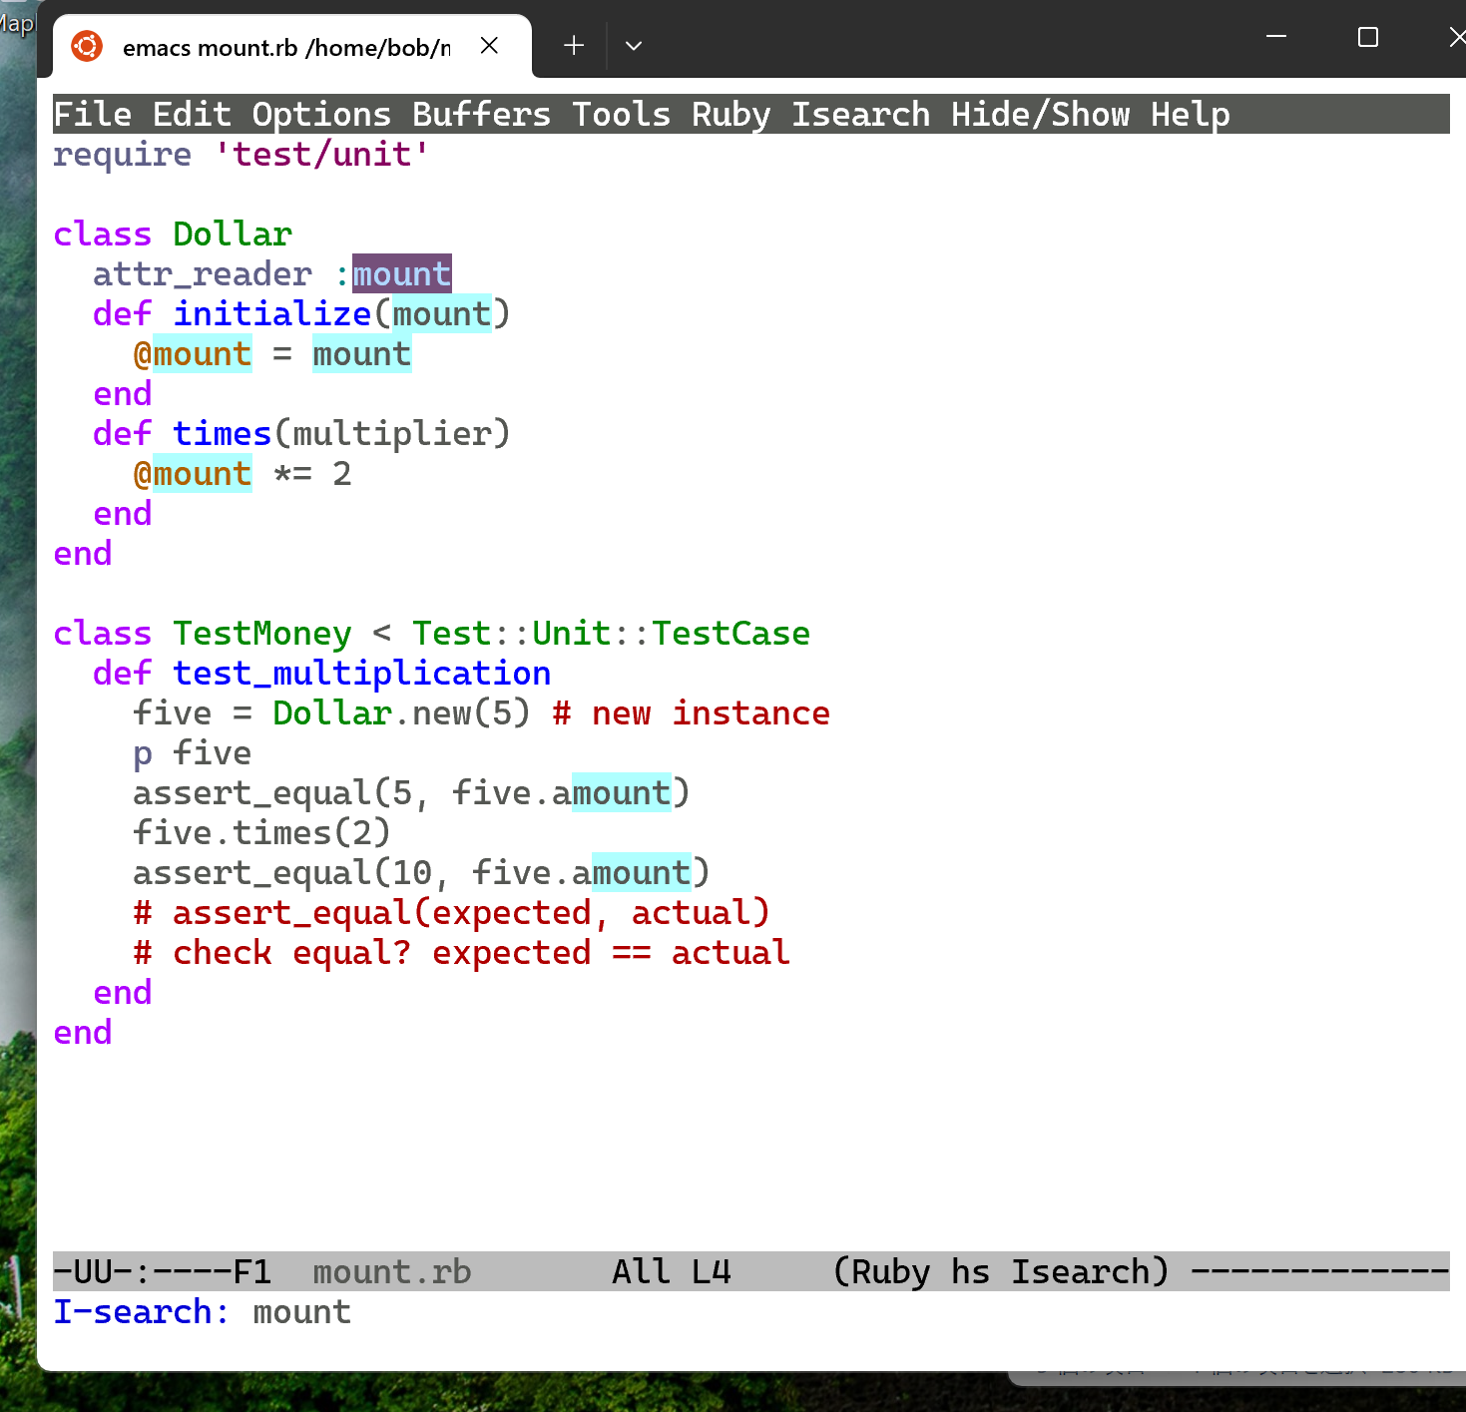


















(1) c-sでsearchをかける！！
M-x query-replace mount amount

Slide 3
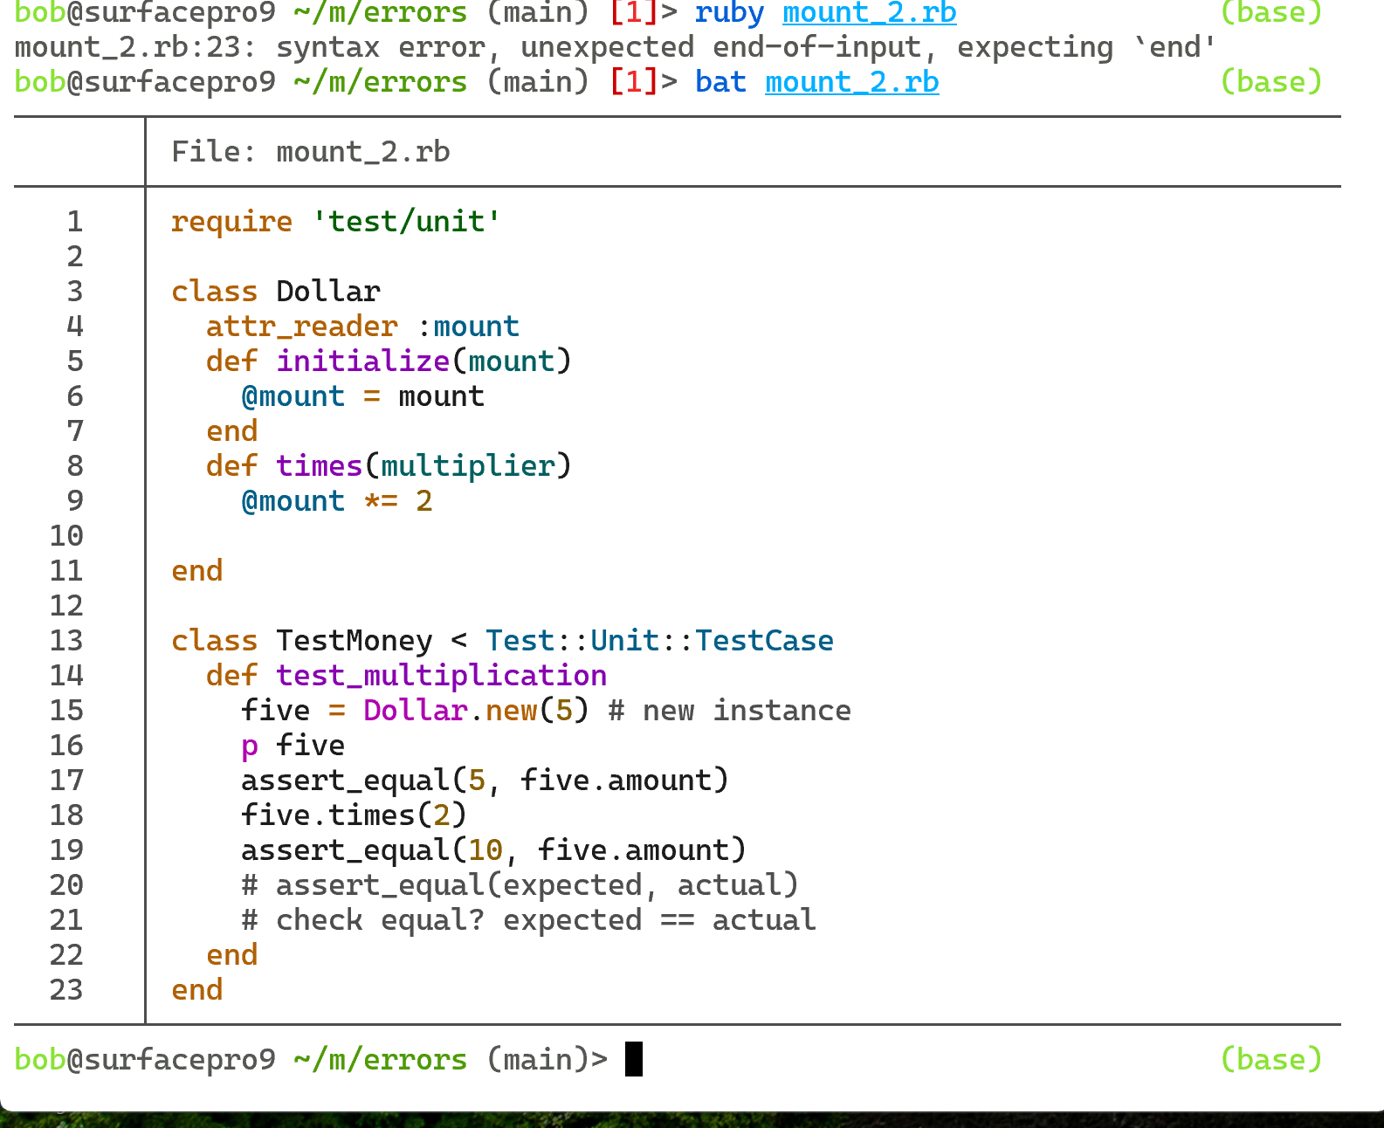


















M-x indent-region

Slide 4

