Slide 1
Sample plot3d
24/11/13 西谷 マルチスケール24f

Slide 2
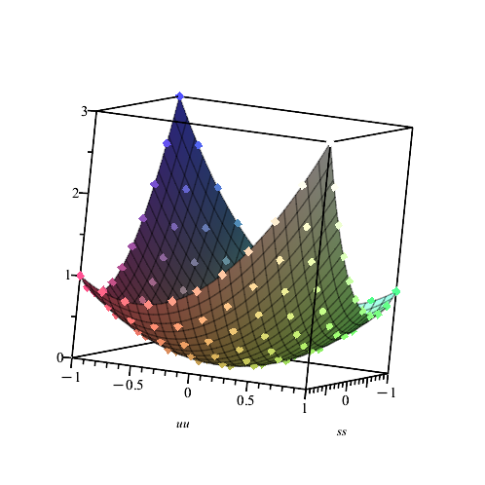
> pwd
/home/bob/multi_scale_24f/w8_3d_plot/3_2d_dir
> ruby task_cont_dir.rb
> ruby mk_maple_plot_dir.rb| clip.exe
with(plots):
AA:=[[-0.19999999999999996, -0.19999999999999996, 0.11999999999999994], [-0.19999999999999996, -0.3999999999999999, 0.27999999999999986], [-1.5600000000000003], [1.0, 0.6000000000000001, 1.9600000000000002], [1.0, 0.8, 2.4400000000000004], [1.0, 1.0, 3.0]]:
p_A:=pointplot3d(AA, symbolsize=20);
with(LinearAlgebra);
data := convert(Transpose(Matrix(AA)), listlist);
with(stats);
fit1 := fit[leastsquare[[s, t, u],
u = a4*s*t + a5*t^2 + a6*s^2 + a2*t + a3*s + a1,
{a1, a2, a3, a4, a5, a6}]](data);
f1 := unapply(rhs(fit1), s, t);
pf1 := plot3d(f1(ss, uu), ss = -1.0 .. 1.0, uu = -1.0 .. 1.0):
display(pf1, p_A);

