Slide 1
Ethereum-based Prediction markets
ChainShot Developer Bootcamp
David DeBruce

Slide 2

Problem Statement
To leverage blockchain technology to develop a crowdsourced collective intelligence platform that allows users to place bets on the outcome of future events.
Using the “wisdom of crowds” phenomenon, aggregated crowdsourcing-based forecasts can outperform experts when predicting the future.

Slide 3
Proposed Solution
Predictors bet that an event will occur by sending ETH to the Prediction Market smart contract.
Each predictor chooses an amount to bet (corresponding to his/her confidence in an event occurring at some point in the future).
Oracle reports the result of event to the Prediction Market smart contract, which will pay the winning predictors.
Winnings come from the loser pool and are proportional to the initial investor for each winning predictor.
Oracle
Smart
Contract
ETH
✅
Predictor 1
Result
ETH
✅
Predictor 2
ETH
❌
Predictor 3

Slide 4
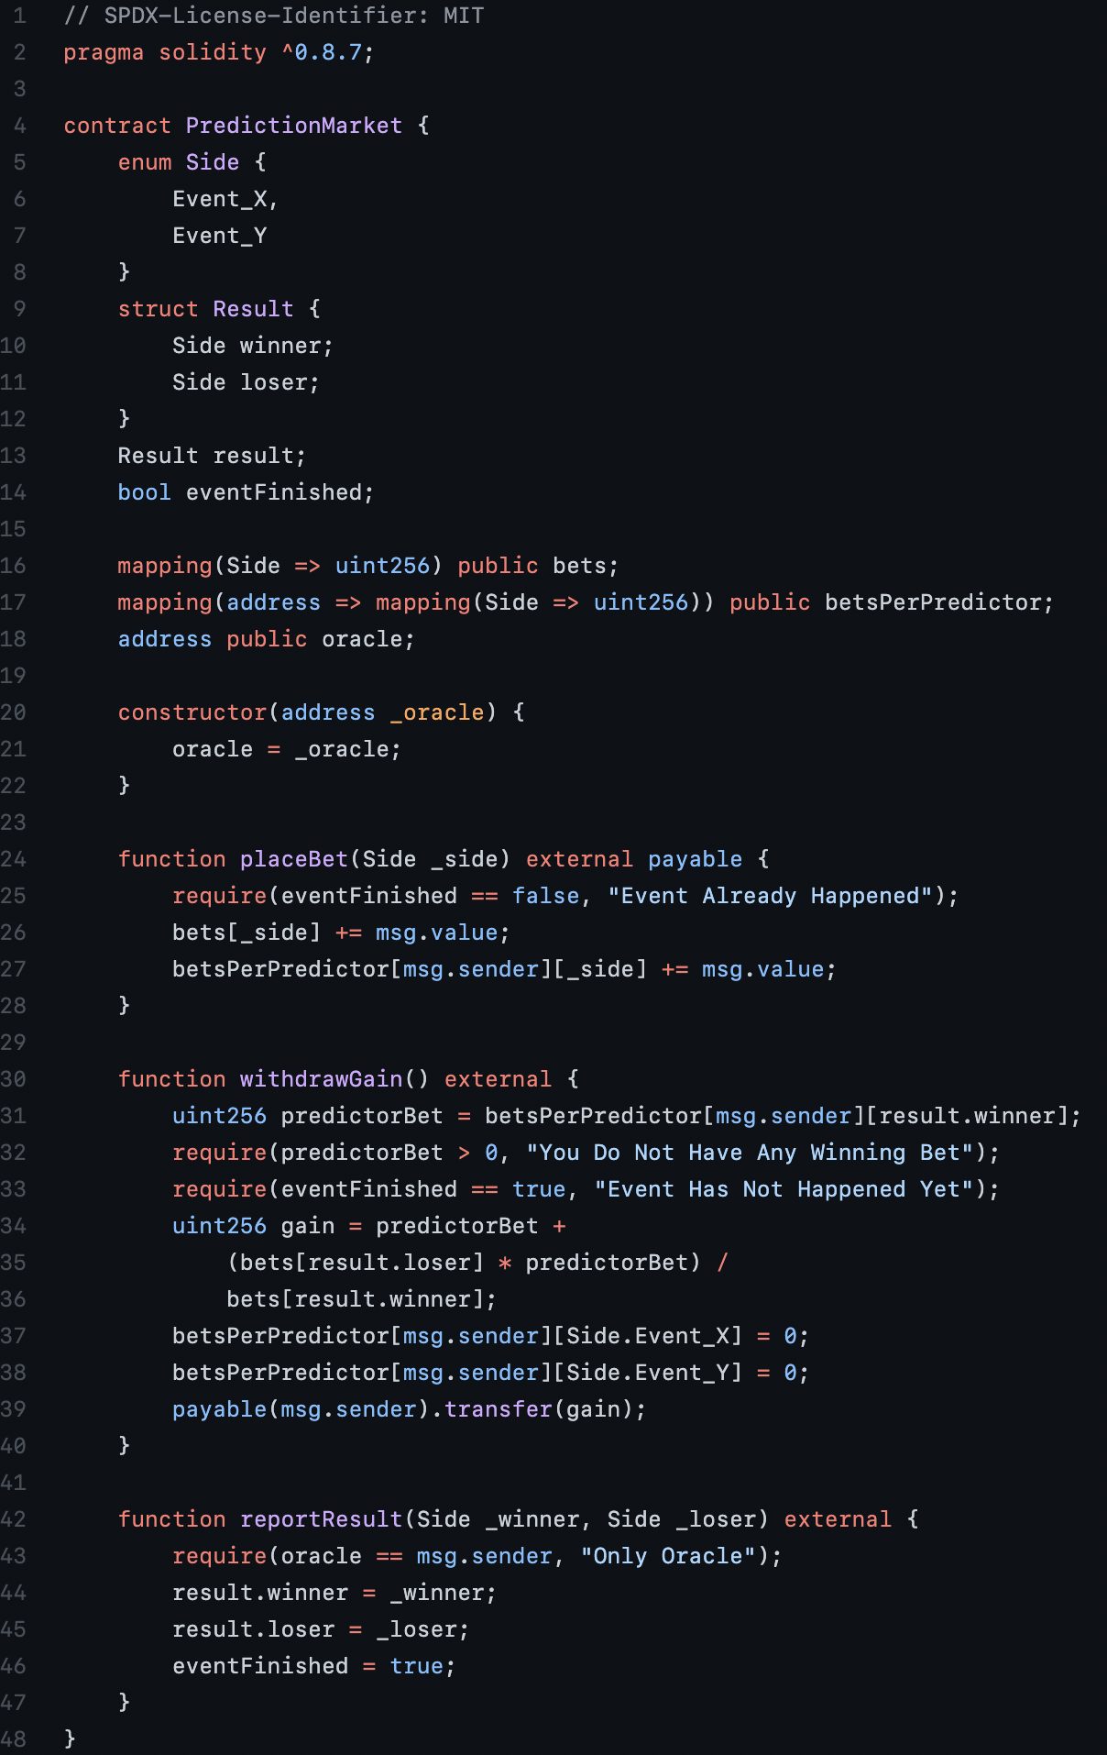
Minimum Viable Product (MVP)
Smart Contract: Solidity & Truffle
Frontend: React & Bootstrap
The MVP for the project is a generic template that can be used to predict any event in the future.

Slide 5

Next Steps
The oracle in this project is static in nature and is just an address that simply sends a transaction to the Prediction Market smart contract.
Integrate Chainlink oracles
Current bets are made that an event will occur at some unspecified date in the future.
Integrate time limit that event must occur before

