Slide 1
Regressions
MKT 566
Instructor: Davide Proserpio

Slide 2
A few things
Homework 1 and the next homework
Groups
Section 16546 (1 student w/o group)
Section 16547 (2 students w/o group)
Project proposal presentations (Oct. 13/15)
“I would like each group to submit and present (approximately 10-15 minutes) a PowerPoint presentation proposal outlining the problem you propose to study and your general approach to the problem.”
Guest speakers:
Jonathan Elliot, Director, Data Science at StubHub (Sept. 29)
Yang Wang, Principal Economist at Amazon (Nov. 5)
Giovanni Marano: Analytics Senior Director at FanDuel (Nov. 17/19)

Slide 3
What we will learn
We continue to talk about covariation and learn how to model it using regressions
We are going to cover linear regressions and important concepts associated with them
Chapter 3.4 of R for Marketing Students
(Advanced & optional) Lecture 6 of Data Storytelling for Marketers

Slide 4
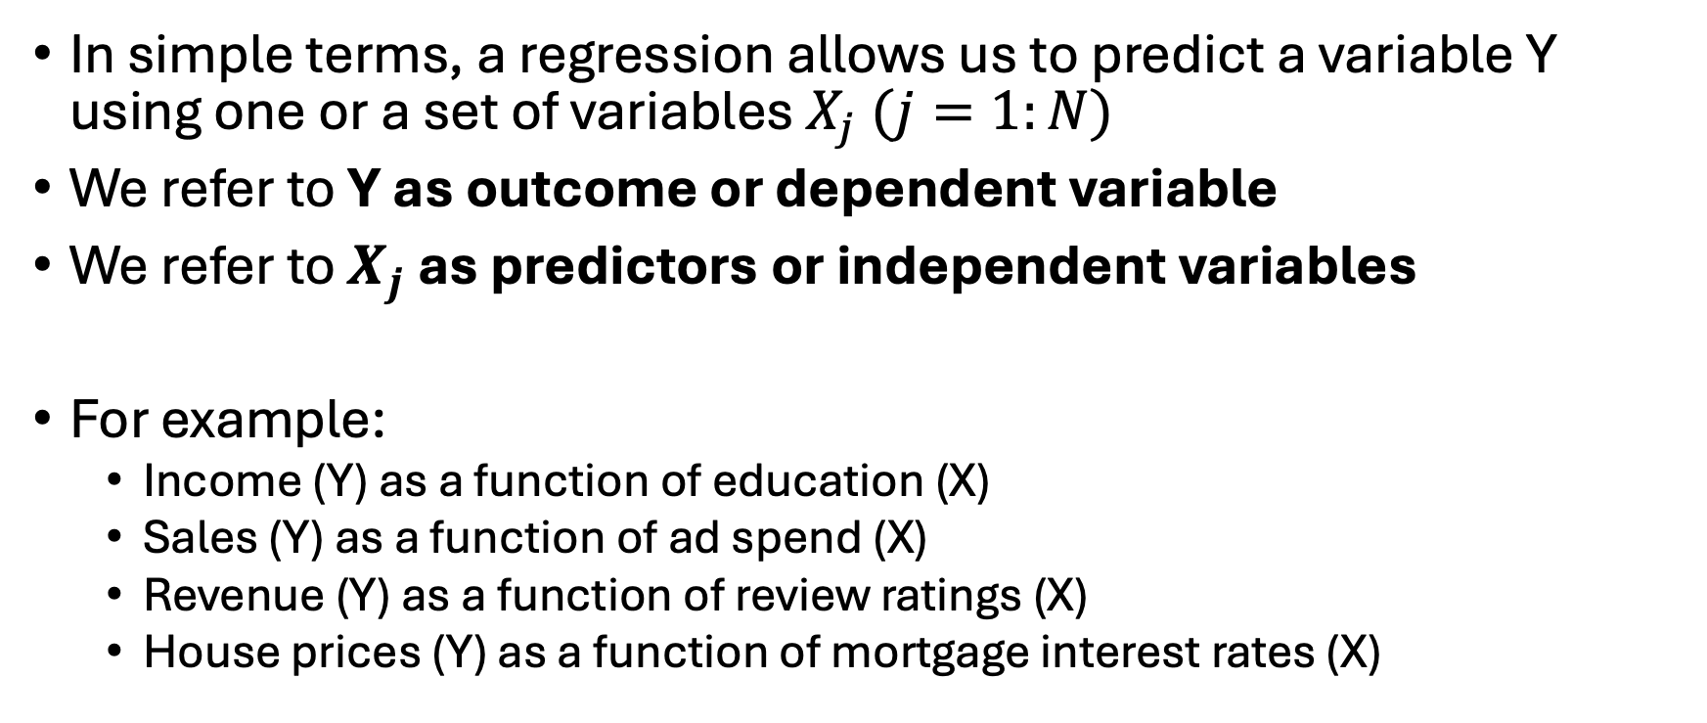
What is a Linear Regression
In simple terms, a regression allows us to predict a variable Y using one or a set of variables $X_{j} (j=1:N)$
We refer to Y as outcome or dependent variable
We refer to $X_{j}$ as predictors or independent variables
For example:
Income (Y) as a function of education (X)
Sales (Y) as a function of ad spend (X)
Revenue (Y) as a function of review ratings (X)
House prices (Y) as a function of mortgage interest rates (X)

Slide 5
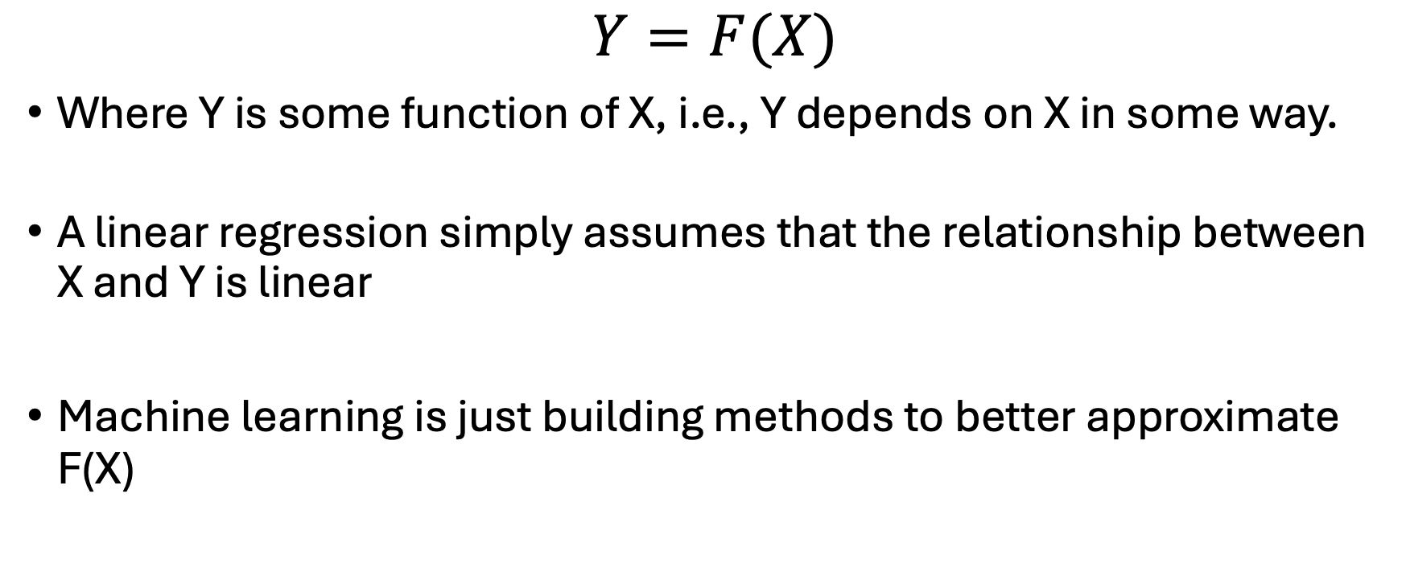
What is a Linear Regression
$Y=F(X)$
Where Y is some function of X, i.e., Y depends on X in some way.
A linear regression simply assumes that the relationship between X and Y is linear
Machine learning is just building methods to better approximate F(X)

Slide 6
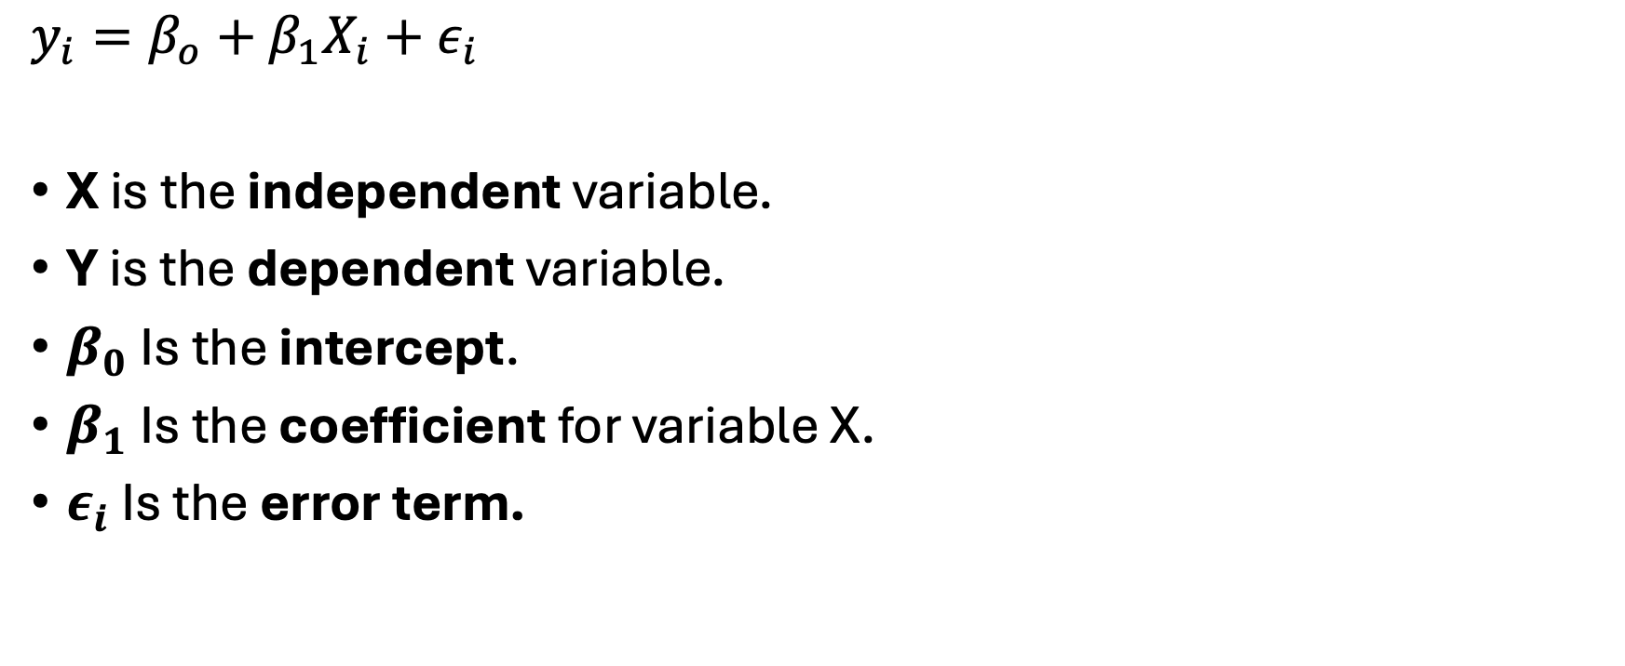
Basic setup and quantities of interest
Data
$$y_{i}=β_{o}+β_{1}X_{i}+ε_{i}$$
X is the independent variable.
Y is the dependent variable.
$β_{0}$ Is the intercept.
$β_{1}$ Is the coefficient for variable X.
$ε_{i}$ Is the error term.
Y | X
3 | 1
2 | 5
… | …
… | …
2 | 4
i = 1:N are the rows of the data

Slide 7


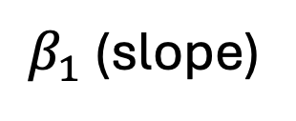
Basic setup and quantities of interest
$β_{1}$ (slope)
$$ε_{i}$$
$$β_{0}$$

Slide 8

Estimating the coefficient
Ordinary least squares (OLS) estimates the beta coefficients that produce the lowest sum of squared differences between actual and predicted values of the dependent variable
$$ε_{i}$$

Slide 9
What is Hypothesis Testing?
Hypothesis testing is a way to use data to decide between two claims:
Null hypothesis H0: the default assumption, such as no effect or no difference
Alternative hypothesis H1: the claim we want to test, such as there is an effect or there is a difference
Steps:
Collect data and compute a test statistic, such as a t-value
Calculate a p-value, which tells us how likely our data is if H0 were true
Make a decision:
Small p-value → reject H0 and conclude there is evidence for H1
Large p-value → fail to reject H0 and conclude there is not enough evidence

Slide 10
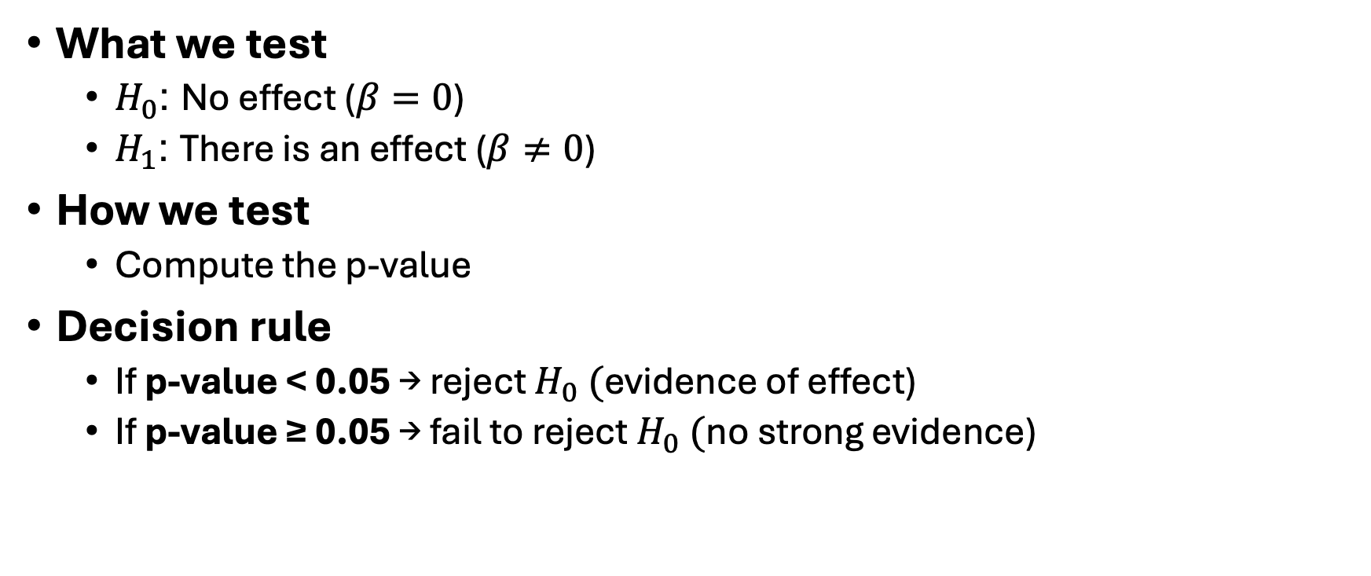
Hypothesis Testing for regressions
What we test
$H_{0}$: No effect ($β=0$)
$H_{1}$: There is an effect ($β≠0$)
How we test
Compute the p-value
Decision rule
If p-value < 0.05 → reject $H_{0} ($evidence of effect)
If p-value ≥ 0.05 → fail to reject $H_{0} ($no strong evidence)

Slide 11
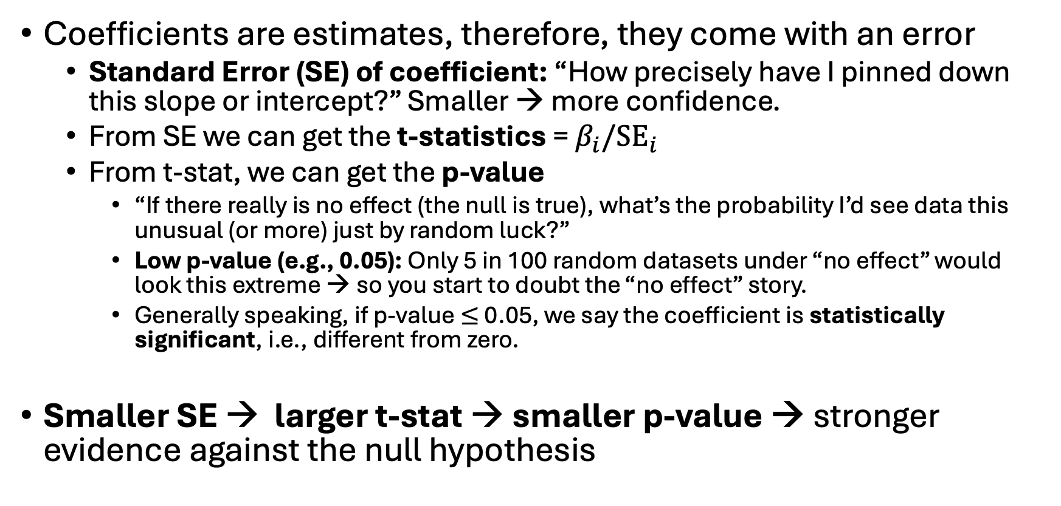
Regression: Quantities of interest
Coefficients are estimates, therefore, they come with an error
Standard Error (SE) of coefficient: “How precisely have I pinned down this slope or intercept?” Smaller → more confidence.
From SE we can get the t-statistics = $β_{i}/{SE}_{i}$
From t-stat, we can get the p-value
“If there really is no effect (the null is true), what’s the probability I’d see data this unusual (or more) just by random luck?”
Low p-value (e.g., 0.05): Only 5 in 100 random datasets under “no effect” would look this extreme → so you start to doubt the “no effect” story.
Generally speaking, if p-value $≤$ 0.05, we say the coefficient is statistically significant, i.e., different from zero.
Smaller SE → larger t-stat → smaller p-value → stronger evidence against the null hypothesis

Slide 12
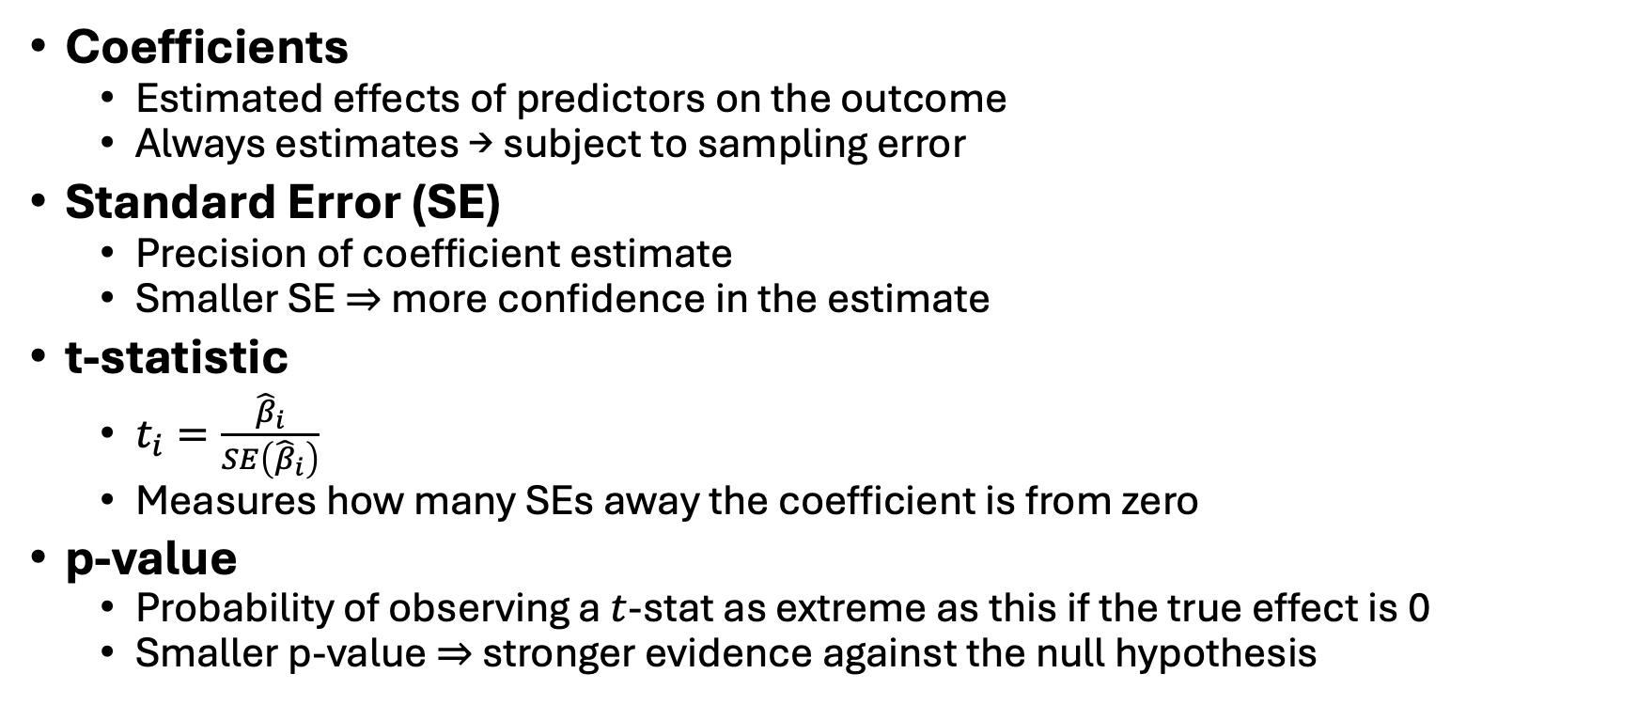
A little more technical summary
Coefficients
Estimated effects of predictors on the outcome
Always estimates → subject to sampling error
Standard Error (SE)
Precision of coefficient estimate
Smaller SE ⇒ more confidence in the estimate
t-statistic
$t_{i}=\frac{{\hat{β}}_{i}}{SE\left({\hat{β}}_{i}\right)}$
Measures how many SEs away the coefficient is from zero
p-value
Probability of observing a $t$-stat as extreme as this if the true effect is 0
Smaller p-value ⇒ stronger evidence against the null hypothesis

Slide 13
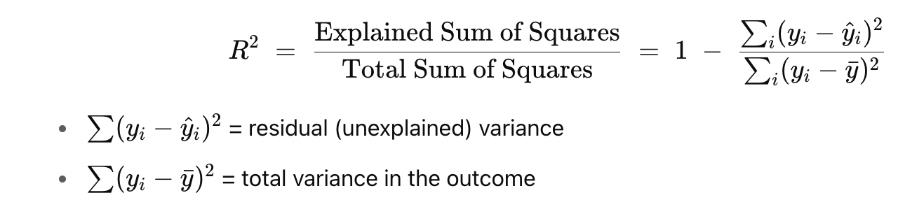

Measure of fit
How do we know if our regression is doing a good job at predicting Y?
R-squared ($R^{2})$is a summary statistic in regressions that tells you how well your model’s predictions match the actual data

Slide 14
Measure of fit
How do we know if our regression is doing a good job at predicting Y?
R-squared ($R^{2})$is a summary statistic in regressions that tells you how well your model’s predictions match the actual data
Model error
Error using the mean

Slide 15
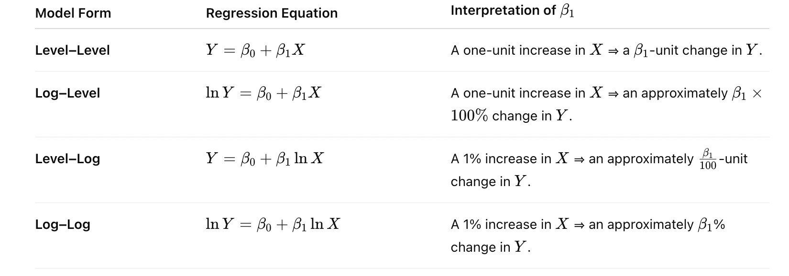

What does $β_{1}$tell us?
All else equal (ceteris paribus), how much Y changes as a function of X
The interpretation depends on the regression functional form
1.
2.
3.
4.
Note: for model 2-4, these approximations hold for small changes in X and/or $β$

Slide 16
Why log numeric variables?
Linearizes Nonlinear Relationships
Many relationships in economics and social science are multiplicative or curved, not straight lines.
Example: A $1 increase in price affects demand very differently when price goes from:
$5 → $6 vs.
$100 → $101
Taking the log of, say price, linearizes this relationship, making it easier for a linear model to fit.

Slide 17
Why log numeric variables?
Reduces Skewness
Variables like price and income variables are often right-skewed (many small values, few large ones).
Taking the log:
Compresses large values
Expands small differences among low values → Makes the distribution more symmetric and closer to normal
This can improve model performance and make OLS assumptions (like normality of errors) more realistic.

Slide 18
Why log numeric variables?
Reduces the influence of outliers
Large numeric variables can dominate the regression, especially if they contain outliers.
Logging reduces their influence, which can help with:
Numerical stability
More robust coefficient estimates

Slide 19
Why log numeric variables?
Interpretability: Elasticities
When you use log of, e.g., price, coefficients are easier to interpret:
In a log-log model, the coefficient is an elasticity: "A 1% increase in price → X% change in demand"
In a log-level model, the coefficient tells you the percentage change in the outcome from a one-unit change in price.
These interpretations are more intuitive, especially in economics or marketing

Slide 20

Multiple independent variables
$y_{i}=β_{0}+β_{1}x_{1,i}+β_{2}x_{2,i}+…+β_{j}x_{j,i}+ε_{i}$
Everything I just discussed applies!

Slide 21
Estimating linear models in R
# estimate the linear model
model = lm(y ~ x, data = yourdata)
# print the results
summary(model)
Library for creating pretty tables: stargazer

Slide 22
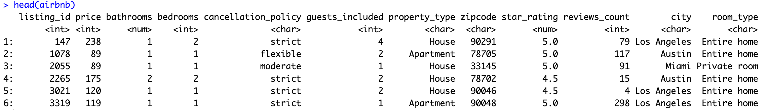
Example: Airbnb dataset
A cross-sectional dataset of about 50k Airbnb listings in the U,S with some variables describing the listing
Cities: Austin, Boston, Los Angeles, Miami, NYC

Slide 23
Example: Airbnb dataset
Let’s predict price as a function of the number of reviews a listing has
What do you expect the relationship to be?

Slide 24
Example: Airbnb dataset

Slide 25
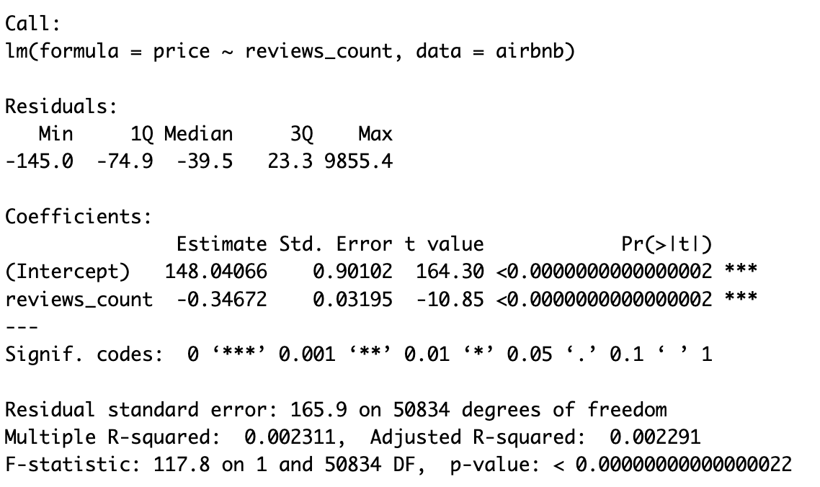
Example: Airbnb dataset
m1 = lm(price ~ reviews_count, data = airbnb)
summary(m1)

Slide 26
Example: Airbnb dataset
m1 = lm(price ~ reviews_count, data = airbnb)
summary(m1)
Notes:
Residual se = how far, on average, your predictions are from the actual values

Slide 27
Example: Airbnb dataset
m1 = lm(price ~ reviews_count, data = airbnb)
summary(m1)
Notes:
Residual se = how far, on average, your predictions are from the actual values

Slide 28
Understanding Regression Output
Residual Standard Error: 165.9
On average, model predictions are about $166 off from the actual values
Multiple R-squared: 0.0023
The model explains 0.23% of the variation in the outcome
Very low explanatory power
Adjusted R-squared: 0.0023
Same as R², but penalizes adding useless predictors
F-statistic: 117.8, p-value < 2.2e-16
Tests whether the predictor(s) together explain anything at all
Large F and tiny p-value mean: Yes, the predictor matters statistically

Slide 29
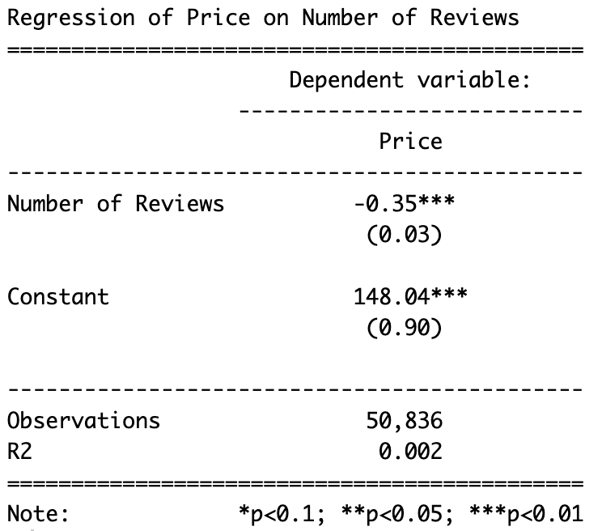
Example: Airbnb dataset
library(stargazer)
# estimate the model
m1 = lm(price ~ reviews_count, data = airbnb)
# create a pretty table
stargazer(m1,
type = "text",
title = "Regression of Price on Number of Reviews", dep.var.labels = "Price",
covariate.labels = "Number of Reviews",
omit.stat = c("f", "ser”, “adj.rsq”),
digits = 2)
Notes:
Residual se = how far, on average, your predictions are from the actual values

Slide 30
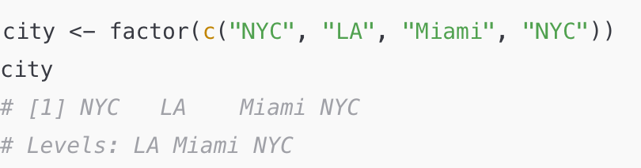
Including categorical variables
How does R deal with categorical variables? Using factors
A factor is R’s special way of storing categorical variables (things like city, gender, yes/no, etc.).
Under the hood, a factor is just numbers with labels.
Example:
Here, LA = 1, Miami = 2, NYC = 3 internally.
R stores numbers, but shows you labels.

Slide 31
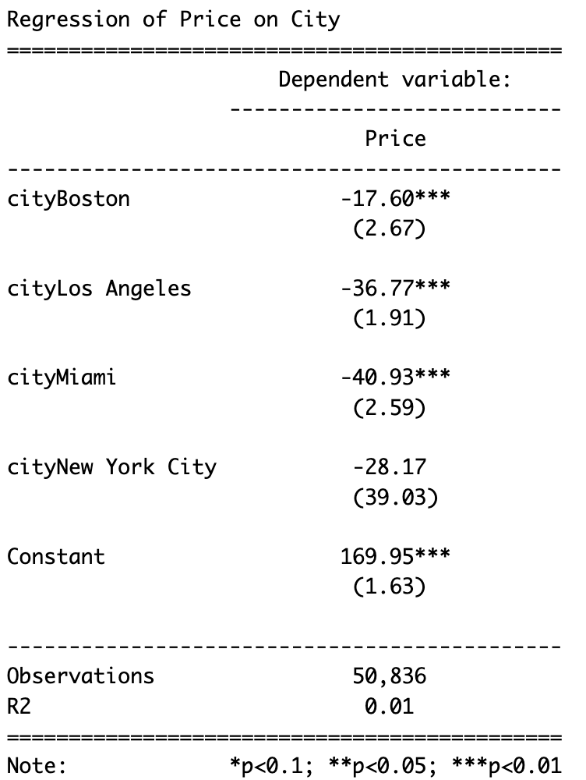
Example: Airbnb dataset
Let’s regress price on city
We have five values:
Austin, Boston, Los Angeles, Miami, NYC
m1 = lm(price ~ city, data = airbnb)
# Create table
stargazer(m1, type = "text", title = "Regression of Price on City",
dep.var.labels = "Price",
omit.stat = c("f", "ser", "adj.rsq"), digits = 2)

Slide 32
Example: Airbnb dataset
Why do we see only four coefficients?
Obs | City | Austin | Boston | Los Angeles | Miami
1 | Austin | 1 | 0 | 0 | 0
2 | Boston | 0 | 1 | 0 | 0
3 | Los Angeles | 0 | 0 | 1 | 0
4 | Miami | 0 | 0 | 0 | 1
5 | New York City | 0 | 0 | 0 | 0

Slide 33
Example: Airbnb dataset
Let’s regress price on city
We have five values:
Austin, Boston, Los Angeles, Miami, NYC
m1 = lm(price ~ city, data = airbnb)
# Create table
stargazer(m1, type = "text", title = "Regression of Price on City",
dep.var.labels = "Price",
omit.stat = c("f", "ser", "adj.rsq"), digits = 2)
Austin
avg. price

Slide 34
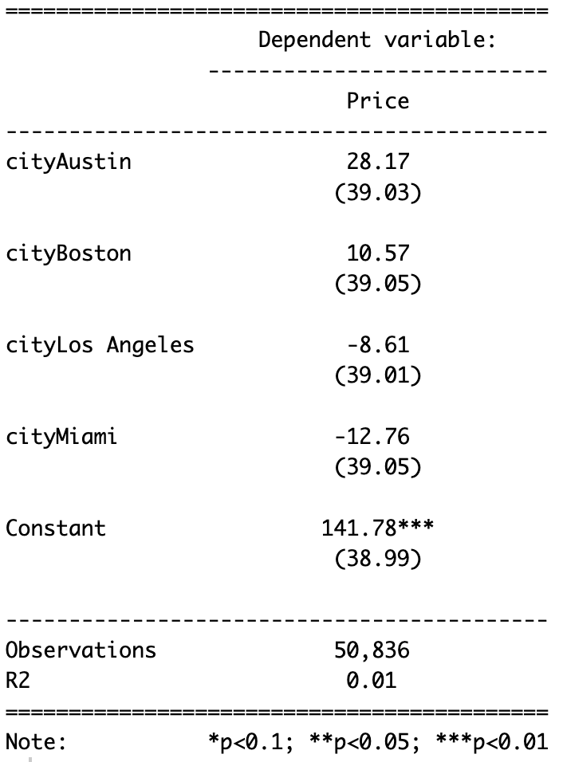
Example: Airbnb dataset
Change the base level city:
# convert city to factor
airbnb$city = as.factor(airbnb$city)
# set a different level
airbnb$city = relevel(airbnb$city, ref = "New York City")

