Slide 1
Regressions
MKT 566
Instructor: Davide Proserpio

Slide 2
A few things
Homework 1 and 2
Groups

Slide 3
What we will learn
We continue to talk about covariation and learn how to model it using regressions
We are going to cover regressions for binary outcomes, i.e., logistic regressions
Chapter 3.6 of R for Marketing Students

Slide 4
Binary outcomes: Logistic regression
Let’s assume Y is binary, e.g.: 1 if consumer i buys a product, 0 otherwise
Linear regression can return predictions outside [0,1]
We need a different functional form that can force predictions between [0,1]

Slide 5
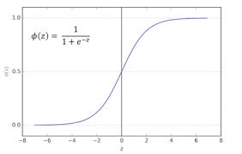

Binary outcomes: Logistic regression
Solution: use the logistic (sigmoid) function, which maps any real number into [0,1]$:$
$$p=P\left(Y=1∣X\right)=\frac{1}{1+e^{−z}}$$
Where: $z=β_{0}+β_{1}X$
Odds and Log-Odds:
The odds of success are: $\frac{p}{1−p}=e^{z}$ ()
Taking the natural log gives the log-odds (logit): $\log\left(\frac{p}{1−p}\right)=z=β_{0}+β_{1}X$
So, the logistic regression models the log-odds of success as a linear function of the predictors.

Slide 6
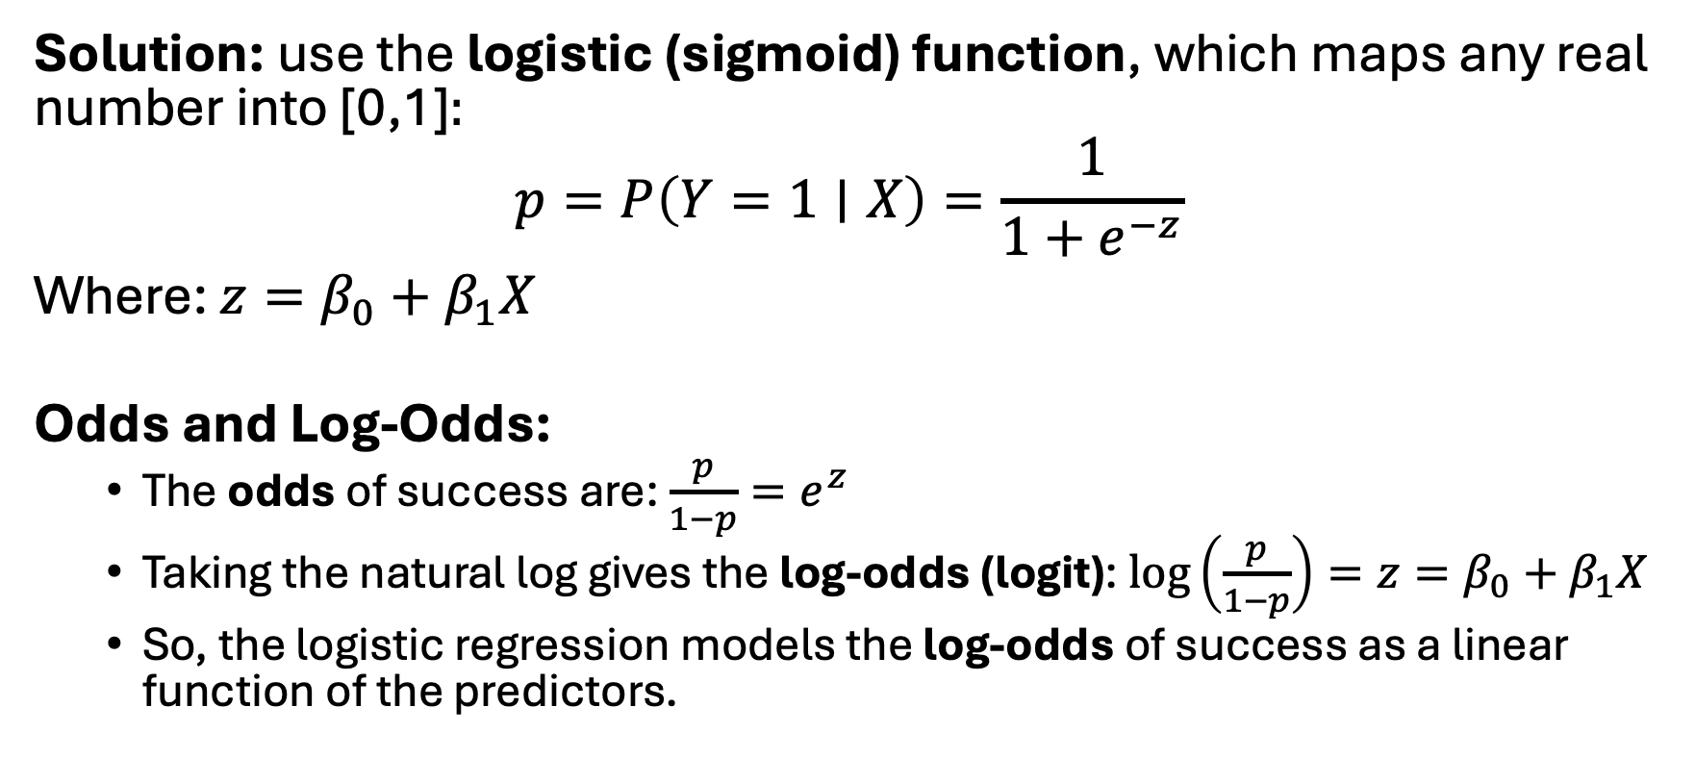
Binary outcomes: Logistic regression
Solution: use the logistic (sigmoid) function, which maps any real number into [0,1]$:$
$$p=P\left(Y=1∣X\right)=\frac{1}{1+e^{−z}}$$
Where: $z=β_{0}+β_{1}X$
Odds and Log-Odds:
The odds of success are: $\frac{p}{1−p}=e^{z}$
Taking the natural log gives the log-odds (logit): $\log\left(\frac{p}{1−p}\right)=z=β_{0}+β_{1}X$
So, the logistic regression models the log-odds of success as a linear function of the predictors.

Slide 7
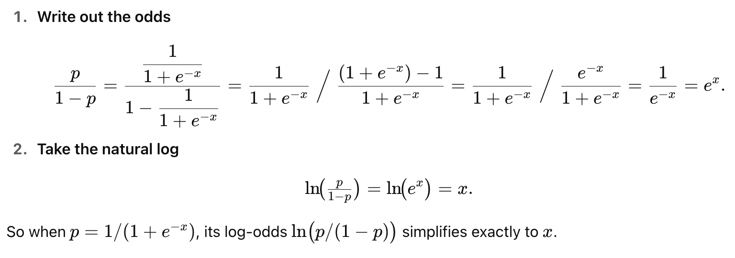
Proof

Slide 8
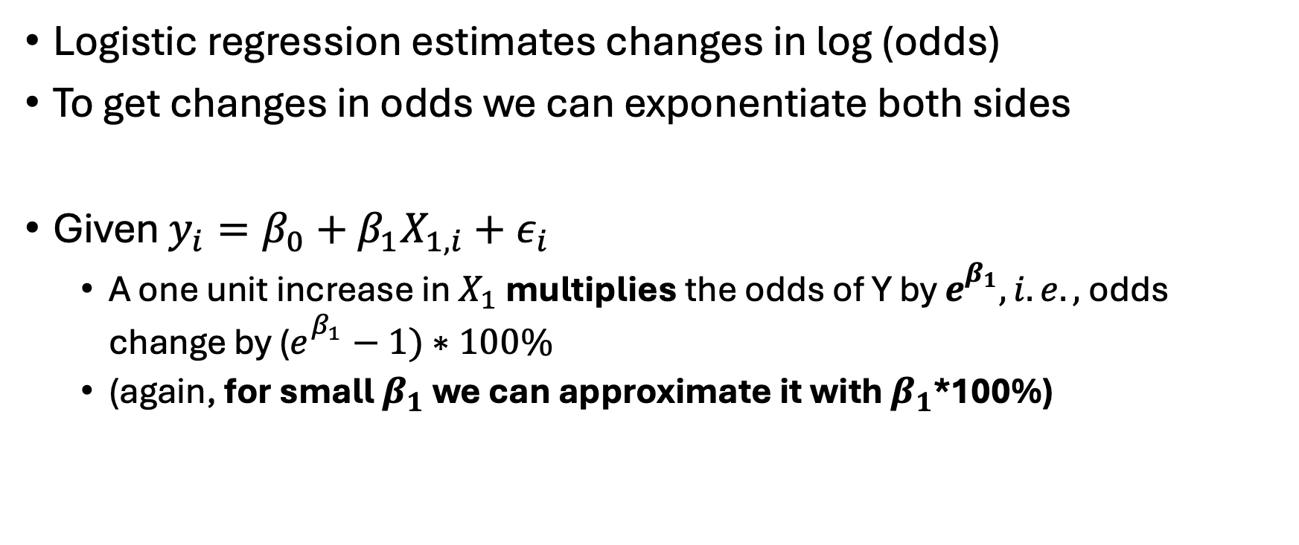
Binary outcomes: Logistic regression interpretation
Logistic regression estimates changes in log (odds)
To get changes in odds we can exponentiate both sides
Given $y_{i}=β_{0}+β_{1}X_{1,i}+ε_{i}$
A one unit increase in $X_{1}$multiplies the odds of Y by $e_{}^{β_{1}}, i.e.,$odds change by ($e_{}^{β_{1}}−1)∗100\%$
(again, for small $β_{1}$ we can approximate it with $β_{1}$*100%)

Slide 9
Estimation
Unlike linear regression (which minimizes squared errors), logistic regression maximizes the likelihood of observing the actual outcomes, given the model.

Slide 10
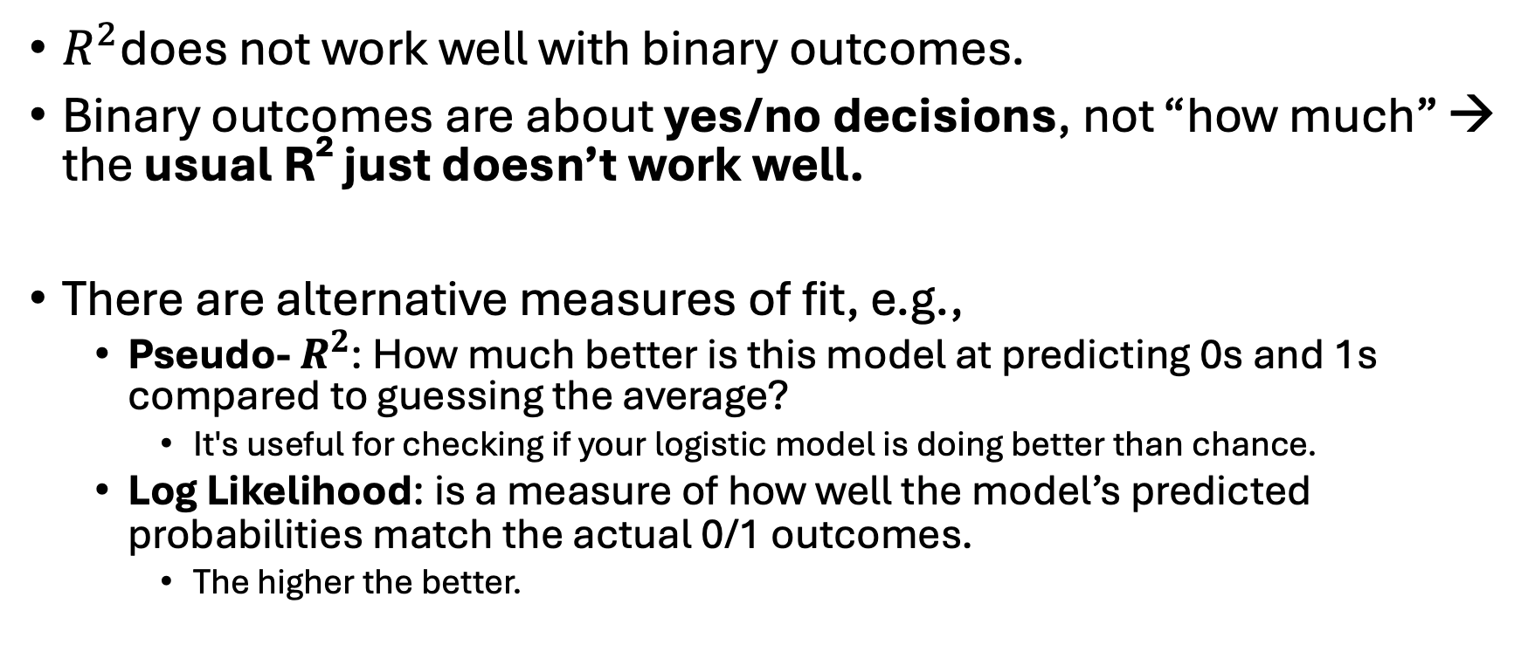
Model fit
$R^{2}$does not work well with binary outcomes.
Binary outcomes are about yes/no decisions, not “how much” → the usual R² just doesn’t work well.
There are alternative measures of fit, e.g.,
Pseudo- $R^{2}$: How much better is this model at predicting 0s and 1s compared to guessing the average?
It's useful for checking if your logistic model is doing better than chance.
Log Likelihood: is a measure of how well the model’s predicted probabilities match the actual 0/1 outcomes.
The higher the better.

Slide 11
Logistic regression in R
# Crate the variable gem which identifies very good listings
airbnb[, gem:=as.integer(star_rating>=4.5 & reviews_count>20)]
# Predict probability of being a gem using logistic regression
m_logit = glm(gem ~ price + guests_included + city + room_type, data = airbnb, family = binomial)
# Print results
stargazer(m_logit, type = "text",
omit.stat = c("f", "ser", "aic", "bic"))

Slide 12
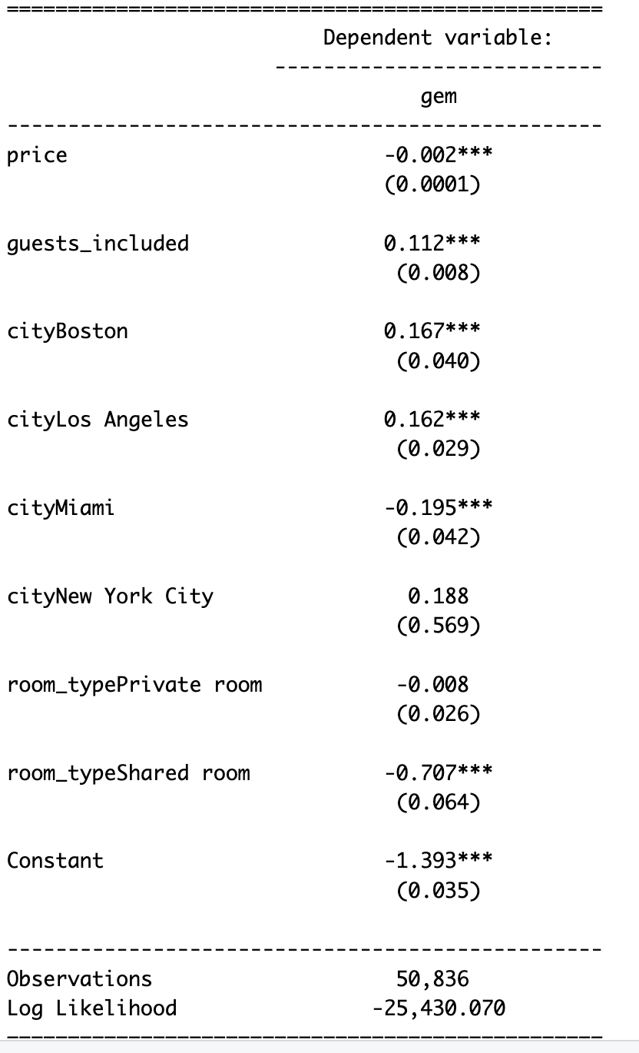
Logistic regression in R
# Crate the variable gem which identifies very good listings
airbnb[, gem:=as.integer(star_rating>=4.5 & reviews_count>20)]
# Predict probability of being a gem using logistic regression
m_logit = glm(gem ~ price + guests_included + city + room_type, data = airbnb, family = binomial)
# Print results
stargazer(m_logit, type = "text",
omit.stat = c("f", "ser", "aic", "bic"))

Slide 13
Logistic regression in R
# Crate the variable gem which identifies very good listings
airbnb[, gem:=as.integer(star_rating>=4.5 & reviews_count>20)]
# Predict probability of being a gem using logistic regression
m_logit = glm(gem ~ price + guests_included + city + room_type, data = airbnb, family = binomial)
# Print results
stargazer(m_logit, type = "text",
omit.stat = c("f", "ser", "aic", "bic"))
The coefficient of –0.002 means each $1 increase in price decreases the odds of being a gem by about 0.2%.

