Slide 1
Programmiersprachen und Compilerbau
Sommersemester 2022
Von Julian Gross und Daniel Köllgen

Slide 2

Was wurde umgesetzt:
Erweiterung des Compilers
Operatoren: && || != < <= > >= Pow Modulo
Switch Statement
Read Statement
Print Statement
Pretty Printer
Formatierung des Quellcodes
Highlighting des Quellcodes
Ein kleines Demonstrationsprogramm
The Insane Fortune Teller

Slide 3
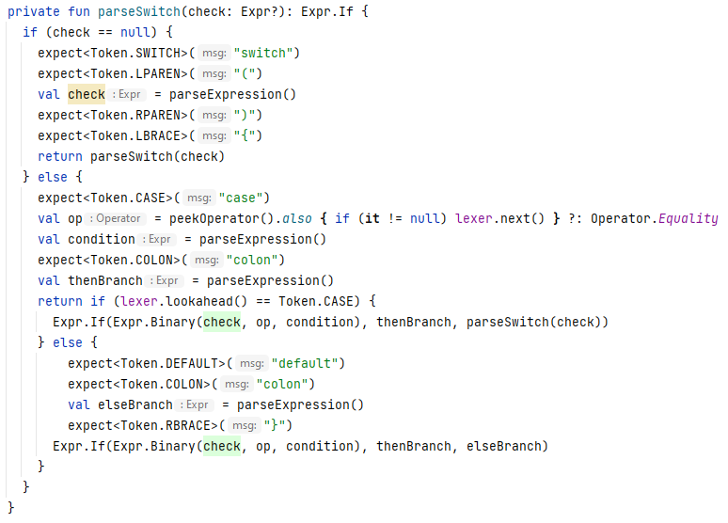
Switch Statement
Syntax
let deathTime =
switch(age) {
case 1: age + 100
case <=10: age + 30
case <=20: age + 20
default: age + 10
}
in
Parser
①
②
③
Expression
if (age == 1)
then age + 100
else
if (age<=10)
then age + 30
else
if (age<=20)
then age + 20
else age +10

Slide 4
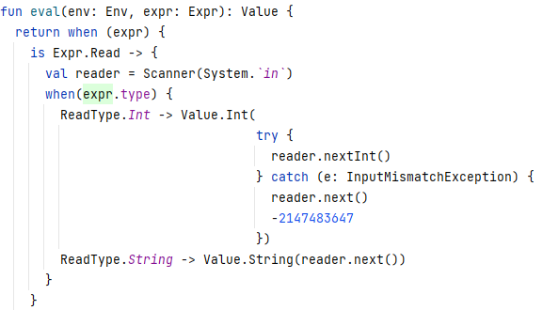

Read Statement
Syntax
let name = read(String) in …
let deathTime = read(Int) in …
Interpreter
Expression

Slide 5
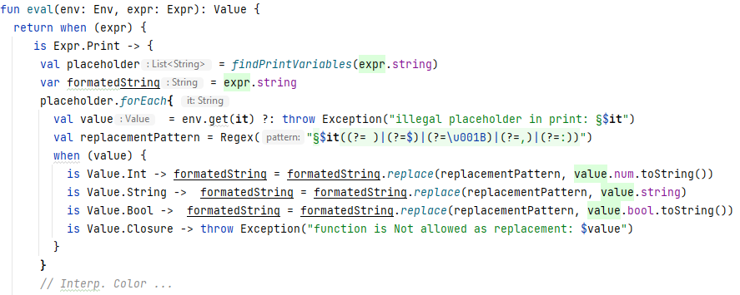
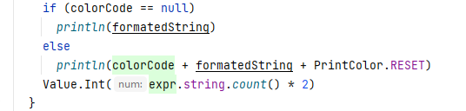
Print Statement
Syntax
let name = “Sam” in
let age = 30 in
let _ = print(“§ ist § Jahre alt.”) name age in …
Expression
\a => \b => print( “§ ist § Jahre alt.” )
FunctionType: String -> Int -> Int
ReturnValue: String in Bytes
Syntax
let name = “Sam” in
let age = 30 in
let _ = print(“§name ist §age Jahre alt.”:red) in …
Expression
print( “§name ist §age Jahre alt.”, Color.Red )
Type: Int
ReturnValue: String in Bytes
Interpreter

Slide 6
Demo Programm
Funktion: Abfrage des Alters
let rec readAge = \x =>
let _ = print("Bitte geben Sie Ihr Alter ein: ":blue)
in
let input = read(Int)
in
if input == 0-2147483647 || input <= 0 || input > 120
then let _ = print("Kein gültiges Alter!!!":red)
in
readAge 0
else input
In
…
Aufruf: Abfrage des Alters
let age = readAge 0
in
…

Slide 7
Pretty Printer
...
Single-Line:
IF {cond} THEN {then-branch} ELSE {else-branch}
IF
Multi-Line:
IF {cond} THEN {then-branch} ELSE {else-branch}
cond
then
else
IF {looong-cond} THEN {then-cond} ELSE {else-cond}
IF
...
...
...

Slide 8
Parent
[indentations] IF {cond} THEN {then-branch} ELSE {else-branch} [...] | Line-wrap
true
eval a
let c = switch(a) {
case <18: false case >=18: true
}
in
c a
Line-Count
Line-Total-Size

Slide 9
Child
let x = IF {loooooong-cond} THEN {then-branch} ELSE {else-branch} in
Reserved:
Indentations
Characters
LineLength – Reserved = Remaining
Reserved (first line):
let x = IF {loooooong-cond } | Line-wrap
THEN
{then-branch}
ELSE
{else-branch} [...]
in
Indentations:

Slide 10
Exchange
(LineMode) -> Format
(LineMode) -> Format
Parent
Child
Child’s Child
Pair<LineMode, List<Line>>
Pair<LineMode, List<Line>>

