Slide 1

NAPHTHA HYDRODESULFURIZATION
By Group-3
PRESENTED BY:
1). Aarav Gupta(25%)
2). Mitanshu Kumawat (25%)
3). Mohak Dadhich(25%)
4). Priyanshu Patel(25%)

Slide 2
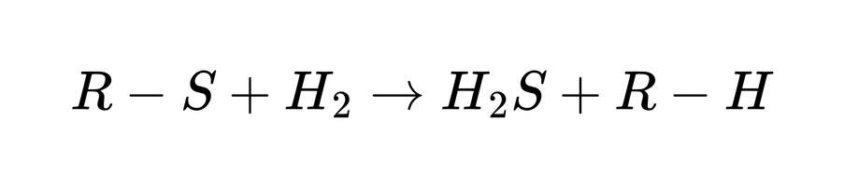
OVERVIEW
Objective
Remove sulfur compounds from naphtha to meet fuel quality standards
Convert organosulfur compounds into H₂S using hydrogen
Importance
Prevents catalyst poisoning in downstream units
Reduces SO₂ emissions → environmental compliance
Improves fuel stability and quality
Simulation Tool
Aspen Plus V14
Reaction

Slide 3


PROCESS FLOW
Feed Preparation & Preheating
Naphtha pumped from 2 → 41 bar
Mixed with hydrogen
Heated to 350°C in two stages
Reaction Section (RPlug Reactor)
Plug Flow Reactor (PFR)
Operating at 350°C, 40 bar
Sulfur compounds → converted to H₂S
Recycle & Purge System
Hydrogen-rich gas recycled
10% purge to prevent inert buildup
Separation Section
Flash Drum: separates gas and liquid
Absorber: removes H₂S using amine
Distillation Column: purifies final naphtha

Slide 4
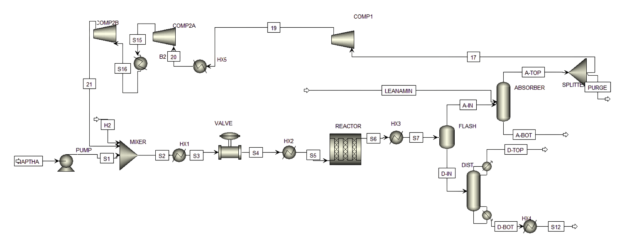
PROCESS FLOW

Slide 5
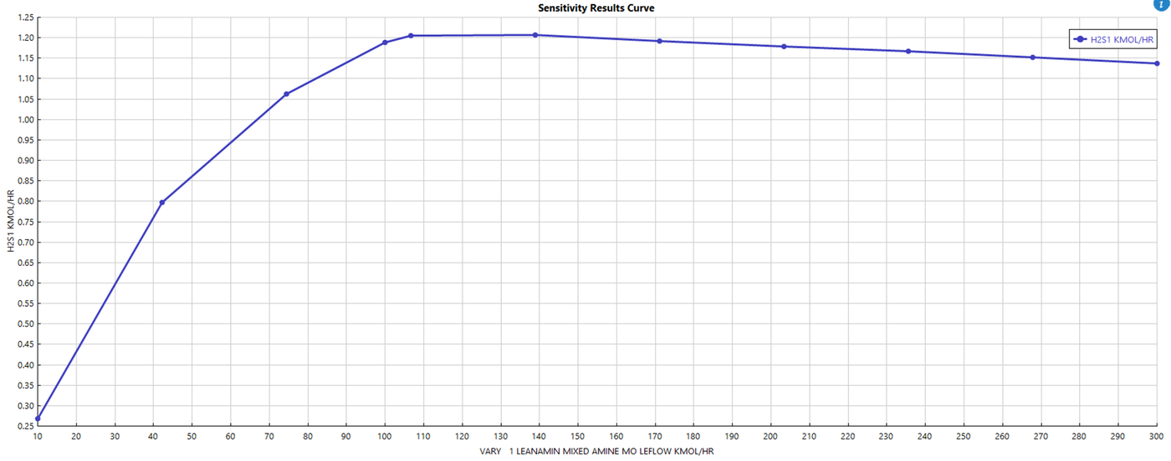
SENSITIVITY
H₂S Absorption vs. Lean Amine Flow Rate
• H₂S absorption increases sharply with amine flow up to ~100 kmol/hr due to greater solvent availability, reaching near-complete removal.
• Beyond this point, performance plateaus and slightly declines as the system becomes H₂S-limited and dilution effects occur at high L/V ratios.

Slide 6
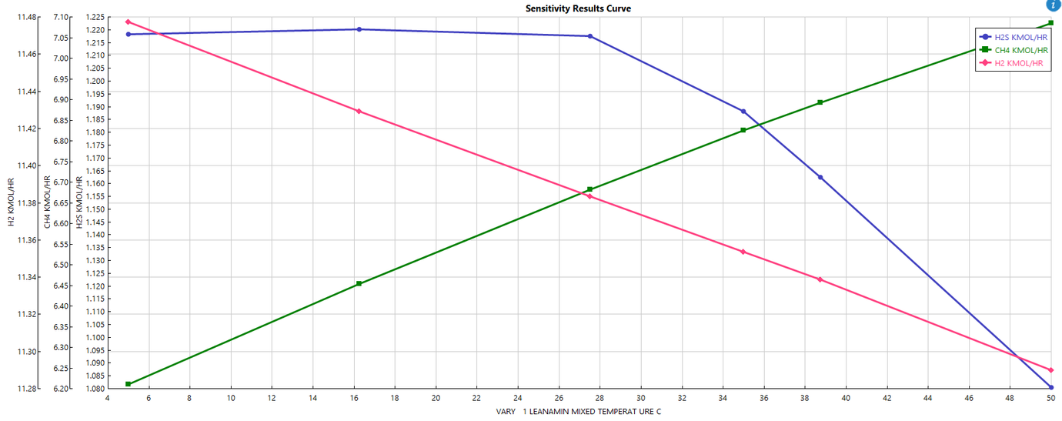
Absorber Performance vs. Lean Amine Temperature
• Increasing amine temperature reduces H₂S absorption because the exothermic reaction shifts backward, lowering solvent loading capacity.
• Higher temperature also decreases CH₄ solubility (more CH₄ overhead) while H₂ changes slightly due to multicomponent equilibrium effects.

Slide 7
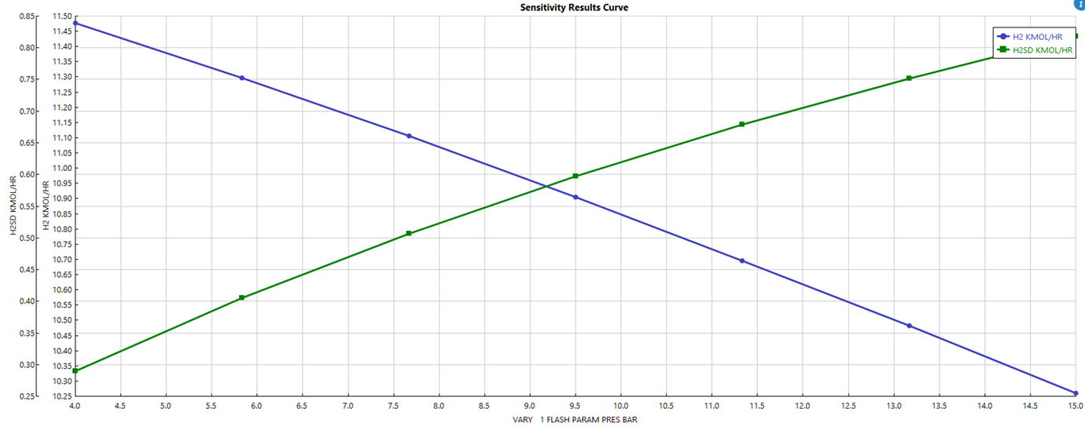
Flash Drum Pressure Effect
• Increasing flash pressure reduces H₂ in the absorber feed while increasing H₂S in the distillation feed, creating an inverse (X-shaped) trend.
• Higher pressure increases gas solubility; H₂S dissolves preferentially into liquid naphtha, while less H₂ flashes to vapor and reaches the absorber.

Slide 8
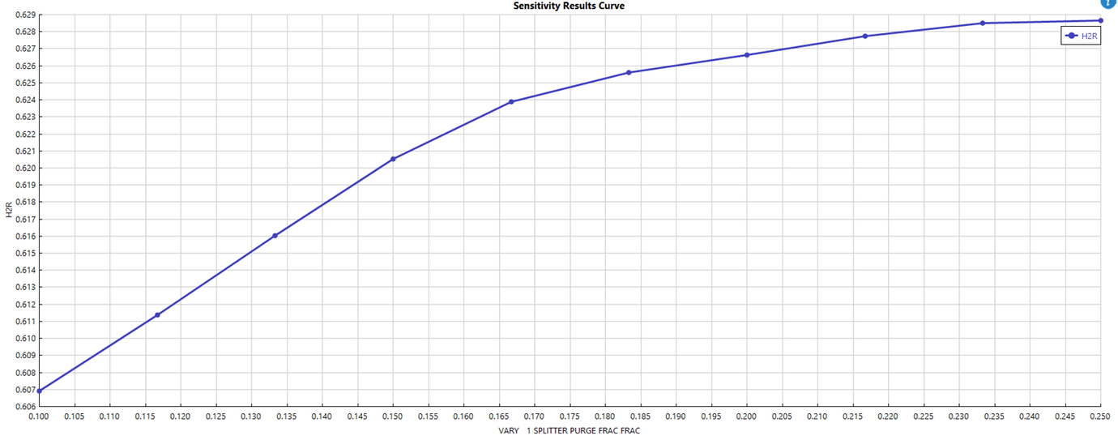
Recycle H₂ Purity vs. Purge Fraction
• Increasing purge fraction removes accumulated inerts, raising H₂ purity in the recycle gas, with a steep improvement at low purge values.
• Beyond ~20% purge, gains become minimal due to diminishing returns while hydrogen losses increase.

Slide 9
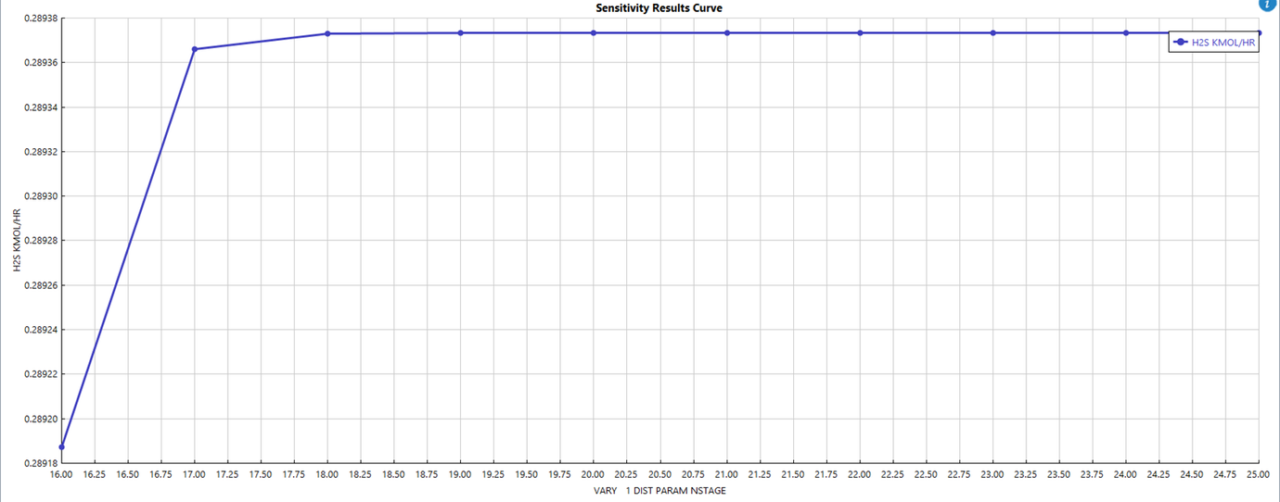
Distillation Stages vs. H₂S Recovery
• H₂S in the overhead increases slightly up to ~17 stages and then reaches a flat plateau, showing separation is nearly complete.
• Beyond 17 stages, the column becomes feed-limited, so additional stages give no improvement in H₂S recovery.

Slide 10
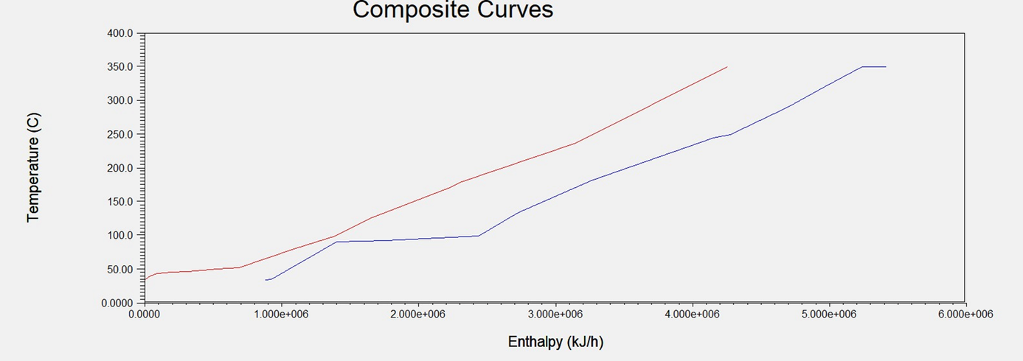
HEAT INTEGRATION & PINCH ANALYSIS
Composite Curve
• The composite curves show maximum heat recovery between ~40–250°C, where hot reactor effluent heats the feed (HX1), with the pinch around T_hot = 97.5°C and T_cold = 87.5°C
• Cold overshoot at high temperature requires fired heater duty, while hot overshoot at low temperature represents condenser/cooling utility.

Slide 11
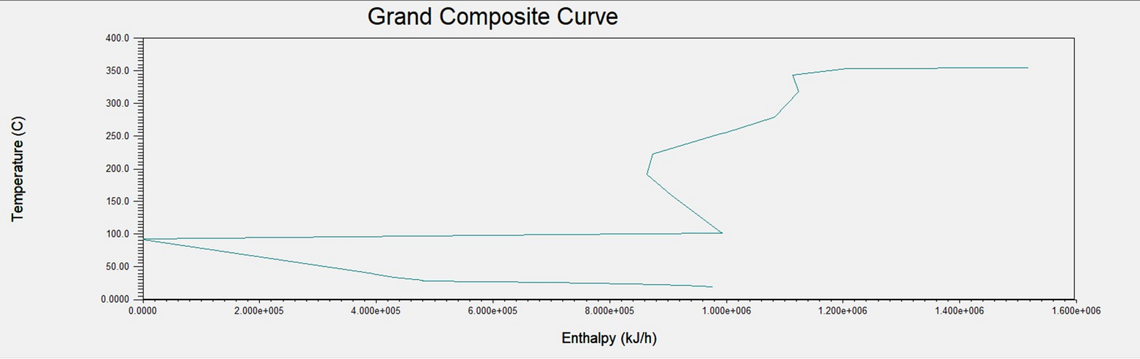
HEAT INTEGRATION & PINCH ANALYSIS
Grand Composite Curve
The GCC shows a pinch at ~100°C, with heat surplus below the pinch (cooling required) and heat deficit above the pinch (external heating required).
The upper pocket (~150–200°C) indicates internal heat recovery, while the high-temperature deficit confirms the need for fired heater/HP utility above ~200°C.
Hot utility required ≈ 1.4 × 10⁶ kJ/h
Cold utility required ≈ 1.0 × 10⁶ kJ/h

Slide 12
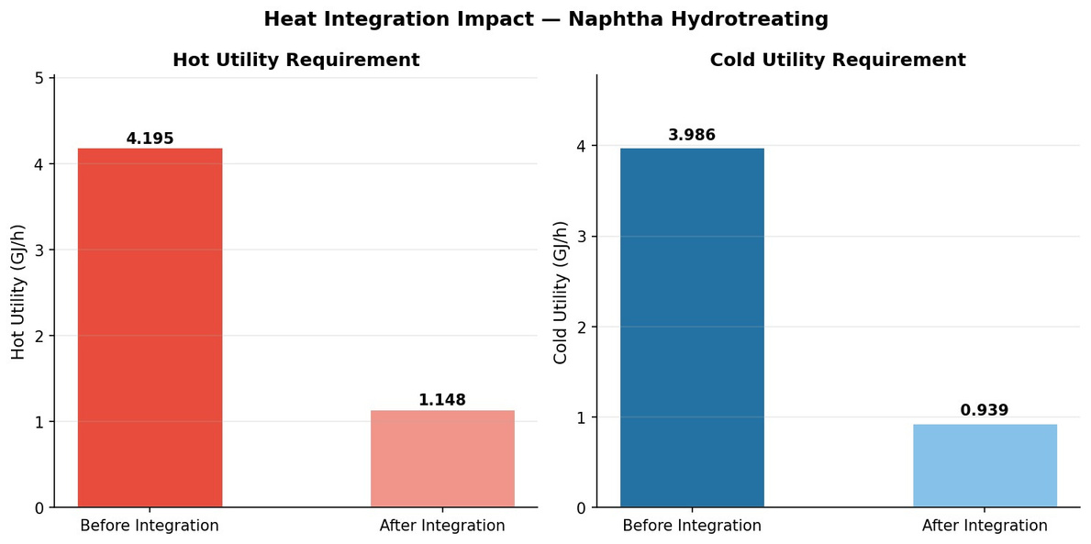
HEAT INTEGRATION & PINCH ANALYSIS
Pinch Analysis Results
 | Before | After | Saving
Hot utility | 4.195 GJ/h | 1.148 GJ/h | 72.60%
Cold utility | 3.986 GJ/h | 0.939 GJ/h | 76.40%
Annual Cost Savings
Fired heater fuel saved: $134,052/year
Cooling water saved: $1,219/year
Total: ~$135,000/year

Slide 13
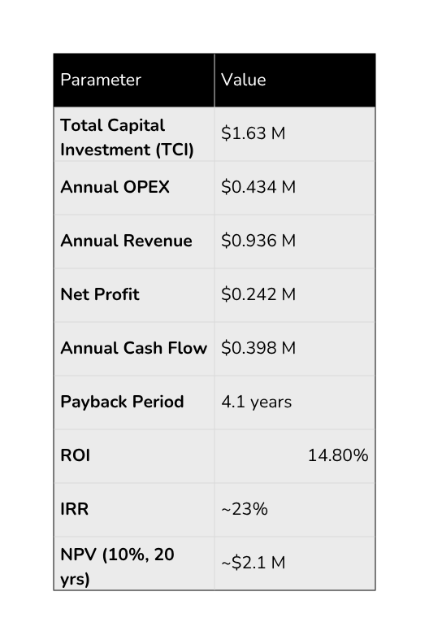
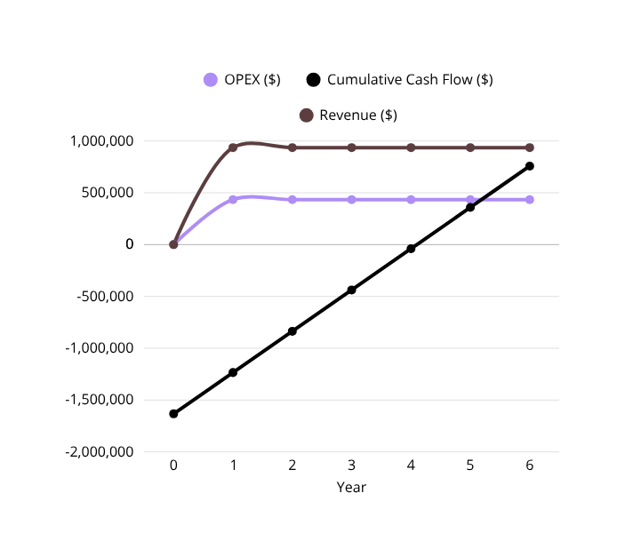
ECONOMIC ANALYSIS
Fixed plant design (no process/equipment changes)
Operating time: 8,000 h/year (~91% uptime)
Plant life: 20 years
Depreciation: Straight-line (10 years, no salvage)
Tax rate: 30%
Discount rate: 10%
Maintenance: 3% of CAPEX/year
Insurance & taxes: 1% of CAPEX/year
Stable pricing (no inflation considered)

Slide 14
CONCLUSION
🔹 Process Performance
Successful simulation of complete Naphtha HDS process in Aspen Plus
Efficient conversion of sulfur compounds to H₂S
🔹 Separation & Recycle Efficiency
Effective removal of H₂S using amine absorption
Hydrogen recovery through recycle loop improves process economy
🔹 Design Justification
PFR ensures high conversion and realistic reactor modeling
High pressure and hydrogen excess enhance reaction performance
🔹 Energy Optimization
Heat integration significantly reduces utility requirements
Pinch analysis highlights potential energy savings

Slide 15
THANK YOU

