Slide 1
ASSISTIVE EXOSKELTON FOR ELDERLY Final review
Guide: Dr. MM Ramya
Batch:(Mech-8A)
PVNS Sathwik-15127001
D Jaswanth-15127032
D Mahesh-15127064
D Vishnu Vardhan-15127066

Slide 2
Abstract
Exoskeletons - wearable robots that are created to assist the human body or increase the muscular power of the wearer.
Used to protect soldiers and construction workers,
Aid the survival of people in dangerous environments,
Assist patients in rehabilitation.
At age of 60, 85% of seniors have normal gait and this proportion drops to 18% by age 85[1].
Gait problems in adults is due to
depletion of calcium in bones
sudden increase in weight [2].
percentage of older people with obesity in India will increase from 7.5% to 21 % by 2050[3].
This project aims to
Design of an assistive, Lower Limb Exoskeleton for elderly during Sit-To-Stand cycle and walking,
Test the exoskeleton for its structural strength.
Static Structural Analysis was carried out in Ansys Workbench
to check whether the design can withstand a load of 100 kg.
to find the Maximum stresses and Total deformation of the structure for the entire Exoskeleton and the Hip frame alone t.

Slide 3
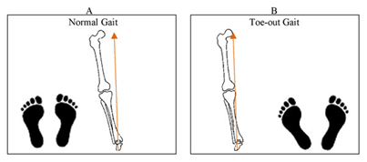
Problem statement
Osteoporosis - weakens the bone strength by reducing its density in elderly people.
causes difficulty in mobility by changing the gait pattern in Elderly.
This project deals with
the study of gait patterns in this elderly people and
designing an Exoskeleton for assistance while sitting, standing and walking.
solving the mobility problems in elderly caused by Osteoporosis.

Slide 4
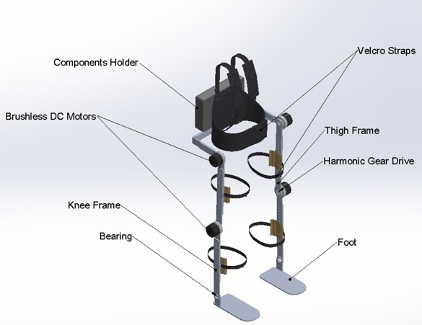
Literature survey
Electrically actuated device with four DC Brushless motors were used at the Hip and Knee Joints. Harmonic gear drives of type CSD are coupled with the motors to reduce the speed and increase the torques of the motor [4].
Aluminium 7075 is used to design the frame because it is light in weight and can withstand varying loads.
Velcro straps are provided making the design compact and comfortable for the wearer by taking ergonomics into consideration [5].
According to [6], it is empirically found that for one kilogram of body weight a torque of 1 Nm is required utmost at the hip joint and an average torque of 35 Nm is adequate for a normal person. The DC brushless motor coupled with Harmonic Gear Drive will give net output Torque of 35 Nm and a peak torque of 180 Nm.

Slide 5
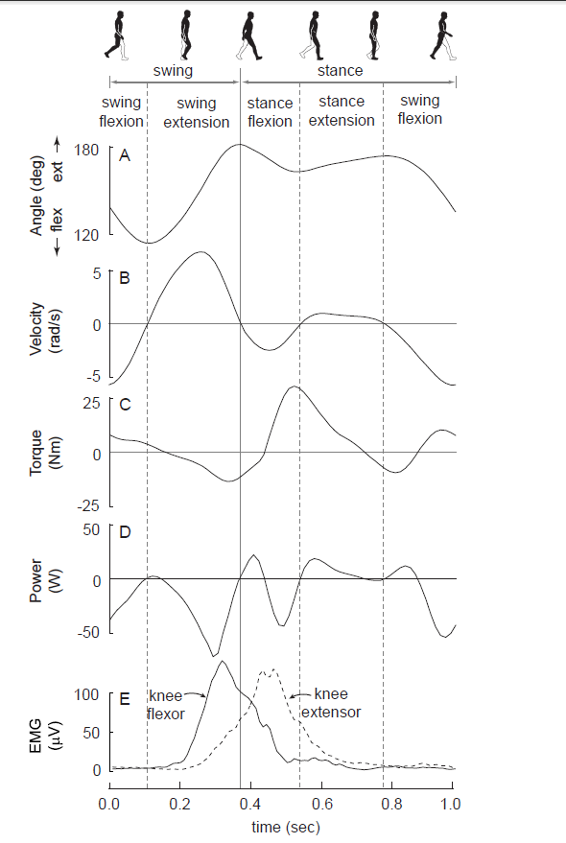
Literature survey continue..
The Figure shows typical knee joint mechanics and muscle activity during walking (subject mass = 58 kg; speed = 1.3 m/s;
step frequency = 1.8 Hz. Data from [7,8]).
Knee joint angle - 180 degrees is full knee extension.
Knee joint angular velocity using the convention that positive angular velocity is motion in the extension direction.
Knee joint torque with the convention that extensor muscle torques are positive.
Knee joint power.
Rectified and filtered electromyograms (EMG) from one knee flexor muscle (solid line) and one knee extensor muscle (dashed line).
A detailed study is made on the torques and power consumption before designing the exoskeleton actuation system.

Slide 6
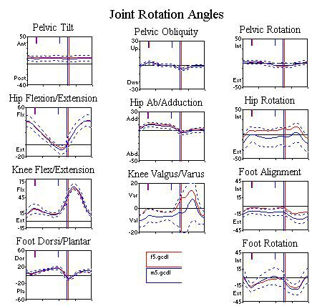
Literature survey continue..
The adjacent Joint rotation angles data is taken from the website Clinical Gait Analysis(CGA).
The graphs for the Joint rotation angles are plotted with the help of the gait data of the subjects age ranging from 35-50 years age.
The subjects have no gait related problems and are considered to have a normal gait.
This rotation angles data are going to be considered as the standard data for comparing with respect to the data obtained form the elderly people gait.
After wearing the Exoskeleton the older adults should have a comparatively nearer results while walking.
These values are used to find the overall efficiency of the exoskeleton.

Slide 7
Age group and Anthropometric data considered for design of exoskeleton:
Mobility efficiency of a person can be evaluated by the walking speed and falls.
According to [10-11], the research results show that the walking velocity decreases with the age making the gait less efficient.
Elderly mobility statics Table
Gender | Age | Velocity(m/s) | Height(cm) | Weight(kg)
Male | 60-69 | 1.24 | 170-189 | 62-93
Female | 60-75 | 1.09 | 159-173 | 48-87

Slide 8
Exoskeleton Design Requirements
Parameter | Consideration
Age | 55-65 years
Height | 153-183 cm
Waist | 32 – 44 inches
Weight | 75-100 kg
Payload | 120 kg
Weight of Exoskeleton | 11 kg (approx.)
Degrees of Freedom | Six (four-actuated, two –free)

Slide 9
Static structural Analysis in Ansys Workbench
A. FULL EXOSKELTON:
Solidworks Assembly file is imported in Ansys workbench in STEP file Format.
Aluminium 7075 – is used as the primary material for the Analysis because of its higher yield strength and low density.
Nitronic 60 Stainless steel and 15-5 Ph stainless steel are defined as the material for the harmonic drive.
Property(Aluminium 7075) | Value
Yield strength | 503 Mpa
Density | 2.81 g/cc
Poisson’s ratio | 0.33
Young’s modulus | 71.7 GPa
Property(Nitronic60 stainless steel) | Values
Yield strength | 655 Mpa
Density | 7.58 g/cc
Poisson’s ratio | 0.28
Young’s Modulus | 179.2 GPa
Property(15-5 ph stainless steel) | Values
Yield strength | 1000 Mpa
Density | 8.01 g/cc
Poisson’s ratio | 0.29
Young’s Modulus | 200 GPa

Slide 10
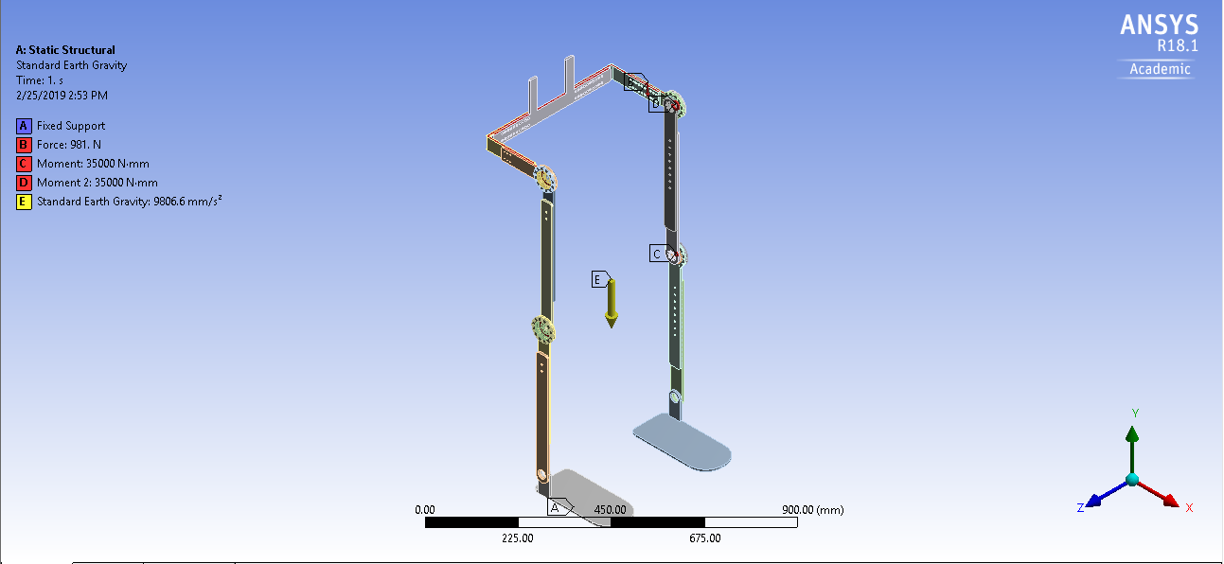
Figure(I)
A force of 981N (100kg) is applied in negative y-direction on the hip frame of the Exoskeleton[9].
The fixed supports and the standard earth gravity are also defined before solving the problem, see figure (I).

Slide 11
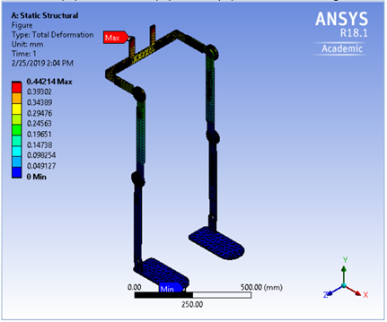
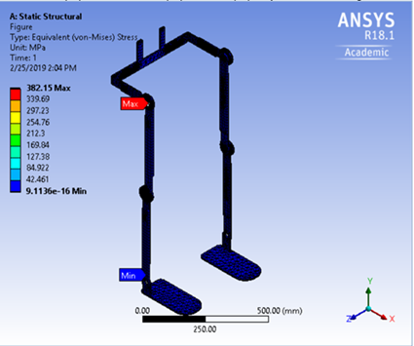
Figure(II). Deformation Results
Figure(III). Stress Distribution results

Slide 12
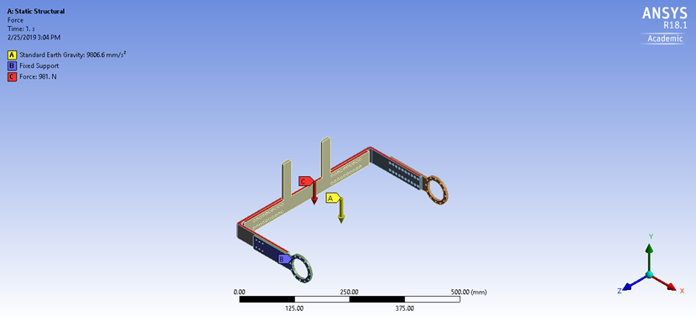
B. Hip Frame:
Hip frame Solidworks part is imported into Ansys workbench in STEP file format.
Aluminium 7075 – is the material used for defining the hip frame.
A load of 981N (100 kg) is applied on the hip frame and the ends of the hip frame are made as fixed support.
Standard Earth gravity is also added on the Hip frame, see figure I(a).
Figure I (a)

Slide 13
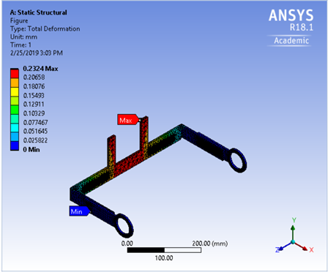
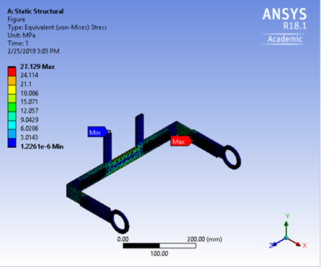
Equivalent von-Mieses stress and the Total deformation solutions are found using the Ansys workbench.
Figure.II(b) Deformation Result
Figure.III(c) Stress Distribution

Slide 14
Result and Conclusion
Structure | Max.Deformation(mm) | Max.Stress (MPa) | Min.Stress (MPa) | Yield strength (MPa) | Result
Full Exoskeleton | 0.44 | 382.15 | 9.11e-16 | 503 | safe
HIP Frame | 0.23 | 27.12 | 1.22e-6 | 503 | safe
The Static Structural Analysis results shows that on using Aluminium 7075 T6 as the primary material for the Exoskeleton, the design is under safe loading conditions. The results show that Hip frame alone can withstand a load of 100kg. So the design is suitable for withstanding the loads that act on the exoskeleton under static conditions.

Slide 15
Cost estimation
The cost estimation for this project based on the selected components and material is shown in the table below
S.no | Components | Cost | Quantity | Total Cost
1. | Motors | 18000 | 4 | 72,000
2. | Gear Drive | 40,000 | 4 | 160,000
3. | Material | 800/kg | 3 | 2400
4. | Battery(Li-Po) | 3000 | 1 | 3000
5. | Machining | 5000 |  | 5000
 | TOTAL |  |  | 2,42,400

Slide 16
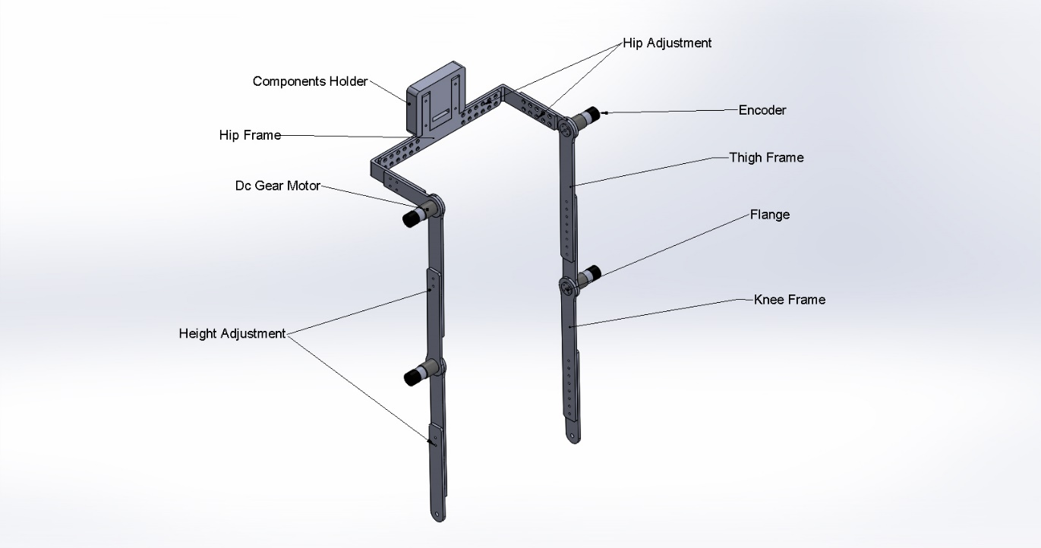
Fabricated design of Exoskeleton
To develop a proper control system a test exoskeleton is designed to perform a series of control algorithms on it.
Height of the exoskeleton can be adjusted between ---81cm to 106 cm.
The waist circumference can be adjusted varying between --- 80 to 106 cm.
Dc servo motors with incremental rotory encoders are used for the fabrication.
Microcontroller – Arduino UNO + Motor Driver
Power- Dc power supply source 12V.

Slide 17
Cost estimation for the Fabricated Exoskeleton:
Component | Quantity | Cost
Material(Aluminium 6061) | 11 kg X 375/kg | Rs.4125 /-
Motors(DC servo motors) | 4 X 2500 | Rs.10000 /-
3D-printed casing | ABS 41 metres + printing cost | Rs.750/-
Microcontroller(Arduino Uno) | 1 | Rs.500/-
Motor Driver shield | 1 | Rs.1500/-
Machining cost |  | Rs.5000/-
Dc power supply | 1 | Rs.2000/-
 | Total cost | Rs.23875/-

Slide 18
References
[1] Gait and cognition in older adults: Insights from the Bronx and Kerala, Year: 2010 | Volume: 13, Department of Neurological Sciences, Baby Memorial Hospital, Calicut, Kerala, India.
[2]Health Issues in Geriatrics, Santosh B Salagre, Indian geriatrics society.
[3] Health consequences of obesity in the elderly, 26 January 2014.
[4] ] ADAM ZOSS and H. KAZEROONI, Design of an electrically actuated lower extremity exoskeleton, 27 March 2006
[5] Yeo Wei Hong, Yeong-Jin King, Wei-Hong Yeo, Chen-Hunt Ting, Yea-Dat Chuah, Jer-Vui Lee and Eu-Tjin Chok, Lower Extremity Exoskeleton: Review and Challenges Surrounding the Technology and its Role in Rehabilitation of Lower Limbs, Australian Journal of Basic and Applied Sciences,2013.
[6]Gery Colombo, MS; Matthias Joerg, MS; Reinhard Schreier, BNIE, Volker Dietz, MD, Treadmill training of paraplegic patients using a robotic orthosis, Journal of Rehabilitation Research and Development, 6, December 2000.
[7] Winter DA: Biomechanics and motor control of human movement 2nd edition. New York: Wiley; 1990.
[8] Hof AL, Elzinga H, Grimmius W, Halbertsma JP: Speed dependence of averaged EMG profiles in walking. Gait & Posture 2002, 16:78-86.
[9] Mei-Cheng Li, Li-Rong Wang, Dai-Min Chen, Jing-Jing Tao, Dong Chen, The Static Analysis of Wearable Lower Extremity Exoskeleton Based on ANSYS Workbench, 2013 IEEE 9th International Conference on Mobile Ad-hoc and Sensor Networks, 30 January 2014.
[10] Hageman P A, Blanke D J. Comparison of gait of young women and elderly women. Ph.vs Ther 1986; 66: 1382- 1387.
[11] Winter D A,The Biomechanics and Motor Control of Human Gait: Normal, Elderly and Pathological, 2nd edition. Waterloo: University of Waterloo Press, 1991.

Slide 19
Thank You

