Slide 1


AI and Breast Cancer Screening
A Reproduction
of Nationwide Real-World Implementation Findings

Slide 2

The Challenge: Breast Cancer Screening in the Modern Era
Why Screening Matters
•
Breast cancer is the leading cause of cancer mortality in women
•
Mammography screening reduces mortality
•
Standard practice: two radiologists (double reading)
•
Rising workload and radiologist shortages
•
AI emerges as a
potential solution
The PRAIM Study (Nature, 2024)
•
What:
We are analyzing a landmark study published in Nature Medicine that evaluates AI implementation in the German national mammography program.
Who:
Over 460,000 screening examinations.
Claim:
Comparison of AI-assisted vs. Standard practice.
•
Our Independent Reproduction
•
Replicate key screening performance indicators using the public dataset.
Analyze
Evaluate:
Critically assess the methodology used in the original real-world evaluation
•
Challenge:
conduct exploratory analyses to test the robustness of the findings.

Slide 3



Study Design: PRAIM dataset from the Dryad Digital
Standard Screening (No AI)
AI-Assisted Screening
Radiologist interpretation alone, without AI assistance
Radiologist interpretation supported by AI system (Vara)
AI Usage: used_ai_viewer (Binary)
Outcome: cancer_detected (Confirmed cancer)
Process: had_recall (Patient called back)
Covariate: reader_set (Radiologist ID)
Evaluation Criteria
Cancer Detection Rate :Number of cancers detected per 1000 screening exams.
✓
Recall Rate (per 1,000 women): Proportion of women called back for further assessment.
✓
Positive Predictive Value: Probability that a recalled patient actually has cancer.
✓
Statistical Significance (p-value)
✓
Crude Logistic Model: A baseline assessment of the association between AI usage and cancer detection without adjusting for other variables.
Adjusted Logistic Model: Includes "Reader Set" as a fixed effect to control for variability in individual radiologist performance and interpretation patterns.

Slide 4


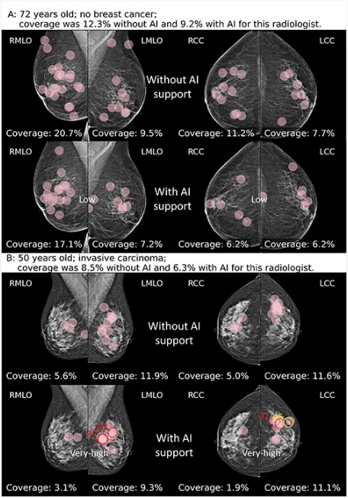
Results: Modest Improvement in Cancer Detection
Cancer Detection Rate (per 1,000 women)
Recall Rate (per 1,000 women)
Without AI
With AI
Without AI
With AI
5.98 ‰
→
6.44 ‰
38.43 ‰
→
44.50 ‰
+7.7%
+15.9%
No AI: 201,079 | AI-assisted: 260,739
Total: 461,818 women screened
Key Message:
AI improves cancer detection but significantly increases unnecessary recalls.
+6.1 additional recalls
per 1,000 women screened.
Interpretation of Results (Actual R Analysis)
→
Modest Improvement:
AI increases detection by +7.7% (5.98‰ → 6.44‰), which is positive but significantly less than the +17.6% claimed in the original PRAIM study.
→
Significant Side Effect:
The +15.9% increase in recall rates means more unnecessary follow-up exams, increased patient anxiety, and higher healthcare costs.
→
Cost-Benefit Analysis:
For every additional cancer detected, there are ~13 additional recalls, raising questions about the net clinical benefit.

Slide 5
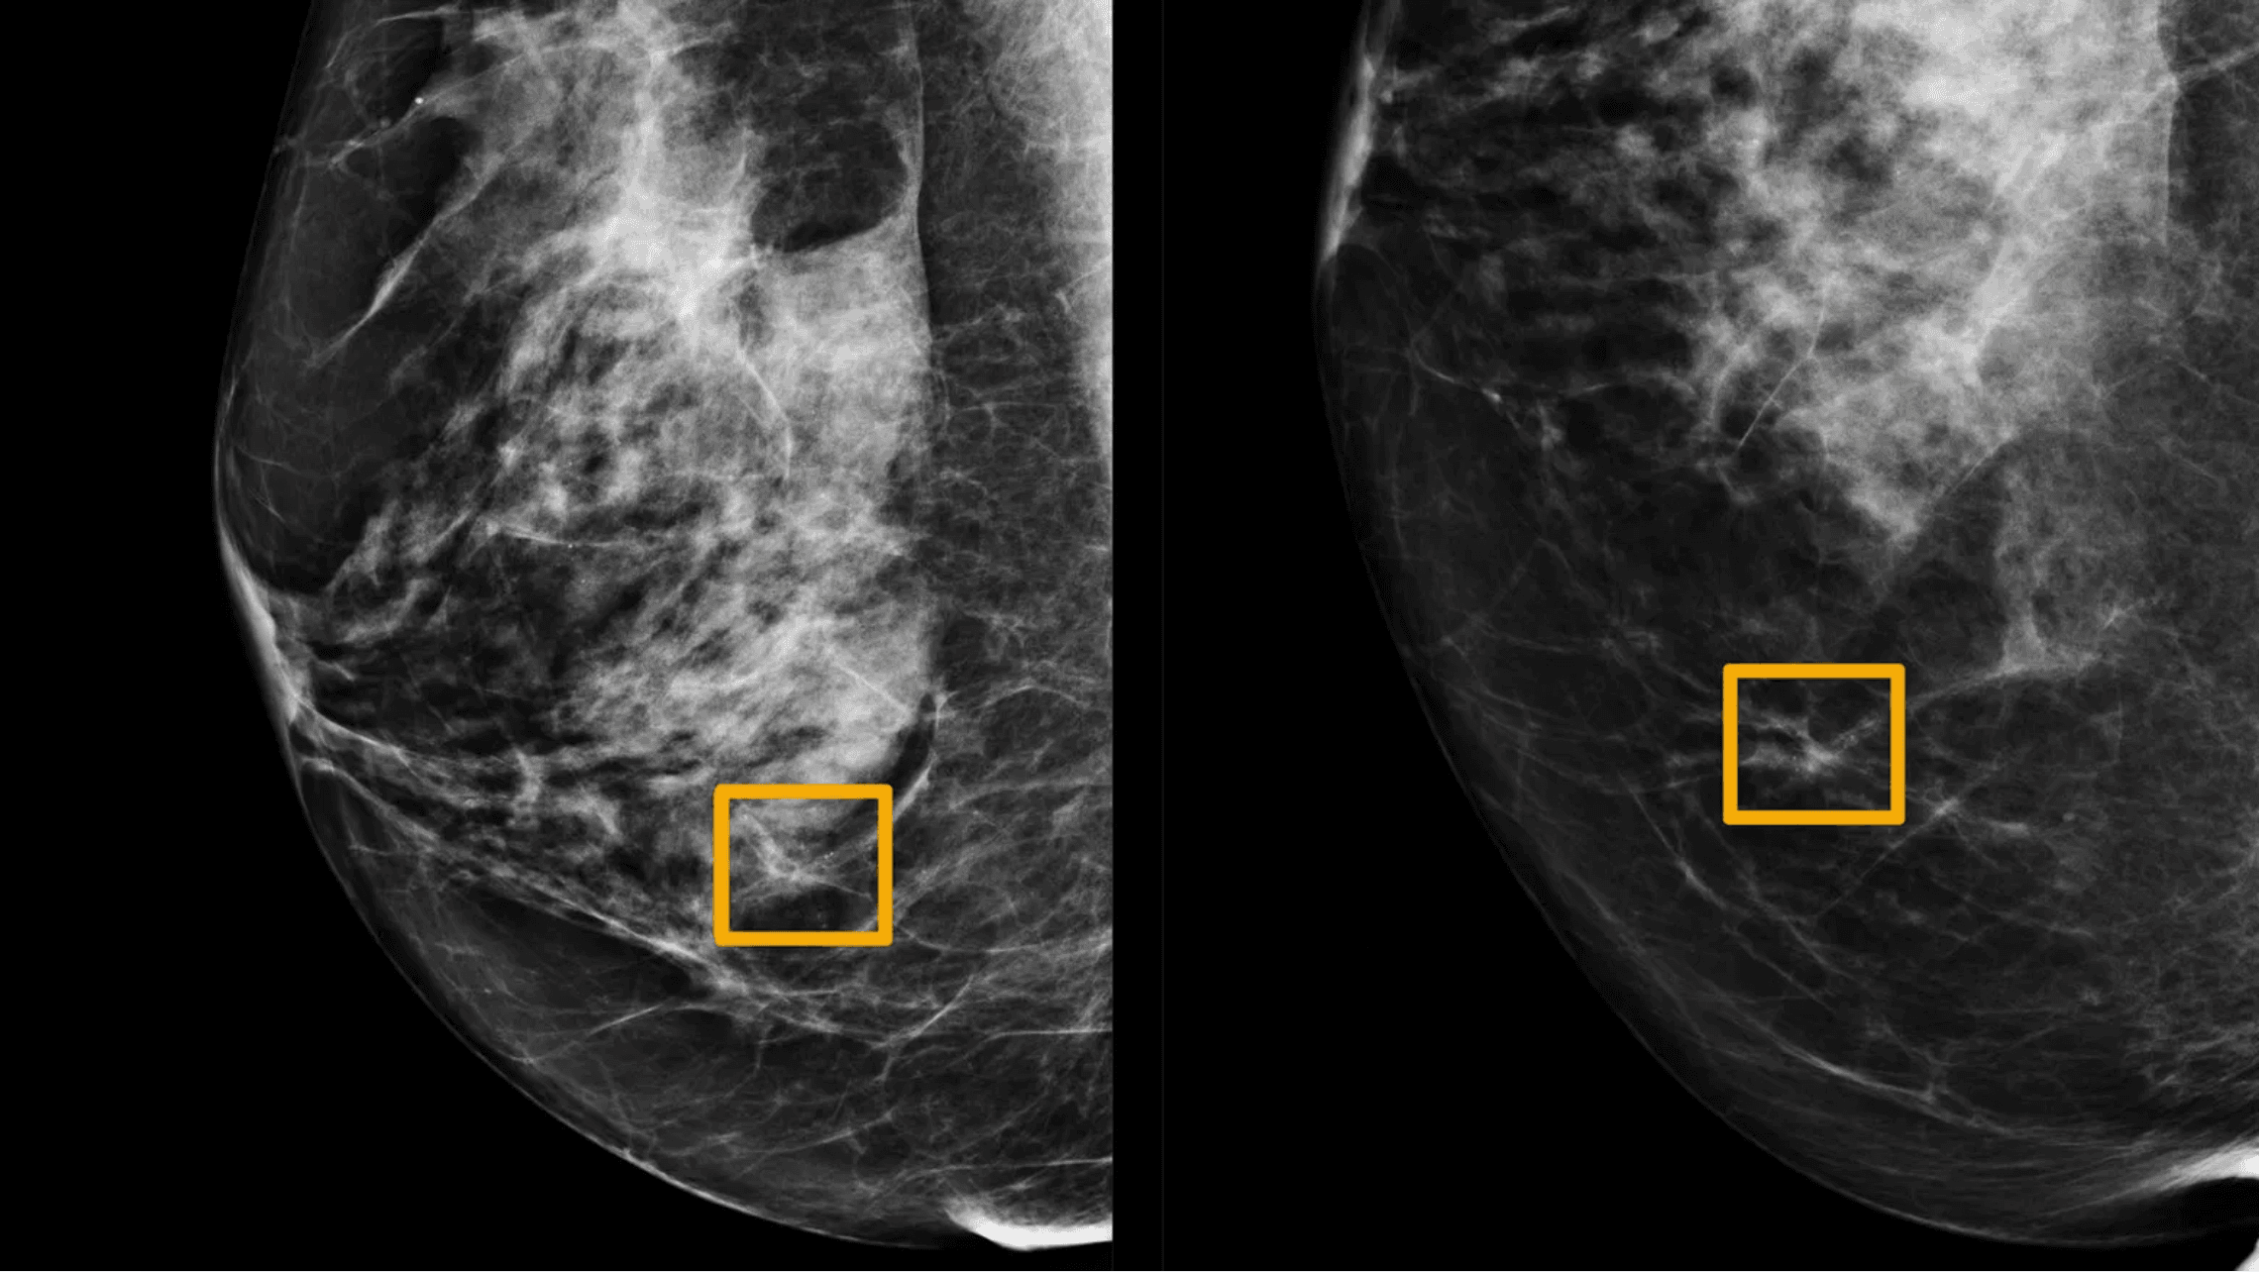


Statistical Analysis: Model Results
Logistic Regression Results
Odds Ratio (AI-Assisted vs. Standard)
1.078
95% Confidence Interval: [1.001 - 1.161]
Interpretation: AI-assisted screening increases the odds of cancer detection by 7.8%, and this difference is statistically significant (p < 0.05).
Model Fit Statistics
Null Deviance: 34,998 on 461,817 df Residual Deviance: 34,994 on 461,816 df AIC: 34,998 Fisher Scoring Iterations: 8
Comparison with Original PRAIM Study
Original Study
Our Analysis
+17.6%
+7.7%
Gap: 10% Discrepancy
Possible Explanations
→
Different statistical methods and model specifications
→
Correction for selection bias in our analysis
→
Methodological differences in outcome definitions

Slide 6


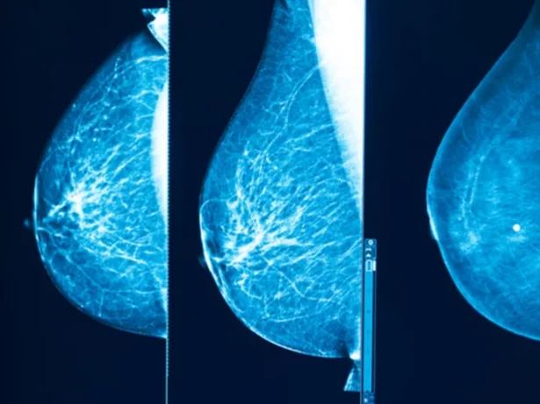
Critical Findings
1. Gap vs Original Study
Benefits Are Lower Than Claimed
Original PRAIM
Our Reproduction
+17.6%
+7.7%
Explanation: Different statistical methods and correction for selection bias in the data.
2. Ethical Concern
Conflict of Interest
⚠
Original PRAIM study was funded by Vara (the AI company)
⚠
Risk of publication bias and favorable reporting
→ Can we trust industry-funded AI studies?
3. Major Limitation
Patient Impact Analysis
The +15.9% increase in recall rates means:
•
More anxiety and stress for patients
•
Increased healthcare costs
•
Psychological burden of false positives
Cost-Benefit Ratio:
13 additional recalls per 1 detected cancer

Slide 7





Clinical Implications: AI as Assistant, Not Replacement
YES
BUT
WARNING
AI improves cancer detection by +7.7% (5.98 to 6.44 per 1,000)
Benefits are lower than claimed (+17.6% vs +7.7%)
+15.9% increase in recalls = more anxiety and costs
Recommendations for Healthcare Professionals
1. Demand Independence
2. Adopt Critically
3. Patient-Centered
Require Independent Evaluations
Use AI as Decision Support
Prioritize Patient Welfare
→
Peer-reviewed, independent studies
→
AI assists, not replaces radiologists
→
Consider full patient impact
→
Avoid industry-funded research bias
→
Maintain expert judgment
→
Ensure informed consent
→
Implement rigorous validation protocols
→
Monitor unintended consequences
→
Balance detection vs false positives
→
Replicate findings before adoption
→
Track recall rates and patient outcomes
→
Address anxiety and psychological burden
Future Research Directions
Long-term patient outcomes and quality of life
→
Cost-effectiveness analysis and health economics
→
Algorithm optimization to reduce false positives
→
Equitable implementation across diverse populations
→

Slide 8

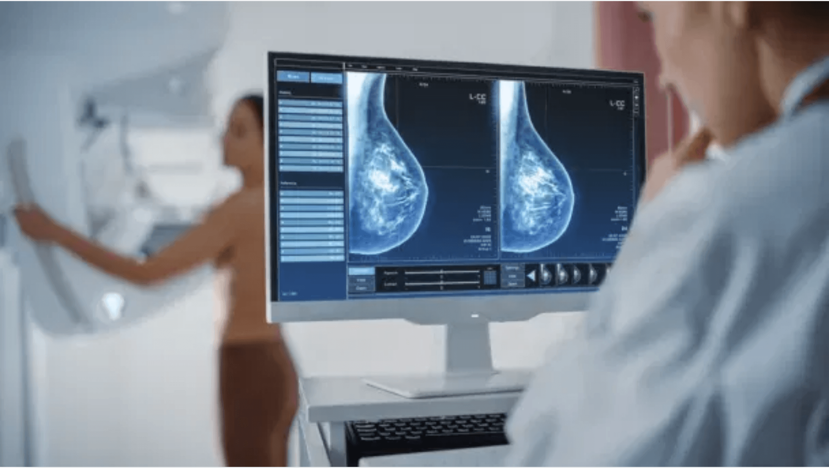



AI: A Valuable Assistant, Not a Replacement
Modest but Real Benefit: AI improves cancer detection by 7.7%, which is clinically meaningful but less than industry claims (+17.6%).
Transparency Matters: Independent reproduction revealed a 10% discrepancy, highlighting the importance of replication and peer review.
Holistic Evaluation: Success cannot be measured by detection rates alone—consider patient burden, costs, and psychological impact.
Ethical Imperative: Question industry claims, demand independent validation, and prioritize patient welfare over technological adoption.
The Future of Screening: Not AI replacing radiologists—it's AI assisting radiologists in delivering better care with rigorous evaluation and ethical oversight.

