Slide 1
Simple Algorithms for Protein-Protein Interaction (PPI) Networks
Dan Adler
Network Models Project

Slide 2
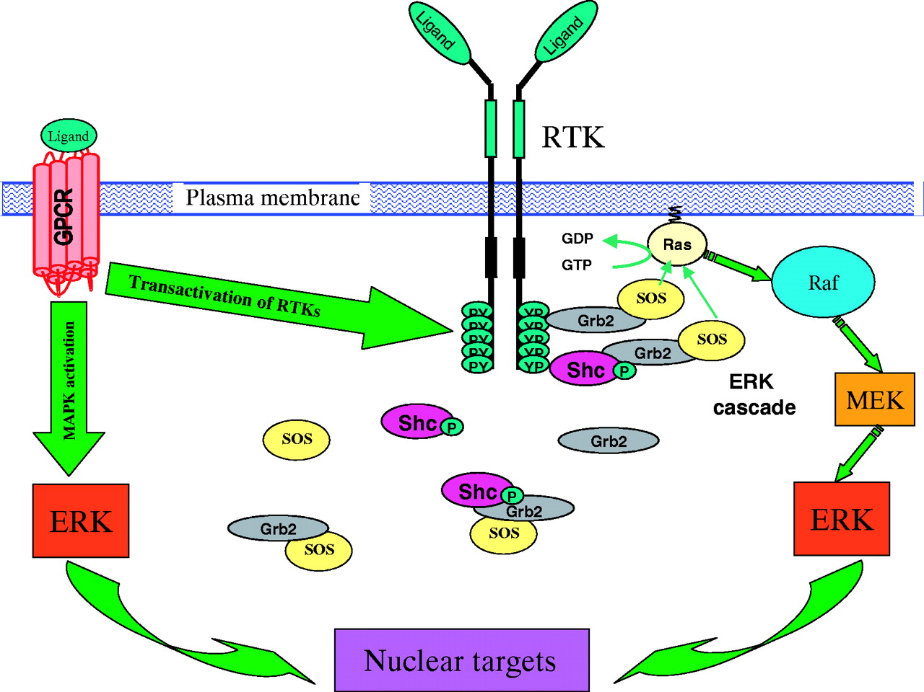
Protein-Protein Interactions
Cells receive signals in many forms
Signal begins a cascade of interacting proteins
Cascades can proceed in different ways
Usually termination in the cell nucleus
Example signal cascade.
Source: http://jeb.biologists.org/content/206/12/2073

Slide 3
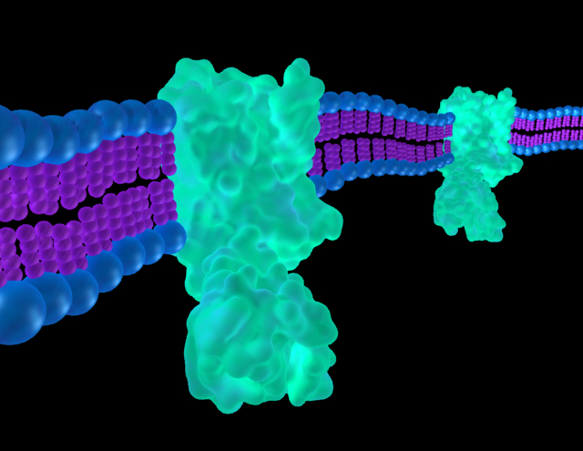
Common Questions
How many steps until we reach the nucleus?
If we want to target a specific protein, is there a way to reach it in the cascade through k proteins?
^ we’ll be solving this problem
GPCR 3D Reconstruction in a cell membrane.
Source:https://laurenhamm.wordpress.com/2011/07/27/beta-2-andrenergic-gpcr/

Slide 4
The Network Problem
Let each protein in the cascade starting from the signal to a protein entering the nucleus represent a node
An edge exists between two nodes if the two vertices can react with each other
The edge has a weight that represents the probability of a reaction between its two protein nodes
GPCR
P(GPCR,PY) = 0.10
PY

Slide 5
The Network Problem (2)
I
Let signal nodes represent a subset I of the total nodes in the network
We want to find the most probable path with ‘k’ nodes between each node in I and any other node in the network
Assume:
Reactions are independent:
P(i,j intersect j,k) = P(i,j)*P(j,k)
Issue: underflow with paths:
P(1)*P(2)*...*P(k) gets very small with large k
Graphical representation of example signaling cascade...

Slide 6
The Network Problem (3)
I
Another thought:
-log(P(i,j intersect j,k)) =
-log(P(i,j)) + -log(P(j,k))
Thus if P has nodes 1...k:
-log(P(1,2,3,...,k) =
-log(P(1)) + ... + –log(P(k))
argmax(P(1)*...*P(k)) =
argmin(-log(P(1)) + ... –log(P(k))
Problem is now a min-path problem with some modifications.
Graphical representation of example signaling cascade..
...with negative log probabilities
Highlighted: min path of k = 7 from I to nucleus

Slide 7
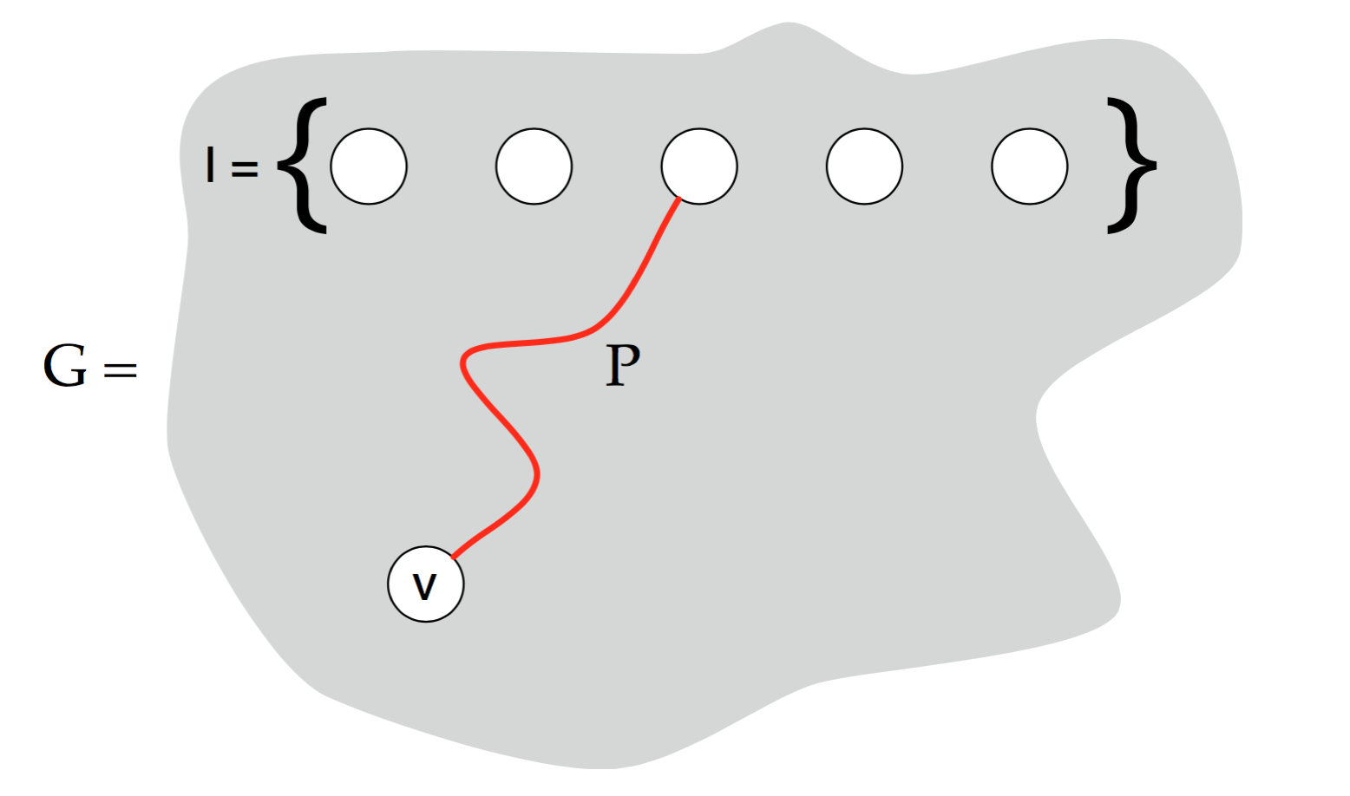
Simple Algorithm
Let G = G(N,E) d
Idea is to take every node i in I
Then take a permutation of (k-1) nodes in {N/I}:
Permutation is {u,...,v}
Check if there exists a path in G on P = {i,u,...,v}
If there is keep it
Lastly, output only argmin(i,v) paths
Pircure of the idea: Set of nodes {I} and finding path with k nodes to V. Source:
https://www.cs.umd.edu/class/fall2009/cmsc858l/lecs/Lec14-colorcode.pdf

Slide 8
Implementation
Inputs:
3 Column Matrix N = [i j P(i,j)]
Column Vector of Nodes in I
K
Running the algorithm
ColorCoding(N, I k)
Main function with inputs as above
Outputs a matrix where:
Rows = # of length k paths from i
Columns = nodes in path
Last column = probability of path
Each path is the most likely (i,v) path of length k
See README.txt in PROGRAMS
I = {1,2,3,4}

Slide 9
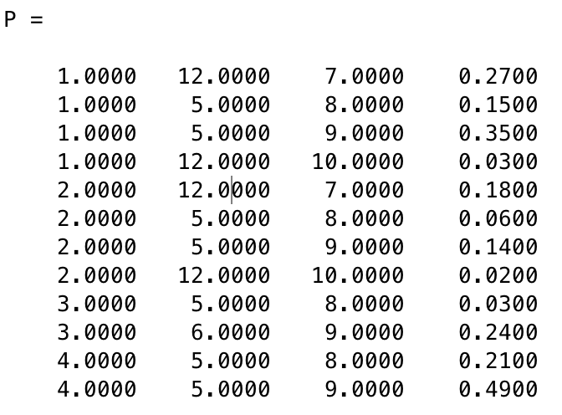
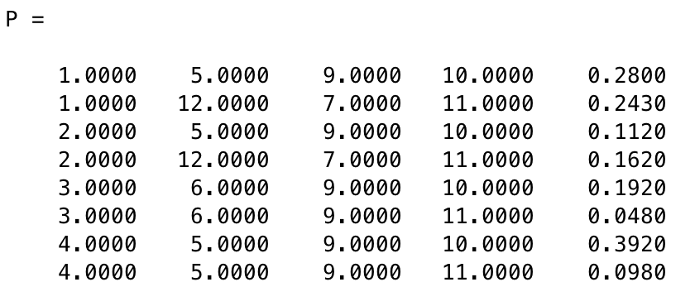
Example
Example with k = 3 paths:
Example with k = 4 paths:
I
V
P
I
V
P
I = {1,2,3,4}

Slide 10
Analysis
nchoosek(|N| - |I|,k-1) *(k-1)! permutations to check
If N >> k, about:
N*(N-1)*...(N-k) about N^k, thus O(N^k) time
Takes O(k) time to check whether each path exists
If we save the minimum or use a smart data structure (heap), O(1) to get minimum of each (i,v) path.
RUNTIME: O(N^k * k)...not great

Slide 11

Coloring Coding
Idea:
Partition nodes in k colors (not like graph coloring...adjacent nodes might have same colors)
For each node, sample from Uniform(1,k) to decide color
Start at a node in I and see if there exists a ‘colorful’ path, i.e. a path that has each color
After enough sampling, every path should have been looked at
From literature:
O(2^k*k*m) time, where |E| = m
Colorful k paths are kept
Source: https://www.cs.umd.edu/class/fall2009/cmsc858l/lecs/Lec14-colorcode.pdf

Slide 12
Realities
Networks are large...and none of these algorithms are very efficient
Independence is not really true
The coloring algorithm is not very practical to implement
With enough sampling we still could miss the minimum path
Algorithms get more complicated

Slide 13
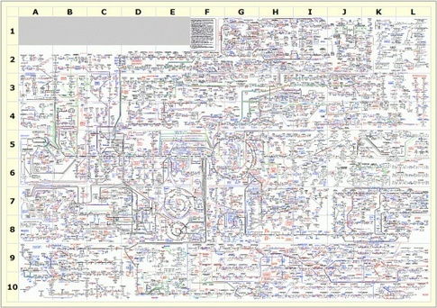
Realities
You can get this poster for free! ☺ Source: https://www.quora.com/What-are-some-of-the-most-amazing-molecular-and-cellular-biology-diagrams

Slide 14
references
Alon N, Yuster R, Zwick U (1994). Color-coding. J. ACM 42 844-56.
Scott J, Ideker T, Karp RM, Sharan R (2006). Efficient Algorithms for Detecting Signaling Pathways in Protein Interaction Networks. Journal of Computational Biology 13(2), 133-44.
Yeh CY, Yeh HY, Arias CR, Soo VW (2012). Pathway Detection from Protein Interaction Networks and Gene Expression Data Using Color-Coding Methods and A* Search Algorithms. The Scientific World Journal 2012.

