Slide 1

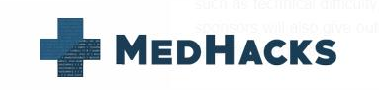

Dan Adler Gaby Frid April Lo Nisu Patel Amy Sun
Bridging the gap between ambulances and ERs
Notes:
by facilitating real time data transfer

Slide 2



Notes:
Emerge
EMTs paramedics record important patient data in a tablet
only transferred to emergency room once patient physically arrives
except 15sec radio call which the paramedic is simultaneously taking care of patient, there is no data transfer to the ER

Slide 3



Gaps in Standard of Care
15-30 minute commute time
ER not prepared
Deteriorating patient health
Notes:
few of gaps
where there is a lot of down time in 15-30 min commute, where hospital could be preparing for patient care
however, not info until the ambulance arrives, the ER isn’t prepared to take care of the patient
finally, in emergency situations, patient health deteriorate during commute time, hospital not aware, no real time data transfer

Slide 4
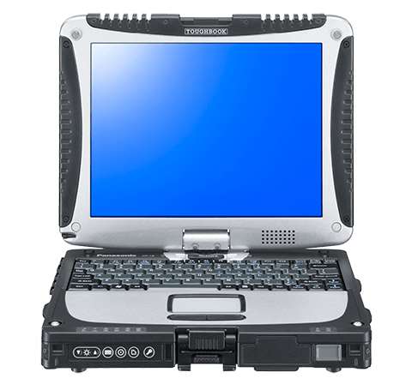

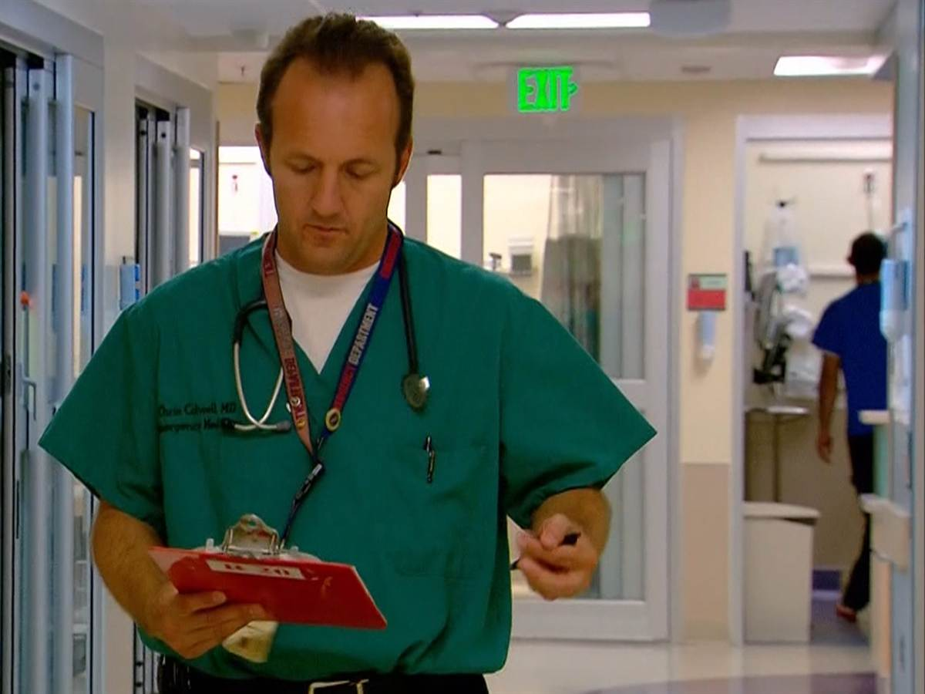

Notes:
this is where we emerge
we are using wireless capabilities of ambulances, to send data emts already record to the ER in real time
we do this by sending the data over through the cloud
we wrote a machine learning algorithm that prioritizes and ranks notes and symptoms based on the possible patient diagnosis
this distill pages of patient to hospital in readible format. informed clinical decision

Slide 5
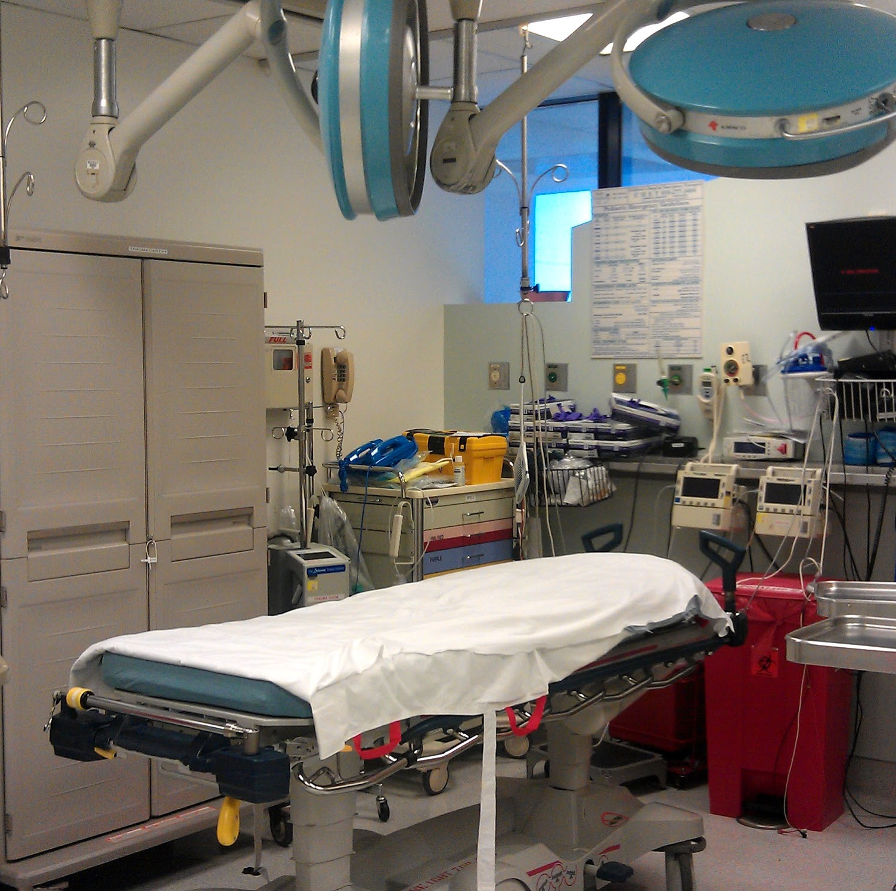

System: Constant Real Time Updates
e-MEDS Patient Input in Transit
Cloud ML Algorithm to Highlight Critical Information
Send to ERs to allow them to prepare for the arrival
Real time Cloud Upload
Real time Cloud Upload
Notes:
possible use case
paramedic use logbook
suffer asthma
transported through cloud into ER prioritized to ER based on diagnosis
demo of app
This app is valuable for all stakeholders involved.
for patients, the system is more seamless every time they are switched, leading to less complications
for EMTs, this would facilitate better patient care through more time treating patients and less administrative work,
and for the ER, it minimizes the time until patient care can be initated, the ultime goal of emergency room services

Slide 6
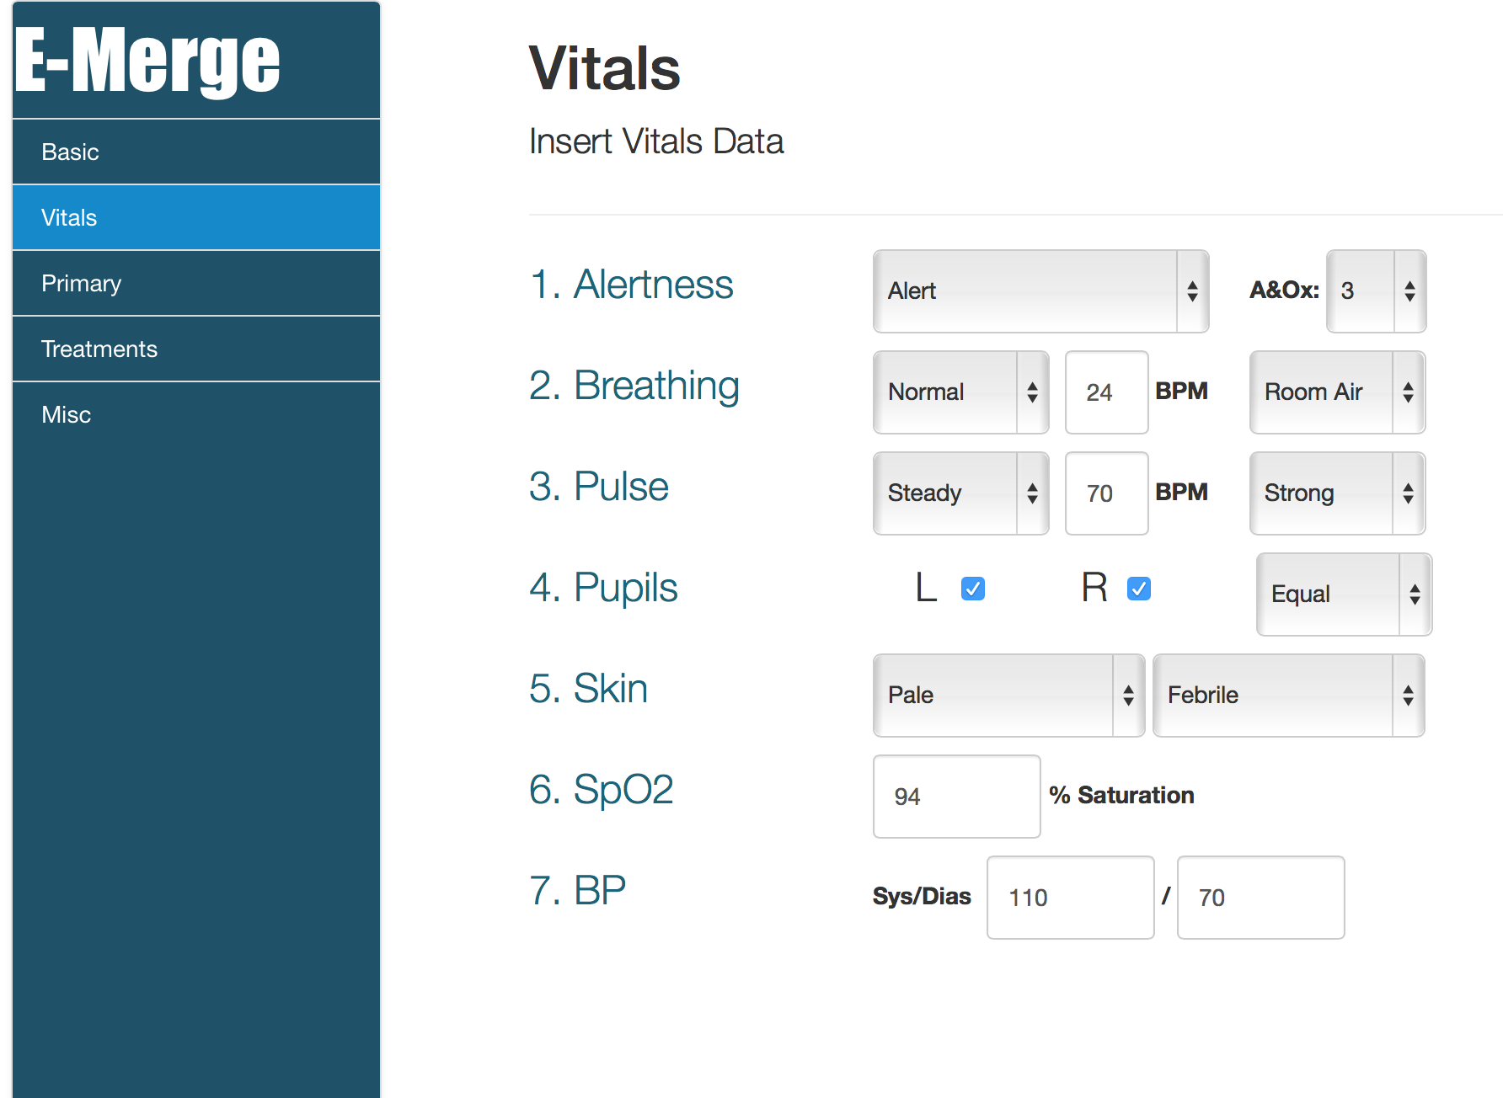
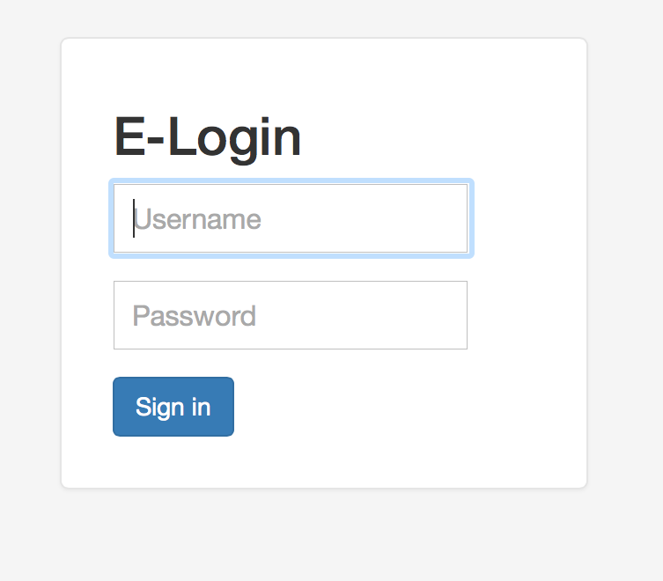
EMR Screens

Slide 7
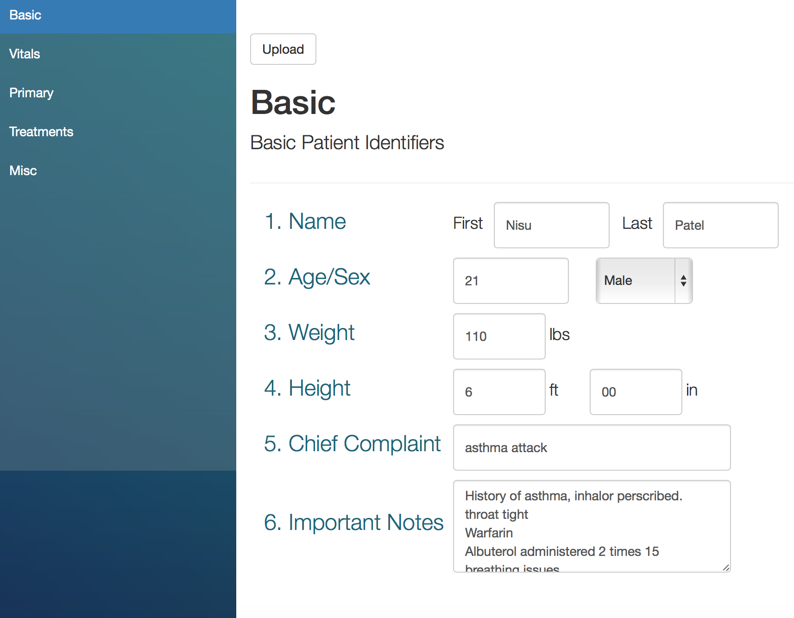
Physician Screens

