Slide 1
Analysis of Portfolios and Diversification with Bitcoin
EDOARDO ANFELLI,
THADDEUS DA SILVA CORREA,
FELIPE FERREIRA MACEDO MALHEIRO

Slide 2
Introduction and objectives
Objective: Analyze the performance of Bitcoin (BTC) and its role in portfolio diversification and as an inflation hedge.
Questions:
What are the characteristics of BTC excess monthly returns?
Is BTC a hedge against U.S. inflation (2014-2024)?
How do portfolios perform under different constraints (long-only, long-short, restricted 2-5 assets)?
Does BTC diversify stock market risk?

Slide 3
BTC Excess Monthly Returns & Inflation Hedge
1-Basic Characteristics of BTC Returns (all monthly datas):
High volatility (standard deviation of 20%).
Average excess monthly return: -3%.
Negative Sharpe Ratio (r-rf/std)
Extreme Loss: -41%, Extreme Profit: 60%.
Positive skewness and high kurtosis, indicating extreme events.
The Jarque-Bera p-value of 0.01 , we accept normality because >significance level (1/117)
2-Is BTC a Hedge Against U.S. Inflation (2014-2024)?
Inflation Data: Stable, with a mean of 0.25% per month (3% annually).
BTC & Inflation Correlation: -0.0219(Near zero) indicating no hedge properties.
Conclusion: BTC does not act as a reliable hedge against U.S. inflation.
Comparison with SP500
Inflation

Slide 4
3-Portfolios
ASSETS:
S&P 500: ^GSPC
Nikkei 225: ^N225
Gold: GLD
NASDAQ 100: QQQ
NASDAQ Composite: ^IXIC
Financial Select Sector SPDR Fund: FNCL
IBEX 35: ^IBEX
Bitcoin: BTC-USD
Three Portfolio Scenarios:
Long-only Portfolios:
Conservative, lower risk-return.
Long and Short Portfolios:
More aggressive, higher potential returns by exploiting negative correlations.
Restricted Portfolios (2-5 assets):
Limited diversification, lower efficiency.

Slide 5
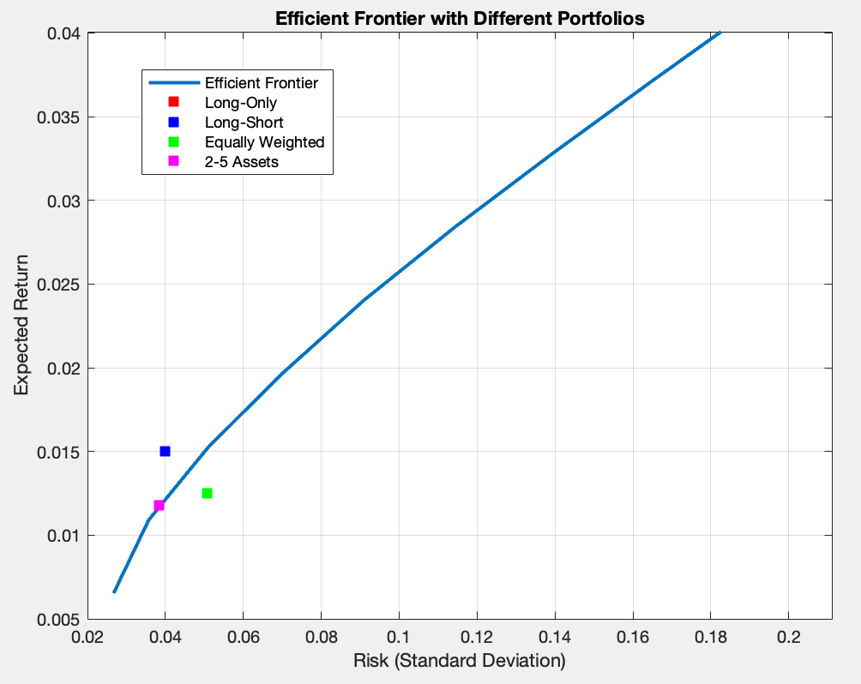
Portfolios & The Efficient Frontier
(Red and pink overlaps)
Long-Short overperformed (thanks to more freedom in weights)
Long-Only and Restricted stay on the Frontier
Equally Weighted underperformed
(in terms of risk-return)

Slide 6
Equally-Weighted Portfolio & Performance
Equally-Weighted Portfolio:
Each asset receives an equal allocation. This is a common method.
Main Results:
Likely not on the efficient frontier.
Ignores risk-return characteristics of individual assets.
We can’t treat BTC as Commodities…
Conclusion:
Equally-weighted portfolios are less efficient compared to optimized portfolios due to lack of focus on asset covariance.

Slide 7
4-BTC as a Stock Market Risk Diversifier
Conclusion:
While BTC is not an inflation hedge, it provides potential diversification benefits.
Investors must consider BTC’s high volatility and risk-return profile in their strategy.
Bitcoin’s Role in Diversification:
BTC often shows low linear correlation with stock indexes like S&P 500 and NASDAQ.
i.e.: Corr(SP500,BTC) 0.1773 P = 0.0559 with an accepting standard of 1/117
Result: Supports the argument that BTC can diversify stock market risk.

Slide 8
Conclusions
BTC exhibits high volatility and extreme return potential but does not act as a hedge against U.S. inflation.
Optimized portfolios outperform equally-weighted ones by balancing risk and return more effectively.
Bitcoin serves as a diversifier, reducing stock market risk, but its role depends on market conditions and investor risk tolerance.

